Slide 1
King Saud University – College of Medicine FORM321, 21/2/2019 Supervisor: Dr.Khaldoon Aljerian Group B3 Hussam Alkhathlan – Khalid Alamri Presenter: Walid AlOrainy

Slide 2
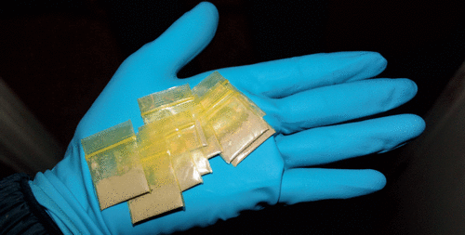
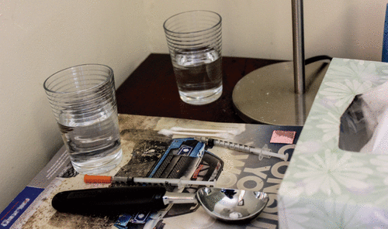
Case: Heroin overdose

Slide 3
Case Scenario
A case of a man collapsed moments after injecting heroin into his arm.
Acute venipuncture marks with blood around the injection site.

Slide 4
Discussion
What are the most common findings seen in association between intravenous drugs and injection site?

Slide 5
Refrences
Scientific references:
Simpson's Forensic Medicine 13th ed. - J. Payne-James, et. al. (Hodder-Arnold, 2011)
Case reference:
https://journals.sagepub.com/doi/full/10.23907/2017.006

