Slide 1
asphyxia
KSU- Collage Of Medicine
Forensic medicine PBL course 21/2/2019
Session:12
Group: B3
Supervisor: Dr. Khaldoon Aljerian
Presenter: Turki Maddi

Slide 2
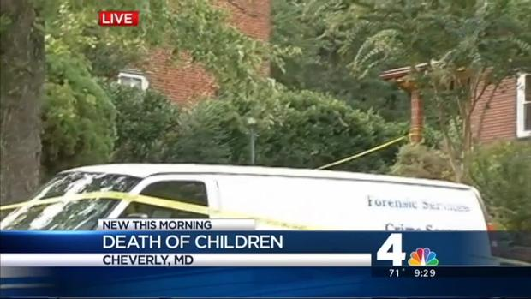

Slide 3
Case scenario
Ayden and Kayla, 1 and 3 years old kids,
were found unconscious and died in the hospital.
Findings: Suffocation with plastic bags and duct tape around their heads.

Slide 4
Discussion
Suffocation?
Smothering?
Postmortem examination?

Slide 5
References
https://edition.cnn.com/2014/09/08/justice/maryland-children-suffocated/index.html
http://murderpedia.org/female.S/s/spoon-sonya.htm
Simpson’s Forensic Medicine 13th edition.

