Slide 1
Course: Form 321 | Session #3 | 21/2/2019
Supervisor: Dr. Khaldoon Aljerian
Group: B4
Presenter: Khalid Alshehri

Slide 2
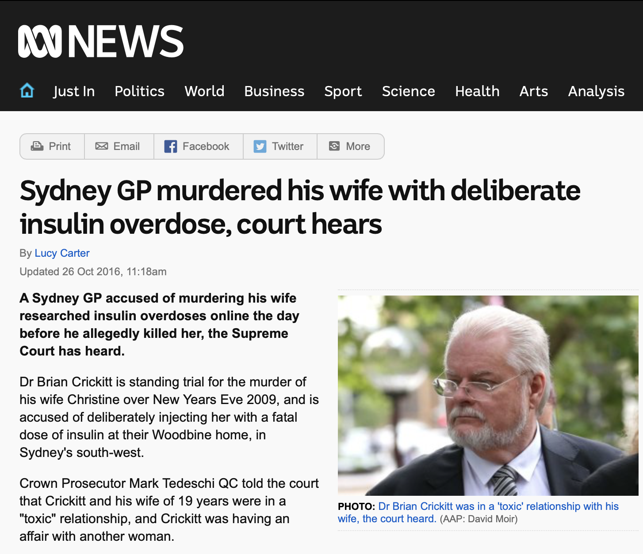
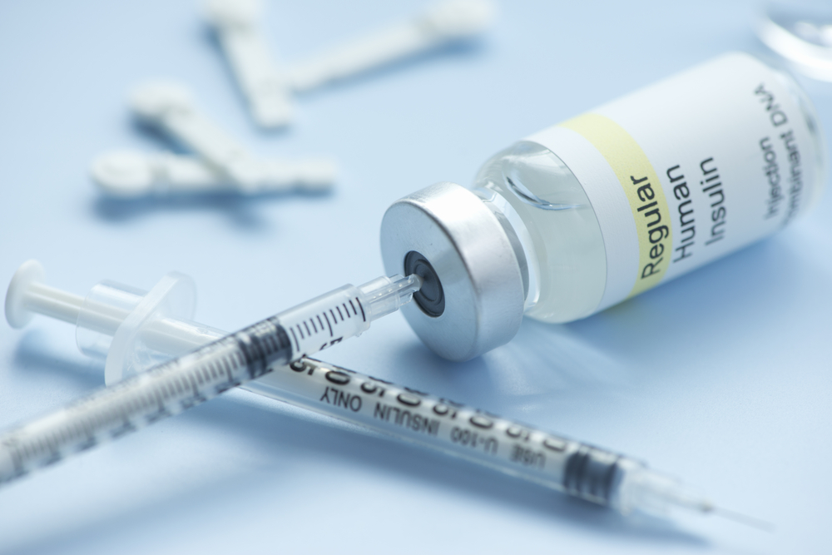
News Clip
Insulin Injection

Slide 3
Case scenario
A wife was deliberately injected with insulin.
The Husband administered a fatal dose of insulin.
He murdered his wife for her life insurance.
Searched on Google for 'intentional insulin overdose'
Autopsy found no clear cause of death

Slide 4
discussion
Which two disorders predominate prescription medication poisoning?
How can insulin poisoning be confirmed?

Slide 5
References
Simpson's Forensic Medicine 13th ed. - J. Payne-James, et. al. (Hodder-Arnold, 2011)
https://www.abc.net.au/news/2016-10-26/sydney-gp-on-trial-over-insulin-ovedose-murder-of-wife/7965630

