Slide 1
King Saud University - College Of Medicine
Forensic medicine,Session:6,Date:21-2-2019
Supervisor: Dr.Khaldoon Aljerian
Group:B4
Presenter: Fahad Alzahrani
.

Slide 2
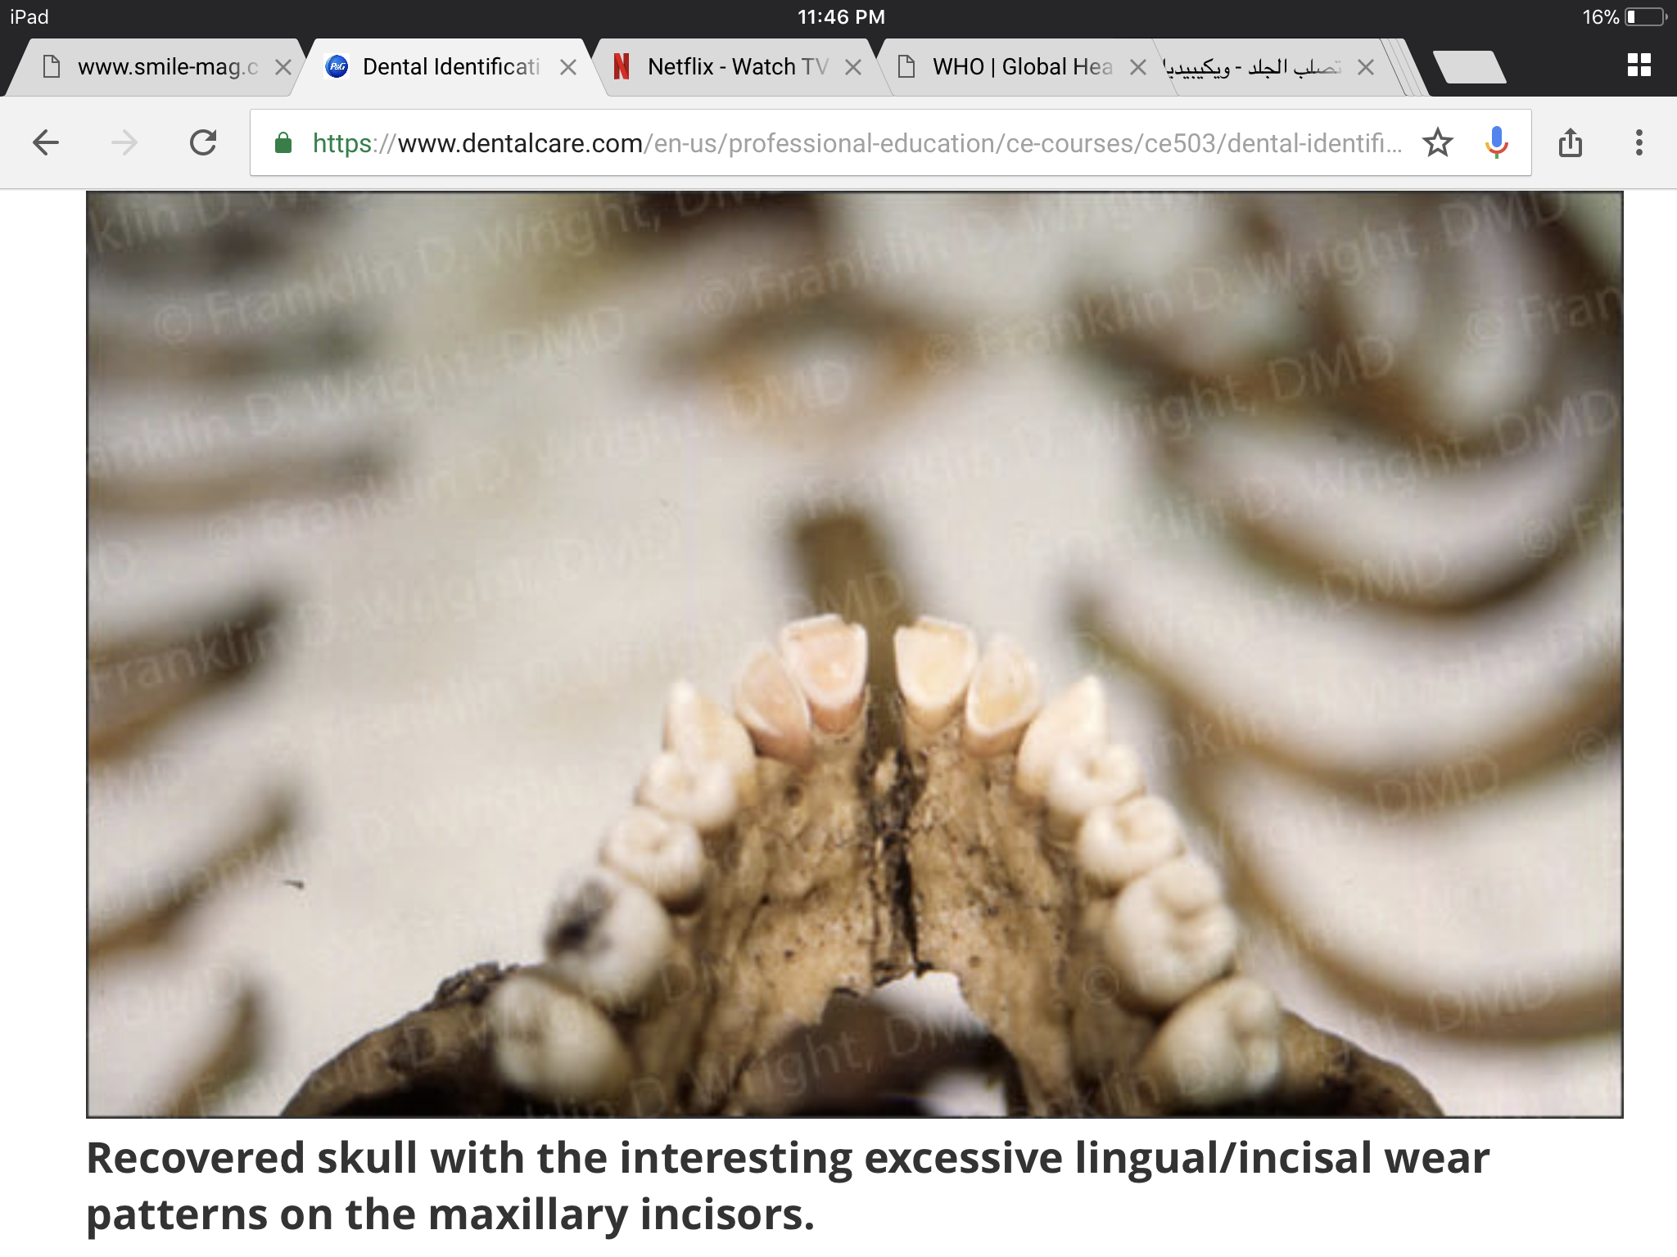

Slide 3
Case scenario:
Skeletonized remains were discovered in a park.
Examination showed a pattern of a heavy lingual and incisal wear on the upper incisors.
The victim had an open bite occlusion with no incisor contact.

Slide 4
Discussion
How can forensic odontologist help us identify the victim in this case?
What makes forensic odontology a great method for identification?
Mention other identification methods

Slide 5
References:
Simpson’s Forensic Medicine, 13th edition
https://www.dentalcare.com/en-us/professional-education/ce-courses/ce503/dental-identification-case-1

