Slide 1
College of medicine
Forensic Medicine Course
21st Feb 2019
3rd session
Supervisor: Dr.Khaldoon AlJerian
Group B4
Presenter : Abdulrahman Alomrani

Slide 2
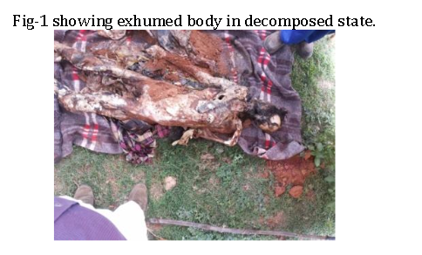
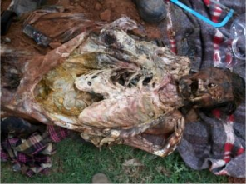
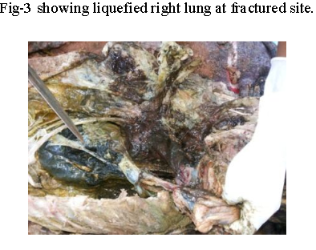

Slide 3
A 30 year old male was buried and the body was exhumed after suspected foul play.
On examination:
extravasation of blood was present And fracture of the 2nd, 3rd and 4th ribs on the right side.
100cc Blood stained dark fluid was present in the right pleural cavity.

Slide 4
Discussion:
What type of trauma could've caused this case?
What is flail chest?

Slide 5
References:
Simpson's Forensic Medicine, 13th Edition
http://medind.nic.in/jbc/t15/i1/jbct15i1p26.pdf

