Slide 1
Child Assault and Protection
King Saud University – collage of medicine
Forensic Course – Feb,21st 2019
Supervisor: Khaldoon Aljerian
GROUP: 4
Presenter: Moyed Ahmed

Slide 2
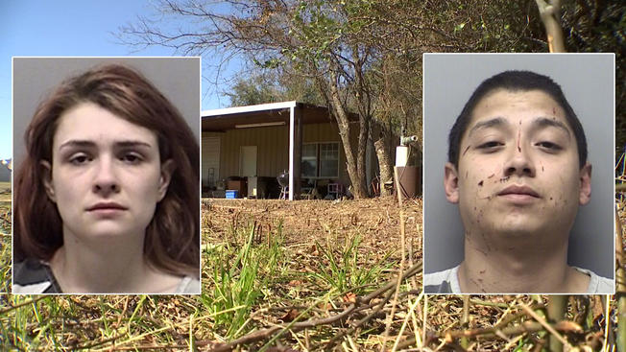

Slide 3
Case scenario
History: Aged five, four, three, and one were found in a ‘state of neglect’ on a property near Rhome, Texas, about 20 miles (32 km) on Tuesday Feb12th 2019, The older two children were locked in a 3-by-3 foot dog cage (90-by-90 centimeters).
Examination: malnourished ,covered in feces and urine amidst ‘filthy’ and ‘cluttered’ living conditions

Slide 4
Discussion
What are the complications of malnutrition in young patients?
Do the children in this case need psychological support?

Slide 5
References
Simpson's Forensic Medicine 13th ed. - J. Payne-James, et. al. (Hodder-Arnold, 2011)
Parents and house pictures: https://www.nbcdfw.com/news/local/Children-Found-in-Kennels-on-Wise-County-Property-505723901.html
Case: https://www.independent.co.uk/news/world/americas/child-abuse-texas-dog-crate-cage-found-home-paige-harkings-andrew-fabila-a8777726.html

