Slide 1
King Saud University – College Of Medicine
Course: Forensic medicine, Session 4,Date:21.February.2019
Supervisor : Dr. Khaldoon Aljerian
Group name: B4
Presenter: Muhanned Ali Alzahrani

Slide 2
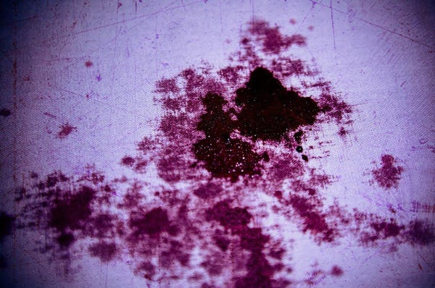

Slide 3
The case . . .
James Allen Smith, Jr. claimed he killed his wife in self-defense in 2000 after she attacked him. Unfortunately for Smith, a blood spatter expert testified at the trial that Smith's wife wasn't standing when she was hit with six bullets. This indicated that she couldn't have been physically attacking her husband, and Smith was convicted of murder

Slide 4
Discussion
In means of blood patterns , what is the difference between the terms "swipe" and "wipe" ?
Identify the shape If a blood drop from a finger lands on a smooth/wood/absorbent surface

Slide 5
References
Simpson's Forensic Medicine, 13th Edition by Jason Payne-James, Richard Jones Steven B Karch, John Manlove
https://caselaw.findlaw.com/va-supreme-court/1412422.html

