Slide 1
MEDCOURSE 341
Endocrine Block
February 2018
Adrenal Disorders
MUHAMMAD MUJAMMAMI, MD, M.Sc, ECNU
Assistant Professor of Medicine.
Consultant in Medicine, Endocrinology, Diabetes & Thyroid & Endocrine Oncology.
Endocrine & Metabolism Unit, Department of Medicine King Saud University

Slide 2
Objectives
Understand anatomy, physiology and biochemistry of adrenal
glands
Understand clinical approach and management of adrenal disorders:
  Function: hyper and hypo-secretion
  Structure

Slide 3
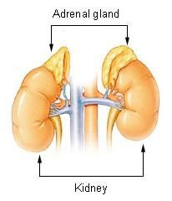
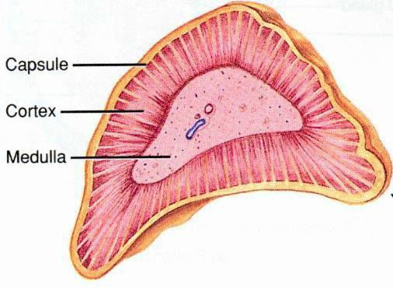
Anatomy

Slide 4
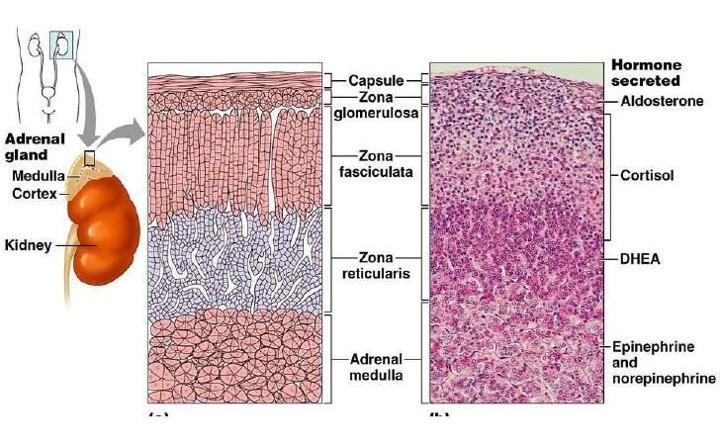
Anatomy

Slide 5
Zona | Hormones | Effects | Regulatory Control
Glomerulosa | Salt Mineralocorticoids (aldosterone) | Kidney: Maintain intravascular volume by : Increase reabsorption of Na+ and water | angiotensin II, K+ Na+؛
Fasciculata | Sweet Glucocorticoids (cortisol) | Lipolysis Increase blood sugar | ACTH
Reticularis | Sex Androgens | It is the main source of androgen in human But it is important in the disorders | ACTH
Medulla | Catecholamines (Epinephrine,Norepinephrine, Dopamine) | Most of the time activate sympathetic fibers and increase ( BP, HR, blood sugar) But could present with activations of parasympathetic as pathologic disorders

Slide 6
Biochemistry
All adrenal cortex hormones are originating from Cholesterol
All adrenal medulla hormones are originating from amino acid Tyrosine

Slide 7
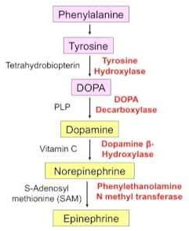
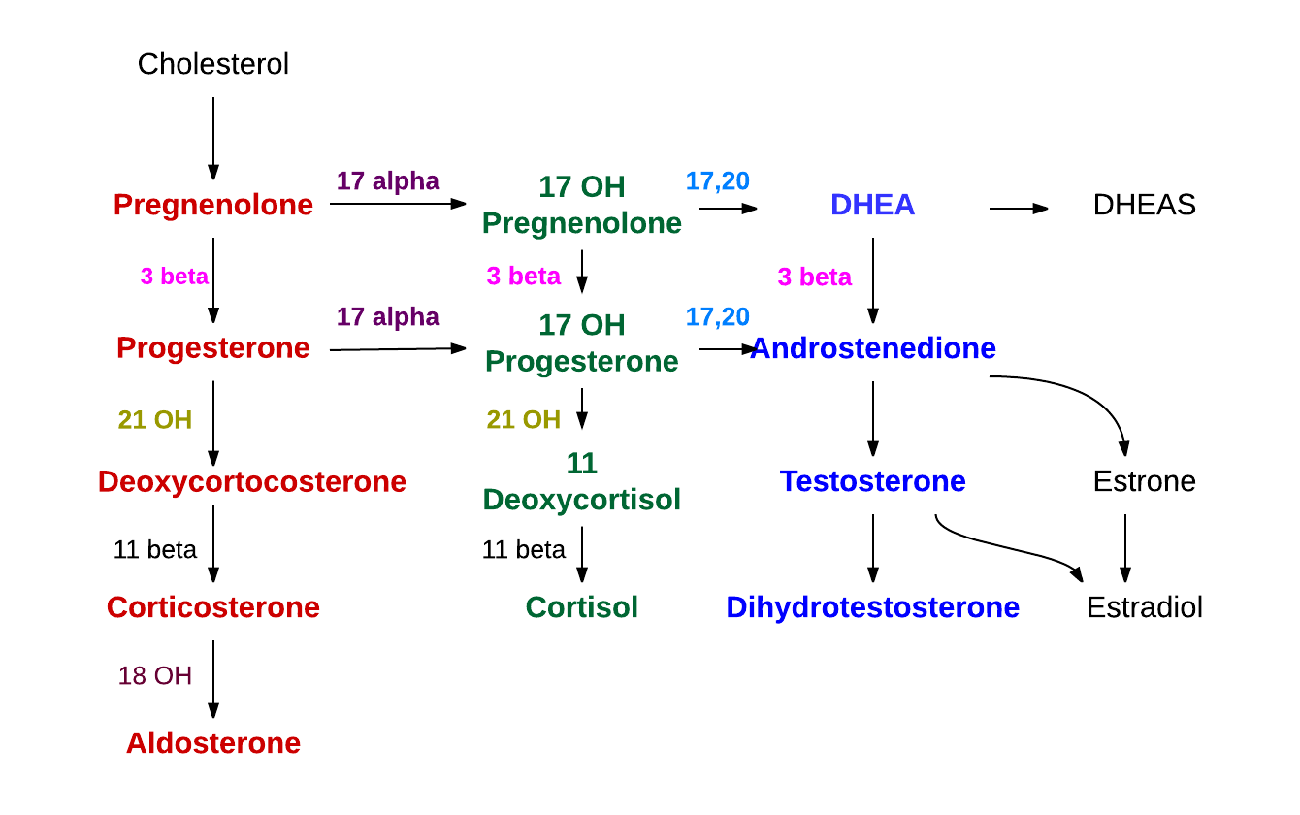
Adrenal Medulla
Adrenal Cortex

Slide 8
Adrenal Disorders
Function:
Hypersecretion
Hyposecretion
Primary and Secondary
Structural
Adenoma
Hyperplasia
Bilateral vs unilateral
Adrenal vs extra-adrenal

Slide 9
Evaluation of Adrenal disorders
C: Clinical ( History and Examination)
function ( oversecretion or hyposecretion )
Structural ( headache, visual symptoms )
B: Biochemical
  Screen Test
  Confirmatory Test
A: Anatomical
  CT or MRI adrenal
( adenoma, hyperplasia, uni or bilateral, adrenal , extradrenal, benign or malignant)
Then treatment:

Slide 10
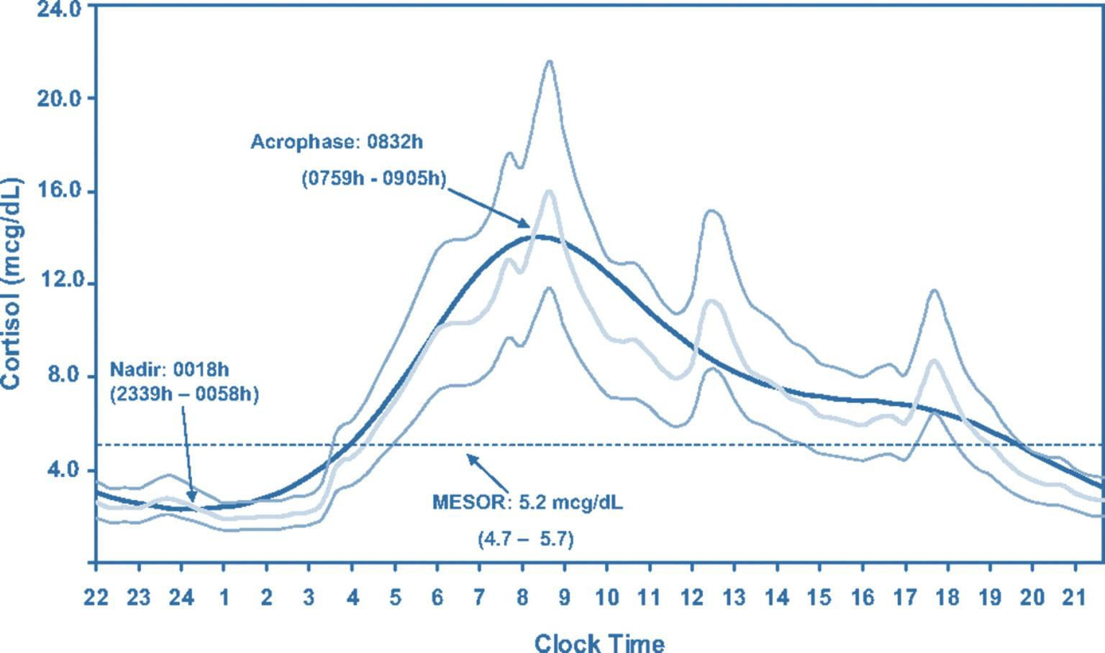
Physiological cortisol circadian rhythm
Grossman, A. B. J Clin Endocrinol Metab 2010;95:4855-4863

Slide 11
Adrenal hypofunction
1. Adrenal insufficiency
2. Congenital Adrenal Hyperplasia

Slide 12
1- Primary adrenal insufficiency
Idiopathic atrophy (autoimmune)
  isolated
  or part of polyglandular disease (type 1 or type 2).
Infection ( TB, fungal: Histoplasmosis, CMV HIV, Syphilis, ..etc)
Infiltration (lymphoma, Hemochromatosis, Amyloidosis, Sarcoidosis, malignancy)
Iatrogenic
  Surgical removal
  Anticoagulation and hemorrhage
Medications (ketoconazole, rifampin, phenytoin, Phenobarbital, Mitotane, Metyrapone, Aminoglutethimide )
Hereditary
  (Congenital adrenal hyperplasia,adrenal unresponsiveness to ACTH, adrenoleukodystrophy, adrenomyeloneuropathy, Refsum disease, Wolman disease)
Miscellaneous:
  Triple A syndrome= Allgrove syndrome
  Adrenal hemorrhage

Slide 13
Secondary/Tertiary adrenal insufficiency
Pan hypopituitarism (congenital / acquired):
  Tumors, surgery, radiation therapy
  Hypothalamic / pituitary disorders
Isolated ACTH deficiency
Withdrawal from glucocorticoid therapy
Inadequate glucocorticoid replacement
Infant born to steroid-treated mother
Surgical removal of ACTH-producing adenoma of the pituitary gland (Cushing's disease)

Slide 14
Primary adrenal insufficiency
(Addison disease)
destruction of adrenal cortex ( 3 layers)
Dr. Thomas Addison in 1849, TB was the commonest cause.
Now, autoimmune: the most common cause.
Often positive adrenal antibodies
Could be:
  an isolated problem
  or associated with other autoimmune diseases:
    Type I (APECED) : affects children: Adrenal insufficiency, hypoparathyroidism, pernicious
anaemia, chronic candidiasis, chronic active hepatitis, and hair loss)
    Type II “Schmidt's syndrome” usually affects young adults : hypothyroidism, adrenal insufficiency and diabetes mellitus, vitiligo

Slide 15
Clinical
weakness, tiredness, fatigue, Nausea, Vomiting, Constipation, Abdominal pain, Diarrhea, weight loss, Hyperpigmentation, fasting hypoglycemia.
Hypotension, Shock and death
Decreased axillary and pubic hair ( ? Clinical significant)
NB:
  destruction of adrenal cortex ( 3 layers)
  Hyperpigmentation: only in Primary adrenal insufficiency due to melanocyte stimulating hormone (MSH) from pro-opiomelanocortin (POMC) Not ACTH

Slide 16
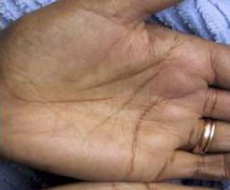
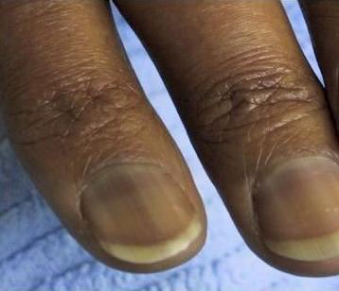
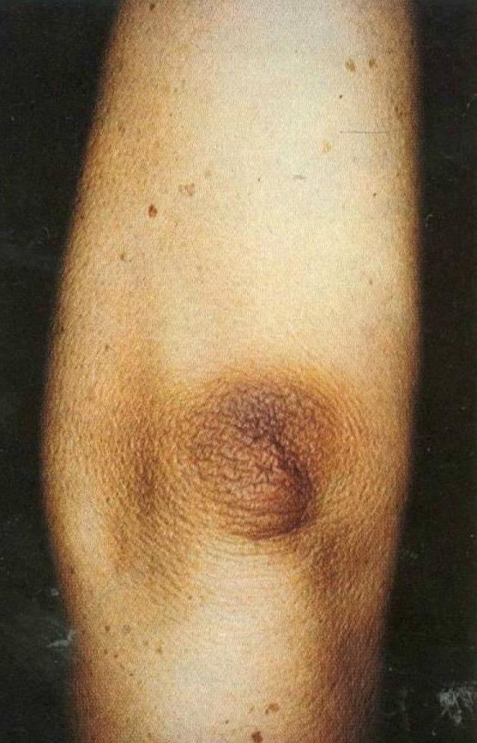
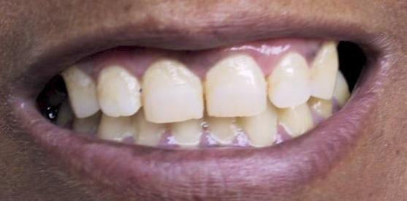
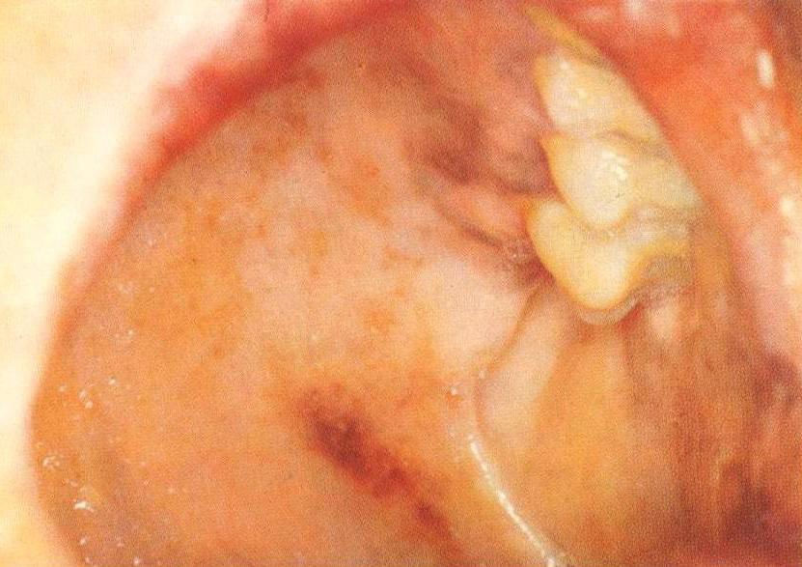
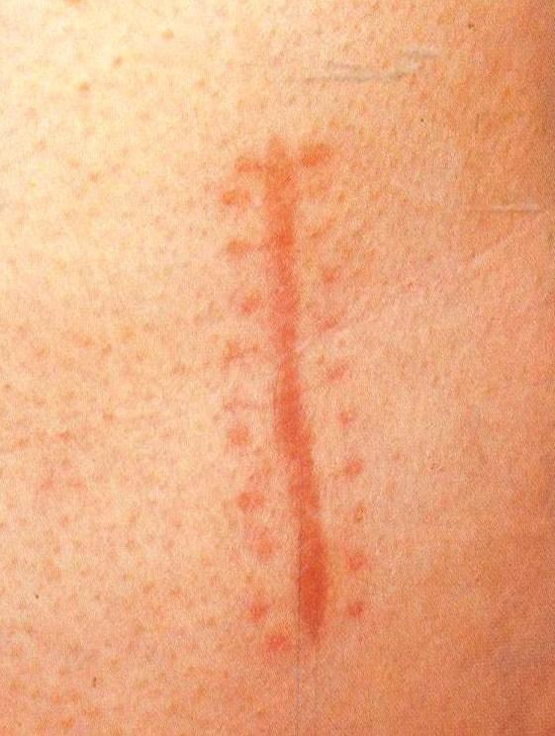

Slide 17

Hypotension
BP and HR
Standing and supine
Think about AI, if not respond to IVF and initial management

Slide 18
B: Biochemical
 | Primary | Secondary
ACTH | high | low
cortisol | low | low
Androgen (adrenal) | Low High in CAH | low
Aldosterone | low | Normal N.B: RAS
K | high | Normal/high
Na | Low | Low/ normal
Glucose | low | low
Hb | Normal or low | low

Slide 19
B: Biochemical
Measure am cortisol
  If high : R/O
  If very low : diagnosis
  If borderline result : proceed for confirmatory test
    ACTH stimulating test
Measure ACTH
  to differentiate primary or secondary

Slide 20
A: Anatomical
Adrenal insufficiency is clinical and biochemical diagnosis
No indications to do imaging unless clinically indicated such as:
  Patient on anticoagulation
  Malignancy with metastasis
  Or other infiltrative disease

Slide 21
Treatment
IVF: dextrose and salt for:
  Rehydration and to restore intravascular volume
  Electrolytes replacement
Steroid replacement
  If primary:
    replace both Glucocorticoids (cortisol): hydrocortisone and Mineralocorticoids (aldosterone):
Fludrocortisone
  if secondary: replace Glucocorticoids (cortisol): hydrocortisone only
NB: hydrocortisone has some Mineralocorticoids activity, so if you use hydrocortisone in high IV dose , stop Fludrocortisone

Slide 22
2- Congenital Adrenal Hyperplasia
90–95% of CAH cases are caused by 21- OHD
Ambiguous genitalia ( Female)
Failure to thrive
Dehydration & Shock ( usually male)
Salt-loss presentations with electrolytes imbalance:
  Hyponatremia
  Hyperkalaemia
  Hypoglycemia
Hyperpigementation

Slide 23
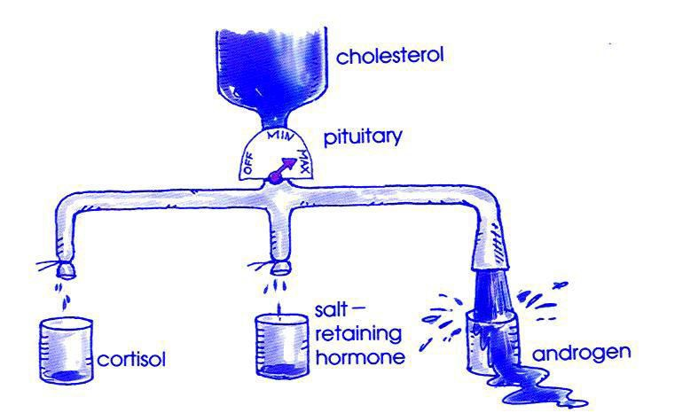

Slide 24
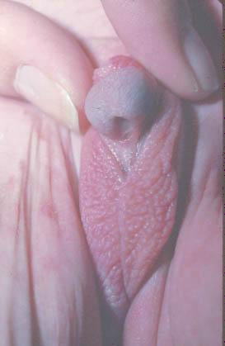
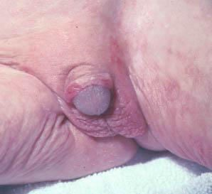
Is it a boy or a girl ?

Slide 25
Diagnosis
Clinical: History and examination (B.P)
Biochemical:
  Serum electrolytes & glucose:
    Low Na & high K
    Fasting hypoglycemia
    Elevated serum urea due to associated dehydration
Elevated plasma Renin & ACTH levels
Low Cortisol
High 17 – OHP
High androgens especially testosterone level
Low Aldosterone ( in salt losing types only)

Slide 26
Management
Hydrocortisone:
  10-20 mg/m2/day divided into three doses
  Adult usually 10-5-5 mg
  Fludrocortisone 0.05 - 0.2 mg/day
During adrenal crisis intravenous hydrocortisone 50-100 mg Q 6-8hrs
IVF D5 0.9% saline
During fever or sickness 2-3 fold increment in hydrocortisone dose
In vomiting or diarrhea, parental therapy is indicated
Medical Alert : bracelet

Slide 27
Adrenal Cortical Hyperfunction

Slide 28
Adrenal Cortical Hyperfunction
Hypercortisolism : Cushing syndrome
  First described by Cushing in 1932
  A constellation of clinical abnormalities due to chronic exposure to excesses of cortisol
  ACTH dependent ( pituitary or ectopic)
  ACTH independent (Iatrogenic ( most common), adrenal adenoma or carcinoma)
Hyperaldosteronism

Slide 29
1- Hypercortisolism
rounded "moon" facies with a plethoric appearance
truncal obesity with prominent supraclavicular and dorsal cervical fat pads
"buffalo hump“
distal extremities and fingers are slender
Muscle wasting and weakness
The skin is thin and atrophic, with poor wound healing and easy bruising
Purple striae may appear on the abdomen
Hypertension
renal calculi
osteoporosis

Slide 30
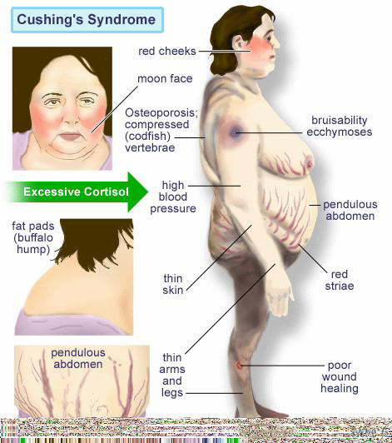
Clinical
DM, HTN, Obesity
easy bruises, hirsuitism
Fractures
Recurrent infections
Clinical features

Slide 31
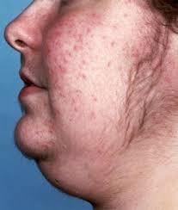
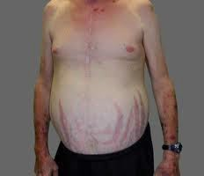
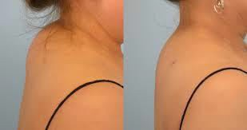
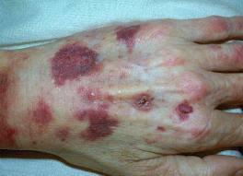

Slide 32
Cushing’s ( excessive cortisol)
C: Clinical | Function : Hirsutism, acne, easily bur DM,HTN, irregular period, proximal weakness, recurrent infections, depression O/E: hirsutism, acne, moon face, central obesity, stria, proximal weakness, supraclavicular fat pad,
B: Biochemical | High cortisol , high ACTH (ACTH dependent) and low if (non-ACTH dependent) 24hrs for UFC 1MG DST Midnight salivary cortisol
A: Anatomical | if ACTH: high: MRI pituitary If ACTH: low: history then CT adrenals
Treatment | Surgical or Medical

Slide 33
2- Conn's Syndrome
Primary hyperaldosteronism
  Adenoma, usually unilateral, of the glomerulosa cells of the adrenal cortex
  rarely, adrenal carcinoma
  Hyperplasia
The clinical picture may mimic CAH from of 11 α-hydroxylase deficiency
Secondary HTN
High Na, high Cl, high Aldosterone
Alkalosis
low K ( episodic weakness, Paresthesias, transient paralysis, tetany, nephropathy with polyuria and polydipsia)

Slide 34
Biochemical
Screening test:
  aldosterone /renin ratio
    If high: do confirmatory test
    If low: look for secondary causes
Confirmatory test:
  Saline infusion test
  Oral salt loading test
  Captopril test
  Fludrocortisone suppression test

Slide 35
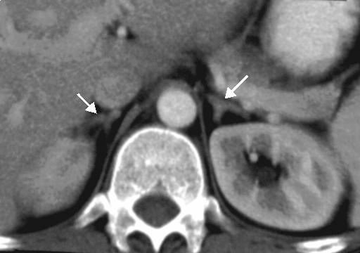

Slide 36
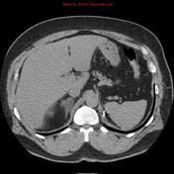
Anatomical
CT adrenal

Slide 37
Treatment
Adenoma → Surgical resection
Adrenal hyperplasia:
  Spironolactone.

Slide 39
Pheochromocytoma
Adrenal medulla: sympathetic nervous system
50% are silent. ( NO symptoms)
Pheochromocytoma:
  Isolated
  or part of MEN type II A or MEN type II B
Secondary HTN
Episodic (spells): sweating, palpitation, headache

Slide 40
When you should think about
Pheochrocytoma ?
Typical symptoms
Secondary HTN
  Young age < 40
  3 anti-HTN medications
  Resistant HTN
  Accelerated HTN
Any adrenal mass in image: adrenal incidentaloma
You should R/O
  pheochromocytoma
  Cushing
  and if there is HTN ,you should R/O hyperaldosteronism also

Slide 41
Biochemical
24 hr urine collection of Metanephrines ( 2X)
Plasma Metanephrines
Make sure about medications that affect the result of the test (false positive )

Slide 42
A: anatomical
CT scan = MRI
MIBG: if
Paraganglioma
Young
large size
or malignant features
Genetic Tests:
N.B: 30-40% of Pheochrocytoma and Paraganglioma Have positive genetic test. ( not 10 % )

Slide 43
Management
Control HTN
  α-blocker then B-Blocker ( 10-14 days before operation)
  Ca-blockers: can be used
•
Salt loading
  Oral NaCl: 3 days
  Or IVF 0.9% saline 1-2 days before surgey
Surgical removal

Slide 44
?

