Slide 1



OBESITY
Prof. Assim A Alfadda
MD, FRCPC, FACP, MSc
ةنمسلا ثاحبلأ يعماجلا زكرملا دوعس كلملا ةعماج – بطلا ةيلك
www.obesitycenter.edu.sa

Slide 2
Objectives
Why to study obesity?
What is obesity?
Body weight regulation?
Why do people come obese?
How to manage obesity?

Slide 3
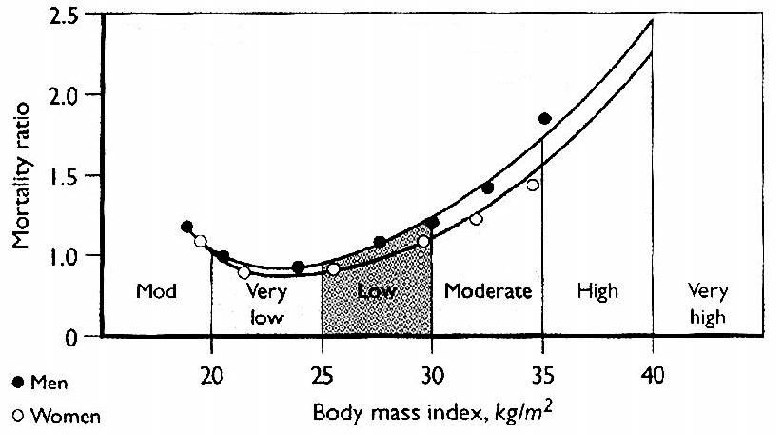
Obesity and mortality

Slide 4

Obesity: cardiovascular risk
6.6
60
Total cholesterol
6.2
50
SBP
5.8
40
2.8
2.6
30
2.4
2.2
Triglycerides
2.0
20
1.8
1.6
10
1.4
1.2
HDL cholesterol
1.0
18
0
20 22 24 26 28 30 32 34
Body Mass Index (kg/m²)
Data from British Regional Heart Survey.

Slide 5
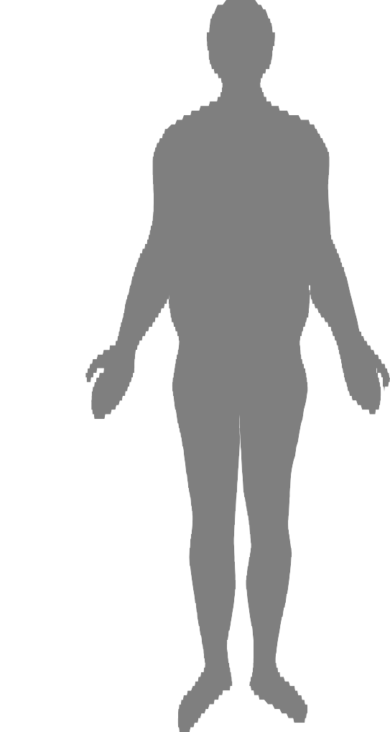
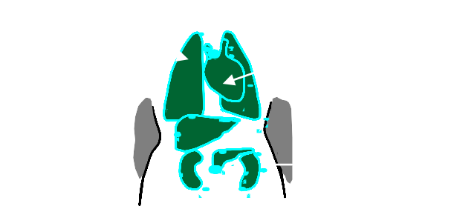


Physical Effects of Obesity
Stroke Cardiovascular
Diabetes
Osteoarthritis
Cancer
Respiratory disease
Gall bladder disease
Hormonal abnormalities
Hyperuricaemia and gout

Slide 6
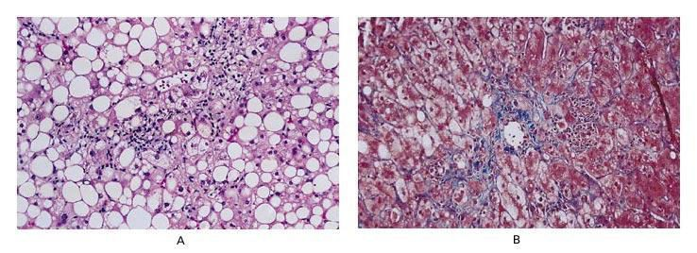
Nonalcoholic fatty liver
disease
Steatohepatitis
Fibrosis
NEJM 2002;346:1221-1230

Slide 7
Obesity
WHO:
“Abnormal or excessive fat accumulation in adipose tissue, to the extent that health is impaired”^{(1,2)}
Presence of an abnormal absolute amount or relative proportion of body fat.
WHO. Obesity: Preventing and Managing the Global
Epidemic. Technical report 894. Geneva: WHO, 2000;256
Garrow JS. Obesity and Related Diseases. Edinburgh: Churchill Livingstone, 1998.

Slide 8

Amount of adipose tissue in human
body
Possible
Difficult
Time consuming
Expensive

Slide 9
Surrogate measures of adiposity
Ideal body weight
Weight
Anthropometric measures
Body mass index (BMI):
Recommended by WHO
Relatively reliable except in:
- Extremes of age or height
- Very fit individuals with muscular build
Physical status: the use and interpretation of anthropometry. Report of a WHO expert committee. Geneva: WHO, 1995; 329

Slide 10
WHO recommended definition of
obesity (2000)
Classification | BMI(kg/m²) | Risk of co- morbidities
Underweight | <18.5 | Low (but risk of other clinical problems increased)
Normal range | 18.5-24.9 | Average
Overweight Pre-obese | >25.0 25-29.9 | Mildly increase

Slide 11
WHO recommended definition of
obesity (2000)
Classification | BMI(kg/m²) | Risk of co- morbidities
Obese | >30 | Moderate
Class I | 30-34.9
Class II | 35-39.9 | Severe
Class III | >40.0 | Very severe
WHO. Obesity: Preventing and Managing the Global Epidemic. Technical report 894. Geneva: WHO, 2000

Slide 12
Definition
Production of ethnic-specific cut-points for
obesity
BMI
Body
fatness
Morbidity
& Mortality
Additional interim cut-point of BMI of 23kg/m² or greater to indicate
overweight
in Asian populations and a BMI of 25kg/m² to represent a higher level of risk equivalent to
obesity
WHO (Western Pacific Region), International Obesity Taskforce and International Association for the Study of Obesity. The Asia-Pacific Perspective: Redefining obesity and its Treatment. Sydney: Health Communication, 2000

Slide 13
Central Obesity
Central or visceral obesity is associated
with more metabolic disease:
DM₂
Hypertension
Dyslipidemia
? How to assess central or visceral obesity?

Slide 14
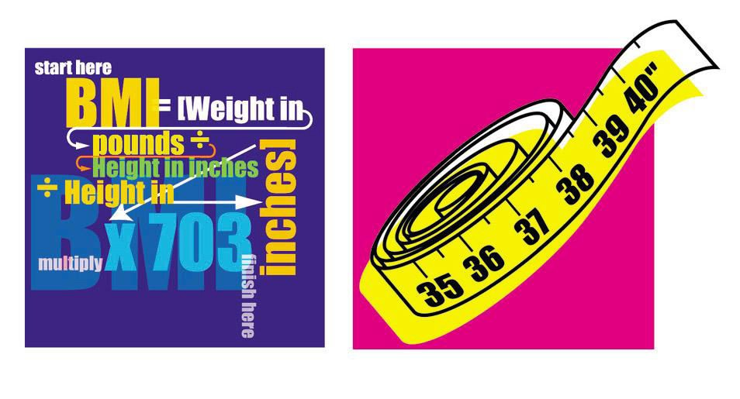
Waist Measurement or BMI?

Slide 15
Central Obesity
MRI
Dual X-ray absorptiometry (DEXA)
Single CT slice L4/L5
Waist: hip ratio
Waist circumference
The narrowest circumference midway between the lower border of the ribs
and the upper border of the iliac crest, taken from the side

Slide 16
Waist circumference (measure of visceral obesity)
Population | Risk of metabolic complications of obesity
 | Increased | Substantially Increased
Caucasian (WHO)
Men | >94 cm | >102 cm
Women | >80 cm | >88 cm
Asia (IASO/IOTF/WHO)
Men |  | >90 cm
Women |  | >80 cm
China (WGOC)
Men |  | >85 cm
Women |  | >80 cm

Slide 17
Obesity in children
Growth charts
BMI-for-age reference charts
“International standard” BMI-for-age:
- Cole et al. (BMJ 2000; 320:1240-1243)
Combined sample of seven countries
By tracking the percentile representing a BMI of 25kg/m² and 30kg/m² at 18 years backthrough to birth.
It’s use will provide a standard definition and enable
meaningful comparisons to be made between countries.

Slide 18
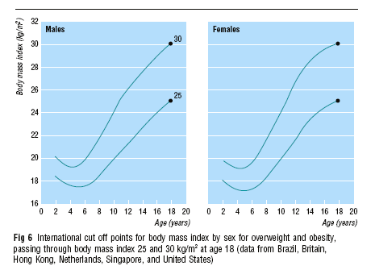
Cole et al. (BMJ 2000; 320:1240-1243)

Slide 19
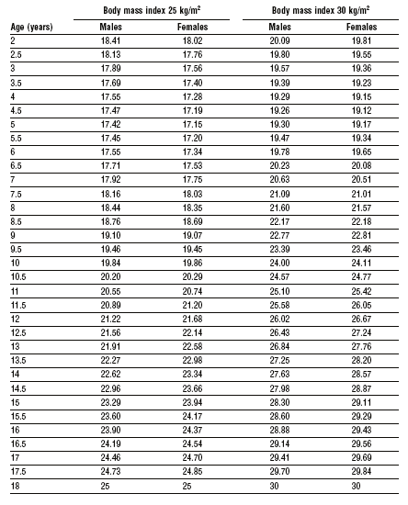
Cole et al. (BMJ 2000; 320:1240-1243)

Slide 20
Etiology & Pathogenesis
Multifactorial
Biochemical/Dietary/behavioral pathways.
Imbalance between energy intake and energy expenditure
Caloric intake
Energy expenditure
Diet composition

Slide 21
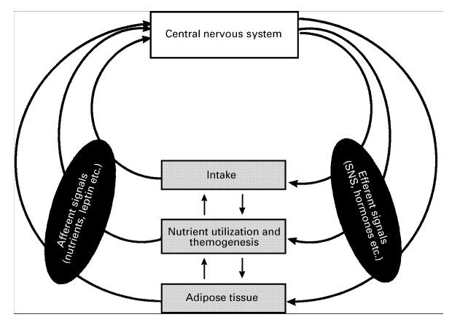
Body weight and composition regulation

Slide 22
Hypothalamic modulators of food
intake
Orexigenic | Anorexigenic
NPY | CART
AGRP | CCK
MCH | CRH
Galanin | α−MSH
Orexin | Insulin
Ghrelin | GLP-1
Noradrenaline | PYY 3-36
Endocannabinoids | Leptin
μ, к Opioids | Urocortin
Neurotransmitters | Bombesin

Slide 23
Etiology & Pathogenesis
Body weight is ultimately determined by the
interaction of:
Genetic
Environmental and
Psychosocial factors
Acting through several physiological mediators of food intake and energy expenditure
(Jebb, 1997; Cooling et al. 1998; Weinsier et al. 1998).

Slide 24
Etiological classification of obesity
Neuroendocrine disease
Drug-induced
Dietary
Reduced energy expenditure
Genetic factors

Slide 25
Neuroendocrine obesity
Ventromedial hypothalamus damage:
Tumors
Inflammatory lesions
Other hypothalamic disease
Cushing disease

Slide 26
Drug-induced obesity
Hyperinsulinism
Insulin
Sulfonylureas
Antidepressants
Antiepileptics
Neuroleptics

Slide 27
Dietary obesity
High carbohydrate diet
Hi fat diet

Slide 28
Change in BMI (kg/m²) from 1989
to 1991
0.25
0.2
0.15
LO FAT
HIGH FAT
0.1
0.05
0
S Paeratakul, et al. Int J Obesity (1998) 22, 424-431

Slide 29
Change in BMI (kg/m²) from 1989
to 1991
0.3
0.25
0.2
Same or Inc.
P/E Dec. P/E
0.15
0.1
0.05
0
S Paeratakul, et al. Int J Obesity (1998) 22, 424-431

Slide 30
Change in BMI (kg/m²) from 1989
to 1991
0.35
0.3
0.25
0.2
0.15
0.1
0.05
0
LO fat & same
or inc. P/E
HIGH fat & dec
P/E
S Paeratakul, et al. Int J Obesity (1998) 22, 424-431

Slide 31
Energy expenditure
Resting metabolism:
- 800 to 900 kcal/m²/24hr
Females < Males
Declines with age
Physical exercise:
~ 1/3 of daily energy expenditure
Most easily manipulated

Slide 32
Energy expenditure
Dietary thermogenesis (thermic effect of food):
Energy expenditure which follow the ingestion of meal
May dissipate ~ 10% of the ingested calories
In the obese, the thermic effects of food are reduced (especially in patients with diabetes)
Adaptive thermogenesis:
With acute over – or underfeeding
Shift in overall metabolism as large as 20%

Slide 33
Genetic factors in obesity
Dysmorphic or syndromic obesity:
Bardet-Biel syndrome
Alström syndrome
Carpenter syndrome
Cohen syndrome
Prader-Willi syndrome

Slide 34
Genetic factors in obesity
Single-gene cause of obesity:
Leptin and leptin gene deficiency
POMC deficiency
Genetic defects with nonsyndromic obesity:
- Melanocortin receptor system
abnormalities

Slide 35
Genetic factors in obesity
Genetic susceptibility to obesity:
If both parents are obese ~ 80% of the offspring will be obese
If only one parent ~ 10% of the offspring will be
obese
Studies with identical twins:
Hereditary factors account ~ 70%
Environmental (diet, physical inactivity, or both) account ~ 30% of the variation in the body weight

Slide 36
Genetic factors in obesity
The notion that obesity is a genetic
disorder is misleading:
The prevalence of obesity has increased markedly, world-wide, in recent years, yet genes have not changed.
Changes occur within population when
migration occurs.
Phenotypic expression of genes for obesity are environment specific Obesity is a disorder of gene-environment interaction

Slide 37
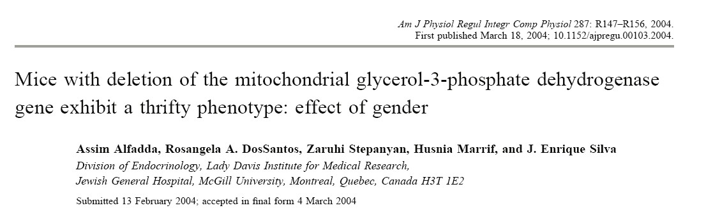
METABOLIC CONSEQUENCES OF DELETING THE MITOCHONDRIAL GLYCEROL 3-PHOSPHATE DEHYDROGENASE GENE IN MICE

Slide 38


The NADH glycerol 3-phosphate shuttle
glycolysis
NAD
NADH,H+
lipolysis
cGPD
Cytoplasm
DHAP
G3P
H+
H+
H+
nH+
ATP
mGPD
I
III
IV
synthase
II
Mitochondrial Matrix
_{nATP} nADP + nP

Slide 39
F 1,6 Bis-P
Glucose
Transfers electrons to the respiratory chain
Glycer- aldehyde 3-P
DHAP
TG
FADH2
mGPD
FAD
TPI
Glycerol
FFA
NADH+H⁺
GK
cGPD
G3P
ATP
NAD⁺
ADP
TRIGLYCERIDES
GLYCOLYSIS

Slide 40
Objectives
We studied the consequences of deleting
the mGPD gene regarding:
Responses to fat- or carbohydrate-rich diets.
Tolerance and responses to caloric
restriction and fasting.

Slide 41
Serum Triglycerides
A
Basal
B
PostTyloxapol
C
Production rates
Serum TG (μmol/ml)
0.6
0.5
0.4
0.3
0.2
0.1
0.0
P<0.001
Serum TG (μmol/ml)
4
WT mGPD-/-
TG PR (μmol/h/100g)
14
12
10
8
6
4
2
0
WT mGPD-/-
3
2
1
0
WT mGPD-/-
0 60 120
TIME(min)
Alfadda, et al. Am J Phy Reg Comp Phy 287: R147-R156, 2004

Slide 42
Food intake
High Fat
Low Fat
25
20
15
10
5
0
25
20
15
10
Food intake (g/d/100g BW)
Food intake (g/d/100g BW)
WT NULL
5
0
WT NULL
0
4 8
Time(weeks)
12
0
4 8
Time(weeks)
12
20
20
Food intake (Kcal/d)
15
Food intake (Kcal/d)
15
10
10
5
5
0
0
0
4 8
Time (weeks)
12
0
4 8
Time (weeks)
12

Slide 43
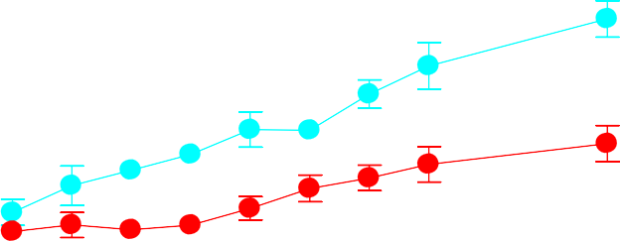
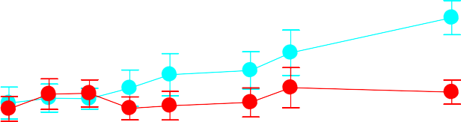
Body Weight
High Fat
Low Fat
32.5
30.0
27.5
25.0
22.5
20.0
17.5
30.0
27.5
25.0
22.5
20.0
17.5
P<0.001
*
*
P<0.004
Weight(gm)
Weight(gm)
*
*
WT NULL
WT NULL
0
2
4 6 8 10
Time(weeks)
0 2 4 6 8 10
Time (weeks)
Alfadda, et al. Am J Phy Reg Comp Phy 287: R147-R156, 2004

Slide 44
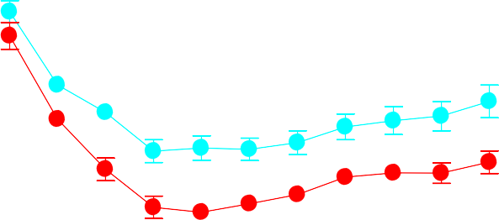
Weight Loss
Food restriction
30-hour fast
0
25.0
-50% -30%
WT NULL
Weight(gm)
22.5
Weight (% loss)
-5
20.0
*
*
* *
-10
* *
*
* *
17.5
-15
P<0.001
15.0
P<0.001
WT
NULL
0 1 2 3 4 5 6 7 8 9 10
Time (days)
Alfadda, et al. Am J Phy Reg Comp Phy 287: R147-R156, 2004

Slide 45
Change in Energy
Expenditure
30-hour fast Food restriction
0
0
QO₂
(% change)
QO₂
(% change)
-10
-10
-20
-20
-30
-30
WT
NULL
WT
NULL
Alfadda, et al. Am J Phy Reg Comp Phy 287: R147-R156, 2004

Slide 46
Core temperature change at
22°C
30-hour fast
Food restriction
0.0
-0.5
-1.0
-1.5
-2.0
-2.5
0.0
-0.5
-1.0
-1.5
-2.0
-2.5
-3.0
Temperature change (°C)
Temperature change (°C)
P=0.032
P=0.032
WT
NULL
WT
NULL
Alfadda, et al. Am J Phy Reg Comp Phy 287: R147-R156, 2004

Slide 47
Conclusions
Thus,
The mGPD can be considered a spendthrift
enzyme that significantly contributes to
obligatory thermogenesis
Alfadda, et al. Am J Phy Reg Comp Phy 287: R147-R156, 2004

Slide 48
Conclusions
The mGPD gene may play a role in the development of obesity if we consider the readiness with which some patients gain weight, and the difficulties the have to lose weight when undergoing a low calorie diets
Alfadda, et al. Am J Phy Reg Comp Phy 287: R147-R156, 2004

Slide 49
Conclusions
Dietary habits
Metabolic utilization of nutrients
Physical activity
Factors participating in body-weight maintenance •
= Susceptibility genes

Slide 50
Obesity
Management

Slide 51
Diet
Careful Training in :
Selection of lower fat, lower carb foods Modified food guide pyramid
Increase fruits & vegetables Lower fat preparation techniques Estimation of portion size

Slide 52
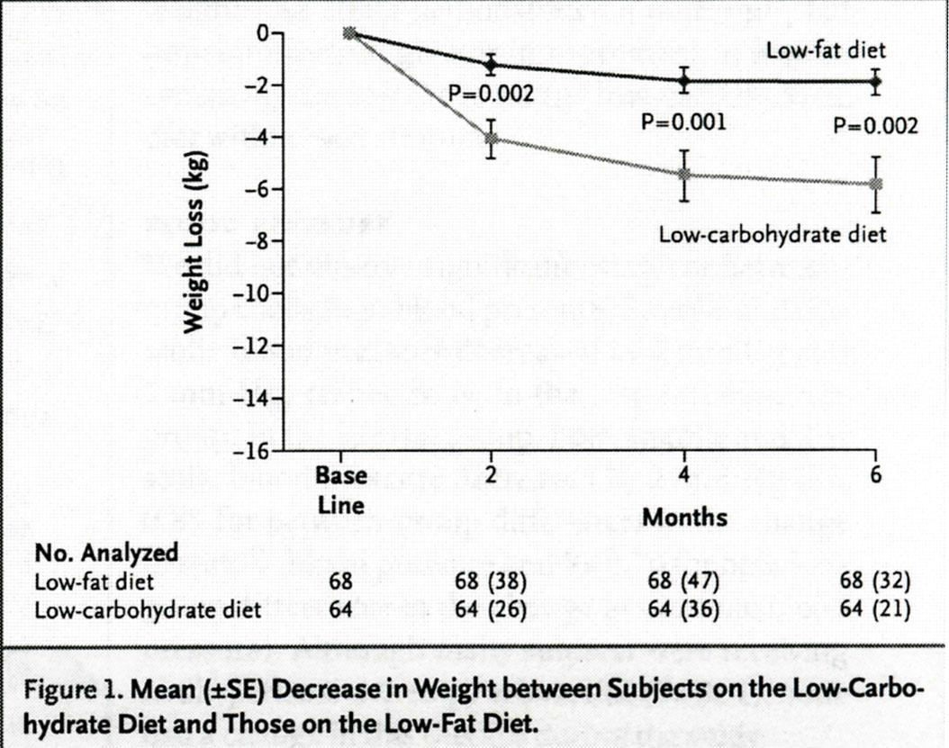
Atkins diet 6 mo results
BMI 42.9, 40% diabetic. TG, insulin, glucose; p<0.01.
NEJM 2003;348: 2074

Slide 53
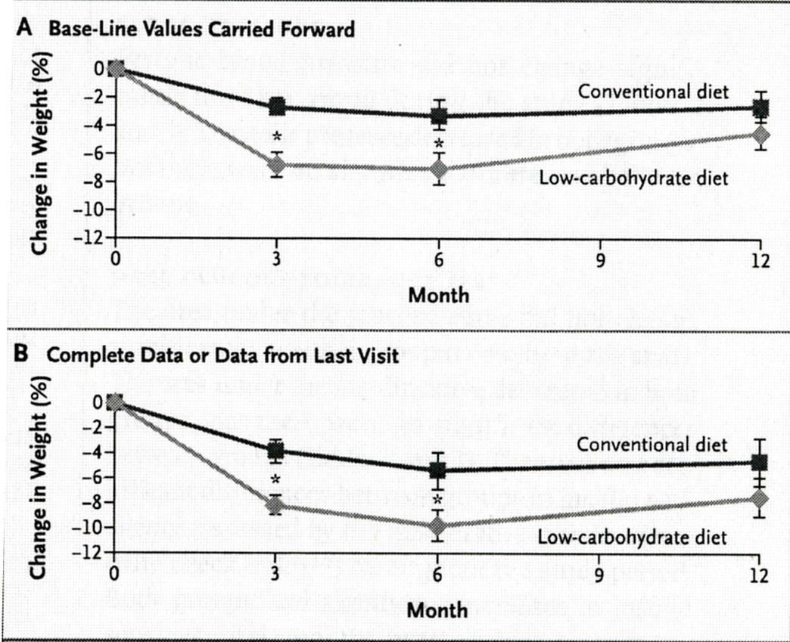
Atkins diet 24 months
33 each group; 1/3 dropouts; no diabetics, BMI 33; ↓ ΤG ↑ HDL
NEJM 2003;348: 2082

Slide 54
Dangers of Atkins diet
High saturated fat and cholesterol: CVD
High protein: decline in renal function, urinary calcium losses (osteoporosis)
Lack of fiber: increase colon cancer risk
Avoidance of carbs results in decreased intakes of essential vitamins (thiamin, folate,B6) and anti-oxidant phytochemicals

Slide 55
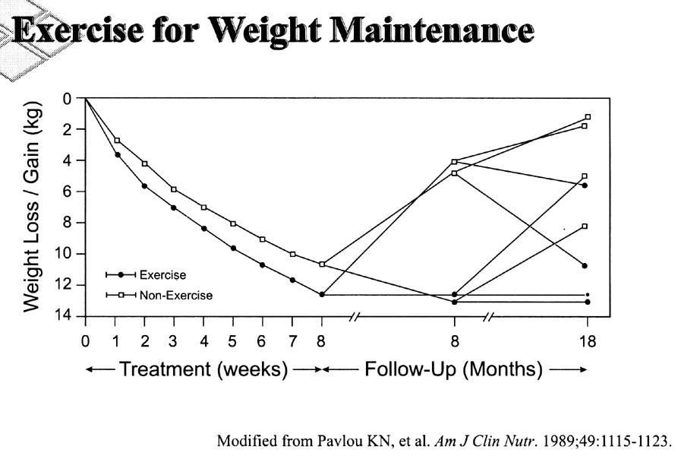

Slide 56
Orlistat
A lipase inhibitor, reduces the absorption of dietary fat
Lowers Cholesterol (4-11%) & LDL (5-10%)
Major C/I:
Chronic malabsorption syndrome
Cholestasis
Pregnancy and breast feeding
Dose:
120 mg/ immediately before, during, or up to 1 hour after each main meal (up to max. 360mg/day)
Max. period of treatment is 2 year

Slide 57



Body Weight Over 2 Years of
treatment with orlistat
0
Year 1:
Hypocaloric diet
Year 2:
Eucaloric diet
% change from initial weight
-2
Placebo/Placeb
-4
o
120/Placebo
-6
120/60
-8
120/120
-10
-12
-4
0
16
32
48
Week
64
80
104
JAMA. 1999;281:235-242

Slide 58
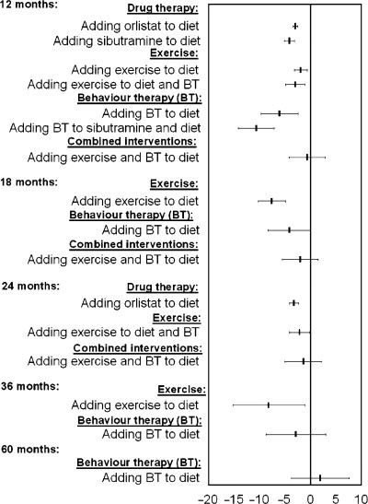
What interventions should we add to weight reducing diets in adults with obesity?
A systematic
review of randomized controlled trials of adding drug
therapy, exercise, behaviour therapy or combinations
of these interventions
Avenell, at al. The British Dietetic Association Ltd 2004. J Hum Nutr Dietet, 17, pp. 293–316

Slide 59
For Those Who Don’t Lose
Weight
Reassess:
  Understanding and compliance with diet, physical activity, and drug regimen
  Accuracy of weight recordings
  Possible Fluid retention (salt intake, etc)
  Changes in medical condition
  Motivation for change
  Social and personal stress
  Is the provider of health care the root of the
problem ?

Slide 60
For Those Who Don’t Lose Weight and There is no Cause Except Noncompliance with Diet & Exercise
Consider changing medication
consider referral to:
Dietitian
Behavioral counselor Exercise professional
Reconsider goal: i.e. simple maintenance or
a rest from weight loss efforts
Discuss surgical options if medically or
psychologically indicated

Slide 61
Obesity
Surgery

Slide 62
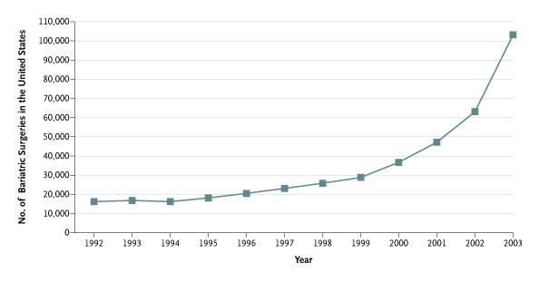
Estimated Number of Bariatric
Operations Performed in the United
States, 1992-2003
Steinbrook, R. N Engl J Med 2004;350:1075-1079

Slide 63
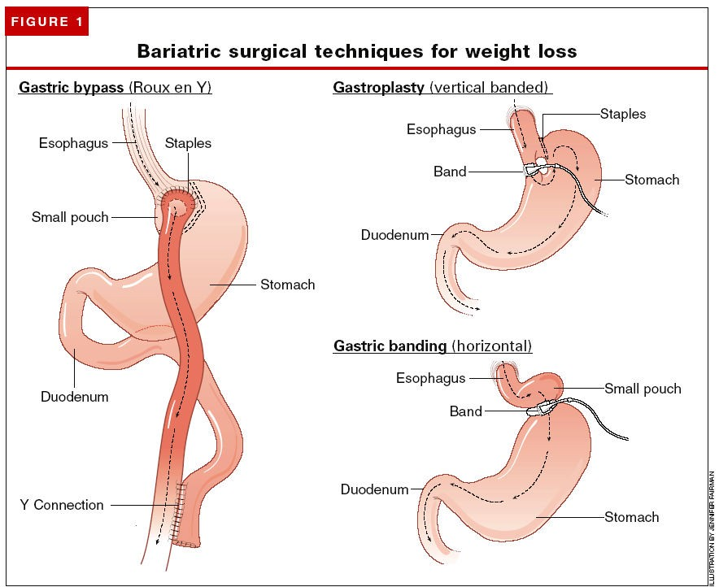

Slide 64
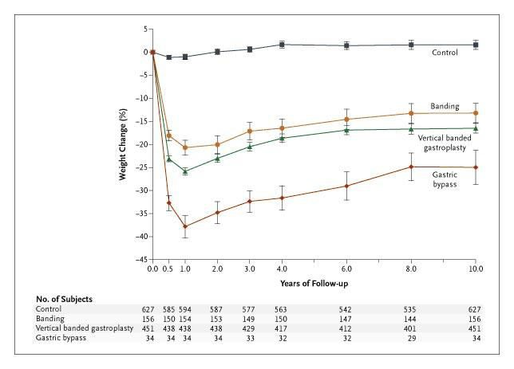
Sjöström, et al. NEJM. 2004. 351:2683-2693

Slide 65
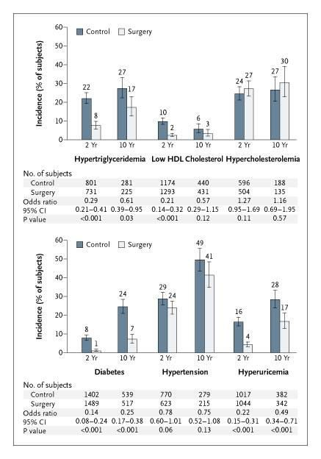
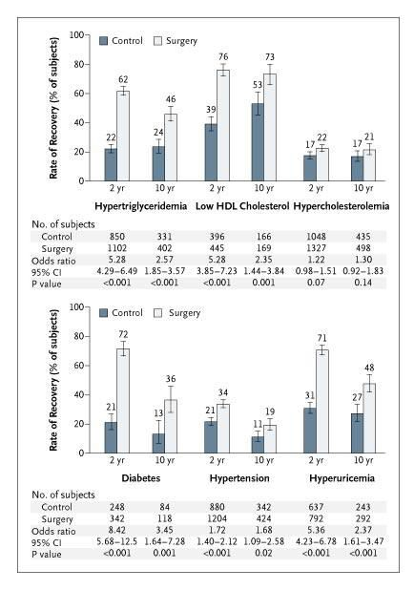
Sjöström, et al. NEJM. 2004. 351:2683-2693

Slide 66
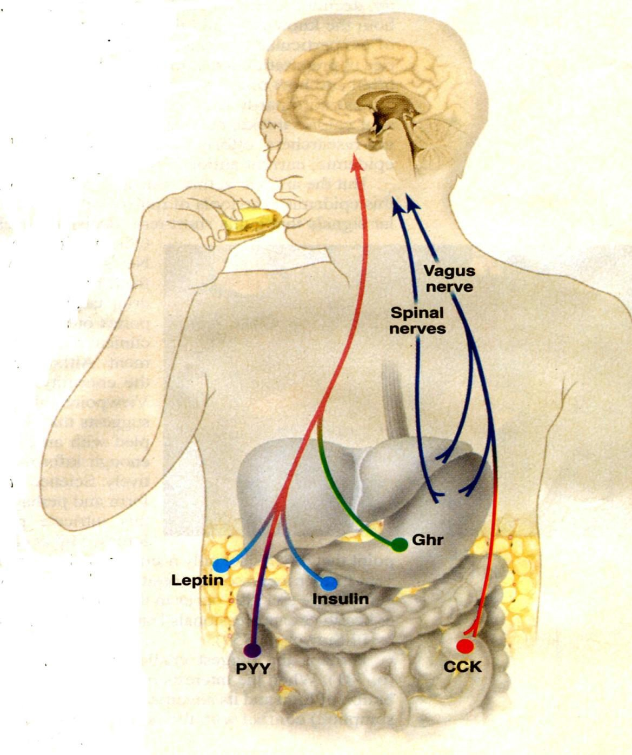
Gut to brain signaling

Slide 67
Ghrelin
Ghrelin is a recently discovered orexigenic
hormone
Secreted primarily by the stomach and duodenum
Has been implicated in both mealtime hunger and the long-term regulation of body weight

Slide 68
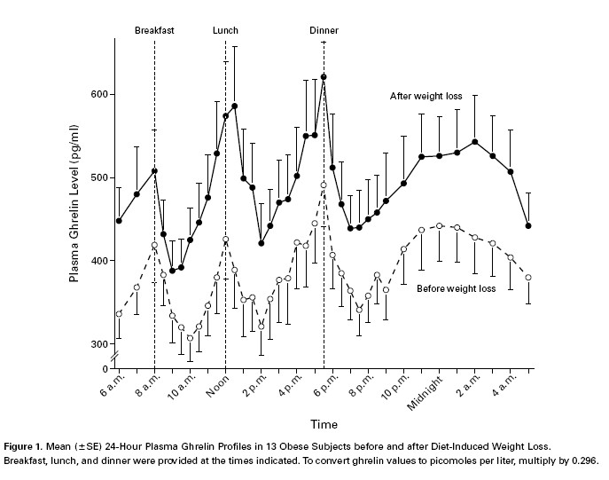

Slide 69
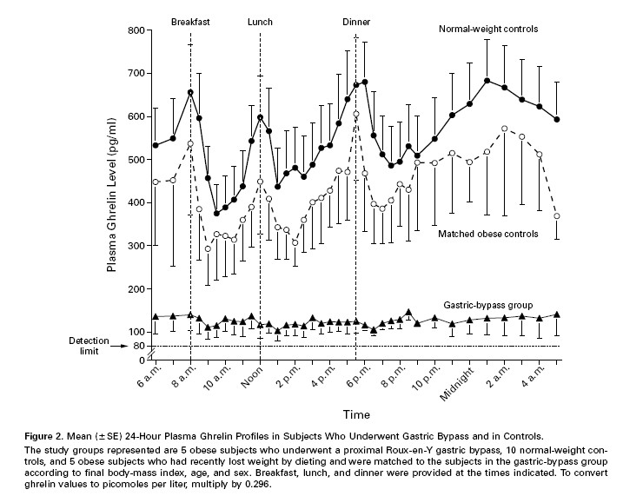

Slide 70
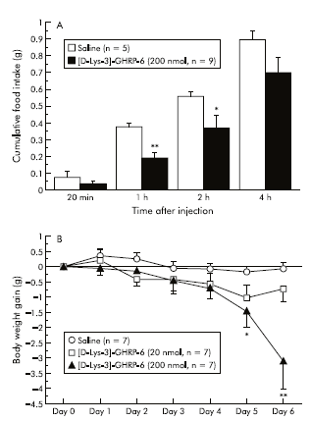
(A) Acute effects of intraperitoneally administered [D-Lys-3]-GHRP-6 (200 nmol/mouse) on cumulative food intake in food deprived ob/ob obese mice: *p<0.05, **p<0.01 compared with physiological saline treated controls. (B) Chronic effects of [D-Lys- 3]-GHRP-6 administered intraperitoneally (20–200 nmol/mouse every 12 hours for six days) on body weight gain innon-food deprived ob/ob obese mice.
Asakawa et al.Gut. 52 (7): 947. (2003)

Slide 71
اركش
Thank You
ةنمسلا ثاحبلأ يعماجلا زكرملا
دوعس كلملا ةعماج – بطلا ةيلك
www.obesitycenter.edu.sa

