Slide 1
Intracerebral Hemorrhage
Yousef Mohammad MD., MSc., FAHA
Associate Professor of Neurology
King Saud University

Slide 6
Mortality and Disability
Overall, 40% mortality at 1 month and 54% at one year
Only 12-40% are functionally independent long term
2010 – 62.8 million lost DALYs with ICH compared to 39.4 million in ischemic stroke

Slide 8
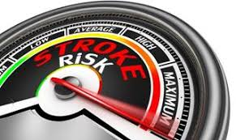
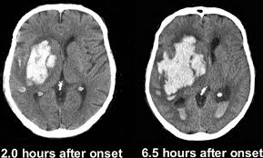
Risk Factors
HTN
Excessive ETOH use
Smoking
Age
Ethnicity/Race
Medications
Sympathomimetics

Slide 17
The Workup…
CT head – no contrast
CTA head/neck – suspect vascular etiology
Careful interpreting noncon CT head after CTA or other dye study
MRI brain – with gado if looking for neoplasm
MRA/MRV - if allergic to CT dye or if looking at venous outflow
Cerebral angiography

Slide 18
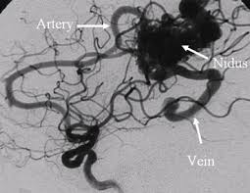
Other Causes
AVM, aneurysms, and other vascular malformations (venous and cavernous angiomas)
CVT
Intracranial neoplasm
Amyloid angiopathy
Moya Moya

Slide 20
The Workup…
CT head – no contrast
CTA head/neck – suspect vascular etiology
Careful interpreting noncon CT head after CTA or other dye study
MRI brain – with gado if looking for neoplasm
MRA/MRV - if allergic to CT dye or if looking at venous outflow
Cerebral angiography

Slide 21
What to do?????
Control BP!!!!
Guidelines – reduction of SBP to 140 is safe
Anderson/Qureshi studies – Interact 2 and ATACH 2
Not clear if SBP > 220
Use labetalol and/or nicardipine drip to titrate blood pressure
Between 15-23% of patients > hematoma expansion in first few hours
A word about penumbra

Slide 22
What do we do??
EBP nursing care
Watch for neuro decline
Type and cross with your labs!!!
HOB > 30
Head midline
Prevent vagal maneuvers
Control SBP
Treat hyperglycemia
Treat hyperthermia
Seizure prophylaxis
DVT prophylaxis
Typically, do not make patients DNR within the first 48 hours

Slide 23
Cerebral Edema: Sodium and CO2
Use the ventilator to manage CO2
Get the sodium up
Mannitol/3% or even 23.4% (requires central line) for herniation

Slide 24
Surgery anyone????
EVD
CLEAR III trial – no outcome benefit with vent use of tPA
Craniotomy
Depends on etiology
**Depends on AC/APT status
Depends on timing
Depends on location
STICH II – no overall favorable outcome
MISTIE II – MIS techniques
MISTIE III – underway
Cerebellar ICH

Slide 25
Subarachnoid Hemorrhage
Usually due to aneurysm rupture
Can be perimesencephalic SAH
Coil/Clip
NIMOTOP/NIMODIPINE
Strict BP control
Hydrocephalus
Vasospasm
Sodium
Urine output

Slide 26
Hemorrhagic Transformation HI 1/2 – PH 1/2
> 50% have some hemorrhage
0.6%-3% >> untreated patients
6% in treated patients
Risk Factors
Older age
larger stroke size
cardioembolic stroke etiology¹
anticoagulant use
fever
hyperglycemia
low serum cholesterol
Acutely elevated systolic blood pressure
thrombolytic therapy/recanalization
Treatment

Slide 27
Hypertensive hemorrhage
Putamen
Thalami
Pontine
Cerebellum
Lobar

Slide 28
Putamen Hemorrhage

Slide 29
Thalamic hemorrhage

Slide 30
Pontine hemorrhage

Slide 31
Cerebellar hemorrhage

Slide 32
AVM

Slide 33
AVM

Slide 34
SAH

Slide 35
Aneurysm

Slide 36
Amyloid Angiopathy

Slide 37
EDH

Slide 38
SDH

Slide 39
Lobar hemorhage

Slide 40
Tumor with ICH

