Slide 1
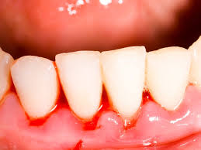
Bleeding Disorders
“ Made Easy”
Dr. Ahmed M Gamal
Consultant Adult Hematology & Internal Medicine
King Khalid University Hospital – King Saud University

Slide 2
Outlines
Overview of Hemostasis.
Congenital Bleeding Disorders.
Acquired Bleeding Disorders.
Platelet Disorders (Number & Function).
Approach to the bleeding Pt.
Management of Bleeding Pt.
Bleeding Disorders

Slide 3
Hemostasis
The process through which bleeding is controlled at a site of damaged or disrupted endothelium.
A dynamic interplay between
Cellular Components: ( PLTs & Endothelium )
Plasma Proteins Components: 3 protein systems
Blood Coagulation ( Clot Formation )
Fibrinolysis ( Clot Lysing )
Anticoagulant ( Regulating )
Bleeding Disorders

Slide 4
PLATELETS
Produced in the Bone Marrow by fragmentation of the cytoplasm of megakaryocytes.
Each megakaryocytes rise Plt from 1000 to 5000.
Time interval from differentiation of the human stem cell to the production of Plts ( ~ 10 days )
Thrombopoietin >> the major regulator of Plt production via c-MPL receptor (produced by Liver & Kidney)
Normal PLT counts ( 150 – 400 x 10⁹ )
PLT Life Span ( 7 – 10 days )
Bleeding Disorders

Slide 5
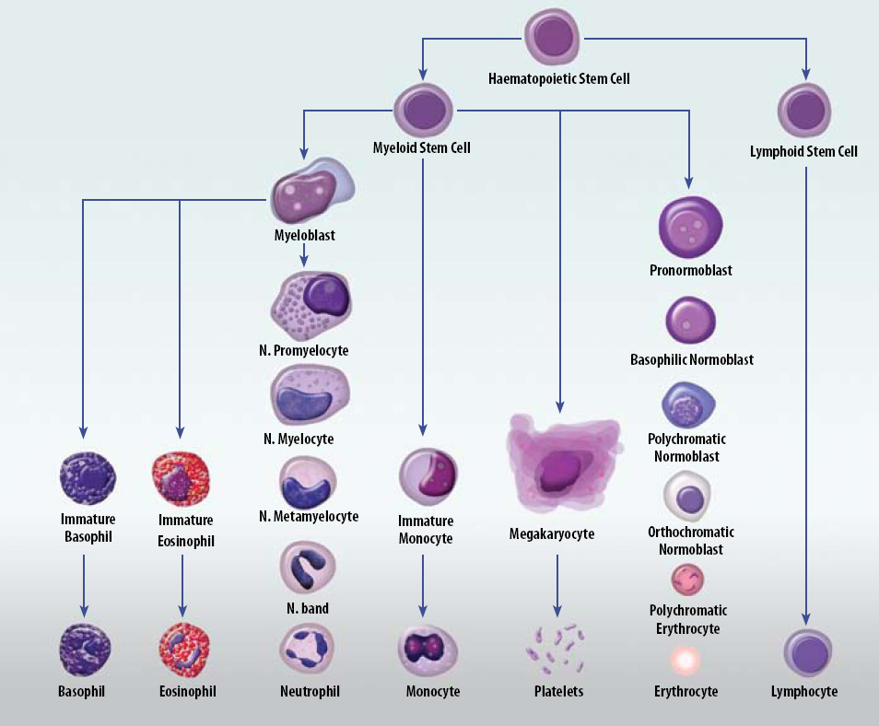

Slide 6
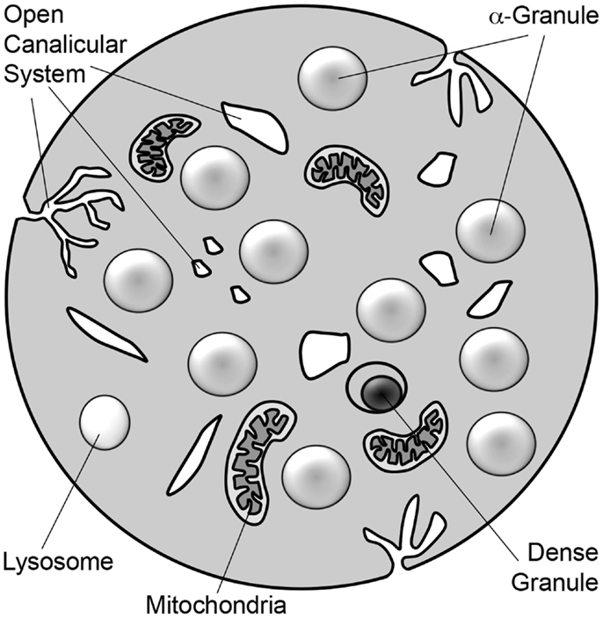
PLTs Ultrastructure
Extremely small & discoid (3 x 0.5 µm in diameter)
3 types of storage granules
α Granules
Clotting Factors
VWF
PDGF
ILGF1
Dense Granules ( δ Granules )
ADP & ATP
Serotonin
Histamine
Ionized Ca
Lysosomes
Hydrolytic enzymes
Bleeding Disorders

Slide 7
PLTs Functions
Adhesion ( PLT – Vessel Wall )  VWF through GP Ib/IX/V (synthesized in endothelial cells & megakaryocytes / stored in storage granules of endothelial cells & α granules of Plt / Rise with stress, exercise, adrenaline, infusion of DDAVP)
Aggregation ( cross linking of PLT – PLT )  VWF & Fibrinogen through GP IIb/IIIa receptors
Release Reaction & Amplification ( aggregation formation & stabilization ) 
release of α granules contents, & ADP from dense granules
formation of Thromboxane A2 by various agonists induces intracellular signaling.
Bleeding Disorders

Slide 8
PLTs Inhibitors
PLT Function Inhibitors
Prostacyclin (PGI₂);
synthesized by vascular endothelial cells 
potent inhibitor of PLT aggregation & causes vasodilation by rising cAMP 
prevents Plt deposition on normal vascular endothelium
Nitric Oxide (NO);
released from endothelial cells, macrophages, & Plt 
inhibit Plt activation & promotes vasodilatation
Bleeding Disorders

Slide 9
Clotting Factors
Bleeding Disorders

Slide 10
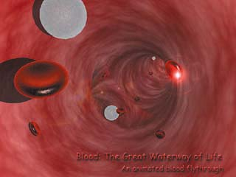
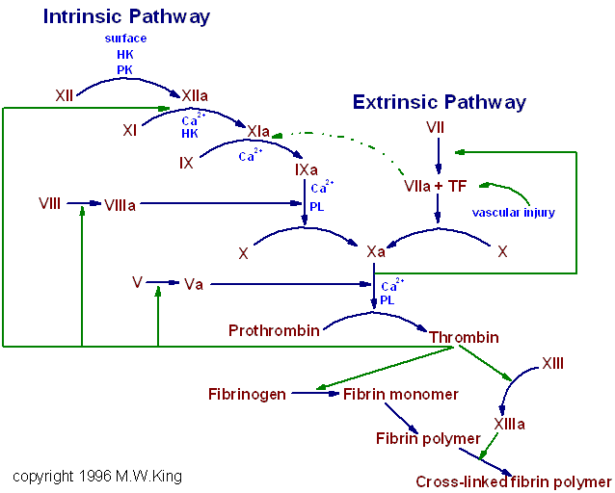
Coagulation Cascade
Contact Activation
(Intrinsic) Pathway
Tissue Factor
(Extrinsic) Pathway
Common Pathway
Ca

Slide 11
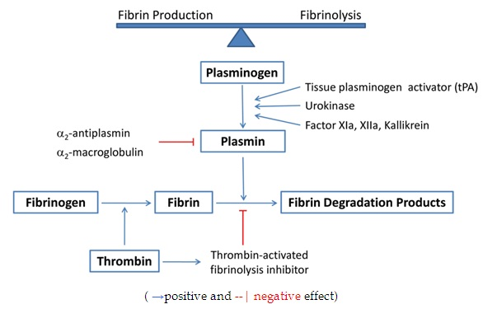
Fibrinolysis
Plasminogen Activators Inhibitors (PAIs)
Bleeding Disorders

Slide 12
Hemostatic Phases
Vascular Phase:
release of locally active vasoactive agents (Endothelin, Thromboxane A2, Fibrinopeptides)  Vasoconstriction at the site of injury  reduced blood flow
Platelet Phase: Plt Adhesion & Aggregation (via VWF, ADP, TXA2)  formation of PLT Plug
Plasma Coagulation Phase: Propagation of the clotting process by the coagulation cascade  formation of Fibrin Clot
Fibrinolysis Phase: Termination of clotting by antithrombotic control mechanisms & removal of the clot
Primary Hemostasis:
Endothelium Injury
Platelet
Von Willebrand Factor
Secondary Hemostasis:
Clotting Factors
Soluble Protien Fibrinogen converted to insoluble Fibrin
Bleeding Disorders

Slide 13
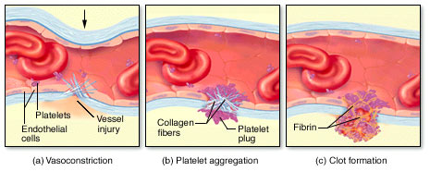
Hemostatic Phases
Primary Hemos.
Secondary Hemos.
https://youtu.be/HFNWGCx_Eu4
Bleeding Disorders

Slide 14
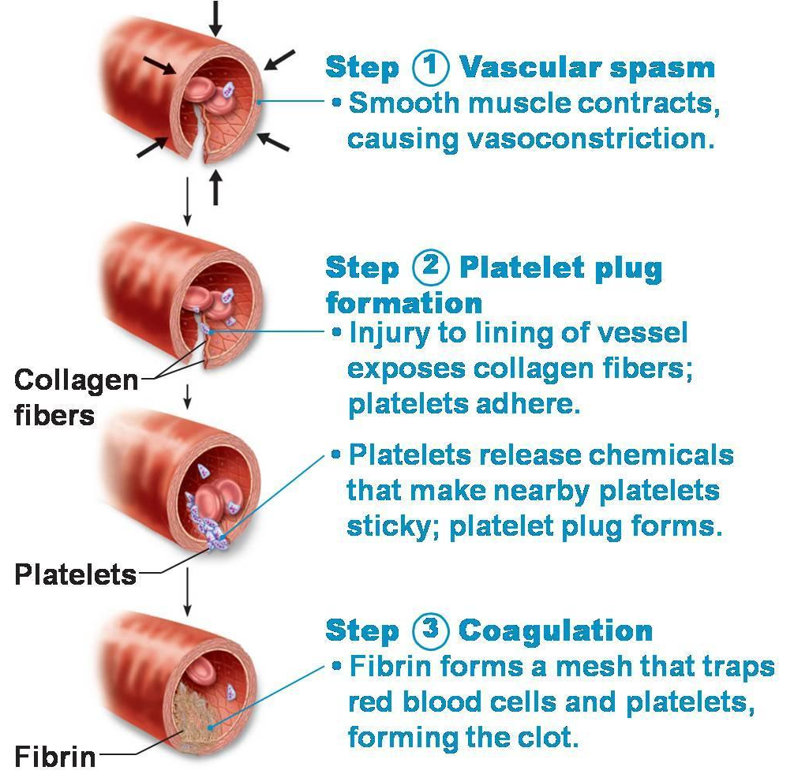
Hemostatic Phases
Bleeding Disorders

Slide 15
Congenital Bleeding Disorders

Slide 16
Hemophilia
an inherited bleeding disorder caused by deficiency of coagulation.
(the most common inherited bleeding disorders)
● Hemophilia A – Inherited deficiency of factor VIII (8); an X-linked recessive disorder.
● Hemophilia B – Inherited deficiency of factor IX (9); also called Christmas Disease; an X-linked recessive disorder.
● Hemophilia C – Inherited deficiency of factor XI (11); also called Rosenthal Syndrome; an autosomal recessive disorder. Rarely, heterozygotes may have bleeding (ie, autosomal dominant transmission, due to heterodimer binding). especially common in Ashkenazi Jews (ie, Jews from Eastern Europe).
Bleeding Disorders

Slide 17
Hemophilia
characterized based on the residual or baseline factor activity level (also referred to as "factor level"); expressed as a % of normal or in IU/mL.
Factor levels typically correlate with the degree of bleeding Symptoms.
• Severe Hemophilia – defined as <1 % factor activity (<0.01 IU/mL).
• Moderate Hemophilia – defined as a factor activity level ≥1 % of normal and <5 % of normal ( ≥0.01 - <0.05 IU/mL).
• Mild Hemophilia – defined as a factor activity level ≥5 % of normal and <40 % of normal (≥0.05 - <0.40 IU/mL).
Bleeding Disorders

Slide 18
Hemophilia
Congenital >> genetic mutation in F8 & F9 located on the long arm of X chromosome.
Observed commonly in males due to their hemizygous state
Rarely in females due to (Heterozygous females as result from nonrandom X chromosome inactivation, skewed Lyonization, or the presence of other genetic abnormalities (Turner Syndrome or X autosomal translocations).
Acquired >> development of autoantibodies most commonly directed against FVIII – ass. with pregnancy, malignancy, advanced age.
Clinically >> hematomas, hemarthroses, bruising, bleeding (mucosal, GI, GU)
Dx >> ☹ aPTT,  Factor Level, Mixing study (corrected), N VWF & PT
Rx >> Replacement of the deficient coagulation Factor (recombinant or plasma derived) + Adjunctive therapy (Desmopressin (DDAVP), Antifibrinolytic agents (Tranexamic Acid, Aminocaproic Acid), rFVIIa (with inhibitors)
Bleeding Disorders

Slide 19
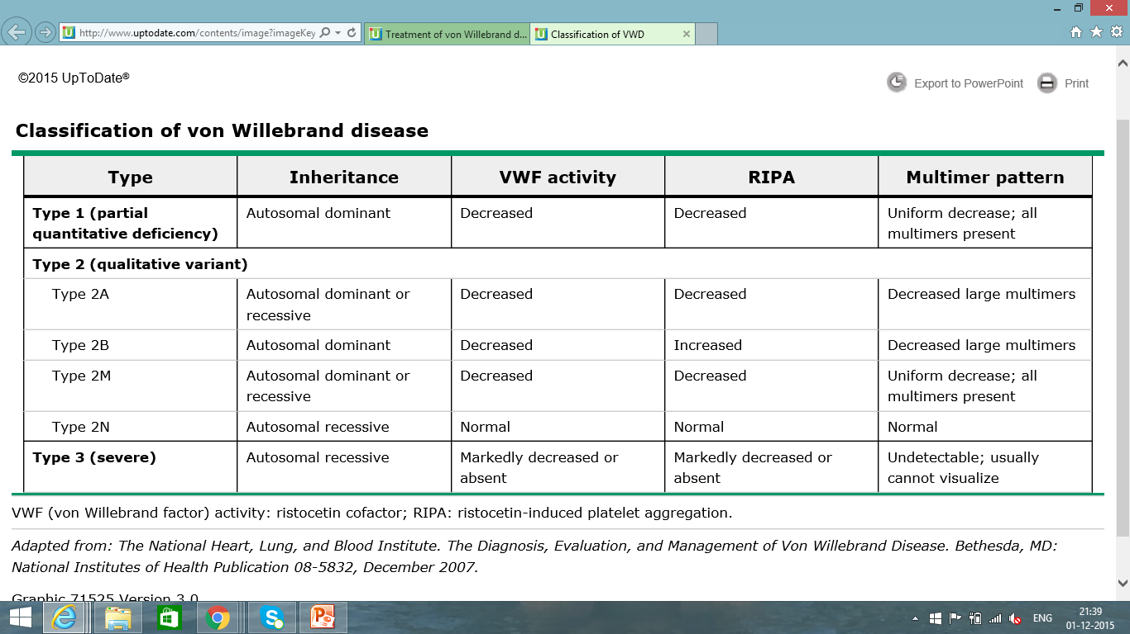
Von Willebrand Disease
The most common bleeding disorder.
Bleeding Disorders

Slide 20
Von Willebrand Disease
Congenital >> autosomal dominant (most types), recessive (rarely)
Acquired >> rare, caused by autoantibodies against vWF & immune complex formation, vWF binding to cancer cells, Congenital Heart Disease, Aortic Stenosis, Angiodysplasia. Rx (of the underlying disorder)
Dx >> normal aPTT in (Type 1 & 2), prolonged aPTT in (Type 2N, 2B, & 3), vWF:Ag, vWF:RCo, vWF multimers (to differentiate subtypes), FVIII assay (low in 2N & 3), Plt (low in 2M)
Rx >> Replacement of exogenous vWF concentrate, Desmopressin (DDAVP; intranasal), Antifibrinolytic agents (Tranexamic Acid, Aminocaproic Acid), Conjugated Estrogens & oral contraceptive Agents (for menorrhagia)
Bleeding Disorders

Slide 21
Platelets Disorders

Slide 22
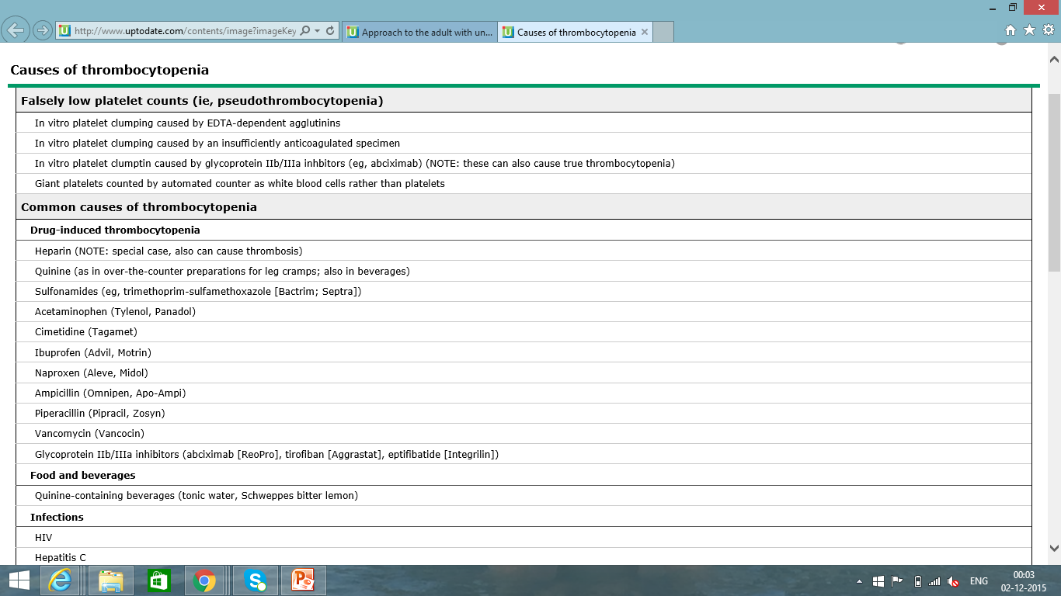
Plt Disorders (Quantitative)
Causes of Thrombocytopenia
Bleeding Disorders

Slide 23
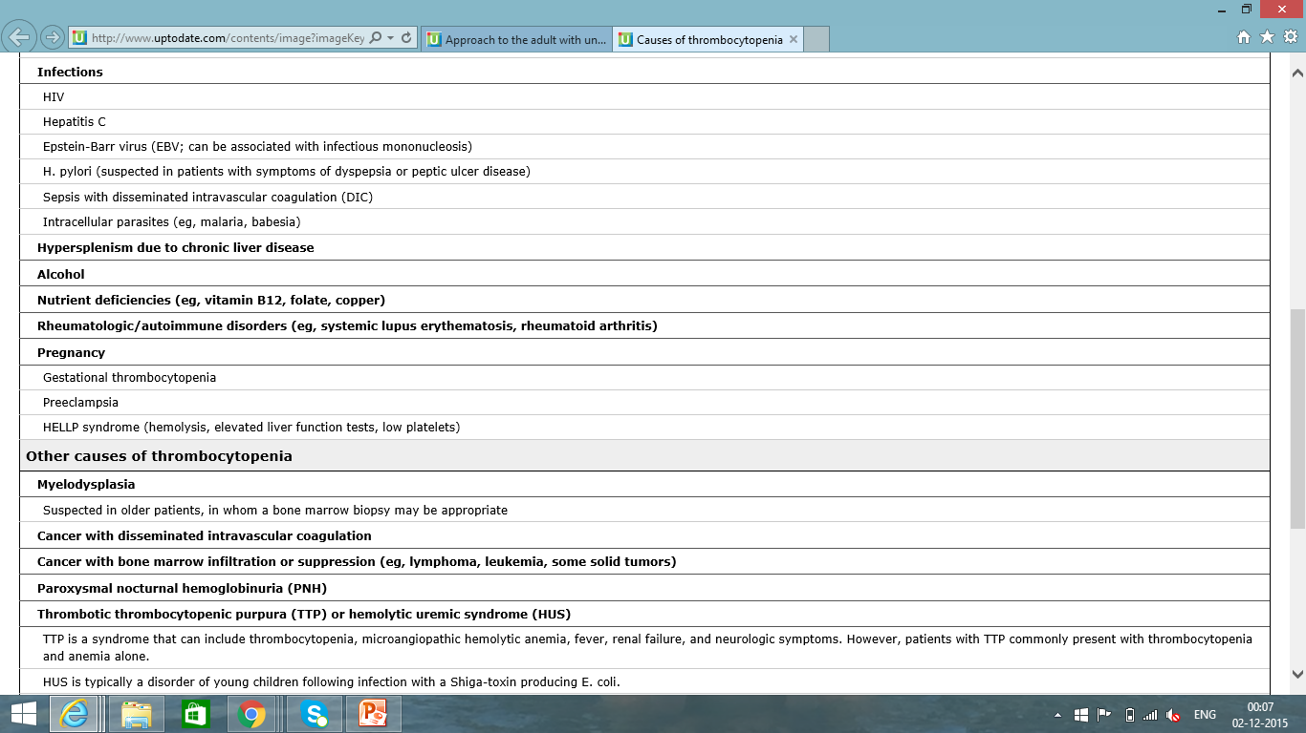
Plt Disorders (Quantitative)
Causes of Thrombocytopenia
Bleeding Disorders

Slide 24
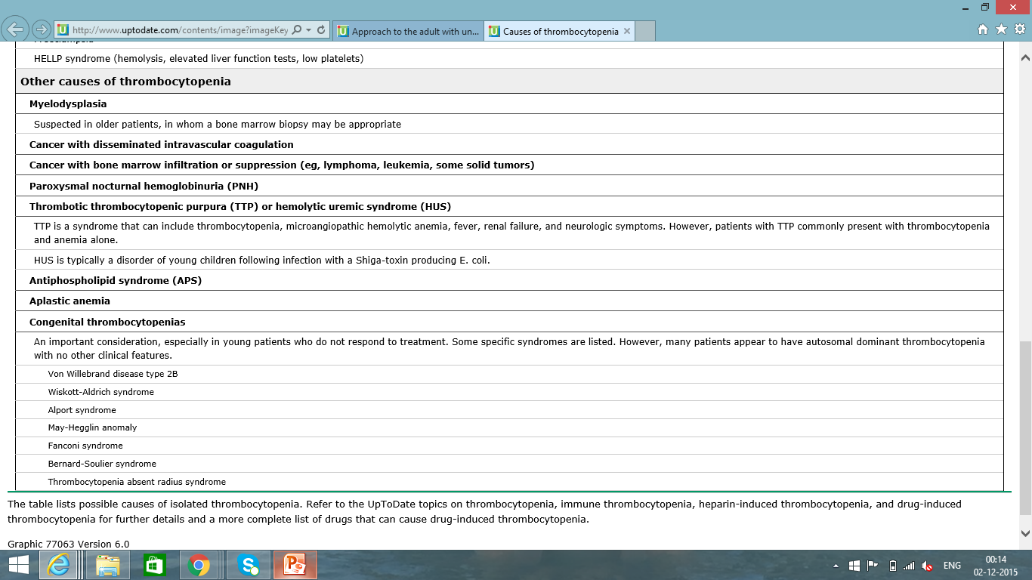
Plt Disorders (Quantitative)
Causes of Thrombocytopenia
Bleeding Disorders

Slide 25
Approach to Thrombocytopenia
Bleeding Disorders

Slide 26
Immune Thrombocytopenic Purpura (ITP)
Primary : isolated thrombocytopenia due to immune Plt destruction &  production (auto AB to megakaryocytes)
Secondary : a/w disease/drug exposure  Viral (HIV, HCV, HBV, EBV, CMV, Parvovirus), SLE, APLS, H. Pylori Infection, Chronic Lymphocytic Leukemia (CLL), Hodgkin Lymphoma, AIHA
Dx >> Dx of exclusion, no robust clinical or Lab parameters, Typically CBC (Isolated  PLT < 100.000), 10% have ITP + AIHA (Evans Syndrome), PBS (Large Plts), Anti-Plt AB (not useful)
Clinically >> insidious onset of mucocutaneous bleed, M:F (3:1)
Rx >> rarely indicated if PLT > 50.000 unless bleeding, trauma/surgery, anticoag, comorbidities
Steroids, IVIG, Splenectomy, TPO agonists (Romiplostim, Eltrombopag)
Bleeding Disorders

Slide 27
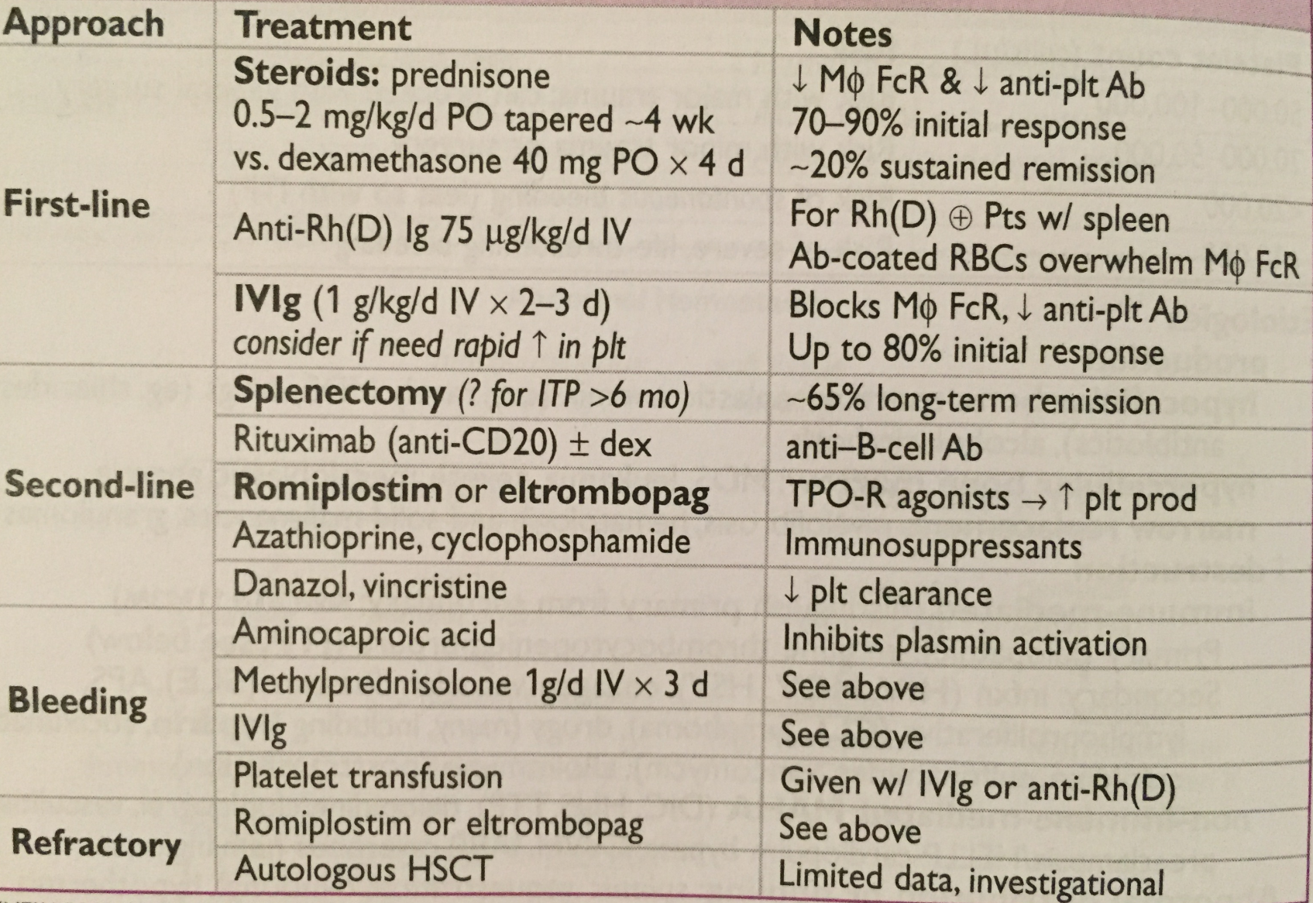
Immune Thrombocytopenic Purpura (ITP) Treatment
Bleeding Disorders

Slide 28
Disseminated Intravascular Coagulation (DIC)
Etiology : Trauma, shock, infection, malignancy (esp APML), Obstetric complications.
Pathogenesis :
massive activation of coagulation that overwhelms control mechanisms  thrombosis
Acute consumption of coagulation factors & Plts  bleeding
Dx >> ☹ PT, ☹ aPTT,  Fibrinogen (may be N b/c acute phase), +ve D-Dimer/FDP,  PLT, +ve Schistocytes, ☹ LDH,  Haptoglobin
Rx >> treat underlying process, FFP, Cryoprecipitate (Goal Fibrinogen > 100 mg/dL), PLT Tx
Bleeding Disorders

Slide 29
Plt Disorders (Qualitative )
ACQUIRED PLT FUNCTIONAL DISORDERS
Liver Disease
Cardiopulmonary Bypass
Uremia
Dysproteinemia ( Multiple Myeloma or Waldenstrom Macroglobulinemia )
Myeloproliferative Disorders (MPDs)
Diabetes Mellitus
Acquired Glanzmann Tthrombasthenia
Bleeding Disorders

Slide 30
Plt Disorders (Qualitative )
INHERITED DISORDERS OF PLT FUNCTION
Giant platelet disorders includes Plt GP abnormalities (eg, Bernard-Soulier Syndrome, Deficiency of Platelet Alpha granules (eg, Gray Platelet Syndrome), Deficiency May-Hegglin Anomaly (which also involves the presence of abnormal neutrophil inclusions (ie, Döhle-like bodies)), & some kindreds with type 2B vWD (Montreal Plt Syndrome)
Wiskott-Aldrich syndrome
Storage Pool Disorders such as Hermansky Pudlak Syndrome (HPS) (Deficiency of Dense Granules)
Glanzmann thrombasthenia
Platelet release disorders
Glycoprotein VI defects
Sticky platelet syndrome
Congenital Deficiency of the ADP receptor P2Y₁₂
Scott syndrome
Bleeding Disorders

Slide 31
Approach to Pt with
Potential Bleeding

Slide 32
Approach to Pt with
Potential Bleeding
Detailed Pt & Family Medical History (Crucial & Vital regardless of the prior Lab testing)
>> establish likelihood of a bleeding disorder
>> guide laboratory Testing
Early in the newborn period (circumcision)
After hemostatic Challenges ( delivery, injury, trauma, surgery, invasive dental procedure, menstruation )
Frequency & pattern
Duration
Sx onset ( congenital vs. acquired )
time required for cessation
Bleeding Disorders

Slide 33
Approach to Pt with
Potential Bleeding
Detailed Pt & Family Medical History (Crucial & Vital regardless of the prior Lab testing)
Sites of bleeding (specific or multiple)
Primary Hemostasis Defects
( PLT or vW Factor )
Secondary Hemostasis Defects
( Clotting Factors Deficiencies )
Mucocutaneous Bleeding
Easy bruising
Epistaxis
Menorrhagia
Deep Tissue Bleeding
Joints
Muscles
Central Nervous System
Bleeding Disorders

Slide 34
Approach to Pt with
Potential Bleeding
Detailed Pt & Family Medical History (Crucial & Vital regardless of the prior Lab testing)
Current use of medications or herbal supplements
Use of Bleeding Assessment Tools (differentia bleeding phenotypes, require validation by prospective studies)
Bleeding Disorders

Slide 35
Drugs Used for Clotting Disorders
Half Life | Trade Name | Generic Name
12 – 28 hr | Pradaxa | Dabigatran
39 – 51 min | Acova | Argatroban
1.3 hr | Refludan | Lepirudin
25 – 57 min | Angiomax | Bivalirudin
Anticoagulants
Direct Thrombin Inhibitors
Indirect Thrombin Inhibitors
Vitamin K epoxide reductase Inhibitor
Direct Xa Inhibitors
 | ………………………….. | Unfractionated Heparin (UFH)
4.5 – 7 hr | Clexan | LMWH - Enoxaparin
3 – 4 hr | Innohep | LMWH - Tinzaparin
 |  | LMWH - Deltaparin
17 – 21 hr | Arixtra | Fondaparinux
7 – 11 hr | Coumadin | Warfarin
5 – 13 hr | Xarelto | Rivaroxaban
5 – 13 hr | Eliquis | Apixaban
10 – 14 hr | Savaysa | Endoxaban
Bleeding Disorders

Slide 36
Drugs Used for Clotting Disorders
Antiplatelets
Prostaglandin/COX Inhibitors
Glycoprotein IIb/IIIa Inhibitors
P2Y₁₂ ADP Inhibitors
Half Life | Trade Name | Generic Name
24 – 72 hr | ………………………….. | Aspirin
72 hr | Reopro | Abciximab
4 hr | Integrilin | Eptifibatide
4 hr | Aggrastat | Tirofiban
6 hr | Plavix | Clopidogrel
3 – 6 min | Kengreal | Cangrelor
7 – 15 hr | Effient | Prasugrel
13 hr | Ticlid | Ticlopidine
7- 9 hr | Brilinta | Ticagrelor
Bleeding Disorders

Slide 37
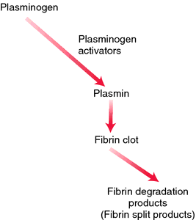
Drugs Used for Clotting Disorders
Thrombolytics
Plasminogen Activators
Alteplase | Tissue Plasminogen Activators (t-PA)
Reteplase
Teneteplase
 | Streptokinase (SK)
 | Urikinase (UK)
Bleeding Disorders

Slide 38
Screening Tests
CBC (Platelet count)
Prothrombin Time (PT) >> measures F VII, X, V, II, I - (N Time 10-14 secs)
International Nmalized Ratio (INR) >> the ratio of a pt's PT to a normal (control) sample, raised to the power of the ISI value for the control sample used.
Activated Partial Thromboplastin Time (aPTT or PTT) >> measures F XII, XI, IX, VIII, X, V, II, I - (N Time 30 – 40 secs)
Thrombin (Clotting) Time (TT) >> sensitive to deficiency of Fibrinogen or inhibition of thrombin - (N Time 14 – 16 secs)
Bleeding Time >> (3-8 secs) (not sensitive – not specific )
Screening tests (not sensitive to all abnormalities ass. w a bleeding disorder)
Bleeding Disorders

Slide 39
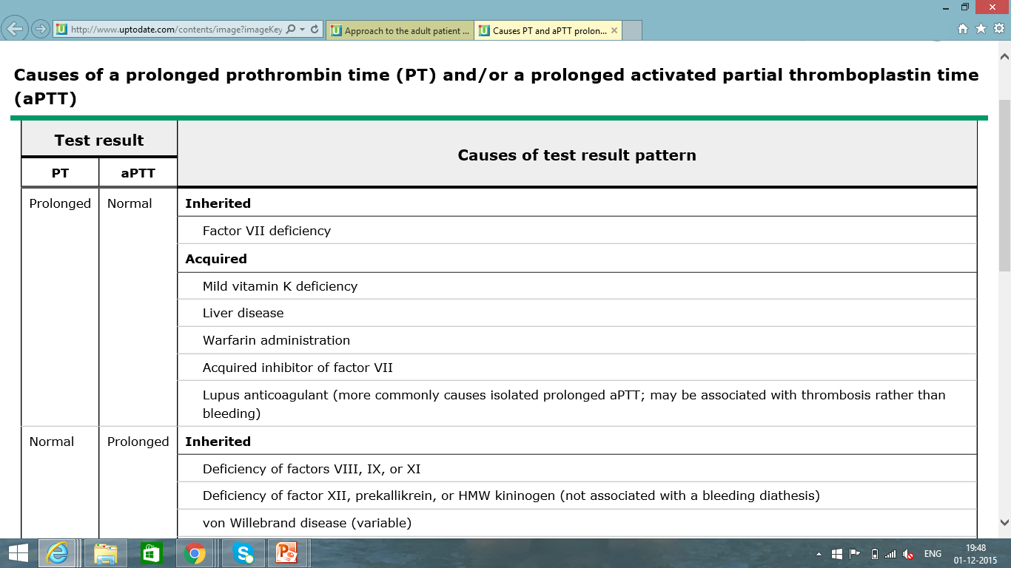
Causes of Prolonged
Coagulation Profile
Bleeding Disorders

Slide 40
Causes of Prolonged
Coagulation Profile
Bleeding Disorders

Slide 41
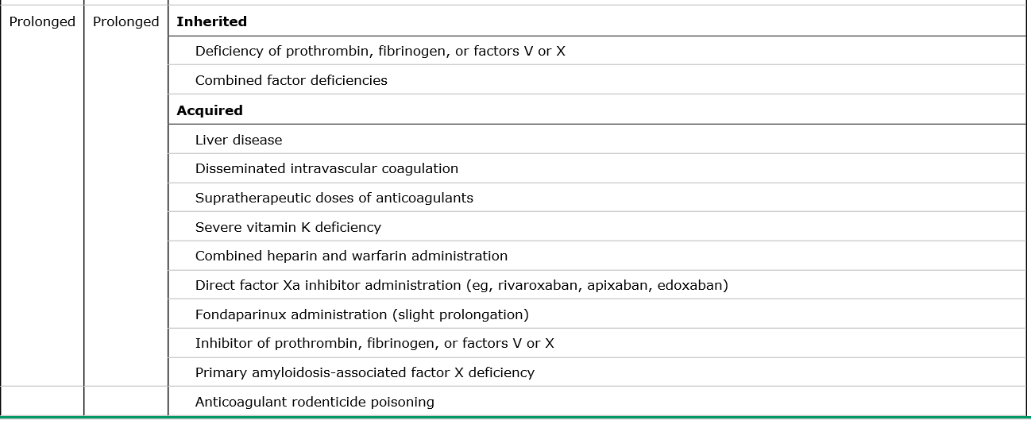
Causes of Prolonged
Coagulation Profile
Bleeding Disorders

Slide 42
APTT
PT
PT – APTT
TT
Ca

Slide 43
Specialized Tests
Mixing Study (one to one mix of Pt’s plasma & known normal standard plasma, only if PT of aPTT prolonged)
Corrected  clotting factor deficiency (risk of bleed)
Not corrected  inhibitors (directed against specific factor or global inhibitors “ Lupus Inhibitor, risk of thrombosis “)
Bleeding Disorders

Slide 44
Specialized Tests
PLT Function Assay (PFA - 100): assess PLT function Specificity  90 % for severe PLT dysfunction of vWD (vWF plasma levels < 25%) Sensitivity  24 – 41 % (low) in mild PLT secretion defect or Storage Pool Disease  ( not screening tool )
PLT Aggregation Tests: (5 external aggregating factors; ADP, Collagen, Ristocetin, Arachidonic Acid, Adrenaline)
Von Willebrand Factor ( Antigen & Activity )
Factor XIII assay (F XIII Deficiency >> normal PT & PTT)
Human Plasminogen Activator Inhibitor (PAI-1)
Alpha 2 AntiPlasmin Inhibitor (α2 AP)
Bleeding Disorders

Slide 45
Take Home Message
Although screening tests are used widely to identify hemostatic abnormalities associated with bleeding, they are NOT perfect


The Clinical suspicion for a bleeding disorder is Critical to determine extent of the laboratory investigations
Bleeding Disorders

Slide 46
Recommended Books
Essential Hematology (A. V. Hoffbrand, P. A. H. Moss)
Uptodate
Oxford Handbook of clinical hematology.
Bleeding Disorders

Slide 47
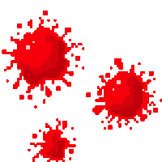
Thank You
Dr. Gamal

Slide 48
Management in the Perioperative Stage

Slide 49
Management of Bleeding Pt
Therapeutic decisions should not be based solely on laboratory testing, since abnormalities in Plt function as measured by the tests mentioned are not necessarily predictive of the presence or absence of clinical bleeding.
Since medications such as ASA are the most common causes of Plt dysfunction, a careful history of medication use, including use of over-the-counter aspirin-containing preparations, is crucial >> the most prudent decision prior to an operation or other invasive procedure may simply be to withhold any medication in question prior to the procedure.
If a pt has a Hx of clinically significant bleeding suggestive of Plt dysfunction, whether provoked or spontaneous, appropriate Plt function tests should be obtained so that risk for bleeding can be adequately assessed and therapy chosen more rational.
Bleeding Disorders

Slide 50
Management of Bleeding Pt
1. Desmopressin (dDAVP) is commonly used to correct the hemostatic defect in VWD (releases endogenous VWF from the endothelium) - effective in preventing bleeding after dental extraction and minor surgery in pts with milder Plt defects, including storage pool disease, acquired platelet dysfunction, cirrhosis or uremia, & cardiopulmonary bypass.
significantly reduced mean operative and early postoperative blood loss.
Plasma levels of vWF were higher after desmopressin than placebo.
2. Platelet transfusion >> may be required in pts with disordered Plt function - indicated in cases of severe, uncontrolled bleeding, when prior treatments (eg, dDAVP, estrogen) have been unsuccessful, and/or in the presence of, or anticipation of, excessive traumatic or surgical bleeding.
3. Antifibrinolytic Agents (Tranexamic Acid, epsilon Aminocaproic Acid) >> may be helpful in reducing bleeding in pts with disordered plt function following dental extraction.
Bleeding Disorders

Slide 51
Management of Bleeding Pt
4. Conjugated Estrogens >> used most commonly for uremic bleeding or in pts with mild to moderate type 1 vWD. Intravenous estrogen 0.6 mg/kg per day for 4-5 days, oral estrogen 50 mg/kg per day, or transdermal estradiol 50 to 100 mcg/24 hours applied as a patch twice weekly have been shown to be effective, particularly for GI bleeding.
5. Erythropoietin >> used successfully in uremic pts to both reduce and prevent bleeding
6. Recombinant Factor VIIa (rFVIIa) >> some success for Rx of bleeding in pts with congenital Plt disorders.
Potential mechanisms >> a local procoagulant effect at sites of vascular damage or tissue factor-independent thrombin generation induced by binding of rFVIIa to the surface of activated Plts.
Pts who cannot receive platelet transfusions because of alloimmunization or antibody formation to the absent platelet glycoprotein (eg, Glanzmann Thrombasthenia and Bernard-Soulier Syndrome) may benefit from rFVIIa.
one or more bolus infusions of approximately 90 to 100 mcg/kg.
approved in Europe for use in pts with Glanzmann thrombasthenia refractory to Plt Tx.
Benefits of rFVIIa must be balanced against the risk of thrombosis.
Bleeding Disorders

Slide 52
Preoperative Management of Agents Affecting Hemostasis
Warfarin >>
typically discontinue 5 days before elective surgery (ie, last dose of warfarin is given on day minus 6).
check the PT/INR on the day before surgery & If INR is >1.5 >> ?? administer low dose oral vitamin K (1 - 2 mg) to hasten normalization of the PT/INR and recheck the following day.
proceed with surgery when the INR is ≤ 1.4 (An INR in the normal range is especially important in pts undergoing surgery ass with a high bleeding risk (eg, intracranial, spinal, urologic) or if neuraxial anesthesia is to be used).
Heparin / LMWH Bridging considered >> Pts with very high or high thromboembolic risk.
Bleeding Disorders

Slide 53
Preoperative Heparin Bridging
generally initiate heparin bridging 3 days before a planned procedure (2 days after stopping warfarin), when the PT/INR has started to drop below therapeutic range.
PRE OP //
● LMWH >> discontinue 24 hours before the planned surgery or procedure, based on a biologic half-life of most subcutaneous LMWH of ~ 3-5 hours.
If a twice-daily LMWH regimen is given >> evening dose the night before surgery omitted.
if a once-daily regimen is given (Dalteparin 200 IUs/kg), ½ of the total daily dose is given on the morning of the day before surgery >> ensures that no significant residual anticoagulant will be present at the time of surgery.
● UFH >> Therapeutic dose IV infusion continue until 4-5 hours before the procedure, based on the biologic half-life of IV UFH of ~ 45 minutes.
If SC UFH is used (dose of ~ 250 IUs/kg BID), the last dose can be given the evening before the procedure.
Bleeding Disorders

Slide 54
Preoperative Heparin Bridging
Post OP
Resumption of UFH & LMWH is similar, based on the onset of anticoagulation at ~ 1 hour after administration for both forms of heparin (peak anticoagulant activity at ~ 3-5 hours)
● The resumption of bridging, especially when given as a therapeutic-dose regimen >> should be delayed until there is adequate hemostasis based on a clinical assessment of the wound site, drainage fluid amount, and expected postoperative bleeding; coupled, where appropriate, with hemoglobin levels >> This assessment will vary depending on the surgery type and individual pt considerations, and it may be difficult for surgery where ongoing bleeding is not readily apparent (eg, cardiac, intracranial).
● For Major Surgery or those with a high bleeding risk procedure >> therapeutic-dose UFH or LMWH should be delayed for 48 to 72 hours after hemostasis has been secured.
● For Minor Procedures associated with a low bleeding risk in which bridging is used (eg, laparoscopic hernia repair) >> therapeutic-dose UFH or LMWH can usually be resumed 24 hours after the procedure.
Bleeding Disorders

Slide 55
Preoperative Management of Agents Affecting Hemostasis
Bleeding Disorders

Slide 56
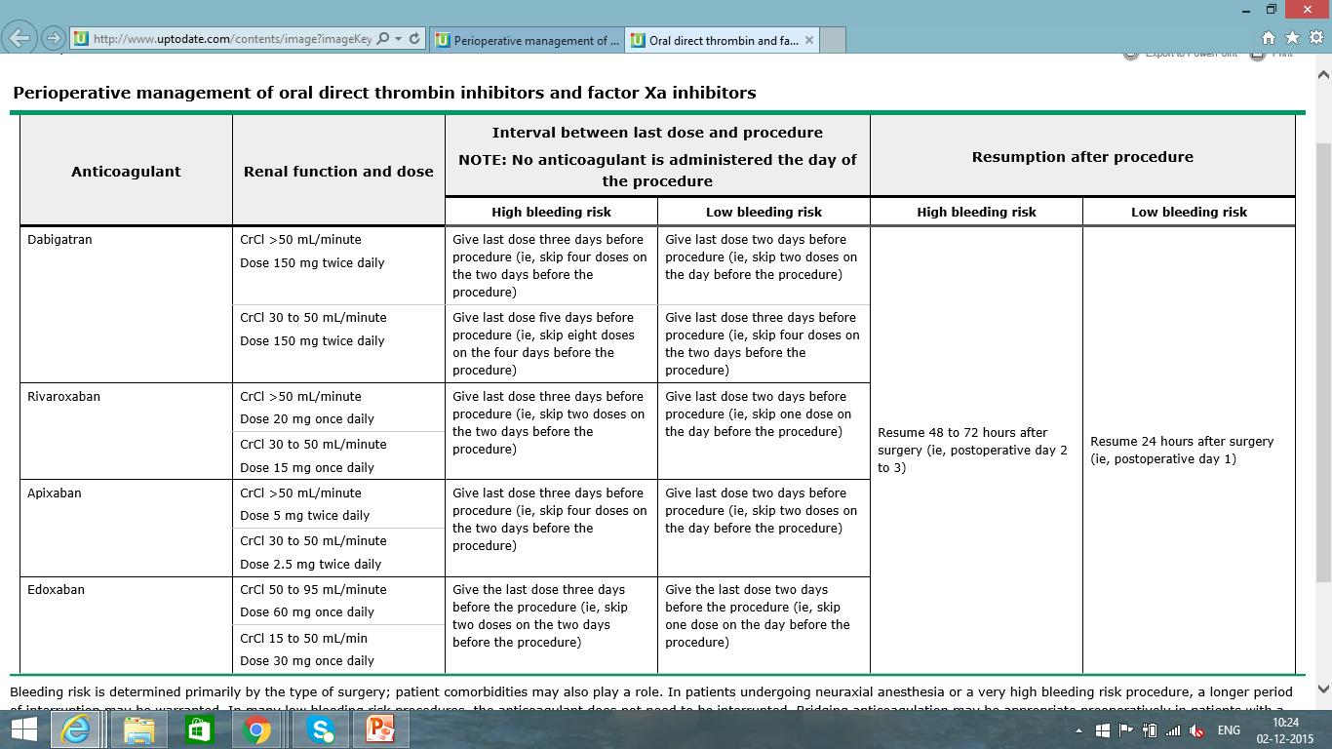
Perioperative Management of Agents Affecting Hemostasis
Bleeding Disorders

Slide 57
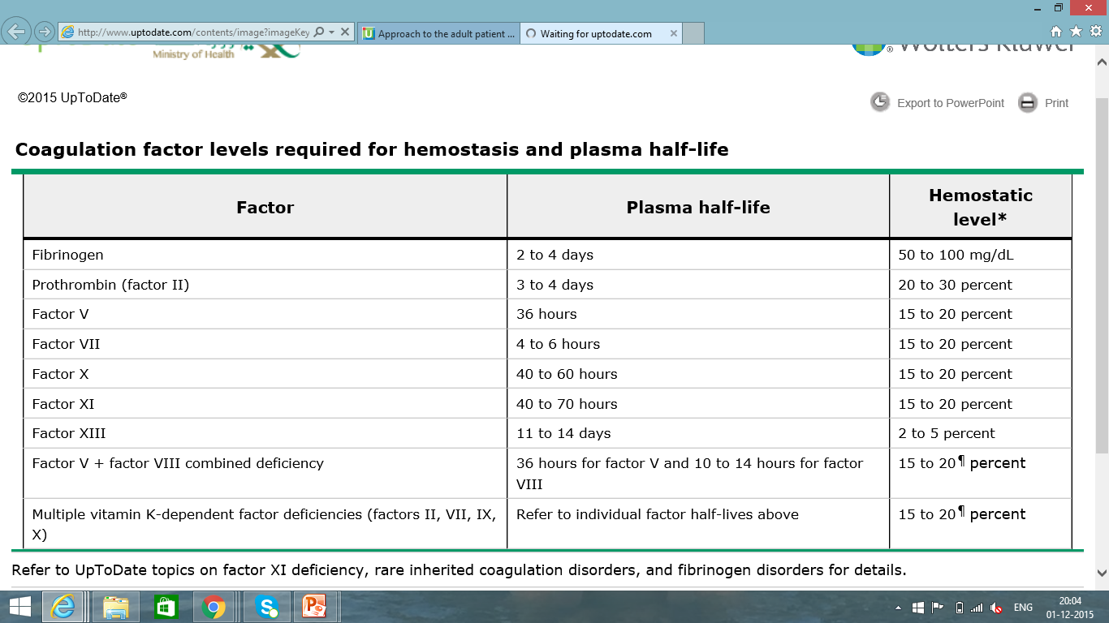
Coagulation Factor Levels Required For Hemostasis
Bleeding Disorders

Slide 58
INHIBITORS
A serin protease inhibitor (serpin) that degrades the serine proteases; (thrombin, IXa, Xa, XIa, XIIa). Constantly active, but its adhesion to these factors is increased by the administration of heparin. Quantitative or qualitative deficiency of antithrombin (in born or acquired) leads to Thrombophilia. | 1. Antithrombin III
Activated to PCa by thrombin bound to thrombomodulin (protein on the surface of endothelial cells); then degrades (VIIIa & Va), reducing further thrombin generation. PS acts as cofactor of PC by enhancing binding of PCa to phospholipid surface; both contain gal residues. | 2. Protein C & Protein S
Inhibits VIIa-related activation of IX & X after its original initiation. | 3. Tissue Factor Pathway Inhibitor (TFPI)

Slide 59
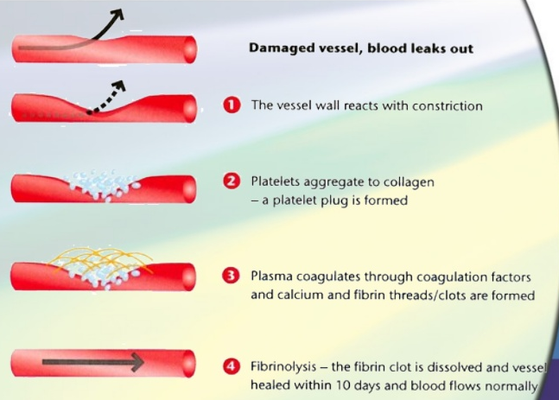
Hemostatic Phases
Bleeding Disorders

Slide 60
Diagnostic Approach
to Plt Disorders
Bleeding Disorders

Slide 61
Thrombotic Thrombocytopenic Purpura / Hemolytic Uremic Syndrome (TTP/HUS)
Primary : isolated thrombocytopenia due to immune Plt destruction &  production (auto AB to megakaryocytes)
Secondary : a/w disease/drug exposure  Viral (HIV, HCV, HBV, EBV, CMV, Parvovirus), SLE, APLS, H. Pylori Infection, Chronic Lymphocytic Leukemia (CLL), Hodgkin Lymphoma, AIHA
Dx >> Dx of exclusion, no robust clinical or Lab parameters, Typically CBC (Isolated  PLT < 100.000), 10% have ITP + AIHA (Evans Syndrome), PBS (Large Plts), Anti-Plt AB (not useful)
Clinically >> insidious onset of mucocutaneous bleed, M:F (3:1)
Rx >> rarely indicated if PLT > 50.000 unless bleeding, trauma/surgery, anticoag, comorbidities
Steroids, IVIG, Splenectomy, TPO agonists (Romiplostim, Eltrombopag)
Bleeding Disorders

