Slide 1
Osteoarthritis
Rizwan Mansoor m.D.
Consultant Rheumatologist

Slide 2
OA - Definition
Heterogeneous group of conditions resulting in common histopathologic and radiologic changes involving
Entire joint organ, including:
the articular cartilage
the subchondral bone and
the synovium.

Slide 3
Epidemiology
Internationally, osteoarthritis is the most common articular disease. Estimates of its frequency vary across different populations.
80-90% of individuals older than 65 years have evidence of radiographic osteoarthritis.
the prevalence of osteoarthritis is higher among women than among men.
Interethnic differences in the prevalence of osteoarthritis have been noted.
Notes:
more prevalent in Native Americans than in the general population.. Symptomatic knee osteoarthritis is extremely common in China. ^{[61]}
osteoarthritis is more common in whites than in blacks. Knee osteoarthritis appears to be more common in black women than in other groups., African American men and women had a slightly higher prevalence of radiographic and symptomatic knee osteoarthritis but a significantly higher prevalence of severe radiographic knee osteoarthritis. ^{[62]}

Slide 4
Involved joints
Weight-bearing joints, including:
the knees
the hips
cervical and lumbosacral spine
feet.
Non weight bearing joints:
the(DIP), the(PIP), and the(CMC) joints.

Slide 5
Joint classification
Functional:
Synarthroses (immovable)(Skull)
Amphiarthroses (slightly moveable)(symphysis pubis, verebral)
Diarthroses (freely moveable)

Slide 6
Joint Classification
Structural
Synovial
Fibrous
Cartilaginous

Slide 7
Synovial Joints
Articular cartilage
Subchondral bone
Synovial membrane
Synovial fluid
Joint capsule

Slide 8
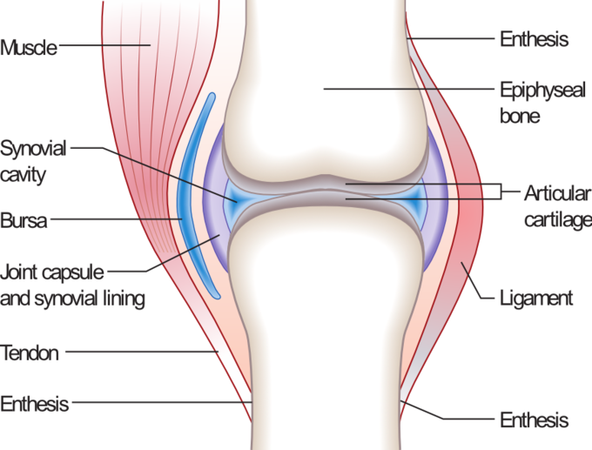
Synovial joint anatomy

Slide 9
The normal articular surface of synovial joints
articular cartilage ( chondrocytes) surrounded by extracellular matrix includes
proteoglycans and collagen. The cartilage facilitates joint function and protects the underlying subchondral bone by
distributing large loads,
maintaining low contact stresses, and
reducing friction at the joint.

Slide 10
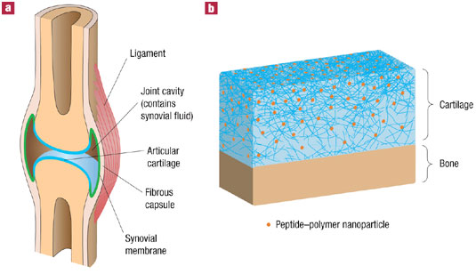
Synovial cartilage

Slide 11
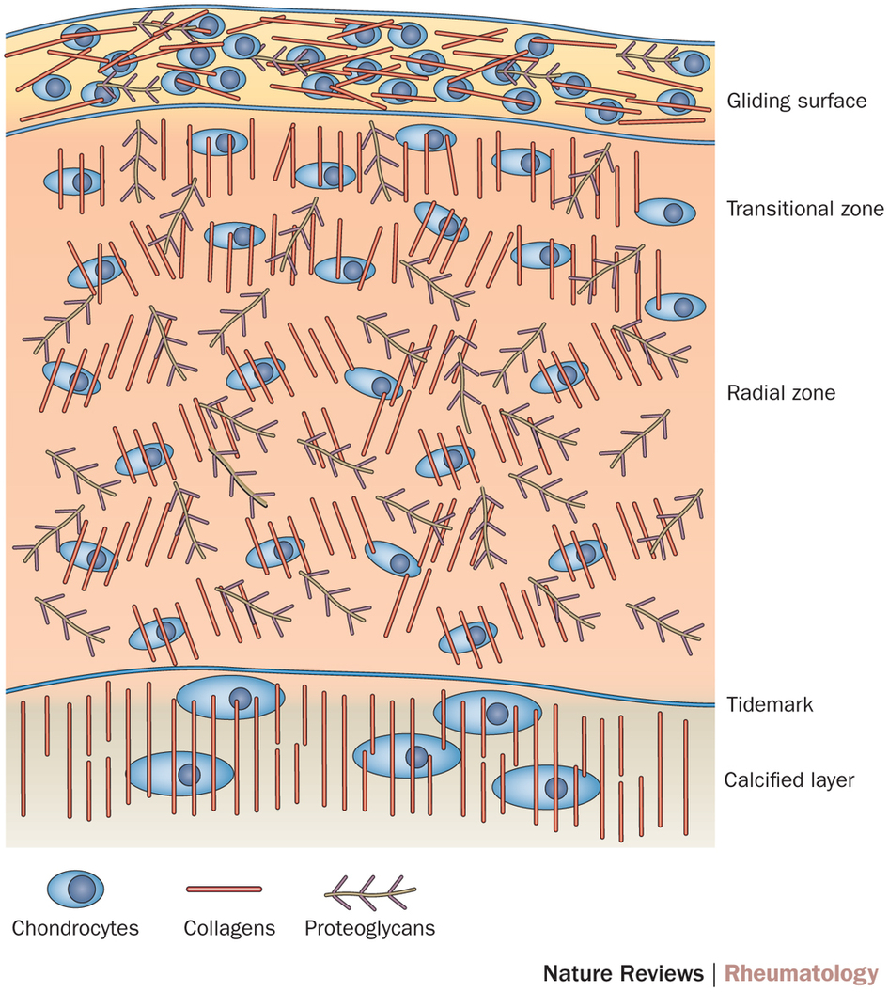
Synovial cartilage

Slide 12
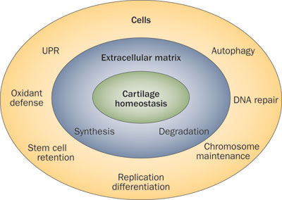
Cartilage homeostasis
Notes:
cartilage homeostasis depends on normal extracellular matrix structure, which is maintained by a balance between rates of synthesis and degradation. Cellular homeostasis requires defense mechanisms that protect cells against oxidants and prevent DNA mutations and telomeric DNA damage. The UPR is activated upon detection of unfolded or misfolded proteins and prevents protein dysfunction and aggregation. The process of autophagy has roles in nutrient and energy homeostasis, and is essential for the removal of dysfunctional cellular organelles and macromolecules. Normal functioning of cellular homeostasis mechanisms maintains a physiological rate of cell replication, retention of adult stem cell populations and normal differentiation. Abbreviation: UPR, unfolded protein response.

Slide 13
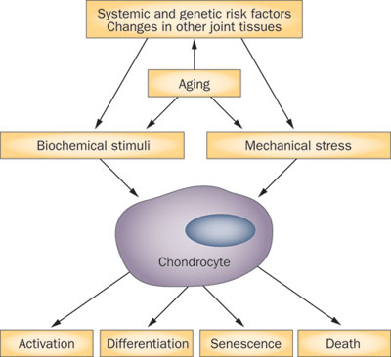
Pathogenesis Pathways in OA
Notes:
Cartilage degradation is influenced by systemic risk factors (genetic risk, obesity), joint instability or malalignment, and changes in other joint tissues. In established OA, cartilage lesion progression is mediated through the action of biochemical stimuli and mechanical stress on chondrocytes, which have altered gene expression patterns due to aging-related intracellular changes. Effector mechanisms activated in the chondrocyte include production of inflammatory mediators, extracellular matrix degradation, abnormal differentiation, and cell death. Abbreviation: OA, osteoarthritis.

Slide 14
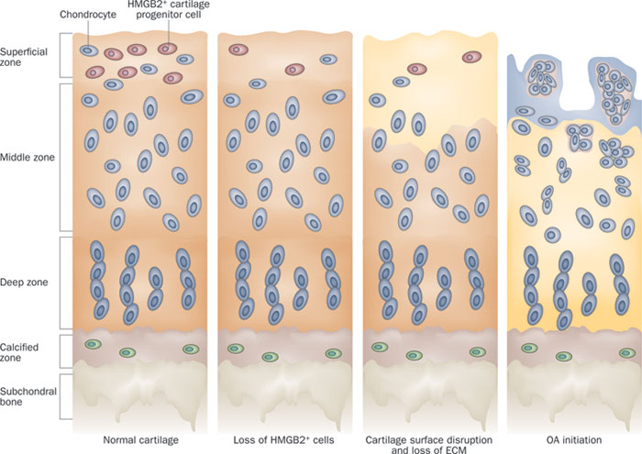
Cartilage Disruption
Notes:
In the pathogenesis of OA, the earliest molecular changes, which precede the loss of cells and the destruction of ECM in cartilage, involve the chromatin protein HMGB2, which is uniquely expressed in the cartilage superficial zone. This protein supports chondrocyte survival and regulates the specific differentiation status of superficial zone cells, including progenitor cells. Aging-related loss of HMGB2 expression or deletion of the HMGB2 gene leads to superficial zone cell death, loss of progenitor cells, and reduced synthesis of ECM components such as the important lubricant proteoglycan 4. This loss causes the initial disruption of the cartilage superficial zone and initiates OA pathogenesis via the pathways shown in Figure 1. Once the superficial zone is disrupted, remaining cartilage cells are activated and proliferate. This cellular response leads to tissue destruction and remodeling that extends into the deeper zones of articular cartilage. Abbreviations: ECM, extracellular matrix; HMGB2, high mobility group protein B2; OA, osteoarthritis.

Slide 15
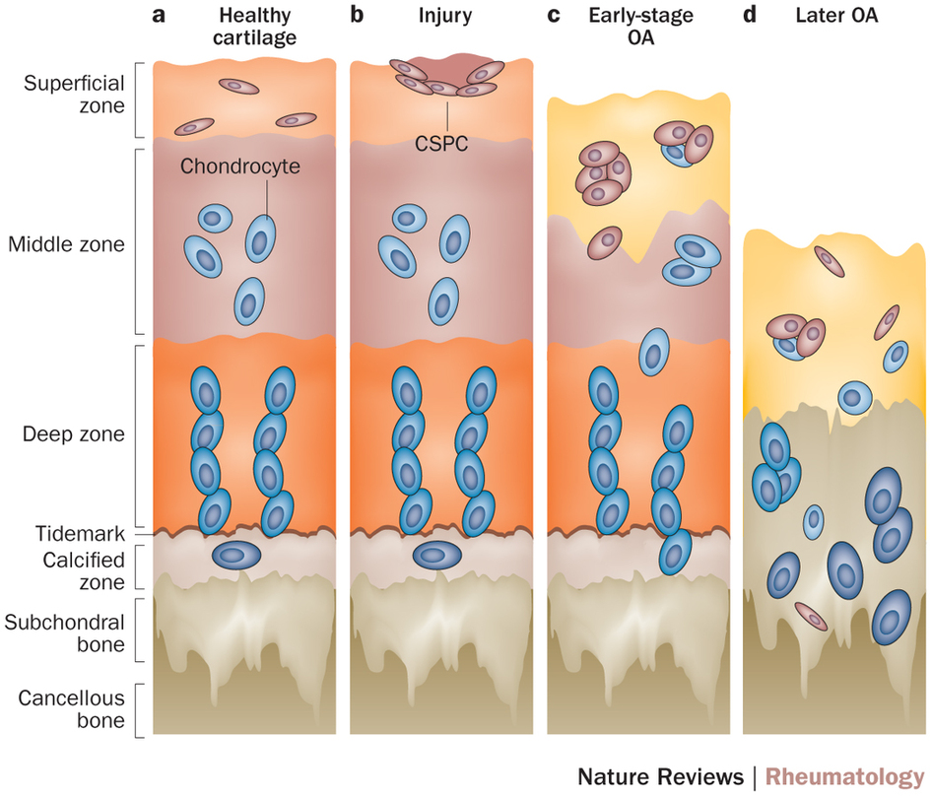
CSPC distribution in normal articular cartilage and, OA pathogenesis.
Notes:
a | In normal adult cartilage, Notch-1-expressing CSPCs probably reside in the superficial zone.⁴⁵ b | In response to injury, spindle-shaped CSPCs appear and migrate to the injury site.³¹ c | In early OA, characterized by loss of the superficial zone and changes to the internal structure of articular cartilage, cells express surface markers such as CD105 and CD166,²⁸ and cell clusters emerge, containing cells positive for stem-cell-related markers such as Notch-1, STRO-1 and VCAM-1.^{30, 58} d | In late-stage OA, characterized by continued ECM loss and chondrocyte hypertrophy, CSPCs seem to migrate throughout the articular cartilage.³²

Slide 16
Synovial Fluid
Synovial fluid is formed by (synoviocytes).
Synovial cells also manufacture hyaluronic acid (HA, also known as hyaluronate), a glycosaminoglycan that is the major noncellular component of synovial fluid.
Synovial fluid supplies nutrients to the avascular articular cartilage; it also
provides the viscosity needed to absorb shock from slow movements
provides elasticity required to absorb shock from rapid movements.

Slide 17
There is Inflammation in OA
Inflammation occurs as cytokines and metalloproteinases are released into the joint. These agents are involved in the excessive matrix degradation that characterizes cartilage degeneration in osteoarthritis.
Notes:
Candidate drugs that have shown disease-modifying activities in such models include inhibitors of matrix-degrading enzymes (matrix metalloproteinases, aggrecanases), inhibitors of inflammatory mediators (IL-1, TNF, cyclo-oxygenase-2, inducible nitric oxide synthase), growth factors (bone morphogenic protein 7, fibroblast growth factor 18), drugs targeting bone remodeling (bisphosphonates, calcitonin, osteoprotegerin), kinase inhibitors, lubricants (hyaluronic acid, proteoglycan 4), and vitamins.^{16, 17} Nutraceuticals such as glucosamine, chondroitin sulfate, and avocado extracts have also shown efficacy in these models.^{18,}

Slide 18
Pathogenesis
Swelling of the cartilage usually occurs
the level of proteoglycans eventually drops very low, the cartilage softens and lose elasticity and compromising joint surface integrity.
Flaking and fibrillations (vertical clefts) develop along on the surface of an osteoarthritic joint. Over time, the loss of cartilage results in loss of joint space.
a greater loss of joint space occurs at those areas experiencing the highest loads.
Notes:
, because of the increased synthesis of proteoglycans-an effort by the chondrocytes to repair cartilage damage. This stage may last for years or decades and is characterized by hypertrophic repair of the articular cartilage.

Slide 19
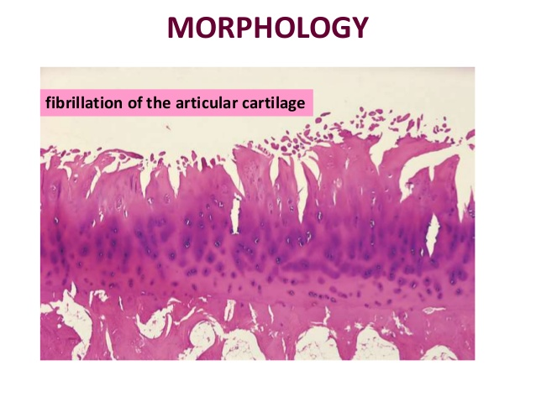
Cartilage changes

Slide 20
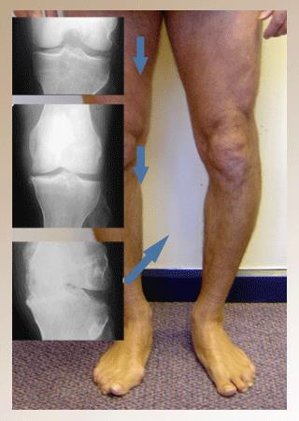
Clinical and Radiological

Slide 21
Bone changes
Bone denuded of its protective cartilage continues to articulate with the opposing surface.
Eventually, the increasing stresses exceed the biomechanical yield strength of the bone.
The subchondral bone responds with vascular invasion and increased cellularity, becoming thickened and dense (a process known as eburnation) at areas of pressure.

Slide 22
Bone changes
subchondral bone undergo cystic degeneration.
Osteoarthritic cysts are also referred to as subchondral cysts, pseudocysts, or geodes and may range from 2 to 20 mm in diameter.
Osteoarthritic cysts in the acetabulum are termed Egger cysts.

Slide 23
Joint changes
vascularization of subchondral marrow,
osseous metaplasia of synovial connective tissue, and
ossifying cartilaginous protrusions lead to irregular outgrowth of new bone (osteophytes).
Fragmentation of these osteophytes or of the articular cartilage itself results in the presence of intra-articular loose bodies (joint mice).

Slide 24
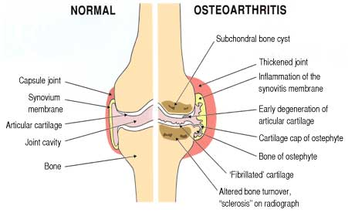
Joint changes

Slide 25
Etiology
Risk factors-
Age, obesity,trauma, genetics, hypogonadism, muscle weakness, repetitive use, Infection, crystal deposition, acromegaly, previous inflammatory arthritis (burnt-out rheumatoid arthritis)
Heritable metabolic causes (alkaptonuria, hemochromatosis, Wilson disease)Hemoglobinopathies (sickle cell disease and thalassemia)Neuropathic disorders leading to a Charcot joint (syringomyelia, tabes dorsalis, and diabetes)Underlying morphologic risk factors (congenital hip dislocation and slipped femoral capital epiphysis)
Disorders of bone (Paget disease and avascular necrosis)Previous surgical procedures (meniscectomy)Diabetes mellitus ^{[44]}

Slide 26
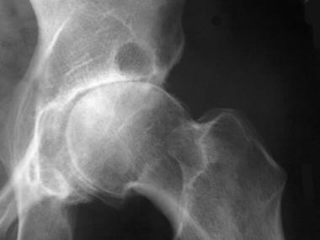
Radiographic changes
Notes:
This radiograph demonstrates osteoarthritis of the right hip, including the finding of sclerosis at the superior aspect of the acetabulum.

Slide 27
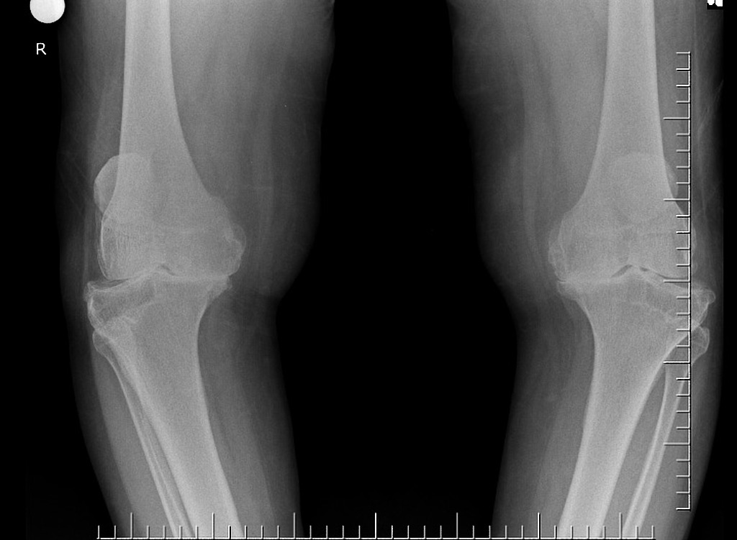
Radiological changes

Slide 28
Osteoarthritis Progression
Stage 1- breakdown of the cartilage matrix occurs.
Stage 2 - involves the fibrillation and erosion of the cartilage surface
Stage 3 - a chronic inflammatory response in the synovium.
Further Progression - the above events alter the joint architecture, compensatory bone overgrowth occurs. joint architecture is changed mechanical and inflammatory stress occurs on the articular surfaces, the disease progresses unchecked.
Notes:
1-Chondrocyte metabolism is affected, leading to an increased production of enzymes, which includes metalloproteinases (eg, collagenase, stromelysin) that destroy the cartilage matrix.
2-release of proteoglycan and collagen fragments into the synovial fluid.
3-Synovial macrophage production of MMP, cytokines ,(IL) 1, (TNF)-alpha, occurs. These can diffuse back into the cartilage and directly destroy tissue or stimulate chondrocytes to produce more MMPs. Other proinflammatory molecules (eg, nitric oxide [NO], an inorganic free radical) may also be a factor in stage 3. proteoglycan and collagen fragments into the synovial fluid.

Slide 29
Primary Osteoarthritis
Three subtypes
Primary generalized OA
Erosive osteoarthritis
Chondromalacia Patellae
Notes:
PGOA -familial and often premature development of Heberden and Bouchard nodes, as well as the precocious degeneration of the articular cartilage at multiple joints, including the first carpometacarpal joints, knee joints, hip joints, and spine articulations.
EOA - greater degree of inflammation, with erosive abnormalities and, in some cases, osseous ankylosis. The disease most commonly occurs in postmenopausal women, and it may be hereditary.
CP- a syndrome of crepitus and pain at the anterior knee that most commonly occurs in young adults.

Slide 30
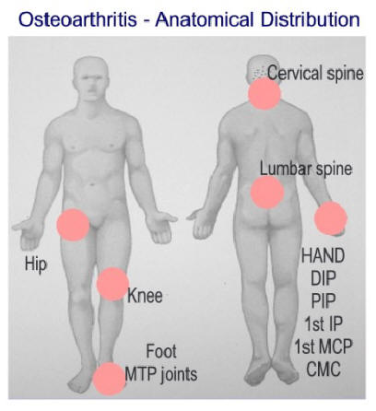
PGOA

Slide 31
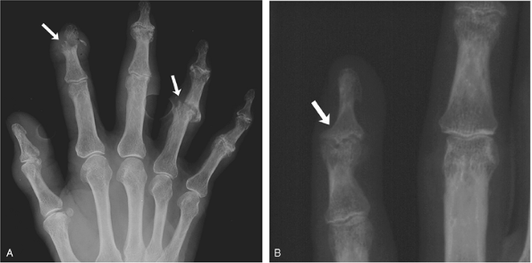
Erosive OA

Slide 32
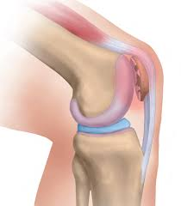
Chonromalcia Patellae

Slide 33
Differential Diagnosis
Crystalline arthropathies (ie, gout and pseudogout)
Inflammatory arthritis (eg, rheumatoid arthritis)
Seronegative spondyloarthropathies (eg, psoriatic arthritis and reactive arthritis)
Septic arthritis or postinfectious arthropathy
Fibromyalgia
Tendonitis

Slide 34
Work Up
Laboratory
Plain Radiography
CT scan, MRI scan, ultrasonography
Bone scintigraphy
Arthrocentesis

Slide 35
Treatment
Non pharmacologic-
Life style modification, physical and rehab therapy
Pharmacotherapy
Arthroscopy
Osteotomy
Arthroplasty
Fusion and joint Lavage
Stem cell therapy

Slide 36
References
1.Hunter, W. Of the structure and diseases of articulating cartilages. Phil. Trans. Royal Soc. 470, 514–521 (1743).
  2.National Collaborating Centre for Chronic Conditions (UK).
  National Clinical Guideline for Care and Management in Adults(Royal College of Physicians of London, 2008).
  3.Felson, D. T. An update on the pathogenesis and epidemiology of osteoarthritis. Radiol. Clin. North Am. 42, 1–9 (2004).
4.WHO. The World Health Report 2002: reducing risks, promoting healthy life (WHO, 2002).
  5.Centers for Disease Control and Prevention (CDC). Prevalence of doctor-diagnosed arthritis and
  arthritis-attributable activity limitation—United States, 2010–2012. MMWR Morb. Mortal. Wkly Rep. 62, 869–873 (2013).

