Slide 1
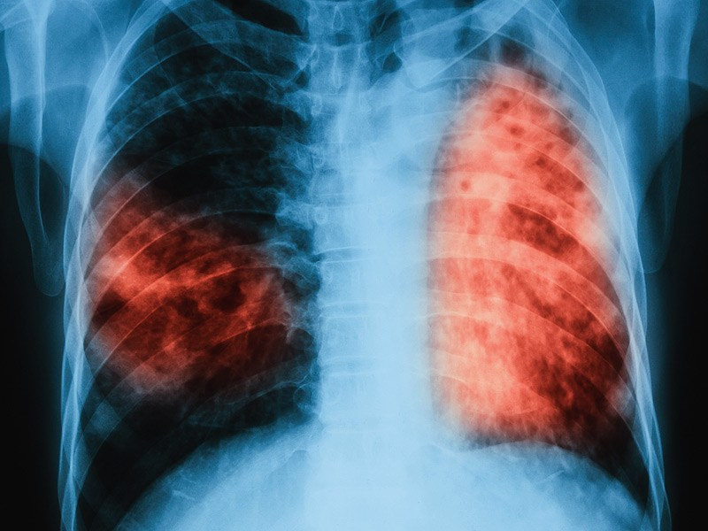
TUBERCULOSIS
Awadh R. Alanazi M.D
College of Medicine
King Saud University
1440/2019

Slide 3
Objectives
By the end of this lecture, students should know the following about Tuberculosis:
Overview of Tuberculosis (TB) Epidemiology.
Transmission and Pathogenesis of TB.
Testing for TB Infection and Disease.
Diagnosis of TB Disease.
Treatment for Latent TB Infection.
Treatment for TB Disease.
TB Infection Control.

Slide 4
OVERVIEW OF TUBERCULOSIS (TB) EPIDEMIOLOGY
Bacterial infection.
Caused by Mycobacterium tuberculosis (also called tubercle bacillus).
Damages a person’s lungs or other parts of the body.
Fatal if not treated properly.

Slide 5
Epidemiology
It is a world wide disease.
TB infects 1.7 billion with 3 million deaths/yr.
UK: 1st half of 20th century: a lot of death secondary to TB epidemic.
90% of cases and 95% of death occurred in developing countries.
Number of cases in developed countries has declined because of: case finding, RX and improved nutrition.

Slide 6
Epidemiology
Tuberculous infection: a state in which the tubercle bacillus is established in the body without symptoms.
Tuberculous disease: a state in which one or more organs of the body becomes diseased by the disease.

Slide 7
Epidemiology
What increases the spread of the disease:
crowding of living.
migration of people from endemic area.
10% of infected people ---- active disease
50%of active disease --- contagious

Slide 8
EPIDEMIOLOGY
What increases the risk of developing disease after TB infection ?
Infecting dose.
Host factors:
Age: under 5 yrs .
Debilitating illness and poor nutrition.
Alcoholism.
Gastrectomy.
Diabetes mellitus.

Slide 9
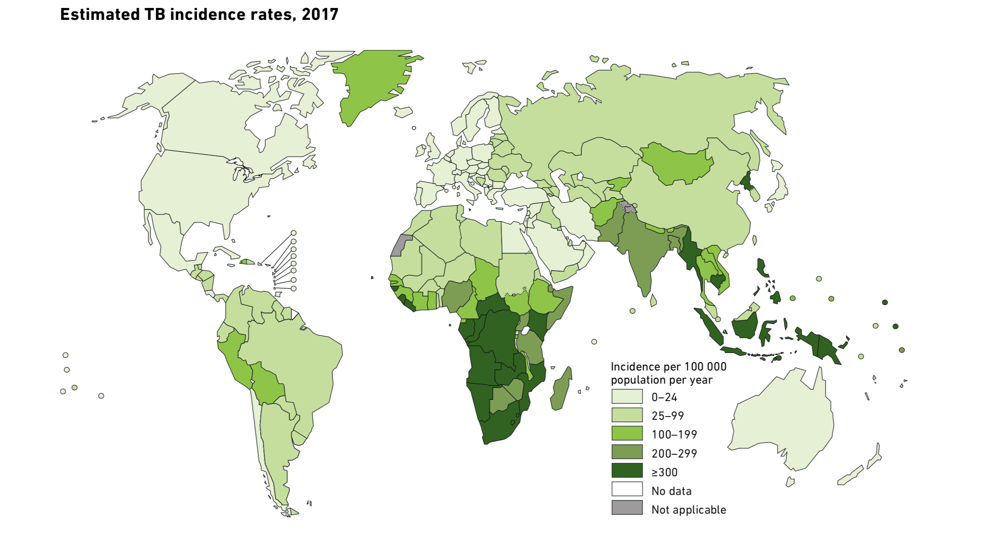

Slide 10
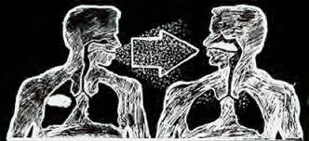
Mode of Spread & Transmission
Inhalation of droplet nuclei.
Spreads through the air when a person with active TB:
Coughs/ Speaks/ Laughs/ Sneezes/ Sings.
Another person breathes in the bacteria and becomes infected.

Slide 11
Transmission of M. tuberculosis
M. tb spread via airborne particles called droplet nuclei
Expelled when person with infectious TB coughs, sneezes, shouts, or sings
Transmission occurs when droplet nuclei inhaled and reach the alveoli of the lungs, via nasal passages, respiratory tract, and bronchi

Slide 12
PATHOGENISIS
Droplet nuclie ---terminal air space ---
Multiplication … initial focus
Subpleural
75%single
Migration through blood and lymph node --- another focus
Ingestion of the bacteria by the macrophage --- slow multiplication

Slide 13
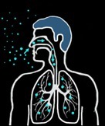
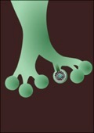
PATHOGENISIS
 | Droplet nuclei containing tubercle bacilli are inhaled, enter the lungs, and travel to the alveoli.
 | Tubercle bacilli multiply in the alveoli.

Slide 14
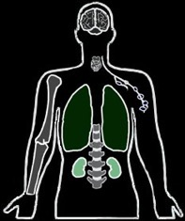
PATHOGENISIS
 | A small number of tubercle bacilli enter the bloodstream and spread throughout the body. The tubercle bacilli may reach any part of the body, including areas where TB disease is more likely to develop (such as the brain, larynx, lymph node, lung, spine, bone, or kidney).

Slide 15
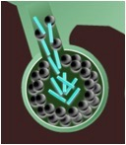
PATHOGENISIS
 | Within 2 to 8 weeks, special immune cells called macrophages ingest and surround the tubercle bacilli. The cells form a barrier shell, called a granuloma, that keeps the bacilli contained and under control (LTBI).
 | If the immune system cannot keep the tubercle bacilli under control, the bacilli begin to multiply rapidly (TB disease). This process can occur in different areas in the body, such as the lungs, kidneys, brain, or bone.

Slide 16
Inside the Body
Breathed in infected air and bacilli go to lungs through bronchioles.
Bacilli infect alveoli.
Macrophages attack bacteria, but some survive.
Infected macrophages separate and form tubercles.
Dead cells form granulomas.
Notes:
-As a person breathes in infected air, the bacilli go the lungs through the bronchioles. At the end of the bronchioles are alveoli, which are balloon-like sacs where blood takes oxygen from inhaled air and releases carbon dioxide into the air exhaled. TB bacilli infect the alveoli and the bodyπs immune system begins to fight them. Macrophages — specialized white blood cells that ingest harmful organisms — begin to surround and "wall off" the tuberculosis bacteria in the lungs, much like a scab forming over a wound. Then, special immune system cells surround and separate the infected macrophages. The mass resulting from the separated infected macrophages are hard, grayish nodules called tubercles. -Active TB spreads through the lymphatic system to other parts of the body. In these other parts, the immune system kills bacilli, but immune cells and local tissue die as well. The dead cells form masses called granulomas, where bacilli survive but donπt grow. As more lung tissue is destroyed and granulomas expand, cavities develop in the lungs, which causes more coughing and shortness of breathe. Granulomas can also eat away at blood vessels which causes bleeding in the lungs, and bloody sputum.

Slide 17
Inside the Body (Cont.)
As a person breathes in infected air, the bacilli go to the lungs through the bronchioles. At the end of the bronchioles are alveoli, which are balloon-like sacs where blood takes oxygen from inhaled air and releases carbon dioxide into the air exhaled.
TB bacilli infect the alveoli and the body immune system begins to fight them. Macrophages — specialized white blood cells that ingest harmful organisms — begin to surround and "wall off" the tuberculosis bacteria in the lungs, much like a scab forming over a wound.
Then, special immune system cells surround and separate the infected macrophages. The mass resulting from the separated infected macrophages are hard, grayish nodules called tubercles.

Slide 18
Inside the Body (Cont.)
Active TB spreads through the lymphatic system to other parts of the body. In these other parts, the immune system kills bacilli, but immune cells and local tissue die as well. The dead cells form masses called granulomas, where bacilli survive but don’t grow.
As more lung tissue is destroyed and granulomas expand, cavities develop in the lungs, which causes more coughing and shortness of breathe. Granulomas can also eat away blood vessels which causes bleeding in the lungs, and bloody sputum.

Slide 19
Immunological Feature
TB require CMI for its control.
Ab response is rich but has no role.
Multiplication proceeds for weeks both in:
initial focus.
lymphohaematogenous metastatic foci.
Until development of cell mediated immunity.

Slide 20
Microbiology
Organism:
Mycobacterium tuberculosis.
Aerobic.
Non-spore forming ,non-motile.
Rod: 2—5 mm long.
Resistant to disinfectant.
Once stained it resists decolorization with acid and alcohol facultative intracellular organism.
Humans are the main reservoir of MTB.

Slide 21
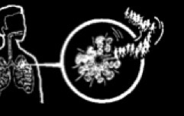
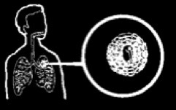
Clinical Features Active VS. Latent Infection
Unhealthy person
Bacilli overwhelm immune system.
Bacilli break out of tubercles in alveoli and spread through bloodstream.
This is (active) TB.
Healthy person
Initial infection controlled by immune system.
Bacilli remain confined in tubercles for years.
This is(latent) TB.
Notes:
ÄTB bacteria become active if the immune system can't stop them from growing. The active bacteria begin to multiply in the body and cause active TB disease. The bacteria attack the body and destroy tissue. If this occurs in the lungs, the bacteria can actually create a hole in the lung. Some people develop active TB disease soon after becoming infected, before their immune system can fight the TB bacteria. Other people may get sick later, when their immune system becomes weak for another reason. ÄFor most people who breathe in TB bacteria and become infected, the body is able to fight the bacteria to stop them from growing. The bacteria become inactive, but they remain alive in the body and can become active later. This is called latent TB infection. Many people who have latent TB infection never develop active TB disease. In these people, the TB bacteria remain inactive for a lifetime without causing disease. But in other people, especially people who have weak immune systems, the bacteria become active and cause TB disease. Difference between active and latent TB: Person with Latent TB: -Has no symptoms -Does not feel sick -Cannot spread TB to others -Usually has a positive skin test -Has a normal chest x-ray and sputum test Person with active TB: -has symptoms -may spread TB to others -has a positive skin test -May have an abnormal chest x-ray, or positive sputum smear

Slide 22
Symptoms
Cough.
Fever.
Weight loss.
Night sweats.
Loss of appetite.
Fatigue.
Swollen glands (lymph nodes).
Chills.
Pain while breathing.

Slide 23
Clinical Features
Pulmonary 80%.
Extra pulmonary 20%.
Pulmonary tuberculosis
Primary: the lung is the 1st organ involved (middle and lower lobe).
Health: asymptomatic .
Heals spontaneously.
CXR normal.

Slide 24
Clinical Features
Post primary (reactivation):
Result from endogenous reactivation of latent infection and manifest clinically:
Fever and night sweat.
Weight loss.
Cough: non-productive then productive (may have hemoptysis).
Signs: rales in chest exam.

Slide 25
CLINICAL FEATURES (cont.)
Extra pulmonary
Lymph node.
Pleural.
Bone and joint.
Meninges.
Peritoneum.

Slide 26
CLINICAL FEATURES (cont.)
Tuberculous lymphadenitis (25 %):
The commonest.
Localized painless swelling.
Common sites: cervical & supraclavicular.
Early: glands are discrete.
Late: glands are matted -/+ sinus.
Dx: FNA 30% in biopsy for histo and culture.

Slide 27
CLINICAL FEATURES (cont.)
Pleural Tb:
Result form penetration by few bacilli into
the pleural space resulting into:
Pleural effusion and fever.
DX; aspirate --- exudate.
AFB rarely seen.
Culture 30% positive.
BX 80% granuloma.

Slide 28
Clinical features (cont.)
Skeletal Tb:
Source:
Reactivation of hematogenous focus.
spread from an adjacent LN.
Common sites: spine, hips and knees.

Slide 29
CLINICAL FEATURES (cont.)
Spinal Tb:
Dorsal site is the commonest site.
Involve two vertebral bodies and destroy the disc in between.
Advance disease .
Collapse fracture of the bodies causing kyphosis and gibbus deformity.
Paravertebral abscess(cold abscess).
Dx: CT scan and MRI
Biopsy: histopath& AFB stain & culture.

Slide 30
CLINICAL FEATURES (cont.)
Tuberculous meningitis:
Most often: children and may affect adults.
Source:
Blood spread.
Rupture of a subependymal tubercle.

Slide 31
CLINICAL FEATURES (cont.)
Symptoms:
Fever.
Headache.
Neck rigidity.
Disease typically evolve in 2 wks.
Dx: CSF studies, AFB stain, WBC, cult, glucose, protein.

Slide 32
CLINICAL FEATURES
Malnutrition.
HIV.
Severe cases:
primary lesion progress to clinical illness.
cavitating pneumonia.
lymphatic spread and lobar collapse due to LN.
40% hematogenous dissemination.

Slide 33
Clinical Features
In children
Asymptomatic state may cause miliary tuberculosis and TB meningitis.

Slide 34
TB & Aids
Person with active TB are more frequent to have HIV than general population.
AIDS in HAITIANS: almost all children are positive for PPD (active TB in 60%).
New York: 50% of active TB patients are HIV+.

Slide 35
TB & Aids
Africans: 60% of active TB patients are HIV+.
TB can appear at any stage of HIV infection but presentation varies with the stage.

Slide 36
TB & Aids
Early:
Typical pattern of upper lobe infiltrate -/+cavitation.
Late:
Diffuse infiltrate .. no cavitation .. LN.
Sputum is less frequent to be +ve for AFB with HIV than without.
Extra pulmonary is more common (40%).

Slide 37
TB & Aids
Pulmonary TB and HIV --- diagnosis is difficult
sputum (-) in 40 %.
atypical CXR.
negativeTST( PPD).

Slide 38
Latent TB Infection (LTBI)
Granulomas may persist (LTBI), or may break down to produce TB disease.
2 to 8 weeks after infection, LTBI can be detected via TST or interferon-gamma release assay (IGRA).
The immune system is usually able to stop the multiplication of bacilli.
Persons with LTBI are not infectious and do not spread organisms to others.

Slide 39
TB Disease
In some, the granulomas break down, bacilli escape and multiply, resulting in TB disease.
Can occur soon after infection, or years later.
Persons with TB disease are usually infectious and can spread bacteria to others(laryngeal & open/smear+ve pulmonary TB).
Positive M. tb culture confirms TB diagnosis.

Slide 40
LTBI vs. TB Disease
Person with LTBI (Infected) | Person with TB Disease (Infectious)
Has a small amount of TB bacteria in his/her body that are alive, but inactive | Has a large amount of active TB bacteria in his/her body
Cannot spread TB bacteria to others | May spread TB bacteria to others
Does not feel sick, but may become sick if the bacteria become active in his/her body | May feel sick and may have symptoms such as a cough, fever, and/or weight loss
Usually has a TB skin test or TB blood test reaction indicating TB infection | Usually has a TB skin test or TB blood test reaction indicating TB infection
Radiograph is typically normal | Radiograph may be abnormal
Sputum smears and cultures are negative | Sputum smears and cultures may be positive
Should consider treatment for LTBI to prevent TB disease | Needs treatment for TB disease
Does not require respiratory isolation | May require respiratory isolation
Not a TB case | A TB case

Slide 41
Most Susceptible
People at higher risk of TB infection:
Close contacts with people with infectious TB.
People born in areas where TB is common.
People with poor access to health care.
People who inject illicit drugs.
People who live or work in residential facilities.
Health care professionals.
The elderly.
Notes:
ÄNationality. People from regions with high rates of TB — especially Africa, Asia and Latin America, are more likely to develop TB. ÄYour sex. In most of the world, more men than women are infected with TB. Men are also more likely to die of the disease. ÄRace. In the United States, Hispanics, American Indians and blacks are at higher risk of TB than are whites. Asian-Americans have the highest TB rate. ÄAge. Older adults are at greater risk of TB because normal aging or illness may weaken their immune systems. They're also more likely to live in nursing homes, where mini-epidemics of TB can occur. ÄSubstance abuse. Long-term drug or alcohol use weakens your immune system and makes you more vulnerable to TB. ÄMalnutrition. A poor diet or one too low in calories puts you at greater risk of TB. ÄLack of medical care. If you are on a low or fixed income, live in a remote area, have recently immigrated to the United States, or are homeless, you may lack access to the medical care you need to diagnose and treat TB.

Slide 42
Most Susceptible (Cont.)
People at higher risk of active TB disease:
People with weak immune systems (especially those with HIV or AIDS).
People with diabetes or silicosis.
People infected within the last 2 years.
People with chest x-rays that show previous TB disease.
Illicit drug and alcohol abusers.

Slide 43
Persons at Higher Risk for Exposure to or Infection with TB
Close contacts of person known or suspected to have active TB.
Foreign-born persons from areas where TB is common.
Persons who visit TB-prevalent countries.
Residents and employees of high-risk congregate settings.

Slide 44
Drug-Resistant TB
Caused by organisms resistant to one or more TB drugs.
Transmitted same way as drug-susceptible TB, and no more infectious.
Delay in detecting drug resistance may prolong period of infectiousness because of delay in starting correct treatment.

Slide 45
Multidrug-Resistant (MDR) and Extensively Drug-Resistant (XDR) TB
MDR TB caused by bacteria resistant to best TB drugs, isoniazid and rifampin.
XDR TB caused by organisms resistant to isoniazid and rifampin, plus fluoroquinolones and ≥1 of the 3 injectable second-line drugs.

Slide 46
Multidrug-Resistant (MDR) and Extensively Drug-Resistant (XDR) TB
MDR TB*
with drug resistance to at least the first-line drugs isoniazid and rifampin
XDR TB**
with drug resistance to the first-line drugs isoniazid and rifampin and to specific second-line drugs
TB with any drug resistance
All TB
*Often resistant to additional drugs.
**Resistant to any fluoroquinolone and at least one of three injectable second-line drugs (i.e., amikacin, kanamycin, or capreomycin).

Slide 47
Diagnosis
Medical Evaluation for TB:
Medical history.
Physical examination.
Test for TB infection.
Chest radiograph.
Bacteriologic examination.

Slide 48
Medical Evaluation for TB (cont.) 1. Medical History (cont.)
Symptoms of pulmonary TB:
Prolonged cough (3 weeks or longer), hemoptysis.
Chest pain.
Loss of appetite, unexplained weight loss.
Night sweats, fever.
Fatigue.

Slide 49
diagnosis
For any respiratory symptoms:
Do chest x-ray … if abnormal ---
Sputum for:
Zn stain.
culture ..definite diagnosis.
Use lowenstein-jansen media.
Slow growth … 3 - 6 wks.
Bactic liquid media.

Slide 50
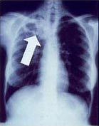
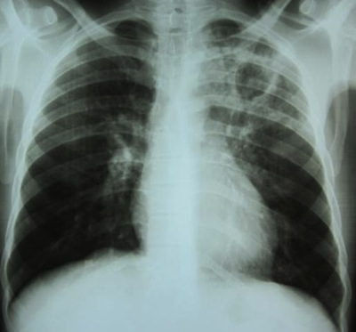
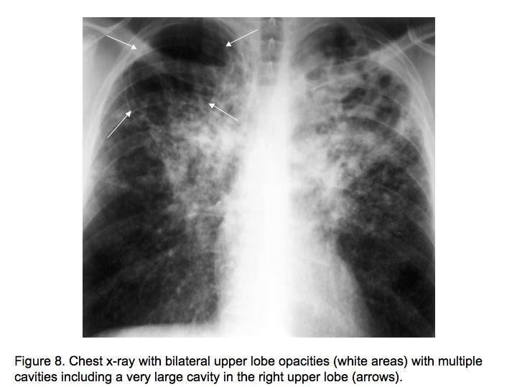

Slide 51
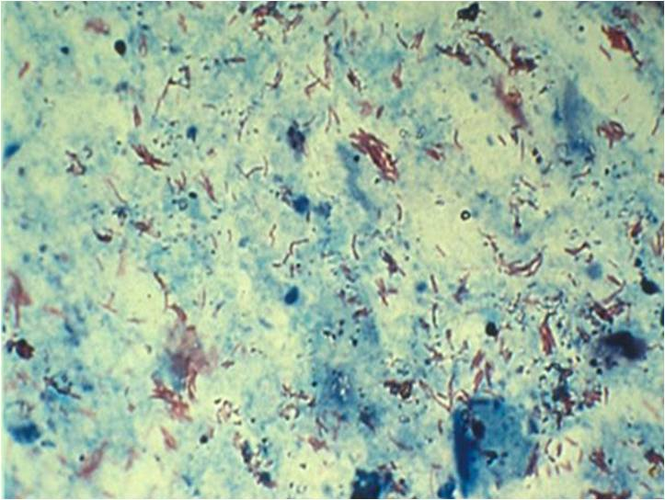
AFB Smear AFB (shown in red) are tubercle bacilli

Slide 52
Culture
Remains gold standard for confirming diagnosis of TB.
Culture all specimens, even if smear or NAA negative.
Results in 4–14 days when liquid medium systems used.
Culture monthly until conversion, i.e., 2 consecutive negative cultures.

Slide 53
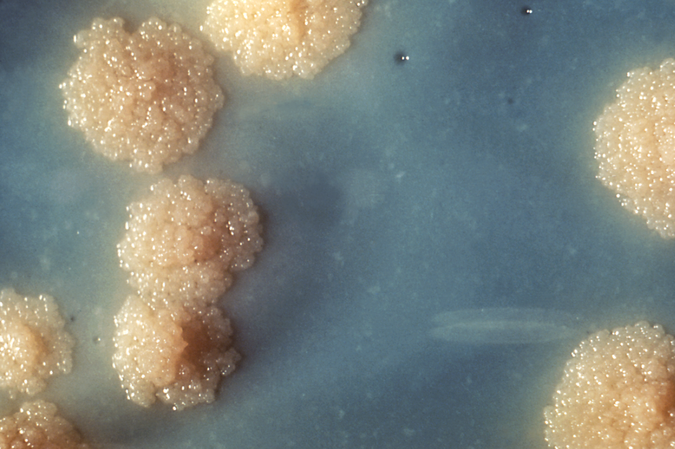
Colonies of M. tuberculosis Growing on Media

Slide 54
Diagnosis
TST(PPD) … intradermally.
5 unit in o.1 ml.
10 mm: 90 % infected.
More than 15 mm: 100% infected.
BCG and positive TST(PPD):
Unless very recent: positive TST(PPD) of more than 10mm should not be due to BCG
>5
>10
>15

Slide 55
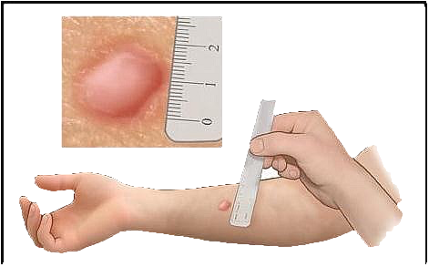
Diagnosis
TST (Mantoux test),(PPD)
TST(PPD) injected in forearm and examined 2-3 days later(24,48&72hrs).
Induration around injection site indicates infection.
Measure Induration NOT redness.
Examine medical history, x-rays and sputum,
Blood tests(B-interferone).
PCR.
Notes:
ÄThe tuberculin Mantoux PPD skin test shows if a person has been infected. Ä A chest X-ray is given if the Mantoux skin test shows that a person has been infected. The X-ray shows if any damage has been done to the lungs. ÄA sputum test shows if TB germs are in the thick liquid a person coughs up.

Slide 56
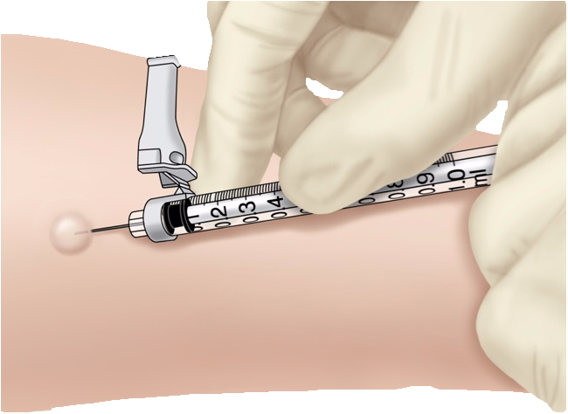
Administering the TST
Inject 0.1 ml of PPD (5 tuberculin units) into forearm between skin layers.
Produce wheal (raised area) 6–10 mm in diameter.
Follow universal precautions for infection control.

Slide 57
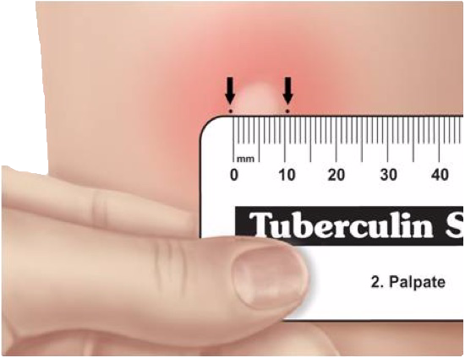
Reading the TST
Trained health care worker assesses reaction 48–72 hours after injection.
Palpate (feel) injection site to find raised area.
Measure diameter of induration across forearm; only measure induration, not redness.
Record size of induration in millimeters; record “0” if no induration found.

Slide 58
Mantoux Tuberculin Skin Test (TST)
Purified protein derivative (PPD), derived from tuberculin, is injected between skin layers using the Mantoux technique
Infected person’s immune cells recognize TB proteins in PPD, respond to site, causing wheal to rise.
Takes 2-8 weeks after exposure and infection for the immune system to react to PPD.
Reading and interpretation of TST reaction must be done within 48–72 hours.

Slide 59
Diagnosis
False negative TST:
20 % of active disease.
Malnutrition.
Sarcoid.
Lymphoproliferative dis.(lymphoma).
Viral infection.
Steroid.
TST(PPD): is of limited value because of low sensitivity and specificity

Slide 60
Factors that May Affect the Skin Test Reaction
Type of Reaction | Possible Cause
False-positive | Nontuberculous mycobacteria BCG vaccination Problems with TST administration
False-negative | Anergy Viral, bacterial, fungal coinfection Recent TB infection Very young age; advanced age Live-virus vaccination Overwhelming TB disease Renal failure/disease Lymphoid disease Low protein states Immunosuppressive drugs Problems with TST administration

Slide 61
Interferon Gamma Release Assays (IGRAs)
IGRAs detect M. tb infection by measuring immune response in blood.
Cannot differentiate between TB and LTBI; other tests needed.
May be used for surveillance/screening, or to find those who will benefit from treatment.
FDA-approved IGRAs are QFT Gold In-Tube and T-Spot.TB test.

Slide 62
Bcg vaccination
Vaccine made from live, attenuated (weakened) strain of M. bovis.
Early version first given to humans in 1921.
Many TB-prevalent countries vaccinate infants to prevent severe TB disease.

Slide 63
BCG Contraindications
Contraindicated in persons with impaired immune response from:
HIV infection, congenital immunodeficiency.
Leukemia, lymphoma, generalized malignancy
High-dose steroid therapy.
Alkylating agents.
Antimetabolites.
Radiation therapy.
BCG vaccination should not be given to pregnant women

Slide 64
General Recommendations for Using IGRAs
May be used in place of, but not in addition to, TST.
Preferred when testing persons:
Who might not return for TST reading.
Who have received BCG vaccination.
Generally should not be used to test children <5 years of age, unless used in conjunction with TST.

Slide 65
Medical Evaluation for TB (cont.) 1. Medical History (cont.)
Symptoms of possible extrapulmonary TB:
Blood in the urine (TB of the kidney).
Headache/confusion (TB meningitis).
Back pain (TB of the spine).
Hoarseness (TB of the larynx).
Loss of appetite, unexplained weight loss.
Night sweats, fever.
Fatigue

Slide 66
Direct Detection Using Nucleic Acid Amplification (NAA)
NAA tests rapidly identify a specimen via DNA and RNA amplification.
Benefits may include:
Earlier lab confirmation of TB disease
Earlier respiratory isolation and treatment initiation
Improved patient outcomes; interruption of transmission
Perform at least 1 NAA test on each pulmonary TB suspect.
A single negative NAA test does not exclude TB.

Slide 67
Treatment for Latent TB Infection (LTBI)
Treatment of LTBI essential to controlling and eliminating TB disease.
Reduces risk of LTBI to TB disease progression.
Use targeted testing to find persons at high risk for TB who would benefit from LTBI treatment.
Several treatment regimens available.

Slide 68
Candidates for Treatment of LTBI (cont.)
High-risk persons with positive IGRA test or TST reaction of ≥10 mm (cont.):
Persons with conditions that increase risk for TB:
Silicosis.
Diabetes mellitus.
Chronic renal failure.
Certain cancers (e.g., leukemia and lymphomas, or cancer of the head, neck, or lung).
Gastrectomy or jejunoileal bypass.
Weight loss of at least 10% below ideal body weight.
Children <4 yrs of age; children/adolescents exposed to adults in high-risk categories.

Slide 69
Major Goals of TB Treatment
Cure patient, minimize risk of death/disability, prevent transmission to others.
Provide safest, most effective therapy in shortest time.
Prescribe multiple drugs to which the organisms are susceptible.
Never treat with a single drug or add single drug to failing regimen.
Ensure adherence and completion of therapy.

Slide 70
Current Anti-TB Drugs
10 or more drugs FDA-approved for treatment of TB:
Isoniazid (INH).
Rifampin (RIF).
Pyrazinamide (PZA).
Ethambutol (EMB).
Rifapentine (RPT).
Streptomycin (SM).
Cycloserine.
Capreomycin.
ρ-Aminosalicylic acid.
Ethionamide.

Slide 71
Treatment
Chemotherapy: cure
Isonised.
Rifampicin.
Pyrazinamide.
Ethambutol/streotomycin.
rapidly reduce the number of viable organism.
kill the bacilli.
slow rate of induction of drug resistance.

Slide 72
Regimen 1 for Treatment of Pulmonary, Drug-Susceptible TB
6-month standard regimen for most patients.
Initial phase:
INH, RIF, PZA, EMB daily (7 or 5 days/week) for 8 weeks.
4-month continuation phase options:
INH, RIF daily (7 or 5 days/week) for 18 weeks.
INH, RIF intermittently (2 days/week or 1 day/week for INH, rifapentine) for 18 weeks.

Slide 73
Treatment cont.
Drug failure:
None compliance.
Inappropriate drug.
Drug resistance.

Slide 74
Infection Control
Active pulmonary tuberculosis:
Isolation of the patient (2wks).
Isolation room should be negative pressure.
Patient remain until 3 negative smears and there is clinical improvement.

Slide 75
TB Infection Control Measures
TB infection control (IC) measures should be based on TB risk assessment for the setting.
The goals of IC programs are:
Detect TB disease early and promptly.
Isolate persons with known/suspected TB.
Start treatment in persons with known/suspected TB.

Slide 76
Thank You for Your Attention

