Slide 1
DR. MOHAMMED AYESH
CONSULTANT RADIOLOGIST
DR.SARAH ALSULTAN
BREAST IMAGING CONSULTANT
KING KHALID UNIVERSITY HOSPITAL
BREAST IMAGING

Slide 2
OBJECTIVES
Radiological anatomy of the breast.
To highlight the suitable modality for each age.
Role of imaging/radiology in diagnosing breast lesions particularly breast cancer.
Notes:
/////////

Slide 3
ANATOMY

Slide 4
ANATOMY

Slide 5
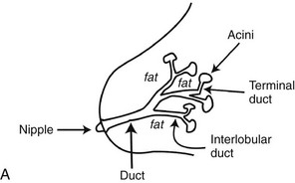
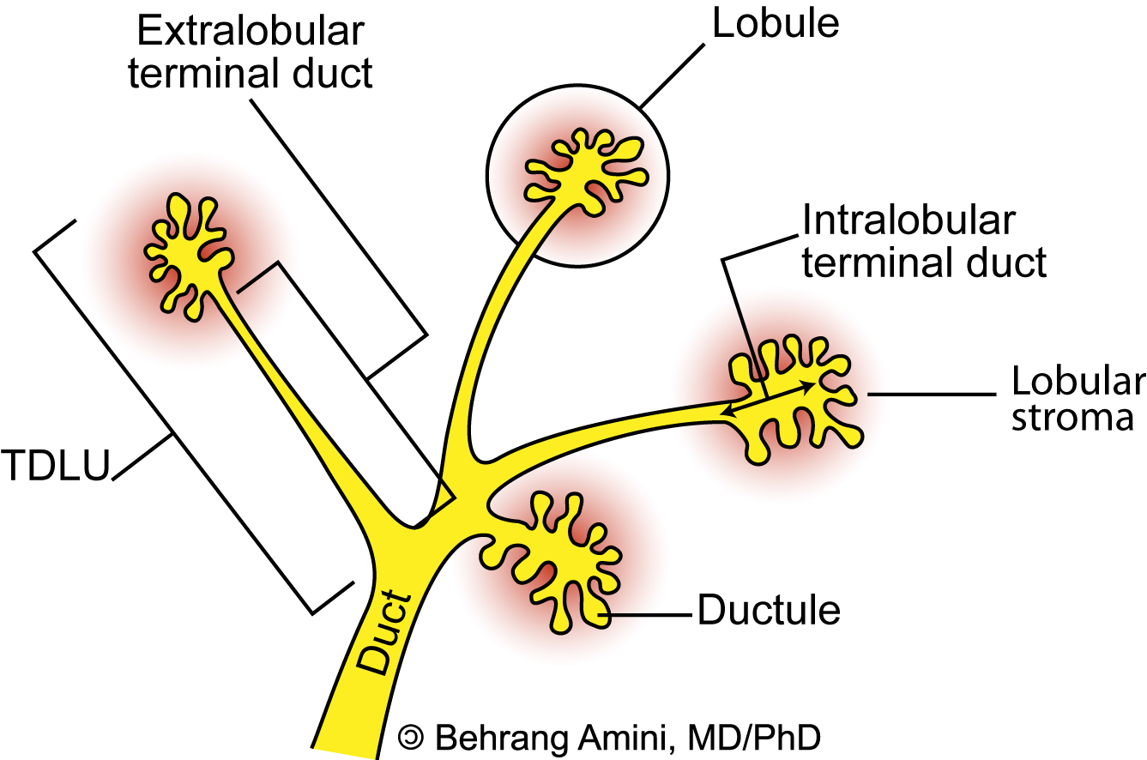
Most breast cancer develops in the terminal ductal lobular unit (TDLU)

Slide 6
Breast cancer can be divided into two major groups
IN SITU
Tumor cells, they do not invade the basement membrane.
Tumor cells remain confined to the ducts or lobules.
INVASIVE
Tumor cells invade the breast stroma.
They have the potential to metastasize and result in death of the patient.

Slide 7
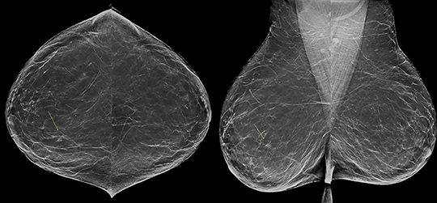
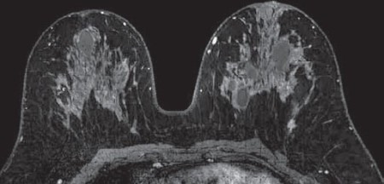
BREAST IMAGING
Mammogram
Ultrasound
MRI

Slide 8
MODALITY AND AGE
< 30
30-39
≥40
US
No complain
Complain
US
MG then US
MG
+ ve
- ve
US
DONE

Slide 9
BREAST IMAGING
Mammogram
Ultrasound
MRI

Slide 10
MAMMOGRAM INDICATIONS
Screening [ No Complain]
Patients 40 Y and above.
Young patient with first degree relative (Mother/ Sister) diagnosed with breast cancer.
Diagnostic [ Complain]
Palpable mass
Nipple discharge
Skin changes

Slide 11
MLO
STANDARD MAMMOGRAM
CC

Slide 12
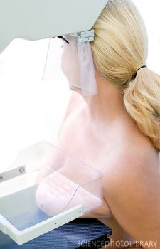
CC view

Slide 13
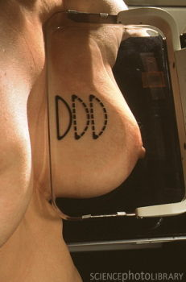
MLO view

Slide 14
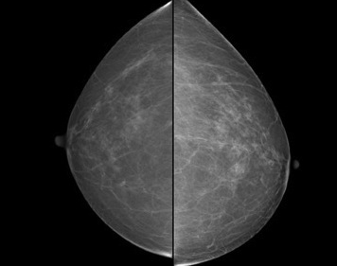
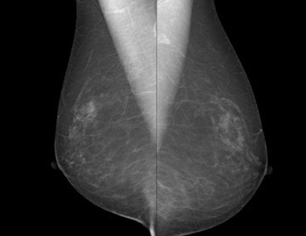

Slide 15
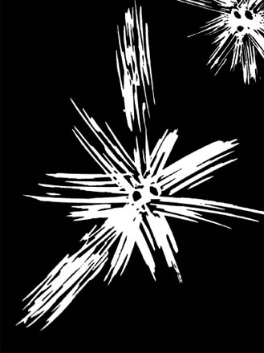
BREAST ABNORMALTY
Mass
Architectural distortion.
Calcifications.
Skin thickening
Nipple retraction
Axillary lymph nodes

Slide 16
MASS
Both views CC &MLO
Pesrsist (spot compression view)
Shape
Margins
Density

Slide 17
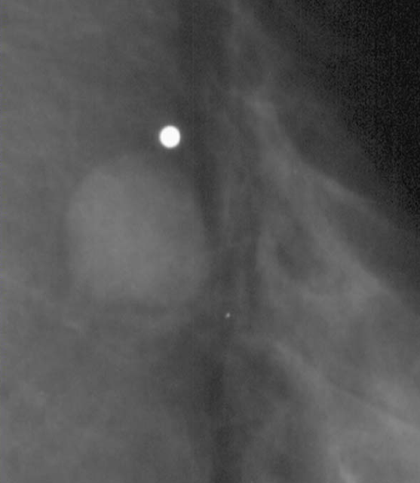
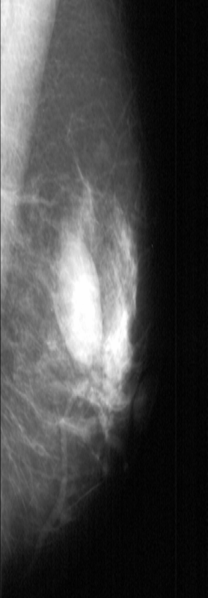
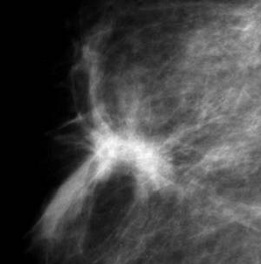
MASS SHAPE
ROUNDED | OVAL | IRRIGULAR

Slide 18
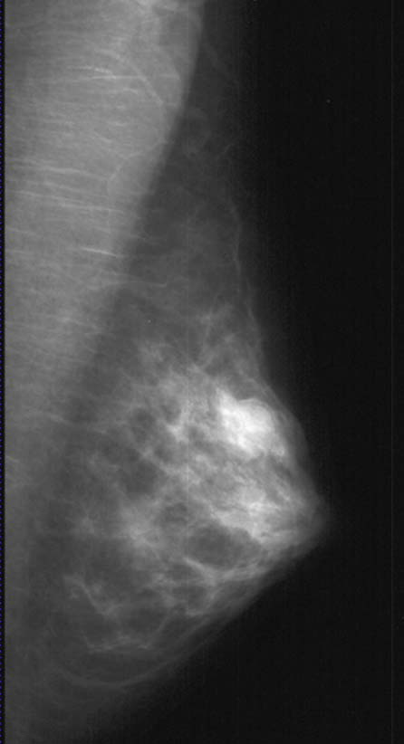
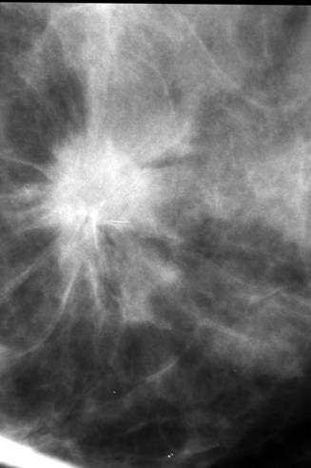
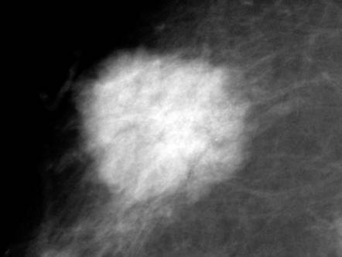
MASS MARGIN
Circumscribed | Obscured | Microlobulated | Indistinct | Spiculated
Abrupt transition between lesion and tissue. DDx 1.Cyst 2.Fibroadenoma | Margins (suspected to be circumscribed) hidden by adjacent superimposed normal tissue Ask for compression or magnification views. | Margin undulated with short cycle 1-2 mm. | Ill defined. Possible infiltration. | lines radiating from margins of a mass. DDx 1.Cancer 2.Surgical scar. 3.Fat necrosis.

Slide 19
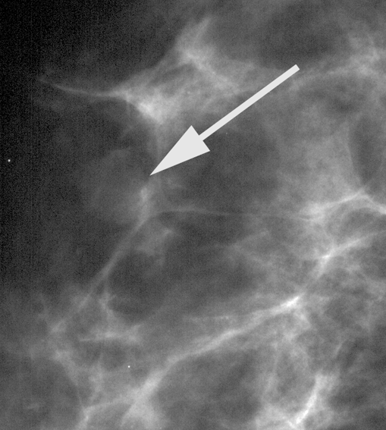
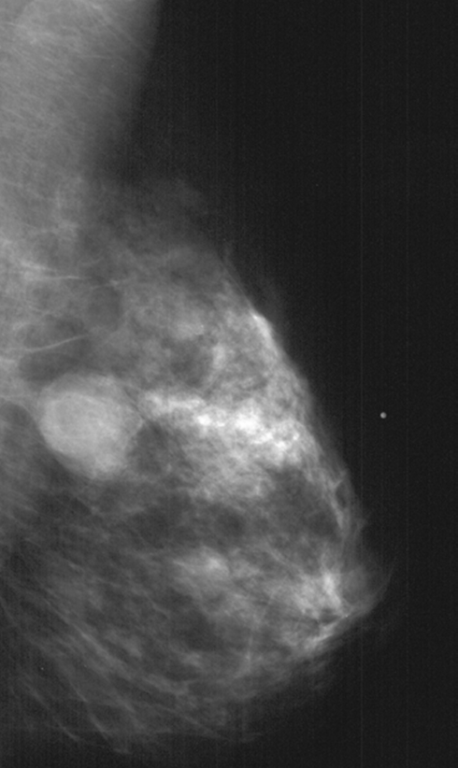
MASS DENSITY
Fat only | Mixed density | Low dense | Equal dense | High dense
Oil cyst/fat necrosis. Lipoma. | Hamartoma Lymph node Fat necrosis Galactocele
If you see fat in a mass, it is benign!!
Suspicious for malignancy
Cancer is less likely but still possible

Slide 20
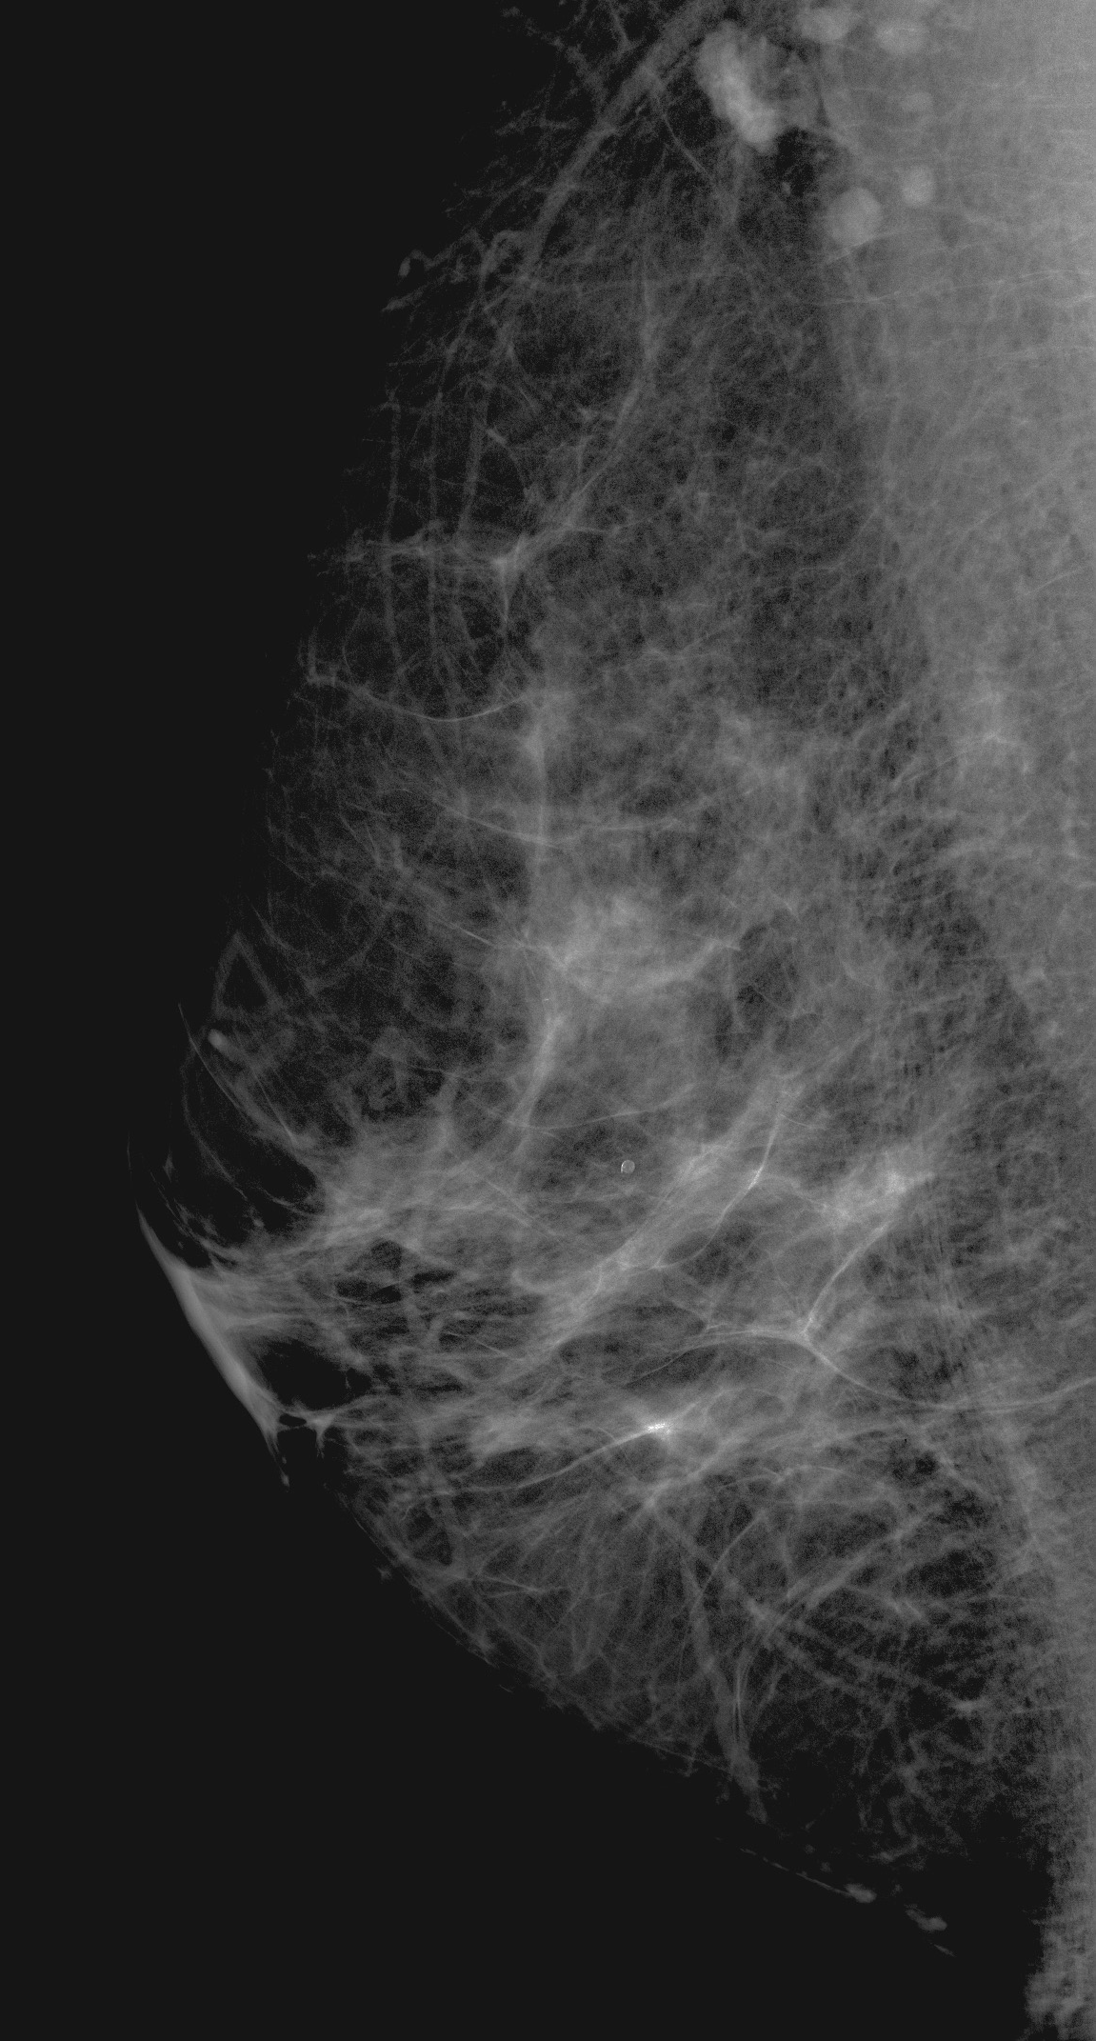
LIPOMA

Slide 21
GALACTOCELE

Slide 22
FAT NECROSIS

Slide 23
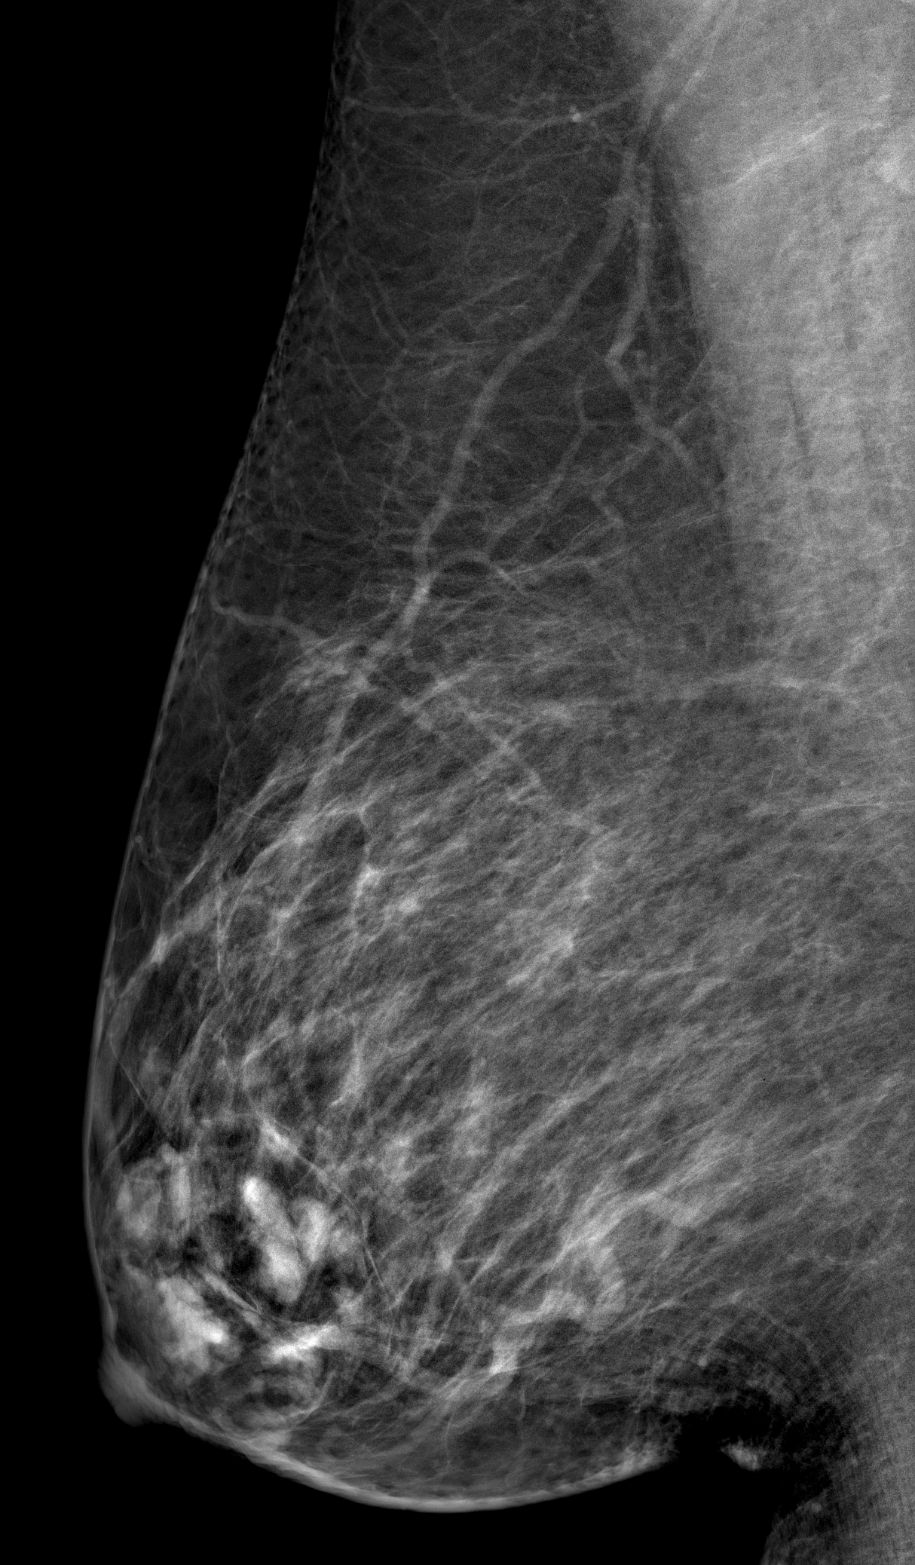
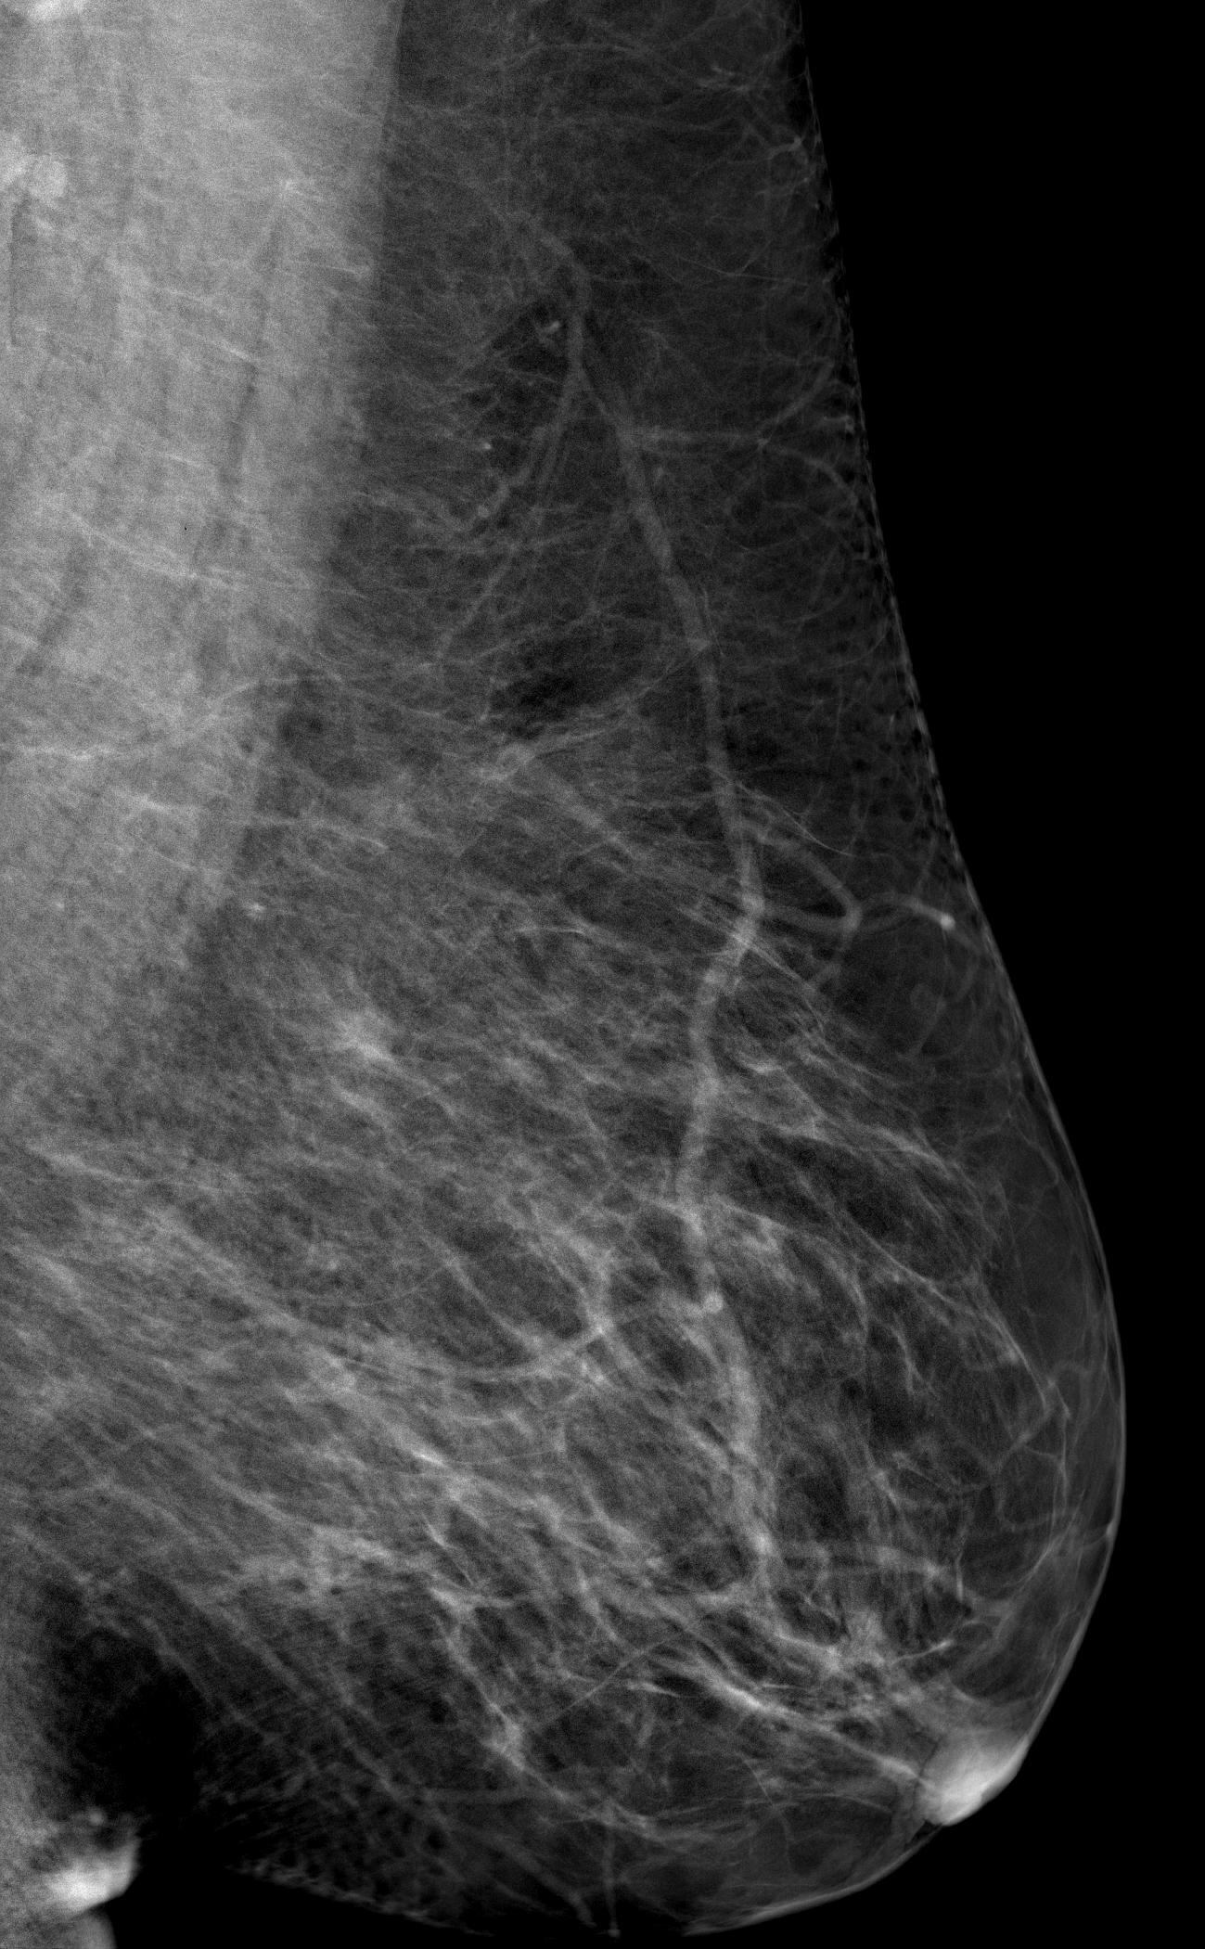
HAMARTOMA(fibroadenolipoma)

Slide 24
BREAST ABNORMALTY
Mass
Architectural distortion.
Calcifications.
Skin thickening
Nipple retraction
Axillary lymph nodes

Slide 25
ARCHTICTURAL DISTORTION
Lines radiating from a point.
Focal retraction/ distortion of parenchymal edge.
Main findings or associated findings.
Differential diagnosis:
Breast cancer.
Radial Scar (complex sclerosing lesion).
Surgical Scar.

Slide 26
BREAST ABNORMALTY
Mass
Architectural distortion.
Calcifications.
Skin thickening
Nipple retraction
Axillary lymph nodes

Slide 27
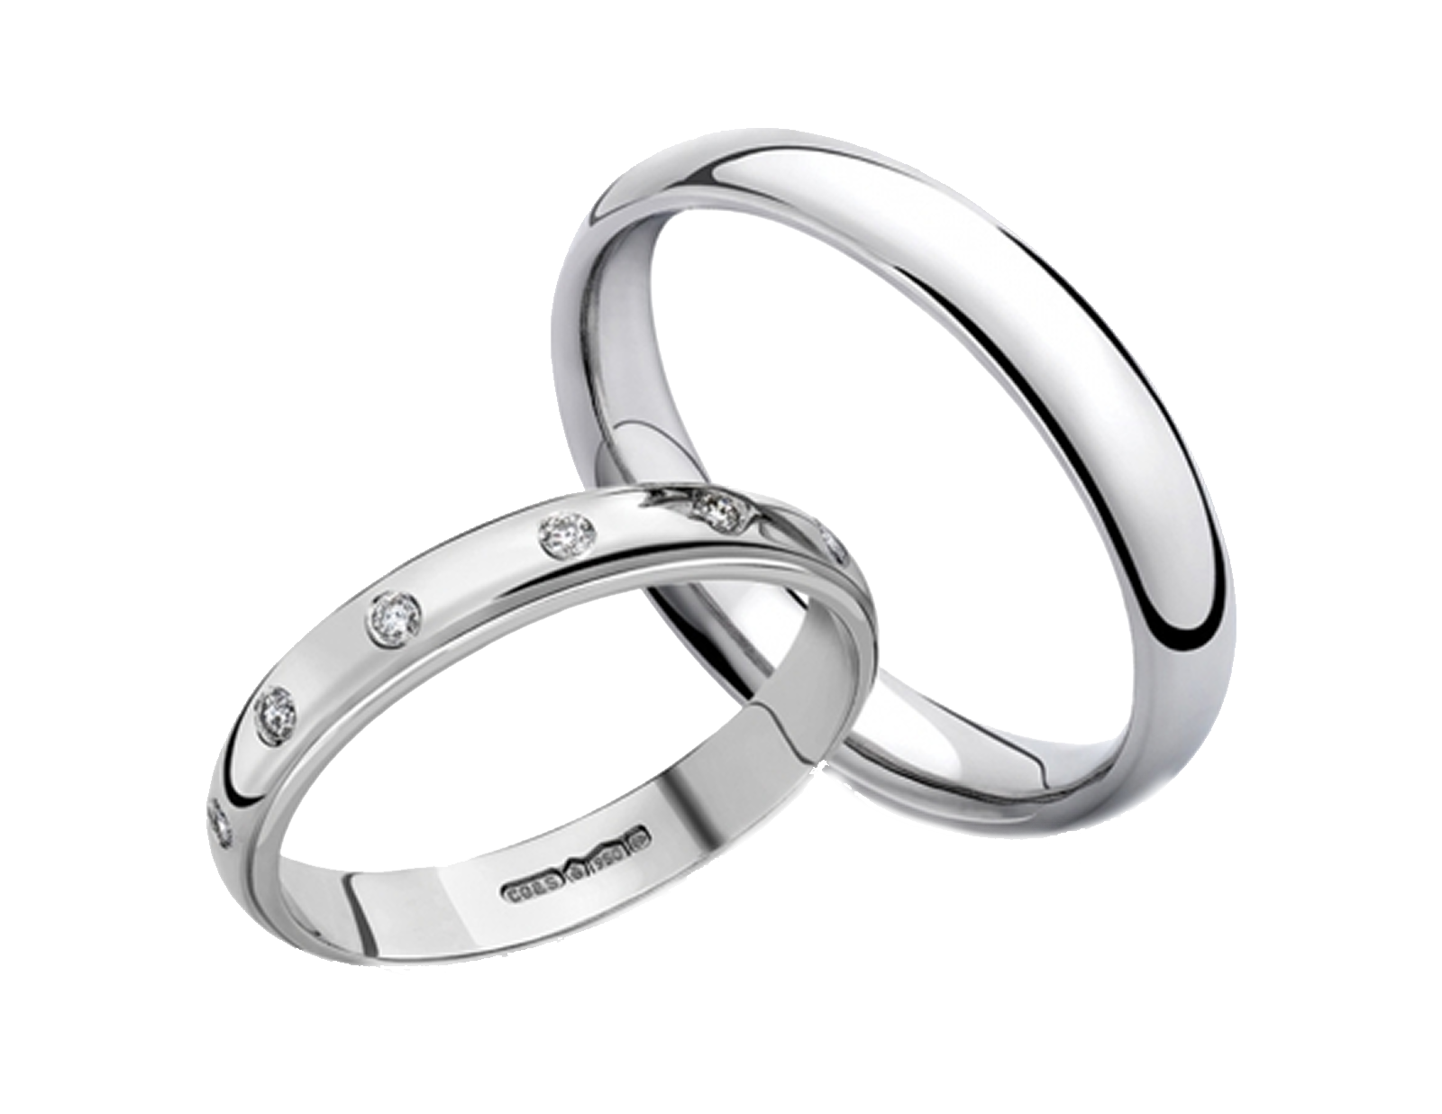
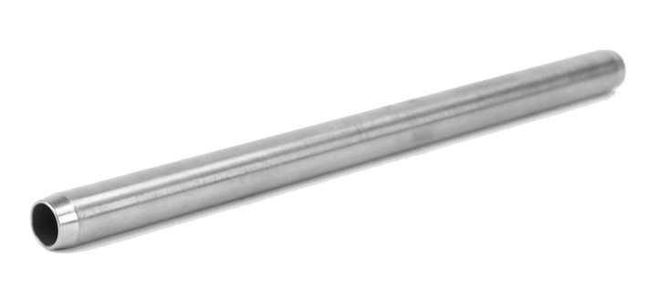
BENIGN CALCIFICATIONS
Skin
Vascular
Rim
Popcorn
Rod-Like
Punctate
Milk of calcium
Suture
Dystrophic

Slide 28
BENIGN CALCIFICATIONS
Skin
Vascular
Rim
Popcorn
Rod-Like
punctate
Milk of calcium
Suture
Dystrophic

Slide 29
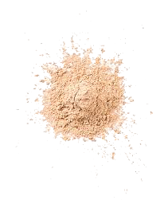
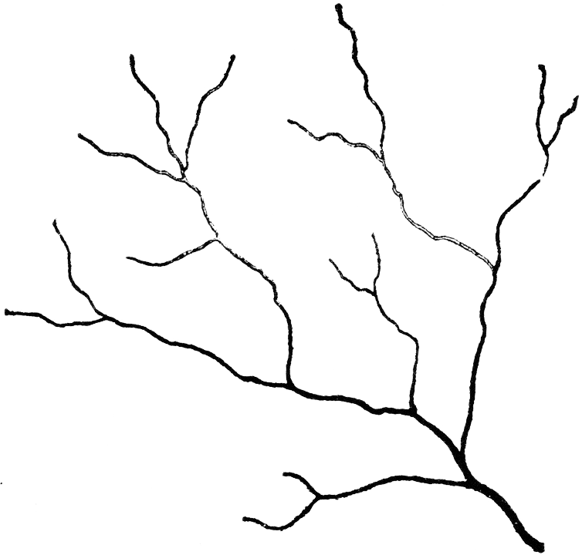
Suspicious Calcifications
Size
Shape
Density
Amorphous
Coarse
heterogenous
Fine
Pleomorphic
Fine Branching
and linear branching

Slide 30
Suspicious Calcifications
Coarse
Heterogeneous
Fine
Pleomorphic
Fine Branching
and linear branching
Amorphous

Slide 31
DISTRIBUTION
Grouped
Linear
Segmental
Regional
Diffused
< 2 cm
5 Calcifications or more
> 2 cm
Entire breast

Slide 32
GROUPED

Slide 33
BREAST IMAGING
Mammogram
Ultrasound
MRI

Slide 34
BREAST US INDICATIONS
Differentiation of both palpable and mammographic lesions as either cystic or solid.
Evaluation of solid masses according to certain sonographic features.
Initial imaging evaluation of palpable breast masses in patients under 30 years and in lactating and pregnant women.
Screening for occult cancers in certain populations, including of women with heterogeneously or extremely dense breasts.
Follow-up of breast cancer treated with neoadjuvant chemotherapy.
Guidance for breast biopsy and other interventional procedures.

Slide 35
MALIGNANT VS BENIGN SONOGRAPHIC FEATURES OF SOLID MASSES
MALIGNANT | BENIGN
Spiculation | Circumscribed, hyperechoic tissue
Angular margins | Parallel orinted –wider than taller
Hypoechogenicity | Gently curving smooth lobulations
Shadowing | Thin echogenic pseudocapsule
Calcification
Duct extension
Branch pattern
Microlobulation

Slide 36
Cyst
Solid
Anechoic
Echogenic Psudocapsule
Posterior enhancement
Spiculated
Circumscribed
Shadowing
Benign
Malignant

Slide 37
BREAST IMAGING
Mammogram
Ultrasound
MRI

Slide 38
MRI INDICATIONS
Staging.
High risk patients.
Response to therapy.
Post operative to differentiate surgical scar versus recurrence
Occult breast cancer.
Assess the contralateral breast.
Breast implant.

Slide 39
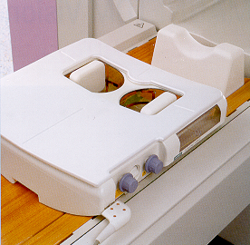
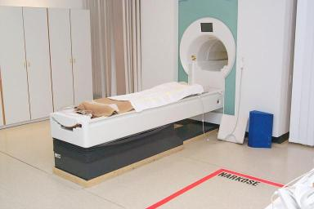
MRI breast- Minimum equipment
System with field strenghts 1.5 T
Dedicated bilateral breast surface coil
Prone positioning.
Images obtained prior to gadolinium and multiple phases following gadolinium administration (Dynamic).

Slide 40
T1 fat sat with Gadolinium
T2 Fat Saturation

Slide 41
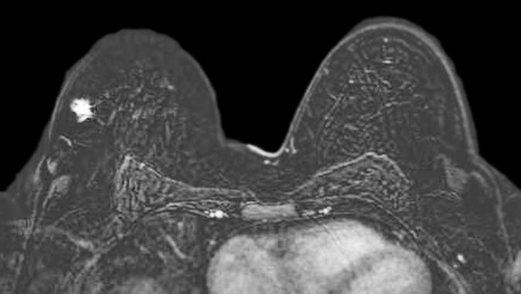
Subtracted images = Enhanced – Unenhanced Images

Slide 42
BI-RADS Breast Imaging Reporting And Data System
0 = Incomplete Additional imaging/view.
1 = Negative Routine screening recommended.
2 = Benign Routine screening recommended.
3 = Probably Benign (< 2% malignant); six-month short interval follow-up.
4 = Suspicious of Malignancy (≥ 2 to 95%); biopsy should be considered.
5 = Highly Suspicious of Malignancy (> 95%); take appropriate action.
6 = Known Biopsy-Proven Malignancy

Slide 43
THANK YOU
Questions?

