Slide 1
Mechanisms of Injury
Ahmed Alburakan, MD, MSc ,FRCSC , FRCPC
Assistant professor & consultant
King Saud University

Slide 2
Introduction
Trauma is the primary cause of death and disability between ages 1 to 44 years.
Analyzing a trauma scene is a vital skill.
Determining the events that lead to trauma, often predict the injuries encountered.

Slide 3
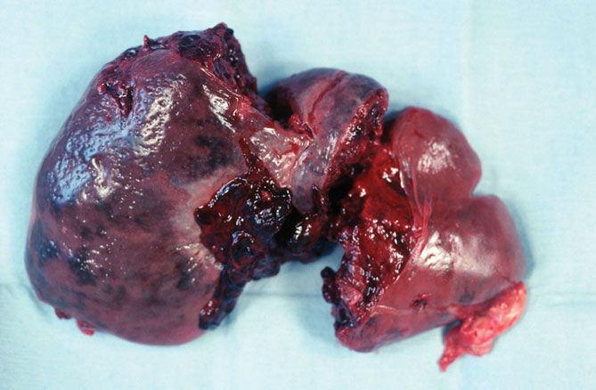
Trauma
Injury occurs when an external source of energy affects the body beyond its ability to sustain and dissipate energy.
© Shout Pictures

Slide 4
Trauma
Different forms of energy produce different kinds of trauma.
Mechanical energy
Chemical energy
Electrical energy
Barometric energy

Slide 5
Factors Affecting Types of Injury
Ability of body to disperse energy delivered
Force and energy
Size of object
Velocity
Acceleration or deceleration
Affected body area
Duration and direction
The larger the area, the more energy will be dissipated.
Position of victim

Slide 6
Factors Affecting Types of Injury
The impact resistance of body parts has a bearing on types of tissue disruption.
Organs that have gas inside are easily compressed.
Liquid-containing organs are less compressible.

Slide 7
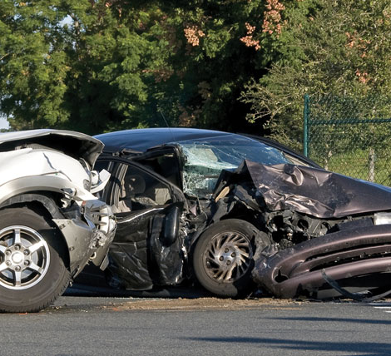
Kinetics
Study of the relationship among speed, mass, direction of force, and physical injury caused by these factors

Slide 8
Kinetics
Newton’s first law of motion: A body at rest will remain at rest unless acted on by an outside force.
Newton’s second law of motion: The force an object can exert is the product of its mass times its acceleration.

Slide 9
Kinetics
Velocity (V): Distance per unit of time
Acceleration (a): Rate of change of velocity
Gravity (g): Downward acceleration imparted to any object moving toward earth
Kinetic energy = mass/2 × velocity²

Slide 10
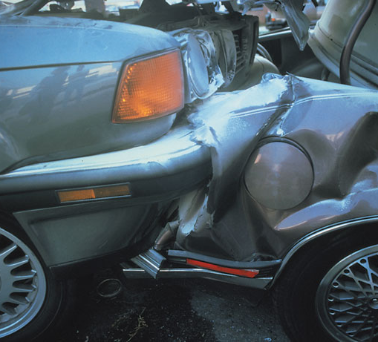
Kinetics
Kinetic energy of a subject in motion that stops suddenly must be transformed or applied to another object.

Slide 11
Kinetics
Other factors that will affect energy dissipation in a crash include:
Vehicle’s angle of impact
Differences in sizes of the two vehicles
Restraint status and protective gear of occupants
Energy dissipation: Process by which KE is transformed into mechanical energy
Protective devices can manipulate the way in which energy is dissipated.

Slide 12
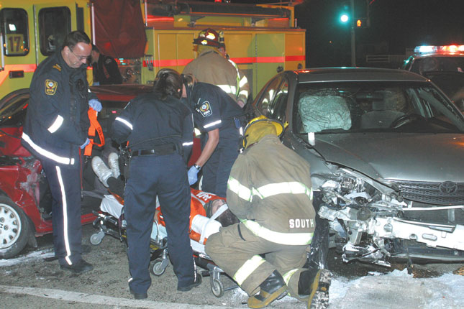
Blunt Trauma
Injuries in which tissues are not penetrated by external object
© Jack Dagley Photography/ShutterStock, Inc.

Slide 13
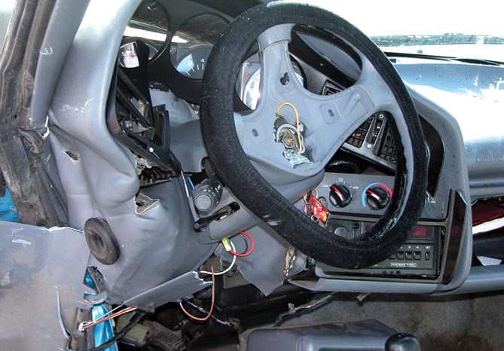
Motor Vehicle Crashes
Five phases of trauma:
Phase 1: Vehicle Deceleration
Phase 2: Occupant deceleration
Courtesy of Captain David Jackson, Saginaw Township Fire Department

Slide 14
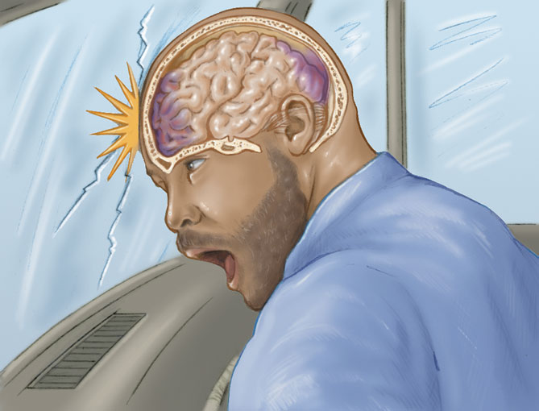
Motor Vehicle Crashes
Five phases of trauma (cont’d):
Phase 3: Deceleration of internal organs
Phase 4: Secondary collisions
Phase 5: Additional impacts received by the vehicle

Slide 15
Impact Patterns
Frontal or head-on impacts
Front end of the car distorts.
Passengers decelerate at same rate as vehicle.
Abrupt deceleration injuries are produced by a sudden stop of a body’s forward motion.

Slide 16
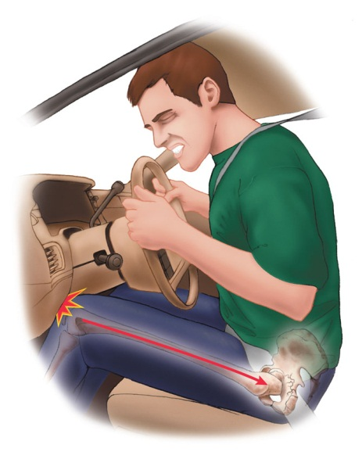
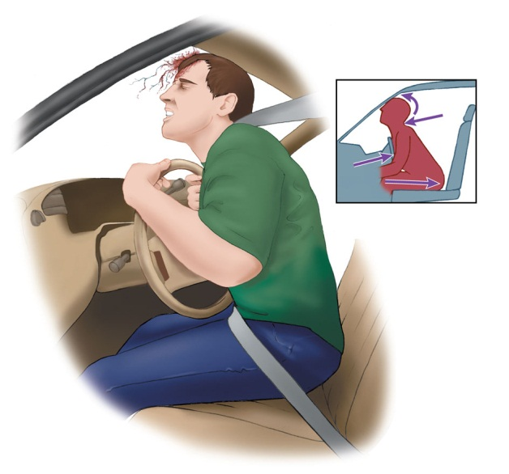
Impact Patterns
Frontal or head-on impacts (cont’d)
Unrestrained occupants usually follow one of two trajectories:
Down-and-under pathway
Up-and-over pathway

Slide 17
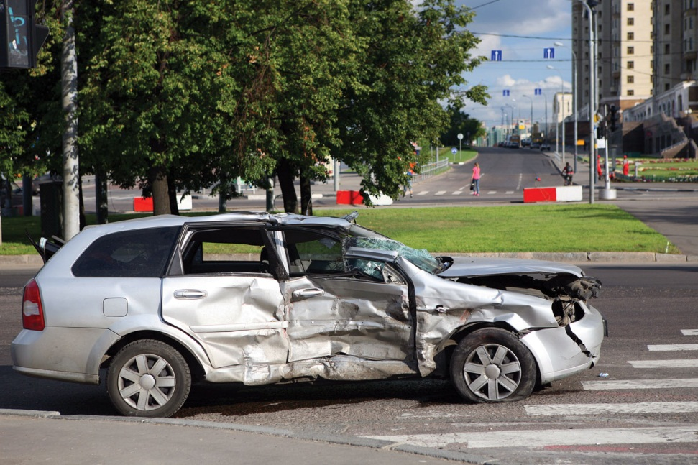
Impact Patterns
Lateral or side impacts
Impart energy to the near-side occupant
Seat belts offer little protection.
The body is pushed in one direction, while the head moves toward the impacting object.
© Alexander Gordeyev/ShutterStock, Inc.

Slide 18
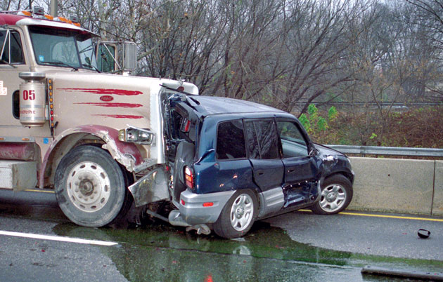
Impact Patterns
Rear impacts
Have the most survivors
Whiplash injury is common.
Energy is imparted to the front vehicle.
© Dennis Wetherhold, Jr

Slide 19
Impact Patterns
Rotational or quarter-panel impacts
Occurs when a lateral crash is off center
The vehicle’s forward motion stops, but the side continues in rotational motion.

Slide 20
Impact Patterns
Rollovers
Patients may be ejected.
Patients may be struck hard against the interior of the vehicle.
© iStockphoto/Thinkstock

Slide 21
Restrained Versus Unrestrained Occupants
Seat belts stop the motion of an occupant traveling at the same speed as the vehicle.
Associated injuries include cervical fractures and neck sprains.

Slide 22
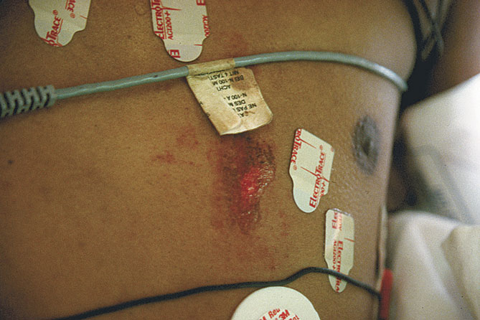
Restrained Versus Unrestrained Occupants
Air bags have reportedly reduced deaths in direct frontal crashes by about 30%.
Can also result in secondary injuries:
Direct contact
Chemicals
Courtesy of AAOS

Slide 23
Pedestrian Injuries
Three predominant MOIs:
First impact:
- Car strikes body with its bumpers.
Second impact:
- Adult is thrown on hood and/or grille of vehicle.
Third impact:
- Body strikes the ground or some other object.

Slide 24
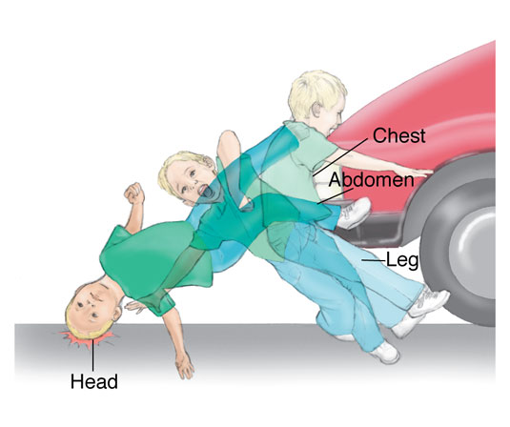
Pedestrian Injuries
Waddell triad: Pattern of injuries in children and people of short stature
Bumper hits pelvis and femur.
Chest and abdomen hit grille.
Head strikes vehicle and ground.

Slide 25
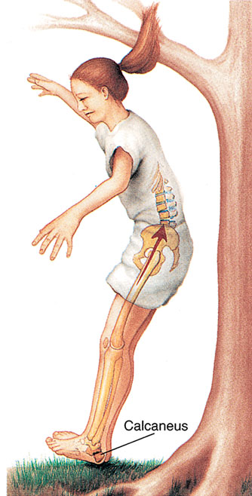
Falls from Heights
Severity of injuries impacted by:
Height
Position
Surface
Physical condition

Slide 26
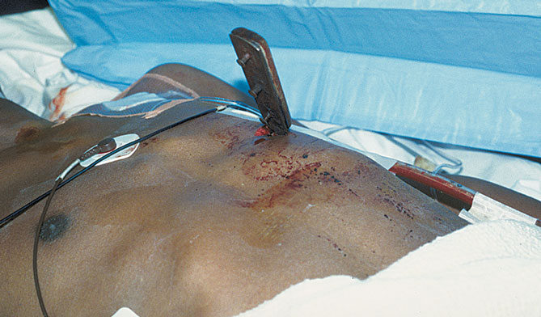
Penetrating Trauma
Involves disruption of skin and tissues in a focused area
Low velocity: Caused by sharp edges
Medium and high velocity: Object might flatten out, tumble, or ricochet.

Slide 27
Stab Wounds
Severity depends on:
Anatomic area involved
Depth of penetration
Blade length
Angle of penetration

Slide 28
Gunshot Wounds
Severity depends on:
Type of firearm
Velocity of projectile
Physical design/size of projectile
Distance of victim from muzzle
Type of tissue struck

Slide 29
Gunshot Wounds
Handgun
Revolver holds 6 to 10 rounds of ammunition
Pistol holds up to 17 rounds of ammunition
Accuracy is limited.
Shotguns
Fire round pellets
Rifles
Fire single projectile at a very high velocity
Impart a spin for accuracy

Slide 30
Gunshot Wounds
The most important factor for seriousness of wound is type of tissue involved.
Entry wound is characterized by the effects of the initial contact and implosion.

Slide 31
Gunshot Wounds
Deformation/ tissue destruction is based on:
Density
Compressibility
Missile velocity
Missile fragmentation

Slide 32
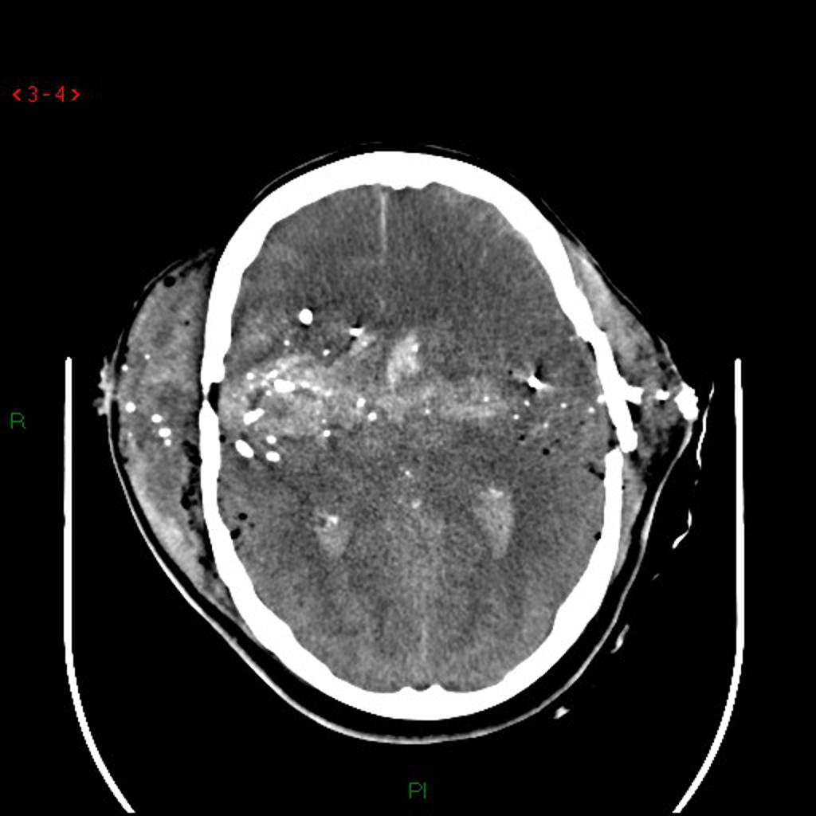
Gunshot Wounds
Projectile creates a permanent cavity.
May be straight line or irregular pathway
Pathway expansion: Tissue displacement that results from low-displacement sonic pressure
Missile fragmentation: Projectile sends off fragments that create paths through tissues.

Slide 33
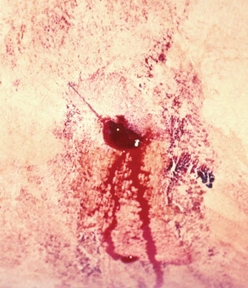
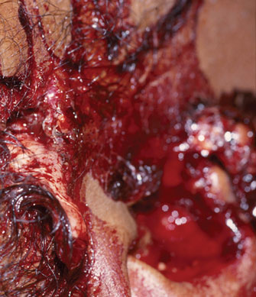
Gunshot Wounds
Exit wounds occur when projectile’s energy is not entirely dissipated.
Size depends on energy dissipated and degree of cavitation.
Entrance wound
Exit wound
© Chuck Stewart, MD
D.Willoughby/Custom Medical Stock Photography

Slide 34
Gunshot Wounds
Wounding potential depends on:
Powder charge
Size and number of pellets
Dispersion of the pellets
Range at which the weapon was fired
Barrel length
Type of choke at the end of the barrel

Slide 35
Gunshot Wounds
Try to obtain the following:
Weapon used
Range fired
Bullet used
Look for:
Powder residue around the wound
Entrance and exit wounds

Slide 36
Primary Blast Injuries
Damage is caused by pressure wave generated by explosion
Close proximity to the origin of the pressure wave carries a high risk of injury or death.

Slide 37
Secondary Blast Injuries
Result from being struck by flying debris
A blast wind occurs.
Flying debris may cause blunt and penetrating injuries.

Slide 38
Tertiary Blast Injuries
Occur when a person is hurled against stationary, rigid objects
Ground shock: Physical displacement when the body impacts the ground

Slide 39
Quaternary (Miscellaneous) Blast Injuries
Occur from the miscellaneous events that occur during an explosion
May include:
Burns
Respiratory injury
Crush injury
Entrapment

Slide 40
Quinary Blast Injuries
Caused by biologic, chemical, or radioactive contaminants added to an explosive
Associated with “dirty bombs”

Slide 41
Summary
Trauma is the primary cause of death and disability in people between ages 1 and 44 years.
Understanding mechanisms of injuries will help in management of trauma victims by predicting injuries.

Slide 42
??

