Slide 1
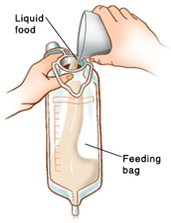
Dietitian: Rashed alnafa KKUH
Nutrition in surgery

Slide 2
Aims of Nutrition in surgery
= PREPARE/ENHANCE RECOVERY
= PREVENT MALNUTRITION OR DIET-RELATED CONSEQUENCES,(eg,nausea, vomiting, diarrhea,dumping syndrome and dehydration)
=DEFINE PATIENT WHO AT RISK AND WHO NEEDS FOR NUTRITION SUPPORT
=DEFINE SPECIAL NUTRITION NEEDS FOR PATIENTS UNDERGOING MAJOR SURGERYS e.g. for cancer

Slide 3
Nutrition care for patient undergoing surgery is vary, in related to:
The type of surgery (Minor, Major, Elective, urgent)
THE require OF extensive nutrition support.
Route of Nutrition, orally or via TF
Postoperative complications such as obstruction, fistula, or anastomotic leaks, delayed recovery.

Slide 4
MALNUTRITON
Malnutrition is a broad term that can be used to describe any imbalance in nutrition; from over-nutrition to under-nutrition.
Observed up to40-60% of surgical patient on admission/remines under-diagnose in 70% of patient in hospital settings.
malnutrition seen in hospitalized patients is often a combination of cachexia (disease-related) and malnutrition (inadequate consumption of nutrients) as opposed to malnutrition alone.
.

Slide 5
How to detect patient at risk
Nutritional risk screening in all patients on hospital admission or first contact:
BMI <18kg/m2
Combined: weight loss >10% or >5% over 3 months and reduced BMI or a low fat free mass index (FFMI)
Preoperative serum albumin < 30 g/l (with no evidence of hepatic or renal dysfunction)

Slide 6
LABORATORY MEASURES
Serum proteins such as albumin and prealbumin
Transferrin,
Nitrogen balance
Electrolytes
Total cholesterol
Indicators of inflammation such as C-reactive protein (CRP) and total lymphocyte count (TLC),

Slide 7
ERAS
ENHANCE RECOVERY AFTER SURGERY

Slide 8
Enhanced recovery of patients after surgery (‘‘ERAS’’) has become an important focus of perioperative management.
From a metabolic and nutritional point of view, the key aspects of perioperative care include:
Avoidance of long periods of pre-operative fasting
Re-establishment of oral feeding as early as possible after surgery
Integration of nutrition into the overall management of the patient metabolic control, e.g. of blood glucose;
Reduction of factors which exacerbate stress-related catabolism or impair gastrointestinal function;
Early mobilization

Slide 9
nutrition Support

Slide 10
WHO NEEDS
Patient at Nutrition risk/or Malnutrished
Postoperative complications:
- Ileus more than 4 days
- Sepsis
- Fistula formation
- Massive bowel resection
Intractable vomiting;
OTHER CONDITIONS :
Maxillofacial and esophageal surgery

Slide 11
Pre-op:
Fasting from midnight is unnecessary in most patients
ALLOW clear fluids until two hours before anaesthesia
Nutritional Support prior to major surgery, appropriate period of (7-14 )days, For patient with sever nutrition risk
POST-op
Oral intake, including clear liquids, can be initiated within hours after surgery in most patients.
Early tube feeding (within 24 h) shall be initiated in patients in whom early oral nutrition cannot be started, and in whom oral intake will be inadequate
(patients undergoing major head and neck surgery or gastrointestinal surgery for cancer, patients with obvious malnutrition at the time of surgery )

Slide 12
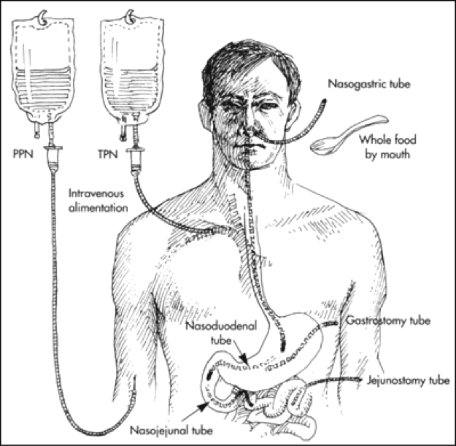
Modes of administration
What Route should be used
EN vs PN

Slide 13
Enteral feeding
Indications:
Malnourished patient expected to be unable to eat adequately for > 5-7 days
Adequately nourished patient expected to be unable to eat > 7-9 days
(Maxillofacial and esophageal surgery)
Adaptive phase of short bowel syndrome
Contraindications:
Intestinal obstructions or ileus,
Severe shock
Intestinal ischemia
High output fistula
Severe GI bleeding

Slide 14
Parenteral nutrition
For the surgical patient PN is beneficial in the following ;
Ileus
Intestinal fistula (high-output)
Initial phase in case of short bowel or after small bowel transplant or during periods of rejection
PN should only be initiated if the duration of therapy is anticipated to be >7 days.
IN some cases, Combined EN/PN showed clinical benefits when compared with EN or PN alone.

Slide 15
Assess nutrition needs

Slide 16
Energy and protein needs
BMI (kg/m2) | Weight (kg) | Kcal/kg | Protein* (gm/kg)
< 30 | Actual | 20-25 (minor) 25-30 (major) | 1g/kg/day (minor) 1.5-2.0 (major)
30-50 | Actual Ideal | 11-14 22-25 | 1.9-2.0 (IBW)
> 50 | Ideal | 22-25 | 2.5 (IBW)

Slide 17
Fluids needs
Age (years) | ml/kg | Increased Fluid needs (30-35 ml/kg actual BW): short gut syndrome, high output ileostomy or fistula, excessive diarrhea, high NGT output, large draining wounds, chest tube and JP drain losses.
18-65 | 30-35
65+ | 25 -30
Reference: http:health.qld.gov.au/masters/copyright.asp

Slide 18
Immunonutrition
In the preoperative phase, formulas enriched with arginine, omega-3 fatty acids have been shown to improve postoperative immune response, gut oxygenation and enhance recovery.
Antioxidants, including vitamins C and E, betacarotene, and selenium are often added in an effort to reduce oxidative stress among patients with acute metabolic stress. (wound healing)

Slide 19
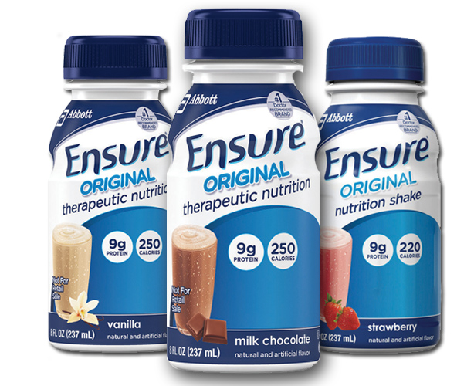
Select Formula

Slide 20
Branched-Chain Amino Acid 1.5kcal/1ml | Nutrihep | Hepatic Encephalopathy, Nutrition support for hepatic disease with elevated ammonia level
Low carbohydrate 1.5kcal/ml | Oxepa Pulmocare | modulate the inflammatory response in critically ill, mechanically ventilated patients, especially those with SIRS (systemic inflammatory response syndrome, eg, sepsis, trauma, burns), ALI (acute lung injury) or ARDS (acute respiratory distress syndrome)
Nutrient Dense/ Immunonutrients 1.2-1.6kcal/ml | IMPACT RECOVERY FORTICARE | For faster recovery ( before and after surgery),Severe trauma/injury, support colonic health, Pressure ulcer/wound, Dietary mgt of Cachexia in cancer , pancreatic cancer, lung cancer undergoing chemotherapy
Clear Liquids with Protein/ Fat-Free 1.5kcal/ml | Resource Breeze Fortijuice | Clear Liquid High Protein, bowel prep, fat malabsorptive/fat restricted, pre or post-surgical , nausea/vomiting/oncology

Slide 21
Standard 1kcal/1ml | Ensure Nutren 1.0 Osmolite RTF Energy zip 1.0 Jevity Trophic with fiber | Standard formula can be used via ENETRAL FEEDING OR orally - Can be used for all cases
Dens-calories 1.5g/ml | Ensure Plus Fortisip Resource Plus Ensure Two-Cal | for stressed patients and those requiring low-volume feedings
Modified carbohydrate 1kcal/1ml | Glucerna Resource Diabetic Diamax | Diabetes Mellitus, Hyperglycemia, Glucose Intolerance
Low elctrolyets 1.5-2kcal/1ml | Novasource Renal HD Max | Dialysis / Renal Failure / Renal Disease, Electrolyte and Fluid restriction

Slide 22
Semi-Elemental | Perative 1.3 Pivot 1.5 Peptamen Complete Alitraq | Malabsorption syndrome, impaired gastrointestinal function, short bowel syndrome, inflammatory bowel disease, pancreatic insufficiency, chronic diarrhea, radiation enteritis, HIV/AIDS-related malabsorption, transition diet from TPN
Protein 6g per scoop | Beneprotein Prosource | Protein-calorie malnutrition, wound healing e.g. burns, pressure ulcers
Prebiotics | Banatrol | Diarrhea and loose stool associated with tube feeding, antibiotics , oncology treatment and Clostridium difficile

Slide 23
THE END

