Slide 1
SUPERFASCIAL LUMPS
Tariq Altokhais
Associate Professor
Consultant, Pediatric Surgeon
Department of Surgery

Slide 3
History of a lump or an ulcer
Duration (when was the first time noticed)
First symptom (how the patient noticed it)
Other symptoms
Progression (change since notice)
Persistence (has it ever disappear or healed)
Any other lumps or ulcers
Cause

Slide 4
Examination of a lump
Palpation:
Inspection:
Shape
Site
Color
Size
Temperature
Tenderness
Surface
Edges
Consistency
Mobility
Pulsation
Compressibility
Fluctuation
Transillumination

Slide 5
Classification
Congenital
Acquired:
Infection
Trauma
Cystic
Solid

Slide 6
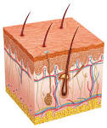
Skin anatomy
Epidermis: openings of glands
Papillary dermis: basal cell layer
Dermis : contains sweat & sebaceous glands

Slide 7
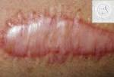

Slide 8
Scar
Fibrous tissue proliferation following :
. Trauma
. Surgery
. Infection
It is usually flat.

Slide 9
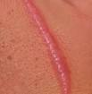
Hyper trophic scar
Excessive fibrous tissue in a scar
. confined to the scar
. no neovascularization
.wound infection is an important factor
.clinically it is a raised , non tender swelling with no itching
.it may regress gradually in six months
. does not usually recur after excision

Slide 10
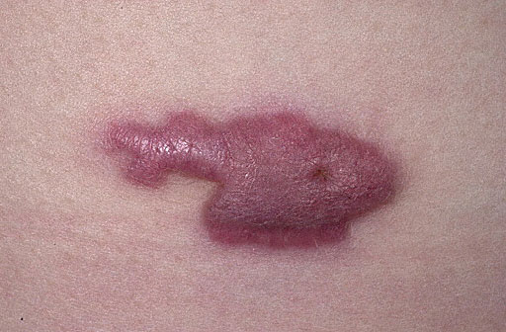
Keloid
Excessive fibrous and collagen tissue with neovascular proliferation in a scar.
usually extends beyond the original scar

Slide 11
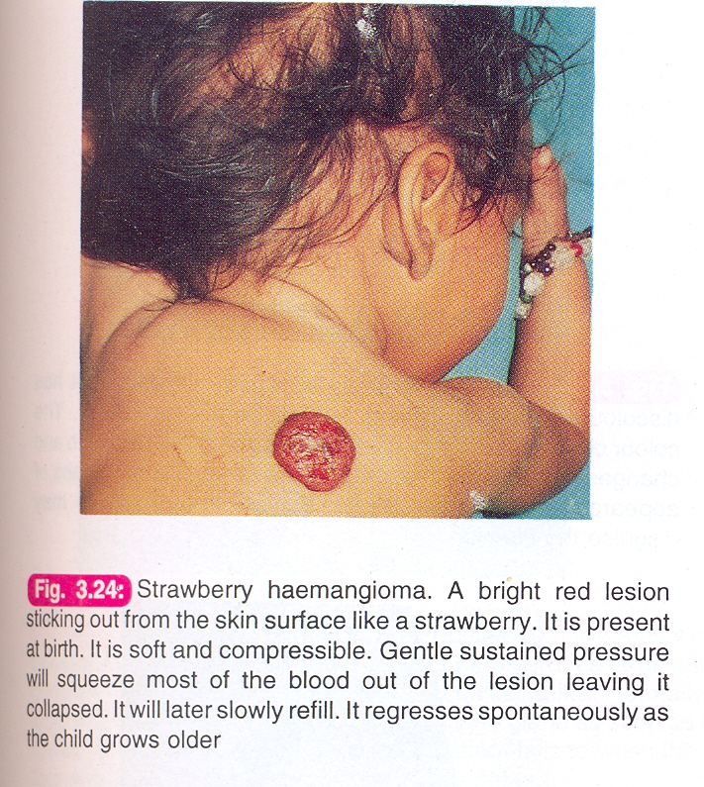
Haemangioma

Slide 12
Papilloma

Slide 13
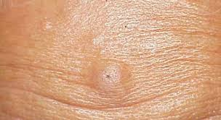
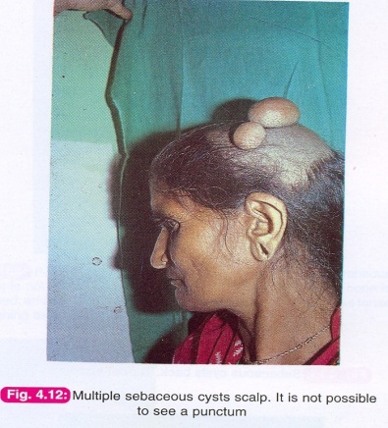
Sebaceous Cyst

Slide 14
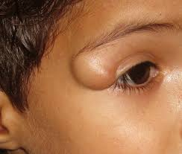
Dermoid
Clinical features:
Painless, spherical,cystic mass.
Appears in childhood or adults.
Smooth surface.
Not attached to skin
No punctum
Not compressible
Trans-illumination test - ve .

Slide 16
Lymphatic Malformation

Slide 17
Lymphatic Malformation

Slide 18
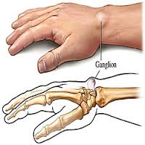
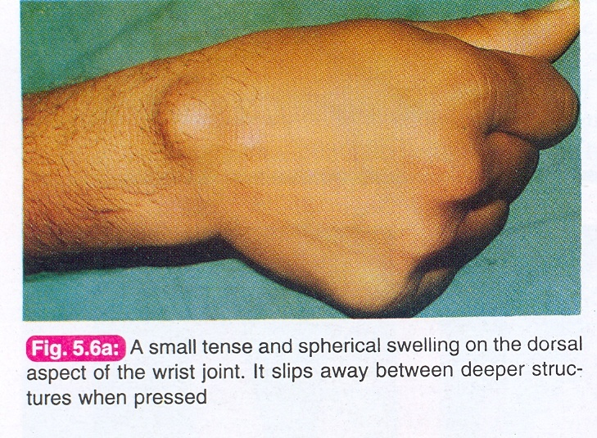
Ganglion

Slide 19
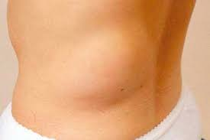
Lipoma

Slide 20
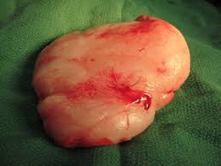
Lipoma

Slide 21
شكراً
Thank you

