Slide 1
COmmon Neck swellings
Dr Mohammad AlShehri, Can. Board, FACS, D Med Edu.
Professor of Surgery

Slide 2
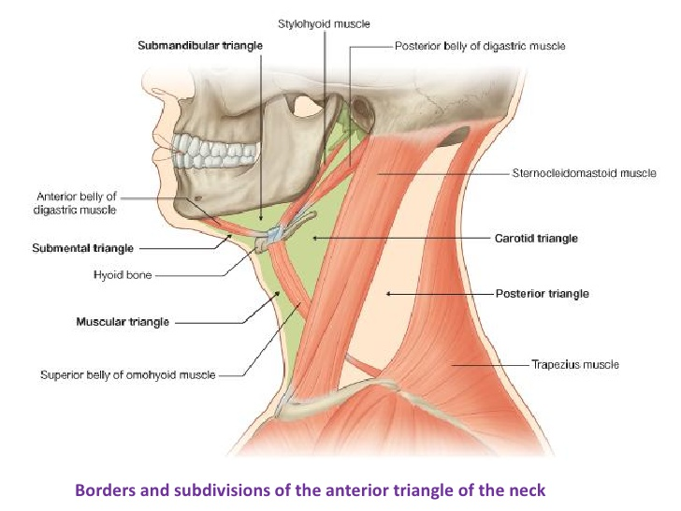

Slide 3
Common Neck Swellings
Thyroid
Lymph nodes
Thyroglossal Cyst
Parathyroid

Slide 4
Thyroid

Slide 5
Causes of Goiter
Thyroid cyst
Physiological goiter
Multinodular goiter
Inflammatory
Benign tumor
malignancy

Slide 6
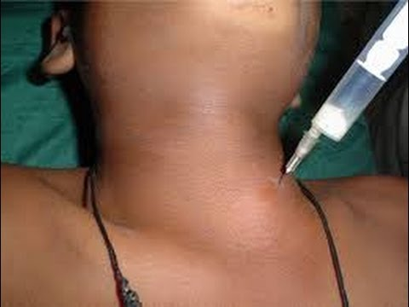
Thyroid cyst

Slide 7
Multinodular Goiter

Slide 8
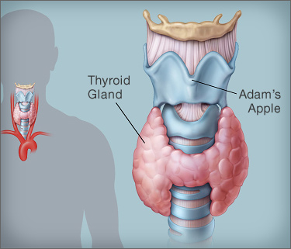
Inflammatory Thyroiditis
Commonest is Hashimoto’s Thyroiditis

Slide 9
Malignant tumors of the Thyroid

Slide 10
Characteristics
Painless enlarging nodule
Lymphadenopathy
Hoarseness of voice
Dysphagia
Function is usually normal

Slide 11
Thyroid Malignancy
85% | Papillary
10% | Follicular
< 5% | Lymphoma
 | Medullary
1% | Undifferentiated

Slide 12
Papillary Carcinoma
Commonest
Incidence is increasing
Exposure to radiation
Familial types
Painless nodule

Slide 13
Papillary Carcinoma
Young age
F : M 3:1
Spreads to lymphatics
Mets to lung & bone
Good prognosis

Slide 14
Follicular Carcinoma
Older patients than papillary
Mets by blood to lung & bone
Takes radio-nuclear iodine

Slide 15
Lymphoma
Approximately 1-5% of all thyroid malignancy
Risk increased in Hashimoto’s thyroiditis
Usually diagnosed by pathology
Treat as lymphoma any where

Slide 16
Medullary Carcinoma
From C-cells
25% heredetary
MEN 2 syndrome
Bad prognosis

Slide 17
Undifferentiated
Elderly patients
Locally invasive
Worst prognosis

Slide 18
Causes of a solitary thyroid nodule
Thyroid cyst
Dominant nodule in a multinodular goiter
Degeneration or hemorrhage into a colloid cyst or nodule
Benign tumor
malignancy

Slide 19
Investigations

Slide 20
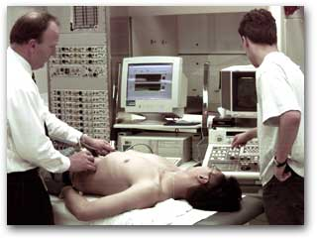
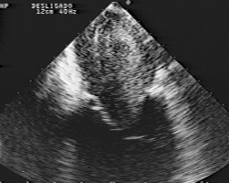

Slide 21
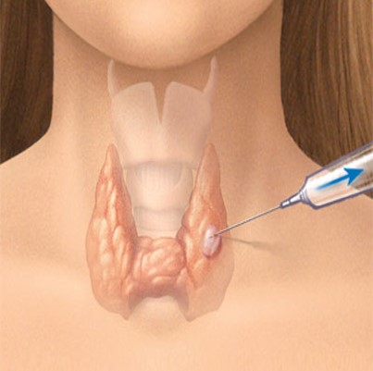
Fine Needle Aspiration (FNA)

Slide 23
Thyroglossal Cyst

Slide 24
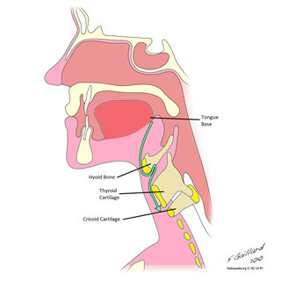

Slide 25
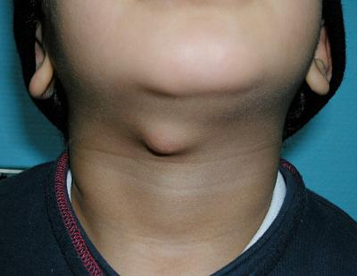

Slide 26
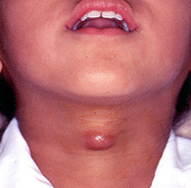

Slide 27
Lymphadenopathy

Slide 28
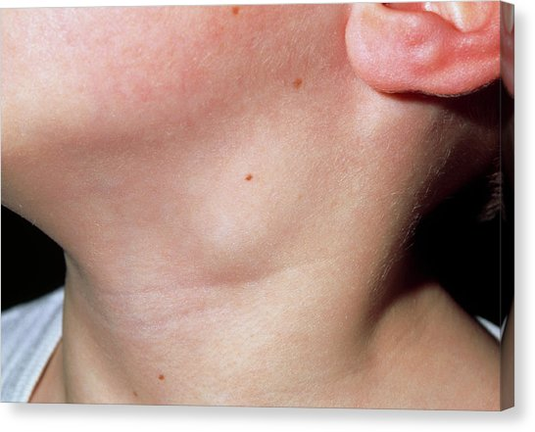
Lymph Node Swellings Inflammatory
Acute

Slide 29
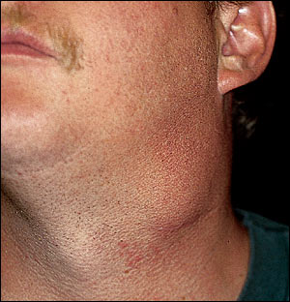
Lymph Node Swellings Inflammatory
Chronic

Slide 30
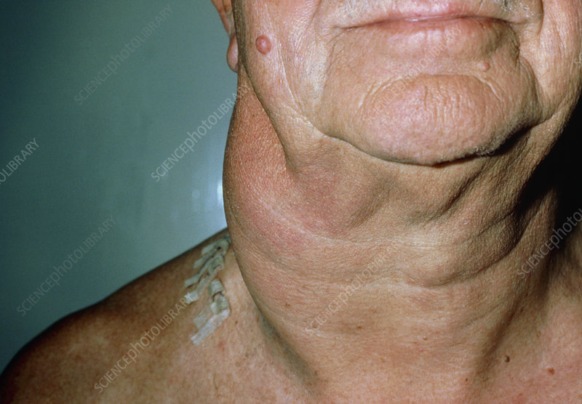
Lymph Node Swellings Neoplastic
Primary

Slide 31
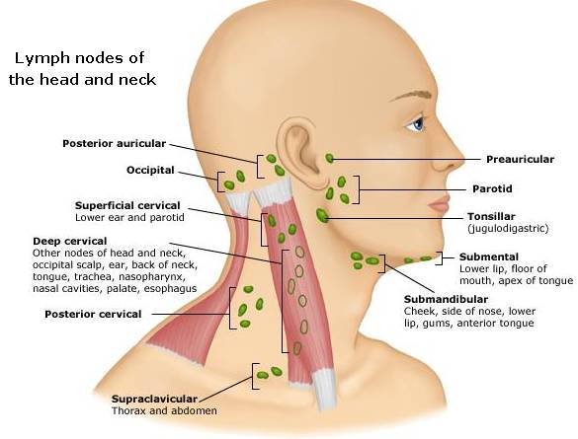
Lymph Node Swellings Neoplastic
Secondary

Slide 32
Primary Hyperparathyroidim

Slide 33
Statistics from Western countries indicate a 0.1-0.5% prevalence rate for PHP.
No evidence for geographical variation

Slide 34
Clinical presentation
In the west 60 - 70% detected by routine screening.
Many are asymptomatic

Slide 35
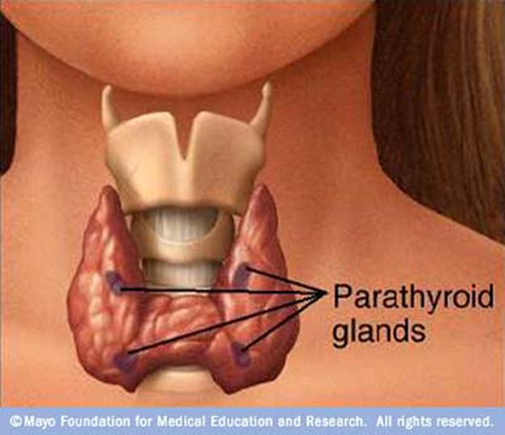
84% | Adenoma
15% | Hyperplasia
1% | Carcinoma

Slide 37
Clinical manifestations
Renal stones
Bone and joint pains
Abdominal groans
Psychic moans
Fatigue overtones

Slide 38
Investigations
Serum Calcium
PTH
Serum Phosphate
Chloride

Slide 39
Lateral Neck Swellings
Lymph nodes
Submandibular gland
Tail of parotid gland
Carotid body tumor
Lipoma.
Laryngocele

Slide 40
Lateral Neck Swellings
Pharyngeal diverticulum
Branchial cyst
Cystic hygroma
Sebaceous cyst
Hemangioma
Aneurysm
Others

Slide 41
Anterior Triangle Neck Swellings
Thyroid
Thyroglossal cyst
Lymph nodes
Lipoma
Dermoid cyst
Sebaceous cyst
Hemangioma
Aneurysm

Slide 43
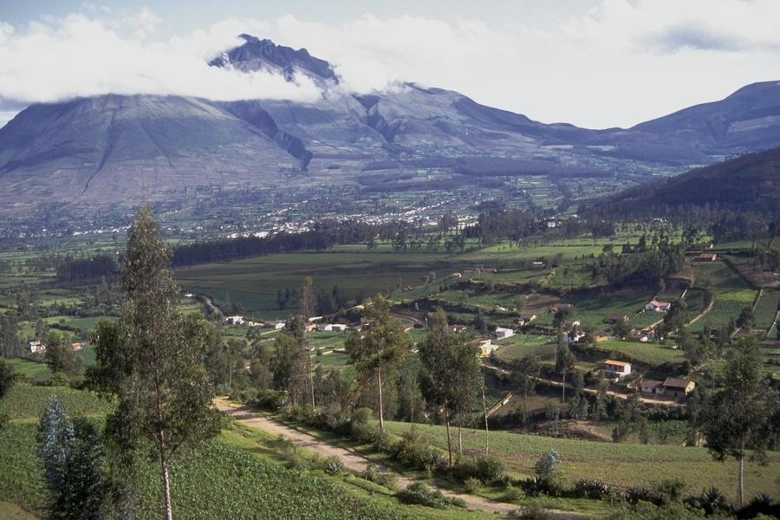
Than you
myshehri@ksu.edu.sa
@myshehri

