Slide 1
Chemicals exposure
Bader Alyahya

Slide 2
Simple asphyxiants Vs Pulmonary irritants
Two mechanistically distinct groups of xenobiotics are capable of interfering with gas exchange:
  Simple asphyxiants
  Pulmonary irritants

Slide 3
Simple asphyxiants
Generally speaking, have No pharmacological activity
displace oxygen from ambient air
Fio₂ < 21%
Decrease partial pressure of O₂
Asphyxiation requires high concentration in a closed space

Slide 4
Simple asphyxiants
Clinical features: mainly symptoms of hypoxia
Goldfrank’s handbook

Slide 5
Simple asphyxiants
Class | Gas | Effect, use
Noble gasses | Helium | SA
 | Neon | SA
 | Argon | SA
 | Xenon | SA, anesthetic properties
Short chain aliphatic hydrocarbon gases | Methane (CH4) | SA, natural gas (fuel)
 | Ethane (C2H6) | SA, natural gas (fuel), refrigerant
 | Propane (C3H8) | SA, fuel, solvent
 | Butane(C4H10) | SA, Fuel, solvent
Nitrogen | SA, nitrogen narcosis (similar to anesthetic gases)
Carbon dioxide | SA, but also causes systemic toxicity
SA: simple asphyxiant

Slide 6
Simple asphyxiants
Treatment:
  Immediate removal from exposure
  Ventilator assistance
  Supplemental oxygen
  Supportive care as needed

Slide 7
Pulmonary irritants
The irritant gases are a heterogeneous group of chemicals that produce toxic effects via a final common pathway: the destruction of the integrity of the mucosal barrier of the respiratory tract
Damage of Pneumocytes Inflammatory reaction
Acute lung injury (ALI) [cellular debris and plasma exudate in the alveolar sacs]

Slide 8
Pulmonary irritants
High water-solubility: Ammonia, Hydrogen fluoride, sulfur dioxide
  affect upper A/W (Oral, nasal, pharyngeal, conjunctival mucosa) and skin
  irritation within seconds
  Intermediate Water Solubility: Chlorine, Hydrogen sulfide (rotten eggs smell)
    Upper and lower respiratory symptoms
    Symptoms develop after several hours
    H₂S inhibits mitochondrial respiration (similar to cyanide)

Slide 9
Pulmonary irritants
Poor Water Solubility: phosgene (used in WWI), oxides of nitrogen, Ozone
  Delayed onset of symptoms
  Affect lower A/W more (although in large concentrations they produce significant upper A/W symptoms
Notes:
Phosgene: Exposure to phos- gene may initially produce limited manifestations but can result in acute muco- sal irritation following intense exposure. In fact, the pleasant odor of fresh hay, rather than prompting escape, may ironically promote deep and prolonged breathing of the toxic gas. Delayed-onset acute lung injury (ALI) follows.
Ozone: produced in significant quantities by welding and high-voltage electrical equipment and in more moderate doses by photocopying machines and laser printers. The pulmonary toxicity associated with ozone is primarily a result of its high reactivity toward unsaturated fatty acids and amino acids with sulfhydryl functional groups. Ozonation and free radical damage to the lipid component of the membrane initiates an inflamma- tory cascade, with resultant influx of inflammatory cells.

Slide 10
Pulmonary irritants
Management:
  A,B,C,D
  Protect the A/W
  Limit secretions
  Oxygen supplementation, bronchodilators
  ?Corticosteroids: may improve oxygenation, no specific benefit, small risk of harm
  PEEP, Prone ventilation, inverse ratio ventilation, low tidal volume (for ALI)
  Neutralization Therapy: nebulized 2% sodium bicarbonate may be beneficial in patients poisoned by acid-forming irritant gases

Slide 11
Pulmonary irritants
Management:
  Antioxidants: Ascorbic acid, NAC (negligible benefit)
  Perfluorocarbon Partial Liquid Ventilation: improve oxygenation and may have anti-inflammatory effect
  Exogenous Surfactant: no benefit in RCTs

Slide 12
Simple asphyxiants Vs Pulmonary irritants
Goldfrank’s 9th edition

Slide 13
Case 1
25 year-old healthy male. Presented to the ED with history of syncope, H/A, SOB, cough and dizziness.
2 of his brothers have similar symptoms
VS: HR=110 beat/min, RR=20, O2 sat= 100% in RA, temp= 37.0
ECG: sinus tachycardia, Glucose= normal

Slide 14
Carbon monoxide (CO)
The leading cause of poisoning morbidity and mortality in the United States
HGB has 200-250 times greater affinity to CO than O₂
Notes:
CO is primarily confined to the blood compartment. but eventually up to 15% of total CO body stores are taken up by tissue, primarily bound to myoglobin.

Slide 15
Sources of CO
Goldfrank’s 9th edition

Slide 16
Half-life of CO
Room air | 300 minutes (5H)
100 % O₂ | 60 minutes
HBO | 30 minutes

Slide 17
Pathophysiology
CO binds HGB rendering it incapable of delivering O₂ to the cells
  leftward shift of the oxyhemoglobin dissociation curve decreases offloading of O₂ to tissues (decrease 2,3-BPG)
Interferes with cellular respiration by binding to mitochondrial cytochrome oxidase
lipid peroxidation, particularly in the hippocampus and corpus striatum

Slide 18
CO poisoning
Goldfrank’s 9th edition
Notes:
Flu-like symptoms
More than one victim is classic

Slide 19
Investigations in CO poisoning
COHb level (Most useful)
ECG, monitor,
VBG, Lactate, CK, Troponin, BNP, +/- Echo
Neurologic exam and mini mental state exam
CT as needed

Slide 21
(CO poisoning)Treatment
Removal from site of exposure
ABCD
O₂ (100% ASAP) Mainstay of treatment
Supportive care ( IV fluid for hypotension, standard ACLS PRN)
HBO

Slide 22
(CO poisoning)Treatment
Goldfrank’s 9th edition

Slide 23
Notes:
RCT 76 pts. In each group.
Conclusions Three hyperbaric-oxygen treatments within a 24-hour period appeared to reduce the risk of cognitive sequelae 6 weeks and 12 months after acute carbon monoxide poisoning.

Slide 24
HBO for CO poisoning
Notes:
Authors’ conclusions
Existing randomized trials do not establish whether the administration of HBO to patients with carbon monoxide poisoning reduces the incidence of adverse neurologic outcomes. Additional research is needed to better define the role, if any, of HBO in the treatment of patients with carbon monoxide poisoning. This research question is ideally suited to a multi-center randomized controlled trial.

Slide 25
HBO for CO poisoning

Slide 26
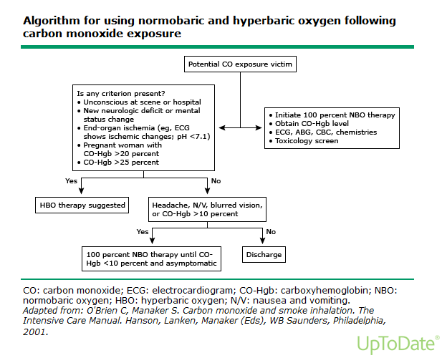

Slide 27
Case 2
30-year-old male. Brought to the ED by EMS following a fire incident at a plastic factory. The patient is unresponsive. His BP= 80/40, HR= 130, RR= 30, O2 Sat is 90% on non-rebreather mask.
He was intubated on arrival to the ED. Vital signs are unchanged.
No obvious skin burn, Chest: few scattered wheezes
CVS: S1+S2+ no added sounds. Abdomen: normal
Investigations: VBG: PH= 7.01, PCO2= 30, PO2=60,HCO3⁻ = 5, lactate = 15, CO= 10%

Slide 28
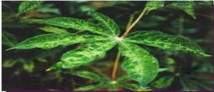
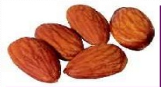

Cyanide

Slide 29
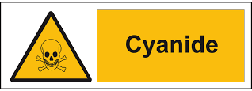
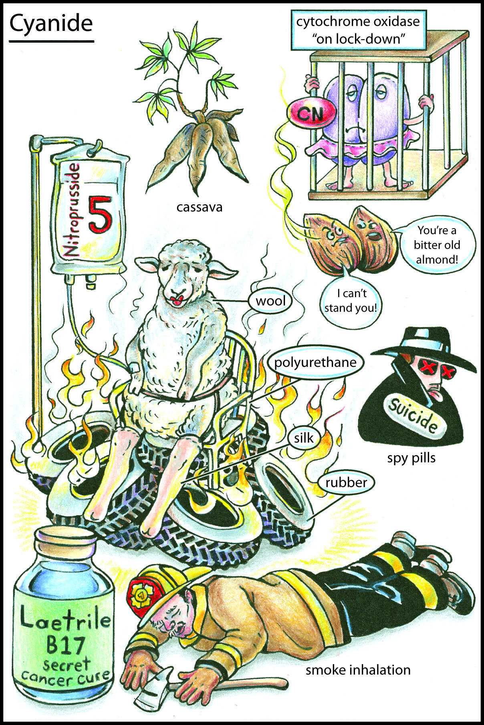
Cyanide exposure
Fire in closed space (plastic burn)
Chemistry labs
Plants (cassava, apricot seeds)
Iatrogenic (nitroprusside)
photographic industries
Jewelry manufacturing

Slide 30
Cyanide
Cyanide is an inhibitor of multiple enzymes, including succinic acid dehydrogenase, superoxide dismutase, carbonic anhydrase, and cytochrome oxidase

Slide 32
Cyanide
Clinical features:
CNS: altered level of consciousness, SZ, Anxiety, H/A, agitation
CVS: Hypotension, tachycardia, arrhythmia (may have transient HTN and tachycardia)
Respiratory: SOB, tachypnea, (later hypoventilation and pulmonary edema) Metabolic: lactic acidosis (classically lactate more than 10) (needs VBG with Carboxyhemoglobin)
[Unconscious, hypotensive, and high lactate]
Notes:
. Inhibition of oxidative metabolism by binding to complex IV of the electron transport chain within mitochondria occurs within seconds.
Hydrogen sulfide exerts its toxic effects both as a pulmonary irritant and as a cellular poison. Its deadly metabolic effects are produced by a mechanism identical to that for cyanide poisoning. However, hydrogen sulfide spontaneous dissociation from the mitochondrial cytochrome complex IV is rapid, allowing many patients to survive after brief exposure.

Slide 33
Cyanide treatment
ABCDE
Antidote: almost always empirical
  Hydroxocobalamin (5 g IV during 15 minutes for adults and 70 mg/kg IV for children, up to an adult dose)
  Cyanide + hydroxycobolamine = Cyanocobalamin
  cyanide antidote kit:
    Amyl nitrite
    Sodium nitrite
    Sodium thiosulfate
Supportive care

Slide 34
Cyanide kit

Slide 35
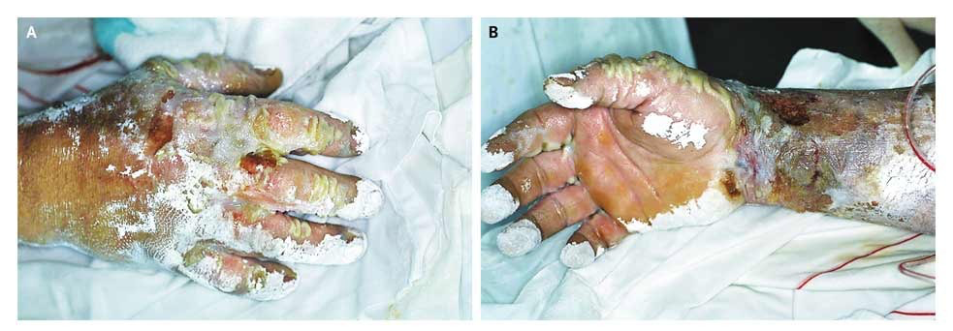
Hydrofluoric acid

Slide 36
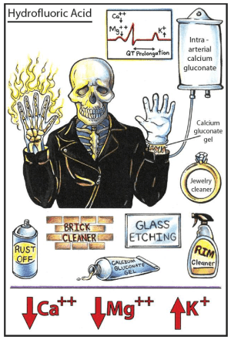

Slide 37
Chemical | Clinical manifestations | Treatment
Hydrofluoric acid (etching glass, removing rust, and cleaning cement and bricks) | Severe painful burn, decrease Ca+, Mg+, arrhythmia | irrigation with water at least 15-30 min, remove blisters, Calcium gluconate (2.5%) gel, SC Ca, IV /IA Ca, regional anesthesia
Formic acid (used in industry and agriculture) | coagulative necrosis, acidosis, hemolysis, and hemoglobinuria. | Copious wound lavage, sodium bicarbonate for PH<7.30, exchange transfusion, HD
Anhydrous ammonia (Fertilizers, manufacture of explosives, petroleum, plastics, and synthetic fibers), Meth dry cook | Can freeze any tissue, chemical burns by liquefaction necrosis | prompt irrigation of the eyes and skin with water and management of inhalation injury
Cement | three types of cement burns. The most common is a chemically abrasive form, heat-related or blast burns can occur | copious irrigation after all clothes have been removed. Early excision and grafting are often necessary
Notes:
mixing 3.5 g of calcium gluconate powder in 150 mL of a water-soluble lubricant (e.g., glycerin- hydroxyethyl cellulose lubricant [K-Y Jelly]).
0.5 mL/ cm2 of 10% calcium gluconate subcutaneously through a 27- or 30-gauge needle.
10 mL of solution of 10% calcium gluconate in 40 to 50 mL of normal saline infused over 4 hours.

Slide 38
Chemical | Clinical manifestations | Treatment
Phenol and derivatives (widely used in the agri- cultural, cosmetic, and medical fields) | Coagulative necrosis, stimulation, lethargy, seizures, or coma. Tachycardia/bradycardia | irrigated with large volumes of water delivered under low pressure. ACLS PRN
White Phosphorus (munitions manufacturing, in fireworks, methamphetamine production, fertilizers, rodenticide) | profound thermal injury, hypocalcemia and hyperphosphatemia, ECG changes Three stages: GI, latent, multi-organ failure | Copious water irrigation, decontamination, treatment of electrolyte disturbances, management of the skin burns is as with any other burn wound
Hydrocarbons (fuels, solvents, paints, paint and spot removers, dry cleaning solutions, lamp oil, rubber cement, lubricants) | aspiration (e.g., coughing, gagging, vomiting, wheezing, tachypnea, or hypoxia). Inhalation (headache, dizziness, nausea, or wheezing). Cardiac sensitization | Removal from exposure site. Supportive care ( O2, B-agonists)
Notes:
Red phosphorus can cause some gastrointestinal illness if consumed orally but is much better tolerated than white phosphorus that has been ingested.
After oral ingestion of white phosphorus, three stages of toxicity are described, although only rarely do all three stages occur. The rst stage is characterized by gastrointestinal tract irritation, including vomiting, abdominal pain, diarrhea, and gastrointesti- nal bleeding. The stool is occasionally described as being lumines- cent or “smoking.” Hypovolemic shock can result. As many as one third of patients who ingest signi cant quantities of white phosphorus will die during this stage. The rst stage can last 8 to 24 hours. The second stage, which lasts 1 to 3 days, is a latent phase in which symptoms appear to improve. However, the third stage is characterized by multisystem organ failure, including hepatic failure, renal failure, and CNS depression. Renal failure is usually present at days 1 to 4, whereas jaundice typically manifests at days 3 to 5.

Slide 39
Chemical | Clinical manifestations | Treatment
Nitrate and Nitrites | Symptoms depend on methemoglobin conc: 20%: headache, anxiety, dyspnea, and tachycardia 40-50%:Confusion, lethargy, and acidosis. 70%: SZ, hypotension, dysrhythmias and death | Supportive care, Methylene blue
Tar | Burn | Immediate cooling with cold water then removal in the ED using Solvents. Sunflower oil can be used. Antibiotic ointment if in cornea
Elemental metals (lithium, sodium, and potassium) | harmless unless they come in contact with water when violent exothermic reaction occurs | Use mineral oil if available before water. If using water use large amount to limit the reaction

Slide 40
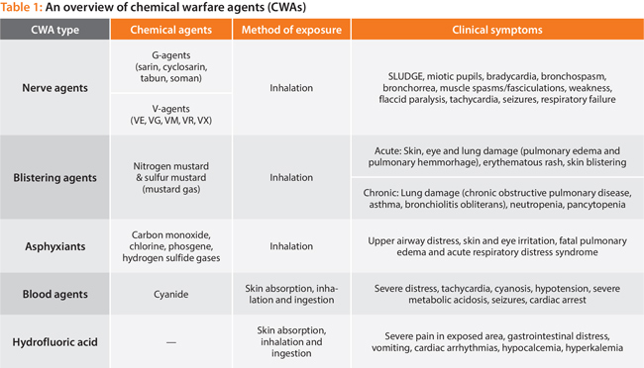

Slide 43
Thank you!
Questions?

