Slide 1
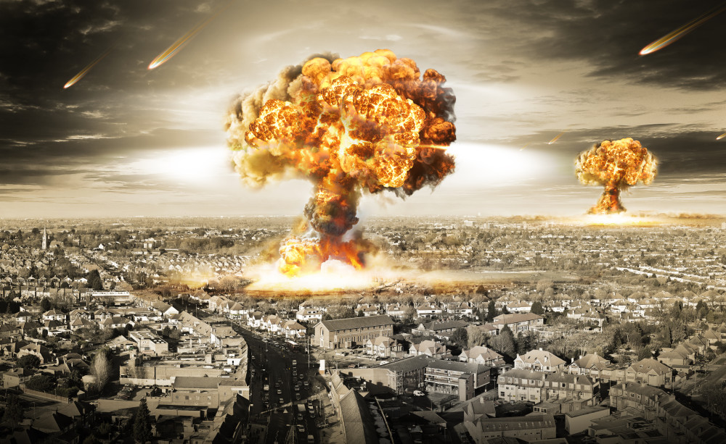
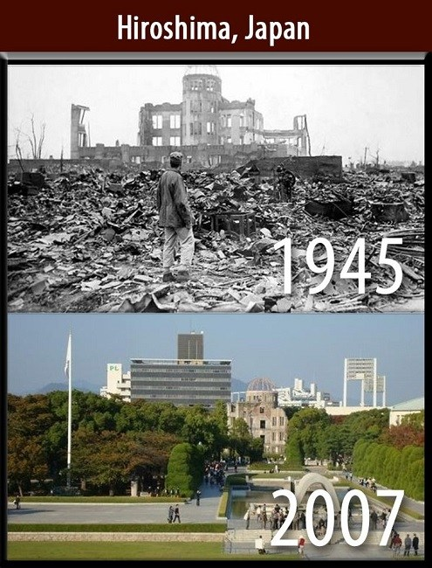
Radiation and Chemical Exposure
Bader Alyahya, MD
FRCPC(EM,CPT),ABEM

Slide 2
Historic radiation disasters
Goldfrank’s 9th edition

Slide 3
Radiation exposure
X-ray discovery 1895 (Wilhelm Roentgen)
1896 Corneal injuries during experiments on newly invented x-ray generator (Thomas Edison)
1917 opening of the Radium Luminous Materials Corporation in Orange, NJ. 1927, about 100 employees died from osteosarcoma of the jaw and brain tumors

Slide 4
Decay
Radioactive decay: Unstable nuclei decay or transform into more stable nuclei (daughters) via the emission of various particles or energy
5 mechanisms of radioactive decay:
Emission of γ rays
Emission of α particles
Emission of β particles
Emission of positrons
capture of an electron
These particles form ionizing radiation

Slide 6
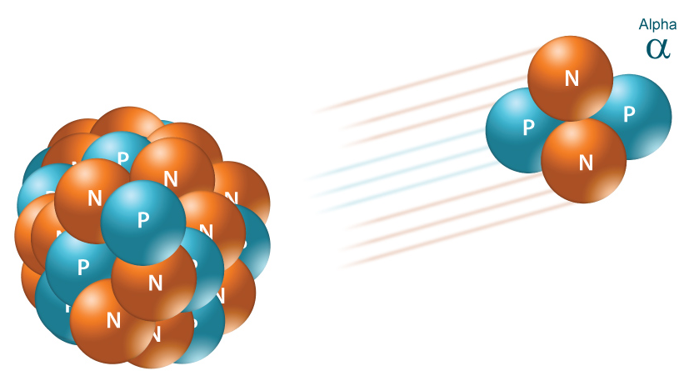
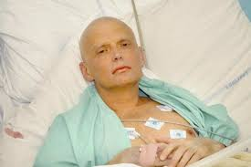
α -particles
Radioactive decay of an atom nucleus giving off 2 protons and 2 neutrons
Travel only few centimeters in air
Unable to penetrate the outer layer of dead skin
Causes serious damage when ingested (incorporated)
E.g. Polonium-210
Alexander Litvinenko
https://youtu.be/fKiwU5TbRI4

Slide 7
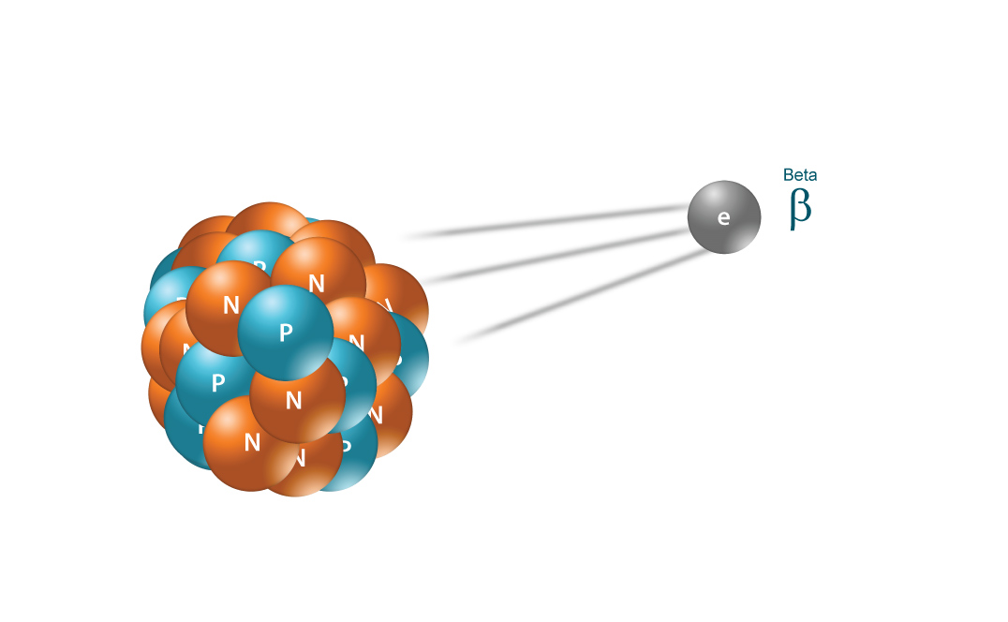
β-particles
Radioactive decay of an atom nucleus giving off an electron or a positron (positively charged electron)
Able to travel a few meters in air due to small size
Can be stooped by a piece of plastic or a stack of papers
Can penetrate the skin a few centimeters
Causes serious damage when ingested (incorporated)

Slide 8
Photons
Photons: massless particles that travel at the speed of light and mediate electromagnetic radiation. Depending on the energy of the particles, and, therefore, their wavelength, the radiation has different names
Radio waves: have the lowest energy and the longest wavelength
Microwaves: higher energy and shorter wavelength

Slide 9
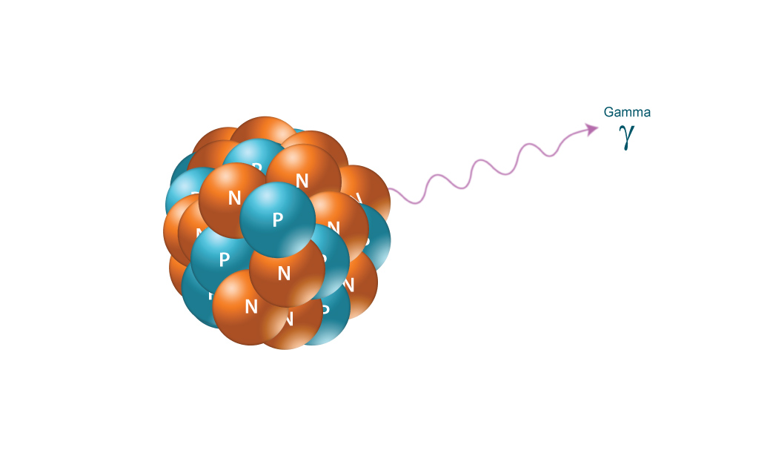
ϒ and X- Rays
γ Rays and x-rays are the same and are only distinguishable by their source
Emission of high-energy wave (photon of energy being emitted) Not a particle
Since it has no mass or charge, it can travel much farther than αor β particles
Can be stopped by thick material (lead is the most effective shield)

Slide 10
ϒ and X- Rays
an x-ray machine generates x-rays by accelerating electrons through a large voltage and colliding them into a heavy metal target

Slide 11
Half-life
Half-life (t_{1/2}): the period of time it takes for a radioisotope to lose half of its radioactivity

Slide 12
Ionizing VS nonionizing radiation
Ionizing radiation: any radiation with sufficient energy to disrupt an atom or molecule with which it impacts
nonionizing radiation: consists of relatively low-energy photons and is used safely in cell phone and television signal transmission, radar, microwaves, and magnetic fields that emanate from high-voltage electricity and metal detectors.

Slide 13
Ionizing VS nonionizing radiation
Rosen’s 8th edittion
Notes:
The electromagnetic spectrum (Fig. 146-2) encompasses a range from microwaves to gamma rays; it includes long-wavelength, low-frequency, low-energy forms of nonionizing radiation and progresses to short-wavelength, high-frequency, high-energy forms of ionizing radiation.

Slide 14
Stochastic versus deterministic effects
stochastic effect : Injuries that do not require a threshold limit to be exceeded
E.g: mutagenic and carcinogenic changes to indi- vidual cells where DNA is ultimate target
Deterministic effect: require a threshold limit to be exceeded. large number of cells of an organ sys- tem must be killed before an effect becomes clinically evident

Slide 15
Irradiation, contamination, and incorporation
Notes:
An object that is irradiated is exposed to ionizing radiation.
Contamination occurs when a radioactive substance covers an object completely or in part.
Incorporation occurs when a radionuclide is incorporated into a patient’s body tissue.

Slide 16
Definitions
Amount of Radioactivity
Amount of radiation emitted
Amount absorbed by tissue
Degree of damage
Goldfrank’s 9th edition
Notes:
FIGURE 133–1. The definitions associated with radiation. Both curie and bequerel describe a quantity of radionuclide in terms of the number of disintegrations rather than mass. Roentgens describes the amount of air ionized by either gamma (γ) or x-rays, which indirectly quantifies the amount of radiation in the air around a source. Rad and gray (Gy) describe the fraction of radiation that actually interacts with cellular material and potentially causes injury. Roentgen equivalent man (Rem) and sievert (Sv) calculate the effective dose taking into account the different particles. For example, a 100 keV alpha (α) particle causes more damage to cellular material than a 100 keV beta (β) particle.

Slide 17
Management
Decontamination
ABCDE
Treat nausea and vomiting
Treat pain (APAP, or opioid)
Serial CBC (biodosimetry)
Electrolytes, Renal and hepatic function
Specific therapy

Slide 18
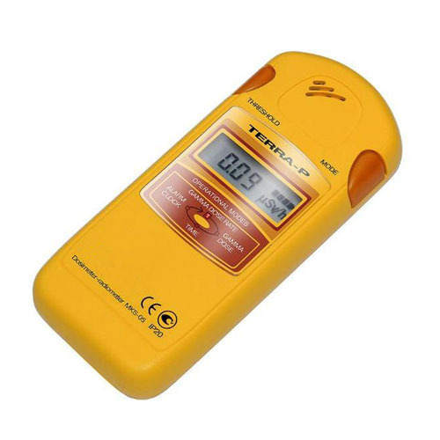
Decontamination
Remove all clothing
Wash thoroughly with soap and water
remove up to 95% of radioactive material
Carefully scrub open wounds: to minimize the risk of internal contamination
Use a portable dosimeter
Collect all clothing and liquid used for decontamination and mark as RADIOACTIVE WASTE

Slide 19
Decontamination

Slide 20
Dosimeter

Slide 21
Goldfrank’s 9th edition

Slide 22
Rosen’s 8th edittion

Slide 23
Acute radiation syndrome

Slide 24
Specific therapy
colony- stimulating factor (3 Gy or greater, 2 Gy if <12 or > 60.
Probiotics
Ca-DTPA and Zn-DTPA (decontamination of plutonium, americium, curium, and soluble uranium salts
Prussian blue (thallium)
KI ( ¹³¹I)

Slide 25
Radiation and pregnancy
Three principal risks to a fetus following radiation exposure:
Congenital abnormalities
Mental retardation
Later Development of neoplasm

Slide 26
Radiation and pregnancy
Early on (0-2 weeks): risk of fatality
3-7 weeks: congenital anomalies and mental retardation
8-25 weeks: mental retardation
The risk generally reduces at the 16th week.
However, the vast majority of routine diagnostic im- aging procedures impart less than 0.05 Sv to the fetus and so are considered a negligible risk

Slide 27
Rosen’s 8th edittion

Slide 28
Thank you!
Questions?

