Slide 1
Antidepressant Overdose!
Aref Melibary MD, FRCPC, DABEM
Assistant Professor of Emergency Medicine
Consultant Emergency Medicine & Critical Care Medicine
Dept. of Emergency Medicine
King Saud University Medical City
dr_aref@hotmail.com

Slide 2
What’s Available?
MAOI’s
TCA
SSRI
SNRI

Slide 3
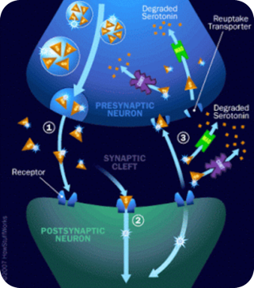
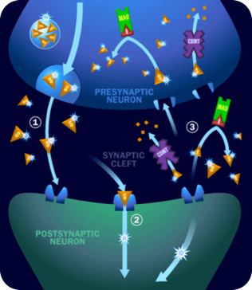
Monoamine Oxidase Inhibitors (MAOIs)
Bind irreversibly to monoamine oxidase thereby preventing inactivation of biogenic amines such as norepinephrine, dopamine and serotonin leading to increased synaptic levels.

Slide 4
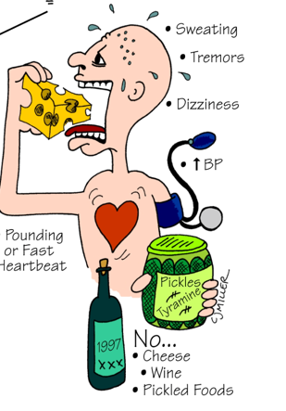
What Happens in MAOI Toxicity?

Slide 5
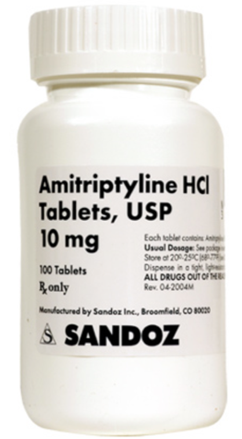
TCA’s

Slide 6
How many different MOA do TCA’s have?
3
4
5
6
7

Slide 7
How many different MOA do TCA’s have?
3
4
5
6
7

Slide 8
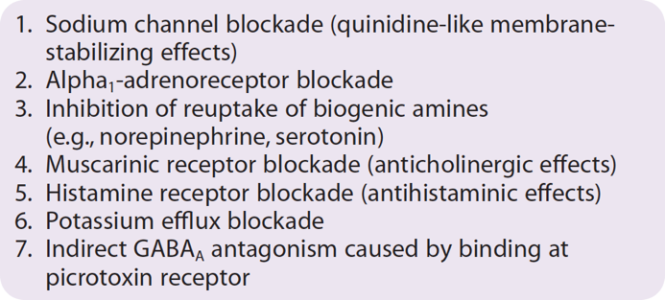
TCA’s
Major Pharmacodynamic Effects

Slide 9
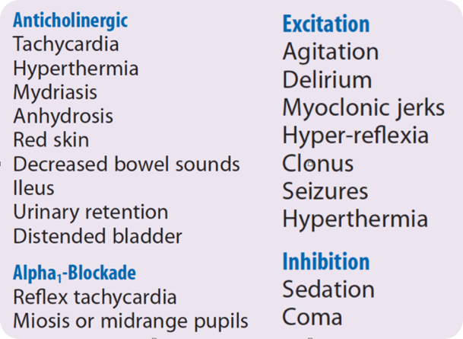
Peripheral & Central Effects of TCA’S

Slide 10
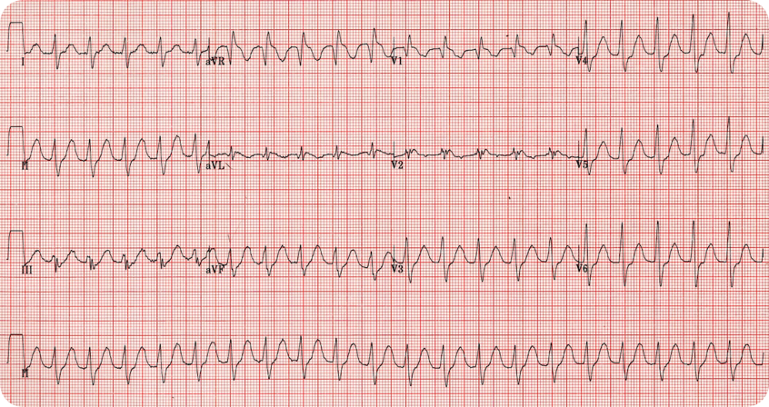
WHAT’S ABNORMAL?

Slide 11
Sinus Tachycardia
Prolonged QT Interval
Widening of the QRS interval
RAD
Prominent R in aVR

Slide 12
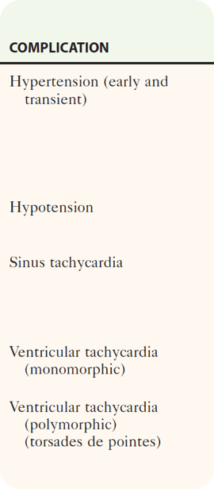

Slide 13
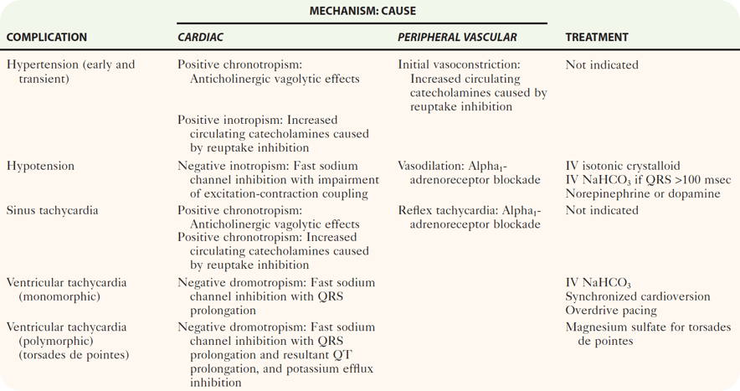

Slide 14
Specific Management
Plasma Alkalinization (NaHCO3/ Hyperventilation)
Sodium Load (NaHCO3 or 3% Saline)

Slide 15
Plasma Alkalinization
Promotes TCA protein binding
Plasma proteins act as a sink that sequesters TCA’s away from the sites of toxicity
Increases the non-ionized form of the drug which UNBINDS TCA’s from Na-Channels

Slide 16
Sodium Load
Leads to over-riding Na-Channel Blockade due to an increased Na concentration gradient across the cell membrane

Slide 17
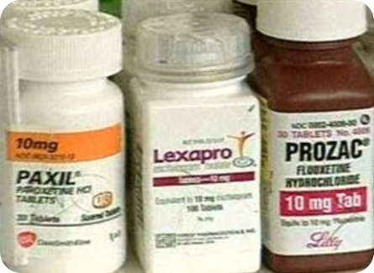
SSRI’s

Slide 18
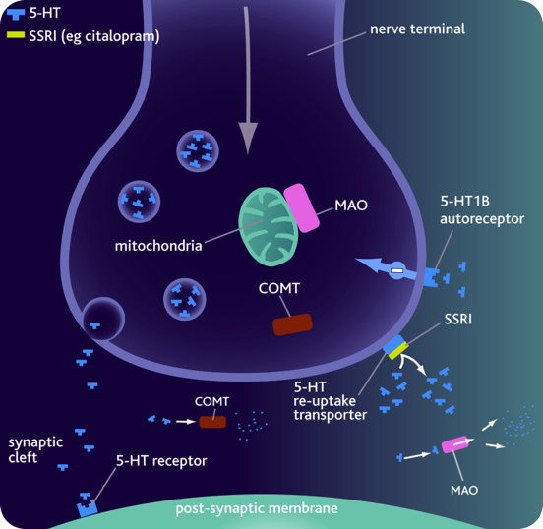

Slide 19
Simple Facts
Mainstay for treatment of depression
SSRIs have a wide therapeutic index
Although they are safer in overdose than MAOIs and TCAs, they do have therapeutic limitations, such as the long delay until onset of antidepressant effect (variable)
Rarely fatal, with ingestions of up to 30 times the daily dose associated with few or no symptoms

Slide 20
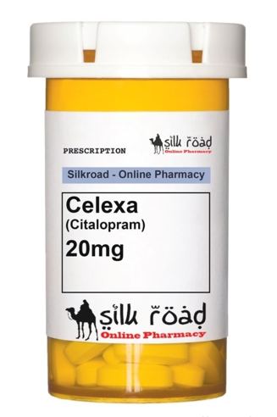
QTc prolongation
Seizures

Slide 21
Remember
SSRIs may be associated with SIADH at therapeutic doses
Most cases of hyponatremia develop within 1 month and frequently within the first 2 weeks

Slide 22
Diagnostic Strategies and Management?
NON SPECIFIC!!

Slide 23
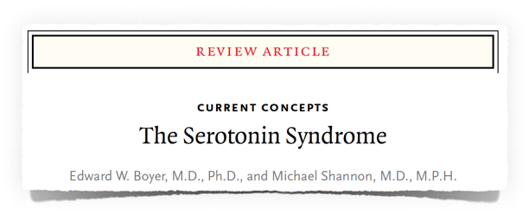
Serotonin Syndrome

Slide 24
Simple Facts
Potentially lethal condition
Excess serotonin accumulation in the synaptic cleft
Likely to develop when drugs from different classes are combined, e.g.increased release and impaired uptake
Syndrome occurs in approximately 14 to16 % of persons who overdose on SSRIs

Slide 25
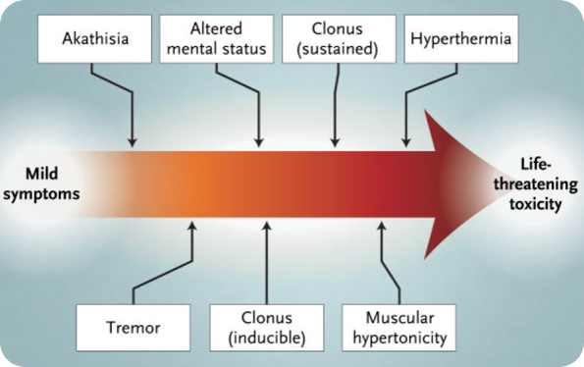
Clinical Features

Slide 26
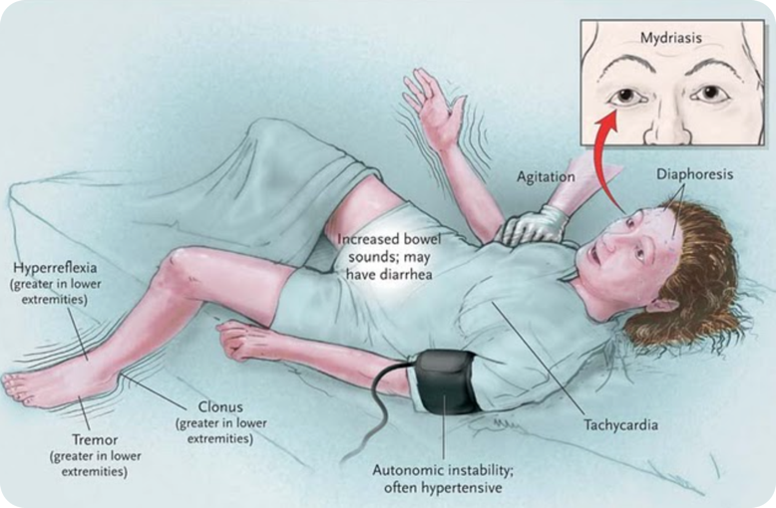

Slide 27
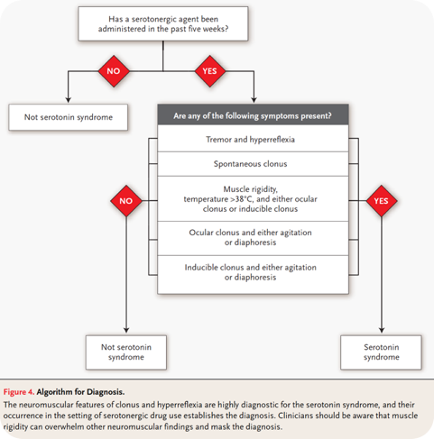
Management

Slide 28
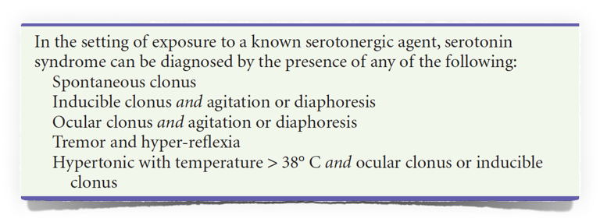
Hunter’s Criteria

Slide 29
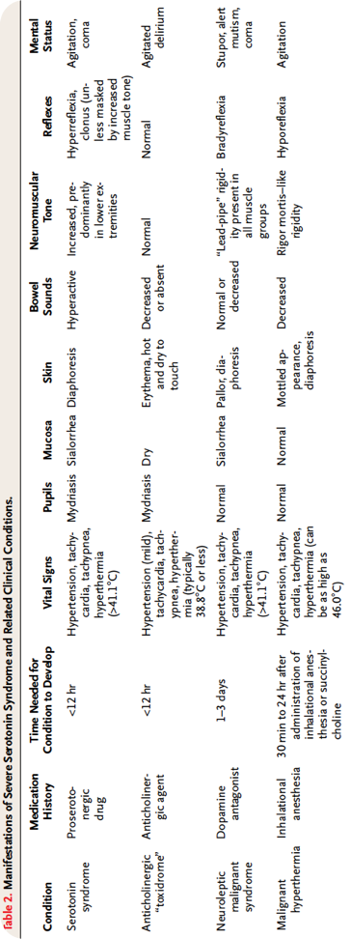
Differential consideration for Serotonin Syndrome

Slide 30
Management
Discontinue the offending agent
Supportive
Cyproheptadine (Serotonin Antagonist)

Slide 31
Discontinuation Syndrome
Rarely life-threatening
Can result in significant discomfort
Typically starts within 3 days after therapy is stopped

Slide 32
Signs & Symptoms
6 Categories
Disequilibrium (dizziness, ataxia)
Sleep disturbances
Gastrointestinal symptoms
Affective symptoms (irritability, anxiety)
Sensory symptoms (electric shock–like sensation, paresthesias)
General somatic symptoms (H/A, tremor, anorexia, diaphoresis)

Slide 33
QUESTIONS?
dr_aref@hotmail.com

