Slide 1
Scientific integrity and Plagiarism

Slide 2
قوله تعالى: } وَيْلٌ لِلْمُطَفِّفِينْ . الّذِينَ إِذَا اكْتَالُوا عَلَى النَّاسِ يَسْتَوْفُون . وَإِذَا كَالُوهُمْ أَو وَّزَنُوهُمْ يُخْسِرُونَ {

Slide 3
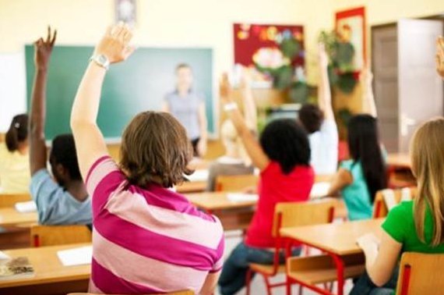
The session will be interactive inshallah

Slide 4
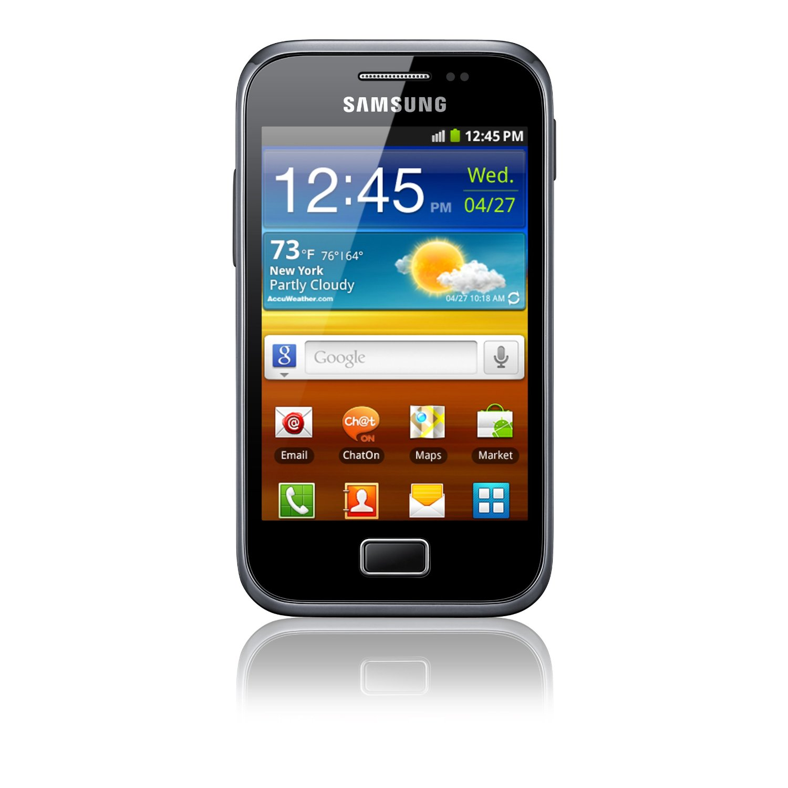

Slide 5
Goals and objectives
To demonstrate in example how to use (quote) others work in an ethical way method(s).
to describe how role models can influence
To explain the Islam and west opinion on plagiarism.

Slide 6
Evaluation sheet
Advantages
Points for improvement

Slide 7
“Rather fail with honor than succeed by fraud.”
Sophocles
“Four plays: Ajax; The women of Trachis; Electra; Philoctetes” (1966) :http://www.quoteyard.com/rather-fail-with-honor-than-succeed-by-fraud/

Slide 8
Background
Misconduct in science is an old problem.
In the last few years it has raised discussions about causes and effects
Science has grown tremendously and the challenges are quite different from the past.
Teaching scientific integrity and research ethics. Forensic Science International,Volume 113, Issues 1–3, 2000, 511–514

Slide 9
Common Forms of Plagiarism
Copying
Collusion
Inappropriate paraphrasing
Relying too much on other people’s material
Inappropriate citation
Self-plagiarising

Slide 10
Current trends
The practice of plagiarism is mainly due to the rapid advancement in information technology. (Hansen, 2003, Introna et al, 2003).
Other reasons or justifications for plagiarizing:
- Pressure to meet deadlines
-Poor skills in writing especially for English as Second Language
A Different Perspective on Plagiarism. The Internet TESL Journal :http://iteslj.org/Articles/Yusof-Plagiarism.html
A Different Perspective on Plagiarism Dahlia Syahrani Yusof Multimedia University (Cyberjaya, Malaysia)

Slide 11
Historical Overview
Plagiarism became the accepted norm sometime in the 1890s (Hansen, 2003).
A Different Perspective on Plagiarism. The Internet TESL Journal :http://iteslj.org/Articles/Yusof-Plagiarism.html

Slide 12
Defining scientific integrity

Slide 13
What is Scientific Integrity?
Scientific integrity has been characterized as a commitment to truthfulness, to personal accountability, and to vigorous adherence to standards of professional conduct (eg accuracy, transparency, fairness)
Scientific integrity, fidelity and conflicts of interest in research.
TD Warner, LW Roberts - Current opinion in psychiatry, 2004

Slide 14
What is scientific integrity? Cont….
A quality of individual scientists (and their reasoning)
Or the maintenance of the proper roles for values in science
Values: are broad beliefs about what is appropriate behavior
Scientific Integrity: From Theory to Practice. Heather Douglas, University of Waterloo,
February 20, 2012, AAAS Meeting Vancouver BC

Slide 15
What violates scientific integrity?
Fabrication (making up results )
Falsification of evidence (manipulation)
Ignoring evidence in preference for one’s values
Cherry-picking evidence or suppressing evidence, the incomplete evidence
Deceptive research that has no possibility for real discovery
Scientific Integrity: From Theory to Practice. Heather Douglas, University of Waterloo,
February 20, 2012, AAAS Meeting Vancouver BC

Slide 16
Scientific and Scholarly Misconduct
Fabrication, falsification, plagiarism, or other practices that seriously deviate from those that are commonly accepted within the scientific community for proposing, conducting, or reporting research.
US Public Health Service (USPHS) 1989

Slide 17
Plagiarism- Kidnapper

Slide 18
Plagiarism: What is it?
Brainstorm few examples of plagiarism

Slide 19
البحث يبدأ بفكرة
أستاذ مساعد في ِكلية الطب..جاء بفكرة بحث على الأطفال المصابين بالربو واستأذن الاستشاريين لإجراء البحث على مرضاهم ووافقوا
وبعد مدة وجد أن أحد الاساتذة المشاركين بدأ بتنفيذ نفس الفكرة على المرضى دون التواصل مع أحد!!!

Slide 20
حصل الطبيب (غ) على منحة مالية من شركة أدوية لإجراء بحث على دواء جديد ستنتجه الشركة،ووعد بمكافأة مالية كبيرة
قام الطبيب بإجراء البحث على مجموعة محدودة من المرضى(22 مريضا) ثم توقف ، نظرا لقلة عدد المرضى ولأن ذلك سيأخذ وقتا طويلا. وبعد مدة سلم نتائج البحث للشركة لتقوم بنشرها
حيث سجل نتائج لعدد 203 مرضى.

Slide 21
شيء لم يسبق إليه يخترعه
شيء ناقص يتمه
شيء مستغلق يشرحه
شيء طويل يختصره
شيء مختلط يرتبه
شيء أخطأ فيه مصنفه يبينه
شيء مفرق يجمعه
From Professor Jamal Jarralah

Slide 22
مر صلى الله عليه وسلم على صُبرة طعام فأدخل يده فيها فنالت أصابعه بللاً. فقال: « ما هذا يا صاحب الطعام؟ » قال: أصابته السماء يا رسول الله. قال: « أفلا جعلته فوق الطعام كي يراه الناس؟ من غش فليس مني » وفي رواية « من غشنا فليس منا » وفي رواية « ليس منا من غشنا » [رواه مسلم].
حذّر النبي صلى الله عليه وسلم من الغش وتوعّد فاعله

Slide 23
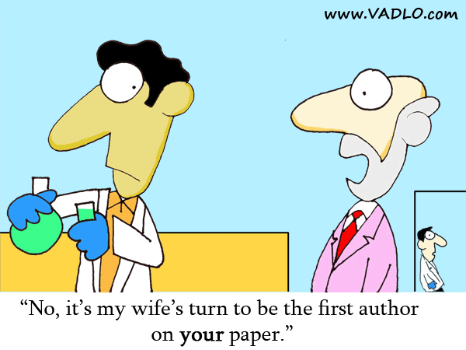
From Professor Jamal Jarralah

Slide 24
What is plagiarism?
Plagiarism is taking the ideas or words of others and passing them off as your own.
Plagiarism is a type of intellectual theft.
Plagiarism can take many forms:
-deliberate cheating
-accidentally copying from a source without acknowledgement
Plagiarism & Academic Integrity:https://student.unsw.edu.au/plagiarism

Slide 25
Plagiarism is unethical for three reasons.
It is a form of theft.
It is unethical because the plagiarizer subsequently benefits from this theft.
A degree is evidence of its holder’s abilities and knowledge.

Slide 26
The best way to avoid plagiarism is to:
Know what it is
Develop the skills to write well and consequently avoid doing it.

Slide 27
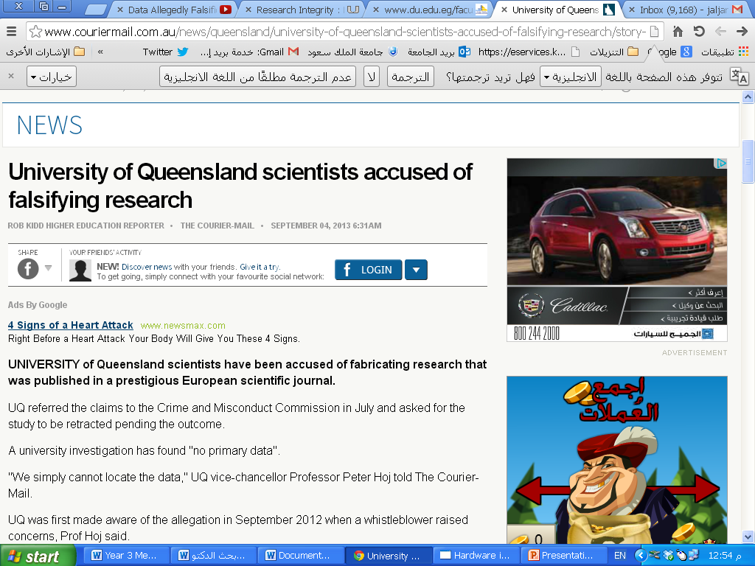

Slide 28
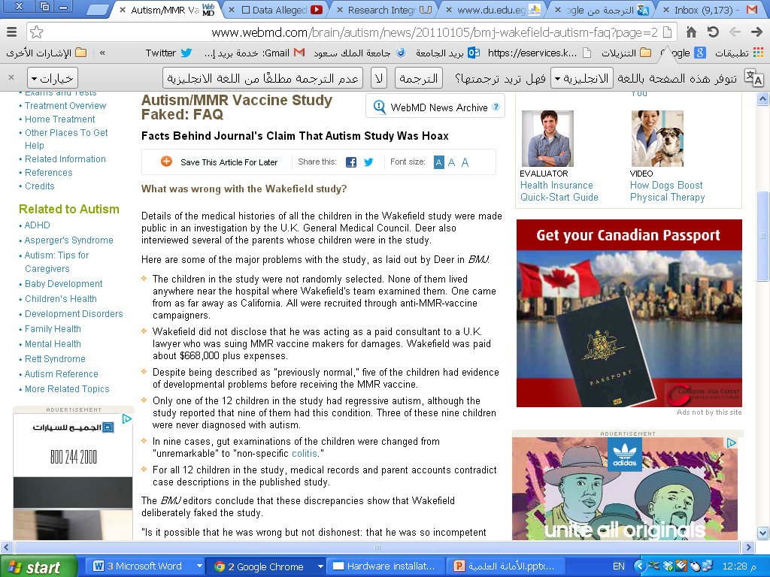

Slide 29
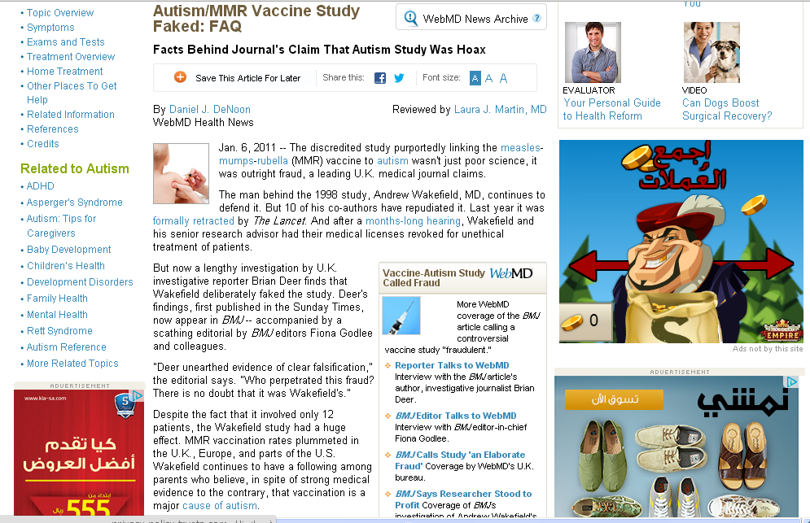
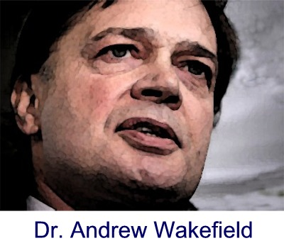

Slide 30
Small group exercise

Slide 31
In June 2015, Dansinger and colleagues from Tufts University, submitted a manuscript to Annals titled “One-Year Effectiveness of the Atkins, Zone, Weight Watchers…: After external peer review, it was decided not to publish the manuscript in July 2015. In August 2016, Dansinger contacted Annals, when he became aware of an article published in the EXCLI Journal on 23 February 2016 that was almost identical to the manuscript that he and his colleagues had submitted to Annals.

Slide 32
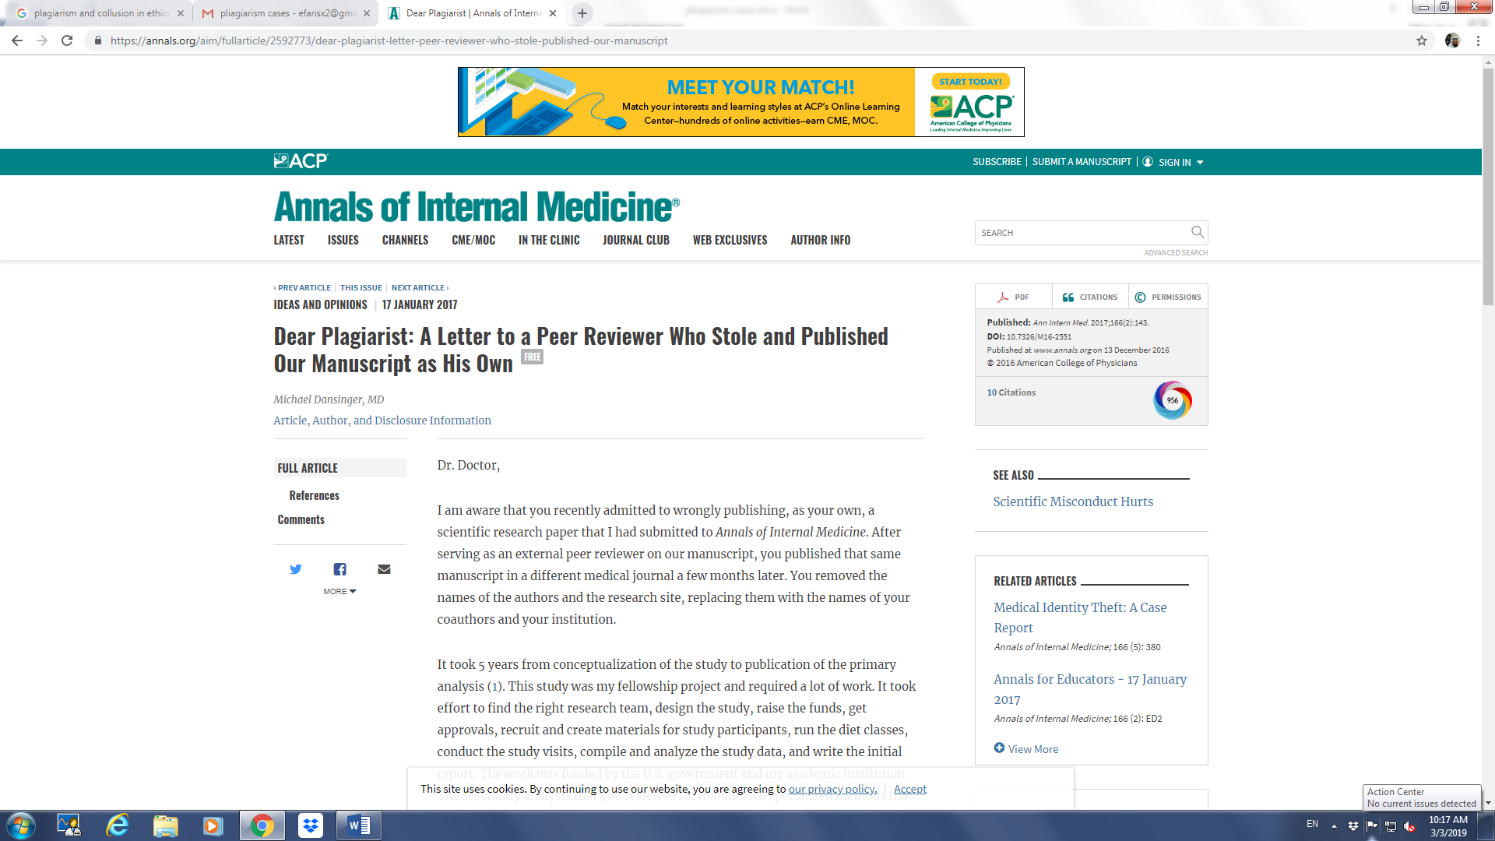

Slide 33
His concern was that an Annals reviewer plagiarized the work, and published it in the EXCLI Journal. The Annals determined that an author of the article in the EXCLI Journal was, in fact, someone who had reviewed the manuscript for Annals. When I contacted that person, he admitted to plagiarism.

Slide 34
How would you feel if you were the victim? The journal editor?
How would you feel if you were (Allah forbid) The plagiarist?
What actions would the journal editor would conduct?

Slide 35
Exercise
Original
The complexity of the current global economy has to do with certain fundamental disjunctures between economy, culture and politics which we have barely begun to theories.

Slide 36
Which one is Plagiarized and which is Acceptable?
The complexity of the current global economy has to do with certain fundamental disjuncture between economy, culture and politics which we have barely begun to theorize.
"The complexity of the current global economy has to do with certain fundamental disjuncture between economy, culture and politics which we have barely begun to theorize" (Appadurai 1999, p. 221).

Slide 37
What makes it acceptable?
The use of quotation marks to indicate borrowed material
Correct in-text citation
The material between quotation marks is exactly the same as the original

Slide 38
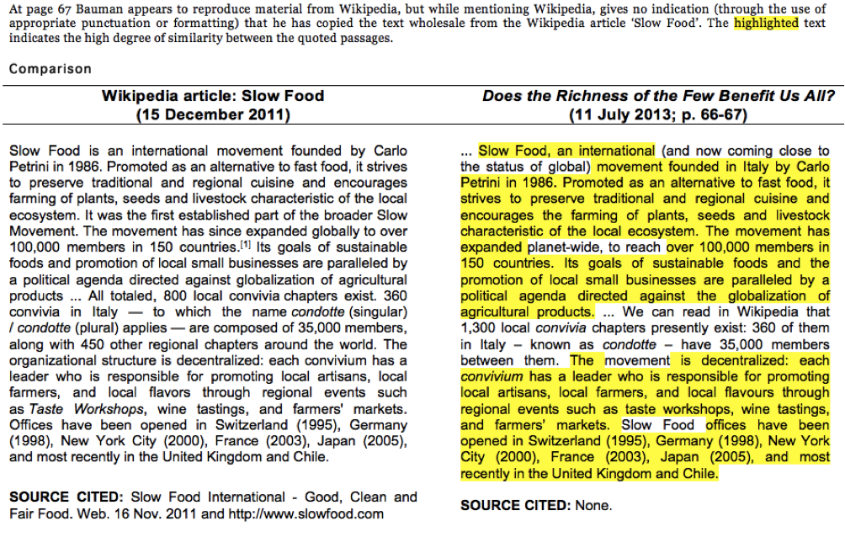

Slide 39
Read through both pieces of text and make your choice whether these examples an instance of plagiarism?

Slide 41
The student has quoted directly from the source but has not indicated the quoted passage. Neither is a citation provided within the text to link the quoted material to the bibliography

Slide 43
This is not plagiarism. The student has quoted verbatim from the source, enclosing the quoted text within quotation marks. A citation is provided within the text allowing the reader to link the information to the source provided in the bibliography.

Slide 44
Relying Too Much on Other People's Material Relying too much on other people's material; that is, repeated use of long quotations (even with quotation marks and with proper acknowledgement).
Unacceptable
Australia's national identity "has always been contested" (Wignam, 1994:38). However, some images of Australianness 'have proliferated more widely than others' (Taylor, 2000:179). The most prominent and "resilient of national types has been the bushman" (Zatakis, 1977:66).

Slide 45
Why is it unacceptable?
The paragraph’s every sentence has been taken directly from another source.
The writer has not included his or her own idea or words.

Slide 46
Evaluation sheet
Advantages
Points for improvement

Slide 47
Conclusion
Plagiarism is unfortunately a common phenomenon.
Most of the incidences are not intentional but still this excuse is no more acceptable.
Avoid grey areas
We need to learn
If in doubt please ask

Slide 50
Quiz After few slides
Please answer the following ten Qs in a separate page before looking at the answers in the last slide

Slide 51
Islamic perspective
Allah says: "Allah commands you to render trusts to their owners, and when you judge between people, that you do so with justice. Excellent indeed is the admonition He gives you, for Allah hears and sees all things." [Sûrah al-Nisâ': 58]
http://en.islamtoday.net/artshow-264-3417.htm

Slide 52
The Prophet (peace be upon him) said: "He who credits himself with what was not given to him is like one who wears a double cloak of deception." [Ibn `Abd al-Barr, Jâmi` al-Tahsîl (1/98)]
http://en.islamtoday.net/artshow-264-3417.htm

Slide 53
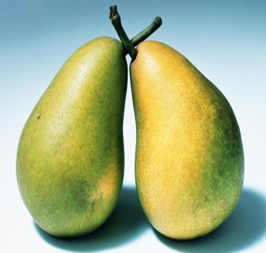
أرسل اللدكتور (ف) ورقة علمية للنشر في مجلة علمية عن بحث لم يقم به عل الإطلاق وإنما قام بوضع نتائج وأرقام من عنده.
From Professor Jamal Jarralah

Slide 54
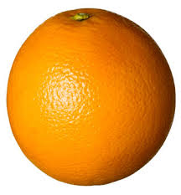
قام البروفيسور (ك) بإجراء تجربة سريرية على المرضى لدواء جديد غير معروف الفعالية.
المرضى لم يكونوا على علم بأن الدواء جديد وأنهم مشمولين في تجربة سريرية
From Professor Jamal Jarralah

Slide 55
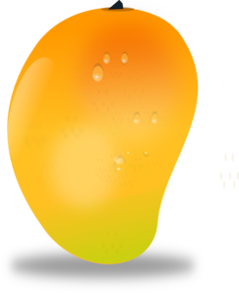
مجموعة من الطلاب يقومون بإجراء بحث يتطلب مقابلة المرضى. أحد الطلاب
قام بتعبئة الاستبانات بنفسه دون مقابلة المرضى
From Professor Jamal Jarralah

Slide 56
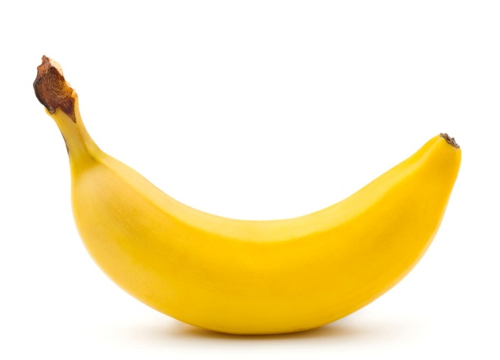
قام مجموعة من الأطباء بالتشارك في بحث على أن ينشربأسمائهم جميعا وفوجئوا بعد فترة بأن الباحث الرئيس نشر البحث باسمه هو فقط وقدم لزملائه الشكر في نهاية الورقة العلمية
From Professor Jamal Jarralah

Slide 57
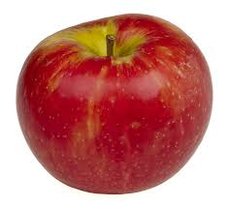
كلف مجموعة من الطلاب بإجراء بحث وعند تقييم البحث وجد أنهم نقلوا حرفيا بحثا سابقا تم إجراؤه من قبل زملاء لهم في السنة الماضية
From Professor Jamal Jarralah

Slide 58
How plagiarism happens?
Most students who plagiarise do so unintentionally
Students don't have the skills to avoid over-reliance on the work of others or because they aren't sure what constitutes plagiarism.
Plagiarism & Academic Integrity: https://student.unsw.edu.au/plagiarism

Slide 59
Students can justify plagiarism in a number of ways:
Lack of "academic" role models
Other students are doing it and getting away with it
Lack of discussion about plagiarism versus real educational goals
Plagiarism--A Guide for Instructors: http://www.southalabama.edu/univlib/instruction/Faculty/plagiarism.html

Slide 60
Q1. Relying on Other People's Phrases and Sentences
Using your own ideas, but with heavy reliance on phrases and sentences from someone else without acknowledgement.
Original
"The complexity of the current global economy has to do with certain fundamental disjunctures between economy, culture and politics which we have barely begun to theorise" (Appadurai 1999, p. 221).

Slide 61
Q1. Which one is Acceptable?
The fundamental disjunctures between economy, culture and politics makes free trade an impossible ideal.
The "fundamental disjunctures between economy, culture and politics" (Appadurai 1999, p. 221) make free trade an impossible ideal.

Slide 62
Most common way that we learned and learn moral and scientific practices is from good or bad role models.

Slide 63
Plagiarism Quiz
Q2. Which of the following are incidents of plagiarism?
You borrow an essay written by another student and then submit it as your own work. Is this plagiarism?
Yes, because it's not my own work.
No, because the other student gave me permission.
Q3. Which type of plagiarism is it called?

Slide 64
Cont….
Q4 You hand in an essay for one subject that you have already submitted for another: Is this plagiarism?
Yes. Students shouldn't 'recycle' assignments.
No. I wrote the essay, so it's my work.
Not sure

Slide 65
Q5 You download an article from the internet, or take a published journal article or a section of a book, and pretend that it's your own work. Is this plagiarism?
Yes
No

Slide 66
Q6 You copy down exact sentences or paragraphs from someone else’s work (essay, article, book, lecture, web page, newspaper) and put them in your essay without using quotation marks or a footnote/ in-text citation. Plagiarism?
Yes
No

Slide 67
Cont….
Q6 You borrow sentences or paragraphs from someone else and put them in your assignment. Although you haven’t used quotation marks, you have provided correct citations (or footnotes): so you haven’t plagiarised, have you?
Yes, because plagiarism applies to both words and ideas.
No, because I've cited my source

Slide 68
Q7 You paraphrase an idea you really like from a reading and put it in the essay you are working on. It's in your own words, so you don't bother with a citation. Have you plagiarised?
Yes
No

Slide 69
Cont….
Q8 You have written a paragraph outlining a concept you have come up with. However, you have used part of sentences that have come from your reading. Because the concept is yours and you have provided references for the words, Have you plagiarised?
Yes, because I've used the words and phrasing of other writers.
No, because it's my own idea.

Slide 70
Cont….
Q9 You hand in an essay where almost every line is a direct quotation from a source. In fact, you have done a lot of reading for this assignment. You have referenced these sources correctly (quotation marks and citation), so is it plagiarism?
Yes, I've relied too much on the words of others.
No, I'm showing that I've done lots of research

Slide 71
Q10 You find a great source for research on the internet. The site has no 'author', so you copy the information and use it in your assignment. Is this plagiarism?
Yes, all sources of information must be cited.
No, information on the net is up for grabs.

Slide 72
Key answers
Q1 B BUT WHY?
Q2 A
Q3 Collusion
Q4 C
Q5 A
Q6 A
Q7
Q8
Q9
Q10

