Slide 1
Death report John F Kennedy
Forensic Medicine Course
Dr. Khaldoon Aljerian
7 Mar 2019
College of medicine
Chapter
Group B2

Slide 2
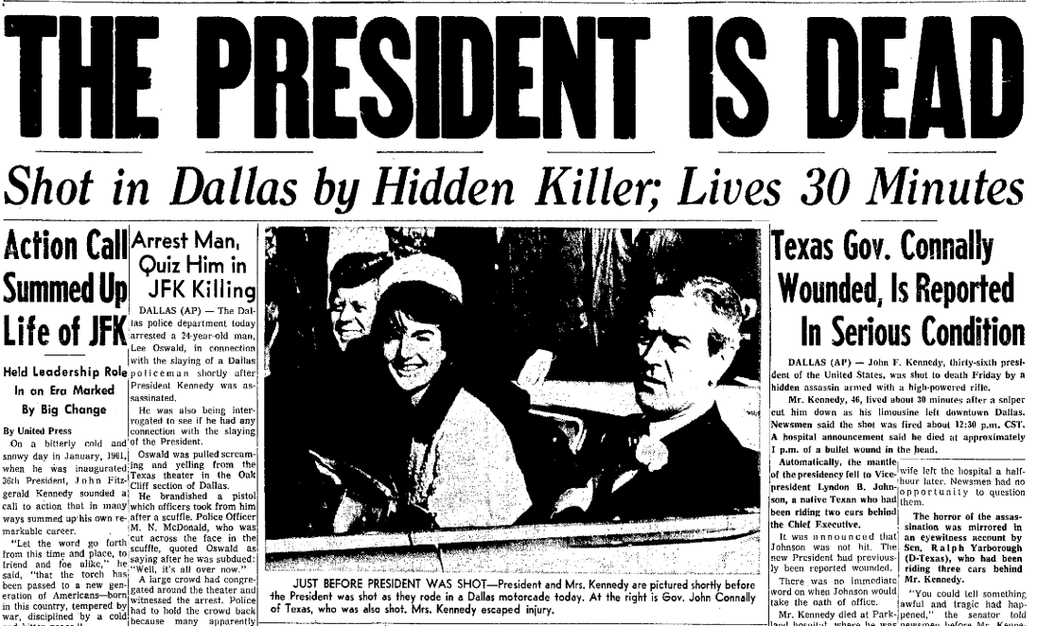
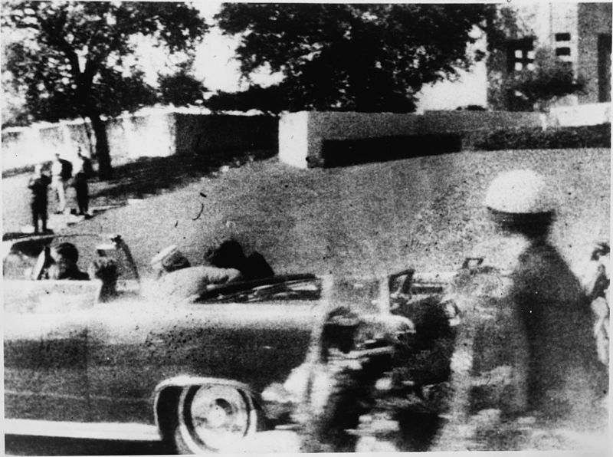

Slide 3
Case scenario
John Fitzgerald Kennedy, the 35th President of the United States, was assassinated on November 22, 1963, at 12:30 p.m. Central Standard Time in Dallas, Texas, while riding in a presidential motorcade through Dealey Plaza.
he was fatally shot in the head by former U.S. Marine Lee Harvey Oswald firing in ambush from a nearby building.

Slide 4
Discussion
What was the cause of death?
What was the manner of death?

Slide 5
References
Stokes, Louis (1979). "Report of the Select Committee on Assassinations of the U.S. House of Representatives". Washington, D.C.: United States Government Printing Office.
Sturdivan, Larry M. (2005). The JFK Myths: A Scientific Investigation of the Kennedy Assassination. St. Paul, MN: Paragon House. ISBN 978-1-55778-847-4.

