Slide 1
Forensic medicine course
21 February 2019
Session meeting
Supervisor :Dr. Khaldoon AlJerian
Group : B2
Presenter : Abdullah AlMana

Slide 2
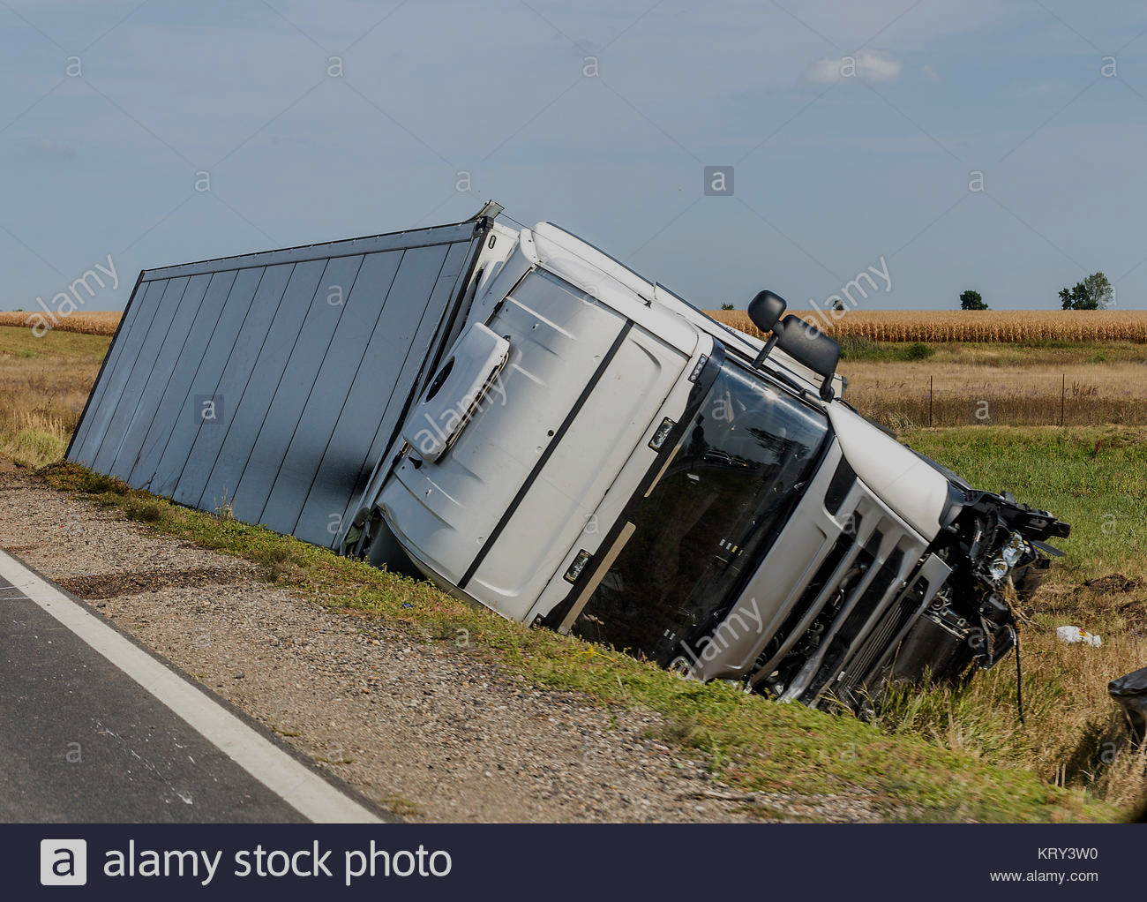
Scene Observation

Slide 3
Case scenario
A 20-year-old girl ,met with a fatal accident. Her car was hit by a speeding truck at a crossing. The girl was decapitated in the accident. Her head was recovered outside the mangled remains of the vehicle and the rest of the body was extracted from the co-driver’s seat of the damaged vehicle.

Slide 4
Discussion
What are the Injuries that may be expected to occur in an unrestrained impact/collision ?
How can Air bags cause injuries ?

Slide 5
References
Simpson's Forensic Medicine, 13th Edition
https://www.sciencedirect.com/science/article/pii/S0379073803002093

