Slide 1
King Saud University – College of Medicine Forensic Medicine, session 4 , 7 February supervisor: Dr.khaldoon aljerian group 3 presenter: abdulrahman alshiekh

Slide 2
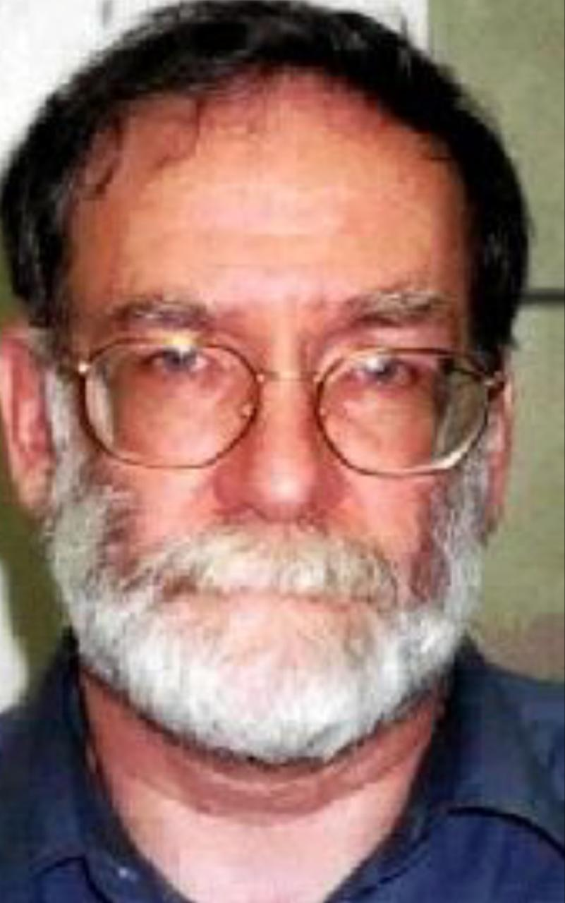
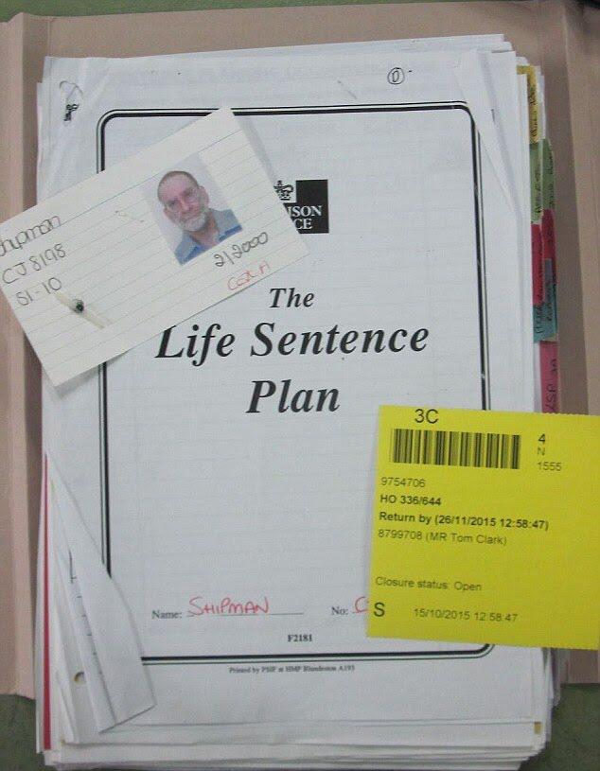

Slide 3
Case scenario
Harold Shipman a former family physician killed at least 250 of his patients over 23 years but, he was convicted of killing 15 of his patients with a lethal dose of morphine.

Slide 4
Discussion
How did Harold killed his patient ?
When confidentiality may not apply ?
Mention one of duties of physicians to patient ?

Slide 5
Reference
Simpson’s Forensic Medicine 13th edition ( chapter 2 )
Https://www.theguardian.com/society/2005/aug/25/health.shipman
http://news.bbc.co.uk/2/hi/health/1431104.stm
https://www.google.com/amp/s/www.dailymail.co.uk/news/article-3501201/amp/Dr-Death-Harold-Shipman-timed-suicide-wife-100-000-pension-payout.html

