Slide 1
Tobacco Use

Slide 2
Group 3
Epidemiology of smoking in Saudi Arabia | Hamad alkhudhayri | 436101499
[Presenter & editor] Types of smoking | Saad Al-Qahtani | 436100168
Risks of smoking | Talal alhuqayl | 436100762
Effect of passive smoking (children / pregnancy) | Abdulaziz Aljasser | 436100502
How to help smokers to Quit | Majed belal alzin | 436103152
Updates on pharmacological management, smoking cessation medications | Hassan alshammari | 436103354
Nicotine preparations, varniciline, bupropion | Faris Aljaafar | 436100645
OSCE station role play | Abdulaziz shadid | 436103141
 | Mohammed nasr | 436102493

Slide 3
Objectives:
1.Epidemiology of smoking in Saudi Arabia.
2.Types of smoking.
3.Risks of smoking.
4.Effect of passive smoking (children / pregnancy).
5.how to help smokers to Quit.
6.Updates on pharmacological management , smoking cessation medications.
7.Nicotine preparations.

Slide 4
Epidemiology of smoking in Saudi Arabia :
The Saudi Health Interview Survey (SHIS) is a large national survey
aimed at assessing chronic diseases, health behaviors, and risk factors
among adults aged 15 or older in the Kingdom of Saudi Arabia. The
survey consists of a household roster, a questionnaire and physical
measurements, and a lab-based biomedical examination. The
questionnaire included several questions on tobacco use. The survey
was developed in partnership between the Ministry of Health in Saudi
Arabia and the Institute for Health Metrics and Evaluation of the
University of Washington.

Slide 5
Methodology used :
SHIS is a multi-stage nationally representative sample survey with probability of selection
symmetric to the size of the population of adults 15 years or older. The survey was
conducted in all Saudi regions, and data were collected between March and July 2013
from 10,827 participants. The sample was weighted to reflect the Saudi population aged
15 and older based on probability of selection and post-stratification.

Slide 6
Findings :
findings are representative of the Saudi population aged 15 years and older.
Overall, 12.1% of Saudis reported that they currently smoke tobacco. This
prevalence was 23.7% among males and 1.5% among females. The prevalence of
tobacco smoking varied by age; among those aged 65 and older, the prevalence of
tobacco smoking was the lowest: 6.5% (9.7% among males and 1.8% among
females). Saudis aged 55 to 64 years had the highest prevalence of current
smoking (15.6%) with 24.7% among males and 4.2% among females.Daily tobacco
smoking is 11.4 with ( 21.5% among males and 1.1% among females).
11.4% (21.5% among males and 1.1% among females) of smokers consume
cigarettes daily with an average of 15.0 cigarettes per day. 11.2% of Saudis
consume shisha daily (20.9% for males and 1.4% for females). 0.3% of Saudis
consumed smokeless tobacco products daily (0.5% among males and 0.2% among
females). On average, Saudis start smoking at age 18 (males at 19 and females
at 21). Overall, 29.7% started smoking before the age of 15, and 60.9% started
smoking before the age of 18.

Slide 7
17.2% of Saudis are exposed to secondhand smoke at home, with an average of 5.1
days of exposure per week. This secondhand exposure is 20.9%, with an average of
4.8 days of exposure per week, for males, and 13.1%, with an average of 5.5 days
of exposure per week, for females. 14.8% of Saudis are exposed to secondhand
smoke at work, with an average of 2.2 days of exposure per week. This secondhand
exposure at work affects 24.9% of males, with an average of 4.3 days of exposure
per week, and 2.6% of females, with an average of 1.4 days of exposure per week.
Among smokers, 49.1% attempted to quit smoking within the last 12 months
(50.1% for males and 34.1% for females). 53.9% of smokers (54.5% for males and
45.2% for females) reported being advised by their doctor or a health care
professional to quit smoking during any visit within the last 12 months.

Slide 8
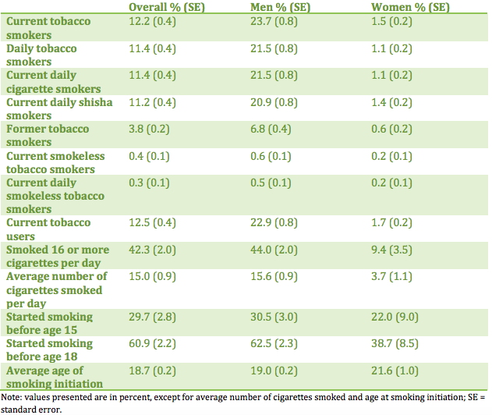

Slide 9
Type of smoking:
Types of Tobacco Products.
Cigarettes are the most common form of tobacco used.
Electronic Cigarettes or E-Cigarettes.
Chewing Tobacco, Snuff Tobacco
Cigars, Cigarillos, Little Cigars, and Blunts.
Pipes.
Hookah or Water Pipe (shisha).

Slide 10
Risk of smoking:
Each year more than 480,000 people in the United States die from illnesses related to tobacco use ,therefore it is one of the most clearly damaging to health.
Smoking contributes to a variety of non-communicable diseases, including: cancer, heart disease, stroke, chronic respiratory diseases, and diabetes.
Cancer:
Smoking accounts for about 30% of all cancer deaths in the United States, including about 80% of all lung cancer deaths ,Not only does smoking increase the risk for lung cancer, it’s also a risk factor for cancers of the: mouth , larynx , pharynx ,esophagus ,Kidney, Cervix ,Liver ,Bladder ,Pancreas ,Stomach and Colon/Rectum

Slide 11
chronic respiratory diseases:
- Smoking damages the airways and small air sacs in the lungs
-It makes pneumonia and asthma worse, It also causes many other lung diseases that can be nearly as bad as lung cancer. Like:
-COPD(chronic obstructive pulmonary disease):
Smoking is by far the most common cause of COPD.
Diabetes:
Among male health care professionals in the US, smoking 25 or more cigarettes daily appears to double the risk of Non insulin-dependent diabetes.
Heart disease:
Over time, chemicals in tobacco smoke triggers plaque buildup in the arteries leading to atherosclerosis and increases the risk of having and dying from heart disease, heart failure, or a heart attack

Slide 12
Not all of the health problems related to smoking result in death, it can steal away a person’s quality of life long before death.
it causes:
Increased risk of gum disease and tooth loss.
Wounds taking longer to heal
Decreased immune system function
Decreased sense of smell and taste
Premature aging of the skin
Bad breath and stained teeth
Increased risk for cataracts

Slide 13
Effect of passive smoking on pregnancy & children
First what is passive smoking ?
Passive smoking (Second-hand smoke) is characterized as the product released into the environment whenever someone who is smoking exhales. It can also come from the end of tobacco-containing smoking products. There are approximately 4,000 chemicals present in second-hand smoke, many of which have been determined to be related to cancer.
Effect of passive smoking on pregnancy:
If a pregnant women get exposed to second-hand smoke during pregnancy, both she and her baby are put at risk.
Some of the health conditions associated with being exposed to second-hand smoke are:
Miscarriage
Low birth weight
Early birth
Learning or behavioral deficiencies in the child,
Sudden infant death syndrome (SIDS)

Slide 14
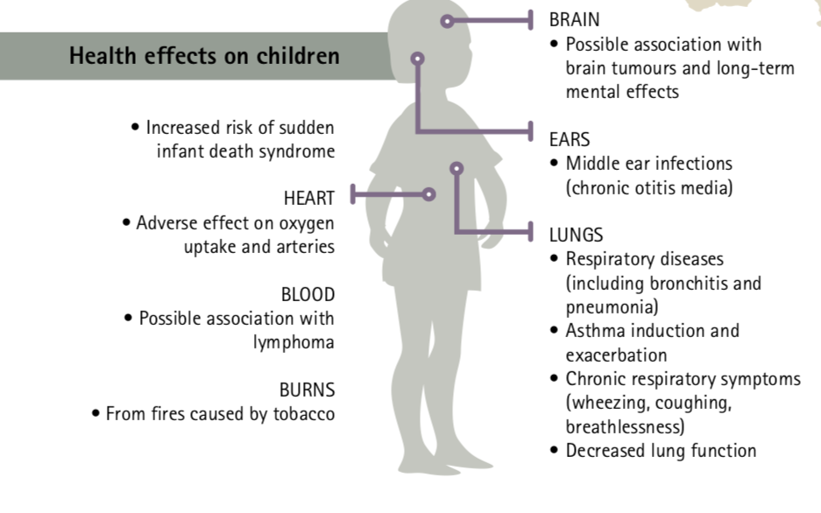
Effect of passive smoking on children:
Almost half the world’s children (about 700 million) are exposed to smoke from burning tobacco and exhaled smoke at home.
Health effects on children :
BRAIN:
Possible association with brain tumors and long-term mental effects.
HEART:
Adverse effect on oxygen uptake and arteries.
LUNG:
Respiratory diseases (including bronchitis and pneumonia)
Asthma induction and exacerbation
Chronic respiratory symptoms (wheezing, coughing, breathlessness)

Slide 15
How to help a smoker to quit and how to overcome withdrawal symptoms:
How to help smokers to quit:
Remind smokers of the importance of stopping smoking with leaflets and posters.
Assess smoking status.
Advise to stop and Assess willingness to change.
1-If smoker wants to stop 2-If smoker does not want to stop
-Offer to refer to the smoke stop clinic.
-Help him to set a quit date and stick to it.
-Advise to stop smoking completely on the quit date.
-Recommend Nicotine replacement therapy.
-Consider offering a follow-up appointment to check progress.
-Record advise given to stop smoking.
-Give the smoker an advice leaflet to take away.
-Repeat advise to stop.

Slide 16
Nicotine withdrawal symptoms:
• Urges to smoke (70%)
• Increase appetite (70%)
• Depression (60%)
• Restlessness (60%)
• Poor concentration (60%)
• Irritability/aggression (50%)
• Night-time awakenings (25%)
• Light headedness

Slide 17
How to overcome withdrawal symptoms?
1. Try nicotine replacement therapy
Prescription nicotine in a nasal spray or inhaler
Over-the-counter nicotine patches and gum
Prescription non-nicotine stop-smoking medications
2. Avoid triggers
3. Physical activity
4. Practice relaxation techniques
5. Go online for support
6. Remind yourself of the benefits
Feeling better
Getting healthier
Saving money

Slide 18
What Are Treatments For Tobacco Dependence?
There are effective treatments that support tobacco cessation, including both behavioral therapies and FDA-approved pharmacotherapies.
Research indicates that smokers who receive a combination of behavioral treatment and cessation medications quit at higher rates than those who receive minimal intervention.

Slide 19
Behavioral Treatments
Behavioral counseling is typically provided by specialists in smoking cessation for four to eight. A variety of approaches to smoking cessation counseling are available:
Cognitive Behavioral Therapy (CBT) : CBT helps patients identify and teaches them relapse-prevention skills and effective coping strategies to avoid smoking in the face of triggers.
Motivational Interviewing (MI) : Studies of MI suggest that this intervention results in higher quit rates than brief advice to stop smoking or usual care.
Mindfulness: In this therapy, Patients learn techniques that help them tolerate negative emotions including stress and cravings without returning to tobacco use or other unhealthy behaviors.

Slide 20
FDA - Approved Pharmacotherapies
Nicotine Replacement Therapy (NRT): ( transdermal patch, spray, gum). NRTs stimulate the brain receptors targeted by nicotine, helping relieve nicotine withdrawal symptoms and cravings that lead to relapse.
Bupropion: It was originally approved as an antidepressant. It works by inhibiting the reuptake of the brain chemicals norepinephrine and dopamine as well as stimulating their release. Bupropion has been found to increase quit rates that’s why it is indicated for smoking cessation.

Slide 21
Varenicline: It is a partial agonist for the α4β2 nicotinic receptor that leads to the release of dopamine and therefore, reduce the feelings of craving and withdrawal caused by smoking cessation.
Transcranial magnetic stimulation (TMS) is a relatively new approach to treat addiction. It is a physiological intervention that noninvasively stimulates neural activity in targeted areas of the brain using magnetic fields.
Research on TMS as a treatment for smoking cessation is in early stages but has shown promise. Among adult smokers who had not been able to quit using other treatments, high-frequency TMS treatment significantly reduced the number of cigarettes smoked.

Slide 22
References:
http://www.healthdata.org/sites/default/files/files/Projects/KSA/Smoking-KSA-Findings-from-the-Saudi-Health-Interview-Survey.pdf
1- http://www.healthdata.org/smoking-tobacco
Rimm EB, Stampfer MJ, Colditz GA, Willett WC.Prospective study of cigarette smoking, alcohol use, and the risk of diabetes in men. BMJ 1995; 310:555-9
https://www.cancer.org/cancer/cancer-causes/tobacco-and-cancer/health-risks-of-smoking-tobacco.html
https://www.nhlbi.nih.gov/health-topics/smoking-and-your-heart
https://www.who.int/ceh/publications/10passivesmoking.pdf
http://americanpregnancy.org/pregnancy-complications/second-hand-smoke-and-pregnancy/
Oxford Handbook of General Practice, 4th Edition (p.183)
https://www.mayoclinic.org/healthy-lifestyle/quit-smoking/in-depth/nicotine-craving/art-20045454
https://www.drugabuse.gov/ (National Institute on Drug Abuse)
Stead LF, Perera R, Bullen C, et al. Nicotine replacement therapy for smoking cessation. Cochrane Database Syst Rev. 2012;11:CD000146. doi:10.1002/14651858.CD000146.pub4.
Stead LF, Lancaster T. Combined pharmacotherapy and behavioural interventions for smoking cessation. Cochrane Database Syst Rev. 2012;10:CD008286. doi:10.1002/14651858.CD008286.pub2
Raja M, Saha S, Mohd S, Narang R, Reddy LVK, Kumari M. Cognitive Behavioural Therapy versus Basic Health Education for Tobacco Cessation among Tobacco Users: A Randomized Clinical Trail. J Clin Diagn Res JCDR. 2014;8(4):ZC47-ZC49. doi:10.7860/JCDR/2014/8015.4279
Sousa AD. Repetitive Transcranial Magnetic Stimulation (rTMS) in the Management of Alcohol Dependence and other Substance Abuse Disorders - Emerging Data and Clinical Relevance. Basic Clin Neurosci. 2013;4(3):271-275.

Slide 23
Thank you

Slide 24
Case scenario:
Mohammed nasr, 21 years old male medically free, smoker for the last 5 years presented to your clinic asking for counseling after his brother was diagnosed with lung cancer.
The doctors told his brother that smoking was one of the major contribution of his illness.

