Slide 1
Forensic Medicine Course
21st Feb2019
Supervisor: Dr. Khaldoon AlJerian
Group:2
Presenter :Abdullah almunyif

Slide 2
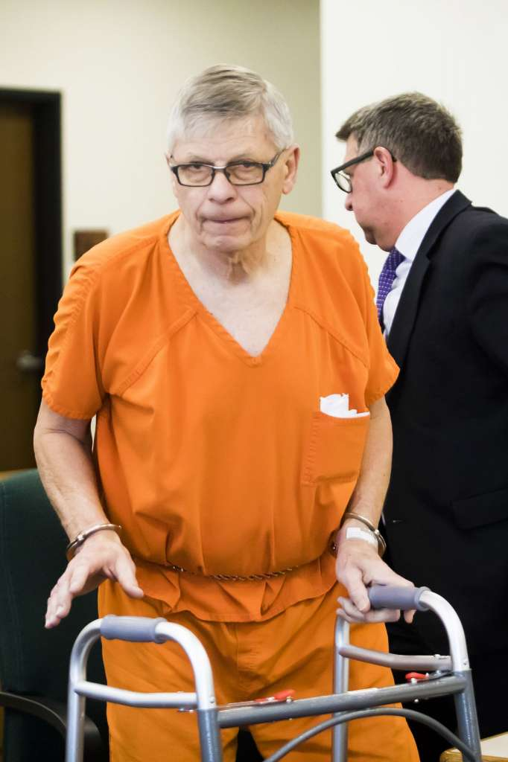

Slide 3
Scenario:
Gary Arthur Gatza, 74, charged with causing the death of a Midland man and the injury of his three passengers during a vehicle crash under the influence of alcohol.
Michigan State Police revealed that Gatza had a blood alcohol content of 0.12 percent which — clearly higher than the state legal limit of 0.08 — at the time of the crash.

Slide 4
Questions:
What alcohol does to your body?
How do the police examine a driver if he is drunk or not?

Slide 5
References:
Simpson's Forensic Medicine, 13th Edition
https://www.ourmidland.com/news/article/Bond-reduced-for-driver-in-deadly-New-Year-s-crash-13630015.php#photo-16951480

