Slide 1
College of medicine
Forensic Medicine Course
19th Feb2019
3rd session
Supervisor: Dr.Khaldoon AlJerian
Group 2
Presenter : Khalil Abdullah Alghalayini

Slide 2
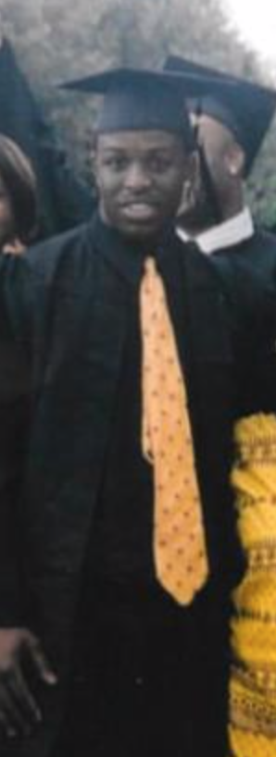
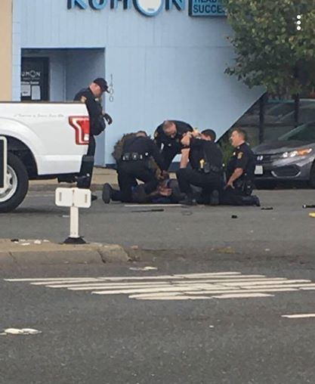
Scene Observation

Slide 3
Case Scenario
Chinedu Okobi, 36-year-old, died shortly after he was Tasered by San Mateo county sheriff’s deputies on 3rd of October 2018. The report states the victim assaulted a sheriff’s deputy who approached him.

Slide 4
Discussion:
What kind of restraint techniques that are used to control groups of individuals or others who are violent or suffering from acute behavioral disturbance?
What are the primary targets of deploying baton on the body?

Slide 5
References:
Simpson's Forensic Medicine, 13th Edition
https://edition.cnn.com/2018/10/17/us/california-chinedu-okobi-police-taser-killing/index.html

