Slide 1
Global Demography Concepts and Population Pyramid
Dr Rufaidah Al Dabbagh, MBBS, MPH, DrPH
Prof Abdulaziz Binsaeed, MBBS, DFE, PhD
Community Medicine Unit, Family & Community Medicine Department
17, 9, 2019

Slide 2
Objectives
Define demography
Describe major sources of population data
List the important factors that determine population growth and calculate measures of these factor
Interpret the population pyramid and differentiate between features of developed and developing countries

Slide 3
Objectives Cont.
Understand the concept and determinants of demographic equilibrium
Describe and understand the theory of demographic transition
Define, compute and interpret the population distribution measures

Slide 4
What is demography?
It is the scientific study of human populations
It encompasses three domains:
Change in population size
Composition of a population
Distribution of a population in space

Slide 5
Why is demography important?
The health of people in a community depends on the dynamic interaction between size of the population and the space they occupy

Slide 6
Sources of demographic data
Vital statistics (Birth and death registration)
General Authority for Statistics (GAS)
Ministry of health
World Health Organization statistics
United Nations
World Bank Statistics
Sources of their Saudi Data are not clear

Slide 7
Available Demographic Indicators from GAS
Demographic Indicators Reported by
Age groups (reported in 5-year bins)
Gender
Region of residence
Nationality (Saudi vs. Non-Saudi)
Marital status
Education status
Number of live births
Use of OCP
Number of deaths
Disability

Slide 8
What determines demographic distribution of a population and population size?

Slide 9
Population size, distribution and composition are determined by:
economic growth
Fertility
Marriage
Mortality
Demography
Social
Mobility
Migration
Notes:
Economic growth on:
-Healthcare systems
-Reducing mortality (whether child or all age)
-Empowering women (reduces fertility)

Slide 10
1-Fertility
The actual bearing of children, is determined by:
Age at marriage (inverse relationship)
Duration of married life (most happen in early y)
Spacing of children
Education (inverse relationship)
Economic status (inverse relationship)
Religion
Nutrition (Inverse relationship)
Family planning
Other factor….physiological, biological, cultural, social

Slide 11
Measures of Fertility
Crude Birth Rate:
Number of live births in a year in a specific locality X 1000
estimated mid-year population size in that same year
and locality

Slide 12
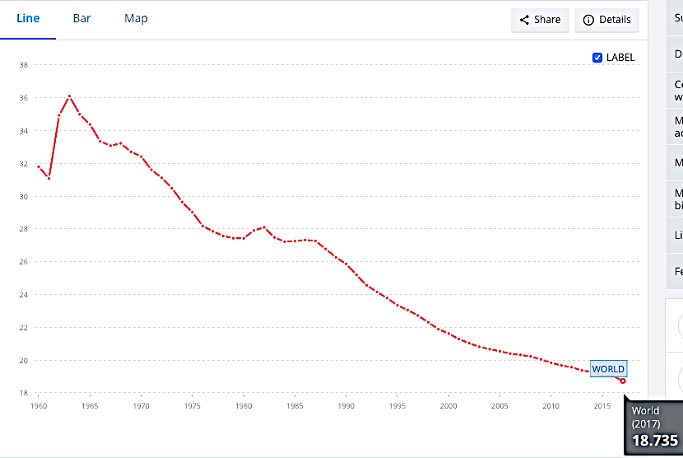
Crude Birth Rate Trend (World Bank)
Source: The World Bank. Available from: https://data.worldbank.org/indicator/SP.DYN.CBRT.IN.

Slide 13
Measures of Fertility cont.
General Fertility Rate:
number of live births per 1000 women in the reproductive age-group (15-44 or 49 years) in a given year
Number of live births in a year in a specific locality X 1000
Mid-year female population age 15-49 (reproductive age) in that same year and same locality
Problems? – not all women in denominator at risk for childbirth or married

Slide 14
Measures of Fertility cont.
General Marital Fertility Rate:
number of live births per 1000 married women in the reproductive age group (15-44 or 49) in a given year
Number of live births in a year in a specific locality X 1000
Mid-year female married population age 15-49
in that same year and same locality

Slide 15
Measures of Fertility cont.
Age-specific Fertility Rate:
number of live births in a year to 1000 wome:n in any specified age-group
Number of live births among a specific age group X 1000
Mid-year female population in that age group
in that same year and same locality

Slide 16
Measures of Fertility cont.
Total Fertility Rate: (rate per woman)
the average number of children a woman would have if she were to pass through her reproductive years bearing children at the same rates as the women now in each age group
Approximates “completed family size”
Sum of age specific fertility rates (rate per woman)
1000
or Sum of age specific fertility rate (rate per 1000 women)
If using a 5-year period, then: Σage specific fertility rate x 5

Slide 17
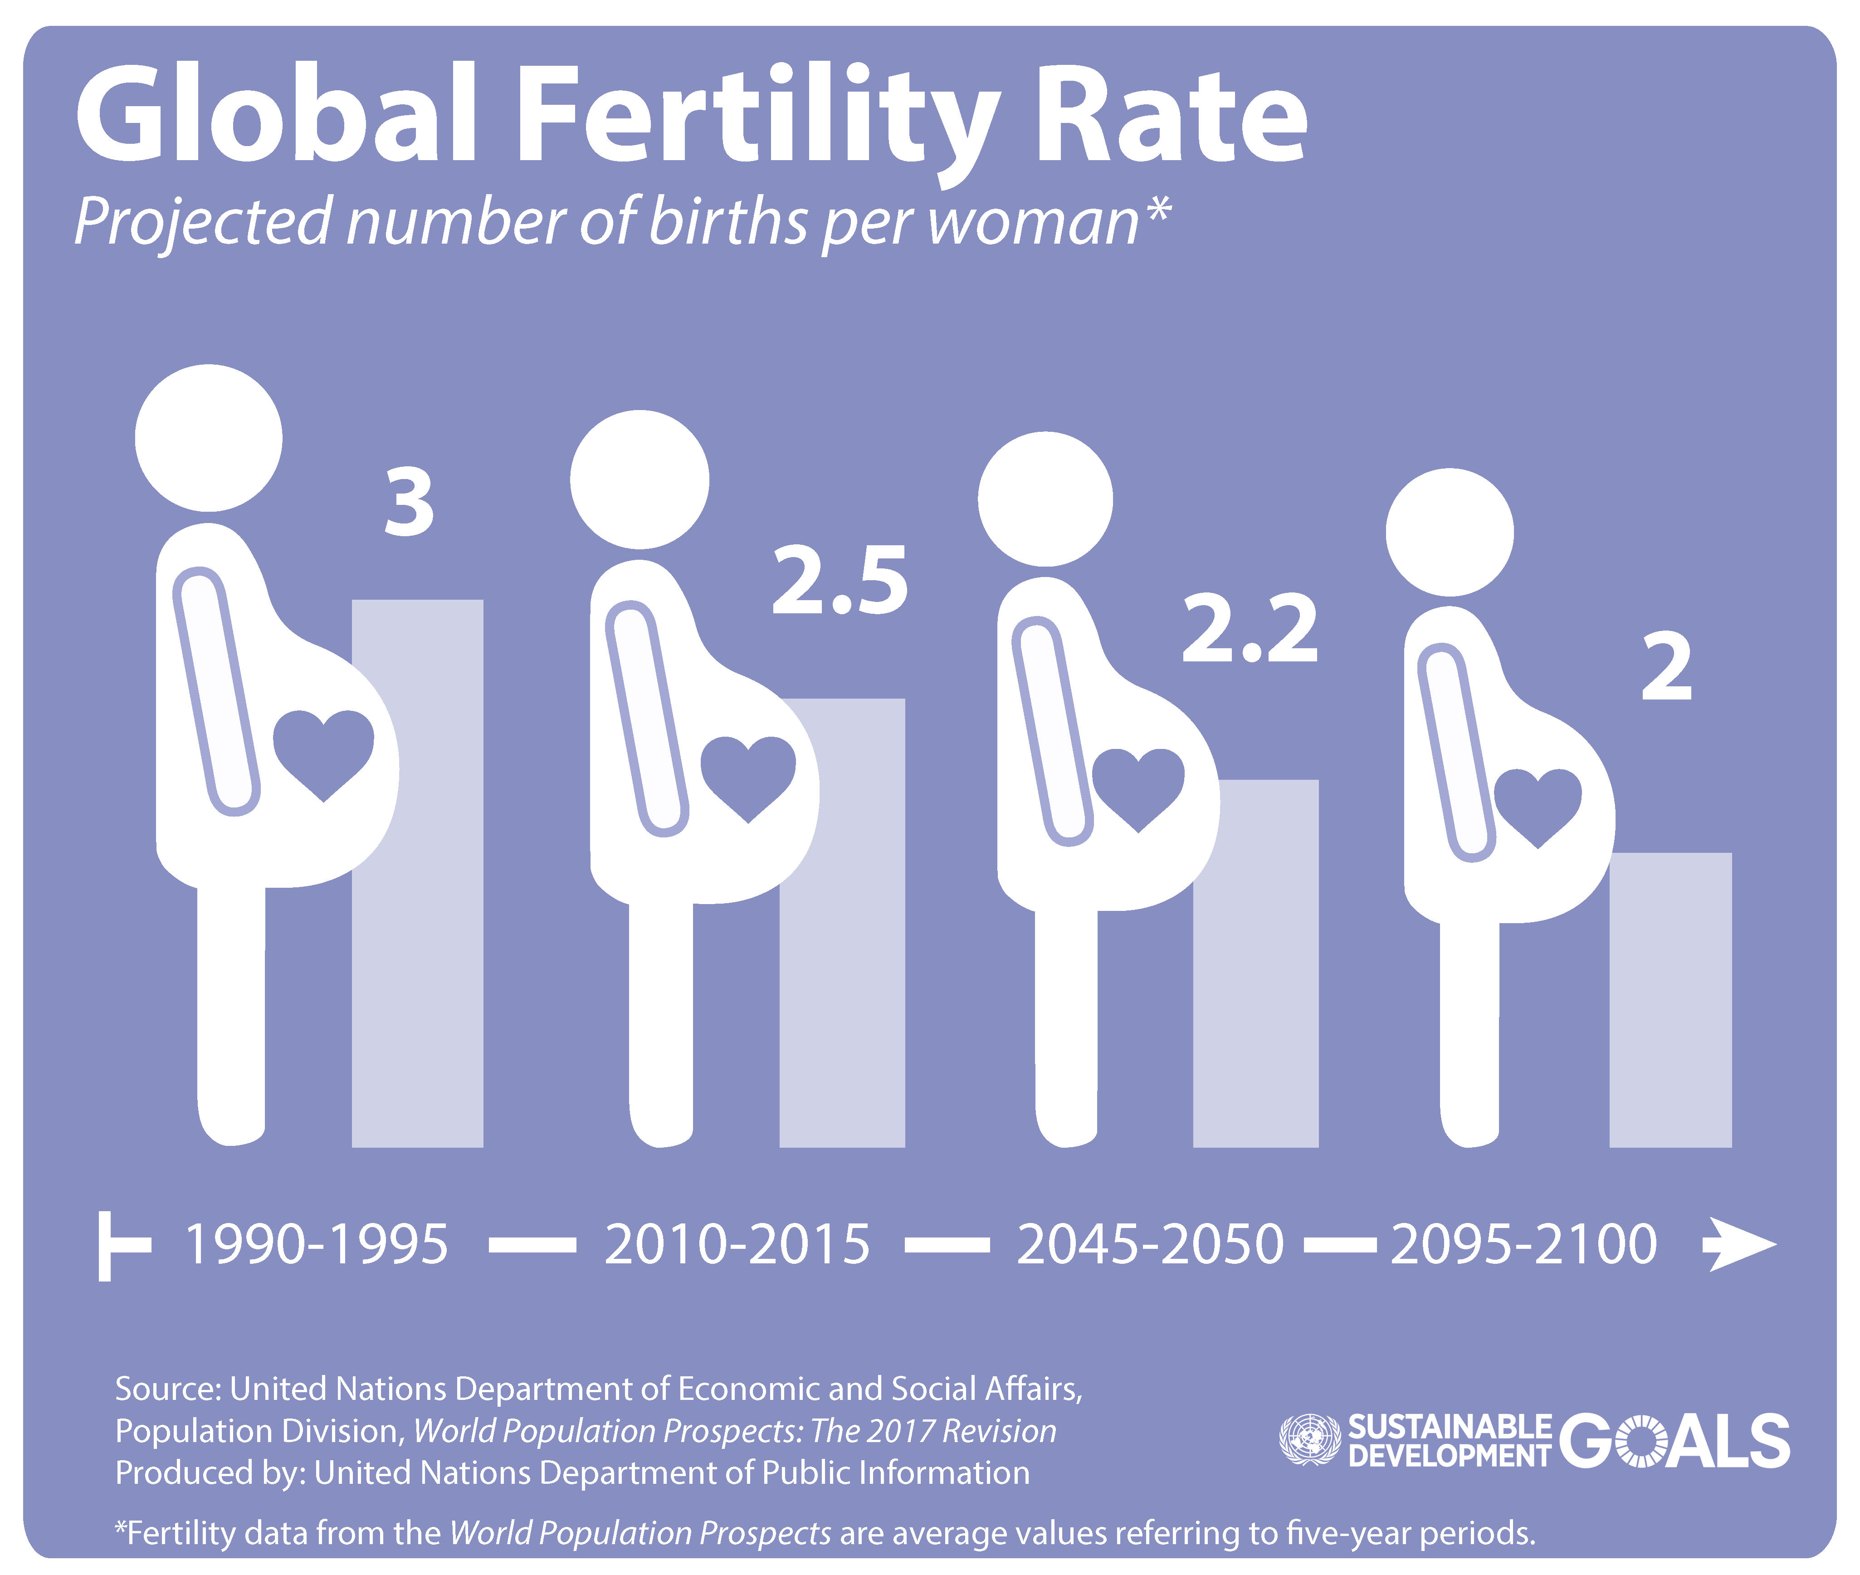
Global Total Fertility Rate 2017

Slide 18
Saudi Arabia Fertility Rate

Slide 19
Impact of fertility on age distribution in a population
High fertility => High proportion of young people in the population (e.g. developing countries)
Low fertility => Condensed proportion of retired people in a population (e.g. developed countries)
How does that impact healthcare needs?

Slide 20
Fertility and population explosion
Controversy starting from the late 1700s
Thomas Malthus theory
Paul Ehrlich: Author of “Population Bomb” ~ 1968
Argument: unless population of the world is controlled, civilization on earth would end
Fallacy in their argument: Only focusing on birth control; not meeting healthcare and development needs of disadvantaged populations

Slide 21
2- Migration
According to UN reports, 258 million people live outside the country where they were born
Of these, 26 million (10%) are refugees or asylum seekers
Migration (for economic opportunities) is towards high-income countries, except for refugees mostly migrate to low-income countries
Median age of migrants is 39 years
Mostly women -> for refuge
Mostly men -> for work

Slide 22
Migration continued.
Ranking of countries that host migrants:
In 2017, Saudi Arabia ranked the second worldwide in hosting migrants
Source: UN International Migration Report 2017. Available at: https://www.un.org/development/desa/publications/international-migration-report-2017.html
 | Country | No. of migrants hosted
1 | USA | 49.8 million
2 | Saudi Arabia | 12 million
3 | Germany | around 12 million
4 | Russia | around 12 million
5 | UK | 9 million

Slide 23
Why is migration important to follow?
It helps predict how the population will be shaped
Migration usually goes from low income to more industrialized countries (more economic opportunity)
Younger and healthier people migrate to more industrialized areas to work
Migration affects economic growth and is affected by economic growth

Slide 24
Relationship between fertility, migration and economic growth
low fertility increases economic growth
Fertility
Economic growth
High economy stimulate birth control
Migration

Slide 25
3-Mortality
Mortality rate:
Number of deaths in a given population in a specific period of time
Expressed as per 100 population or per 1000 population
MR = # of deaths in a given period of time x 100 (or 1000)
Total population in the same given period of time in that same population

Slide 26
Crude death rate
Crude death rate:
Number of deaths in a given population in a specific period of time over the mid-year population of that same time period
CDR = # of deaths in a given period of time x 1000
mid-year population in the same given period of time in that same population

Slide 27
Other measures of mortality
Age-specific mortality rate
All cause mortality rate
Cause-specific mortality rate
Infant mortality rate
peri-natal mortality rate
neonatal mortality rate
Post-neonatal mortality rate
Maternal mortality rate
Maternal mortality ratio

Slide 28
Stages of Demographic Transition
It explains the changes of birth rates and death rates and describes the population growth cycle relation to economic development

Slide 29
5 Stages for Demographic Transition
Stage 1: (High Stationary)
High birth rate
High death rate
Stage 2: (Early expanding)
Birth rates remain the same
Death rates begin to decline
e.g. many of the countries in developing world

Slide 30
5 Stages for Demographic Transition
Stage 3: (Late Expanding)
Death rates further decline
Birth rates begin to fall
Birth rates > death rates => population growth
Stage 4: (Low stationary)
Low birth rate
Low death rate
Population becomes stationary; Zero population growth -> Population equilibrium
Many developed countries

Slide 31
5 Stages for Demographic Transition
Stage 5: (Declining)
Birth rates very low
Death rates very low
Birth rates < death rates
Population decline
e.g. Germany and Hungary

Slide 32
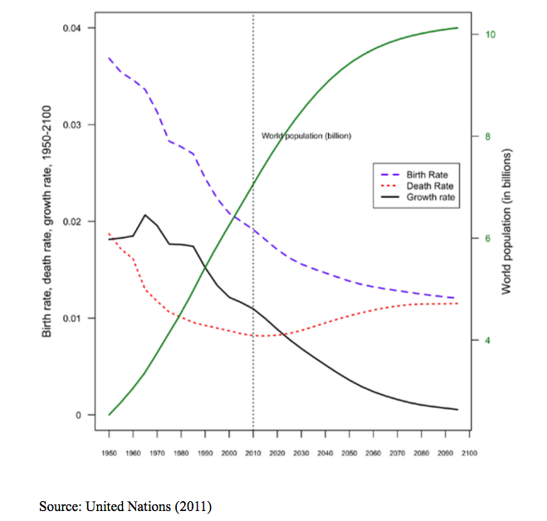
Expected population growth from 1950-2100

Slide 33
Limitations of Demographic Transition Model
Migration is not considered in the model

Slide 34
How do we measure population growth
Population growth
Annual growth rate (expressed in %)=
Crude birth rate – Crude death rate

Slide 35
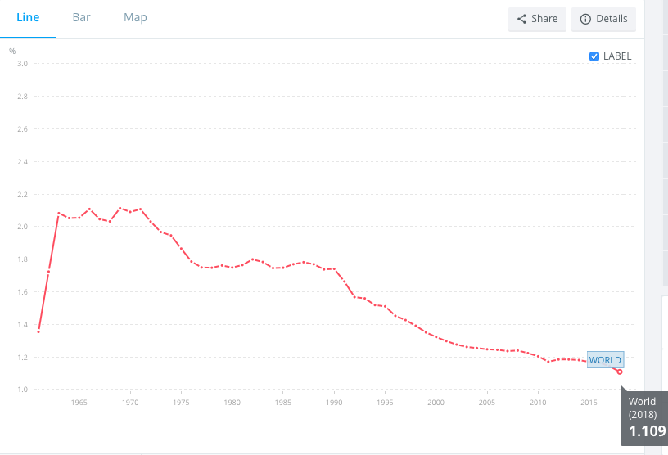
Annual Population Growth Worldwide
Source: The World Bank. Available from: https://data.worldbank.org/indicator/SP.POP.GROW.

Slide 36
Where does KSA stand?
unique cultural and religious norms
death rates have decreased
with economic development, women education and empowerment, fertility rates have not declined as fast as expected (lag in demographic transition)
Result?
Source: Asharaf AS, Mouselhy MA. Aging in Saudi Arabia: Impact of demographic transition. Bold 2013; 24(1): 13-27

Slide 37
Annual Growth Rate in KSA
Reported at 2.52% in 2016 (GAS)

Slide 38
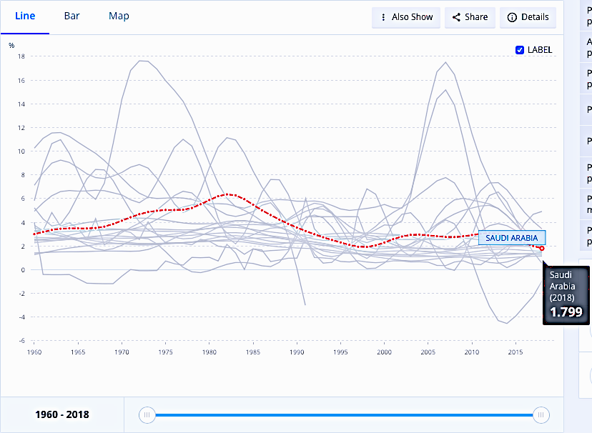
ANNUAL POPULATION GROWTH RATE KSA
Source: The World Bank. Population Growth (Annual %), Saudi Arabia. Available at: https://data.worldbank.org/indicator/SP.POP.GROW?contextual=region&locations=SA. Accessed on Sep 17, 2019.

Slide 39
Exponential growth and doubling time concept
In the 1970s a theory was developed that population size grows exponentially
Actual data historical data until now rebuke this theory
Based on exponential growth, the time needed to double population size (population doubling time) was calculated: (70/growth rate)
Doubling time should NOT be used, as population growth is determined by many factors, and DOES NOT show exponential growth
Source: Bermingham JR. Exponential population growth and doubling times: are they dead or merely quiescent? Population and Environment 2003; 24(4): 313-327.

Slide 40
Example how “doubling time” is flawed
https://data.worldbank.org/indicator/SP.POP.TOTL?locations=SA&view=chart
Using World Bank data:
In 1988:
Annual growth rate=4.2%, size=15,070,082
Exponential growth theory suggests 16.6 years for population to double
In 2013: 30,052,518
In 2014: 30,916,994
Took 26 years for KSA population to double in size

Slide 41
Population Distribution in Saudi Arabia
Total Population in 2018: 33,413,660 (Saudis only: 20,768,627)*
Change in Age Distribution 2007 - 2017
Source: General Authority for Statistics, 2017. Available from: https://www.stats.gov.sa/en/854-0
Source: General Authority for Statistics, 2018. https://www.saudi.gov.sa/wps/portal/snp/pages/saudiReportsAndStatistics

Slide 42
Population Pyramid

Slide 43
Population Pyramid
This shows the age structure in a certain population
By looking at the shape, you will be able to get an idea about:
Proportion age groups in a population
Male to female ratio

Slide 44
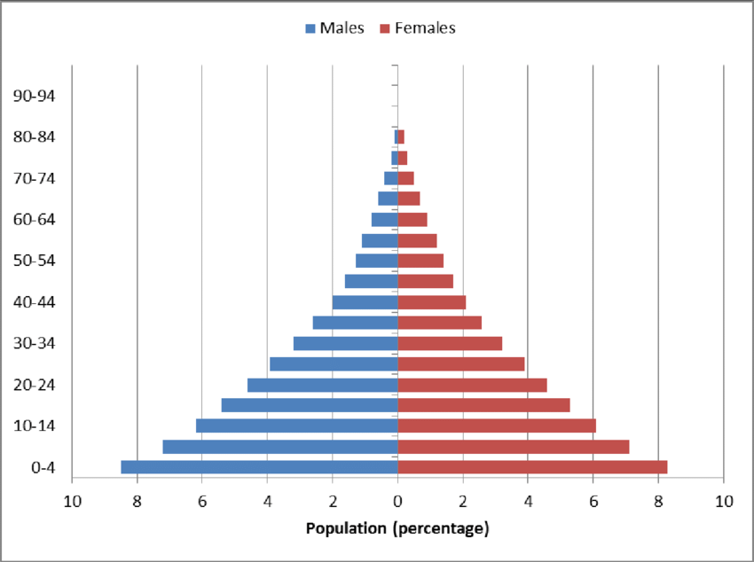
Example of population pyramid

Slide 45
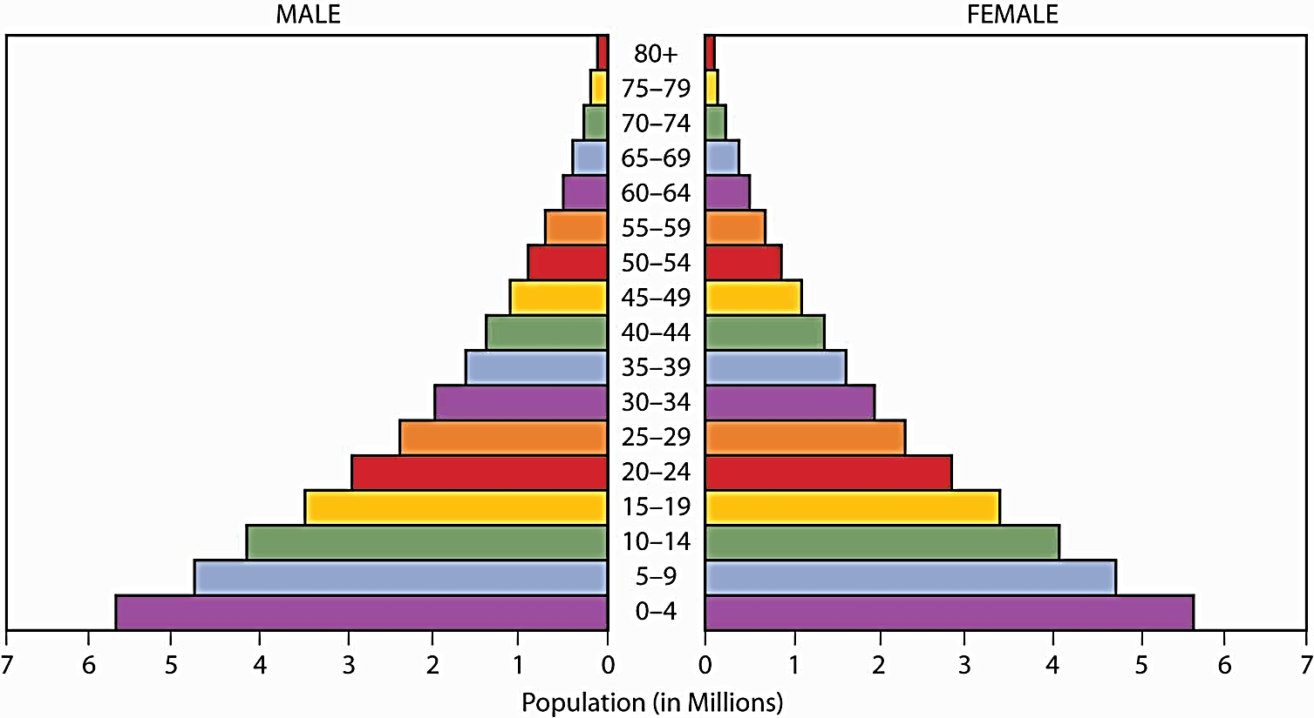
Components of population pyramids
Base: wide => high birth rate
narrow => low birth rate
Apex: old population (retired population) ….wide? narrow?
Height: life span
Side: change in population size due to death or migration

Slide 46
Important demarcating points
Less than 15 -Size of dependent youth < 15
-Large size in rapidly growing population
-Small size in slowly growing population
60 + years -Represents the size of dependent old ≥ 60
-Large size in population with longer life span
-Small size in population with short life span
Median age -Age that divide the population into two halves
-Small in population with high births
-Large in population with low births

Slide 47
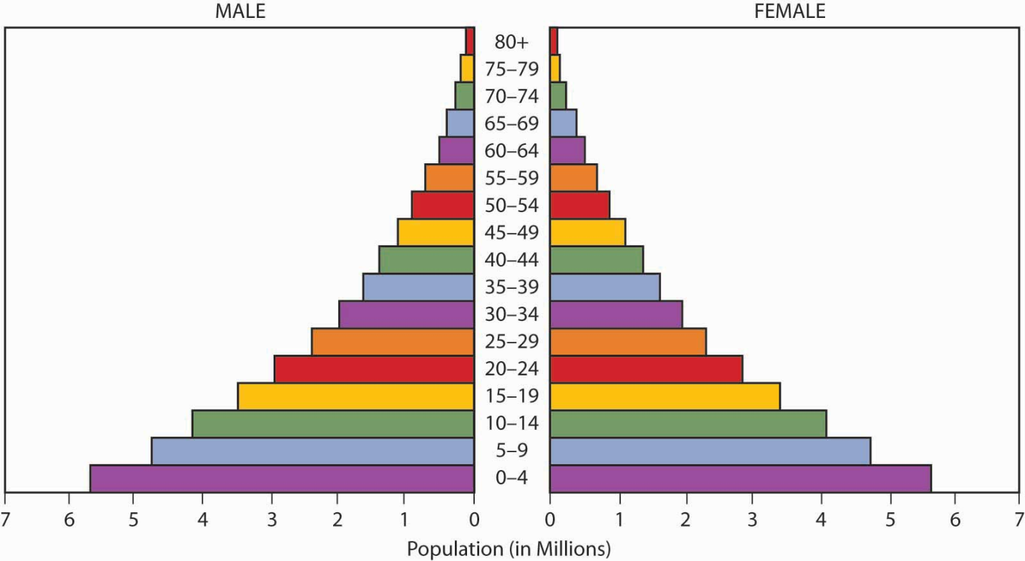
Apex= People living to old age
People ≥ 60 years=
Old dependency
Side= mortality and migration
Height= life span
Median age
People < 15 years=
Young dependency
Base= births

Slide 48
Types of population pyramids
Expansive
Stationary
Constrictive

Slide 49
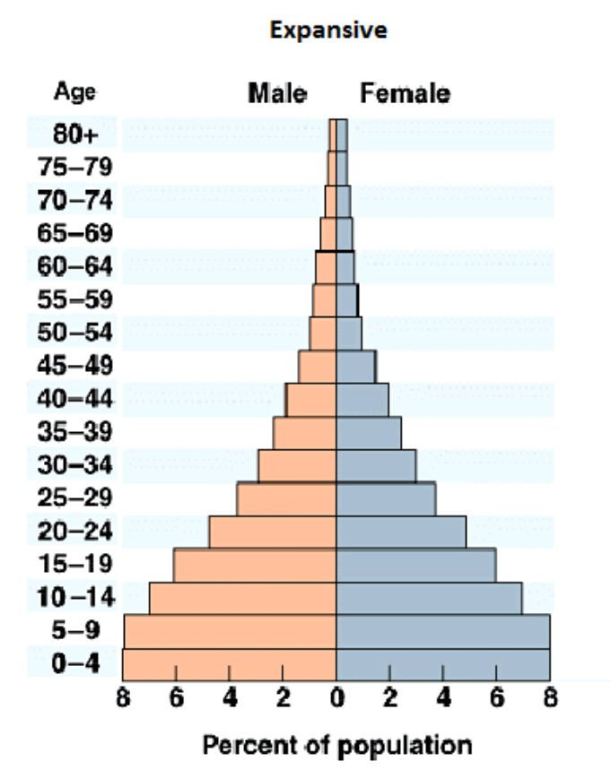
1- Expansive population pyramid
Expansive or expanding pyramid usually presents itself in the form of triangular shape with concaved edges
High population growth due to:
High birth rate
Shorter life expectancy
(high death rate)
Usually associated with lower standard of living

Slide 50
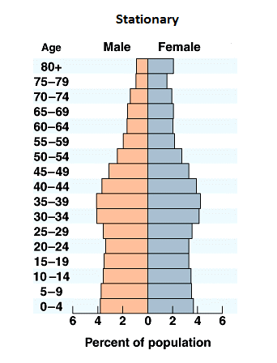
2-Stationary population pyramid
It is showing unchanging pattern of fertility and mortality
Age groups almost equal, but it is expected to see smaller figures at the oldest age groups

Slide 51
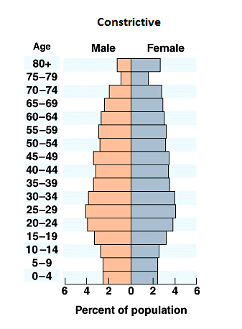
3-Constrictive population pyramid
Narrow base
Apex wider
It is more common when immigrants are factored out
Indicated:
High level of education
Use of birth control
Good health care system

Slide 52
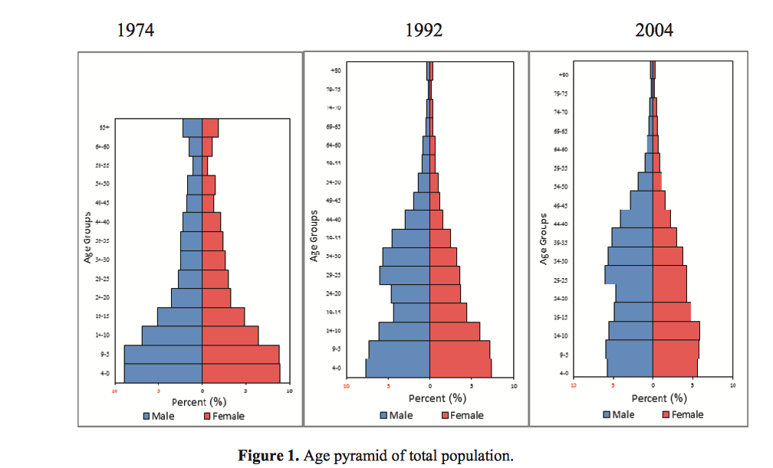
Population pyramid in Saudi Arabia over the years
Source: Abu Ashwan M, Abdul Salam A, Mouselhy MA. Population growth, structure and distribution in Saudi Arabia. Humanities and Social Sciences Review 2012; 1(4):33–46

Slide 53
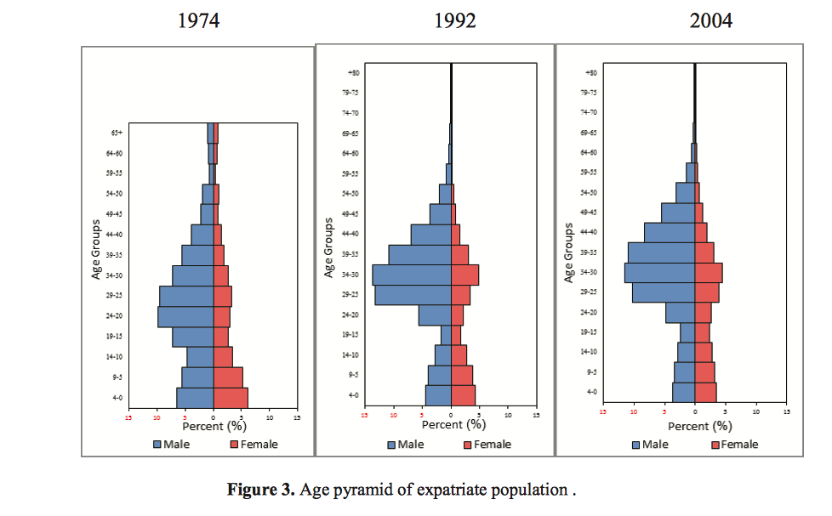
Population pyramid in Saudi Arabia over the years
Source: Abu Ashwan M, Abdul Salam A, Mouselhy MA. Population growth, structure and distribution in Saudi Arabia. Humanities and Social Sciences Review 2012; 1(4):33–46

Slide 54
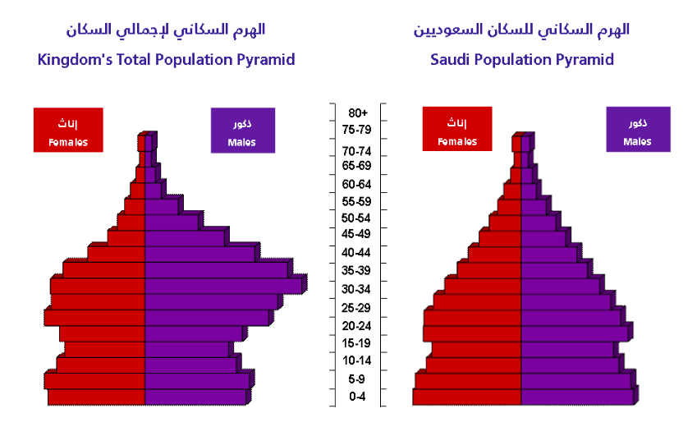
Most recent KSA population pyramid (2016)
Source: General Authority for Statistics, 2016

Slide 55
Other important population distribution measures
Sex Ratio

Slide 56
Other important population distribution measures
Dependency ratio (x 100)
The proportion of persons above 65 years of age and children below 15 years of age are considered to be dependant on the economically productive age group (15-64 years)
Total dependency ratio (x 100)
The ratio of the combined age groups 0-14 years plus 65 years and above to the 15-65 years age group is referred to as the total dependency ratio.

Slide 57
Population density
Total population in a certain region divided by the surface area of that same region

Slide 58
Any
Questions?

