Slide 1
COMM 311
National Health Policies & Programs
Nurah Alamro, MD. MPH. DrPH.
Assistant Professor - Community Medicine Unit, Family & Community Medicine Department
nmalamro@ksu.edu.sa

Slide 2
Objectives
By the end of this lecture, students should be able to:
Describe the national health transformation under vision 2030.
Discuss the National Health Sector Transformation, including needs, goals, and themes.
Discuss the New Models of Care Program including systems, levels of care, and enablers.
Define Health in All Policies (HiAP)
State an example of integrating HiAP into national health policy

Slide 3
1
Health under Vision 2030

Slide 7
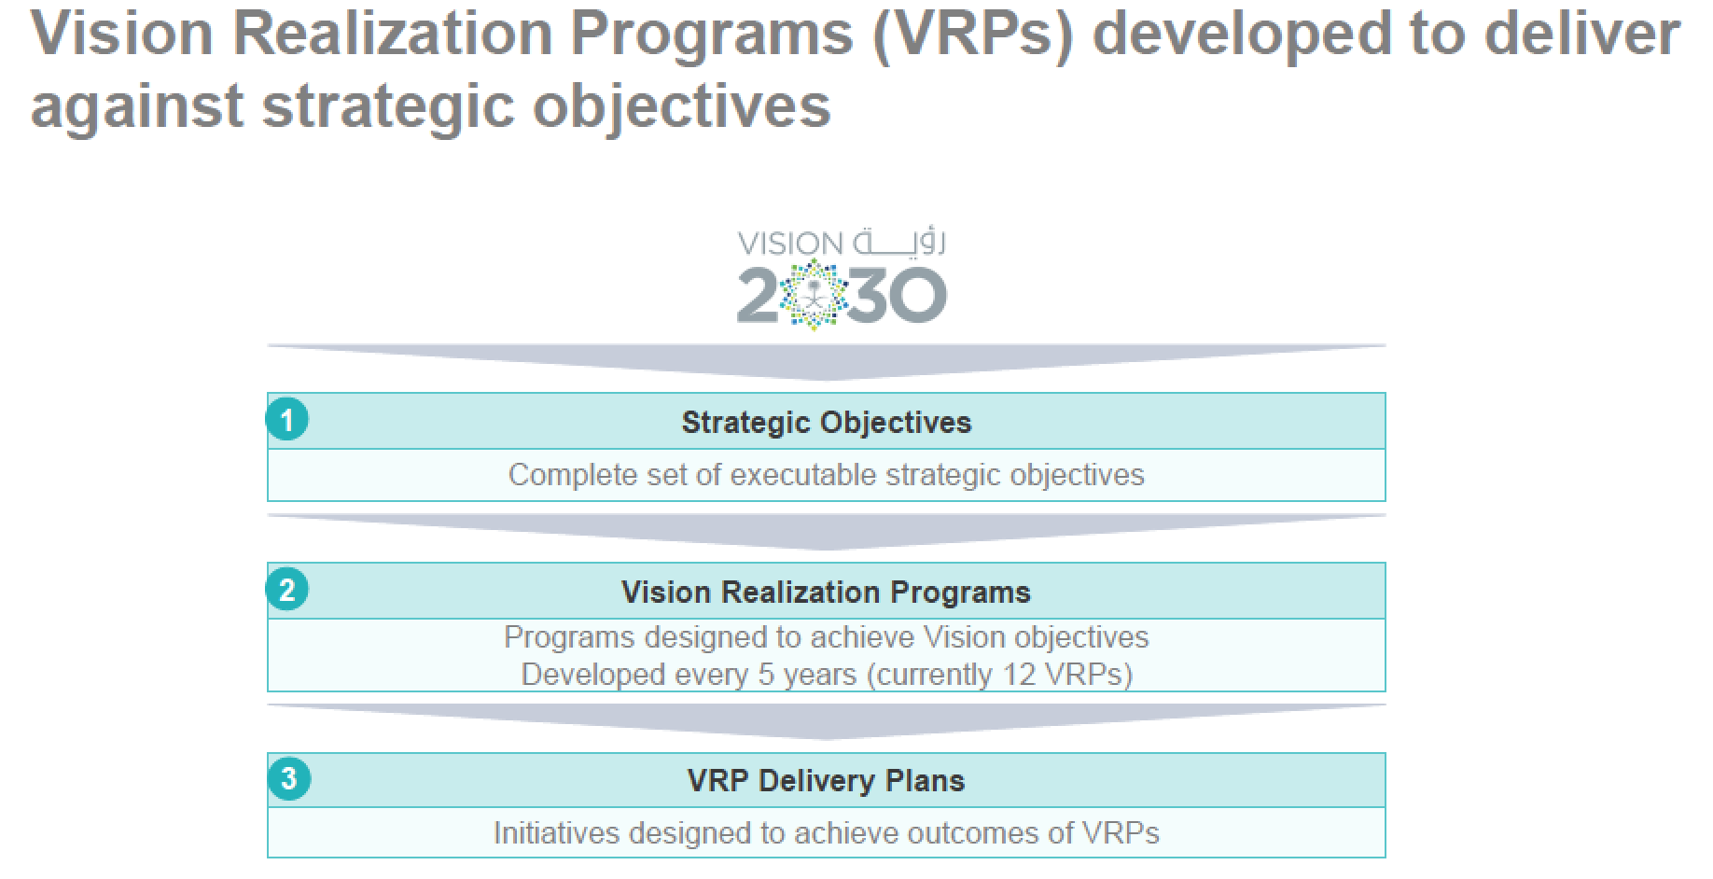

Slide 9
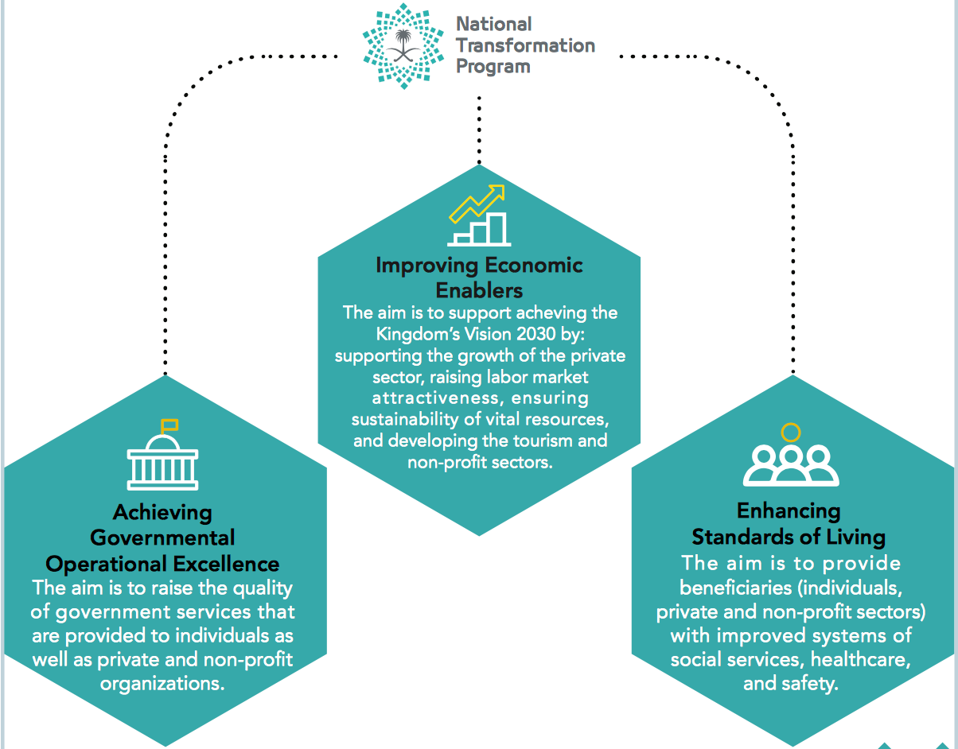
Notes:
Aims of NTP

Slide 10
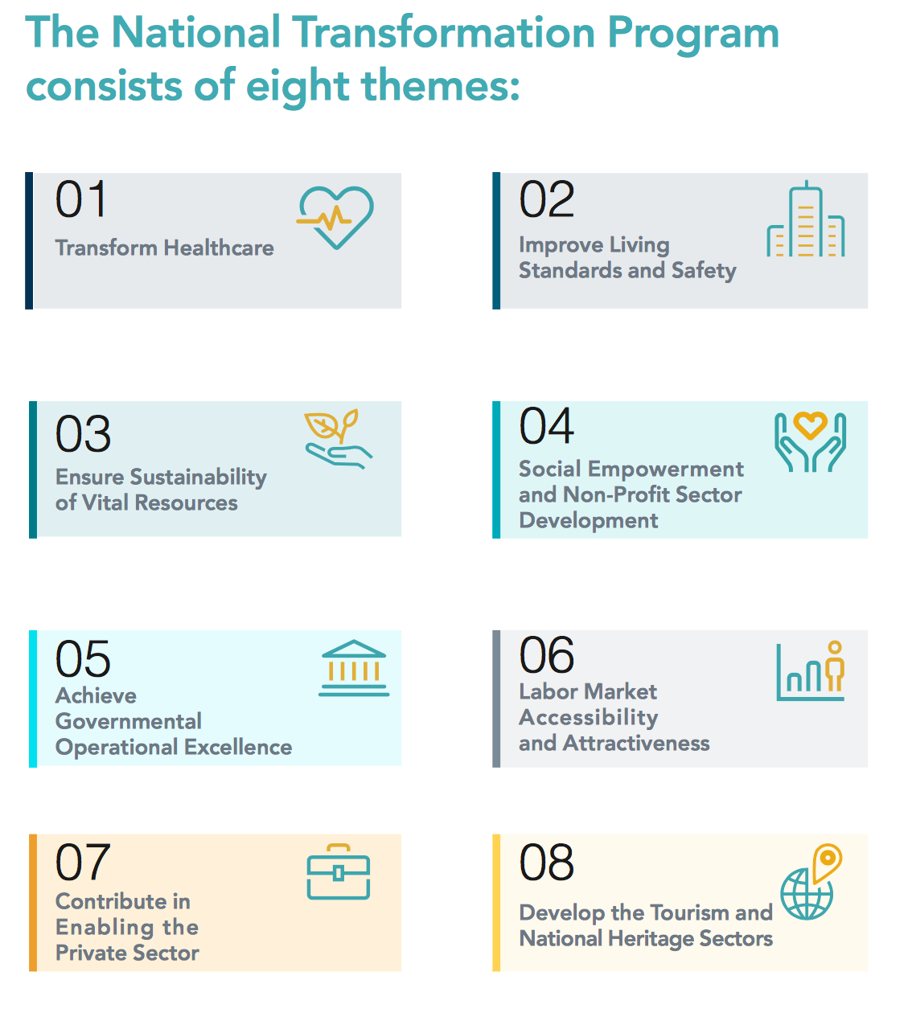

Slide 11
The First Theme (Transform Healthcare) in the NTP seeks to achieve a vibrant society by restructuring the health sector to become a comprehensive and effective system.
However, there are three major challenges:
Difficult access to health services
Limited quality and inefficient health services
Limited preventive healthcare
The main entities involved in Transforming Healthcare:
Ministry of Health
Saudi Health Council
Saudi Food and Drug Authority
King Faisal Specialist Hospital and Research Center
The Saudi Red Crescent Authority
Ministry of Education

Slide 12
Three strategic objectives to transform healthcare under Vision 2030:
Ease Access to Health Services: through:
expansion of total capacity (number of beds and medical staff)
adequate geographical distribution (distance from healthcare provider)
timely and affordable access to related healthcare services.
Improve Quality and Efficiency of Healthcare Services: through:
improvement of the quality and efficiency of the healthcare services
Improvement of the safety of the healthcare facilities
ensuring adequate healthcare coverage with financial sustainability
Promote Prevention Against Health Risks: through:
promoting public health and preventive healthcare (such as awareness and vaccination) to minimize the risks associated with health crises and diseases of communicable diseases, non-communicable diseases, and injuries.

Slide 13
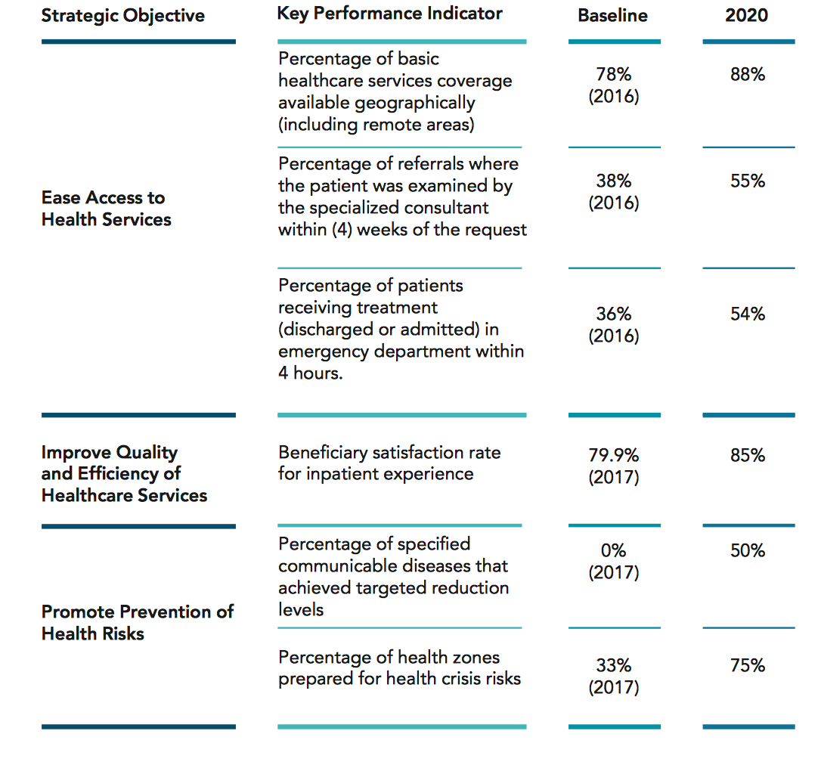
Health Transformation (First Theme of NTP) Major Indicators

Slide 14
2
National Health Sector Transformation التحول في القطاع الصحي

Slide 15
The Need for Transformation: Why do we want to change?
The population of the Kingdom continues to grow and age.
Rates of avoidable injury and non-communicable disease remain high by regional and international standards.
Primary care remains inadequate and inconsistent. Secondary and tertiary hospitals, and associated resources, are poorly distributed across the Kingdom.
There are significant gaps in the quality of services provided to patients
There is unwarranted variation in provision, access and investment when assessed using the population served rather than the patients treated
The system is currently resource and staff centric rather than patient or person centric in its orientation
There are significant gaps in workforce capacity and capability, specifically in relation to Saudi employees.
The health system also needs to support the containment of public expenditure, and the diversification of the Saudi economy.

Slide 16
Defining the Transformation Goals and Methods: What do we want to change?
Transformation Goals
Improve healthcare
Improve value
Improve health
Increase the length, wellbeing and quality of life of Saudi citizens, which includes the Vision 2030 goal of increasing the life expectancy of citizens to 80 years by 2030
By improving the quality and consistency of services and the performance and accountability of healthcare organizations and staff to deliver care that is safe, effective, patient-centered, timely and equitable
by containing costs, improving outcomes, controlling public healthcare expenditure and guiding new investment

Slide 17
All three transformation goals conform with, and are enablers of, the Vision 2030 strategic objectives for health: access, quality and public health

Slide 18
The New Models of Care التحول المؤسسي ونموذج الرعاية الصحية
Financing reforms برنامج الضمان الصحي وشراء الخدمات الصحية
Governance development الحوكمة
Private and third sector participation مشاركة القطاع الخاص والقطاع الثالث
Workforce development القوى العاملة
eHealth development الصحة الالكترونية
Provider reforms التجمعات الصحية
To achieve the previous transformation goals, The Vision Realization Office (VRO) at MOH has organized its work into seven themes (seven programs)

Slide 19
3
New Models of Care Program
التحول المؤسسي ونموذج الرعاية الصحية

Slide 20
Challenges with the Existing Models of Care
Growing hazards within healthcare facilities due to inadequate medical quality and low safety standards
Waiting times are prolonged and they vary considerably across healthcare facilities, causing inevitable dissatisfaction
Shortage of medications and available medicines are dispensed inconsistently
Lack of standardized clinical guidelines and variations in the quality and delivery of care
Poor pathway management ((مسار الرعاية, with inappropriate referrals, and inappropriate presentation by ill-informed patients disrupting patient flow
Lack of out-of-hospital services for diagnostic, preventative, proactive or follow-up care
Poorly coordinated care, particularly between MoH providers and non-governmental organization
Poor communication between providers, and between clinicians and patients

Slide 21
To address these challenges, MoH has developed a program to design, pilot, and implement a patient centric New Models of Care Program

Slide 22
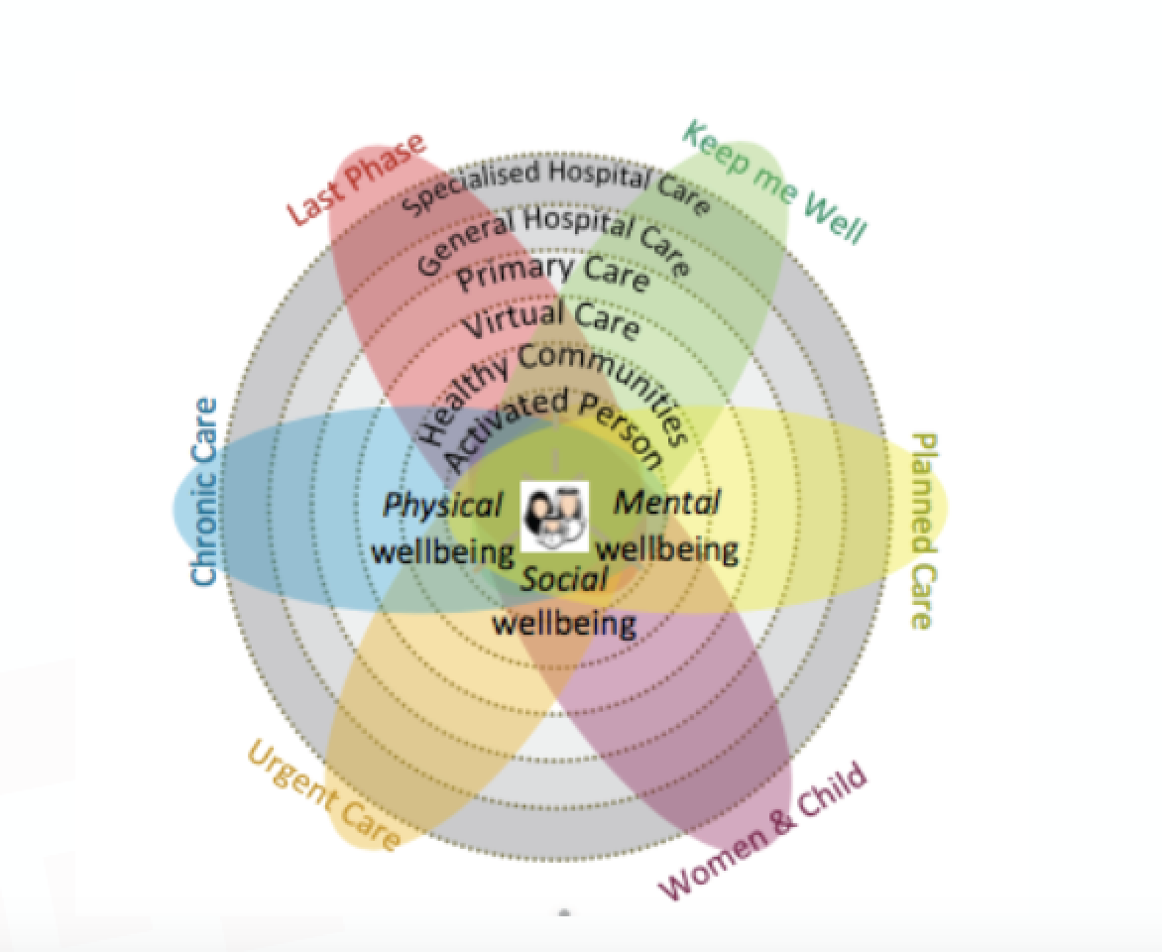
The program has been designed to answer six key questions:
1. How will the system help to keep me well? (preventive care)
2. How will the system support me when I have an urgent problem? (urgent care)
3. How will the system support me to have a great outcome for my planned procedure? (planned care)
4. How will the system support me to safely deliver a healthy baby? (women & child)
5. How will the system support me with my chronic conditions? (chronic care)
6. How will the system support me with compassionate care during the last phase of
my life? (palliative care; last phase)
➔ Systems of Care
Notes:
.

Slide 23
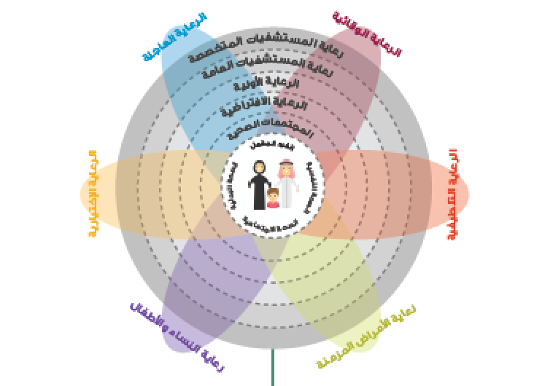

Slide 24
The New Models of Care program is designed to support people with their health and wellness needs: physical wellbeing, mental wellbeing and social wellbeing.
This aligns with the principles set out in the Constitution of the World Health Organization: “health is a state of complete physical, mental and social wellbeing and not merely the absence of disease or infirmity”.

Slide 25
Levels of Care in the New Models of Care Program:
Activated Person: Active individuals are at the heart of the model by enabling them and their families to maintain their health, through self-care services, and health education.
Healthy Communities: The second level emphasizes the role of healthy communities in supporting active individuals By encouraging them to adopt a healthy lifestyle, providing them with appropriate information, and empowering them to access to community health facilities.
Virtual Care: Virtual care will be a powerful source of health advice. Virtual care in most instances will serve as people’s first point of contact with medical care providers, improving people’s access to medical advice and guiding them to navigate the healthcare system and seek appropriate care.
Primary Care.
Secondary Care (general hospital care).
Tertiary Care (specialized hospital care).

Slide 26
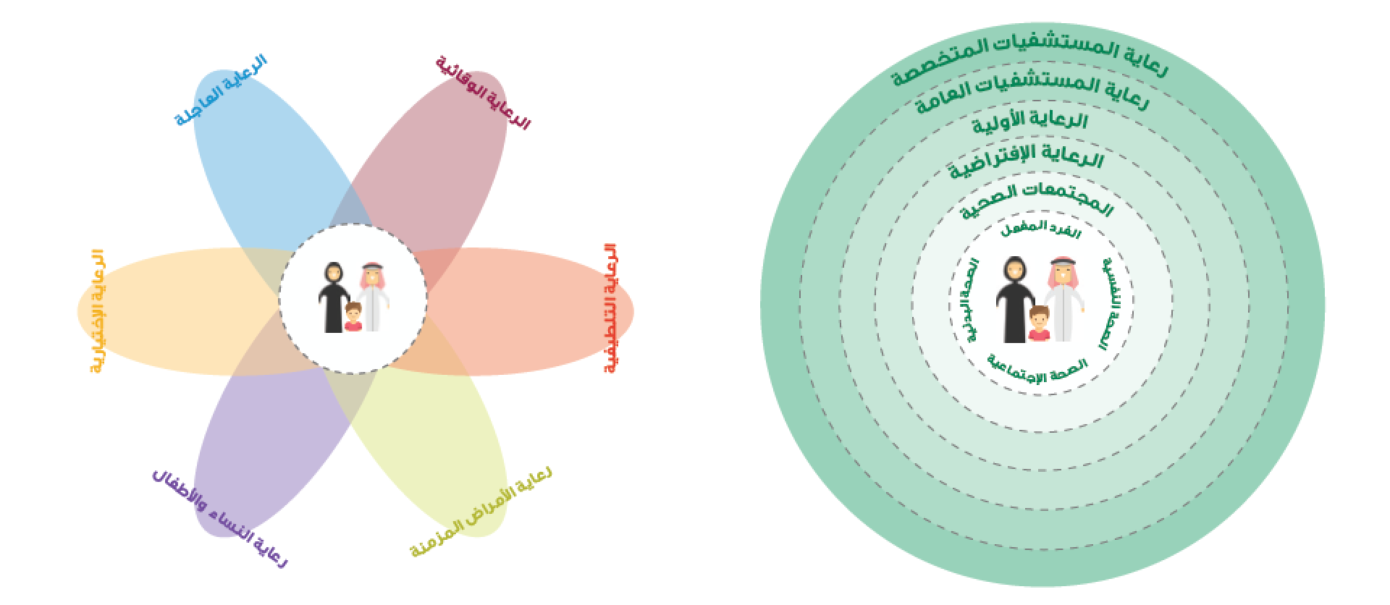

Slide 28
The New Models of Care program has been designed based on the following FIVE principles:
Empowering people and their families to take control of their health
Providing knowledge to people as part of their treatment, and enabling them to be well-informed and in control of their health
Fully integrating the health system from the people’s perspective
Keeping people healthy and focusing on the whole population through a preventive approach, rather than a solely curative approach to health provision
Providing treatment in a patient-friendly and outcome-focused way, without overtreating or under-treating patients.

Slide 29
The Enablers of New Models of Care program
Private Sector Participation
Financing
Non-profit Sector Participation
Governance & Regulations
eHealth
Workforce

Slide 30
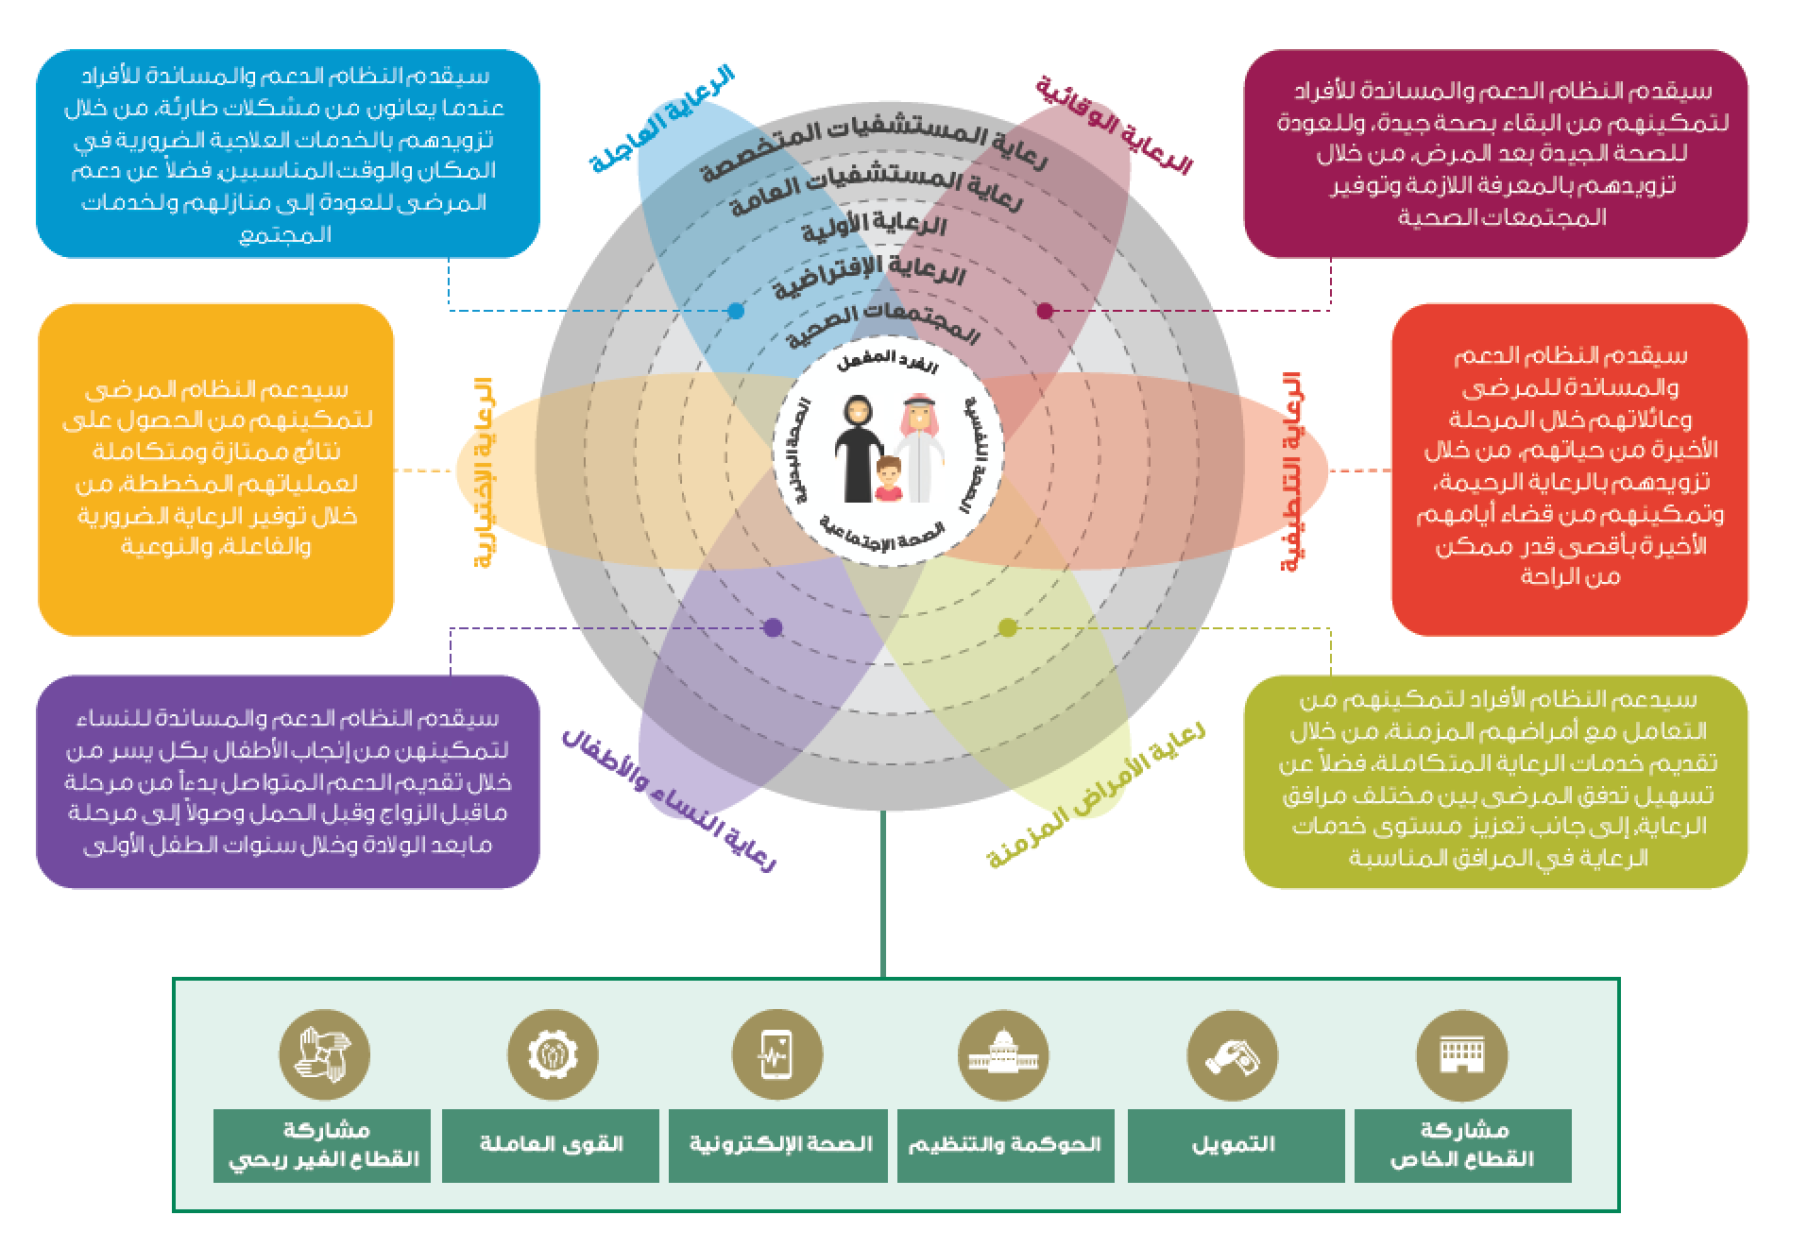

Slide 31
The New Models of Care Program will deliver 42 coordinated interventions (i.e. initiatives), across six ‘systems’ of care by the end of 2020.
The 42 initiatives will include defined patient pathways and key performance indicators (KPIs) including measurement of: safety and quality process metrics, clinical and patient reported outcomes, and financial performance.

Slide 32
4
Health in All Policies (HiAP) in National Health Policy

Slide 33
Health in All Policies (HiAP)
HiAP is an approach to public policies across sectors that systematically takes into account the health implications of decisions, seeks synergies, and avoids harmful health impacts in order to improve population health and health equity.
As a concept, it reflects the principles of: legitimacy, accountability, transparency and access to information, participation, sustainability, and collaboration across sectors and levels of government.
Announced at the 8th Global Conference on Health Promotion, Helsinki, Finland, 10-14 June 2013

Slide 34
“We call on governments:
Commit to health and health equity as a political priority by adopting the principles of Health in All Policies and taking action on the social determinants of health.
Ensure effective structures, processes and resources that enable implementation of the Health in All Policies approach across governments at all levels and between governments.
Strengthen the capacity of Ministries of Health to engage other sectors of government through leadership, partnership, advocacy and mediation to achieve improved health outcomes.
Build institutional capacity and skills that enable the implementation of Health in All Policies and provide evidence on the determinants of health and inequity and on effective responses.
Adopt transparent audit and accountability mechanisms for health and equity impacts that build trust across government and between governments and their people.
Establish conflict of interest measures that include effective safeguards to protect policies from distortion by commercial and vested interests and influence.
Include communities, social movements and civil society in the development, implementation and monitoring of Health in All Policies, building health literacy in the population”

Slide 35
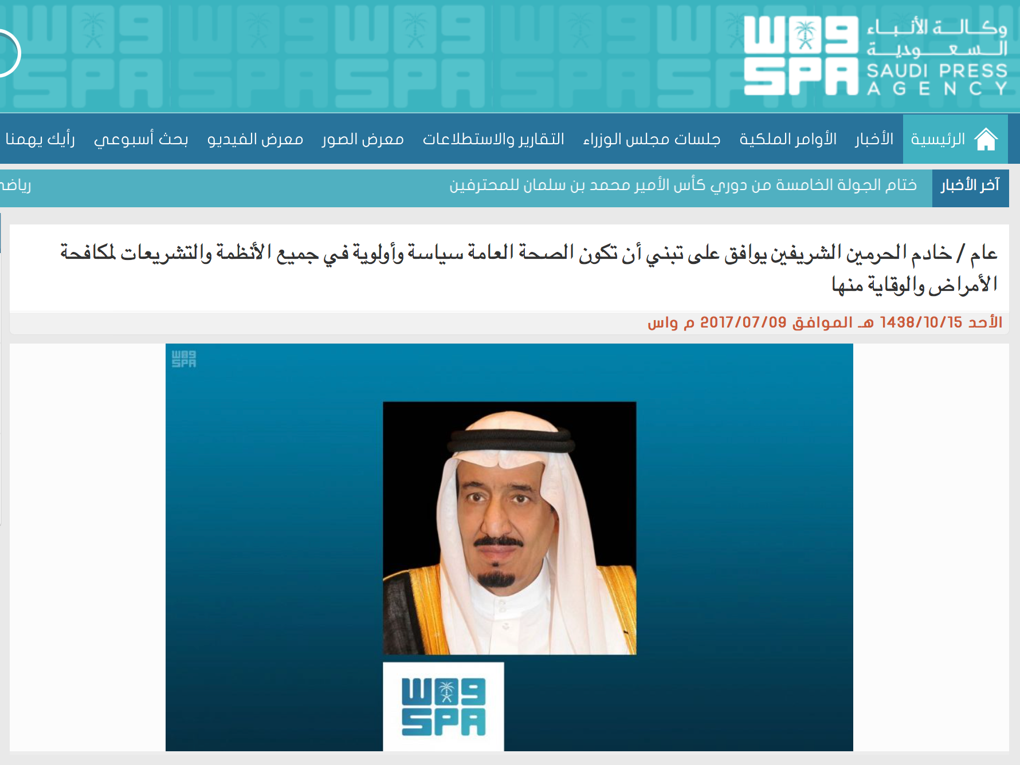
In 2017, An approval was granted by Custodian of the Two Holy Mosques King Salman for Public health to be adopted as a policy and priority in all regulations and legislations for preventing diseases.
A ministerial committee was formed for Health in All Policies in Saudi Arabia with ministerial membership (Health, Education, Commerce, MOMRA, and others)

Slide 36
Thank you!
Office Hours (by appointment via email):
Mondays & Wednesdays
11 AM – 1 PM
West Building
Level 1 - Office 4011034
nmalamro@ksu.edu.sa

Slide 37
References
Saudi Vision 2030. Accessed 28 September 2019: https://vision2030.gov.sa/en/node
Saudi Vision 2030: Strategic Objectives and Vision Realization Programs. Accessed 28 September 2019: https://vision2030.gov.sa/sites/default/files/report/Vision%20Realization%20Programs%20Overview.pdf
Saudi Vision 2030. National Transformation Program Delivery Plan 2018-2020. Accessed 28 September 2019: https://vision2030.gov.sa/sites/default/files/attachments/NTP%20English%20Public%20Document_2810.pdf
Ministry of Health. Healthcare Transformation Strategy, V3. Accessed 28 September 2019: https://www.moh.gov.sa/en/Ministry/vro/Documents/Healthcare-Transformation-Strategy.pdf
Ministry of Health. Health Sector Transformation Plan (HSTP). Accessed 28 September 2019: https://www.moh.gov.sa/Ministry/MediaCenter/Publications/Documents/2019-01-15.pdf
World Health Organization. Health in All Policies: Framework for Country Action. Accessed 28 September 2019: https://www.who.int/healthpromotion/frameworkforcountryaction/en/
SPA. King approves adopting public health as a policy. 2017. Accessed 28 September 2019: https://www.spa.gov.sa/1646247

