Slide 1
Emerging Infectious Diseases
Dr Rufaidah Al Dabbagh, MBBS, MPH, DrPH
Community Medicine Unit, Family & Community Medicine Department
19, 11, 2019

Slide 2
Objectives
Understand the viral antigenic variations of influenza virus
List the different hosts for influenza (according to influenza type), MERS-Cov and SARS
Be familiar with the famous pandemics for each of these viral infections, and measures used to contain spread
Identify the different elements in the infection cycle for these viral infections
Provide appropriate prevention and control measures for each of these viral infections
Outline how to take history of risk factors, and how to give preventive advise

Slide 3
What is an emerging infectious diseases?
Emerging infectious diseases are those that:
Occur among humans for the first time
Occurred previously in a small number and suddenly increased in number
Have been occurring throughout history but only recently recognized as distinct diseases
Source: National Institutes of Health (US); Biological Sciences Curriculum Study. NIH Curriculum Supplement Series [Internet]. Bethesda (MD): National Institutes of Health (US); 2007. Understanding Emerging and Re-emerging Infectious Diseases. Available from: https://www.ncbi.nlm.nih.gov/books/NBK20370/. Accessed on: Nov 19, 2019.

Slide 4
1. Influenza Virus

Slide 5
Influenza Virus
Orthomyxoviridae
Virus subtypes are antigenically distinct (no cross-immunity)
Frequently subject to antigenic variation
Antigenic changes occur in types A or Type B, with type C being stable
This Photo by Unknown Author is licensed under CC BY-ND

Slide 6
Influenza Virus: Types and Variation

Slide 7
Antigenic Types of Influenza Virus
Antigen Type | Who does it infect? | What does it cause?
A | Human | Seasonal epidemic, Pandemic
B | Human | Seasonal epidemic
C | Human | Mild respiratory illness
D | Cattle | --

Slide 8
Influenza A subtypes
Subtypes are based on the two surface proteins;
Hemagglutinin (H); antigen initiates infection
Neuraminidase (N); antigen releases virus
There are:
18 hemagglutinin subtypes (H1 to H18)
11 neuraminidase subtypes (N1 to N11)

Slide 9
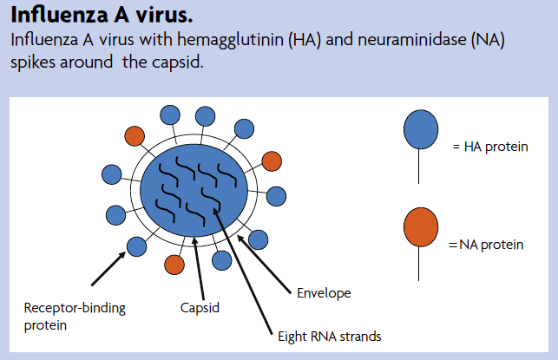
Influenza A Virus
Source: Balgopal M, Bondy C. Antigenic shift and drift. Scientific Teacher 2011; 34-38.

Slide 10
Influenza A subtypes infective to humans
Currently circulating viruses type A are:
H₁N₁
H₃N₂

Slide 11
Influenza Type B
Type B influenza does not have subtypes
It can be divided into two lineages:
B/Yagamata
B/Victoria

Slide 12
Antigenic Variation
Antigenic Shift
Complete sudden change
Results from genetic recombination of human virus with animal or avian virus Responsible for pandemic strains
Antigenic drift
Happens continually over time
Results from point mutation of the gene -> changes in surface proteins

Slide 13
What does this mean?
Antigenic drifts produce viruses with similar antigenic properties -> coss-pretection
Antigenic shifts happen less frequently than antigenic drifts
Type A viruses undergo both antigenic drift and shift
Type B viruses undergo antigenic drift only
Notes:
Several antigenic drifts can occur over time producing viruses to which the human does not have immunity, thus causing infection. This is the reason why people can get the flu more than one time.

Slide 14
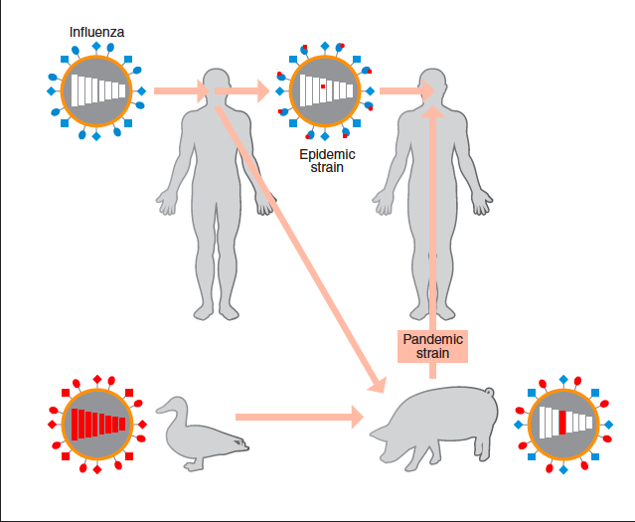
Antigenic Shift
2
1
3
Source: Doherty PC, Turner SJ. Q and A: What do we know about influenza and what can we do about it? J Biol 2009; 8: 46
Notes:
Three different methods for antigenic shift:
1- virus from human and avian reassort in the swine
2- virus jumps from avian to human
3- virus jumps from avian to swine to human without reassortment

Slide 15
Naming of Influenza Viruses
These are named in the following order:
The antigenic type (e.g., A, B, C)
The host of origin (e.g., swine. For human-origin viruses, no host of origin designation is given.)
Geographical origin
Strain number
Year of isolation
For influenza A viruses, the hemagglutinin and neuraminidase antigen description in parentheses

Slide 16
Example of naming
What does this mean?
A/duck/Alberta/35/76 (H1N1)
A/Perth/16/2009 (H3N2)
Antigen
Geographic origin
Year
Hemagglutinin and neuraminidase subtypes
Host of origin
Strain number
No host origin because from human

Slide 17
Reservoir, Mode of Transmission, Symptoms, and Diagnosis

Slide 18
Reservoir for Influenza
Animals (swine, horses, dogs, cats)
Birds (poultry, wild birds)

Slide 19
Characteristics of Influenza Infection
Source of infection is an infected host (a case or subclinical)
Secretions of respiratory tract are infective
Period of infectivity: 1-2 days prior to symptoms, and 5-7 days after symptom onset
Portal of entry: respiratory tract
Incubation period: 18 – 72 hrs

Slide 20
Symptoms
Fever, chills, aches, coughing, generalized malaise
Fever lasts for 1-5 days (average 3 days)
Complications:
Secondary bacterial infection
Otitis media
Sinusitis
Bronchitis
Pneumonia
Raye syndrome
Notes:
Raye syndrome: Rapid hepatic failure and encephalopathy associated with aspirin use in children in a variety of viral infections. Particularly related to type B. Mortality is 30%.

Slide 21
Diagnosis
Testing should not be done for all
Useful in order to verify if the influenza is a cause of an outbreak
Specimen collected within 3-4 days of illness:
Nasopharyngeal swab; nasal swab; nasal wash or aspirate; lower respiratory tract
Lab tests:
Viral culture
Serology
rRT-PCR

Slide 22
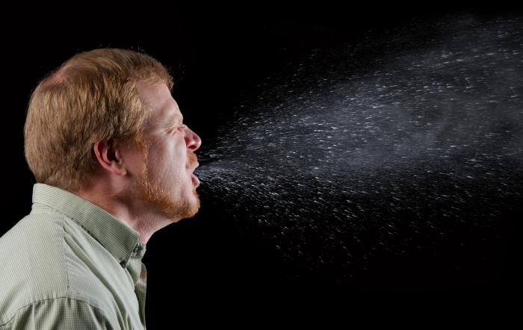
Mode of transmission
person-to-person by droplet or droplet nuclei
Touching surface contaminated with influenza virus
This Photo by Unknown Author is licensed under CC BY-ND

Slide 23
Risk factors for infection
Season: Winter or rainy season
Age: More severe disease in older age and children younger than 18 m
Overcrowding
Contact with infected individual
Immunity
Antibody against H antigen vs. antibody against N antigen
High risk for severe disease:
Chronic diseases; pregnant; elderly; DM; CHD; CLD; Immunocompromised

Slide 24
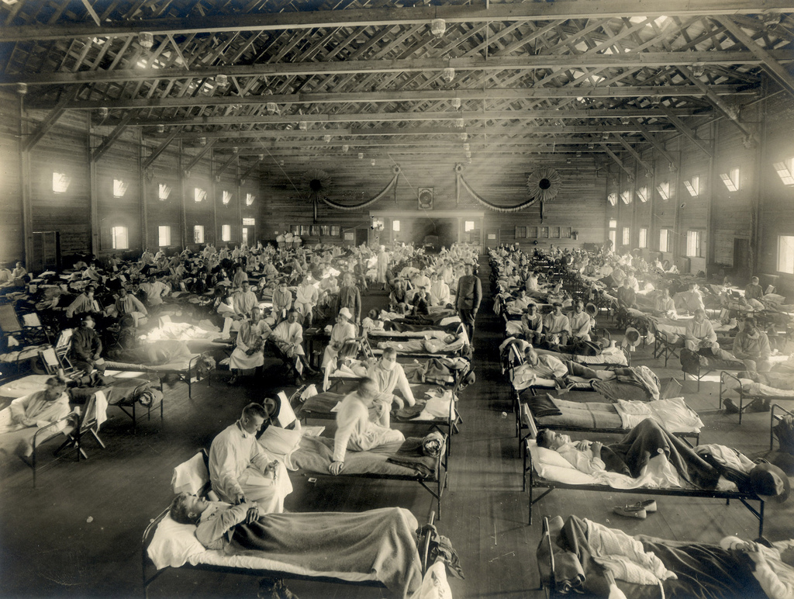
Historical Pandemics
This Photo by Unknown Author is licensed under CC BY-SA

Slide 25
Date of Pandemic | Influenza Subtype | Death Toll
1918-1919 | Spanish Influenza H₁N₁ | 50 million
1957-1958 | Asian Influenza H₂N₂ | 2 million
1968-1969 | Hong Kong Influenza H₃N₂ | 1 million
2009-2010 | H₁ N₁ (Swine flu) – novel subtype | 18.2 thousand +

Slide 26
Signs of an Outbreak
Starts with few cases
Sudden outburst of disease
Increased febrile illness in children followed by adults
Increased hospitalization due to illness
Attack rates are high: 5-10% in adults; 20-30% children
Epidemic peaks within 3-4 weeks then declines
Notes:
What makes influenza easy to spread?
Short incubation period
Increased number of susceptible population
No cross immunity
Large number of subclinical individuals

Slide 27
Control of Infection and Prevention

Slide 28
Prevention of Influenza
Follow cough etiquette ( cover mouth and nose while sneezing)
Wash hands
Vaccination to prevent severe disease

Slide 29
Influenza Vaccine
Provides 90% protection in healthy adults
Reduce severity of disease by 60%; death by 80%
Usually takes two weeks after vaccination for body to produce immunity
One vaccine for northern hemisphere and one for southern hemisphere
Immunity against two type A (H₁N₁; H₃N₂) , and B (trivalent)
Immunity against two type A and two B

Slide 30
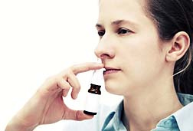
Flu Vaccines Available in KSA
This Photo by Unknown Author is licensed under CC BY-NC
This Photo by Unknown Author is licensed under CC BY-ND
Injection vaccine:
Inactivated virus
Ages 6 months and above
Safe for pregnant women
Targets H antigen
Nasal spray vaccine:
Live weakened virus
Ages 2y to 49 y
NOT safe for pregnant women
Targets both H and A antigens
Source: Ministry of Health. Seasonal influenza vaccination. Available at: https://www.moh.gov.sa/en/Flu/Pages/Prevention.aspx. Accessed on: Nov 18. 2019.

Slide 31
According to the MOH the following are recommended for flu vaccination
All Diabetics
Individuals with asthma; COPD
Patients with chronic cardiac diseases; chronic renal diseases; chronic liver diseases
Neurological Disorders
Immune deficiency patients
Morbidly obese individuals
Pregnant women
6 m - 18 y on long term Aspirin therapy
Children aged 6m – 5y; adults 50+ y
All health care workers

Slide 32
Vaccine Complications and Contraindications
Complications include symptoms that appear for no more than 48 hours:
Mild redness or swelling at the injection site
Slight rise in temperature
Minor body aches
Sore throat
Contraindications:
Those who have severe egg allergy
Previous history of severe allergy to influenza vaccine
History of Guillain Barre Syndrome after taking the vaccine
Children under 6 months
People suffering from very high or moderate temperature
Source: Ministry of Health. Seasonal influenza vaccination. Available at: https://www.moh.gov.sa/en/Flu/Pages/Prevention.aspx. Accessed on: Nov 18. 2019.

Slide 33
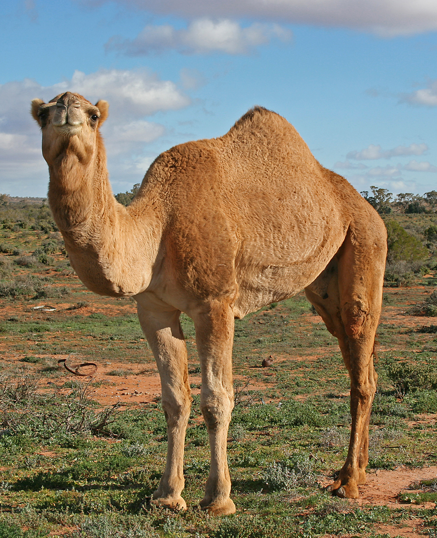
2. Middle Eastern Respiratory Syndrome (MERS-CoV)
This Photo by Unknown Author is licensed under CC BY-SA-NC

Slide 34
MERS-CoV
Caused by the coronavirus
First discovered in Saudi Arabia in 2012
It was a novel virus
Majority of infections occurred in healthcare setting (unprotected healthcare provision)
Countries in which the virus was reported:
Algeria, Austria, Bahrain, China, Egypt, France, Germany, Greece, Islamic Republic of Iran, Italy, Jordan, Kuwait, Lebanon, Malaysia, the Netherlands, Oman, Philippines, Qatar, Republic of Korea, Saudi Arabia, Thailand, Tunisia, Turkey, United Arab Emirates, United Kingdom, United States, and Yemen
Around 80% of cases reported in Saudi Arabia

Slide 35
Reservoir, Mode of Transmission, Symptoms, and Diagnosis

Slide 36
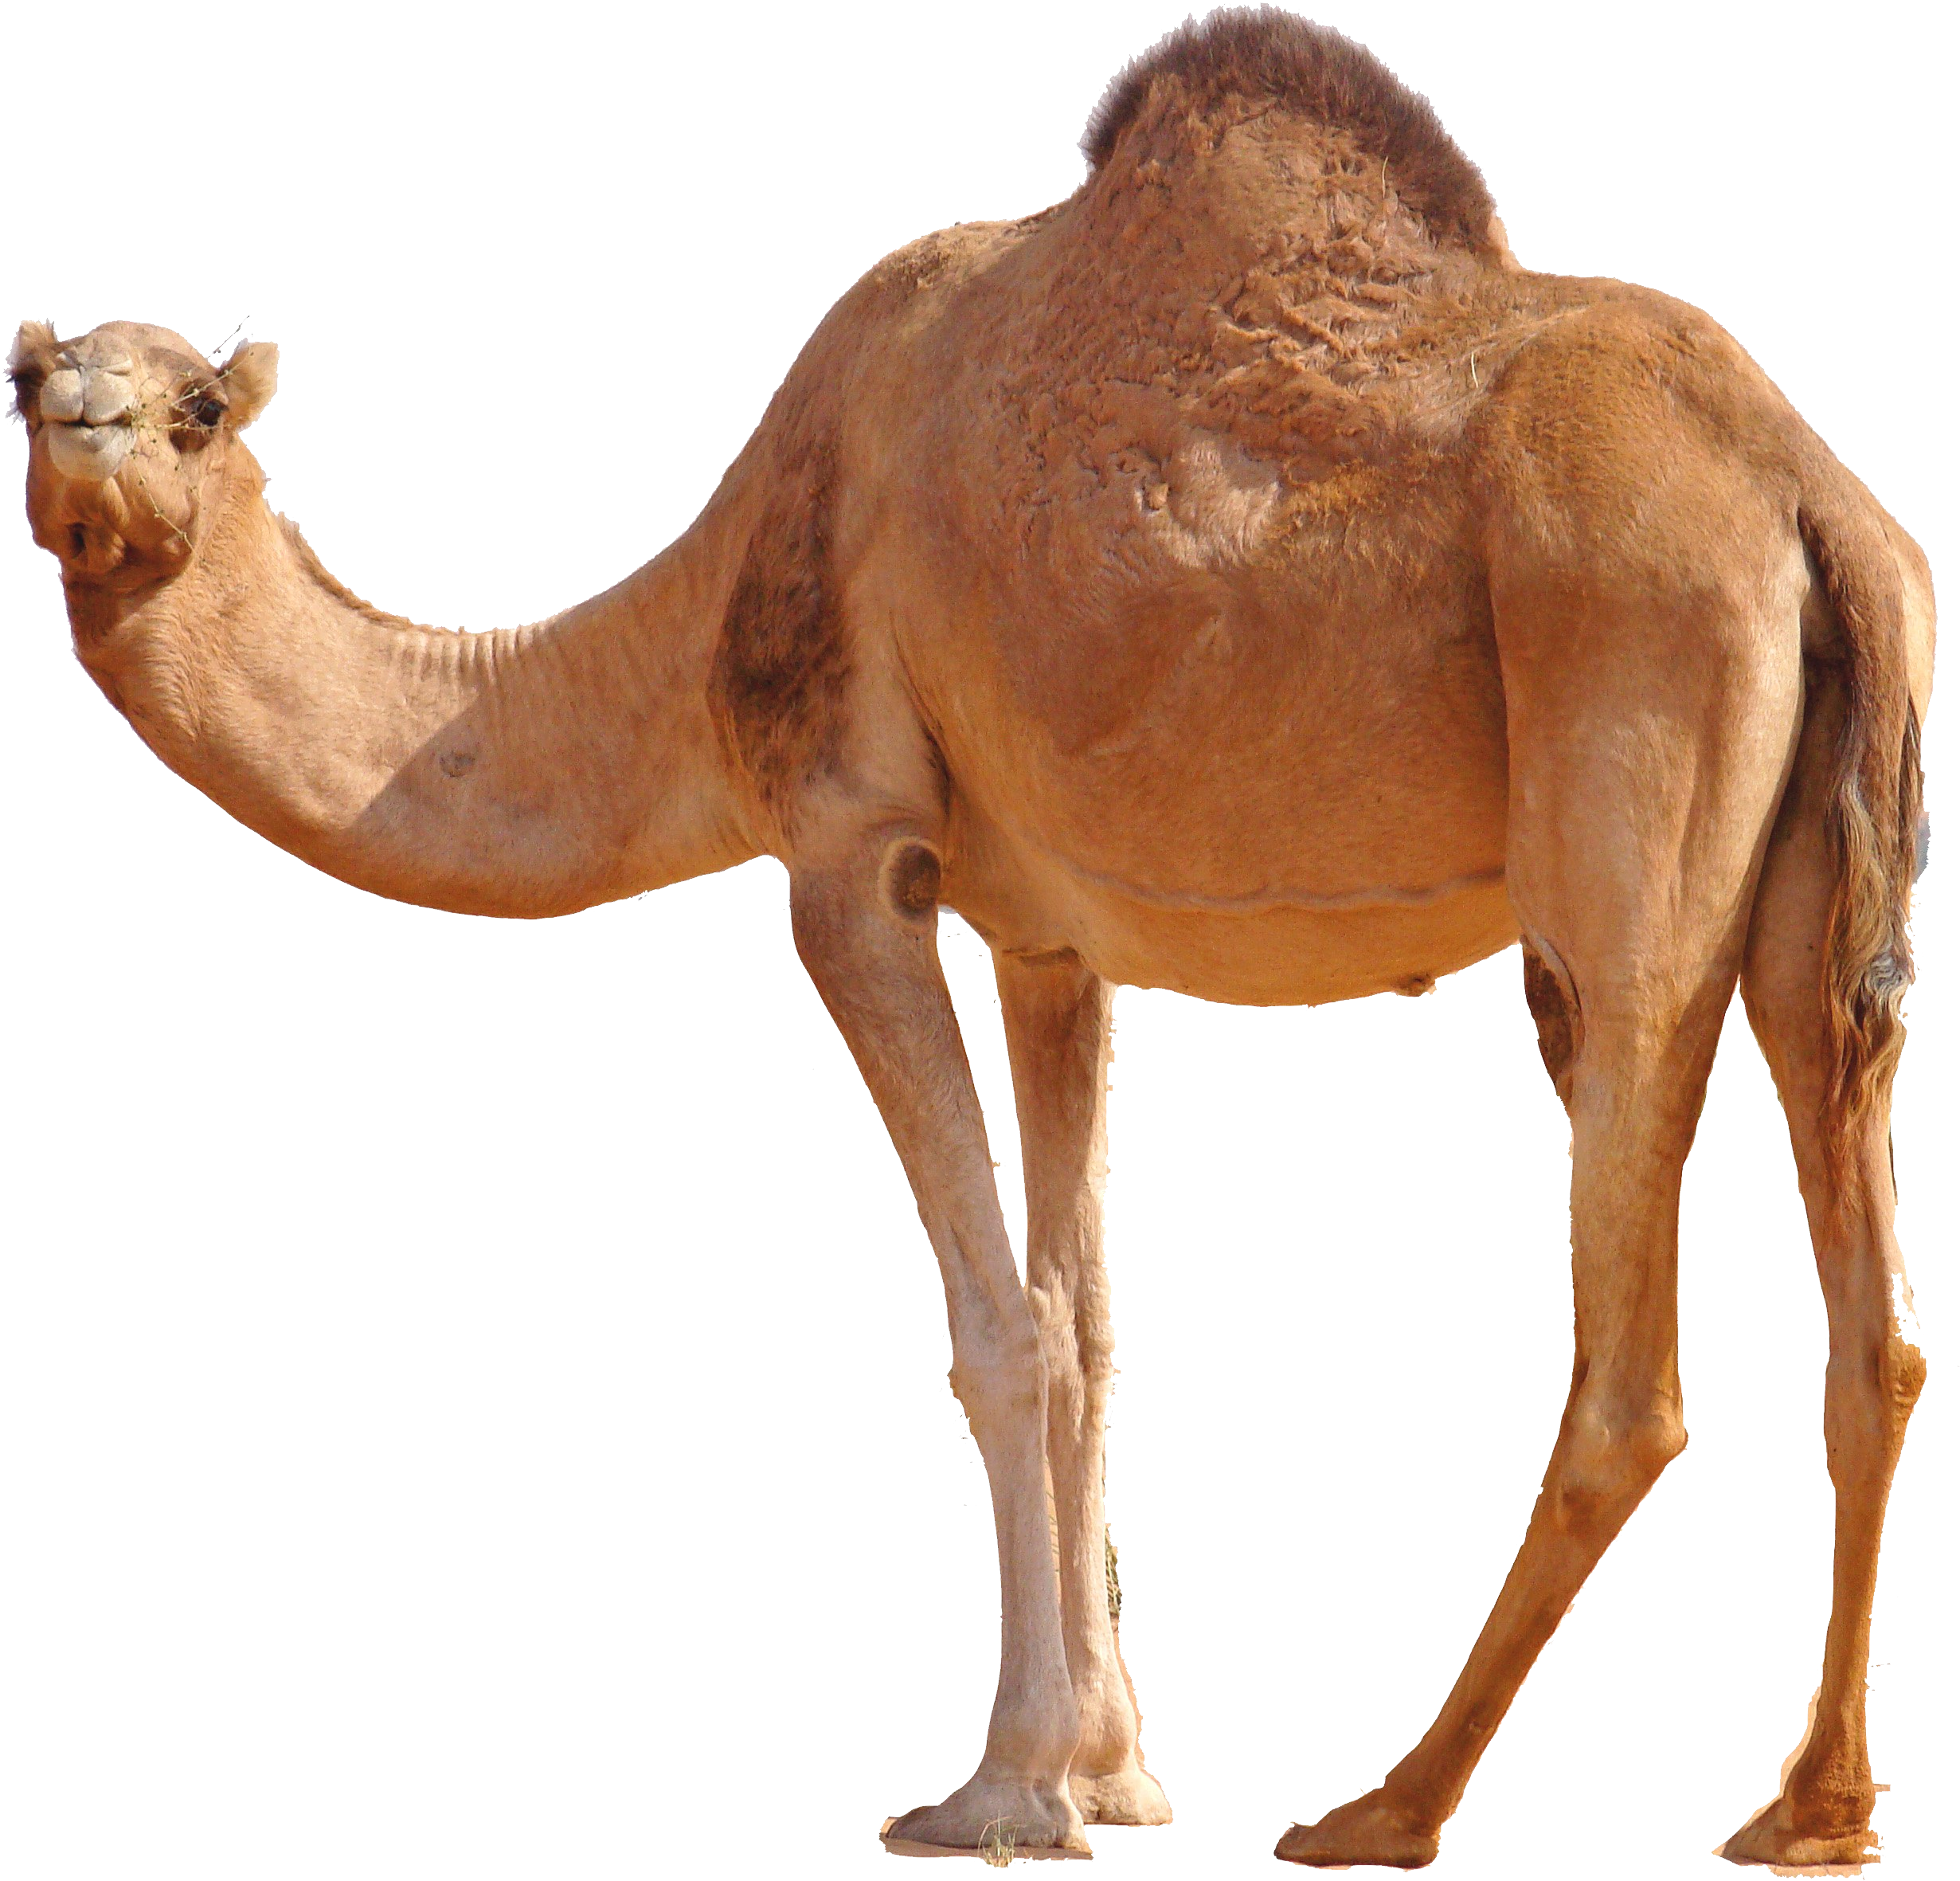
Source of MERS-CoV
Animal source in the Arabian peninsula
The virus has also been found in camels (Dromedary camels)
May have originated in bats then transmitted to camels sometime in the past ?
This Photo by Unknown Author is licensed under CC BY-NC

Slide 37
Symptoms
Fever
Cough
Shortness of breath
Could present with mild symptoms
Could be asymptomatic
GI symptoms
Complications
Pneumonia ; respiratory failure -> ventilator
Death reported in 30% to 40% of infected people

Slide 38
MERS-CoV cont.
Incubation period
2 – 14 days
Mode of transmission
Person-to-person (close contact) ; from patient to healthcare worker; family members; between patients
From camels to humans; Exact route of transmission and role of camel in the infection cycle is not known

Slide 39
Risk Factors for Infection MERS-CoV
People who have had close contact, such as caring for or living with, a confirmed case of MERS
Healthcare personnel who do not use recommended infection-control precautions
People who have had contact with camels; visiting farms
Consumption of raw animal products
Elderly; immunocompromised; chronic disease

Slide 40
Diagnosis of MERS-CoV
Nasopharyngeal swab -> rRT-PCR
If negative -> retest lower respiratory specimen
Cases should be reported within 24 hrs (category 1 reportable disease)

Slide 41
Treatment of MERS-CoV
No treatment is available
Only treatment to relieve symptoms
Support vital organ functions in severe cases
No vaccine is available

Slide 42
Prevention of MERS-CoV
Handwashing
Cough etiquette
Avoid touching your eyes, nose and mouth with unwashed hands
Avoid personal contact, or sharing cups or eating utensils, with sick people
Clean and disinfect frequently touched surfaces and objects, such as doorknobs
Healthcare workers practice infection control precautions; negative pressure room, masks…etc.

Slide 43
Source: https://www.moh.gov.sa/CCC/healthp/regulations/Documents/MERS-CoV%20Guidelines%20for%20Healthcare%20Professionals%20-%20May%202018%20-%20v5.1%20%281%29.pdf

Slide 44
3. Sever Acute Respiratory Syndrome (SARS-CoV)

Slide 45
SARS-CoV
Also an infection caused by coronavirus
First reported in Asia in 2003
Spread to more than 24 countries around the world
8,098 cases -> 774 deaths
No cases have been reported after 2004

Slide 46
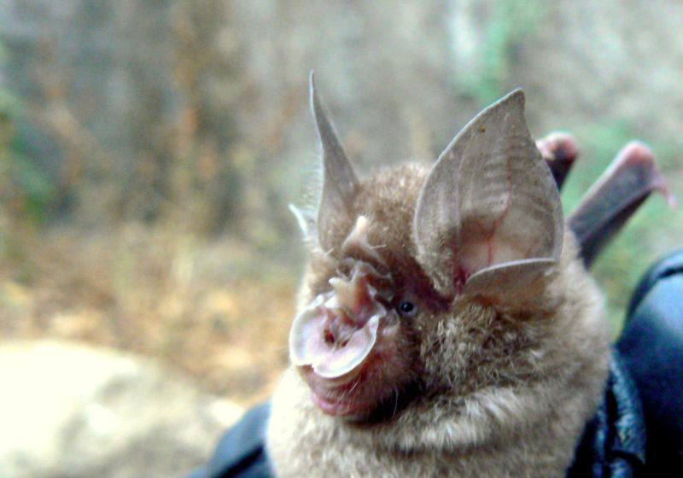
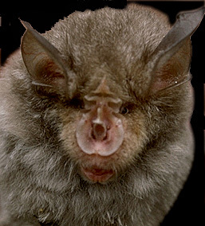
Reservoir
Horseshoe bat
This Photo by Unknown Author is licensed under CC BY-SA
This Photo by Unknown Author is licensed under CC BY-SA-NC

Slide 47
Mode of transmission
Direct: Person-to-person; respiratory droplet
Indirect: Contacting surface contaminated with respiratory droplet
May be airborne ?
In healthcare setting: Aerosol-generating procedures
Virus shed in stool – not clear feco-oral transmission
Incubation period: 2 – 7 days

Slide 48
Symptoms
High fever
Headache
Overall feeling of discomfort
Generalized body aches
Mild respiratory symptoms
Dry cough
Diarrhea
Complications
Pneumonia; pulmonary decompensation; ARDS

Slide 49
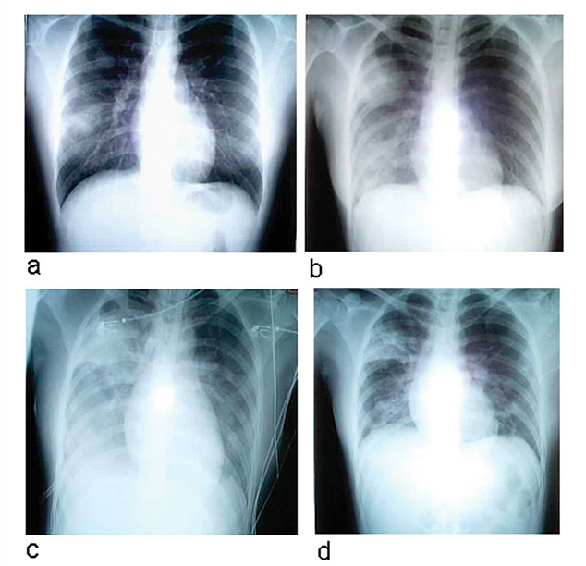
Signs on chest x-ray
Unilateral patchy shadowing
After 1-2 days: bilateral interstitial infiltration
Later: Air-space opacities
Day 5
Day 10
Day 13
Day 15
Source :Hsu LY, Lee CC, Green JA, Ang B, Panton NI, Lee L, et al. Sever acute respiratory syndrome (SARS) in Singapore: clinical features of index patients and initial contact. Emerg Infect Dis 2003; 9(6): 713-717

Slide 50
Diagnosis
Usually based on clinical history
If history suggestive of SARS and x-ray normal -> thin cut CT
Laboratory: rRT-PCR

Slide 51
Treatment
No clear scientifically proven treatment available
Severe cases require intensive care
Antiviral treatment is questionable; some studies suggest poorer outcomes for those receiving antiviral agents

Slide 52
Prevention and Control
No vaccine available
Handwashing and infection control precautions
In case of reported cases, early identification and efficient reporting of cases
Isolation of patients with infection
Exit screening for international travelers
Appropriate protection of medical staff caring for patients

Slide 53
References
Park K. Park's textbook of preventive and social medicine. 23rd Edition. Jabalpur : M/S Banarsidas Bhanot, 2015. (Ch 5)
Centers for Disease Control and Prevention. Types of influenza viruses. Available from: https://www.cdc.gov/flu/about/viruses/types.htm. Accessed on: Nov 18, 2019.
Ministry of Health. Seasonal influenza vaccination. Available from https://www.moh.gov.sa/en/Flu/Pages/Prevention.aspx. Accessed on: Nov 18. 2019.
World Health Organization. Middle East respiratory syndrome coronavirus (MEARS-CoV). Available from: https://www.who.int/news-room/fact-sheets/detail/middle-east-respiratory-syndrome-coronavirus-(mers-cov). Accessed on: Nov 18, 2019.
Centers for Disease Control and Prevention. SARS basics fact sheet. Available from: https://www.cdc.gov/sars/about/fs-sars.html. Accessed on: Nov 18, 2019.

Slide 54
Any
Questions?

