Slide 1
International Health Regulations
(IHR)
Dr. Noura A. Abouammoh
nabouammoh@ksu.edu.sa

Slide 2
Objectives
What are International health regulations? Why are they needed?
What strategies are globally adopted to control public health related diseases?
What are the challenges faced by different countries while implementing IHR?
IHR in Saudi context.

Slide 3
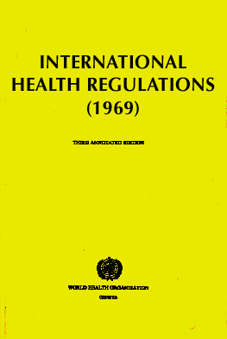
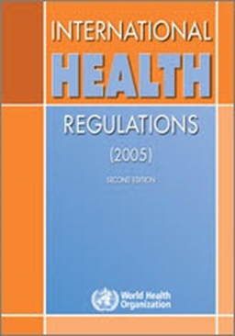
Brief History
1851: First International Sanitary Conference, Paris
1951: First International Sanitary Regulations (ISR)
adopted by WHO member states
1969: ISR replaced and renamed the International
Health Regulations (IHR)
1995: Call for Revision of IHR
2005: IHR (2005) adopted by the World Health Assembly

Slide 4
Brief History
2006: World Health Assembly vote that IHR (2005) will enter into force in June 2007
15 June 2007: IHR entered into force and are binding on 194 States Parties
2007-2009: Member States assessed and improved their national core capacities for surveillance and reporting
2012: the core capacities were in place and functioning

Slide 5
What is IHR?
This legally-binding agreement.
It significantly contributes to global public health security.
providing a new framework for the coordination of the management of events that may constitute a public health emergency of international concern.
improve the capacity of all countries to detect, assess, notify and respond to public health threats.

Slide 6
Purpose and scope of IHR
IHR (2005):
To prevent, protect against, control and provide a public health response to the international spread of disease.
In a way commensurate with and restricted to public health risks.
Which avoid unnecessary interference with international traffic and trade
IHR (1969):
To provide maximum security against international spread of diseases with minimum interference with world traffic
Only 3 diseases (cholera, plague and yellow fever)
Dependence on affected country to notify and lack of mechanism for collaboration between WHO and affected countries.

Slide 8
Assess events and notify potential Public Health Emergency of International Concern
What is PHIEC?
An extraordinary public health event which constitute a public health risk to other countries through international spread of disease and potentially requires a coordinated international response.
They include those caused by infectious diseases, chemical agents, radioactive materials and contaminated food.

Slide 9
Any event irrespective of origin and source meeting 2 or more of the following criteria is considered as PHEIC and should be notified to WHO according to IHR (2005):
1. Unusual or unexpected event
2. Resulting in serious public health impact
3. With significant risk of international spread
4. Significant risk of international travel or trade restriction.

Slide 10
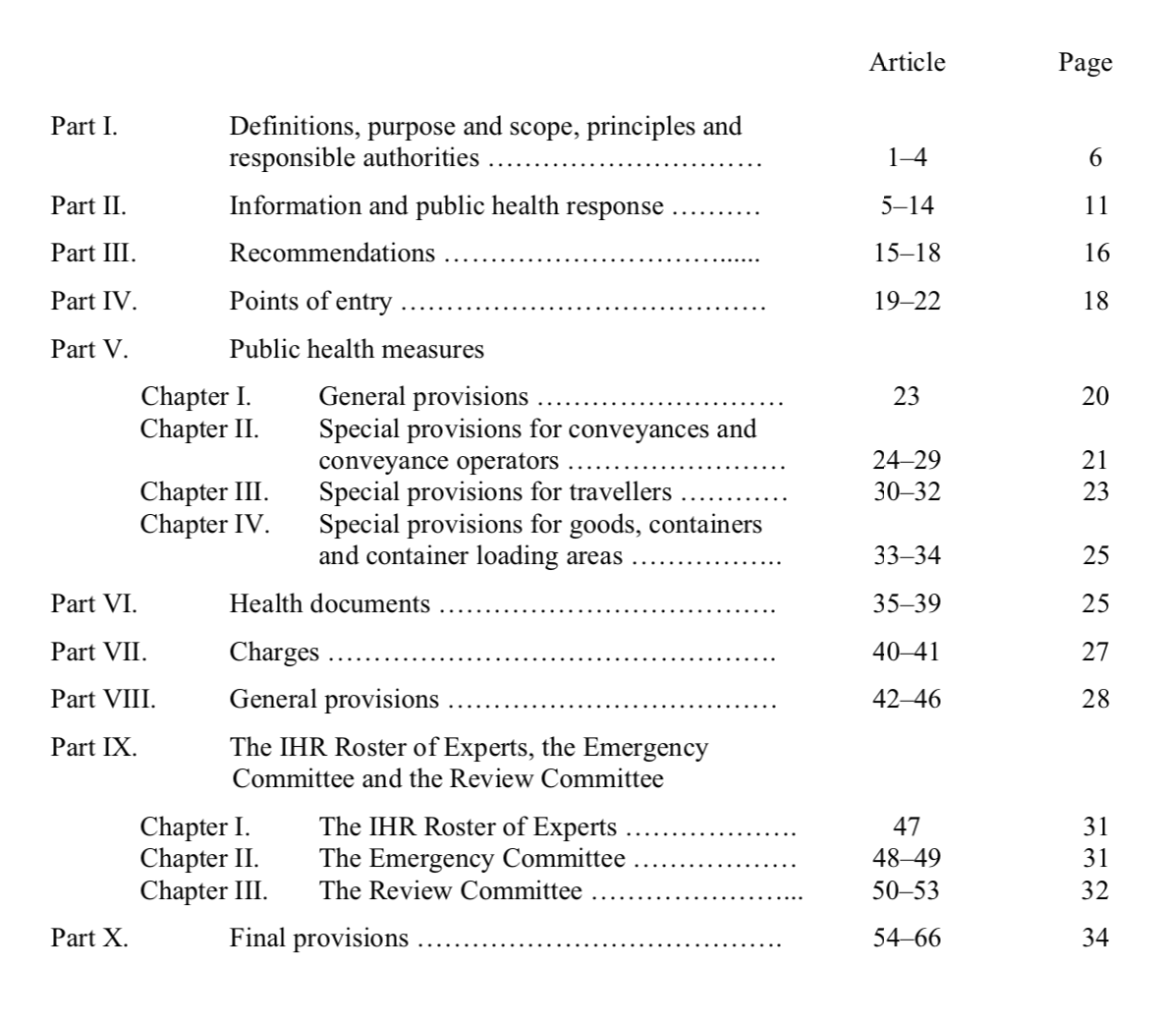
IHR (2005) Document
66 articles organized in 10 parts.

Slide 11
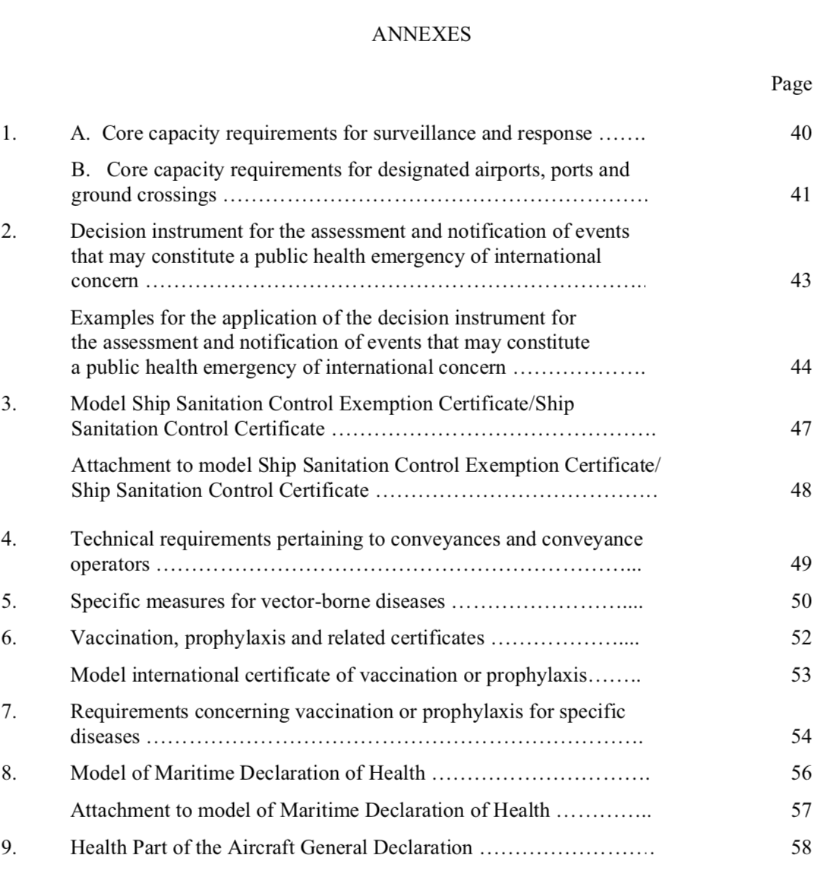
IHR (2005) Document
9 Annexes

Slide 13
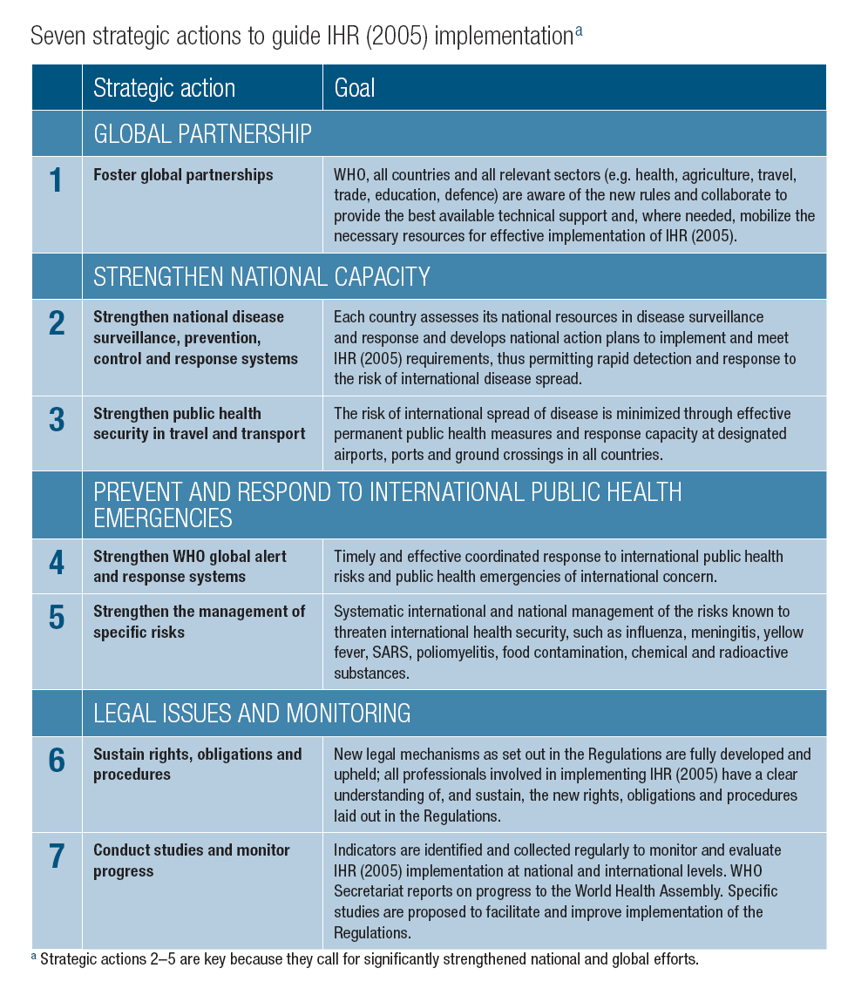
Globally adopted strategies to control public health related diseases
Awareness
Technical areas
Legal and monitoring framework

Slide 14
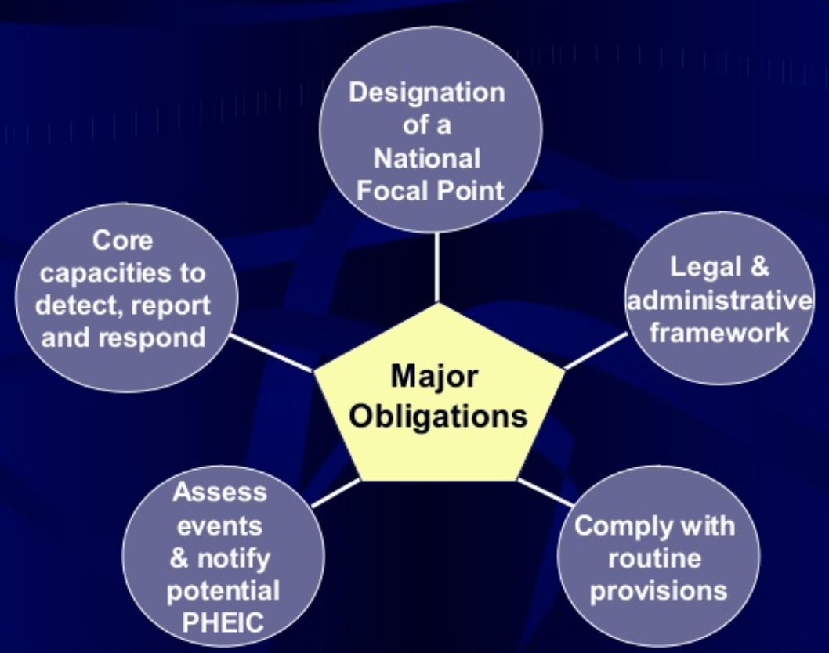

Slide 15
Designation of a National Focal Point
“the national center, designated by each State Party which shall be accessible at all times for communication with WHO Contact Points”
WHO shall designate IHR Contact Points, which shall be accessible at all times for communications with National IHR Focal Points.
Responsible for notification to WHO but not necessarily responsible for carrying out the assessment.

Slide 16
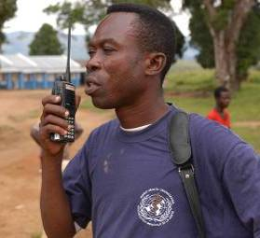

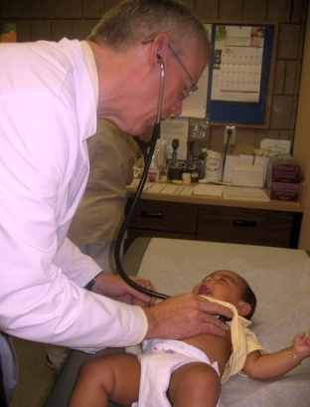
Core capacity to detect, report and respond
Strengthen national capacity at 3 levels: community, intermediate and national.
Health systemالنظام الصحي بشكل عام
Epidemiology وحدات الوبائيات
Laboratory المختبرات
Preparedness الجاهزية في جميع القطاعات
Case management توفر الخدمات العلاجية
Infection control مكافحة العدوى
Disaster managementإدارة الأزمات
Communication التواصل السريع
…

Slide 17

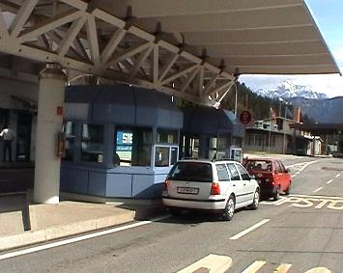
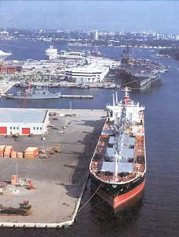
Core capacity to detect, report and respond
Intersectoral collaboration
تقوية القدرات الأساسية من خلال التعاون مع
Aviation sector الطيران المدني
Shipping هيئة الموانئ
Railways هيئة السكة الحديد
Customs & Immigration security
الجمارك و الجوازات والأمن
Ports الموانئ
Airportsالمطارات
Ground crossings
المنافذ البرية

Slide 18
Core capacity to detect, report and respond
Intelligenceالبحث والتقصي
Verificationالتحقق من وجود خطر صحي
Risk assessment تقييم الخطر
Response (GOARN)الاستجابة
Logistics الدعم اللوجستي
…
"Event-based" surveillance and response at global level
الترصد الوبائي والاستجابة والتبليغ على المستوى الدولي عند وجود خطر صحي

Slide 19
Core capacity to detect, report and respond
Influenza
Polio
SARS
Smallpox
Cholera
Meningitis
Yellow fever
Food safety
Chemical safety
Radionuclear safety
…
Collaboration with
International organizations
التعاون مع بعض المنظمات الدولية
للتعامل مع الأحداث الصحية المحددة
Tuberculosis
Malaria
HIV/AIDS
EPI
GFATM
UNAIDS
GAVI
ICG
INFOSAN
IAEA
Notes:
The Global Fund to Fight AIDS, Tuberculosis and Malaria (GFTAM)
United Nations & AIDS‏ (UNAIDS)
Global Alliance for Vaccines and Immunisation (GAVI)
International Crisis Group (ICG)
The International Food Safety Authorities Network (INFOSAN)
International Atomic Energy Agency (IAEA)

Slide 20
Comply with routine provision
NFP Designation and Operations تحديد نقاط الاتصال ومهامها
Detection, reporting, verification and control of eventsأعمال الترصد الوبائي والمكافحة
Implementation of IHR Documents استخدام وثائق اللوائح الصحية
Definition of implementing structures, organization, roles and responsibility تعريف الجهات المسؤولة وتحديد أدوارها
National Legislation should allow Compliance with IHR
القوانين المحلية يجب أن تسمح بتطبيق اللوائح الصحية الدولية

Slide 21
Comply with routine provision
8 Core capacities:
Legislation and Policy التشريعات
Coordination التنسيق بين القطاعات المعنية
Surveillance الترصد الوبائي
Response الاستجابة
Preparedness الجاهزية
Risk Communications إدارة المخاطر
Human Resources الموارد البشرية
Laboratory المختبرات
At 3 levels:
Community/Peripheral
Intermediate
National
تقييم القدرات الأساسية في كل القطاعات المعنية بتنفيذ اللوائح

Slide 22
Challenges faced by different countries while implementing IHR
Mobilize resources and develop national action plans
Strengthen national capacities in alert and response
Strengthen capacity at ports, airports, and ground crossings
Maintaining strong threat-specific readiness for known diseases/risks
Rapidly notify WHO of acute public health risks
Sustain international and intersectoral collaboration
Monitor progress of IHR implementation

Slide 23
IHR in Saudi Arabia: Case Study
During Hajj Season of 2014, the country was subjected to the risk of Ebola Virus Disease outbreak during the Hajj season.
What was the action plan conducted under the IHR?

Slide 24
IHR in Saudi Arabia: Case Study
Firstly: the disease was announced to be endemic in west African countries:
Guinea, Liberia and Sierra Leone in West Africa. Additionally, a localised spread of the virus was announced in certain areas of Nigeria

Slide 25
IHR in Saudi Arabia: Case Study
This announcement indicated a Public Health Emergency of International Concern (PHEIC).
Saudi Arabia, as a member state was informed about this PHEIC through the National IHR Focal Point.
The National IHR Focal Point in Saudi Arabia was a representative of the Saudi Ministry of Health.

Slide 26
How does The National IHR Focal Point in Saudi Arabia receive information from the WHO?
Through the WHO IHR Contact Points.
i.e. (EMRO IHR contact point.)

Slide 27
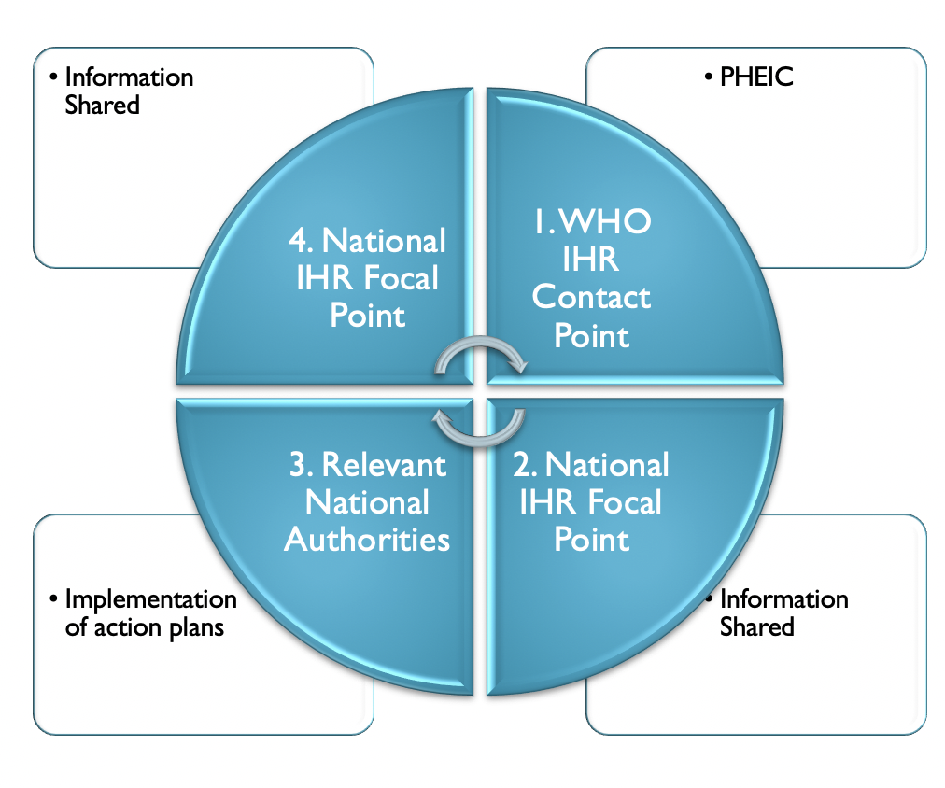
Circle of communication

Slide 28
IHR in Saudi Arabia: Case Study
A) The Information components:
1. Surveillance, notification, consultation, verification, and information sharing at the endemic countries with ED.
2. Announcement of the PHEIC with state parties.
3. Sharing of relevant public health knowledge about ED with state parties.

Slide 29
IHR in Saudi Arabia: Case Study
B) Action plan at endemic countries:
1. Application of prevention and control measures in endemic countries.
2. Application of exit screening measures at Points of Entry.
3. Information sharing with state parties.

Slide 30
IHR in Saudi Arabia: Case Study
C) Action plan at Saudi Arabia:
1. Restriction of entry of citizens of affected countries.
2. Application of entry screening measures.
3. Information sharing with relevant local authorities

Slide 31
IHR in Saudi Arabia: Case Study
C) Action plan at Saudi Arabia:
4. Assessment of the established capacity:
Transportation system adherence to the IHR guidelines.
Maintenance of core capacities at designated Points of Entry in Saudi Arabia: Jeddah airport, Madinah Airport, and Islamic seaports in Jeddah.

Slide 32
IHR in Saudi Arabia: Case Study
C) Action plan at Saudi Arabia:
5. Development of Public health Emergency Contingency Plans at Points of Entry.
6. Plan trials, monitoring and evaluation.

Slide 33
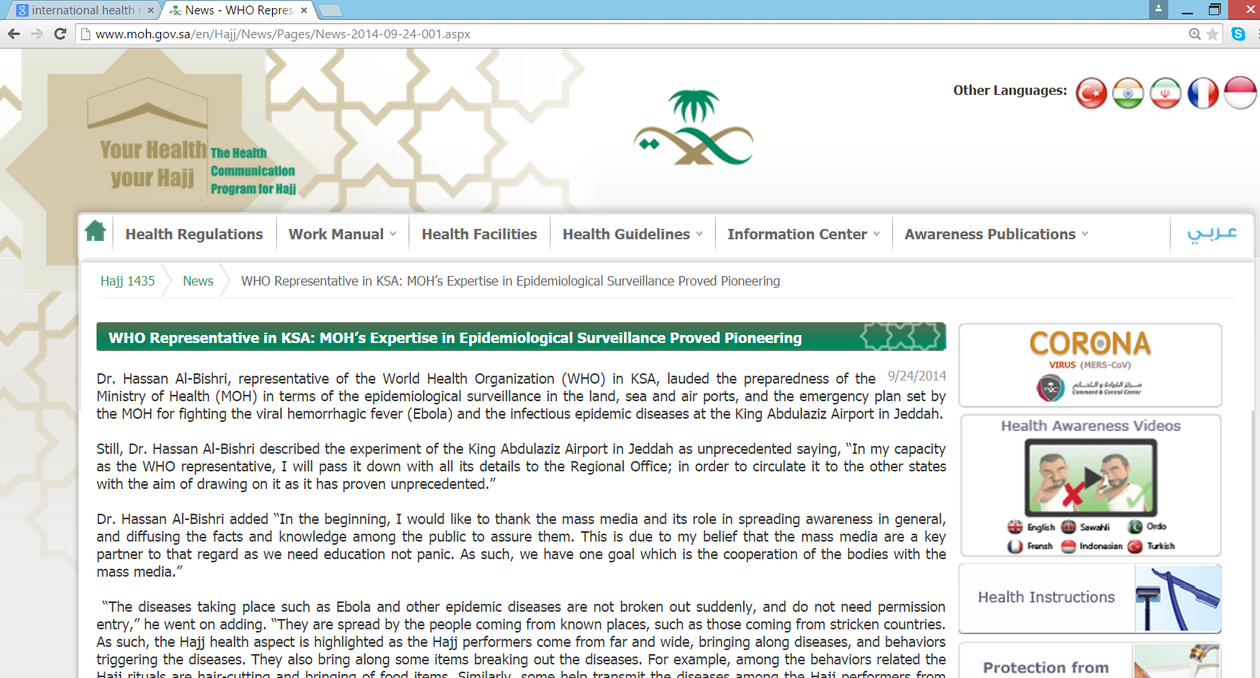

Slide 34
References
http://www.who.int/ihr/en/
http://www.moh.gov.sa/en/Hajj/News/Pages/News-2014-09-24-001.aspx
http://www.who.int/ihr/publications/9789241596664/en/

Slide 35
Thank you

