Slide 1
Maternal & child health CASES Focus on breast feeding positioning, counseling, growth chart
Dr. Nada A. Alyousefi
Associate Professor, Postgraduate Trainer and Consultant of Family Medicine
International Board Certified Lactation Consultant Department Of Family And Community Medicine College Of Medicine, King Saud University (KSU)

Slide 2
Case 1
Fatima goes in to see her pregnancy care provider. He or she does not know if Fatima heard the group talk on breastfeeding and if she has any questions.
How can the pregnancy care provider find out if a pregnant woman knows about the importance of breastfeeding or has questions?

Slide 4
Case 2
Miriam gave her previous baby regular supplements from birth. Now she is hearing that supplements are not good for babies and wants to know why because she want to give her daughter. Her baby now is 3 months ht 58 cm wt 6 kg
What can you say to Miriam?

Slide 5
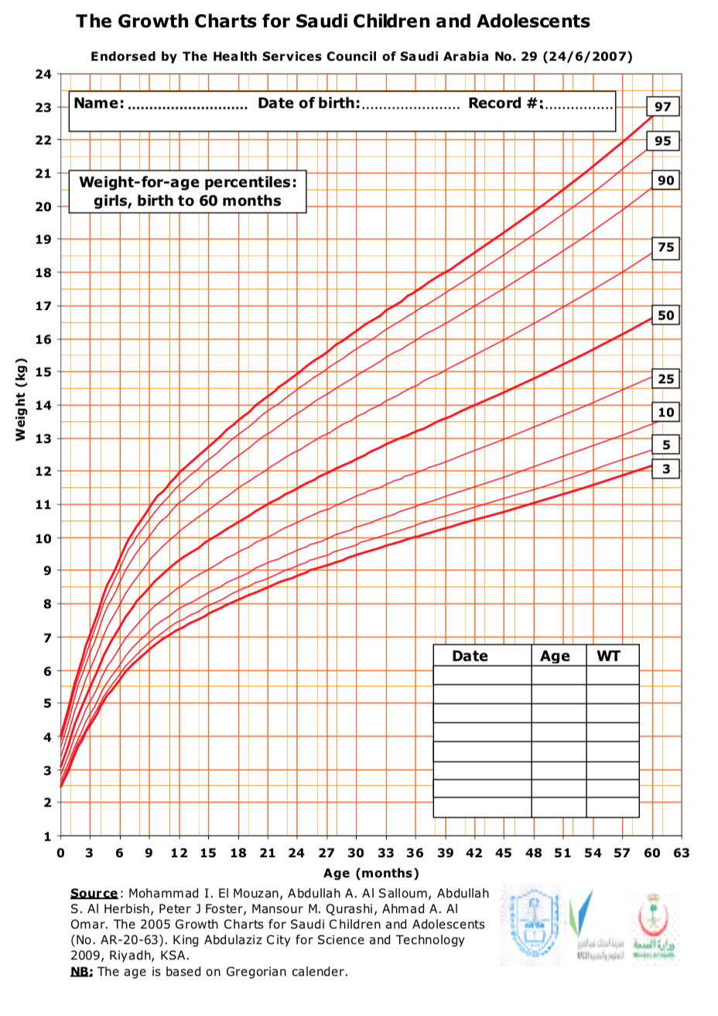

Slide 6
Case 3
Nora gave birth to a healthy boy in the hospital two weeks ago. Today she, the baby, and her mother-in-law are returning to the hospital because the baby is "sleeping all the time" and has passed only three stools this week. When the outpatient clinic nurse weighs the baby, she finds him 12% under birth weight.
Nora feels that her baby is refusing her breasts. Yesterday, the mother-in-law began offering tea with honey in a bottle twice a day.
Upon observing the breastfeed; the baby is held loosely and that he must bend his neck to reach the breast. The baby has very little of the breast in his mouth and falls off the breast easily. When he falls off the breast, he gets upset, moves his head around, crying and has difficulty getting attached again.
How you can approach this case?

Slide 7
The BREASTFEEDING HISTORY JOB AID
When you are talking to a mother, the facts may not all come out in the same order as the Job Aid.
If at any time a mother wants to tell you about something that is important to her, let her tell you that first. Ask about the other things afterwards.
Try to remember the things that she has told you about already.

Slide 10
BREASTFEED OBSERVATION JOB AID

