Slide 1



Maternal & child health
Focus on breast feeding positioning, counseling, growth chart
FEMALE Group
Dr. Nada A. Alyousefi
Associate Professor, Postgraduate Trainer and Consultant of Family Medicine
International Board Certified Lactation Consultant
Department Of Family And Community Medicine
College Of Medicine, King Saud University (KSU)

Slide 2
Objectives
Demonstrate counselling skills for promotion of breast feeding (focused on benefits of breast feeding for the mother and child, and correct way of breast feeding, advise on prevention on breast engorgement and breast abscesses)
Demonstrate skills to plot growth charts of children

Slide 3
Aim
1/3
Every student will be confidently support mothers with early and exclusive breastfeeding.
Every student can help in movement towards achieving Baby-friendly hospitals and communities.

Slide 4

Notes:
Poor infant feeding
What are the effects on:
Families?
Communities?
Health services?

Slide 5

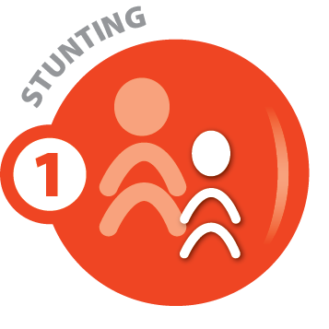





Global targets 2025
To improve maternal, infant and young child nutrition

Slide 6
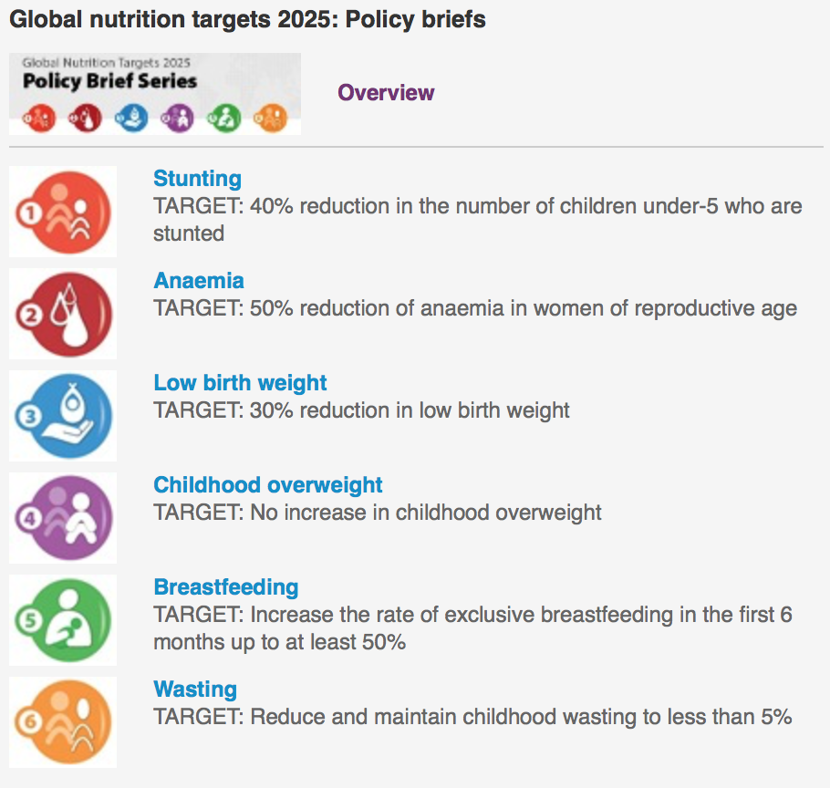

Slide 7
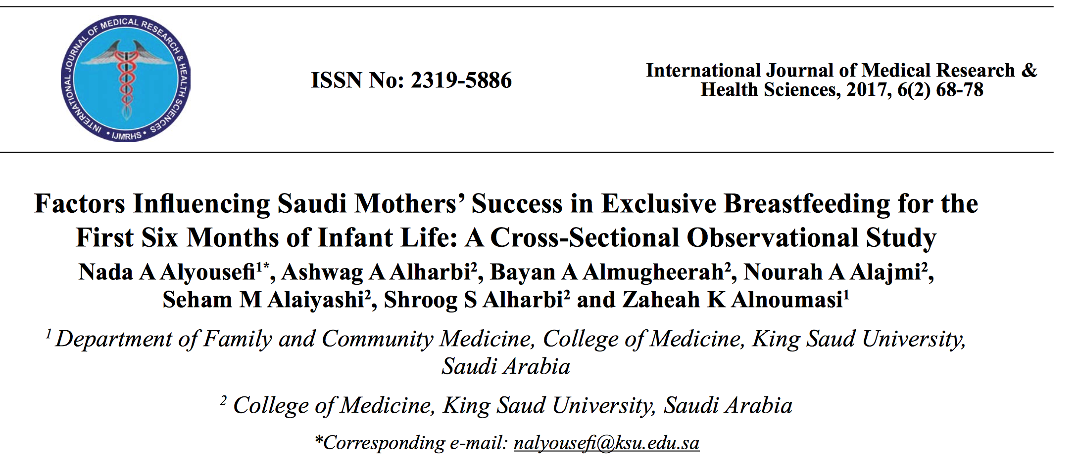
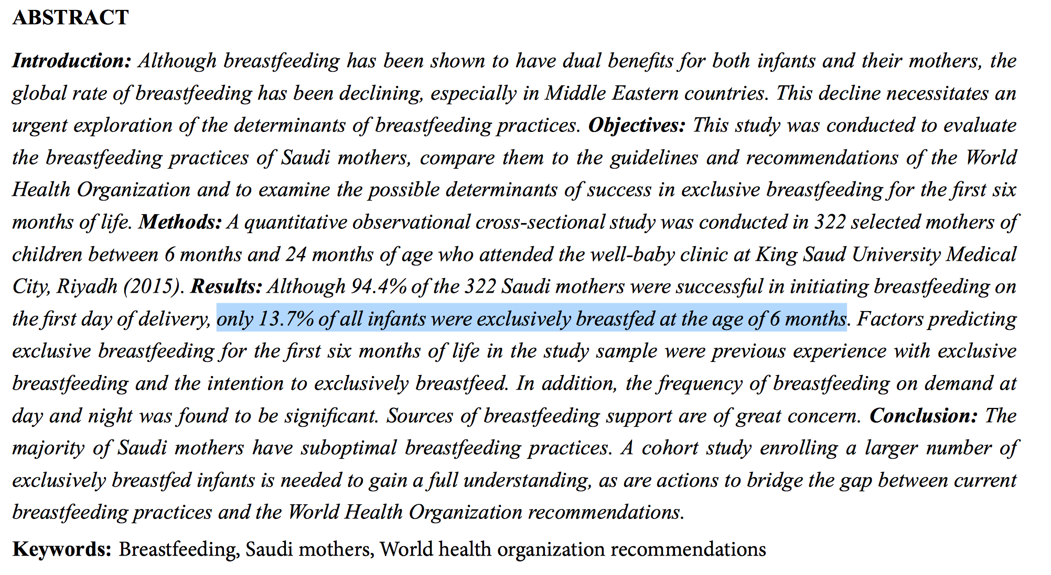

Slide 8
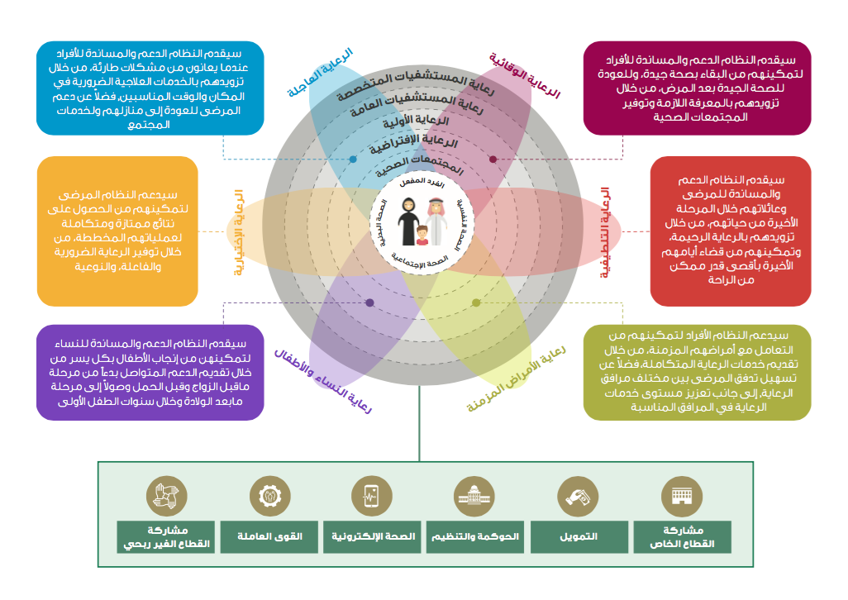

Slide 9
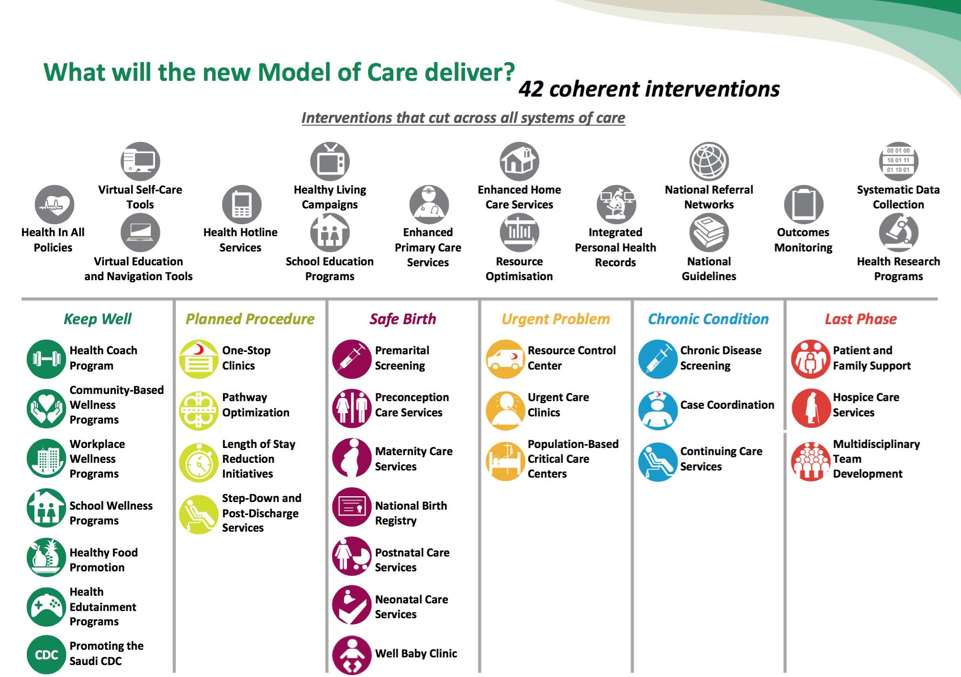

Slide 10

The Baby -Friendly Hospital Initiative
A Part Of The Global Strategy

Slide 11
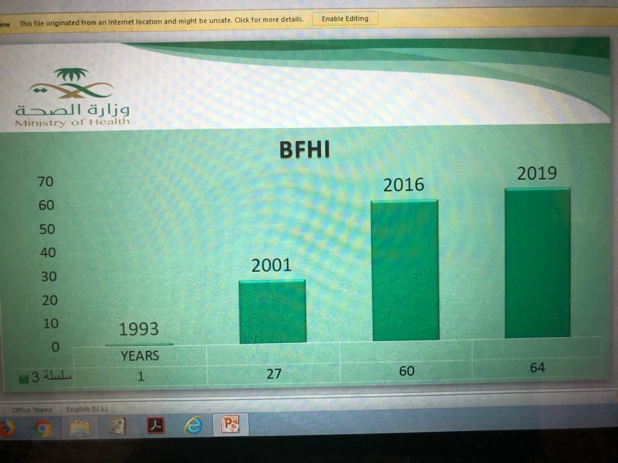

Slide 12
عدد المستشفيات صديقة الطفل في المملكة
31
26
5
2

Slide 13
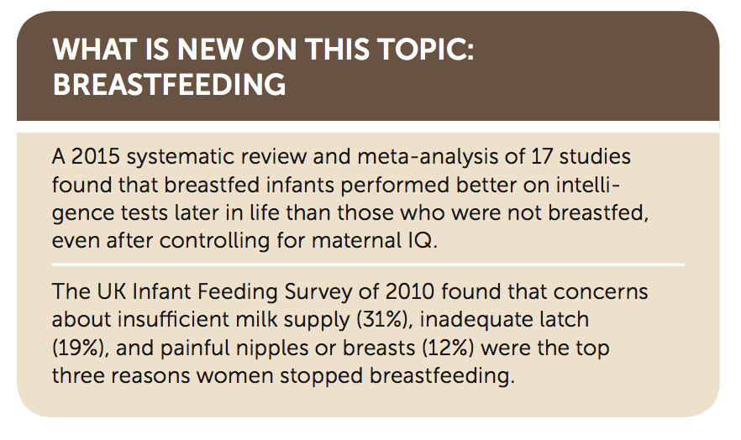
Breastfeeding: Common Questions and Answers. Am Fam Physician. 2018 Sep 15;98(6):368-376.

Slide 14
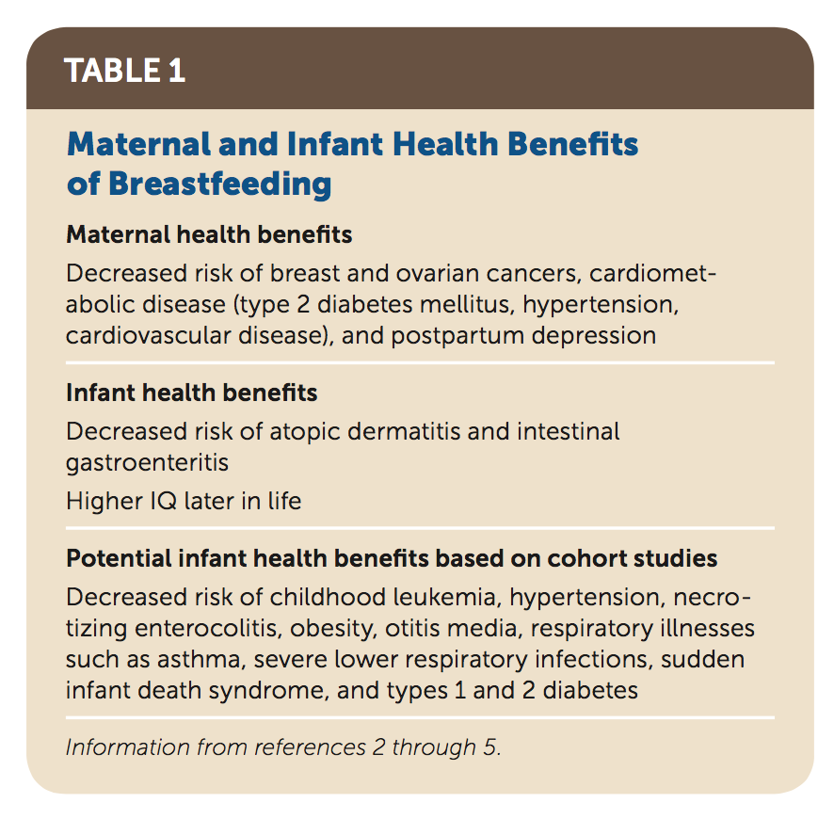
Breastfeeding: Common Questions and Answers. Am Fam Physician. 2018 Sep 15;98(6):368-376.

Slide 15
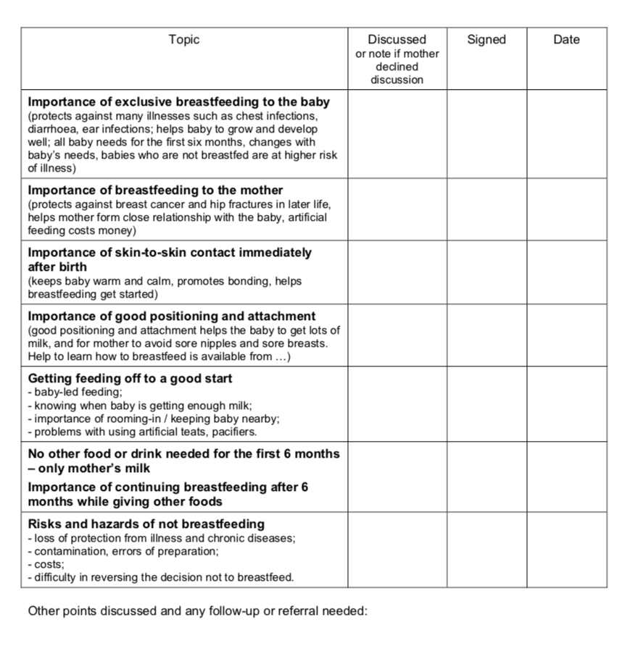
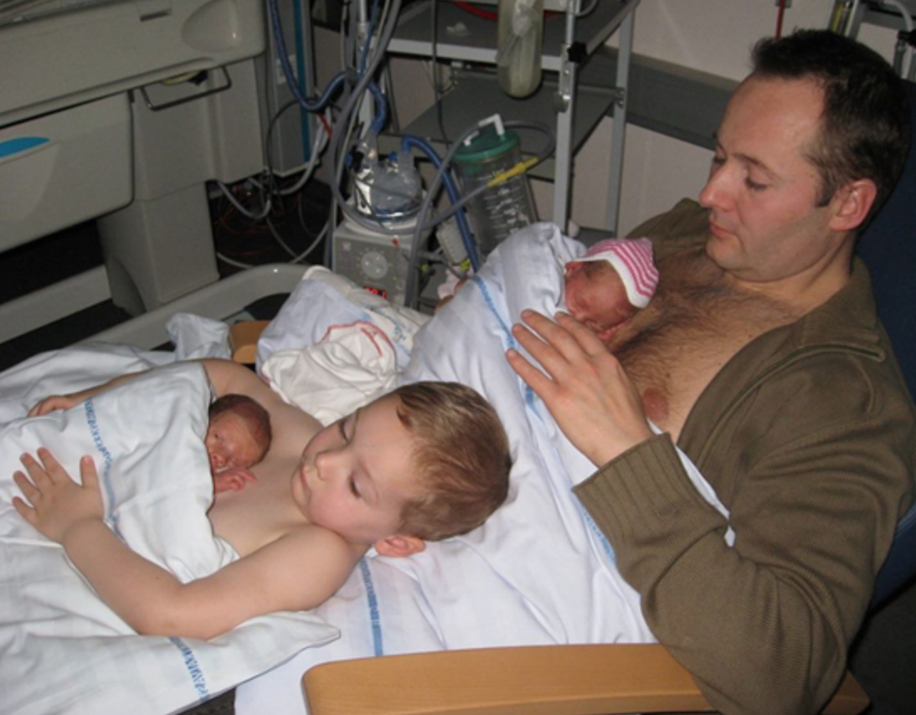

Slide 16


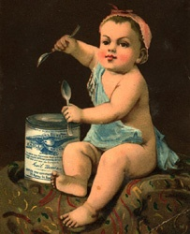
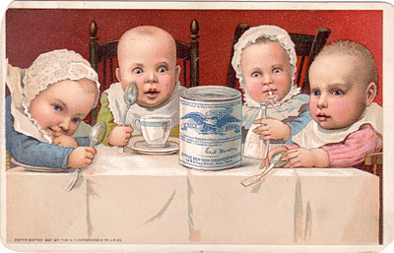


Slide 17


Slide 18

How the Code came about
Nestlé marketing of breast milk substitutes particularly in less economically developed countries
Groups in US and later outside the United States, particularly in Europe started Nestlé Boycott
1988 - present
Longest
Consumer
Boycott
Ever
Some changes in 1984
Not enough, even today

Slide 19


Slide 20


Slide 21
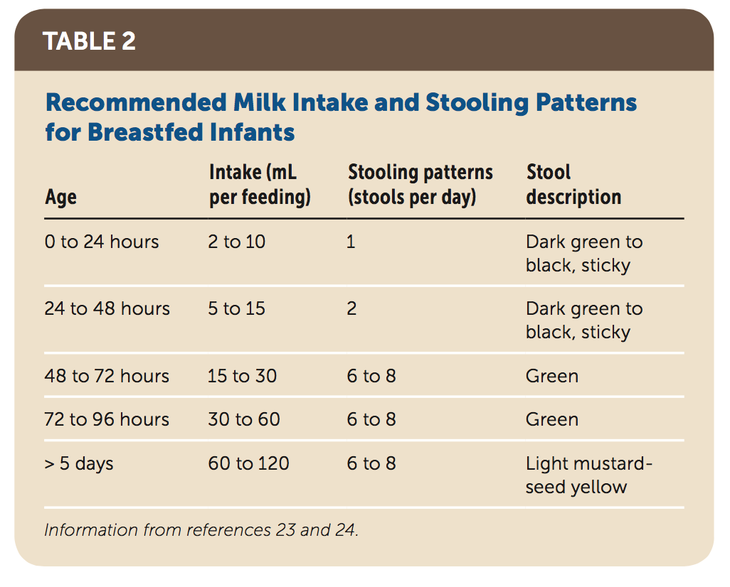
Breastfeeding: Common Questions and Answers. Am Fam Physician. 2018 Sep 15;98(6):368-376.

Slide 22
HOW TO ASSESS A BREASTFEED
Look at the mother herself
Look at how the mother holds her baby
Look at the baby’s condition
Observe how the baby responds to the breast
Observe how the mother holds her breast for the baby
Observe the baby’s attachment and suckling
Notice how the breastfeed finishes
Observe the condition of the mother's breasts

Slide 23
How the mother holds her baby
? mother supports the baby’s whole body
? calm and relaxed ? Nervous
the four signs of good positioning of the baby are:
  the baby should be straight, facing the breast, close to the mother, and supported.
Notes:
How the mother holds her baby
It is easier for the baby to attach to the breast if the mother supports the baby’s whole body.
Supporting only the baby’s head and shoulders makes it more difficult. However, supporting
the whole body is less important after the first few months, when the baby has more control.
If the mother is calm and relaxed, this helps milk flow. If she is nervous, and for example, she shakes or pokes her baby, this can interfere with suckling and breast milk flow.
Key point: the four signs of good positioning of the baby are:
the baby should be straight, facing the breast, close to the mother, and supported.
See also Session 10 ‘Positioning a baby at the breast’.

Slide 24
Baby’s Position
Remember 4 key points :
IN LINE – ear, shoulder, hip in a straight line; neck not twisted/bent forward or backward
FACING – the breast with baby’s nose to nipple
CLOSE to mum’s body – baby to breast
SUPPORTED – at head, shoulders; newborn – support whole body

Slide 25
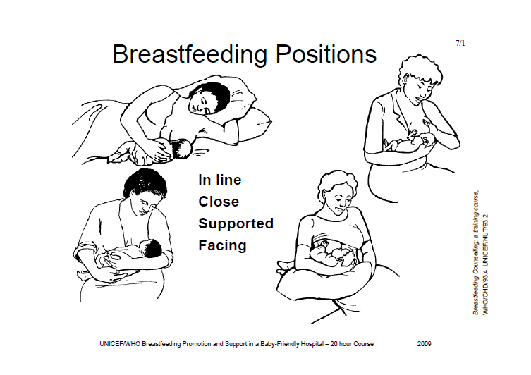

Slide 26
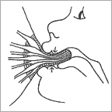
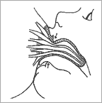
Observe the baby’s attachment and suckling
2
1

Slide 28
How a baby latch
The baby’s mouth is wide open.
The lower lip is turned out.
The chin is touching the breast (or nearly so).
More areola is visible above the baby’s mouth than below
Good attachment
Poor attachment
The mouth is not wide open.
The lower lip is pointing forward (it may also be turned in).
The chin is away from the breast.
More areola is below the baby’s mouth (you might see equal amounts of areola above and below the mouth)

Slide 29
Signs of effective suckling
The baby takes slow deep sucks.
Then he pauses and waits for the ducts to fill up again.
Then he takes a few quick sucks to start the milk flow.
As the milk flows, his sucks become deeper and slower again.
You may see or hear swallowing.
The babies cheeks are round.
Notes:
To demonstrate effective suckling:
Suck on your fist, with your mouth open wide, your tongue forward, and your lower lip curled back. Give slow deep sucks, about 1 per second.
To demonstrate ineffective suckling:
Suck on your thumb, with your mouth almost closed, your lips pointing forwards, and letting your cheeks pull in. Give quick, small sucks.

Slide 30
Signs of ineffective suckling
The baby taking quick shallow sucks all the time.
The baby may make smacking sounds as he sucks.
The baby’s cheeks may be tense or pulled in as he sucks.
  that mean the baby is not getting much breast milk.

Slide 31
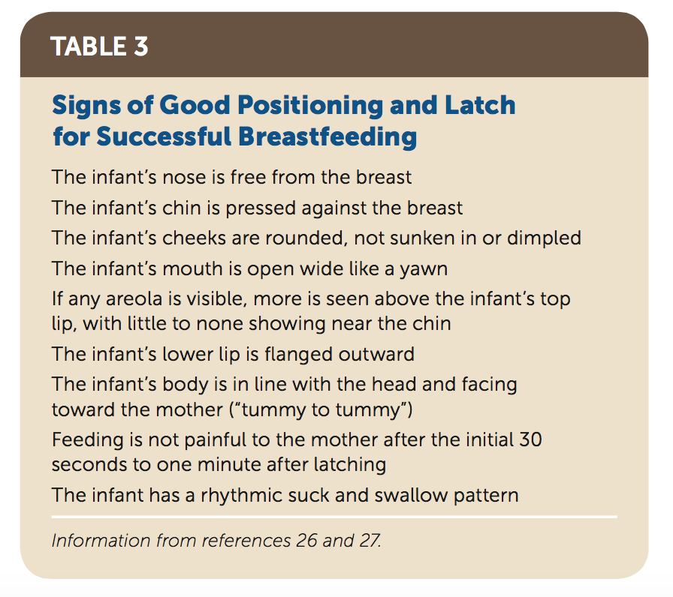
What Are Ways to Ensure an Adequate Latch?
Breastfeeding: Common Questions and Answers. Am Fam Physician. 2018 Sep 15;98(6):368-376.

Slide 32
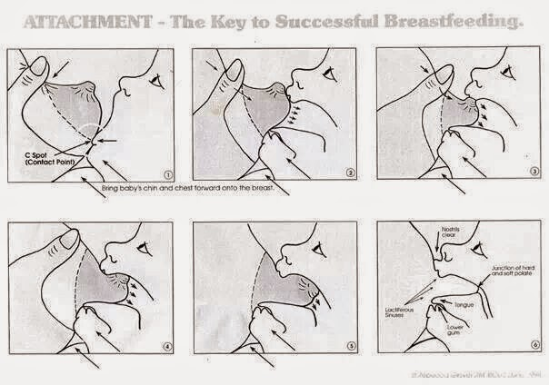

Slide 33

Train of The Trainer in breastfeeding counseling course
SESSION 5
Observing a breastfeed
Dr. Nada A. AlYousefi
MBBS, SB-FM, AB-FM, IBCLC
Associate Professor, Postgraduate Trainer, and Consultant Family Medicine
International Board Certified Lactation Consultant
Department of Family and Community Medicine
College of Medicine (KSU)

Slide 34
Objectives
At the end of this session, participants will be able to:
Recognize the four key signs of good or poor attachment
Recognise good and poor positioning of the baby according to the 4 key points
Assess a breastfeed using the BREASTFEED OBSERVATION JOB AID
Recognise a mother who needs help using the breastfeed observation job

Slide 35
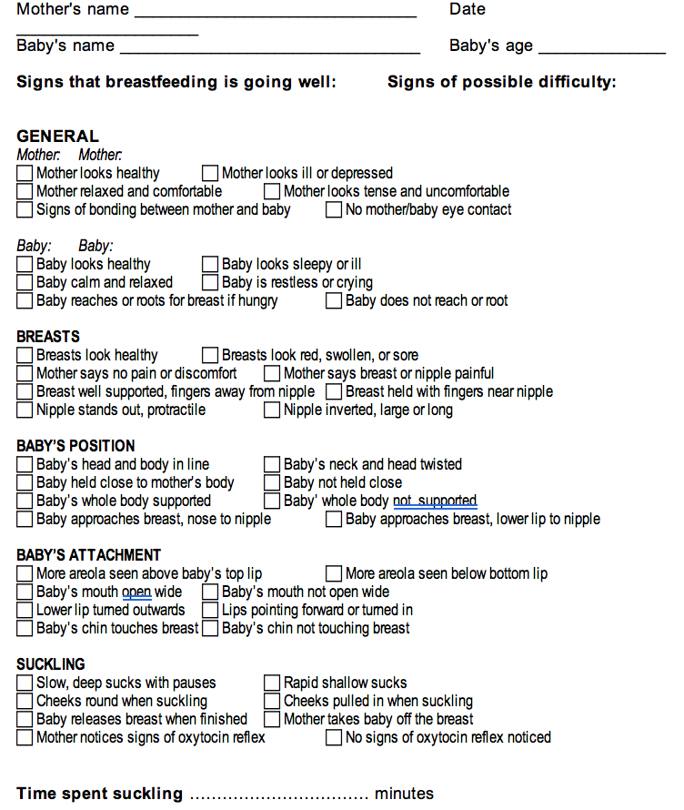
BREASTFEED OBSERVATION JOB AID

Slide 36
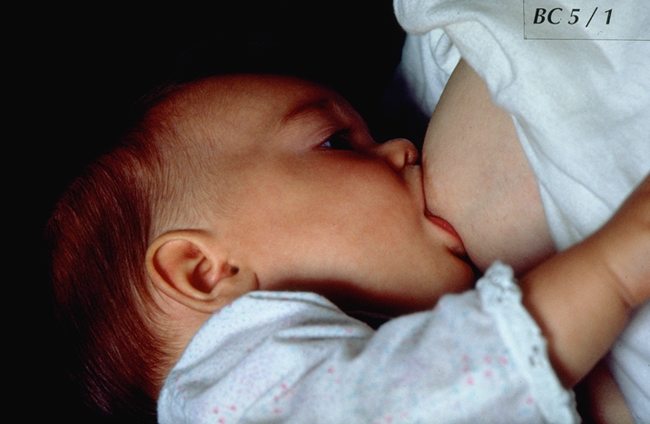
BFC 5/1

Slide 37
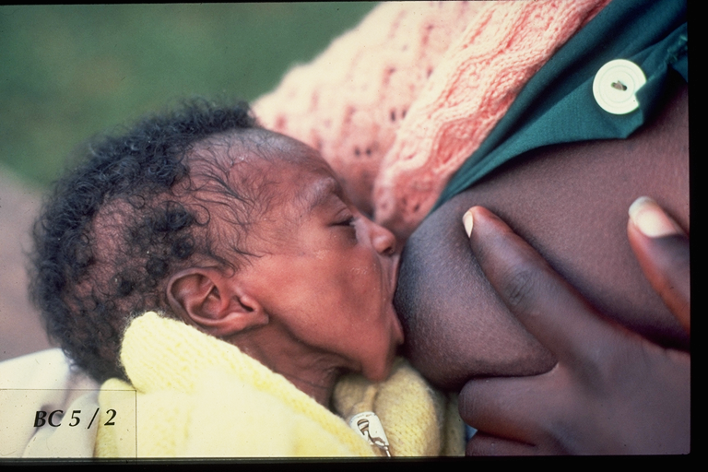
BFC 5/2

Slide 38
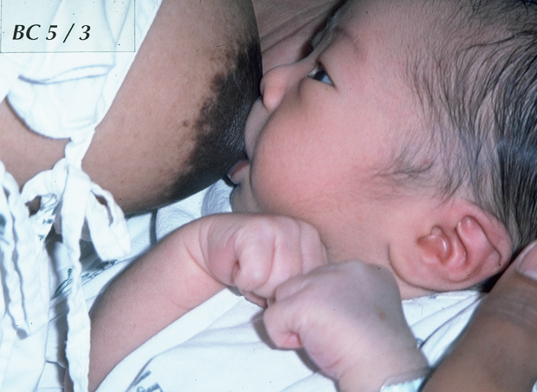
BFC 5/3

Slide 39
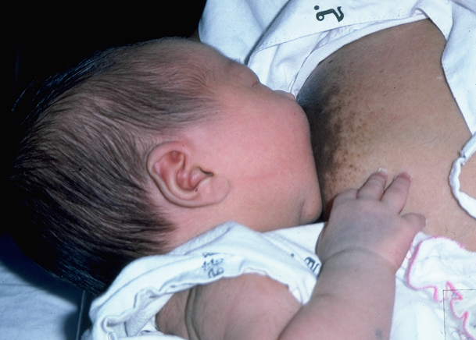
BFC 5/4
BFC 5/4

Slide 40
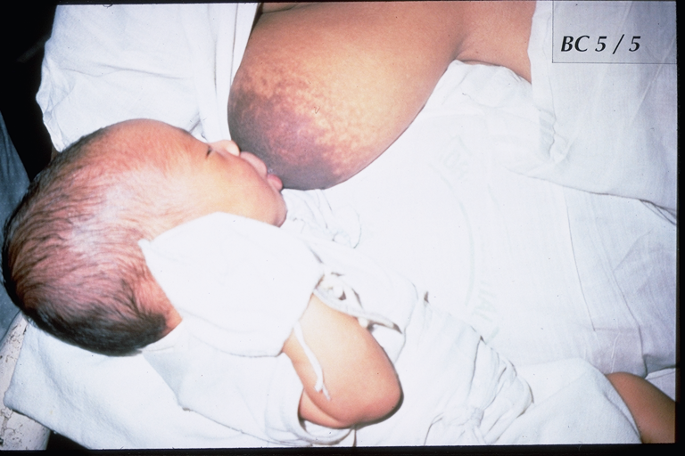
BFC 5/5

Slide 41
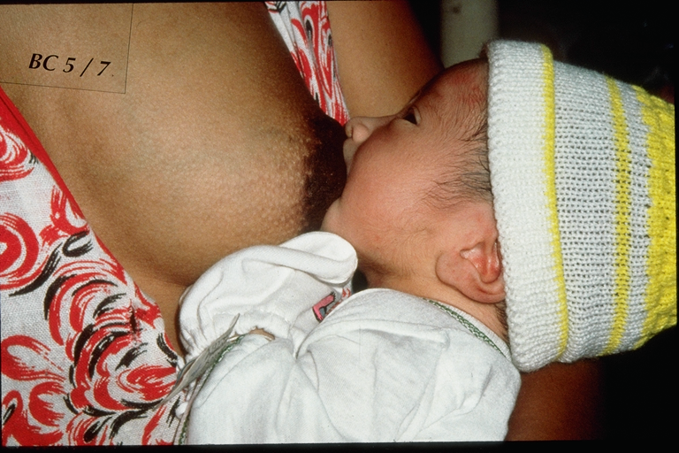
BFC 5/7

Slide 42
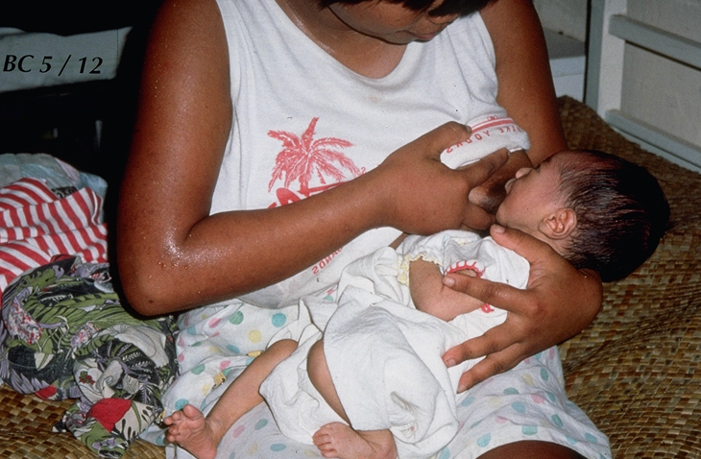
BFC 5/12

Slide 43
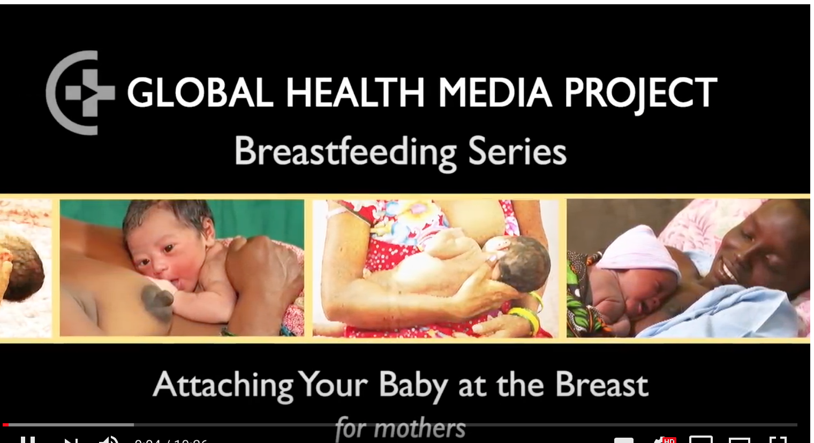
https://www.youtube.com/watch?v=wjt-Ashodw8

Slide 44
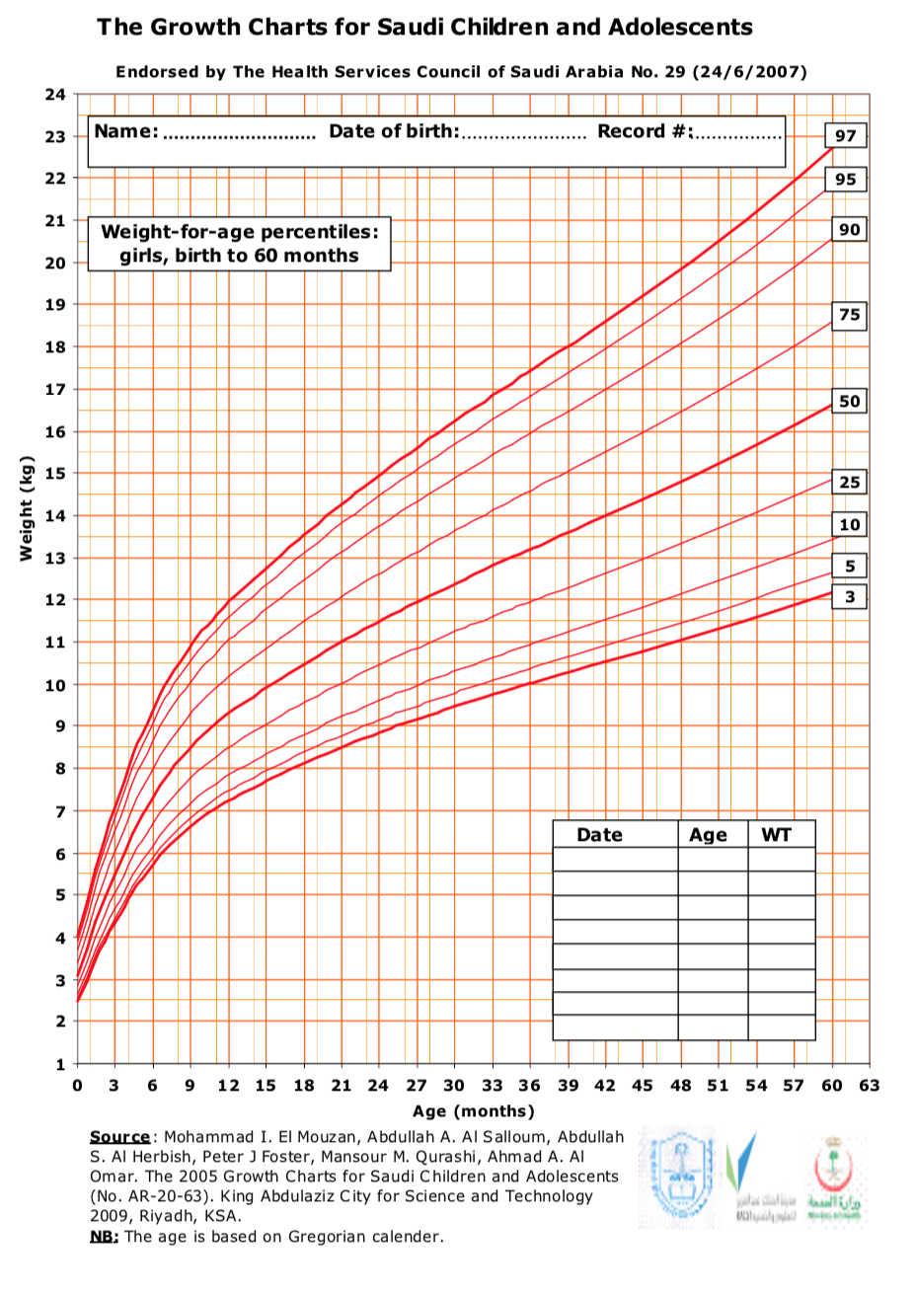
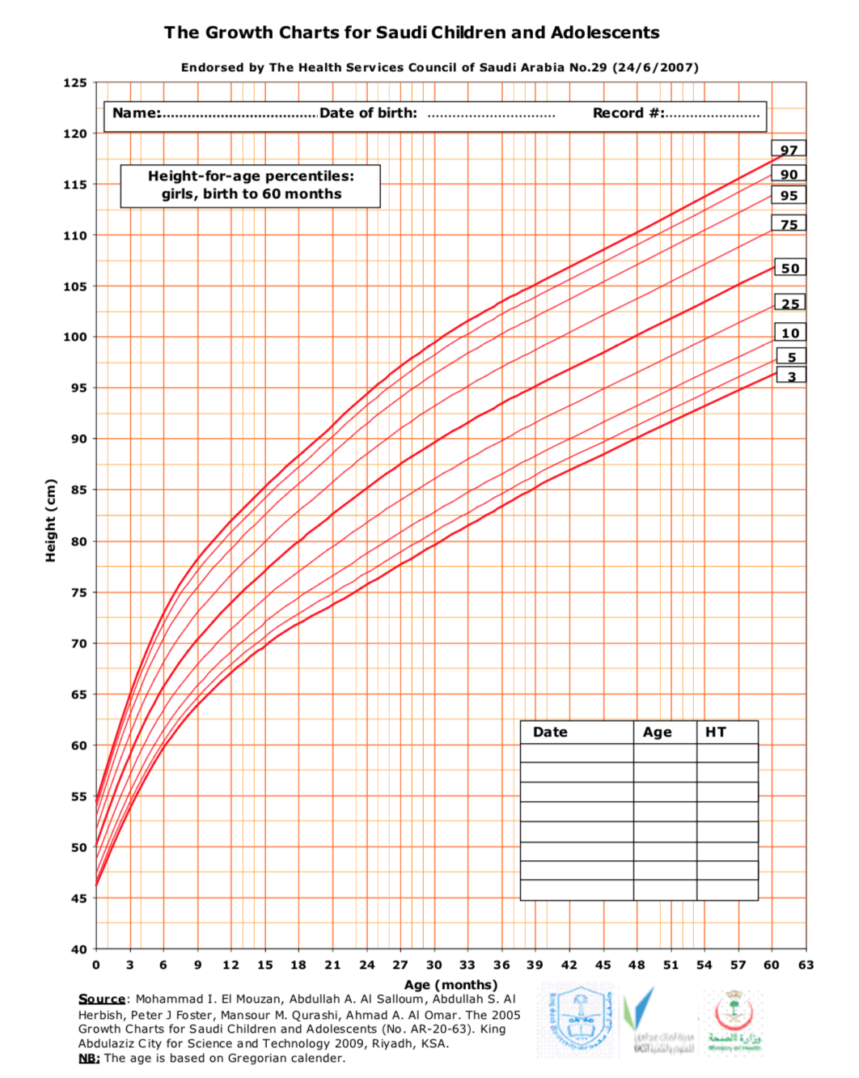

Slide 45
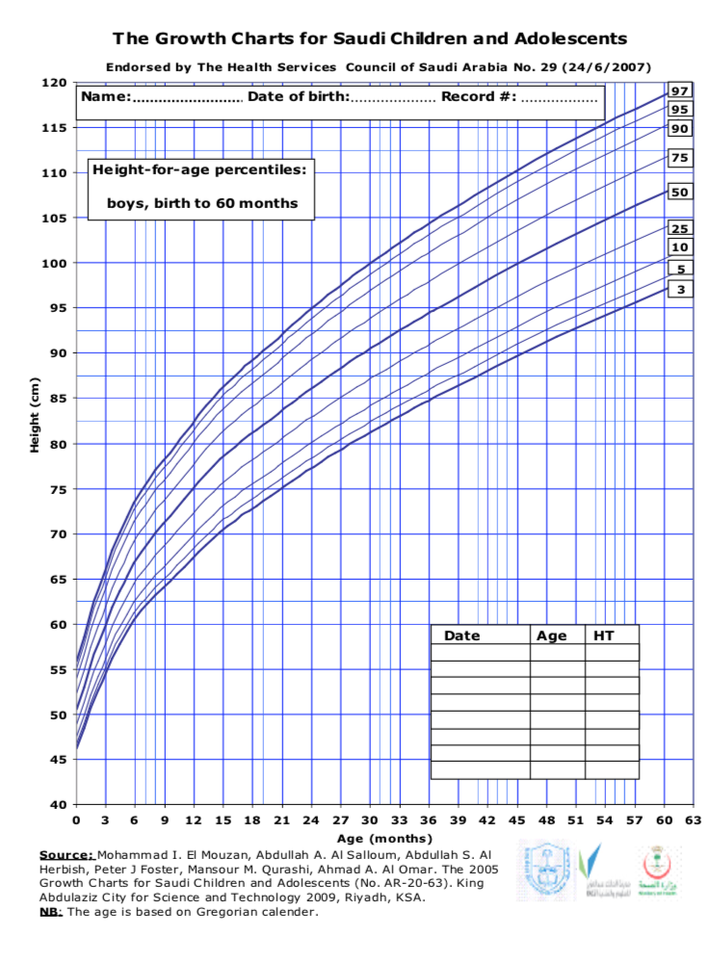
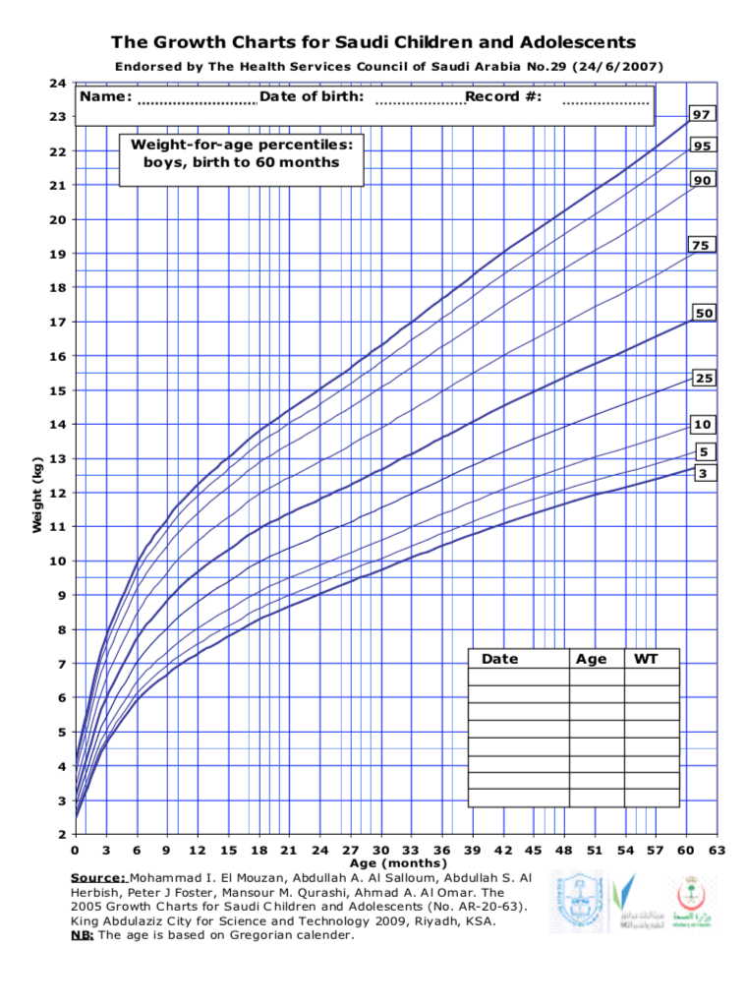

Slide 46
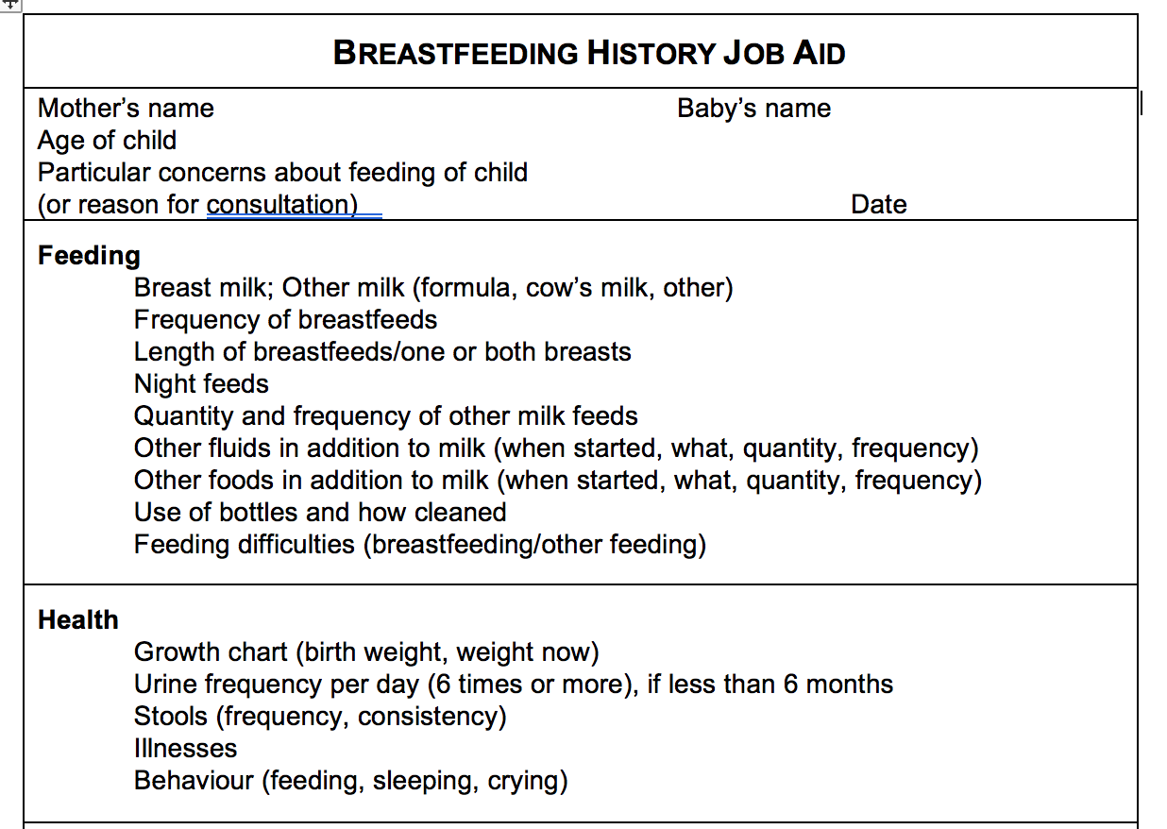

Slide 47
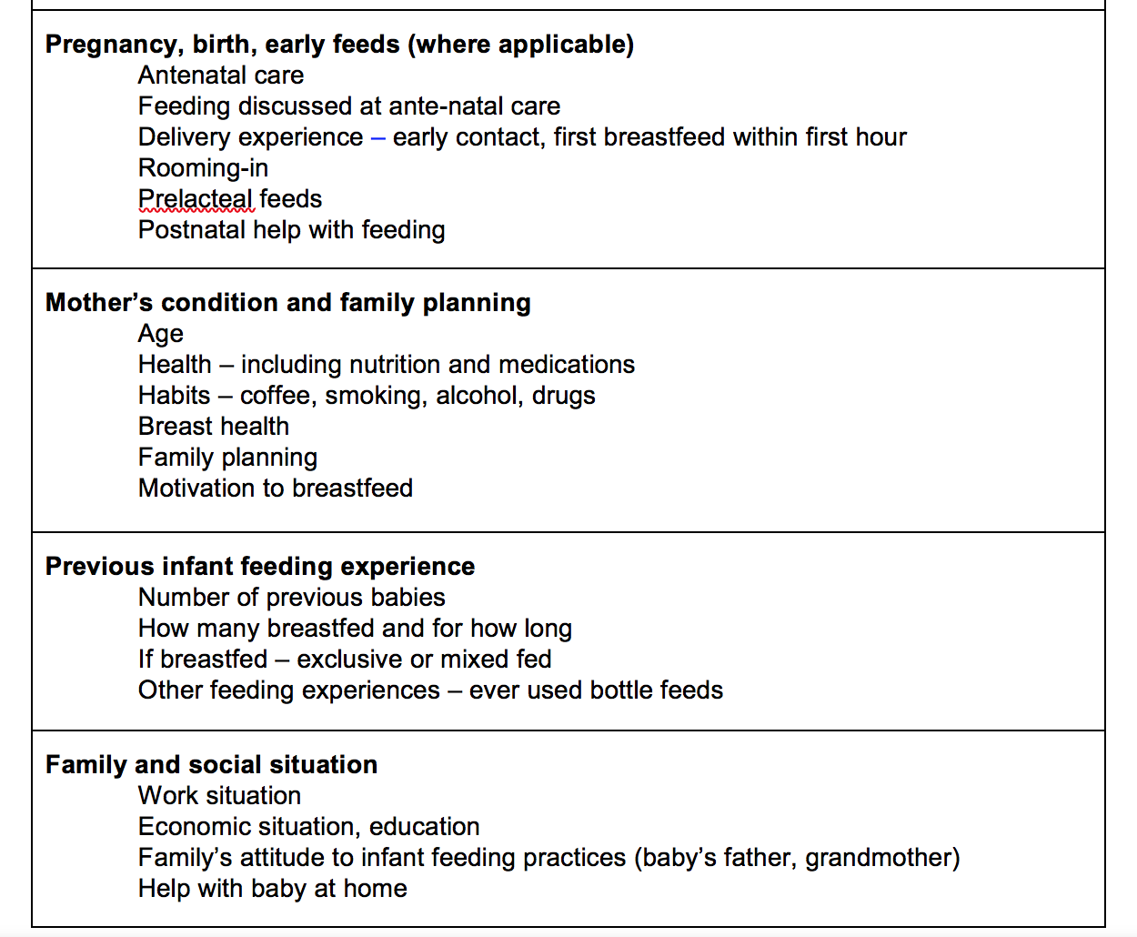

Slide 48
BREASTFEED OBSERVATION JOB AID

Slide 49
BREASTFEED OBSERVATION JOB AID
It summarizes the key points for assessing a breastfeed.
You will use this form to practise observing breastfeeds with mothers and babies.
  The signs are in 6 groups: General signs of the mother, and of the baby; Condition of the breasts; the baby’s position; the baby’s attachment; and suckling. There are 3 signs each for mother and baby, and four signs in each of the other groups.
Notice that the signs on the left all show that breastfeeding is going well. The signs on the right indicate a possible difficulty.
Beside each sign is a box ◻ to mark with a tick ✓ if you have seen the sign in the mother and baby that you are observing.
Notes:
Try to remember the groups, as it will help you to remember the signs with each group. Then, later on, when you have had more practice, you will not need to use the form all the time.

Slide 50
BREASTFEED OBSERVATION JOB AID
As you observe a breastfeed, mark a ✓ in the box for each sign that you observe. If you do not observe a sign, do not make a mark.
If all ✓s are on the left hand side of the form, breastfeeding is probably going well.
If there are some ✓s on the right hand side, then breastfeeding may not be going well. This mother may have a difficulty, and she may need your help.
Notes:
▪ The negative signs, such as "no signs of milk ejection", and "cannot see tongue", do not necessarily mean that there is a difficulty. However, the opposite positive signs are always helpful.
▪ If a mother says that breastfeeding is going well, but you see signs that indicate a possible difficulty, you must decide what to do.
- In the days soon after delivery, while the mother is still learning, offer to help her. Even if she is not aware of any difficulty now, you may prevent one occurring later.
- If breastfeeding seems to be well established, you probably do not want to intervene immediately. It is usually more helpful to see her again soon, and follow the baby's growth, to make sure that breastfeeding continues to go well. Intervene only if a difficulty arises.

Slide 51
Management of common problems can affect Breastfeeding

Slide 52
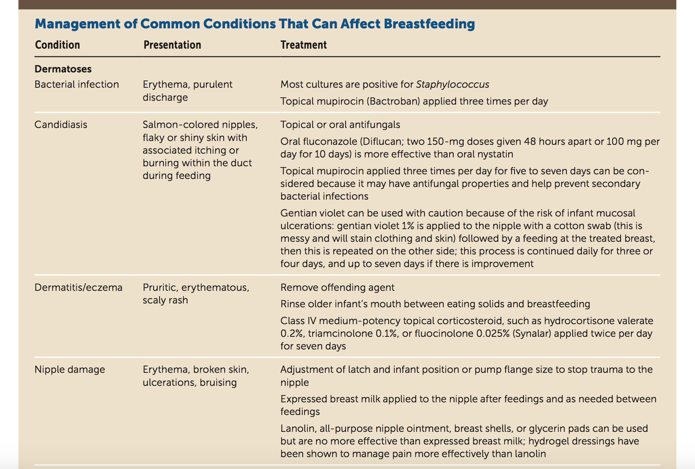
Breastfeeding: Common Questions and Answers. Am Fam Physician. 2018 Sep 15;98(6):368-376.

Slide 53
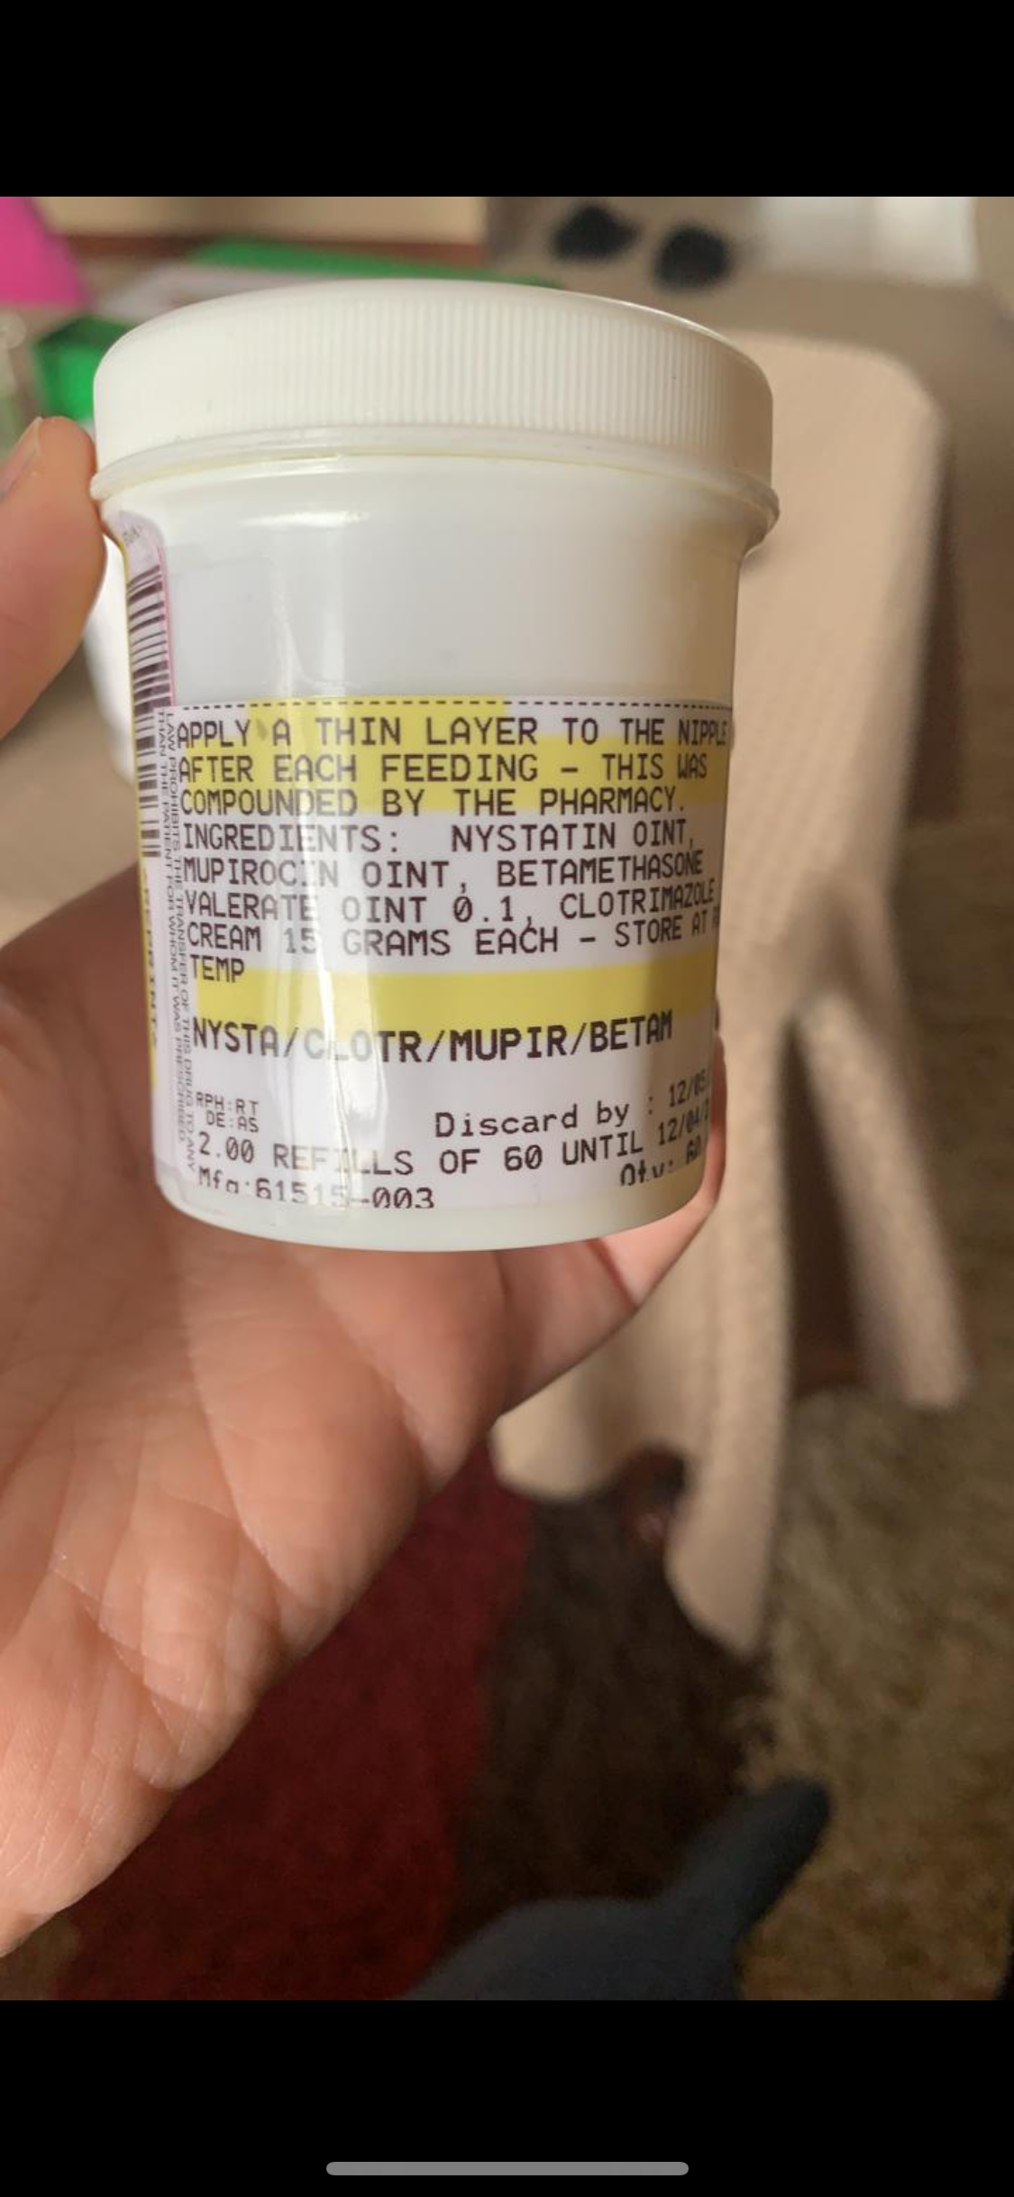

Slide 54
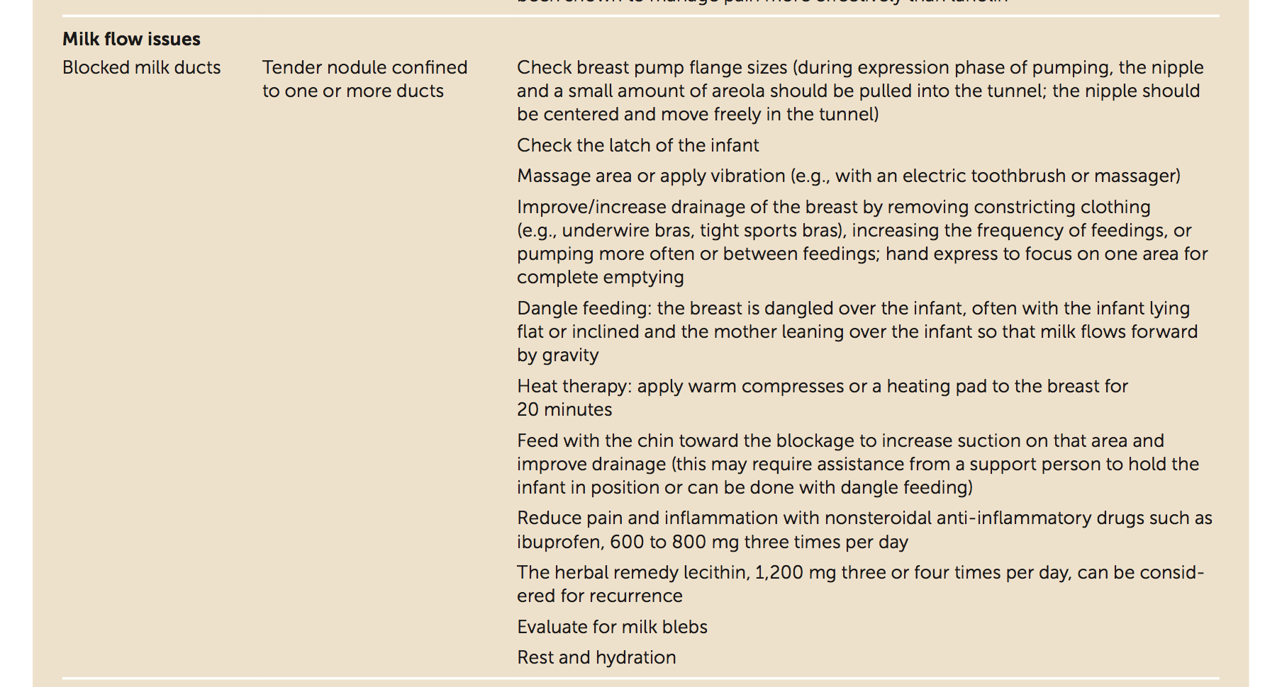
Breastfeeding: Common Questions and Answers. Am Fam Physician. 2018 Sep 15;98(6):368-376.

Slide 55
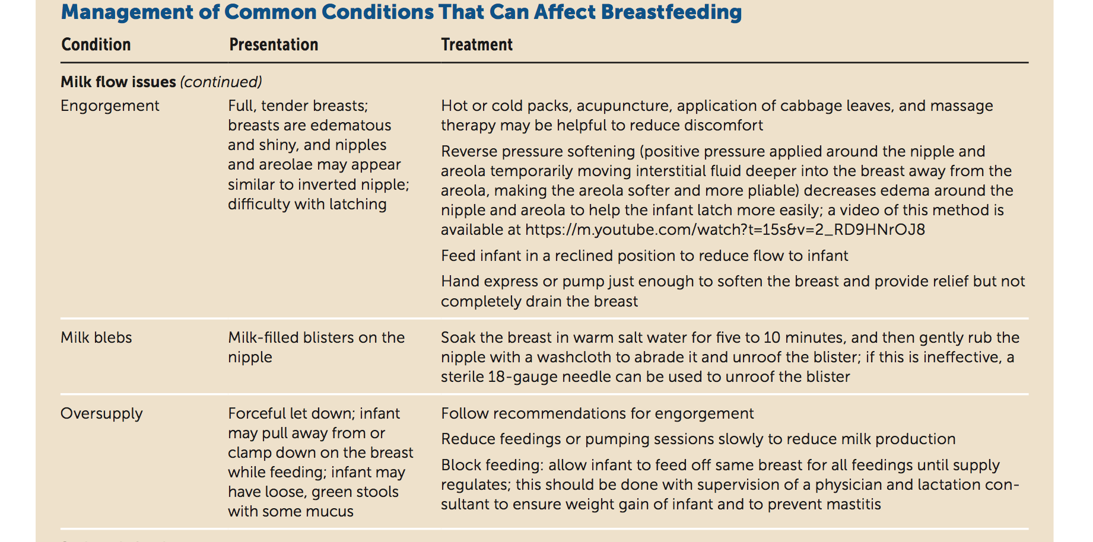
Breastfeeding: Common Questions and Answers. Am Fam Physician. 2018 Sep 15;98(6):368-376.

Slide 56
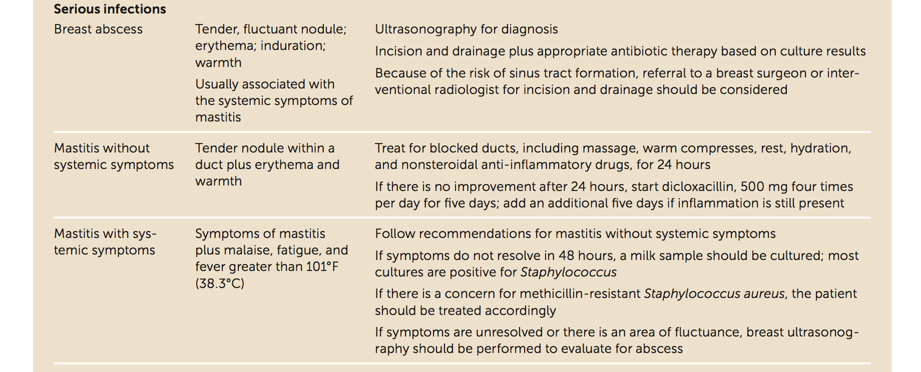
Breastfeeding: Common Questions and Answers. Am Fam Physician. 2018 Sep 15;98(6):368-376.

Slide 57
Nutritional needs of breastfeeding women
What can you say to a woman who asks about what she should eat or avoid eating when
she is breastfeeding?

Slide 58
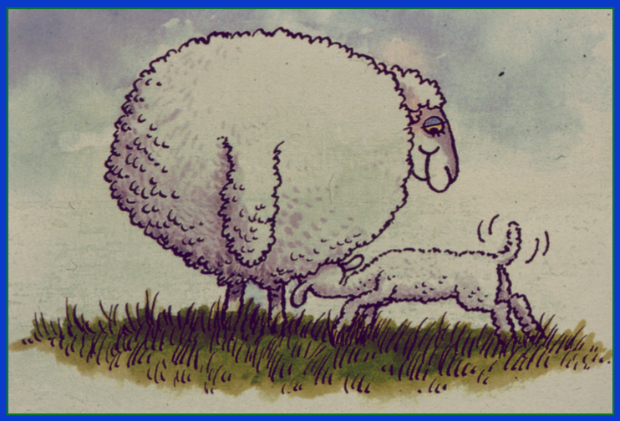
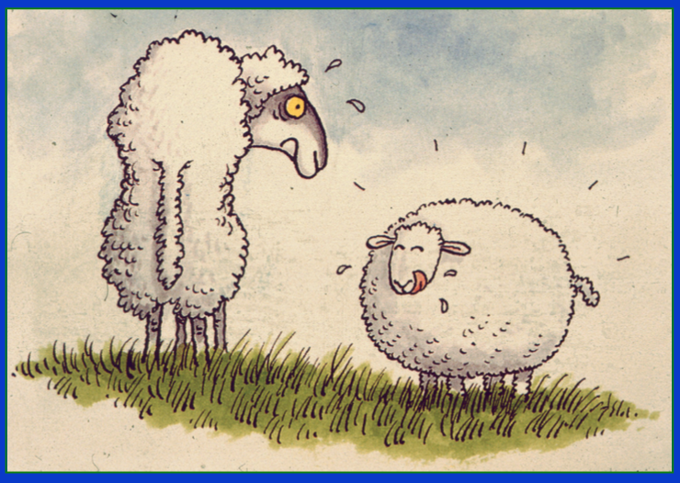

Slide 59
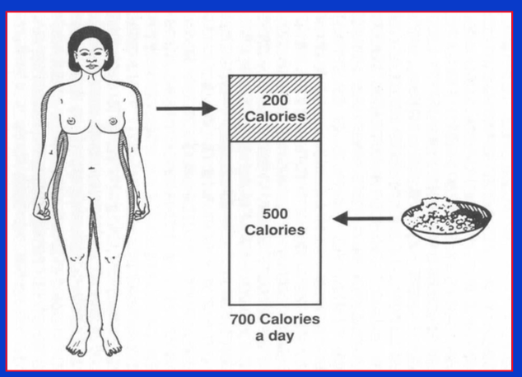

Slide 60
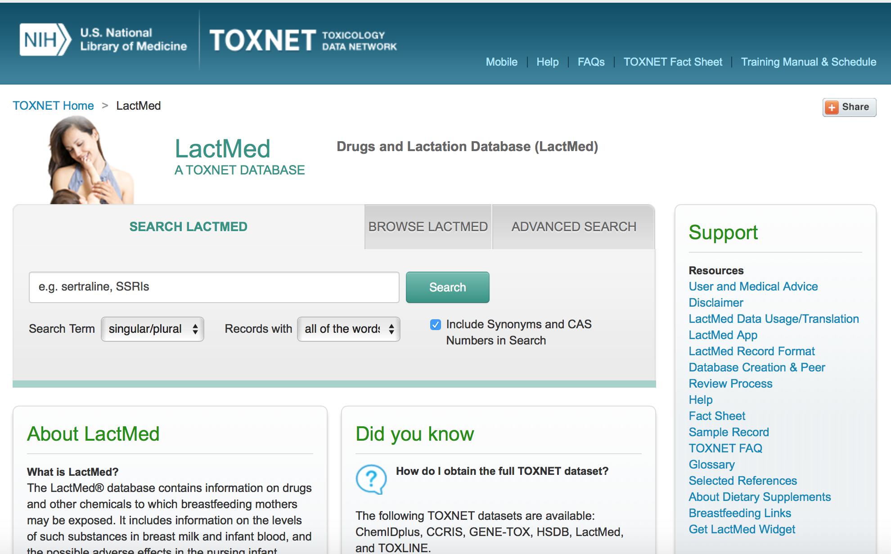
https://toxnet.nlm.nih.gov/newtoxnet/lactmed.htm

Slide 61


Slide 62
What is the situation in Saudi Arabia?
Do we have a Code of Marketing here in Saudi ?

Slide 63


Slide 64

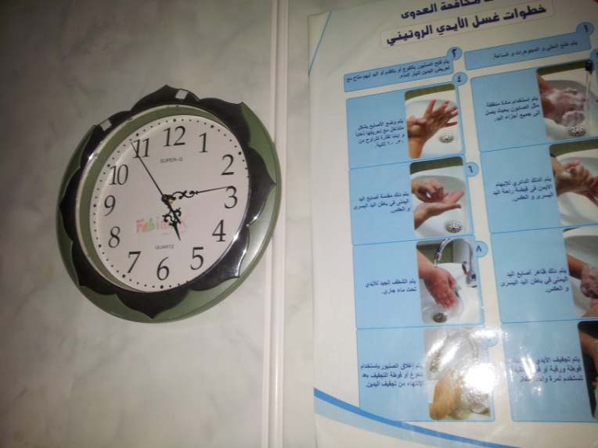

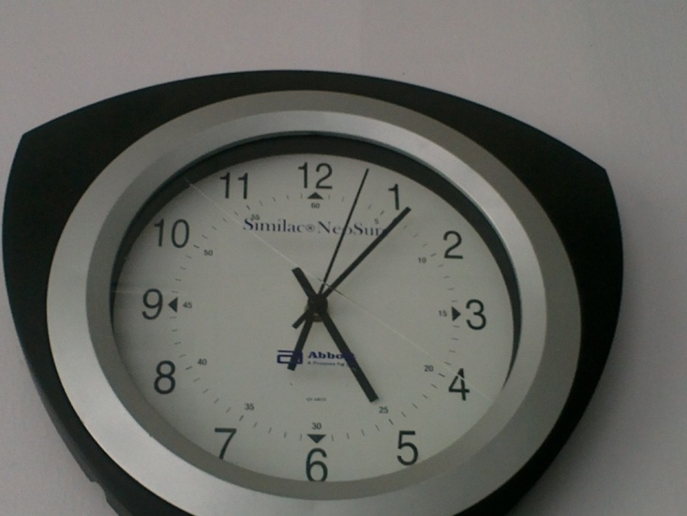

Slide 65
Currently in Saudi Arabia
Yes! there is a Code of Marketing here in Saudi Arabia

Slide 66
The Code and Local Implementation
(individual countries) implement the Code, but they may implement it in the way that they think is best for their countries
they can make their Code a law

Slide 67


The Code and local implementation
2004: National Saudi law released by Royal decree

Slide 68
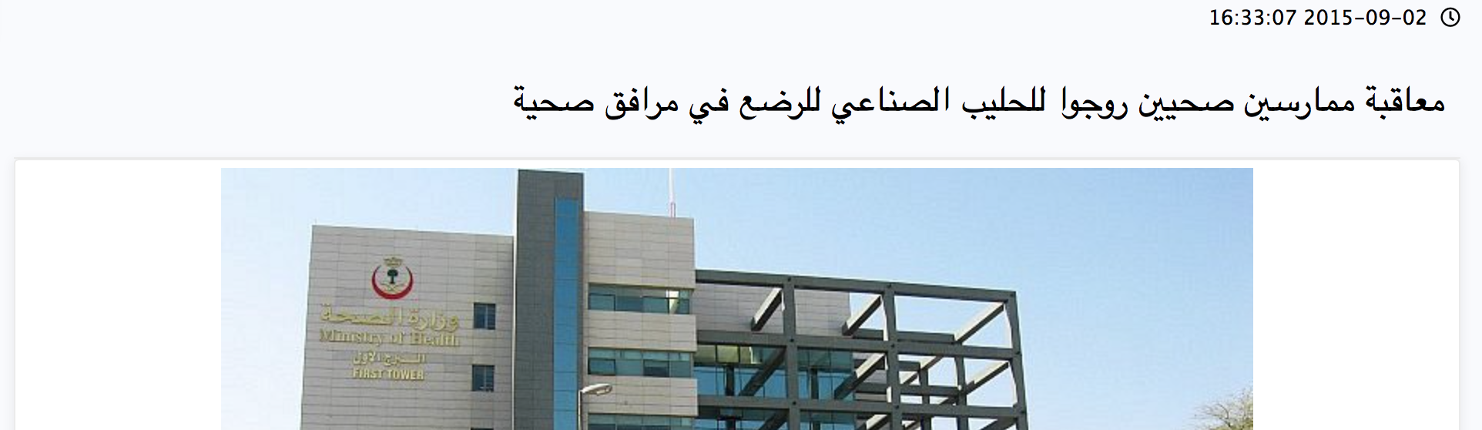



Slide 69

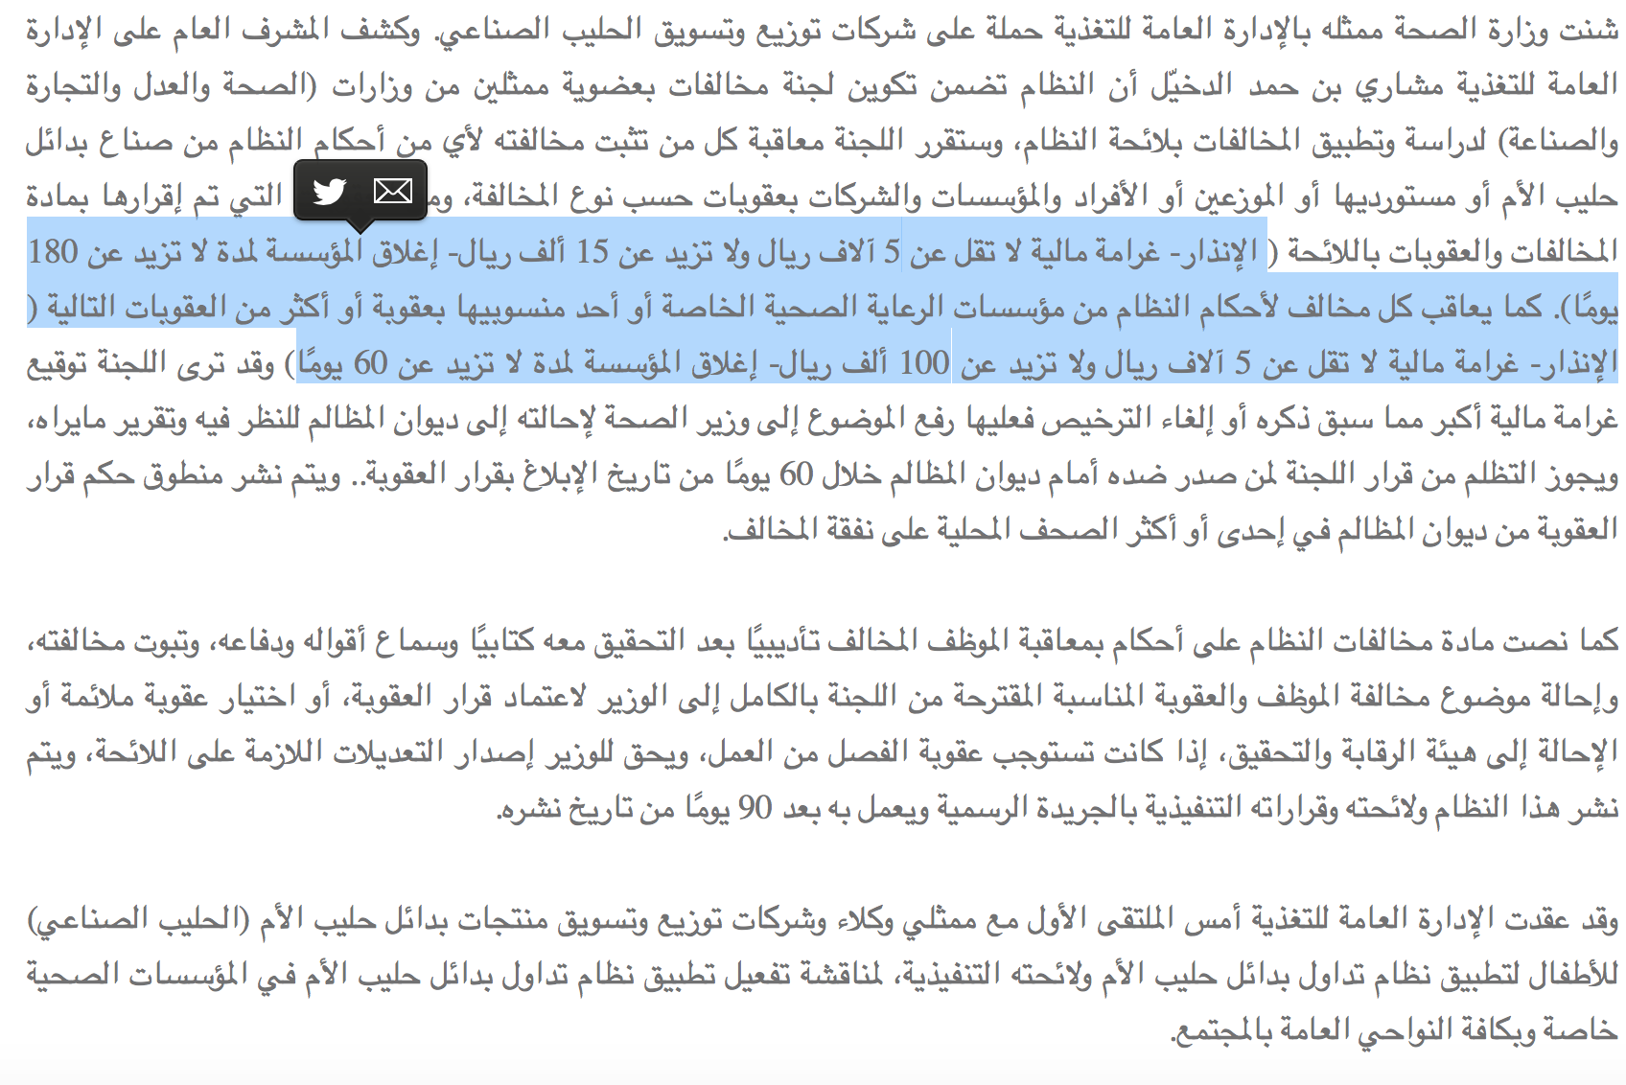

Slide 70



Slide 71


