Slide 1
Course Orientation

Slide 2
Medical Informatics and e-learning
Professor Ahmed Albarrak (albarrak@ksu.edu.sa)
Dr. Nasriah Zakaria (nzakaria@ksu.edu.sa)
Dr Jwaher Almulhem (jalmulhem@ksu.edu.sa)
Dr Samar BinKheder (sbinkheder@ksu.edu.sa)
Notes:
It would be good to make this two points:
Faculty-
Support staff (fatimah, ayah and khlod- also put how they will support student i.e their role . Email and contact)

Slide 3
MIELU staff
Tutorial
Dr Jwaher Almulhem (jalmulhem@ksu.edu.sa)
Dr Samar BinKheder (sbinkheder@ksu.edu.sa)
Fayz Alshehri (saz1408@hotmail.com)
Grades and Attendance
Fatima Al-Alawi (falalawi@ksu.edu.sa)
Technical (E-learning: Blackboard)
Khulood Al-ghamdi (kmalghamdi@ksu.edu.sa)
Asrar Ansari ( aaansari@ksu.edu.sa)

Slide 4
Health/Medical/Biomedical Informatics
The science of health/clinical/bio/medical data/information/knowledge is
Acquired/Collected
Manipulated
Classified
Organized
Retrieved
Stored

Slide 5
Medical Informatics
This course is designed to provide 3rd year students with knowledge and skills about Medical Informatics.
Students will learn how data, information and knowledge is created, managed and processed using Information and Communication Technology.
This course will also introduce the students to electronic health record, computerized physician order entry, imaging, and Internet health applications.

Slide 6
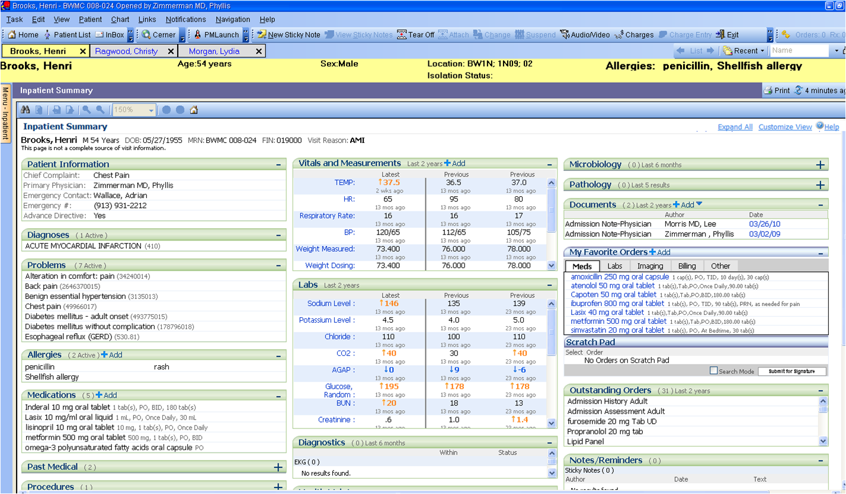
Notes:
More related to dental
A screen shot of an EHR would be nice

Slide 7
Topics
Introduction to Medical Informatics
Clinical Data
Electronic Health Record
CPOE
CDSS
Research Focus in Health Informatics
Consumer Health Informatics
Patient Safety and Medical Error
Computer in Healthcare Education

Slide 8
Resources
Course text book
Shortliffe, E., Cimino, J. (2014). Biomedical Informatics: Computer Applications in Healthcare and Biomedicine, 4th Edition, Springer
Hoyt RE, Hersh WR. (2018) Health Informatics: Practical Guide 7th Edition, AMIA

Slide 9
Resources
Hoyts and Hersh book
Chapter 1 Overview of Health Informatics
Chapter 2 : Clinical Data
Chapter 4 E-HR
Chapter 8 CDSS
Shortliffe
Chapter 17: Consumer Health Informatics and personal health records
Chapter 23: Computer in Healthcare Education

Slide 10
Resources
Main topics covered from books
Workshops and tutorials will be from other resources s
Slides are for guides but not sufficient for examination.
Examination questions come from textbook & Readings

Slide 11
Learning Objectives | Topics Covered | Assessments
LO1 | All topics esp Consumer Health Informatics, Telehealth | Quiz, Midterm, Finals
LO2 | Workshops, EHR, DSS, Patient Safety, CHI,CPOE | Quiz, Midterm, Final, Workshop
LO3 | EHR, DSS CPOE | Quiz, Midterm, Final
LO4 | Research Focus Paper Appraisal Computer in Healthcare Education | Presentation, Report
LO5 | Clinical Informatics as A Career for Physician | Midterm, Final
LO6 | Tutorials & Workshops | Tutorials & Workshops

Slide 12
 | Assessment task | Proportion of Total Assessment
2 | Tutorial (one tutorial per group – 2% presentation & 2% ATTENDANCE) Each absence is 0.5 mark 4 absence – 2 marks will be deducted | 4%
2 | Workshop: Paper Appraisal & Esihi | 14%
3 | Midterm | 20%
4 | Online quiz (3 quizzes) | 20%
5 | Final examination | 40%
6 | Seminar | 2%
 | TOTAL | 100%

Slide 13
Tutorial Participation (4%)
1. There will be 9 tutorials this year
2. Each group will be responsible 2 tutorials
3. Tutorials will include discussion, case study, system review, demonstration etc.
4. Attendance is taken – 2 marks (only up to 4 absences)
5 . Members of designated group will present the tutorial
6. All groups must attend and participate in discussion or Q&A

Slide 14
Example
Week | Topic | Activities | # OF GROUPS
3 | Clinical Data and Databases (Tutorial) | Review Electronic Health Record- review different types of data What kind of errors can occur during data entry? How will this affect the quality of data? | 2 groups

Slide 15
Workshop Participation(14%)
1. There will be 2 Workshops this year
2. Workshops will be 2-3 hours long
3. All groups members must participate actively

Slide 16
Online Quizzes (20%)
Quiz 1 : Week 5
Quiz 2: Week 10
Quiz 3 : Week 13
Quiz will be done online, in the evening. Instructions for Online quiz will be given on Blackboard

Slide 17
Use of Computer and Web
Blackboard
Search Engines
Googledoc, SlideShare, Dropbox
Notes:
I moved this slide to be before Blackboard

Slide 18
Blackboard- Learning Management System
www.lms.ksu.edu.sa
Logging In
Course name
Download lecture slides/View lecture slides
Announcements
Online Quiz
Upload presentations

Slide 19
Attendance
Class Attendance
Please come on time
10% missing- 1st warning
20% missing- 2nd warning
25%- will be barred from taking the final examination
Workshop & Tutorial participation
Active Participation
Reminder: Never SIGN on behalf of your friends. Your integrity is our PRIORITY!
Tutorial Attendance (2 marks are given)
1 missed class-0.5 marks
4 missed class- 2 marks

Slide 20
Course Policy
i. Lecture Hours
Attend class regularly
Pay attention
Questions are welcomed
Respect each other
ii. Tutorial and Workshop Hours
Be prepared
Avoid flaming and arguing without basis
Open discussion
Discussion within given topics
Other issues can be brought up outside classroom

Slide 21
Course Policy
iii. Grades
Follow grading criteria (available on Blackboard)
Re-grading can only be done by submitting written requests and within one week after grade is announced.
Always check Grade Center from time to time and contact us if there’s any error as soon as possible

Slide 22
REMINDER: TUTORIAL #1
Please submit 2 GROUPS that will be responsible of tutorial #1
Submit name to by 5 pm today to nzakaria@ksu.edu.sa
Notes:
As you said add a slide to explain the absenteeism rate and policy (add it before plagiarism)

Slide 23
Stay Connected
Twitter
@MIELU_KSU
Facebook:
https://www.facebook.com/Ksumielu
Notes:
As you said add a slide to explain the absenteeism rate and policy (add it before plagiarism)

Slide 24
Thank You
albarrak@ksu.edu.sa
nzakaria@ksu.edu.sa
Notes:
As you said add a slide to explain the absenteeism rate and policy (add it before plagiarism)

