Slide 1
COPD
Dr R Nadama MD MRCP(lond) MRCP(UK), FRCP(Lond), EDARM, FCCP

Slide 2
Definition
Chronic Obstructive Pulmonary Disease (COPD) is a common, preventable and treatable disease that is characterized by persistent respiratory symptoms and airflow limitation that is due to airway and/or alveolar abnormalities usually caused by significant exposure to noxious particles or gases.

Slide 3
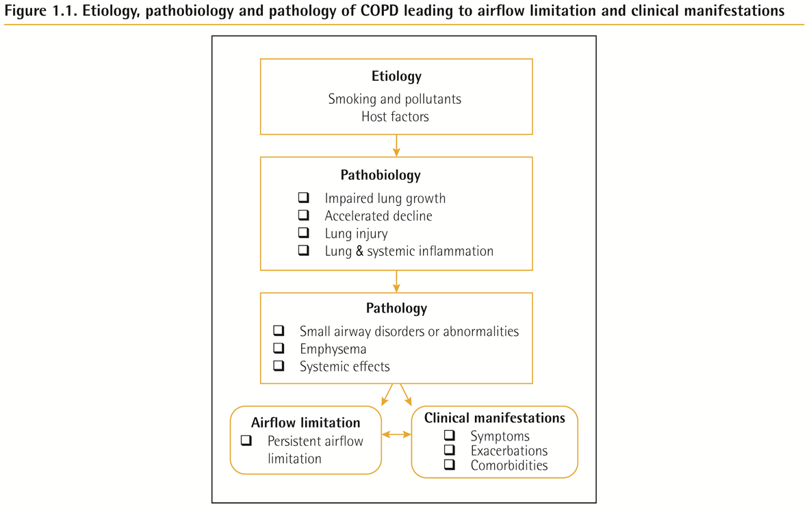

Slide 4
Chronic Obstructive Pulmonary Disease (COPD)
Characterized by respiratory symptoms and airflow limitation that is due to airway and/or alveolar abnormalities usually caused by significant exposure to noxious particles or gases.
The main risk factor for COPD is tobacco smoking but other environmental exposures such as biomass fuel exposure and air pollution may contribute

Slide 5
Prevalence
Prevalence of COPD was higher in smokers and ex-smokers compared to non-smokers
Higher ≥ 40 year group compared to those < 40
Higher in men than women

Slide 6
Prevalence
Estimated 384 million COPD cases in 2010.
Three million deaths annually.
Increasing smoking
By 2030 predicted 4.5 million COPD related deaths annually

Slide 7
Pathology, pathogenesis & pathophysiology
Pathology
Chronic inflammation
Structural changes
Pathogenesis
Oxidative stress
Protease-antiprotease imbalance
Inflammatory cells
Inflammatory mediators
Peribronchiolar and interstitial fibrosis
Pathophysiology
Airflow limitation and gas trapping
Gas exchange abnormalities
Mucus hypersecretion
Pulmonary hypertension

Slide 8
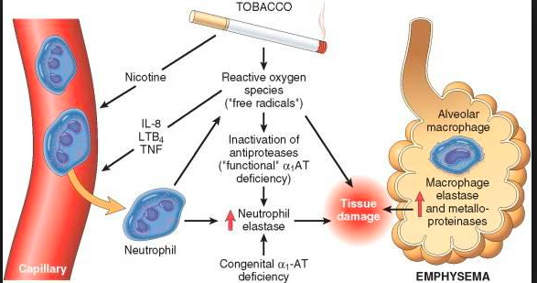
Pathogenesis

Slide 9
Diagnosis and Initial Assessment

Slide 10
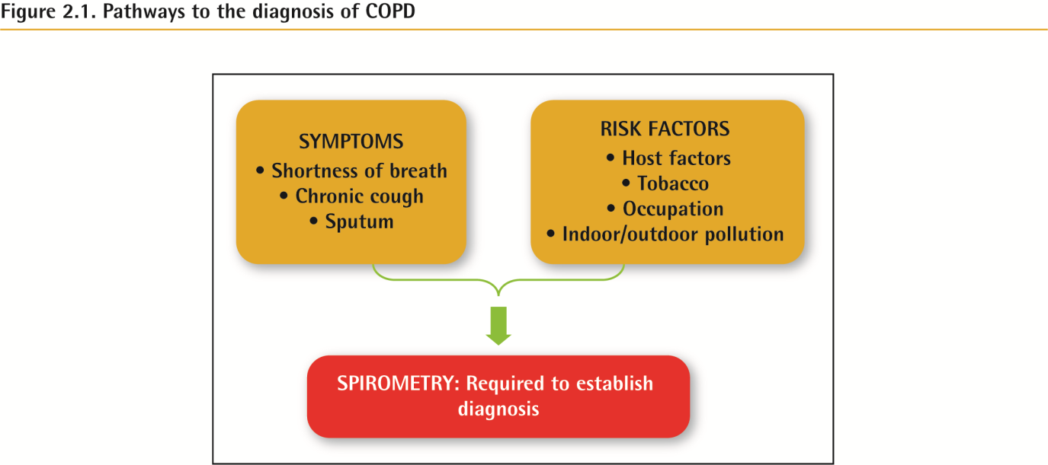
Diagnosis

Slide 11
Symptoms
Chronic and progressive dyspnea
Cough
Sputum production
Wheezing and chest tightness
Others – including fatigue, weight loss, anorexia, syncope, rib fractures, ankle swelling, depression, anxiety.

Slide 14
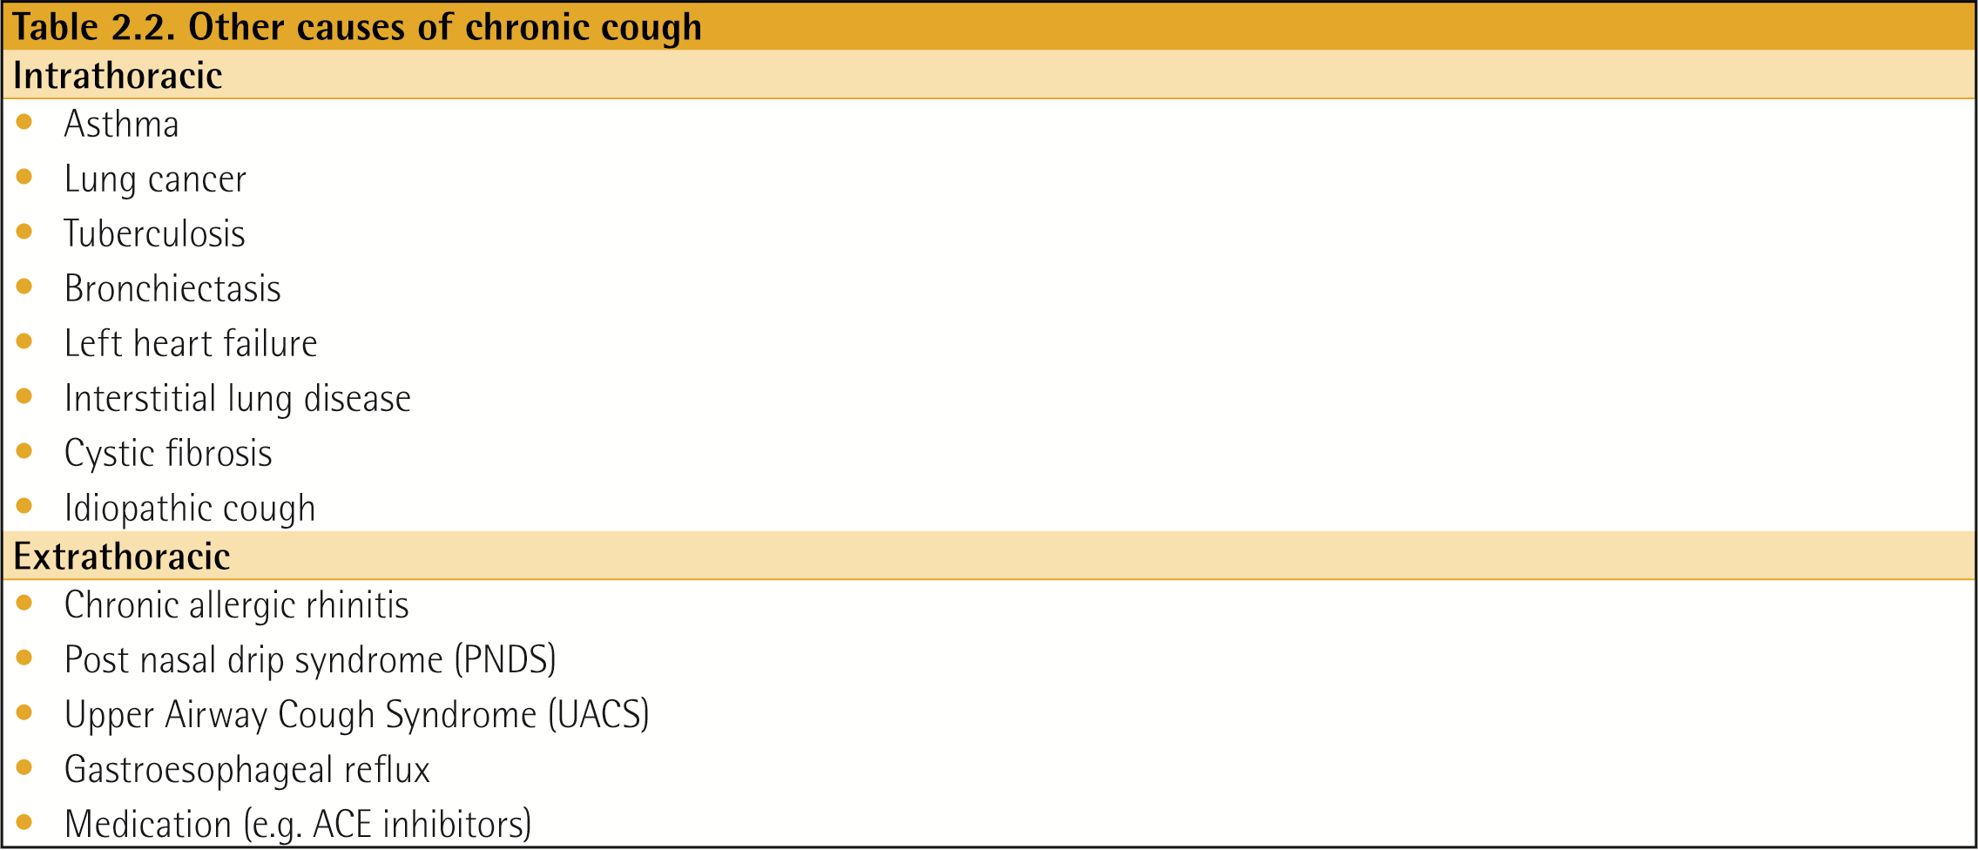

Slide 15
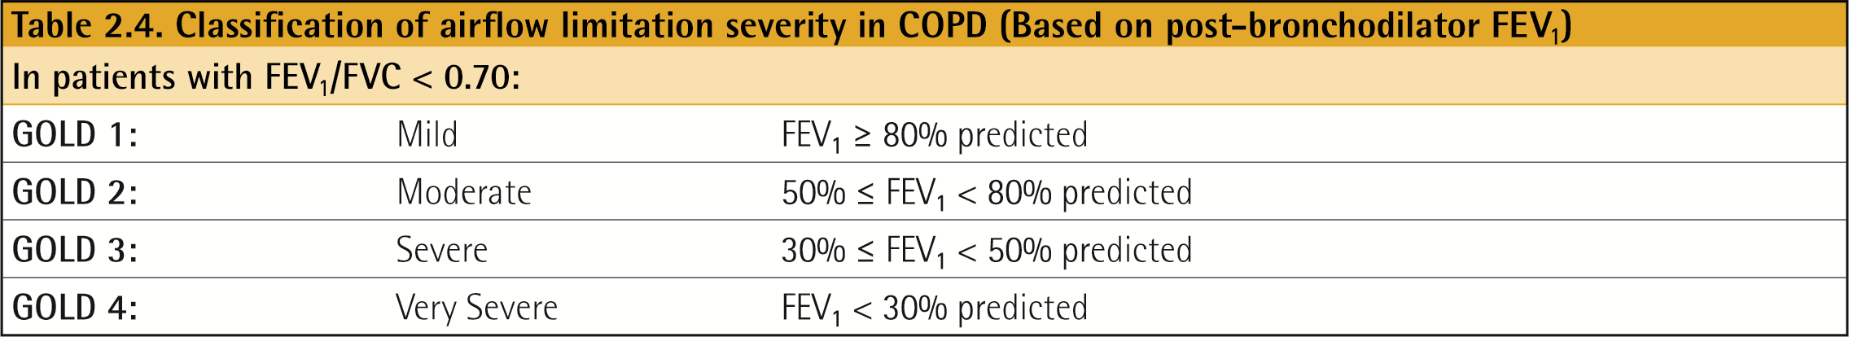
Spirometry

Slide 16
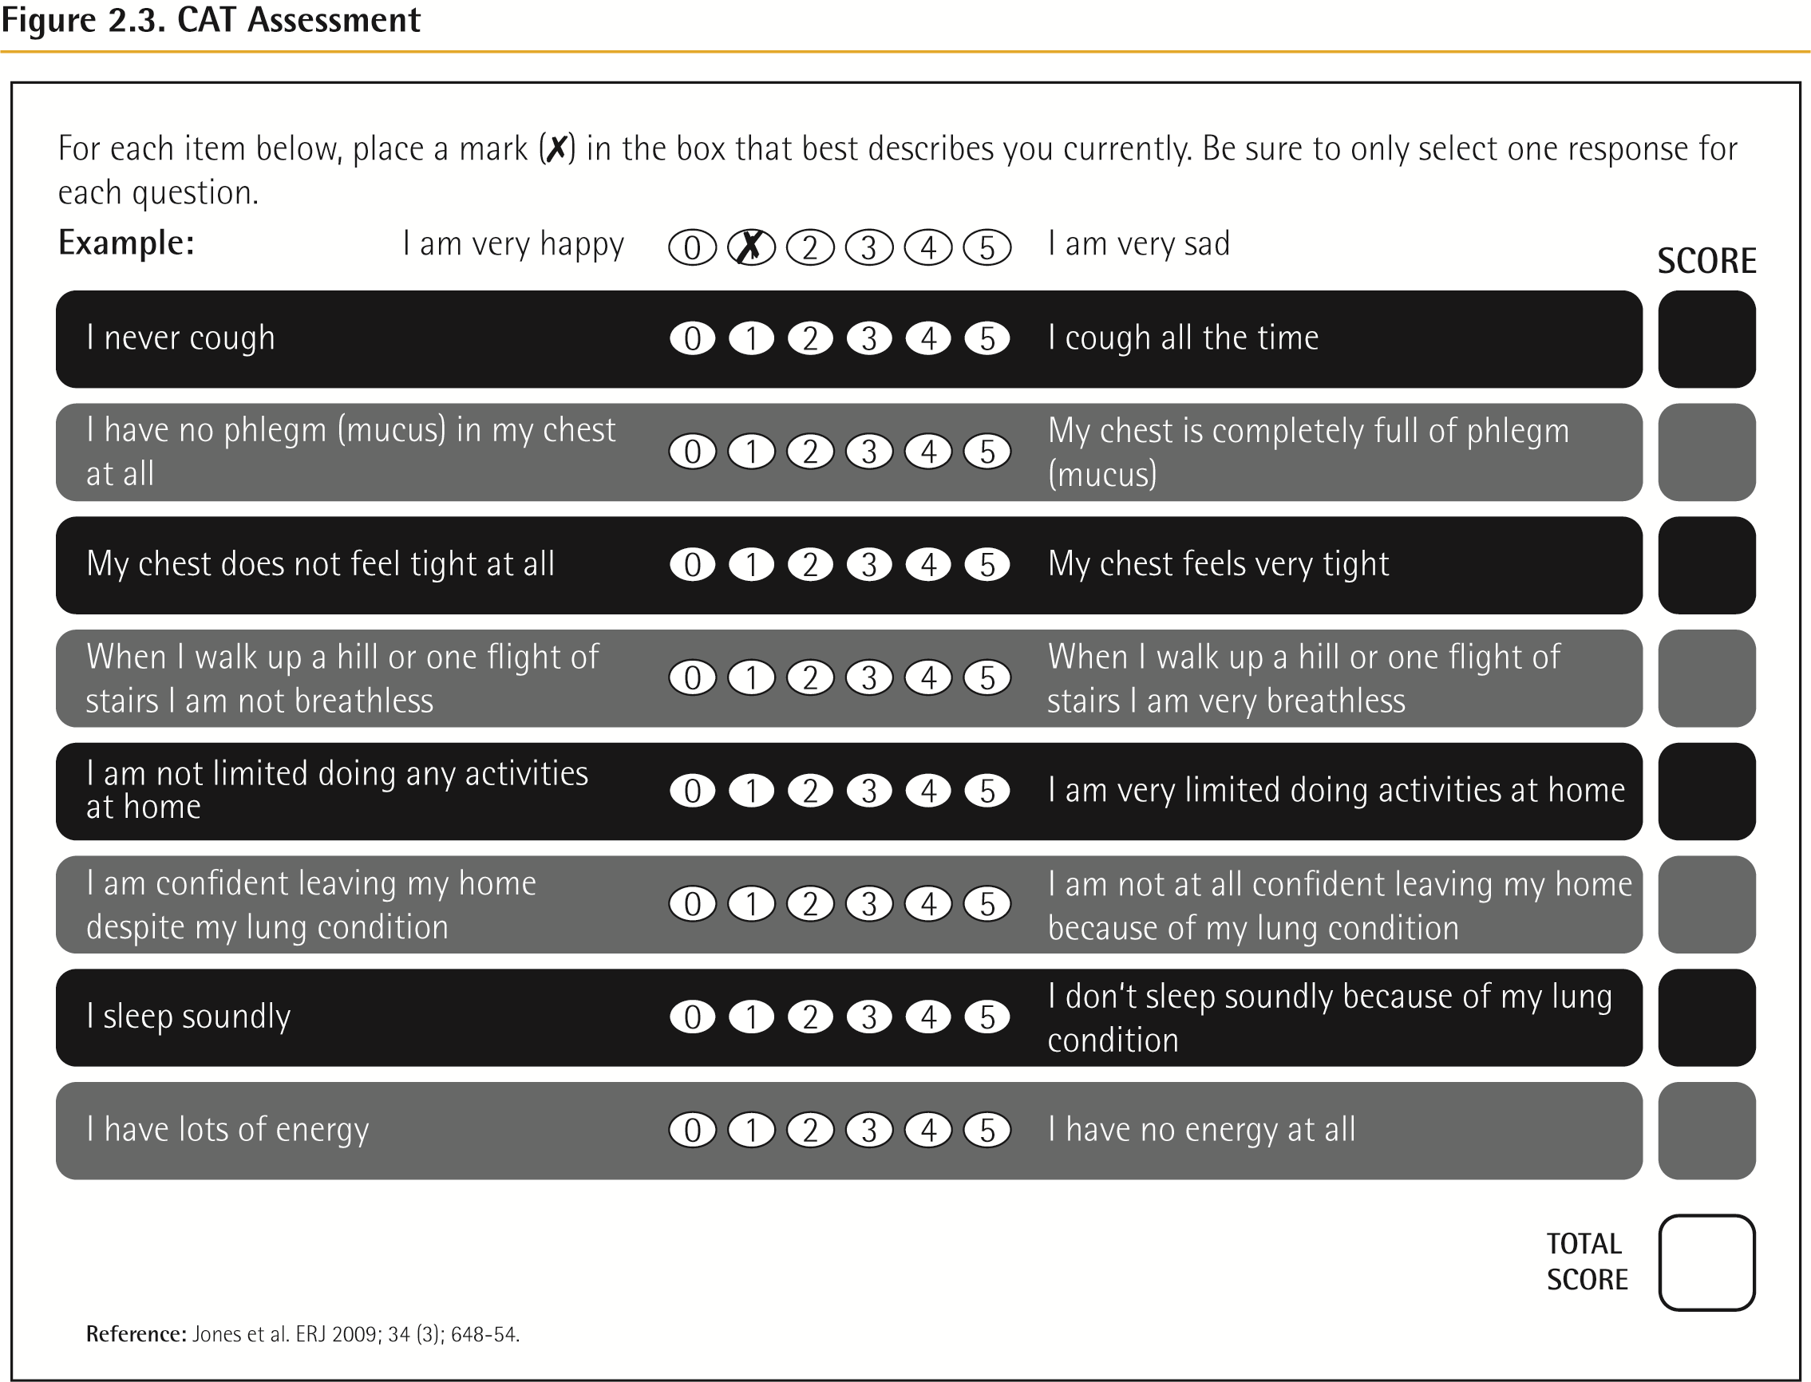
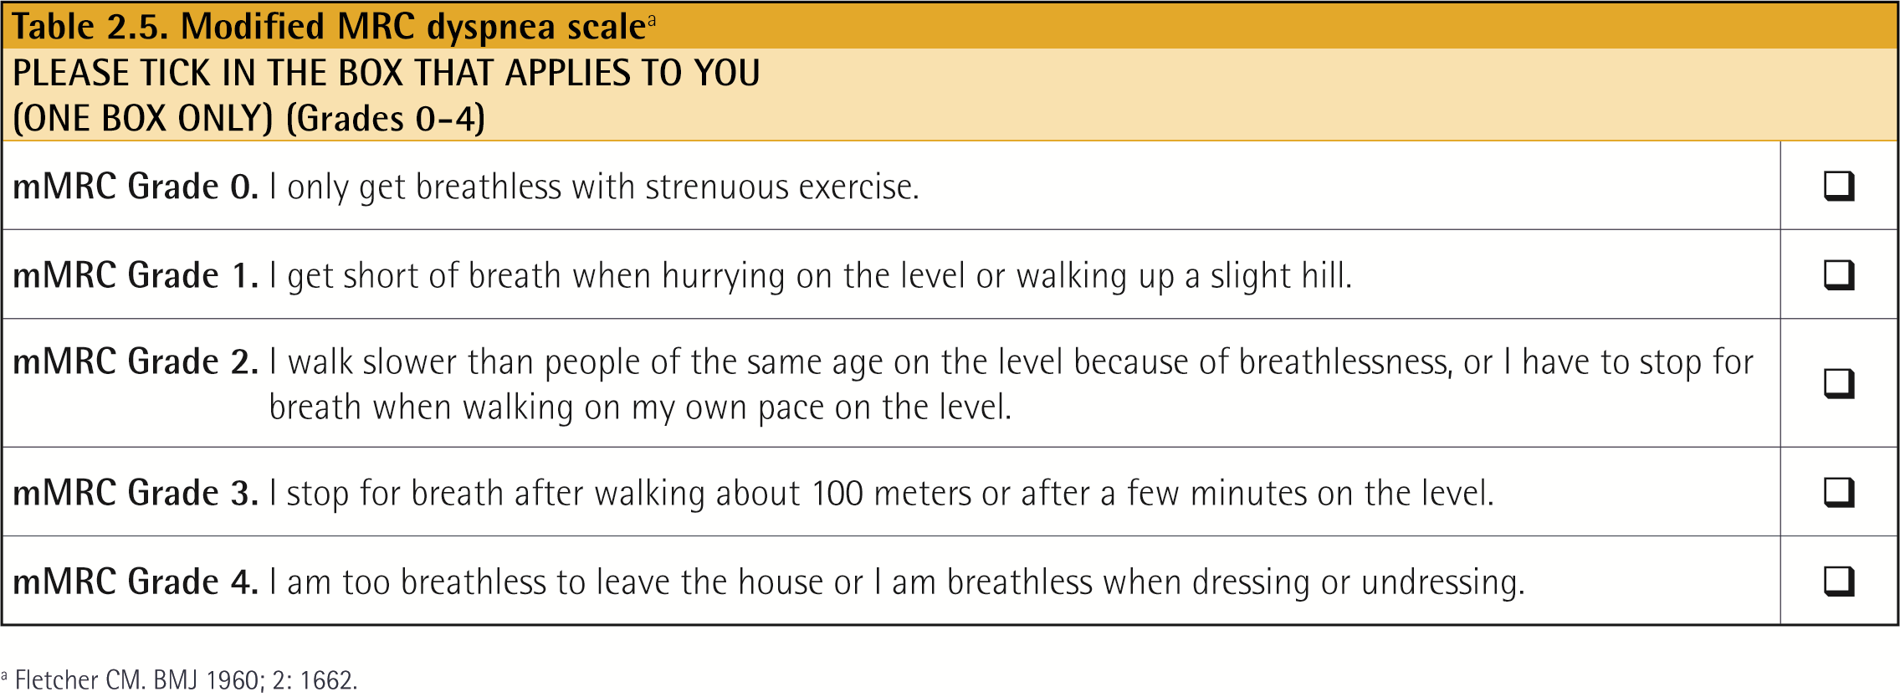
Choice of thresholds
COPD Assessment Test (CAT TM )
Modified Medical Research Council (mMRC) questionnaire

Slide 17
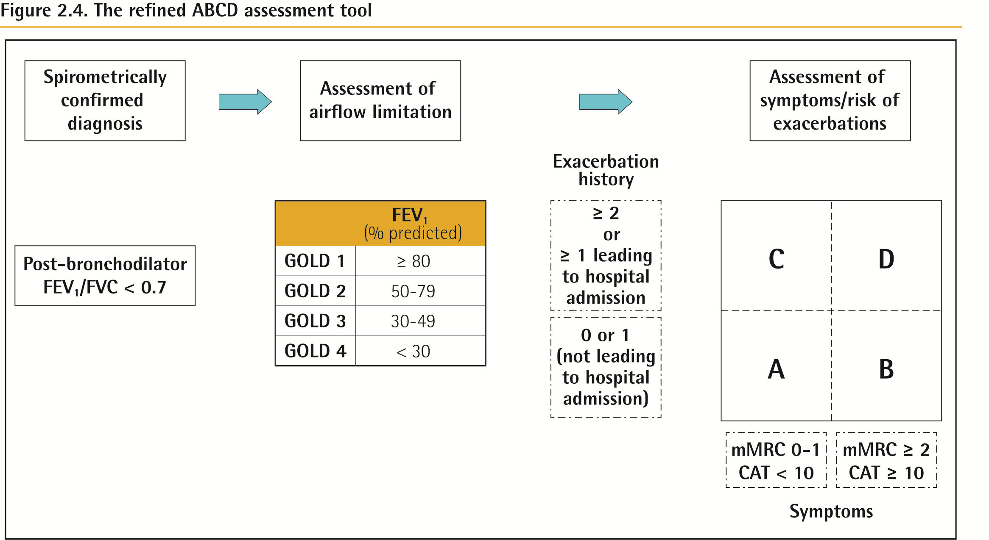
ABCD of COPD

Slide 18
Alpha-1 antitrypsin deficiency (AATD)
The World Health Organization recommends that all patients with a diagnosis of COPD should be screened once especially in areas with high AATD prevalence.
AATD patients are typically < 45 years with panlobular basal emphysema
Delay in diagnosis in older AATD patients presents as more typical distribution of emphysema (centrilobular apical).
A low concentration (< 20% normal) is highly suggestive of homozygous deficiency.

Slide 19
Differential Diagnosis
©

Slide 20
Management
Approach

Slide 21
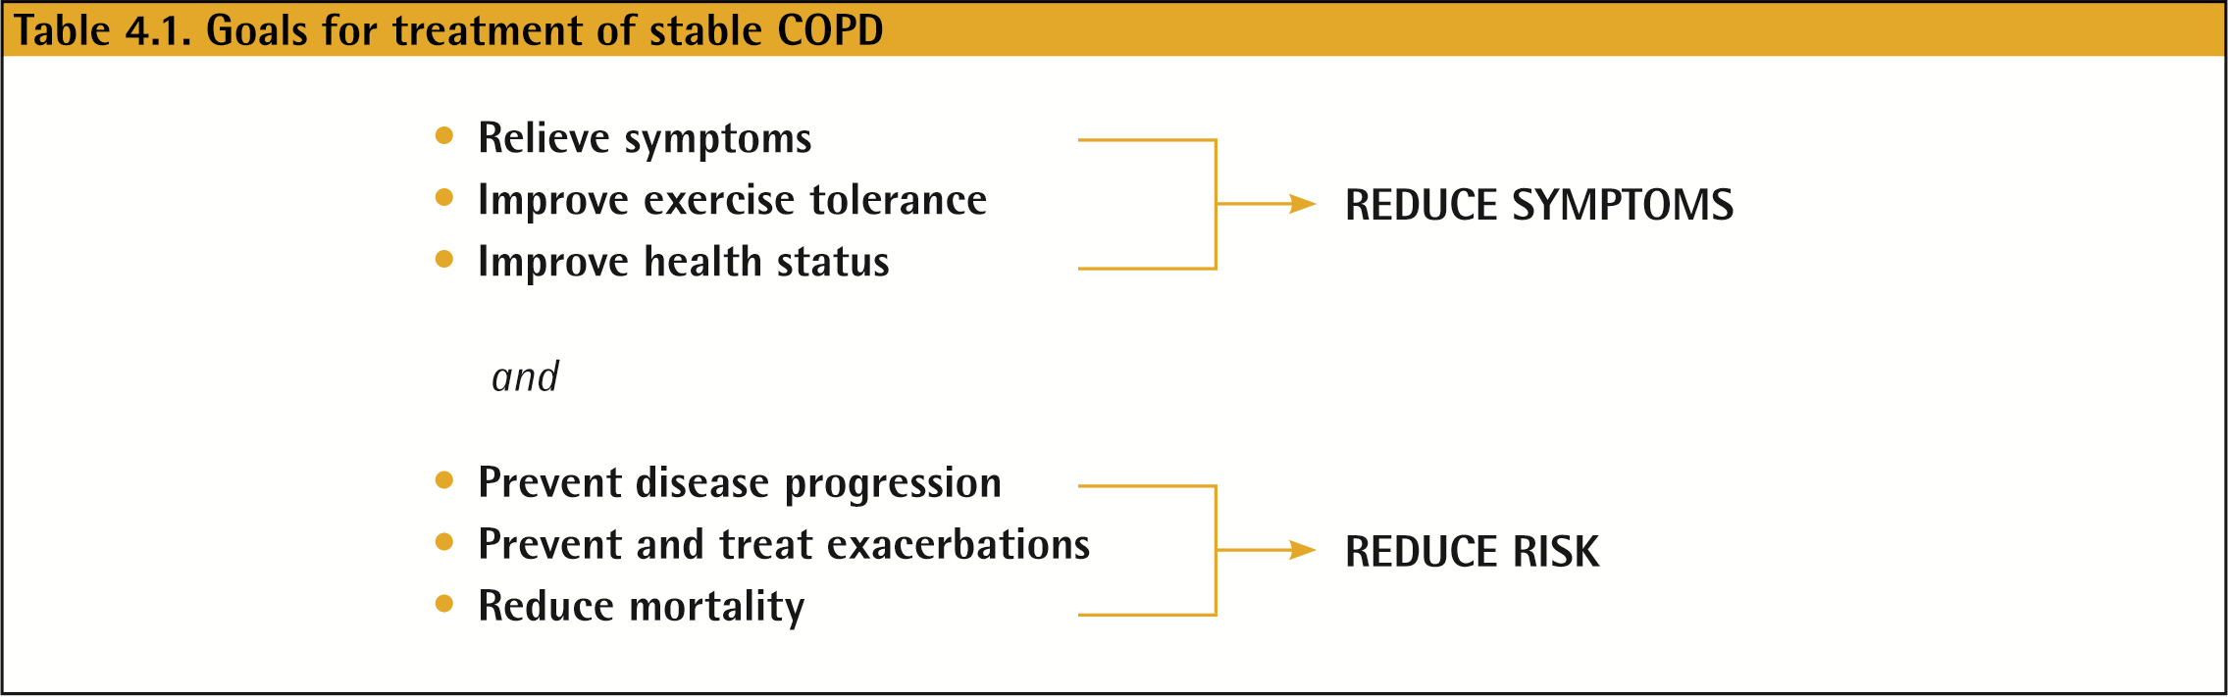
Management of Stable COPD
Once COPD has been diagnosed, effective management should be based on an individualized assessment to reduce both current symptoms and future risks of exacerbations.

Slide 22
Non-Pharmacologic Treatment
Education and self-management
Physical activity
Pulmonary rehabilitation programs
Exercise training
Self-management education
End of life and palliative care
Nutritional support
Vaccination
Oxygen therapy

Slide 23
Smoking
Smoking cessation has the greatest capacity to influence the natural history of COPD.
If effective resources and time are dedicated to smoking cessation, long-term quit success rates of up to 25% can be achieved.

Slide 24
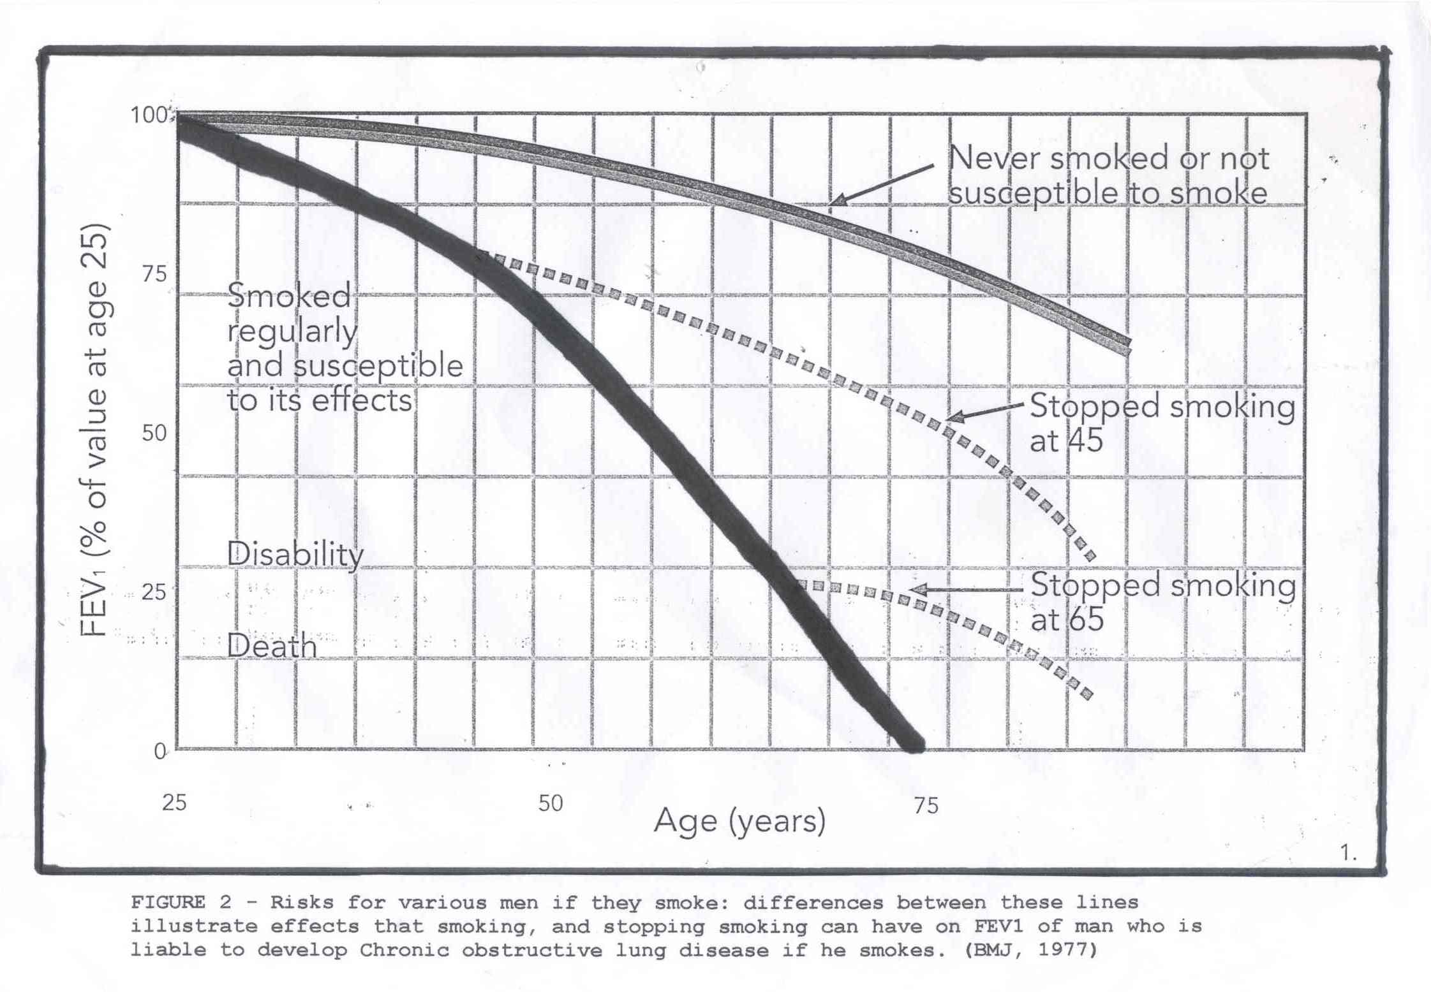

Slide 25
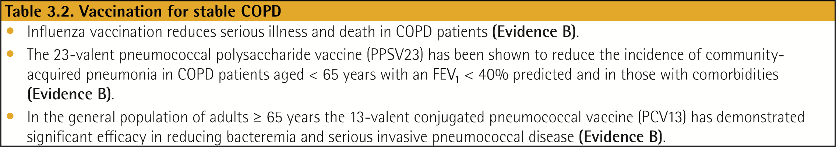
Vaccination
Influenza vaccination can reduce serious illness (such as lower respiratory tract infections requiring hospitalization)24 and death in COPD patients.
Pneumococcal vaccinations, PCV13 and PPSV23, are recommended for all patients ≥ 65 years of age

Slide 26
Pulmonary Rehabilitation
Exercise training
– 6–12 weeks;
longer programs result in larger effects
– 20–30 min walking per session, to limits of symptoms
Patient education
Smoking cessation,
COPD natural history and management,
self-management,
exacerbations
Assessment and follow-up
Nutritional support

Slide 27
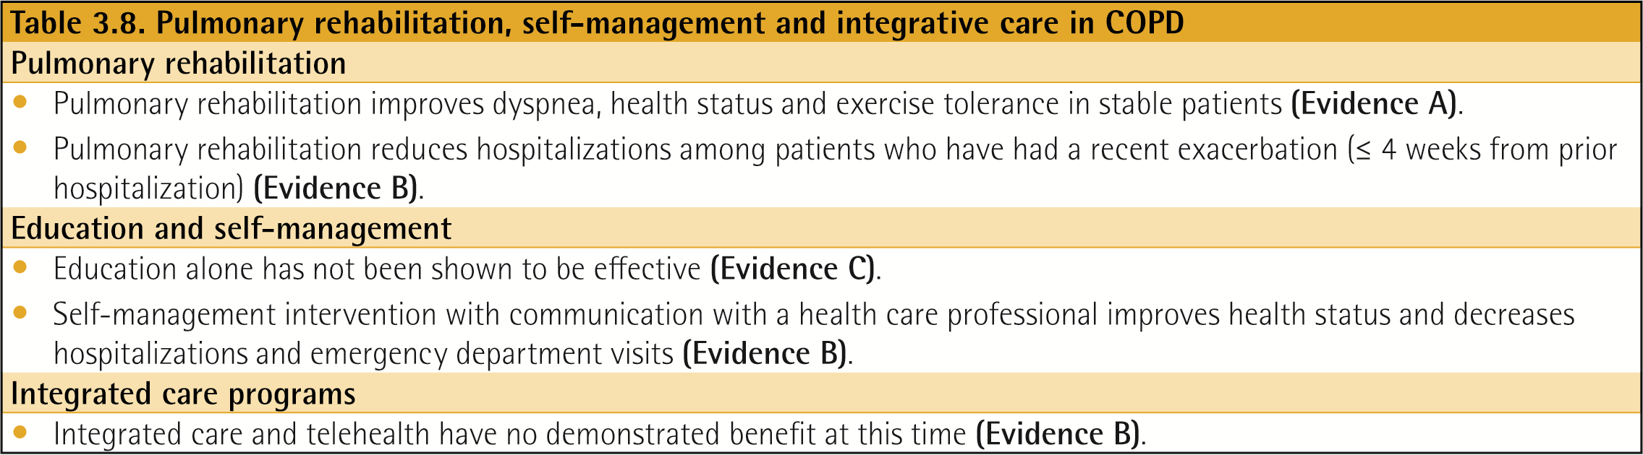
Rehabilitation, Education & Self-Management

Slide 28
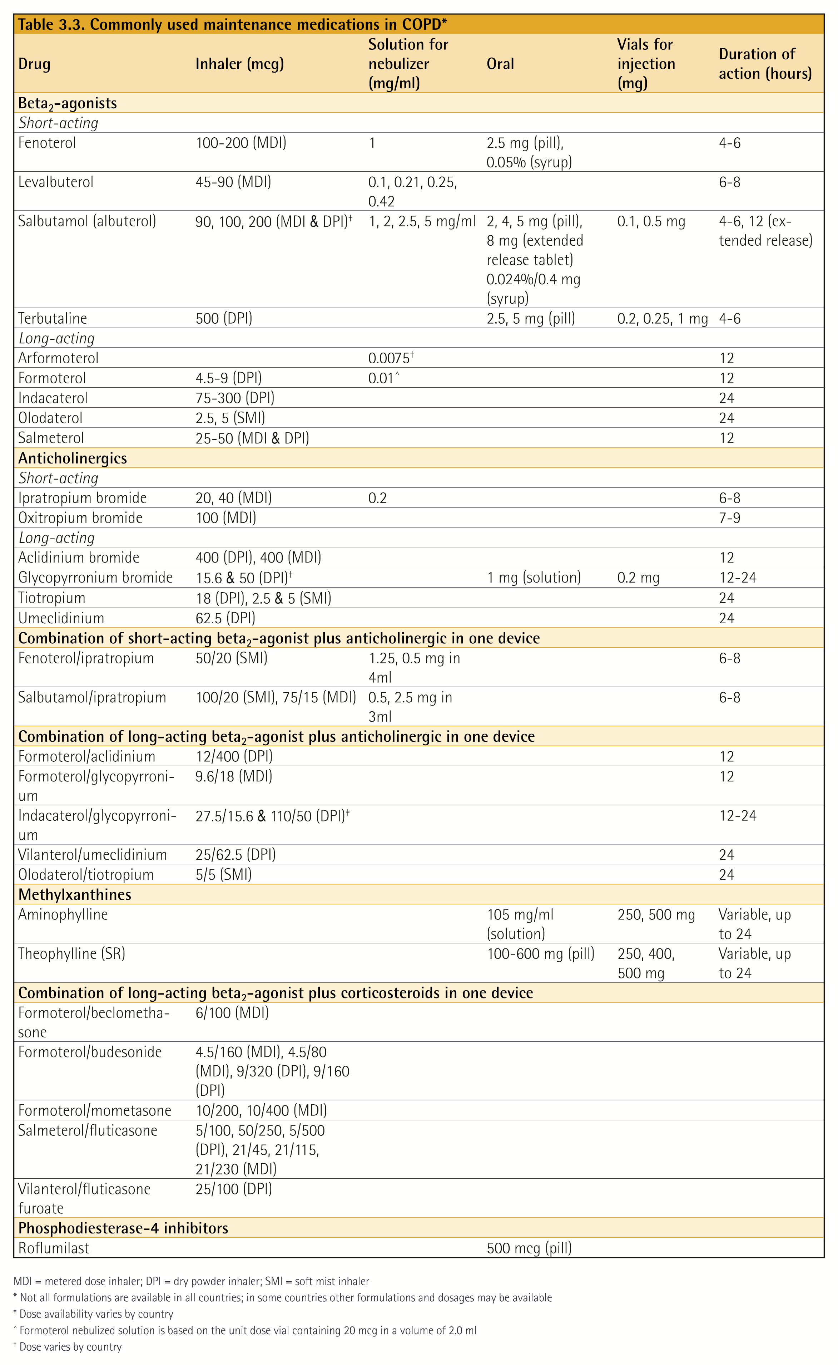
Pharmacological therapy

Slide 29
Pharmacologic Therapy

Slide 30
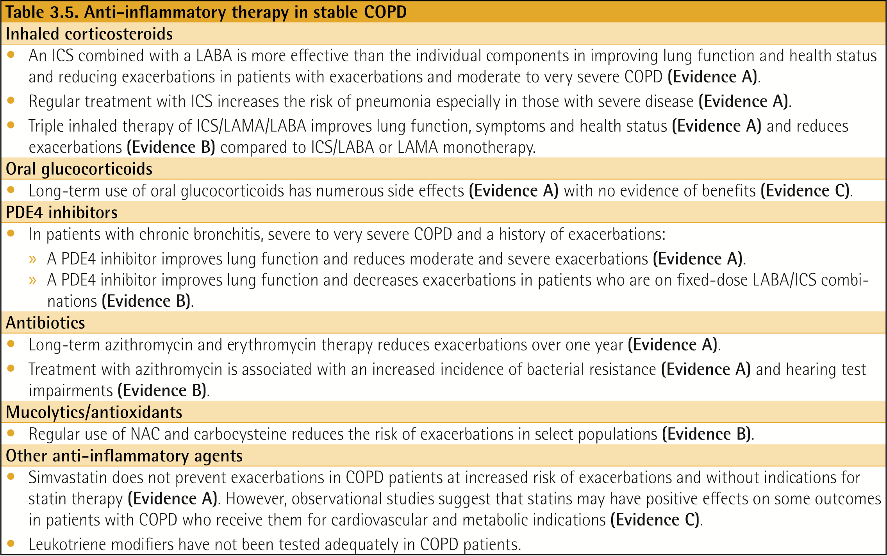
Anti-inflammatory Therapy in Stable COPD

Slide 31
The Inhaled Route
Right inhaler for the Right patient

Slide 32
Oxygen Therapy & Ventilatory Support in Stable COPD
During exacerbations of COPD. Noninvasive ventilation (NIV) in the form of noninvasive positive pressure ventilation (NPPV) is the standard of care for decreasing morbidity and mortality in patients hospitalized with an exacerbation of COPD and acute respiratory failure

Slide 33
ABCD of COPD

Slide 34
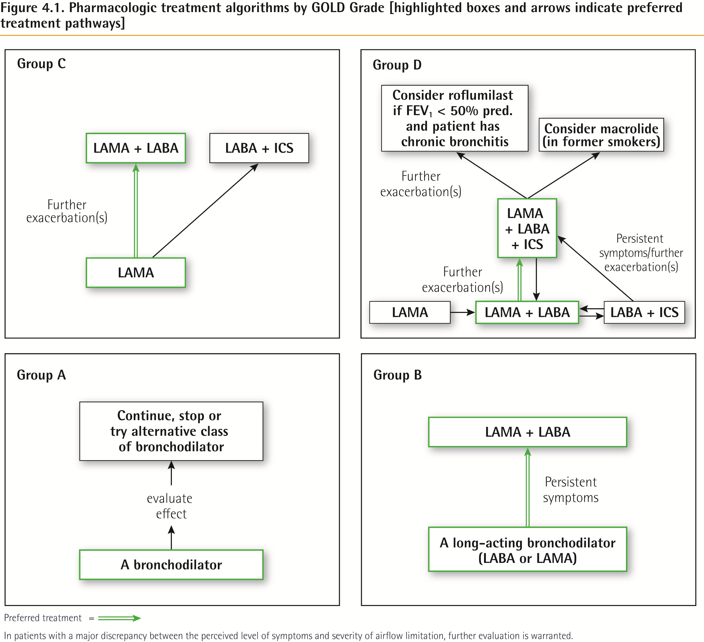

Slide 35
Oxygen therapy
Long-term oxygen therapy is indicated for stable patients who have:
PaO2 at or below 7.3 kPa (55 mmHg) or SaO2 at or below 88%, with or without hypercapnia confirmed twice over a three week period; or
PaO2 between 7.3 kPa (55 mmHg) and 8.0 kPa (60 mmHg), or SaO2 of 88%, if there is evidence of pulmonary hypertension, peripheral edema suggesting congestive cardiac failure, or polycythemia (hematocrit > 55%).

Slide 36
Interventional bronchoscopy and surgery
Surgical or endoscopic LVRS
Bullectomy
Transplant

Slide 37
Management of Exacerbations
COPD exacerbations are defined as an acute worsening of respiratory symptoms that result in additional therapy.
They are classified as:
  Mild (treated with short acting bronchodilators only, SABDs)
  Moderate (treated with SABDs plus antibiotics and/or oral corticosteroids) or
  Severe (patient requires hospitalization or visits the emergency room). Severe exacerbations may also be associated with acute respiratory failure.

Slide 38
Classification of hospitalized patients
No respiratory failure:
Respiratory rate: 20-30 breaths per minute; no use of accessory respiratory muscles; no changes in mental status; hypoxemia improved with supplemental oxygen given via Venturi mask 28-35% inspired oxygen (FiO₂); no increase in PaCO₂.
Acute respiratory failure — non-life-threatening:
Respiratory rate: > 30 breaths per minute; using accessory respiratory muscles; no change in mental status; hypoxemia improved with supplemental oxygen via Venturi mask 25-30% FiO₂; hypercarbia i.e., PaCO₂ increased compared with baseline or elevated 50-60 mmHg
Acute respiratory failure — life-threatening:
Respiratory rate: > 30 breaths per minute; using accessory respiratory muscles; acute changes in mental status; hypoxemia not improved with supplemental oxygen via Venturi mask or requiring FiO₂ > 40%; hypercarbia i.e., PaCO₂ increased compared with baseline or elevated > 60 mmHg or the presence of acidosis (pH < 7.25).

Slide 39
Management of Exacerbations
Bronchodilators
  .
Corticosteroids
Antibiotics

Slide 40
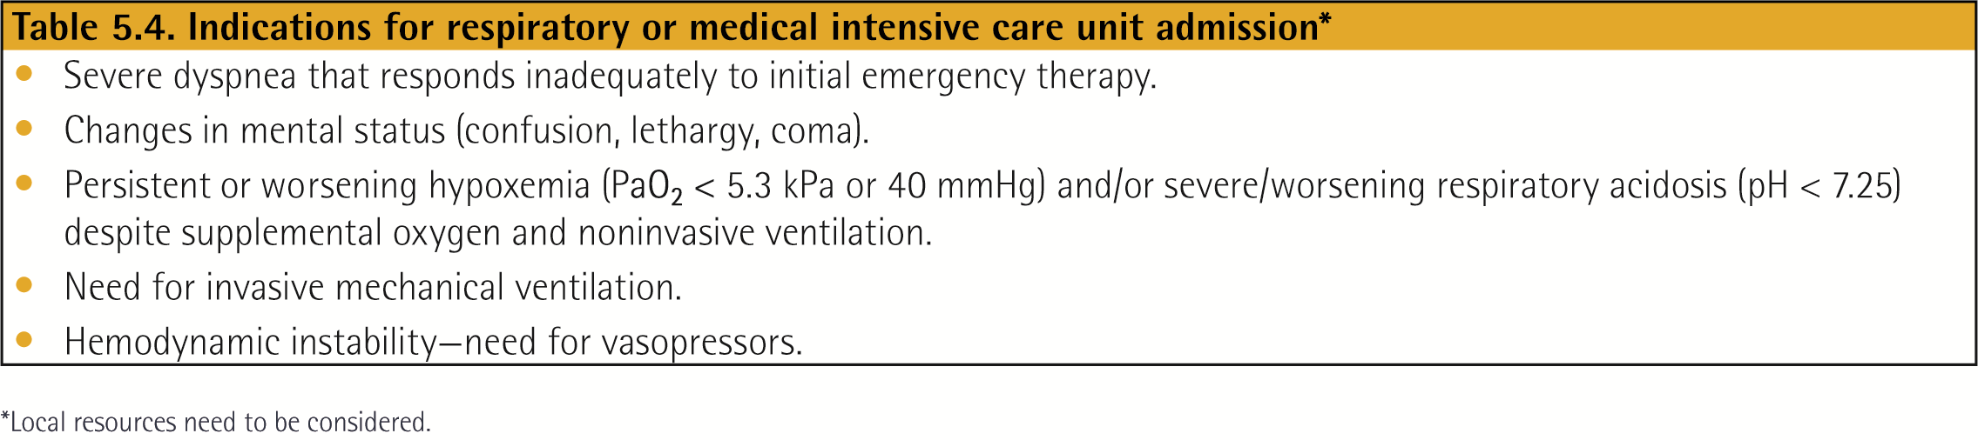
Management of Exacerbations
Respiratory support

Slide 41
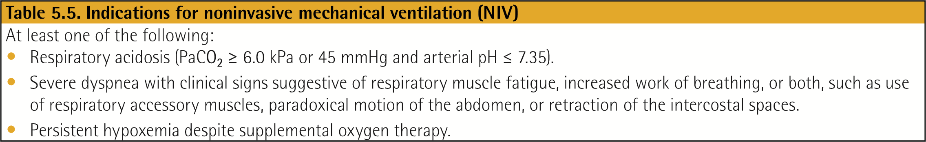
Management of Exacerbations
NIV

Slide 42


