Slide 1
Pleural Effusion
ABDULLAH ALHARBI , MD,FCCP

Slide 2
A 67-year-old man presents to the emergency department
with a 5-day history of fever and cough that produces green sputum.
He has a history of tobacco use and ischemic cardiomyopathy with
a left ventricular ejection fraction of 25%. He was admitted with a presumptive diagnosis of pneumonia and is started on
antibiotics.
A chest radiograph is obtained and shows a left-sided consolidation and moderate-size effusion.
Which of the following studies can be used to determine?
if the patient’s effusion is due to his CHF (a transudate) or is a Para pneumonic effusion (an exudate)?
(A) Pleural fluid pH
(B) Pleural fluid glucose
(C) Pleural fluid cell count
(D) Lactate dehydrogenase (LDH

Slide 3
A 59-year-old male presents with a community acquired pneumonia complicated by pleural effusion. A thoracentesis is performed, , but the results are not currently available. Which characteristic of the pleural fluid is most suggestive complicated parapnemonic pleural effusion?
A. Presence of more than 30% polymorphonucleocytes (PMNs)
B. Glucose less than 150 mg/dL
C. Presence of more than 1000 white blood cells
D. pH less than 7.20
E. Lactate dehydrogenase (LDH) more than two-thirds of the normal upper limit for serum

Slide 4
A 55-year-old man presents with progressive shortness of breath. Other than a history of heavy smoker, the patient has no significant past medical history. Breath sounds are absent two-thirds of the way up on the left side of the chest. Percussion of the left chest reveals stony dullness, the trachea appears to be deviated toward the right. Which of the following diagnoses is most likely?
(A) Bacterial pneumonia
(B) Viral pneumonia
(C) Bronchial obstruction
(D) Pleural effusion
(E) Pneumothorax

Slide 5
Objectives:
Describe the pathophysiology of a pleural effusion
Describe the main causes of a pleural effusion
Differentiate among the manifestations of fluid collections
Describe the signs and symptoms of a pleural effusion
Explain diagnostic methods
Describe the various treatment options

Slide 7
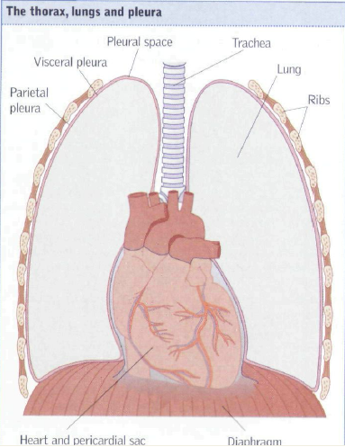
)

Slide 8
Pleura
Serous fluid that allows for the parietal pleura (outer lining) and visceral pleura (inner lining) to glide over each other without separation
contains about 5-15ml of fluid at one time
Pleural fluid is produced by the parietal pleura and absorbed by the visceral pleura as a continuous process.
The visceral pleura absorbs fluid, which then drains into the lymphatic system and returns to the blood
about 100-200ml of fluid circulates though the pleural space within a 24-hour period

Slide 9
Clinical Presentation
History
  Dyspnea
  Pleuritic chest pain
  Cough
  Other symptoms related to underlying cause
Physical exam (Findings usually present for effusions > 300 mL )
  Dullness to percussion, decreased tactile fremitus
  Asymmetric chest expansion
  Decreased breath sounds
  Tracheal shift away from the affected side

Slide 10
Development of Pleural Effusion
pulmonary capillary pressure (CHF)
capillary permeability (Pneumonia)
intrapleural pressure (atelectasis)
plasma oncotic pressure (hypoalbuminemia)
pleural membrane permeability (malignancy)
lymphatic obstruction (malignancy)
diaphragmatic defect (hepatic hydrothorax)
thoracic duct rupture (chylothorax)

Slide 11
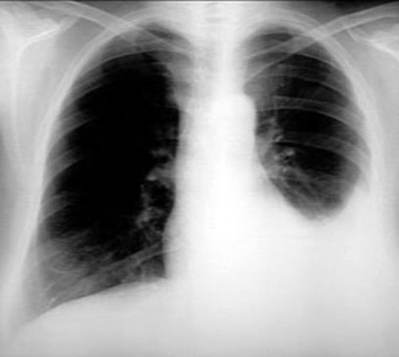
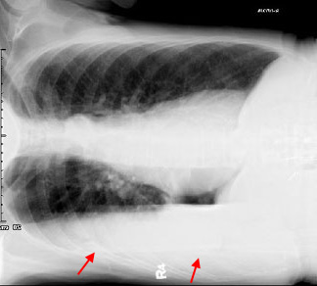
Imaging Studies-Chest Radiographs
Lateral Decubitus – very sensitive,
can detect effusions as small as
50 mL
PA - usually around 250-500 mL needed before visible

Slide 12
Imaging Studies
CT Scan
  Better characterization of underlying lung parenchyma and certain processes that may be obscured on radiographs by large pleural effusions
Ultrasound
  Cheap and available at bedside
  Can help identify free vs. loculated effusions
  Thoracentesis is facilitated by ultrasound guidance

Slide 13
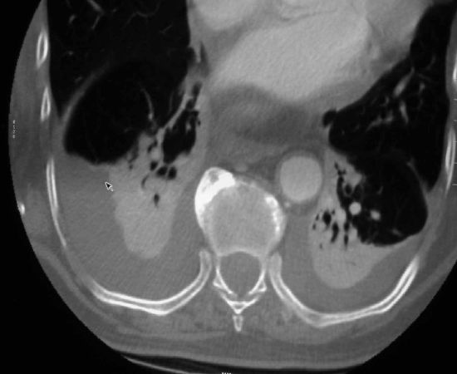
CT Scan

Slide 14
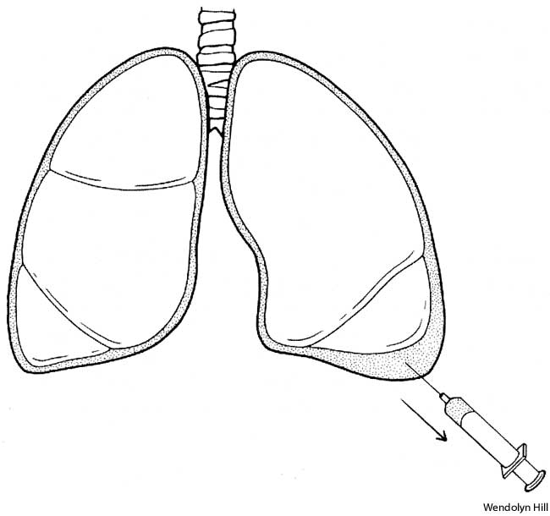
Thoracocentesis

Slide 15
Indications for thoracentesis
Pleural effusion of unknown etiology, with >10mm depth on lateral decubitus CXR or Ultrasound
Therapeutically for symptomatic relief
Concern for empyema
Air fluid level in pleural space
Notes:
-Generally accepted that if the depth is greater than 1cm, the amount of fluid is significant

Slide 16
Pleural Fluid Evaluation
5 Cs
Color
Cytology
Culture
Cell count
Chemistry
Notes:
Other routine and optional thoracentesis labs

Slide 17
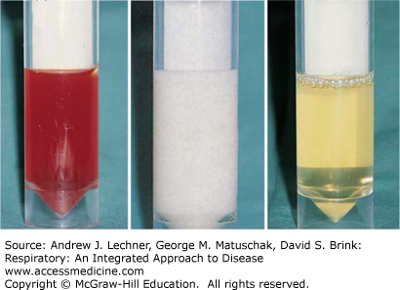
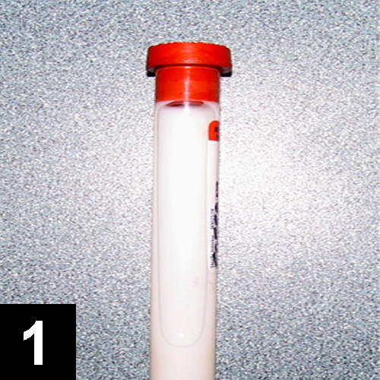
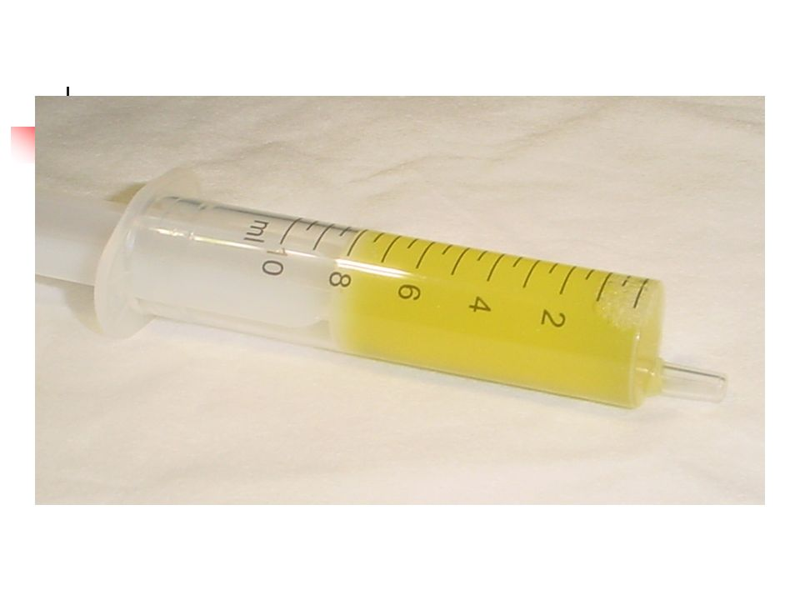

Slide 18
Lights Criteria
Pleural effusion is exudative if one or more of the following:
  Ratio of pleural fluid protein level to serum protein level > 0.5
  Ratio of pleural fluid LDH level to serum LDH level > 0.6
  Pleural fluid LDH level > 2/3 the upper limit of normal for serum LDH level.
98% sensitive and 83% specific for exudative effusion using Lights criteria.
Absence of all 3 criteria = transudative
Notes:
Fun fact: Dr. Light practiced at Long Beach VA

Slide 19
Transudative vs Exudative
Transudative
  CHF
  Nephrotic syndrome
  Hypoalbuminemia
  Hepatic hydrothorax
  Atelectasis
  Hypothyrodism
Exudative
  Pneumonia
  Malignancy
  PE
  Inflammatory (pancreatitis, ARDS, uremic pleurisy etc
  Connective tissue disease
Notes:
Most common causes of transudative and exudative effusions

Slide 20
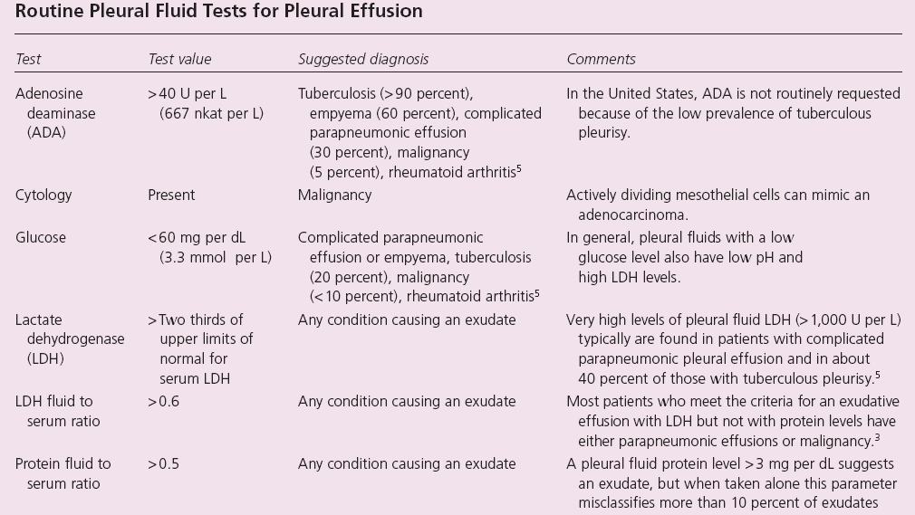

Slide 21
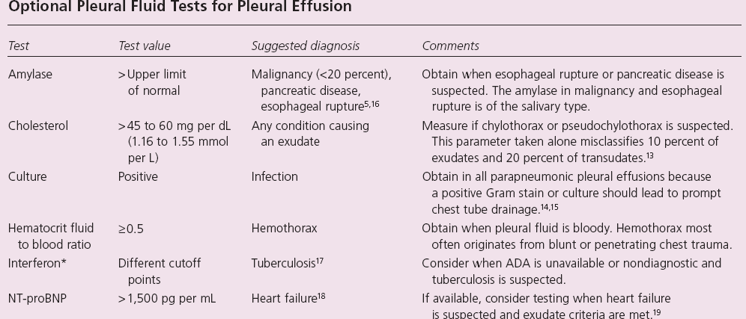

Slide 22
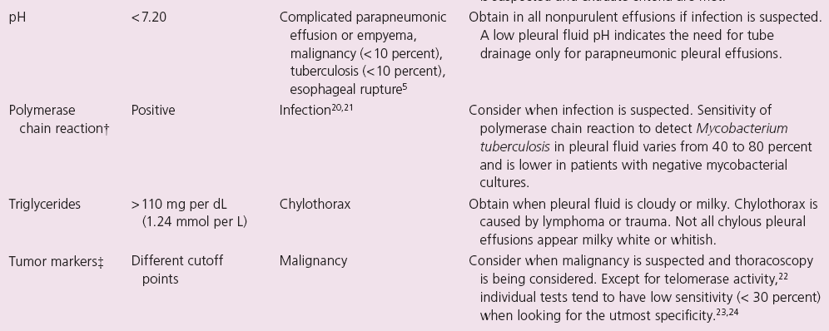

Slide 23
Cell count
Lymphocytic (> 50%)
  CA (30-35%)
  TB (15-20%)
  Sarcoidosis
PMNs
  Empyema
  Parapneumonic
  Rheumatoid
  Pulmonary infarction
PMN or Lymphocytic
  PE
  Conn tissue disease
  Post-cardiac injury
Eosinophilic (> 10%)
  Trauma
  PTX
  CA
  Asbestos, parasites
  Pneumonia
RBC > 100,000/mm
  CA
  Trauma
  Pulmonary infarction

Slide 24
Treatment
Thoracentesis – then treat underlying disease
  Uncomplicated pneumonia – antibiotics
Hemithorax involved/empyema – tube thoracostomy +/- VATS
Malignant effusion- chest tube +/- pleurodesis (sclerosants)
VATS

Slide 25
Summary
Pleural effusions are commonly encountered on wards
Thoracentesis is not immediately indicated if there is a obvious explanation for pleural effusion without atypical features
Pleural effusions are classified as transudative vs exudative.
CHF, pneumonia, malignancy and PE comprise the vast majority of causes for pleural effusions.

