Slide 1
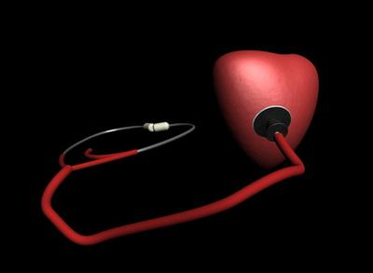
HYPERTENSION
Prof. Jamal Al Wakeel
Consultant Nephrology Division
Department of Medicine
Notes:
1

Slide 2
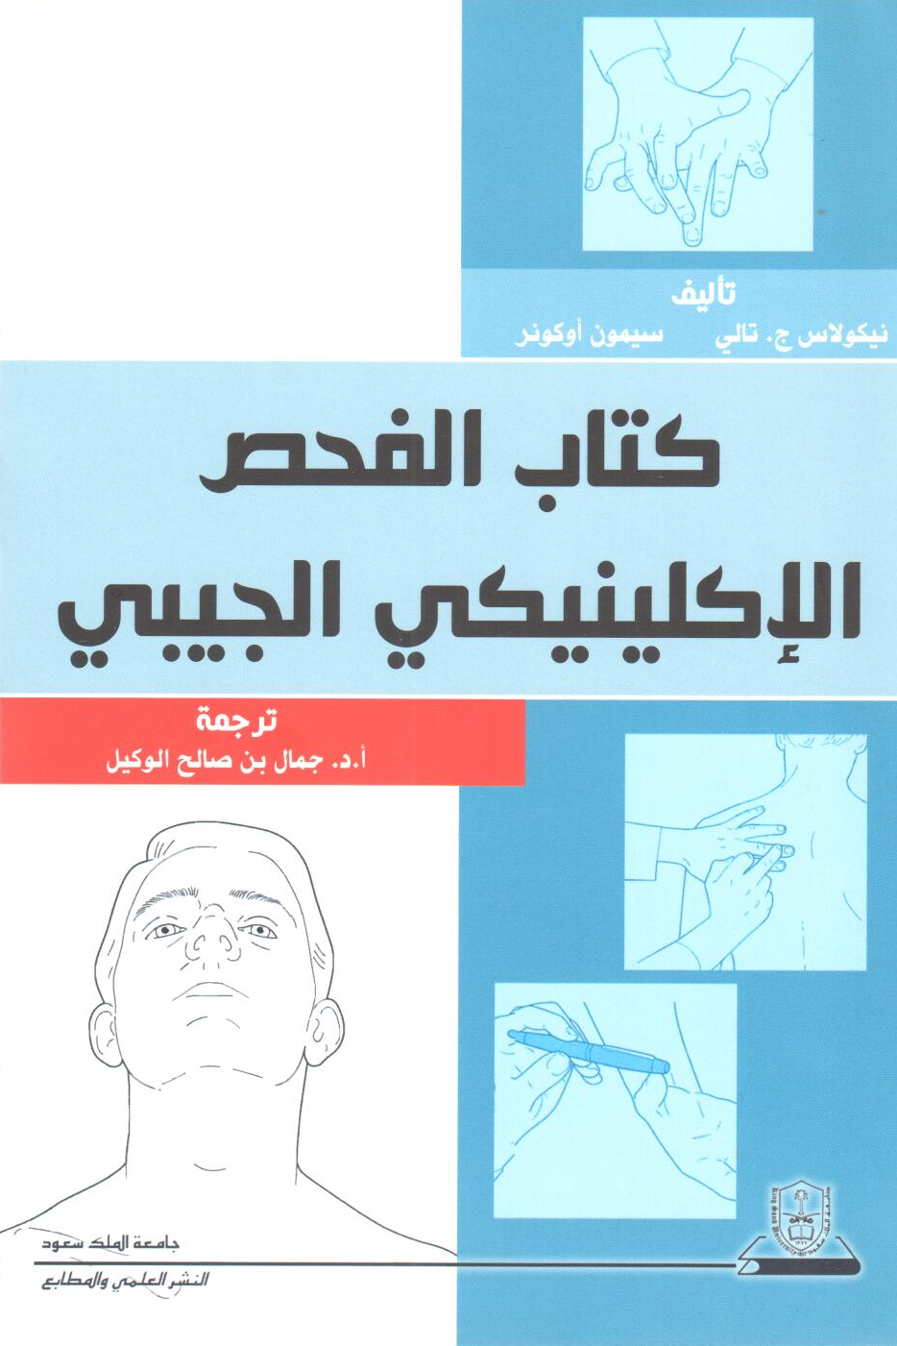
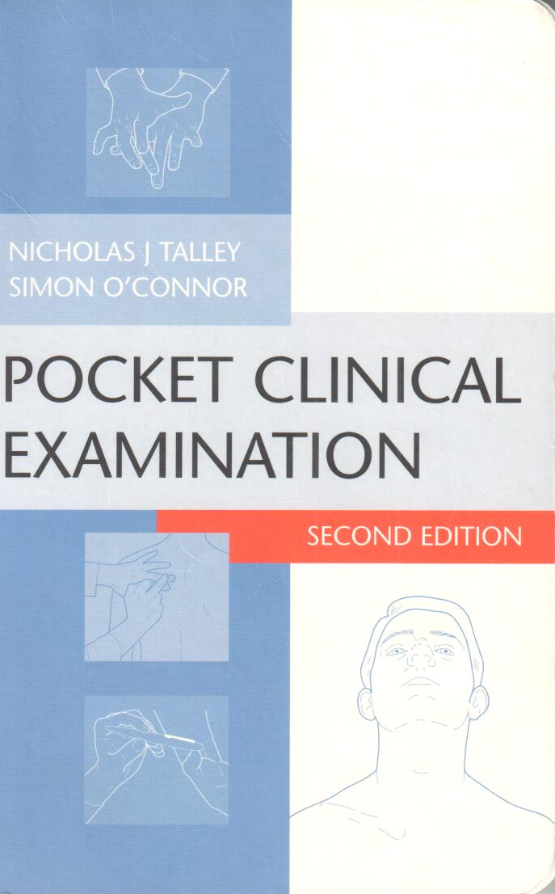

Slide 3
The Objectives of this Lecture are:
To be able to recognize the definition of hypertension
To be able to identify the Stages of Hypertension ( ACC/AHA - European Society of Cardiology/European Society of Hypertension (ESC/ESH)
To find out the complication of Hypertension
To learn how to measure blood pressure
To acquire knowledge on how to treat hypertension

Slide 4
Case
47 year old man came to your clinic with headache for 3 weeks. The nurse measure his Blood Pressure and was found to be 150/95 mmHg:
Does he have Hypertension?
What is the stage of Hypertension?
What investigation should you perform?
What could be your management on his case?
Is their any possible prevention to his disease and its complication?

Slide 5
Prevalence of hypertension
The 4th most common cause of death worldwide
The overall prevalence of hypertension in adults is 30 - 45%
The overall prevalence of hypertension in Saudia is 25.5%- 31.4%
Onset stage 25-55 years mainly in 40-50y
more common with advancing age
prevalence of >60% in people aged >60 years
Risk of HTN : A)As populations age, B) sedentary lifestyles C) increase their body weight
Notes:
The global prevalence of hypertension was estimated to be 1.13 billion in 2015

Slide 6
Only 72% are aware of their disease
55% of participants on medication for hypertension had their blood pressure uncontrolled
Notes:
The 4th most common cause of death worldwide
Directly and indirectly responsible for >20% of all deaths
the global prevalence of hypertension was estimated to be 1.13 billion in 2015
.
15.2% and 40.6% of Saudis were hypertensive or borderline hypertensive

Slide 7
Mechanism of Blood Pressure
Stroke Volume
Cardiac Output
x
HR
Blood Pressure
System Vascular Resistance
Elasticity
Sympathetic
Parasympathetic
Hormonal
Endothelium
Adrenal glands Aldosteron Norepinephine Epinephrine Angiotensin II (vasoconstrictor)
Endothelin-1 Nitric Oxide

Slide 8
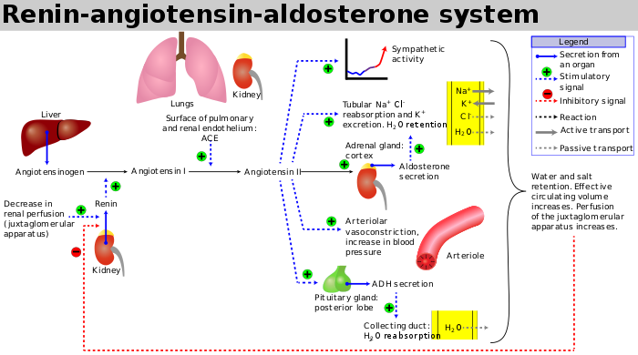
Mechanism of Blood Pressure
Renin–angiotensin system
From Wikipedia, the free encyclopedia
Mechanism of Blood Pressure

Slide 9
Hypertension
In 90%-95% of cases no cause can be found primary hypertension (essential)
Secondary hypertension 5-10%

Slide 10
Essential HTN
Risk factors (modeflied)
Obesity---metabolic syndrome
Unhealthy.diet—Excessive.salt.intake--lowpotassium intake
Excessive alcohol intake
Polycythemia
Lack of exercise
Non-steroid anti-inflammatory drugs
Risk factors (Non modeflied)
Family history of essential HTN
Aging
Race &gentic
Caffeine and smoking increase the BP acutely but are not risk factors for the development of chronic essential HTN

Slide 11
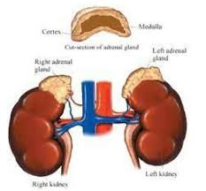
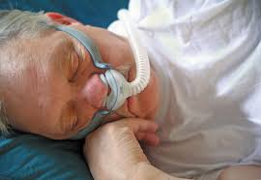
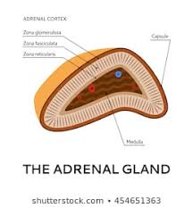
Secondary Hypertension
Primary renal disease
Oral contraceptives
Sleep apnea syndrome
Primary hyperaldosteronism
Renovascular disease
Cushing’s syndrome
Pheochromocytoma
Other endocrine disorders
Coarctation of the aorta

Slide 12
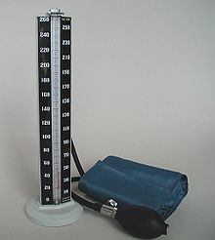
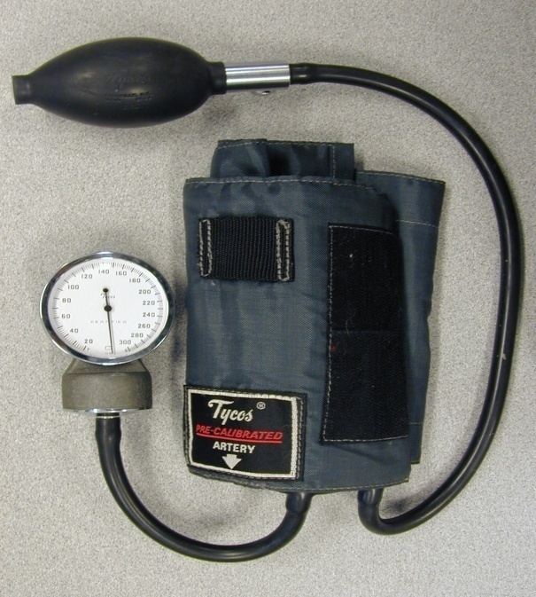
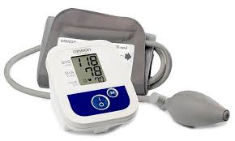
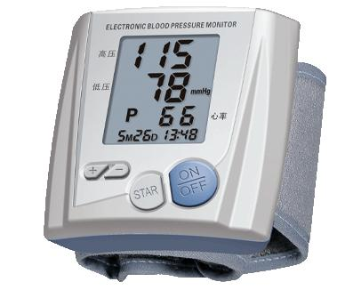
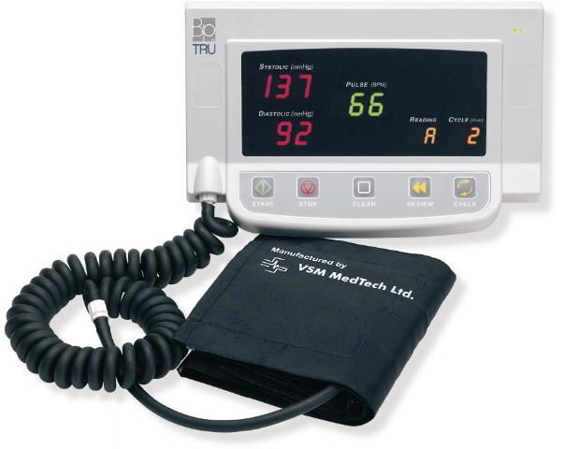
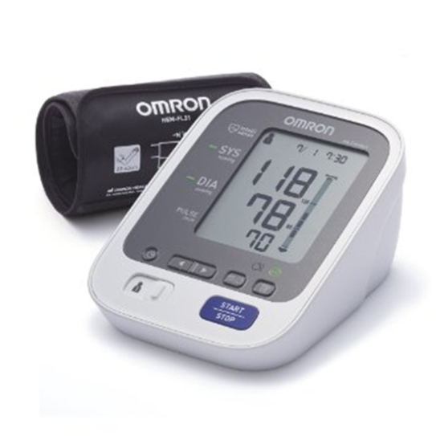
Types Of BP Apparatuses
Non-automated device
[non-AOBP]
Mercury Type
Aneroid Type
Half automated
device
Automated Device
Finger and/or wrist BP measuring devices are not recommended
AOBP is the preferred method of performing in-office BP measurement
Digital Type
Notes:
AOBP is the preferred method of performing in-office
BP measurement (Grade D;new recommendation).
When using AOBP (see the section onRecommended
Technique for Automated Office Blood Pressure in
Supplemental Table S2), a displayed mean SBP of
135 mm Hg or DBP85 mm Hg DBP is high

Slide 13
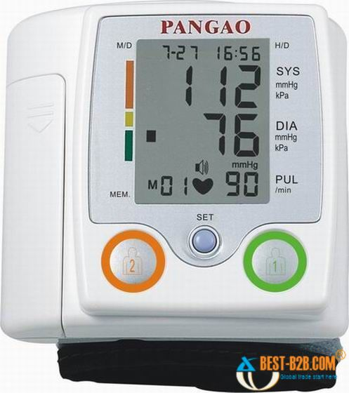
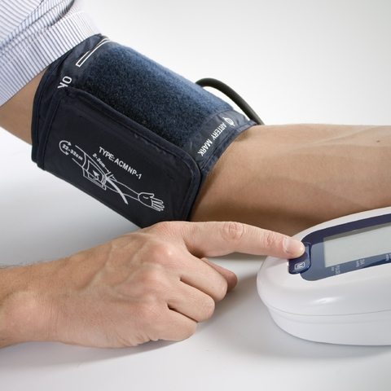
Type of Instrument of Blood Pressure Measurement
Home Blood Pressure Monitoring

Slide 14
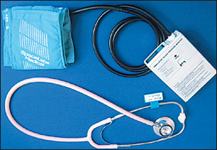
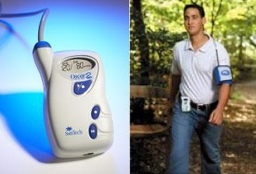
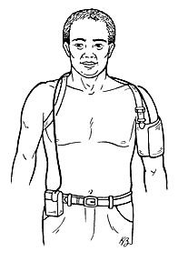
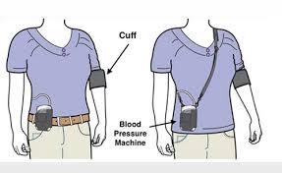
Ambulatory Pressure Monitoring

Slide 15
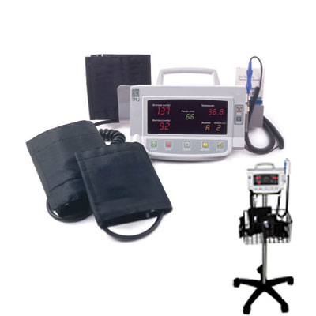
Automated Blood Pressure Tru Device
(Automated Office Blood pressure)
AOBP ≥135 or more than 85
Notes:
AOBP ≥135/85

Slide 16
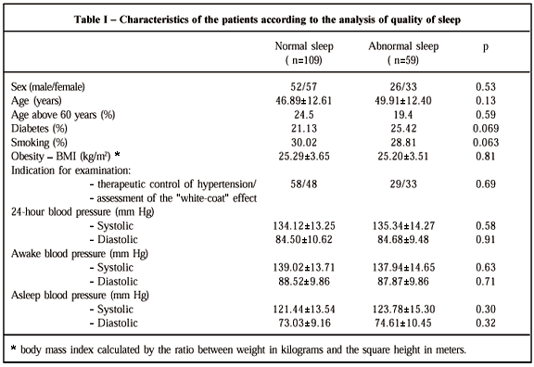
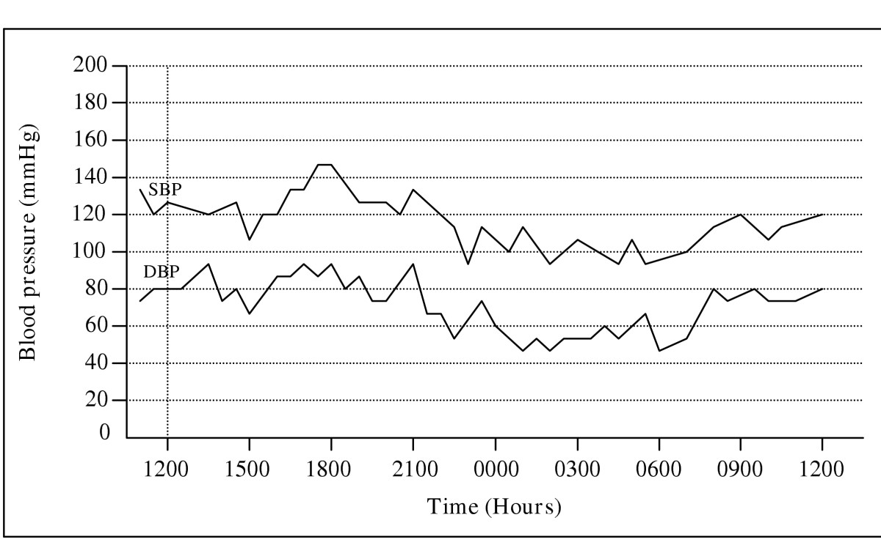
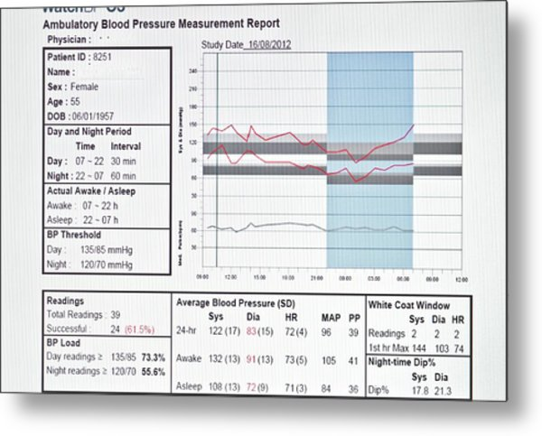
Ambulatory Pressure

Slide 17
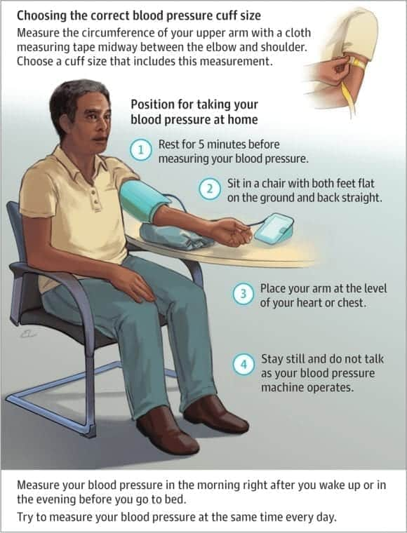

Slide 18
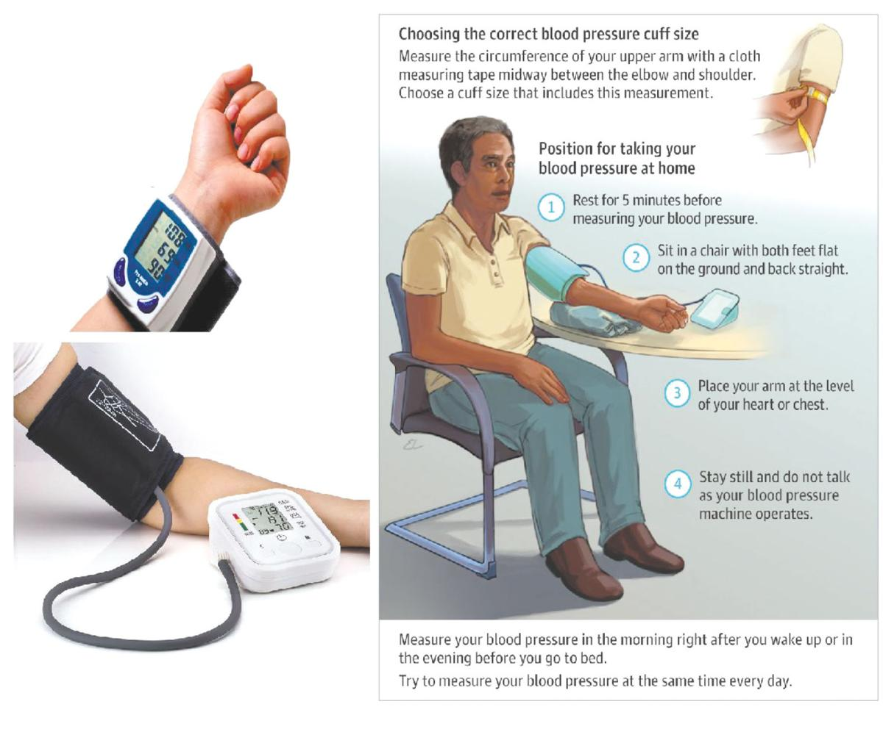

Slide 19
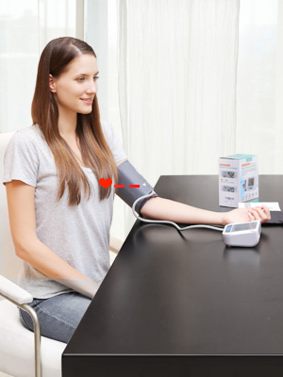

Slide 20
Blood Pressure
Apply to adults on no antihypertensive medications and who are not acutely ill.
If there is a disparity in category between the systolic and diastolic pressures, the higher value determines the severity of the hypertension.
Measure blood pressure to arm the high reading.

Slide 21
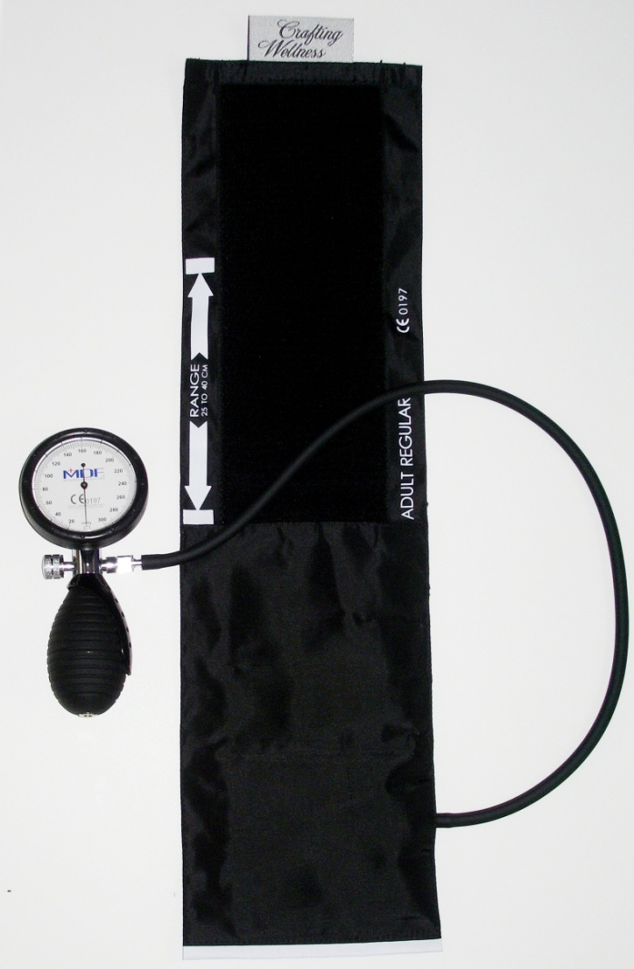
Office blood pressure measurement
To allow the patients to sit for 3–5 minutes before beginning BP measurements
Back straight and arm supported at heart level
Take at least two BP measurements, spaced 1–2 min apart, and additional measurements if the first two are quite different.
Consider the average BP if deemed appropriate.
To use a standard bladder (12–13 cm wide and 35 cm long)
A larger bladder for larger arm (circumference >32 cm)
The bladder of the pressure cuff should encircle at least 80% of the upper arm

Slide 22
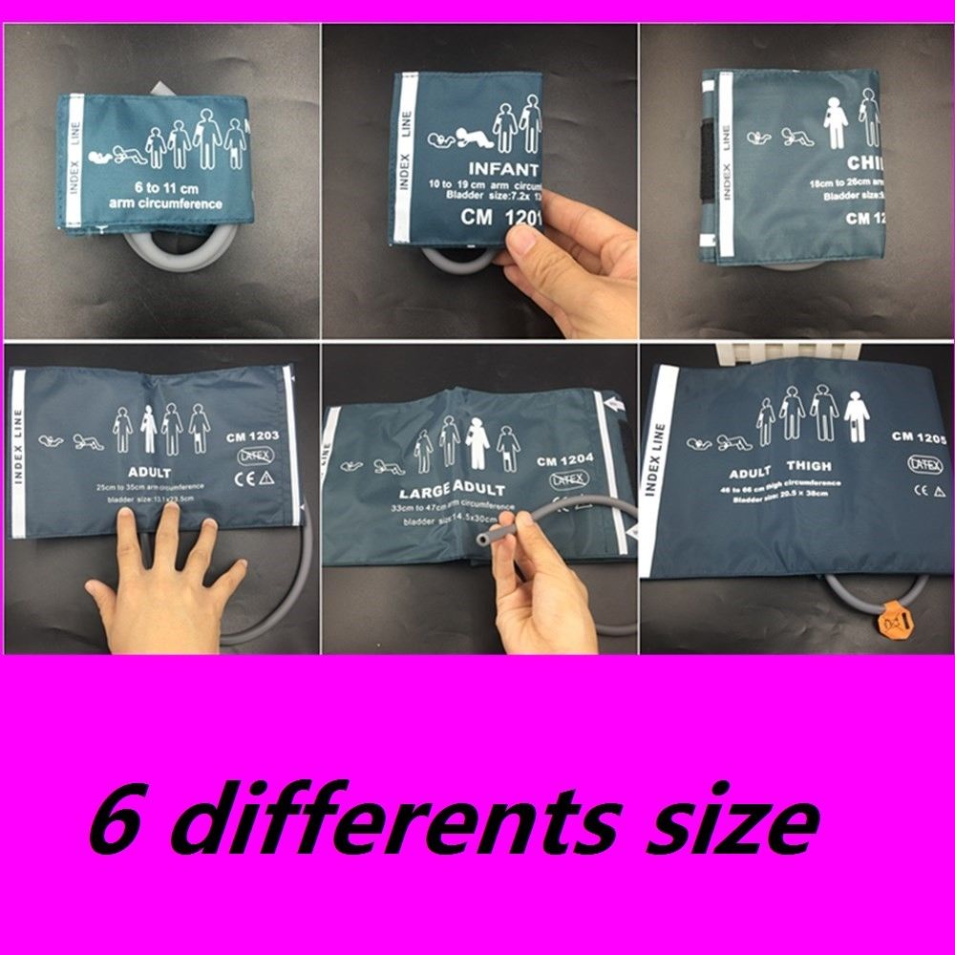
27 to 34 cm
35 to 44 cm
45 to 52 cm

Slide 23
Office blood pressure measurement
Place the cuff at the heart level, whatever the position of the patient.
Measure BP in both arms at first visit to detect possible differences. In this instance, take the arm with the higher value as the reference.
Measure BP in sitting and standing position in elderly subjects and diabetic patients
Use phase I and V (disappearance) Korotkoff sounds to identify systolic and diastolic BP, respectively.

Slide 24
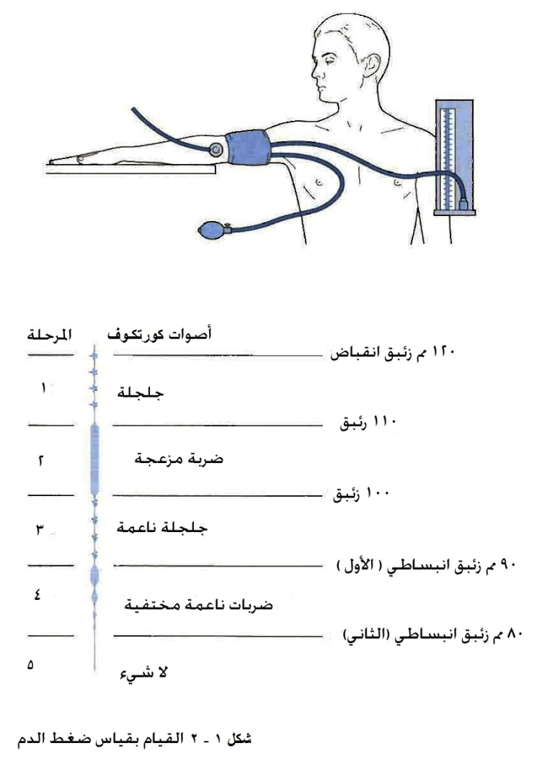
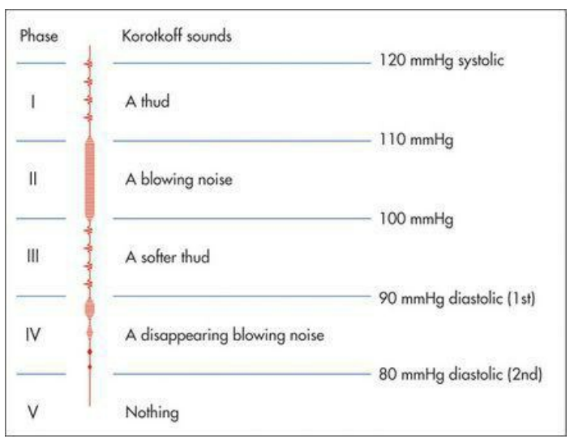
Korotkoff sounds

Slide 25
The diagnosis of mild hypertension should not be made until the blood pressure has been measured on at least two time in three visits
Average of 10 to 15 mmHg decrease between visits 1 and three

Slide 26
White Coat Hypertension
a phenomenon in which patients exhibit a blood pressure level above the normal range, in a clinical setting, though they do not exhibit it in other settings
Approximately 20 to 25% of patients with mild office hypertension
More common in elderly

Slide 27
European Society of Nephrology Classification of Blood Pressure Levels
Category | Systolic blood pressure (mmHg) | Diastolic blood pressure (mmHg)
Optimal blood pressure | <120 | <80
Normal blood pressure | <130 | <85
High-normal blood pressure | 130-139 | 85-89
Grade 1 hypertension (mild) | 140-159 | 90-99
Grade 2 hypertension (moderate) | 160-179 | 100-109
Grade 3 hypertension (severe) | >/= 180 | >/= 110
Isolated systolic hypertension | >140 | <90

Slide 28
Definitions of hypertension by office and out-of-office blood pressure levels
Category | Systolic BP (mmHg) |  | Diastolic (mmHg)
Office BP | ≥140 | and/or | ≥90
Ambulatory BP
Daytime (or awake) | ≥135 | and/or | ≥85
Nighttime (or sleep) | ≥120 | and/or | ≥70
24 h | ≥ 130 | and/or | ≥80
Home BP | ≥135 | and/or | ≥85
2013 ESH and ESC Guidelines

Slide 29
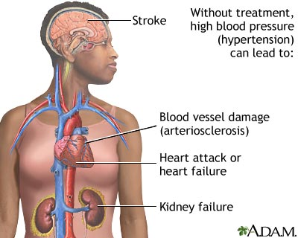
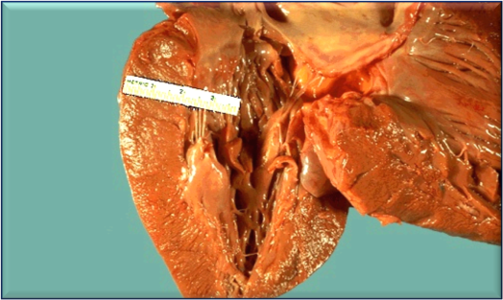
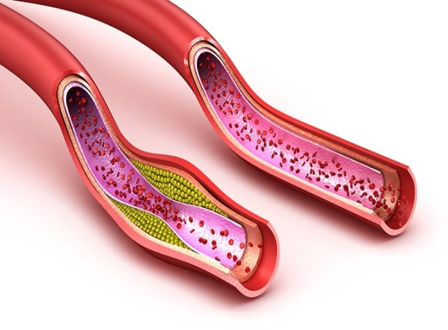
Hypertension
CAD, ECG,
Arrthymia, Sudden Death
Stroke, Ischemia, Hemorrhage, Alzheimer’s Disease, Cognitive, retinal hemorrhage
Renal Disease
Peripheral Vascular Disease
Hypertensive cries urgency&Emergency
CHF
LVH
Aortic Dissection
COMPLICATIONS
Notes:
Hypertension is an important contributing risk factor for morbidity and mortality from both cardiovascular (CV) and renal disease.
Hypertension is one of the most significant contributing factors to the development of CV and renal disease. Complications of hypertension include coronary artery disease, congestive heart failure, stroke, renal disease (including end-stage renal disease), and peripheral vascular disease. These diseases account for significant disability, loss of productivity, and decreased quality of life for many Americans.
National High Blood Pressure Education Program Working Group. National High Blood Pressure Education Program Working Group report on primary prevention of hypertension. Arch Intern Med. 1993;153:186-208.

Slide 30
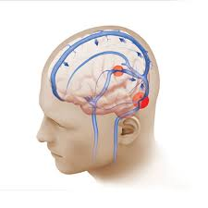
Hypertensive cries
Hypertensive Emergency
Severe hypertension ( systolic BP >180-220 mm Hg or diastolic blood pressure above 120 mmHg) with
+ end organ damage (MI,STROKE,AKI,CHF)
Malignant (Accelerated) Hypertension
hypertensive emergency
systolic BP >180-220 mm Hg or diastolic blood pressure above 110-120 mmHg
+ with encephapapathy&
+ retinal hemorrhages, exudates, or papilledema
Hypertensive Cries necessitate immediate therapy to decrease BP within minutes to hours
usually admitted to an intensive care unit for continuous cardiac monitoring

Slide 31
Hypertensive Urgency
Severe hypertension ( systolic BP >180-220 mm Hg or diastolic blood pressure above110- 120 mmHg) in asymptomatic patients with
no evidence of target organ damage.
There is no proven benefit from rapid reduction in BP in asymptomatic patients who have no evidence of acute end-organ and are little short-term risk.
The goal of therapy is with these cases is to reduce BP within 24 hours.

Slide 32
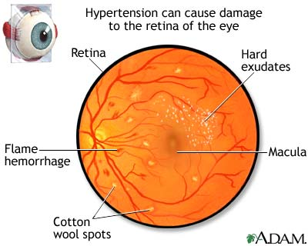
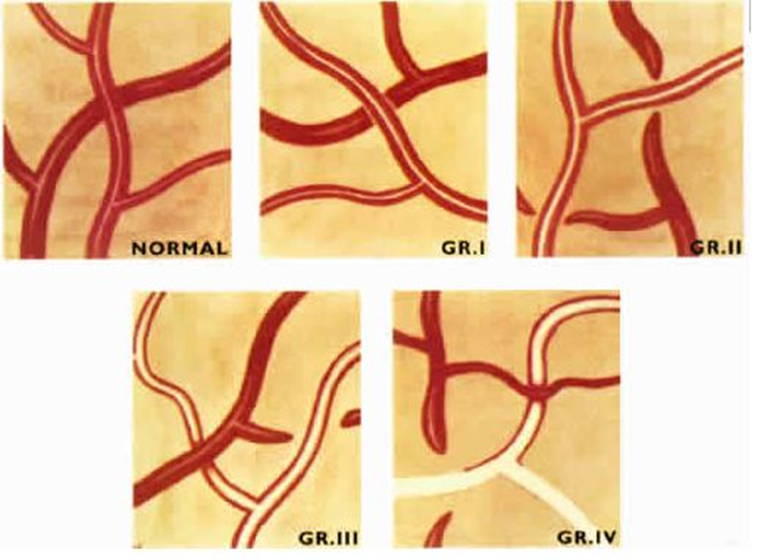
HYPERTENSIVE RETINOPATHY
Grade | Description
I | Minimal narrowing of retinal arteries
II | Narrowing of retinal arteries in conjunction with regions of focal narrowing and arterio-venous nipping
III | Abnormalities seen in Grade 1 and II, as well as retinal hemorrhages, hard exudation and cotton wool spots.
IV | Abnormalities encountered in Grades I through III, as well as swelling of the optic nerve head and macular star

Slide 33
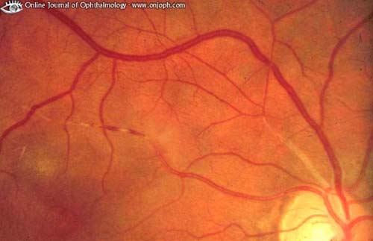

Slide 34
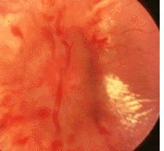
Hypertensive Retinopathy Grade 4
Papilledema from malignant hypertension. There is blurring of the borders of the optic disk with hemorrhages (yellow arrows) and exudates (white arrow)

Slide 35
Diagnosis Hypertension
Clinical Presentations:
Asymptomatic
Headache
Epistaxis
Chest discomfort
Symptom of complications
Screening:
Every one years for persons with systolic and diastolic pressures below< 120 mmHg and 80 mmHg
Every 3-6months for persons with systolic and diastolic pressures higher >120 mmHg and 80 mmHg

Slide 36
Physical Examination
Confirm the diagnosis of hypertension
Detect causes of secondary hypertension
Assess CV risk
Organ damage
Concomitant clinical conditions.

Slide 38
Laboratory Tests
Routine Tests
Electrocardiogram
Urinalysis
Serum sodium, serum potassium, creatinine, or the corresponding estimated GFR, and calcium
Blood glucose, and hematocrit
Lipid profile, after 9- to 12-hour fast, that includes high density and low-density lipoprotein cholesterol, and triglycerides
Optional tests
Measurement of urinary albumin excretion or albumin/creatinine ratio
More extensive testing for identifiable causes is not generally indicated unless BP control is not achieved

Slide 39
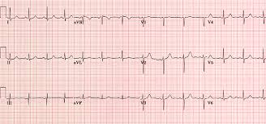
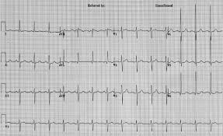

Slide 40
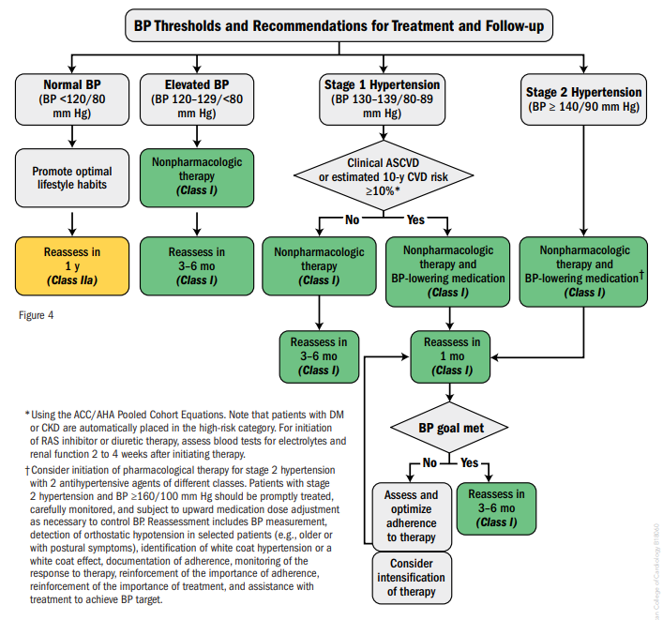
Blood Pressure (BP) Thresholds and Recommendations for Treatment and Follow-Up
Notes:
Adults with an elevated BP or stage 1 hypertension who have an estimated 10-year ASCVD risk less than 10% should be managed with nonpharmacological therapy and have a repeat BP evaluation within 3 to 6 months.
Adults with stage 1 hypertension who have an estimated 10-year ASCVD risk of 10% or higher should be managed initially with a combination of nonpharmacological and antihypertensive drug therapy and have a repeat BP evaluation in 1 month
Adults with stage 2 hypertension whould be evaluated by or referred to a primary care provider within 1 month of the initial diagnosis, have a combination of nonpharmacological and antihypertensive drug therapy (with 2 agents of different classes) initiated, and have a repeat BP evaluation in 1 month.

Slide 41
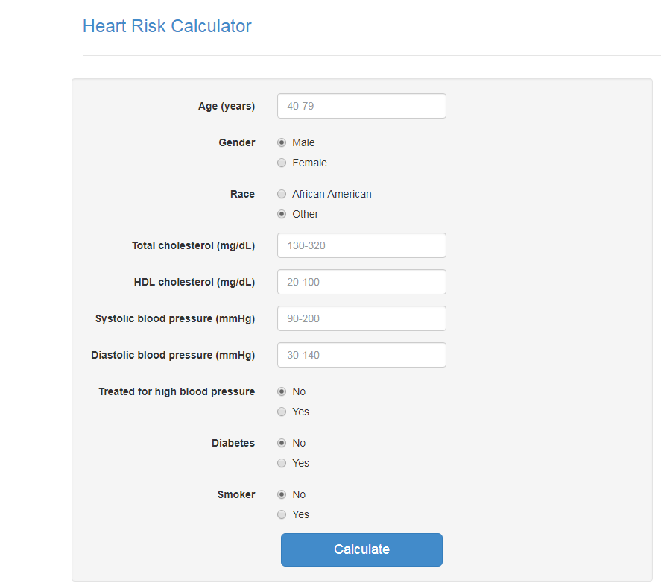
Notes:
Calculate your 10-year risk of heart disease or stroke using the ASCVD algorithm published in 2013 ACC/AHA Guideline on the Assessment of Cardiovascular Risk.
This calculator assumes that you have not had a prior heart attack or stroke. If you have, generally it is recommended that you discuss with your doctor about starting aspirin and a statin. Furthermore, if you have an LDL-cholesterol (bad cholesterol) greater than 190, it is also generally recommended that you discuss with your doctor about starting aspirin and a statin.
Unfortunately, there is insufficient data to reliably predict risk for those less than 40 years of age or greater than 79 years of age and for those with total cholesterol greater than 320.
UPDATE (11/21/17) -- The ACC/AHA has released their 2017 Guideline for the Prevention, Detection, Evaluation, and Management of High Blood Pressure in Adults. At a high level, the new guidelines redefine hypertension as blood pressure >130/80 and recommend starting anti-hypertensives based on ASCVD risk score of >10%. This will be a significant change from JNC-8. Please let us know if you would like us to incorporate the new guidelines into cvriskcalculator.com by completing this 1-question survey.
UPDATE (6/30/16) -- The calculator has been vetted against the final guidelines from the USPSTF for initiating aspirin therapy.
UPDATE (9/18/15) -- The calculator now also incorporates draft guidelines from the USPSTF for initiating aspirin therapy.
UPDATE (5/26/14) -- The calculator now also incorporates guidelines from JNC-8 for blood pressure management.
An excel spreadsheet is also available for download.
If you are an investigator interested in implementing an app for your own risk calculator, please submit an inquiryabout our platform.

Slide 42
High Risk Group Therapy
CHF – Thiazide, ACE-1, Aldosterone, BB
Post Myocardial Infarction – BB, ACEi
Diabetes Mellitus – proteinuria ACEi, ARB,NO
Nonproteinuria Thiazide, CCB,ARB, ACEi
CKD – ACEi, ABB, Thiazide
Stroke – CCB +ACEi
Pregnancy Aldomet ,labetalol, Ca channel bloocker
Start in >130/80(130 – 139)/(85 – 89) mmHg
Lifestyle change +Medication
BP target of less than 130/80 Hg is recommended

Slide 45
Summary of antihypertensive drug treatment
Aged under 55 years
Aged over 55 years or black person of African
Key
A – ACE inhibitor B-angiotensin II receptor blocker (ARB)¹²
C – Calcium-channel blocker (CCB)¹³
D – Thiazide-like diuretic DO NOT START with B-BLOCKER
DO NOT USE A+B
Single mediecine
=>130-160/80-100 or frail older(80y) patients
CORD
AORB
A CCB is preferred but consider a thiazide-like diuretic if a CCB is not tolerated or the person has edema, evidence of heart failure or a high risk of heart failure.
Consider a low dose of spironolactone¹⁵ or higher doses of a thiazide-like diuretic.
Consider an alpha- or beta-blocker if further diuretic therapy is not tolerated, or is contraindicated or ineffective.
=>160/100
A(B) + C or A(B)+D One pill daul combination
If BP not control
A + C + D
One pill triple combination
Resistant hypertension
A + C + D + consider further diuretic^{14, 15} or alpha- or beta-blocker¹⁶
Consider seeking expert advice
Notes:
Step 1 treatment:
Offer people aged under 55 years step 1 antihypertensive treatment with an angiotensin-converting enzyme (ACE) inhibitor or a low-cost angiotensin-II receptor blocker (ARB). If an ACE inhibitor is prescribed and is not tolerated (for example, because of cough), offer a low-cost ARB. [new 2011] [1.6.6]
Do not combine an ACE inhibitor with an ARB to treat hypertension. [new 2011] [1.6.7]
Offer step 1 antihypertensive treatment with a calcium-channel blocker (CCB) to people aged over 55 years and to black people of African or Caribbean family origin of any age. If a CCB is not suitable, for example because of oedema or intolerance, or if there is evidence of heart failure or a high risk of heart failure, offer a thiazide-like diuretic. [new 2011] [1.6.8] [KPI]
If diuretic treatment is to be initiated or changed, offer a thiazide-like diuretic, such as chlortalidone (12.5–25.0 mg once daily) or indapamide (1.5 mg modified-release once daily or 2.5 mg once daily) in preference to a conventional thiazide diuretic such as bendroflumethiazide or hydrochlorothiazide. [new 2011] [1.6.9] [KPI]
For people who are already having treatment with bendroflumethiazide or hydrochlorothiazide and whose blood pressure is stable and well controlled, continue treatment with the bendroflumethiazide or hydrochlorothiazide. [new 2011] [1.6.10] [KPI]
Related recommendations:
Recommendations 1.6.11 and 1.6.12 have not been updated and reviewed since ‘Hypertension’ (NICE clinical guideline 34, 2006).
Step 2 treatment
If blood pressure is not controlled by step 1 treatment, offer step 2 treatment with a CCB in combination with either an ACE inhibitor or an *ARB. [new 2011] [1.6.13]
If a CCB is not suitable for step 2 treatment, for example because of oedema or intolerance, or if there is evidence of heart failure or a high risk of heart failure, offer a thiazide-like diuretic. [new 2011] [1.6.14]
For black people of African or Caribbean family origin, consider an ARB* in preference to an ACE inhibitor, in combination with a CCB. [new 2011] [1.6.15]
*Choose a low-cost ARB
Additional information: the pathway above focuses on stage 1 and 2 hypertension. For the full care pathway see page 35 of the NICE guideline.
Step 3 treatment
Before considering step 3 treatment, review medication to ensure step 2 treatment is at optimal or best tolerated doses. [new 2011] [1.6.16]
If treatment with three drugs is required, the combination of ACE inhibitor (or angiotensin-II receptor blocker), calcium-channel blocker and thiazide-like diuretic should be used. [2006] [1.6.17]
Step 4 treatment
Regard clinic blood pressure that remains higher than 140/90 mmHg after treatment with the optimal or best tolerated doses of an ACE inhibitor or an ARB plus a CCB plus a diuretic as resistant hypertension, and consider adding a fourth antihypertensive drug and/or seeking expert advice. [new 2011] [1.6.18]
For treatment of resistant hypertension at step 4:
Consider further diuretic therapy with low-dose spironolactone⁴ (25 mg once daily) if the blood potassium level is 4.5 mmol/l or lower. Use particular caution in people with a reduced estimated glomerular filtration rate because they have an increased risk of hyperkalaemia.
Consider higher-dose thiazide-like diuretic treatment if the blood potassium level is higher than 4.5 mmol/l. [new 2011] [1.6.19] [KPI]
When using further diuretic therapy for resistant hypertension at step 4, monitor blood sodium and potassium and renal function within 1 month and repeat as required thereafter. [new 2011] [1.6.20]
If further diuretic therapy for resistant hypertension at step 4 is not tolerated, or is contraindicated or ineffective, consider an alpha- or beta-blocker. [new 2011] [1.6.21]
If blood pressure remains uncontrolled with the optimal or maximum tolerated doses of four drugs, seek expert advice if it has not yet been obtained. [new 2011] [1.6.22]
Footnotes
(1) Choose a low-cost ARB. (2) A CCB is preferred but consider a thiazide-like diuretic if a CCB is not tolerated or the person has oedema, evidence of heart failure or a high risk of heart failure. (3) Consider a low dose of spironolactone⁴ or higher doses of a thiazide-like diuretic..) Consider an alpha- or beta-blocker if further diuretic therapy is not tolerated, or is contraindicated or ineffective.

Slide 46
High Risk Group Therapy
CHF – Thiazide, ACE-1, Aldosterone, BB
Post Myocardial Infarction – BB, ACEi
Diabetes Mellitus – proteinuria ACEi, ARB,NO
Nonproteinuria Thiazide, CCB,ARB, ACEi
CKD – ACEi, ABB, Thiazide
Stroke – CCB +ACEi
Pregnancy Aldomet ,labetalol, Ca channel bloocker
Start in >130/80(130 – 139)/(85 – 89) mmHg
Lifestyle change +Medication
BP target of less than 130/80 Hg is recommended

Slide 47
Anti-hypertensive Medications and Complications
Diuretics → Hypokalemia
β-Adrenergic Blocking Agents → Bradycardia
Angiotensin-Converting Enzyme Inhibitors →
Hyperkalemia + cough
Angiotensin II Receptor Blockers → Hyperkalemia
Calcium Channel Blocking Agents → Edema +
Tachycardia + Bradycardia
α-Adrenoceptor Antagonists → 1st dose
hypotension
Drugs with Central Sympatholytic Action →
Drowsiness
Arteriolar Dilators → Tachycardia + Edema

Slide 48
Blood Pressure Reductions as Little as 2 mmHg Reduce the Risk of Cardiovascular Events by up to 10%
7% reduction in risk of IHD mortality
2 mmHg decrease in mean SBP
10% reduction in risk of stroke mortality
Meta-analysis of 61 prospective, observational studies conducted by Lewington et al involving one million adults with no previous vascular disease at baseline mmHg

Slide 49
Benefits of Lowering BP
Average Percent Reduction
Stroke incidence | 35–40%
Myocardial infarction | 20–25%
Heart failure | 50%
Renal Failure | 35-50%

Slide 50
Threshold &Targated BP BP Thresholds for and Goals of Pharmacological Therapy in Patients With Hypertension According to Clinical Conditions
Clinical Condition(s) | BP Threshold, mm Hg | BP Goal, mm Hg
General
Clinical CVD or 10-year ASCVD risk ≥10% | ≥130/80 | <130/80
No clinical CVD and 10-year ASCVD risk <10% | ≥140/90 | <130/80
Older persons (≥65 years of age; noninstitutionalized, ambulatory, community-living adults) | ≥130 (SBP) | <130 (SBP)
Specific comorbidities
Diabetes mellitus | ≥130/80 | <130/80
Chronic kidney disease | ≥130/80 | <130/80
Chronic kidney disease after renal transplantation | ≥130/80 | <130/80
Heart failure | ≥130/80 | <130/80
Stable ischemic heart disease | ≥130/80 | <130/80
Secondary stroke prevention | ≥140/90 | <130/80
Secondary stroke prevention (lacunar) | ≥130/80 | <130/80
Peripheral arterial disease | ≥130/80 | <130/80
An SBP target range of 130–139 mmHg is recommended for people older than 80 years, if tolerate
ASCVD indicates atherosclerotic cardiovascular disease; BP, blood pressure; CVD, cardiovascular disease; and SBP, systolic blood pressure.

Slide 52
summary
The overall prevalence of hypertension in adults is around 30 - 45%
Need proper technique in measurement
Lead cause coronary death or myocardial infarction,CHF or fatal or nonfatal stroke,CKD
Threshold of treatment start 130/80 mm Hg
Target treatment < 130/80 mm Hg
nonpharmacological and antihypertensive drug are effective to reduce all complications in all ages

