Slide 1
Approach to Acid-Base Disorder
Dr. Talal Alfaadhel
2018/10/28

Slide 2
Objectives
Develop an approach to acid base problems
Identify the primary acid base disturbance
Solve simple acid base cases

Slide 3
Introduction
The assessment of acid base abnormalities is typically done using arterial blood gases (ABG)
Given the ease of obtaining venous blood gases (VBG) and capillary blood gases (CBG) these are often used in clinical practice
Normal pH value ranges for arterial blood are 7.35 - 7.45, while normal pH of venous blood is 7.31-7.41
Always check the reference range in your local laboratory

Slide 4
Definitions
Metabolic acidosis | loss of [HCO₃] or addition of [H+]
Metabolic alkalosis | loss of [H+] or addition of [HCO₃]
Respiratory acidosis | increase in pCO₂
Respiratory alkalosis | decrease in pCO₂

Slide 6
Step 1.
Take a thorough history and physical examination, look for clues that may lead to the abnormalities in pH
Vomiting
Diarrhea
Hypoventilation
Respiratory disease
Medications (laxatives, diuretics, etc)
Diabetes
etc
Vomiting for example, causes loss of acid and gastric contents, which suggests development of alkalosis

Slide 7
Step 2
Look at the pH:
Determine if this is
Normal 7.35 – 7.45 (No abnormality or mixed acidosis and alkalosis)
Low <7.35 (acidemic)
High >7.45 (alkalemic)

Slide 8
Step 3 - a
Determine the primary abnormality that is causing the abnormal pH
If the pH is acidemic (<7.35), then look for
Low HCO₃ (Metabolic) or High PCO₂ (Respiratory)
If the pH is alkalemic (>7.45), then look for
High HCO₃ (Metabolic) or Low PCO₂ (Respiratory)

Slide 9
Step 3 - b
If pH is normal, rule out mixed acidosis and alkalosis
Look for high or low PCO₂
Look for high or low HCO₃
Low PCO2 suggests respiratory alkalosis
High PCO2 suggests respiratory acidosis
Low HCO₃ suggests metabolic acidosis
High HCO₃ suggests metabolic alkalosis
Determine what is being mixed

Slide 10
Step 4
After determining the primary abnormality, check for compensation
Compensation is the mechanism by which the body adapts to either acidosis or alkalosis, it will fully correct the abnormality
For example
A patient has diabetic ketoacidosis, pH is 7.29, HCO3 is 15
Expected PCO2 by using Winter’s formula
PCO2 = 1.5 x HCO3 + 8 ( ±2 )
= 1.5 x 15 + 8 = 30.5
So you expect the PCO2 in this patient to be in the range of 28.5– 32.5
If the PCO2 in this patient is higher than 32.5 → consider additional respiratory acidosis
If the PCO2 in the patient is lower than 28.5 → consider additional respiratory alkalosis

Slide 11
Step 4
Compensation calculations

Slide 12
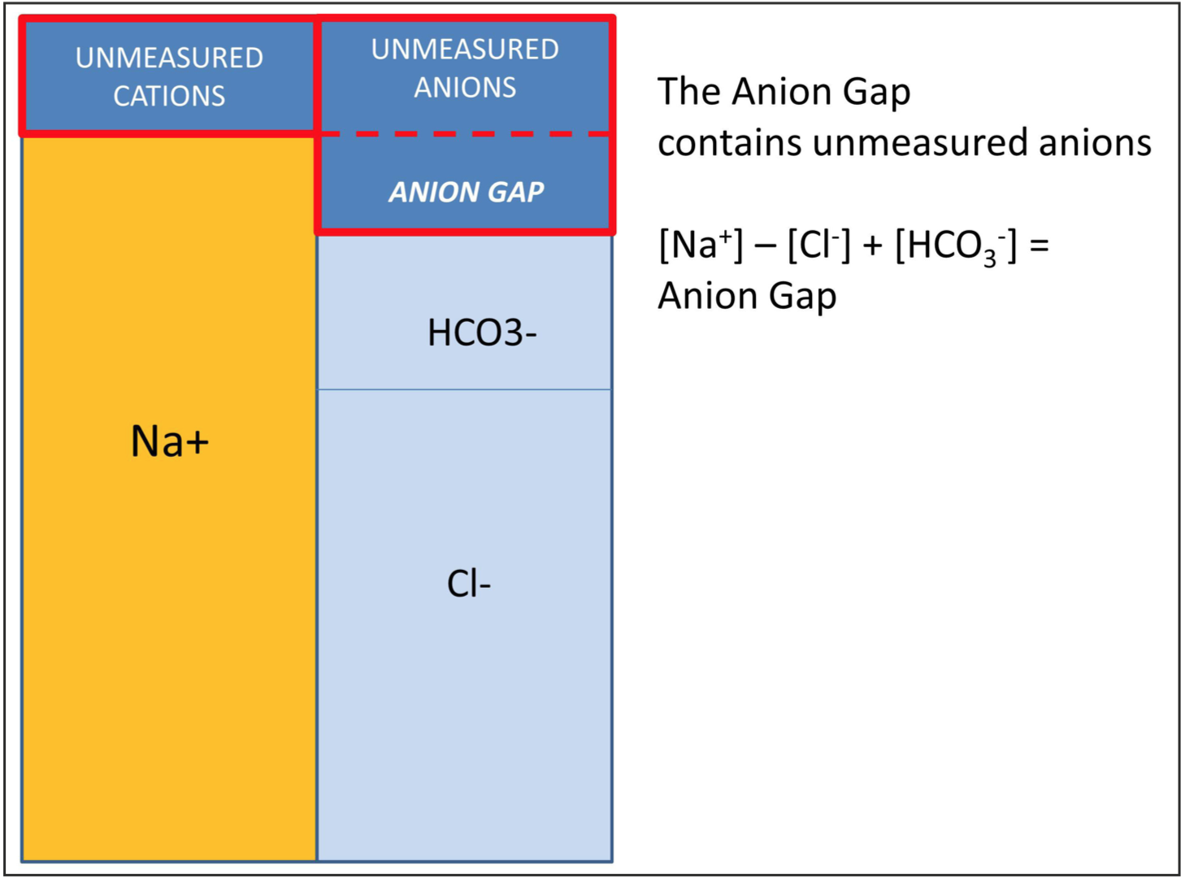
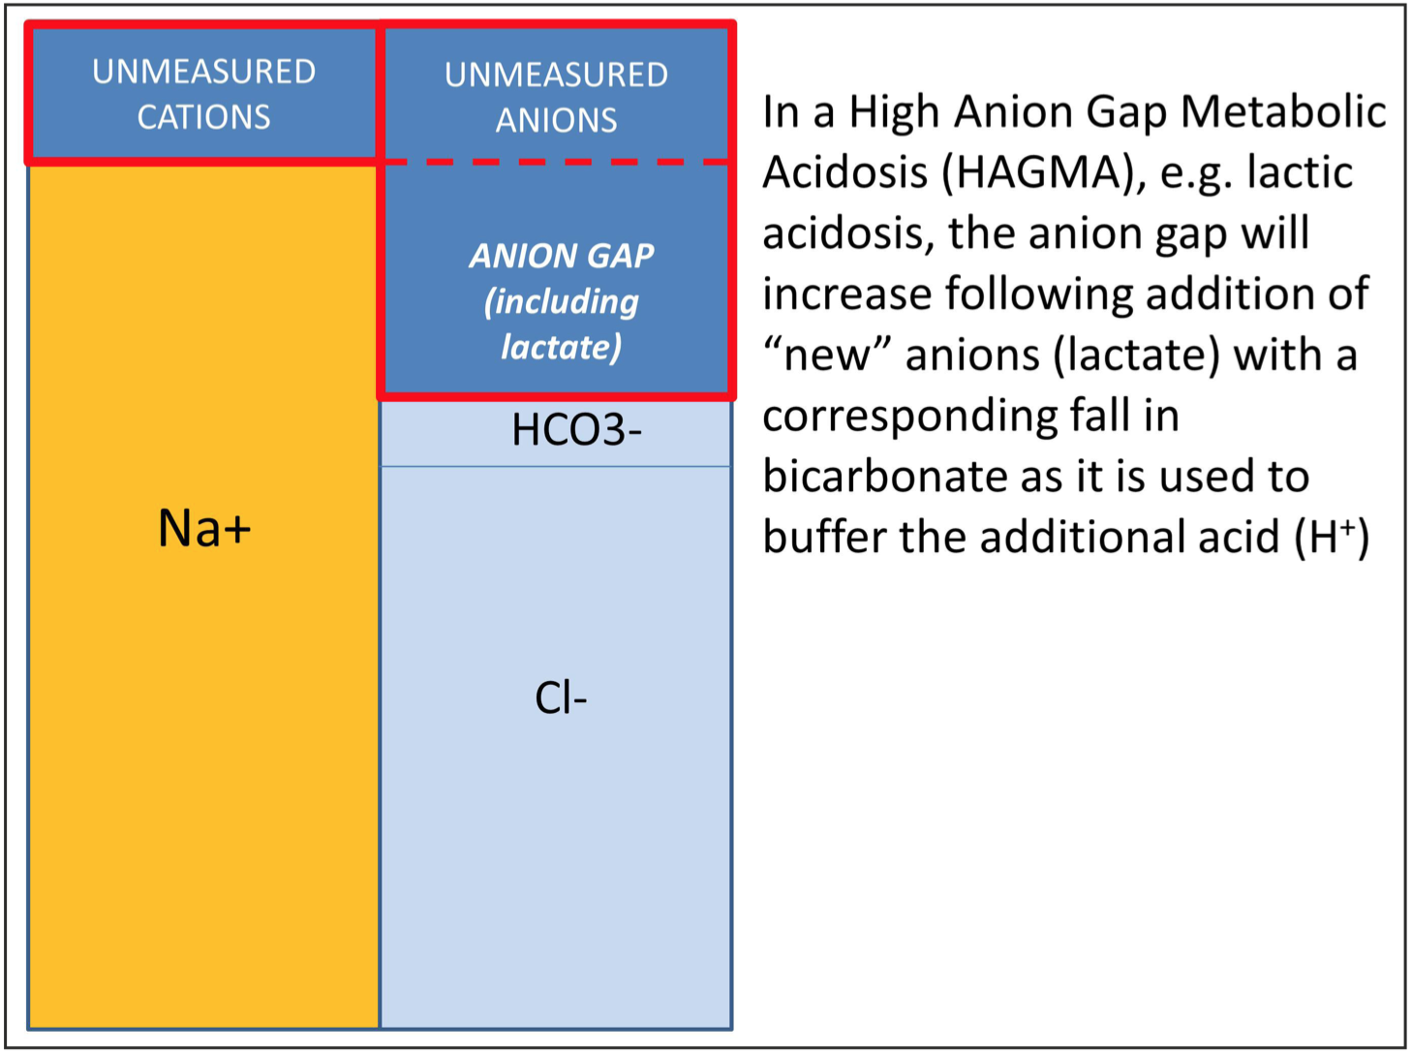
Step 5
Albumin is the main unmeasured anion
To overcome the effects of the hypoalbuminemia on the AG, the corrected AG can be used which is AG + (0.25 X (40-albumin) expressed in g/L
Calculate the anion gap (AG)
AG = Na – (Cl + HCO₃)

Slide 13
Step 5
Causes of High Anion Gap Metabolic Acidosis (MUD PILES)
Methanol
Uremia
DKA
Propylene glycol (not paraldehyde)
INH (impaired hepatic clearance of lactate)
Lactic acidosis
Ethanol/Ethylene Glycol
Salicylates

Slide 14
Step 5
Metabolic acidosis with normal anion gap suggests

Slide 16
Case 1
Normal reference range
pH (7.35-7.45), PCO2 (35-45 mmHg), PO2 (82-105 mmHg), HCO3 (22-26 mmol/L), AG (8-12)
Creatinine (40-110 umol/L), Urea (2.5-7.8 mmol/L), Na (136-145 mmol/L), K (3.5-5 mmol/L)
A 75 year old man is admitted with septic shock. Shortly after admission, blood tests reveal the following:
pH 7.18, PO₂= 150 mmHg, PaCO₂= 16 mmHg, HCO₃ 7 mmol/L
Na 138 mmol/L, K 3.9 mmol/L, Cl 95 mmol/L, Urea 8.2 mmol/L, Creatinine 102 μmol/L
Please identify the acid base disturbance
Please indicate what is causing the acid base disturbance.

Slide 17
Case 2
Normal reference range
pH (7.35-7.45), PCO2 (35-45 mmHg), PO2 (82-105 mmHg), HCO3 (22-26 mmol/L), AG (8-12)
Creatinine (40-110 umol/L), Urea (2.5-7.8 mmol/L), Na (136-145 mmol/L), K (3.5-5 mmol/L)
A 68 year old woman is being treated for congestive heart failure in the coronary care unit. After several days of treatment, the following results are returned:
pH 7.49, PO2= 86 mmHg, PaCO2= 48.5 mmHg, HCO3 39 mmol/L
Na 142 mmol/L, K 3.0 mmol/L, Cl 85 mmol/L, Urea 9.3 mmol/L, Creatinine 84 μmol/L
Please identify the acid base disturbance
Please indicate what is causing the acid base disturbance.

Slide 18
Case 3
Normal reference range
pH (7.35-7.45), PCO2 (35-45 mmHg), PO2 (82-105 mmHg), HCO3 (22-26 mmol/L), AG (8-12)
Creatinine (40-110 umol/L), Urea (2.5-7.8 mmol/L), Na (136-145 mmol/L), K (3.5-5 mmol/L)
A 70 year old man with chronic obstructive pulmonary disease (COPD) is admitted with increasing confusion. Shortly after admission, blood tests reveal the following:
pH 7.21, PO 61.5 mmHg, PaCO2 83 mmHg, HCO3 34 mmol/L
Na 140 mmol/L, K 4.7 mmol/L, Cl 94 mmol/L Urea 8.2 mmol/L, Creatinine 66 μmol/L
Please identify the acid base disturbance
Please indicate what is causing the acid base disturbance.

Slide 19
Case 4
Normal reference range
pH (7.35-7.45), PCO2 (35-45 mmHg), PO2 (82-105 mmHg), HCO3 (22-26 mmol/L), AG (8-12)
Creatinine (40-110 umol/L), Urea (2.5-7.8 mmol/L), Na (136-145 mmol/L), K (3.5-5 mmol/L)
An 40 year old man developed profuse diarrhoea following antibiotic treatment of a chest infection. He is thirsty and lightheaded. Shortly after admission, blood tests reveal the following:
pH 7.25, PO 101 mmHg, PaCO2 31.5 mmHg, HCO3 17 mmol/L
Na 134 mmol/L, K 3.4 mmol/L, Cl 104 mmol/L, Urea 9.3 mmol/L, Creatinine 102 μmol/L
Please identify the acid base disturbance
Please indicate what is causing the acid base disturbance.

