Slide 1

Arrhythmia 341
Ahmad Hersi
Professor of Cardiology

Slide 2
Objectives
Epidemiology and Mechanisms of AF
Evaluation of AF patients
Classification of AF
Treatment and Risk stratification of AF
Identify other forms of Arrhythmia

Slide 3


Slide 5

Pathophysiology of Atrial Fibrillation and associated Stroke

Slide 6

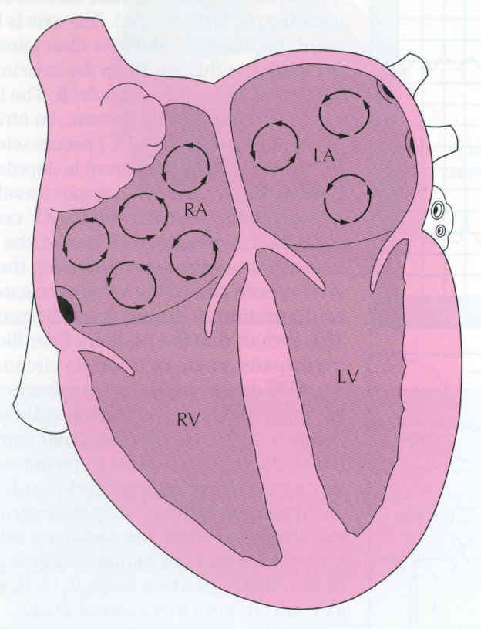
Normal regulation of heart rate and rhythm
Contraction is controlled by the sinoatrial (SA) node

Slide 7

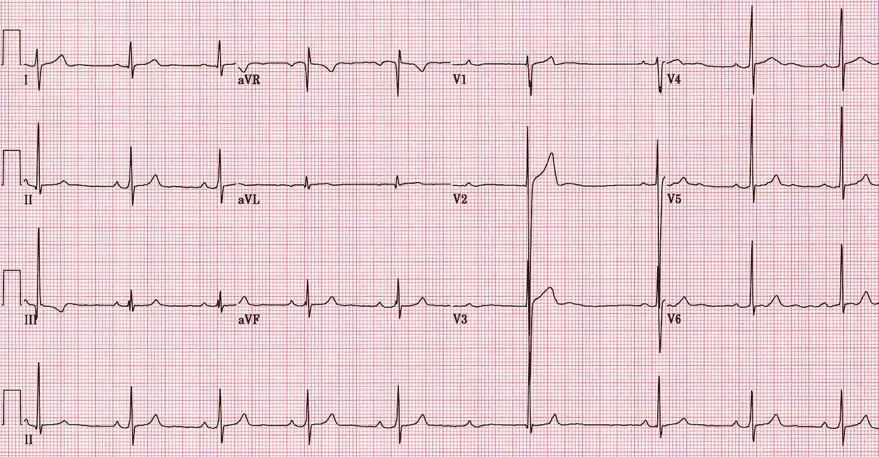
Normal EKG

Slide 8
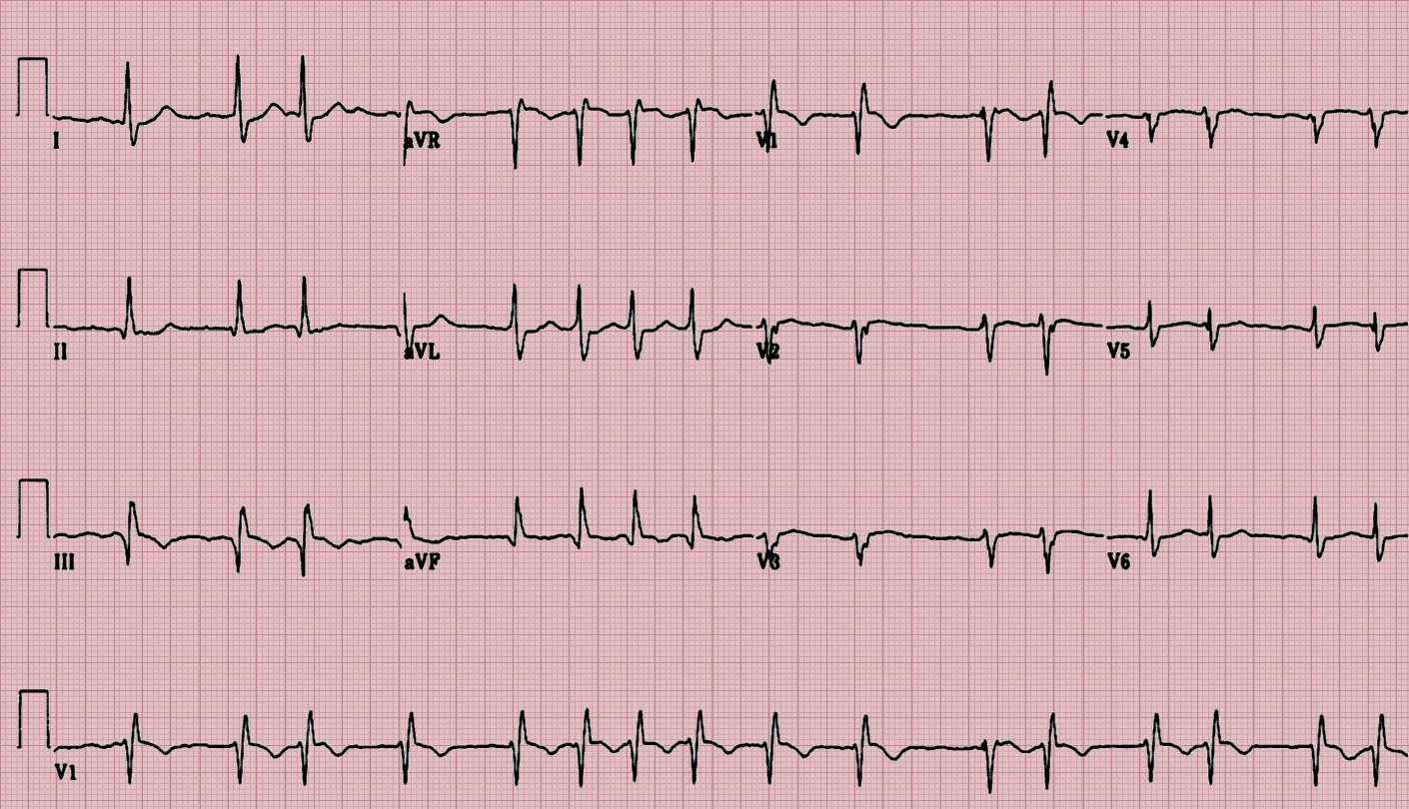
AF

Slide 9
Normal heart rhythm is disrupted in AF
AF is characterized by:
  Rapid (350–600 beats/min) and irregular atrial rhythm
  Reduced filling of the left and right ventricles
Conduction of most impulses from the atria to ventricles is blocked at the AV node
Contraction of the ventricles can be:
  Irregular and rapid (110–180 beats/min; tachycardia)
  Irregular and slow (<50 beats/min; bradycardia)
  Normal
Cardiac output can be reduced

Slide 10
AF begets AF
AF causes remodelling:
  Electrical: shortening of refractory period
  Structural: enlargement of atrial cavities
Many episodes of AF resolve spontaneously
Over time AF tends to become persistent or permanent.

Slide 11
AF begets AF

Slide 12
Consequences of AF

Slide 13
Diagnosis of Atrial Fibrillation

Slide 14
Atrial Fibrillation: Cardiac Causes
Hypertensive heart disease
Ischemic heart disease
Valvular heart disease
  Rheumatic: mitral stenosis
  Non-rheumatic: aortic stenosis, mitral regurgitation
Pericarditis
Cardiac tumors: atrial myxoma
Sick sinus syndrome
Cardiomyopathy
  Hypertrophic
  Idiopathic dilated (? cause vs. effect)
Post-coronary bypass surgery

Slide 15
Atrial Fibrillation: Non-Cardiac Causes
Pulmonary
  COPD
  Pneumonia
  Pulmonary embolism
Metabolic
  Thyroid disease: hyperthyroidism
  Electrolyte disorder
Toxic: alcohol (‘holiday heart’ syndrome)

Slide 16
Clinical presentation of AF
With or without detectable heart disease
Episodic
  Symptoms may be absent or intermittent
  Up to 90% of episodes may not cause symptoms
Symptoms vary according to
  Irregularity and rate of ventricular response
  Functional status
  AF duration
  Patient factors
  Co-morbidities

Slide 17

Signs and symptoms
Cause | Sign/symptom
Irregular heart beat | Irregularly irregular pulse Palpitations
Decreased cardiac output | Fatigue Diminished exercise capacity Breathlessness (dyspnoea) Weakness (asthenia)
Hypotension | Dizziness and fainting (syncope)
Cardiac ischaemia | Chest pain (angina)
Increased risk of clot formation | Thromboembolic TIA, stroke

Slide 18
History and physical examination
Clinical conditions associated with AF
  Underlying heart conditions (e.g. valvular heart disease,
  heart failure, coronary artery disease, hypertension)
  Other reversible conditions
Family history
  Familial AF (lone AF in a family)
  AF secondary to other genetic conditions
  (familial cardiomyopathies)
Type of AF
  First episode, paroxysmal, persistent, permanent
  Triggers – e.g. emotional stress, alcohol, physical exercise, gastroesophageal disease
  Specific symptoms
  Response to any treatments administered

Slide 19
EKG: loss of P wave in AF
AF
  Heart rate increased (tachyarrhythmia)*
  Irregular rhythm
  No P wave
  Irregular baseline

Slide 20
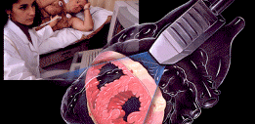
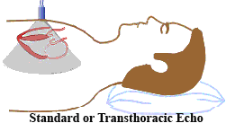
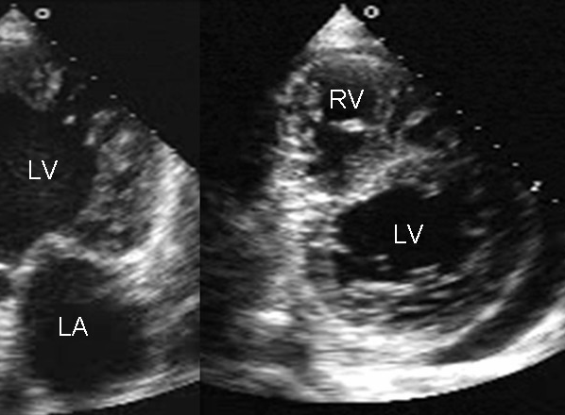
Transthoracic echocardiography (TTE)
Non-invasive
Used to identify
  Size and functioning of atria and ventricles
  Ventricle hypertrophy
  Pericardial disease
  Valvular heart disease

Slide 21
Laboratory tests
Important parameters to assess include:
  Thyroid function
  Renal function
  Hepatic function
  Serum electrolytes
  Complete blood count

Slide 22
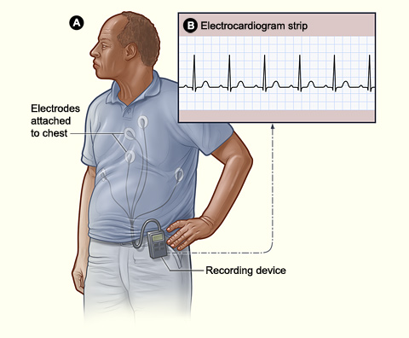
Holter monitor
Portable ECG device
Continuous monitoring for a short period of time (typically 24-48 h)
Useful for
  Detecting asymptomatic AF
  Evaluating patients with paroxysmal AF
  Associating symptoms with heart rhythm disturbance
  Assessing response to treatment

Slide 23
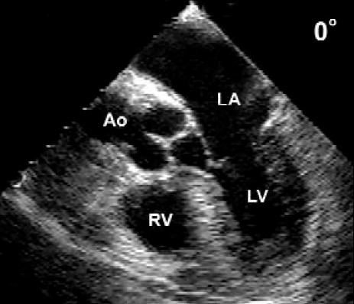

Transoesophageal echocardiogram (TEE)
Ultrasound transducer positioned close to the heart using an endoscope-like device
High quality images of cardiac structure and function
  Particularly the left atrial appendage, the most common site of thrombi in patients
  with AF

Slide 25

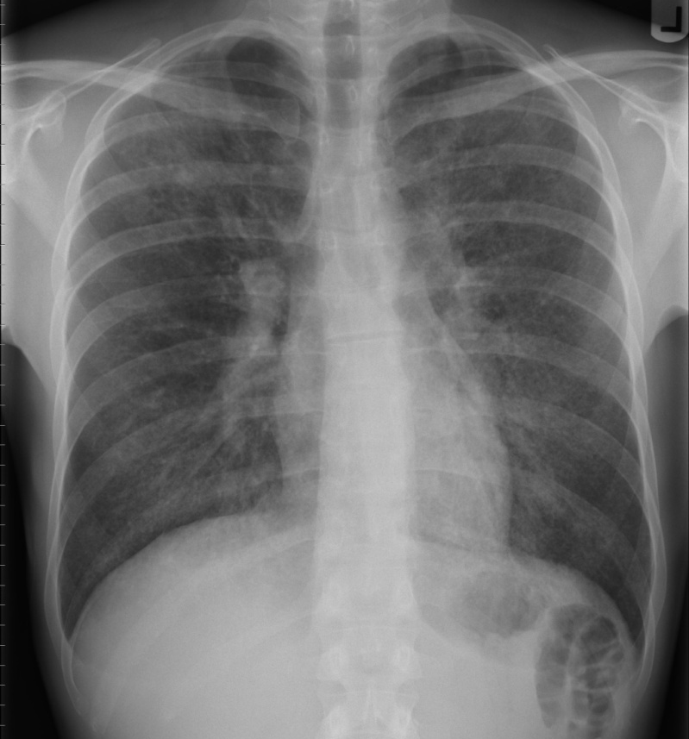
Chest Radiography
When clinical findings suggest an abnormality chest radiography may be used to
  Evaluate pulmonary pathology and vasculature
  Detect congestive heart failure
  Assess enlargement of the cardiac chambers

Slide 26
Summary slide for evaluation of AF patient

Slide 27
Classification of Atrial Fibrillation

Slide 28
Classification of AF

Slide 29
Classification of AF
Classification | Definition
Lone or primary | AF without clinical/ECG evidence of cardiopulmonary disease
Secondary | AF associated with cardiopulmonary disease (e.g. myocardial infarction or pneumonia)
Non-valvular | AF that is not associated with damage to the heart valves (e.g. rheumatic mitral valve disease, prosthetic heart valve or mitral valve repair)

Slide 31
Treatment Atrial Fibrillation

Slide 32
The Five Domains of Integrated AF Management

Slide 33
3 Strategies
Prevention of thromboembolism
Rate control
Restoration and maintenance of sinus rhythm

Slide 36
1-STROKE PREVENTION
Warfarin
Aspirin
Dabigatran
Apixaban
Rivaroxaba
Edoxaban
Removal/isolation of
left atrial appendage,
e.g. WATCHMAN® device
or surgery

Slide 37
2-Rate control
Ca²⁺-channel blockers
β-blockers
Digoxin
Ablate/pace

Slide 38
3-MAINTENANCE OF
SINUS RHYTHM
Antiarrhythmic drugs
– Class IA
– Class IC
– Class III: e.g. amiodarone, dronedarone
Ablation
Surgery (MAZE)

Slide 39
Rhythm-control therapies
The objective of rhythm-control therapy is to restore (cardioversion) and maintain normal sinus rhythm
Cardioversion can be achieved by:
  Pharmacotherapy with antiarrhythmic agents
  Electrical shocks (direct-current cardioversion)
Direct-current cardioversion is generally more effective than pharmacotherapy
Likelihood of successful cardioversion decreases with the duration of AF
  Pharmacological cardioversion is most effective when initiated within 7 days of AF onset
Cardioversion can dislodge thrombi in the atria, increasing the risk of stroke
  Thromboprophylaxis is recommended for ≥3 wk before and for at least
  4 wks after cardioversion in patients with AF that has persisted for ≥48 h
Notes:
39

Slide 41
Atrial Flutter

Slide 42
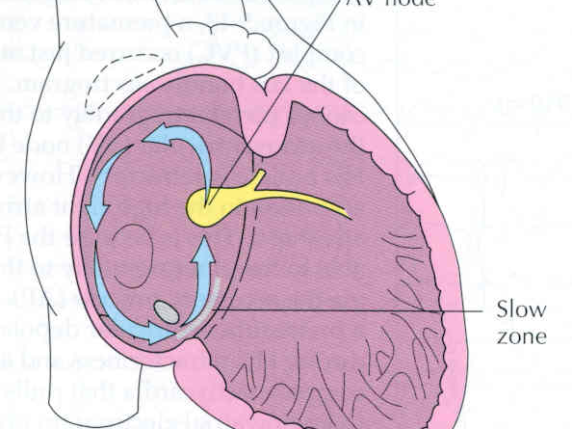

Slide 43
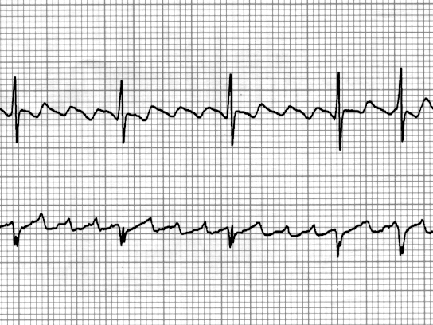

Slide 44
Atrial Flutter
Unstable pt:
    Synchronized cardioversion as per ACLS
Stable pt:
    Rate control :just like atrial fibrillation AF
    Elective cardioversion :just like AF
    Anti-coagulation :just like AF
    Refer for Ablation

Slide 45
SVT

Slide 46
AVNRT

Slide 47
SVT
AVNRT (60%)
AVRT (30%)
Atrial tachycardia (10%)

Slide 51
Treatment options
Medical therapy
Radio Frequency Ablation

Slide 52
Other Arrhythmias
Ventricular Tachycardia
Ventricular Fibrillation

Slide 53
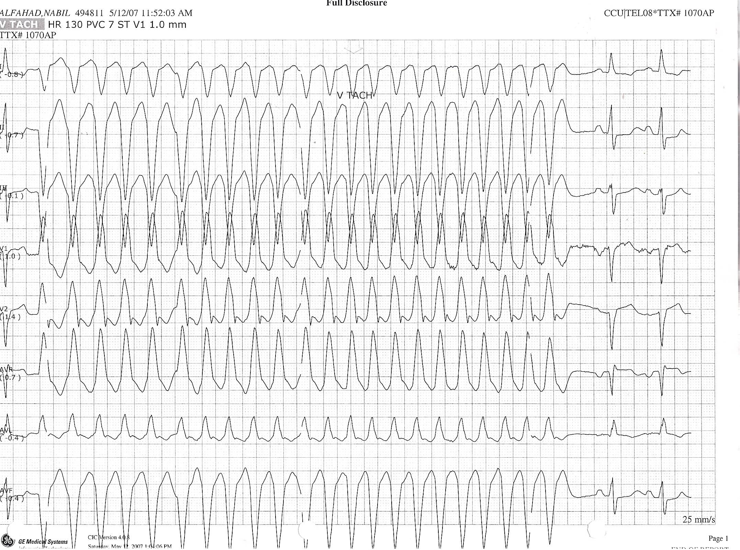

Slide 54
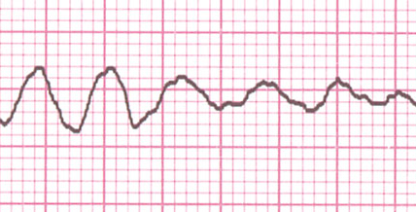
VF

Slide 55

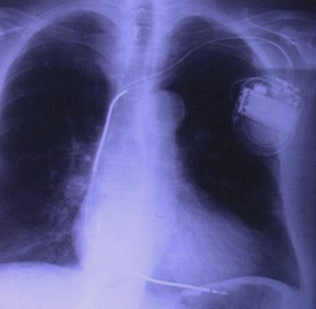
Treatment options
Treat the underlying cause
Automatic Implantable defibrillators

Slide 56

Thank You

