Slide 1
Heart Failure Prognosis & Management
Waleed AlHabeeb, MD, MHA Consultant Heart Failure Cardiologist

Slide 2
Definition
Heart failure is a complex clinical syndrome
Can result from:
structural or functional cardiac disorder
impairs the ability of the ventricle to fill with or eject blood

Slide 3
Inability of the heart to pump blood at an output sufficient to meet the body’s demands

Slide 4
Characterized by:
signs and symptoms of intravascular and interstitial volume overload and/or
manifestations of inadequate tissue perfusion

Slide 5
Common Causes
Coronary artery disease
Hypertension
Dilated cardiomyopathy
Valvular heart disease
Cor-Pulmonale
Notes:
5

Slide 6
Heart failure prevalence is expected to continue to increase¹
21 MILLION
ADULTS WORLDWIDE ARE
LIVING WITH HEART FAILURE
AND THIS NUMBER IS EXPETED TO RISE^{1,2}
AGING POPULATION²
INCREASING PREVALENCE OF RISK FACTORS²
IMPROVED POST-MI SURVIVAL²
A person at age 40 has a 1 in 5 lifetime risk of developing heart failure, and more than 1 million hospitalisations due to heart failure are reported annually in Europe.^{1,4}
MI = myocardial infarction
1. Mozaffarian D, Benjamin EJ, Go AS, et al; for American Heart Association Statistics Committee and Stroke Statistics Subcommittee. Heart disease and stroke statistics—2015 update: a report from the American Heart Association. Circulation. 2015;131(4):e29-e322. 2. Mosterd A, Hoes AW. Clinical epidemiology of heart failure. Heart. 2007;93(9):1137-1146. 3. Velagaleti RS, Vasan R. Epidemiology of heart failure. In: Mann DL, ed. Heart Failure: A Companion to Braunwald's Heart Disease. 2nd ed. St Louis: Saunders; 2011. 4. Ponikowski P, Anker SD, AlHabib KF, et al. Heart failure: preventing disease and death worldwide. ESC Heart Failure. 2014;1(1):4-25.

Slide 7
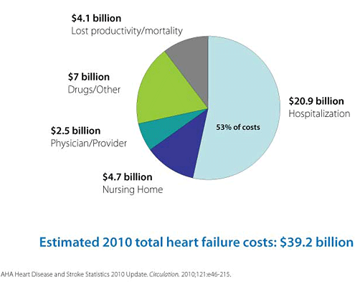

Slide 8
~50% OF PATIENTS DIE WITHIN
5 YEARS OF DIAGNOSIS
~1^{IN}4 HEART FAILURE PATIENTS
DIE WITHIN 1 YEAR OF DIAGNOSIS
www.heartfailure.com

Slide 9
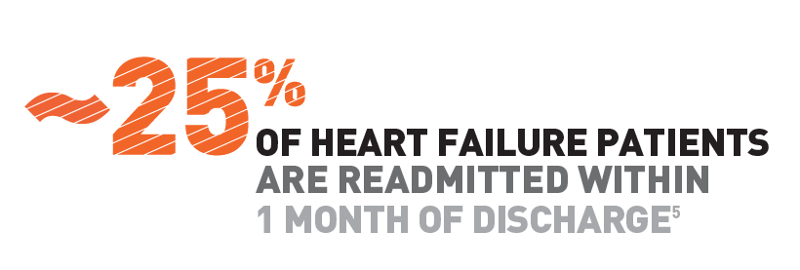
www.heartfailure.com

Slide 10
Heart failure progressive clinical course
Normal heart
Chronic HF
Death
Beginning of congestive HF
ADHF episode:
Congestion, hospital admission
Viability of the heart/survival
Later ADHF episode:
Emergency treatment,
CPAP and ICU
Initial phase
Final year
Modified from Gheorghiade M, et al. Am J Cardiol 2005;96:11G–17G

Slide 11
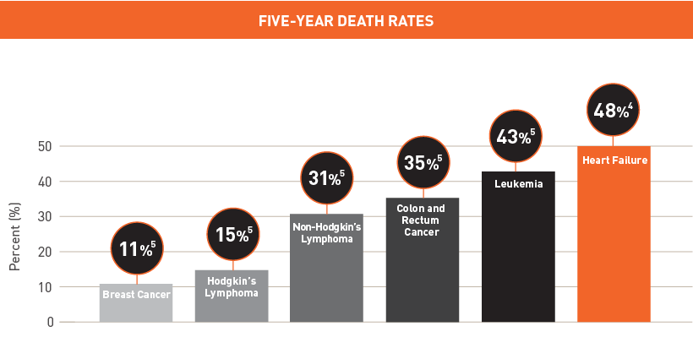
Heart failure is deadlier than many cancers

Slide 12
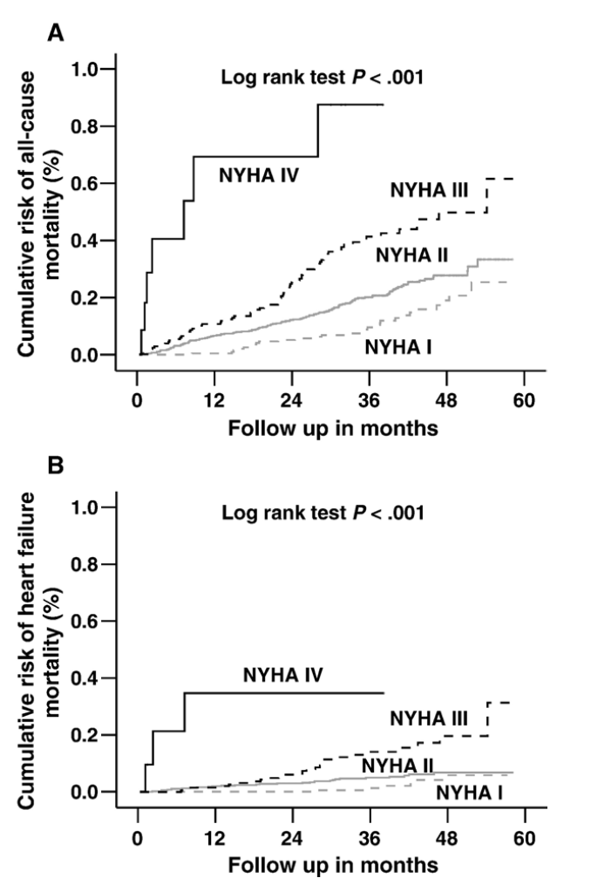
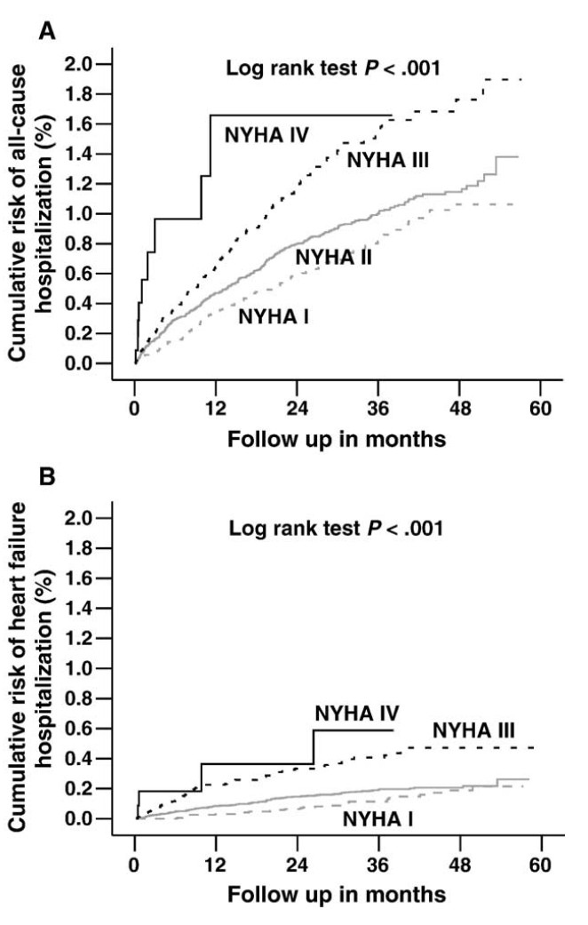
Am Heart J 2006;151:444- 50

Slide 13
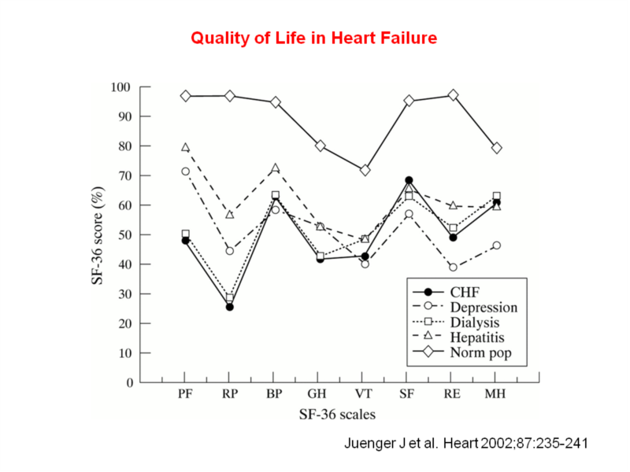

Slide 14
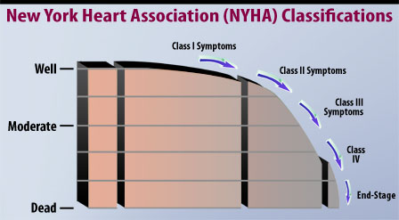

Slide 15
Stages, Phenotypes and Treatment of HF

Slide 16
Nomenclature
Heart failure vs.
Cardiomyopathy
LV dysfunction
Pulmonary edema

Slide 17
Classification
Left vs. Right
Systolic vs. Diastolic
High output vs. low output

Slide 18
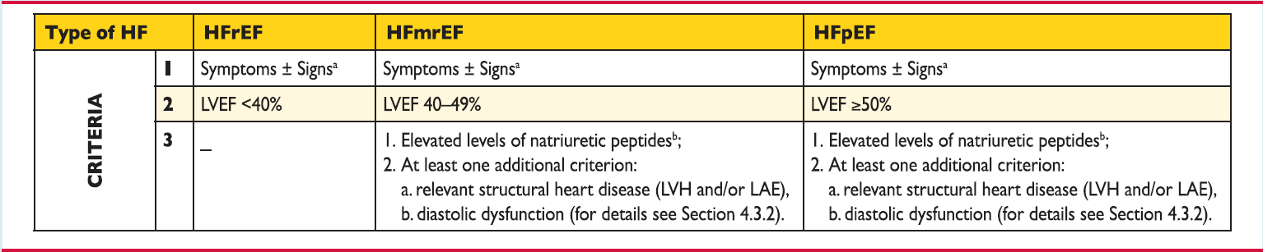
ESC guidelines

Slide 19
Heart Failure Syndrome
The initial manifestations of hemodynamic dysfunction are a reduction in stroke volume and a rise in ventricular filling pressures under conditions of increased systemic demand for blood flow
This stimulates a variety of interdependent compensatory responses involving the cardiovascular system, neurohormonal systems, and alterations in renal physiology

Slide 20
Evaluation

Slide 21
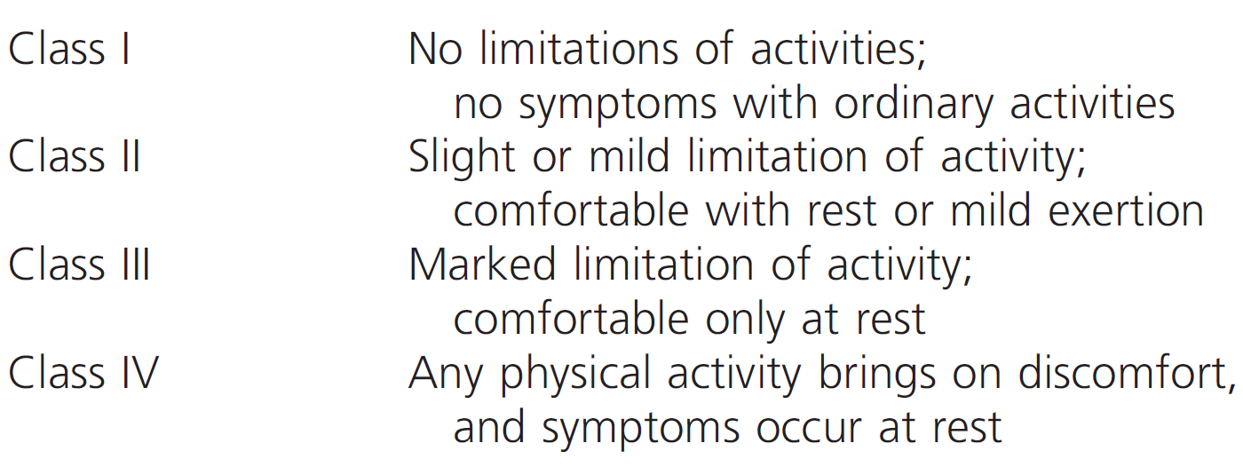
NYHA Classiffication
Notes:
21

Slide 22
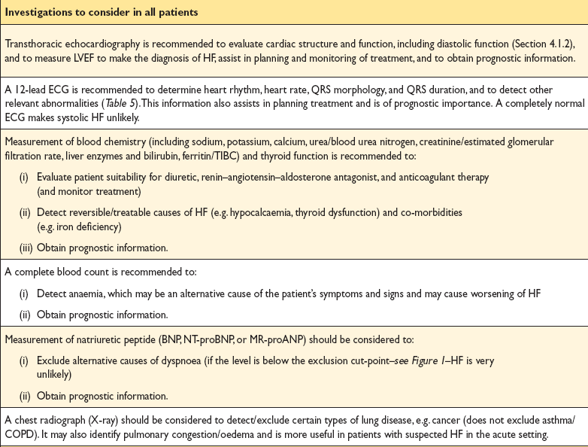

Slide 23
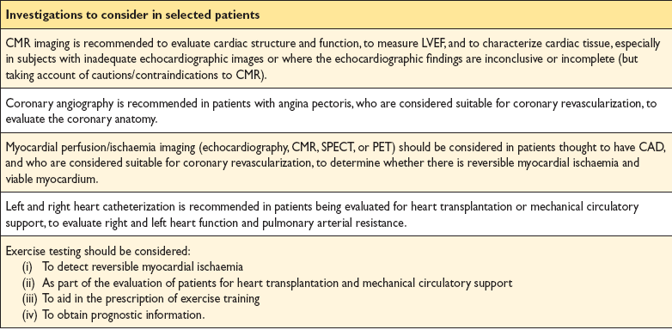

Slide 24
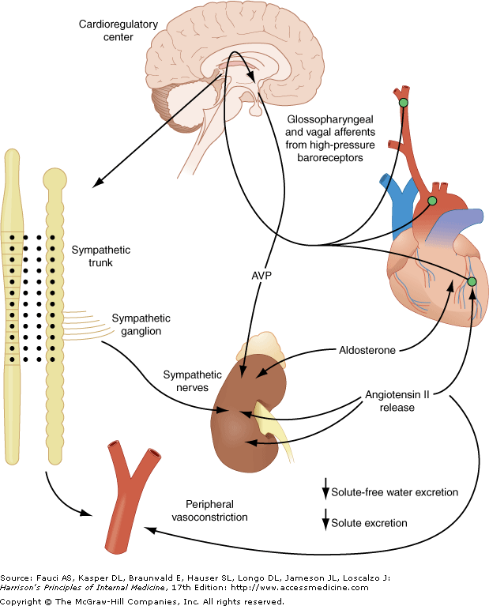

Slide 25
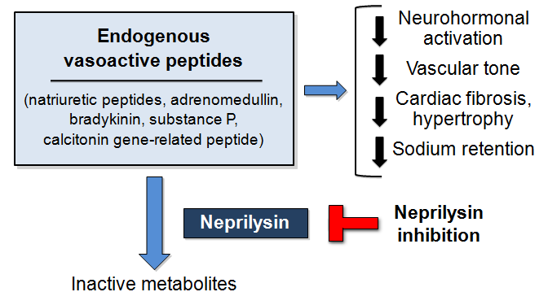
Natriuretic Peptides

Slide 26
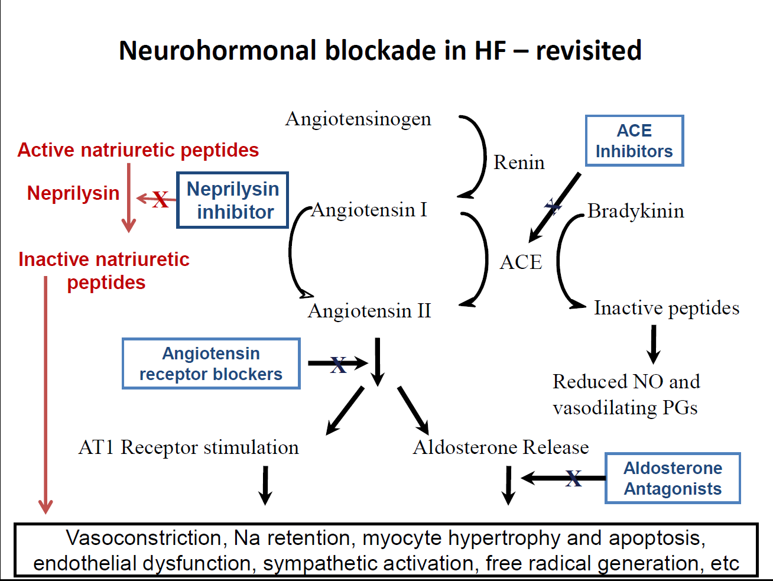

Slide 27
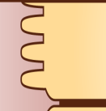
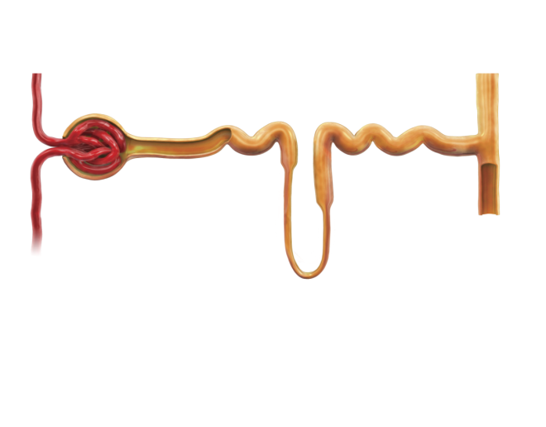

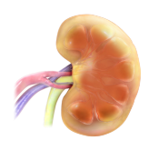


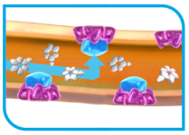

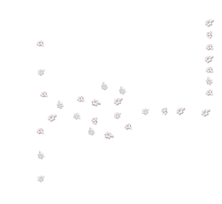
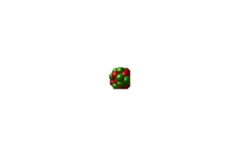
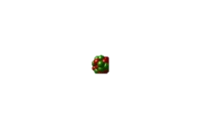





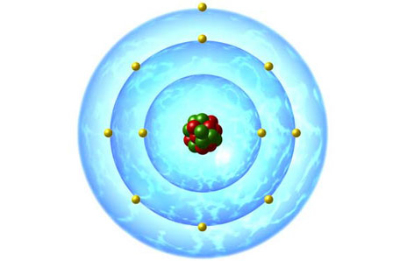

SGLT2 Inhibitors Block SGLT2 and Reduce Glucose and Na⁺ Reabsorption^{1–3}
Reduced glucose and sodium reabsorption
SGLT2
Decrease in intracellular sodium concentration
Proximal tubule
Increased urinary excretion of excess glucose
Based on this MOA, the following occur^{1,a}:
Diuresis
Natriuresis
HbA_{1c} reduction
Weight loss
SBP reduction
Glucose
filtration
Remaining glucose is reabsorbed by SGLT1 (10%)
SGLT2
Glucose
Sodium
Dapagliflozin
Dapagliflozin is >1400 times more selective for SGLT2 versus SGLT1^{b}
ªPlease note that dapagliflozin is only indicated to improve glycemic control; ^{b} Increases urinary volume by only ~1 additional void/day (~375 mL/day) in a 12-week study of healthy subjects and patients with T2DM
The safety profile of SGLT2 inhibitors is currently under review by EMA PRAC. SGLT2 inhibitors are not marketed in France
SBP, systolic blood pressure; SGLT, sodium–glucose co-transporter; T2DM, Type 2 diabetes mellitus
1. Marsenic O. Am J Kidney Dis 2009;53:875–885; 2. FORXIGA. Summary of product characteristics, 2014; 3. Mudaliar S, et al. Diabetes Care 2016;39:1115–1122

Slide 28

Risk factors/Comorbidities
% patients in registry
Hypertension
Dyslipidemia
DM
Smoker and/or ex-smoker
Alcohol consumption
DM, diabetes mellitus

Slide 29
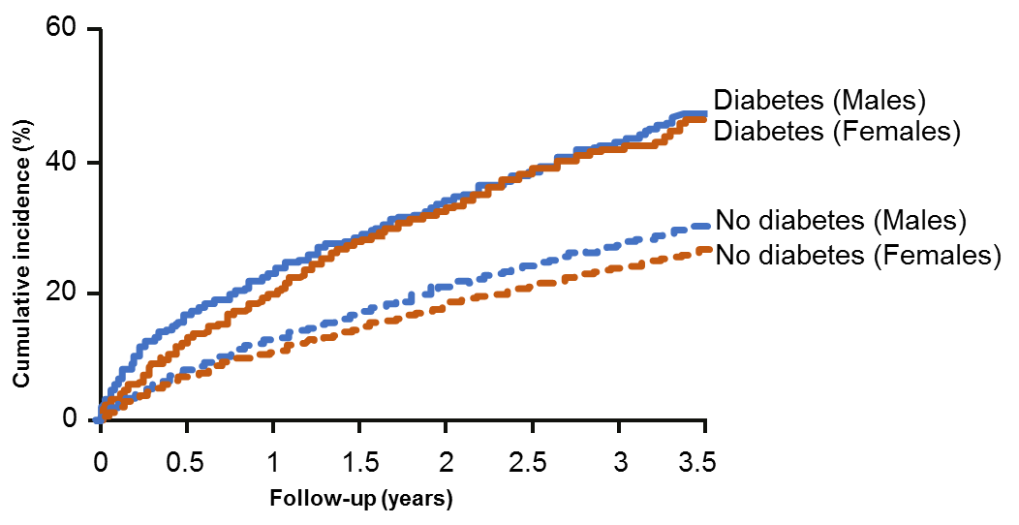
Association of HF and DM predicts worse outcomes than either disease would alone
CV death or HF hospitalization by DM status in patients with HF³
CV death or HF hospitalization by degree of dysglycemia in patients with HFrEF²
Normoglycemia: HbA1c < 6.0%
Pre-diabetes: HbA1c 6.0-6.4%
Undiagnosed DM: HbA1c ≥6.5%
History of DM
0.40
0.30
0.20
Log rank test
<0.001
0.10
0.00
0
0.5
1
1.5
2
2.5
3
3.5
Data from CHARM trial program;
Years from randomization
Data from PARADIGM-HF trial
DM=diabetes mellitus; HbA!c=glycated hemoglobin; HF=heat failure; HFrEF=HF with reduced ejection fraction
1. Dei Cas A et al. Curr Probl Cardiol. 2015 Jan;40(1):7-43; 2. Kristensen et al. Circ Heart Fail 2016; 9(1). pii: e002560; 3. MacDonald et al. Eur Heart J 2008; 29:1377–1385

Slide 30
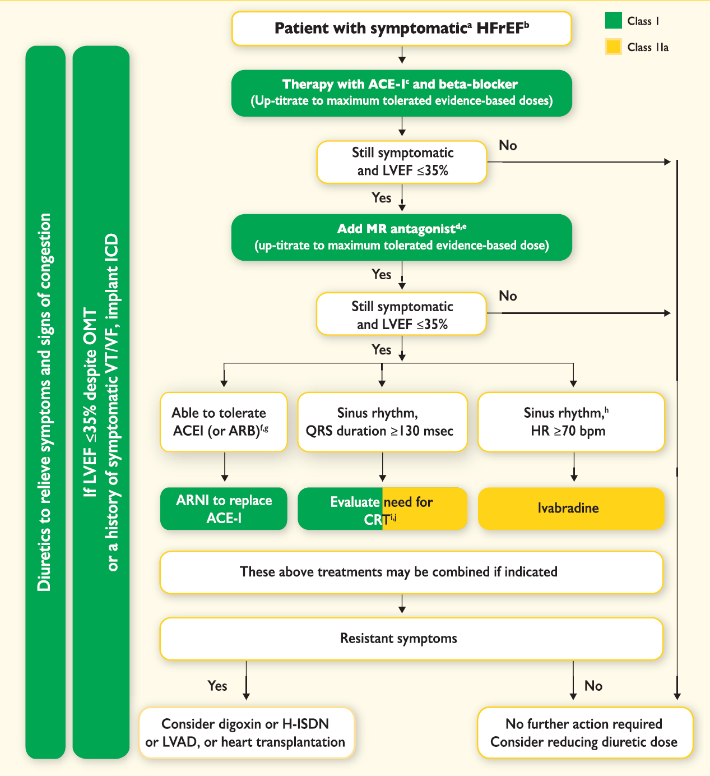
Ponikowski et al. Eur Heart J 2016;37:2129–2200

Slide 31
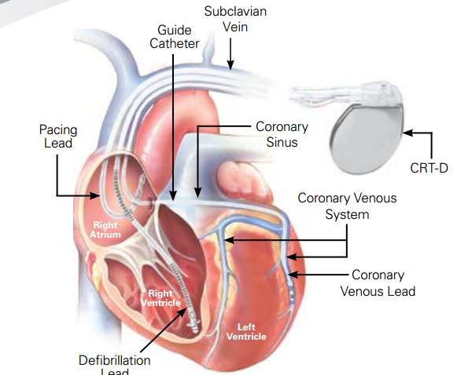
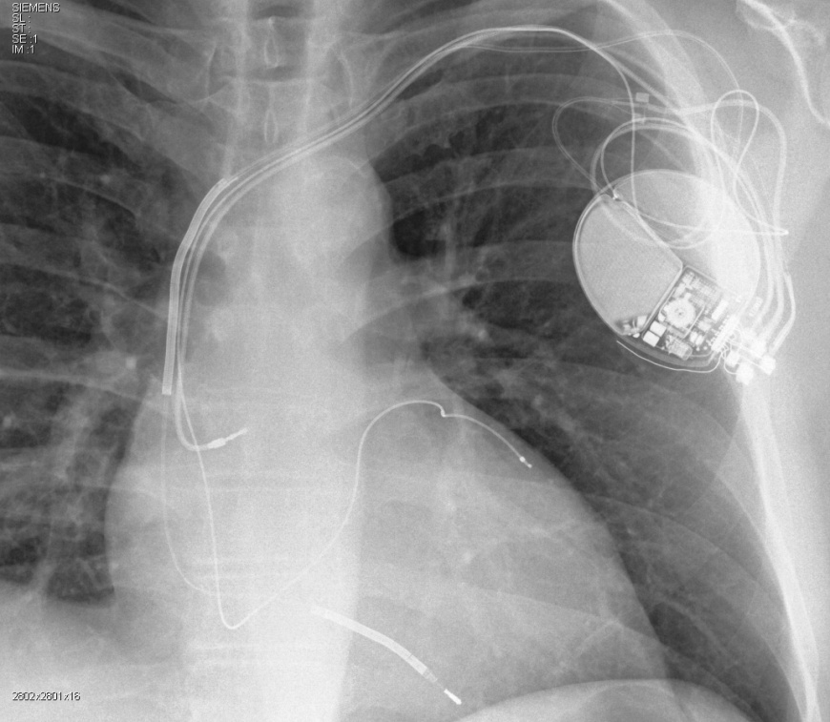
Devices

Slide 32
Advanced heart failure
Defined as persistent symptoms (NYHA class III–IV) that limit daily life despite routine therapy with agents of known benefit
End-stage, refractory heart failure, probably accounts for 5% to 10% of the total population
This group, consumes >60% of health-care expenditures for all patients with heart failure

Slide 33
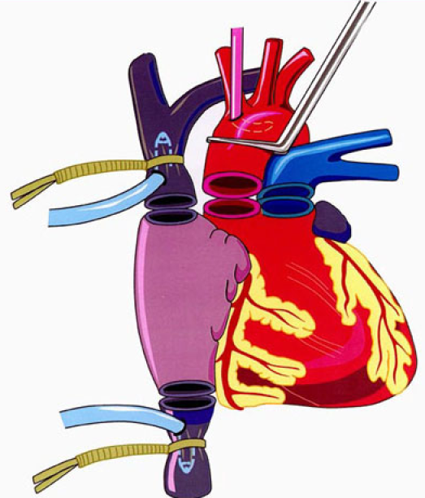
Heart Transplantation
Orthotopic cardiac transplantation remains the definitive therapy for terminal heart failure
5-year survival of 70%,
10-year survival of 60%,
Markedly improved quality of life
Donor organ availability has remained static even as the waiting list for heart transplant grows

Slide 34
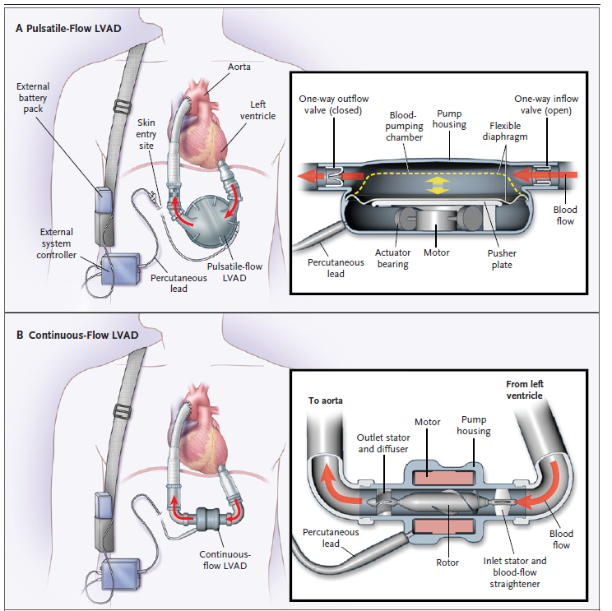

Slide 35
56 Y/O gentleman
Diagnosed dilated cardiomyopathy
LVEF 25%
NYHA class II
O/E B/P 112/68 HR 82 bpm
JVP 7 cm water,
Soft S3 and grade 2 PSM
Chest clear,
No LL edema and warm extremities

Slide 36
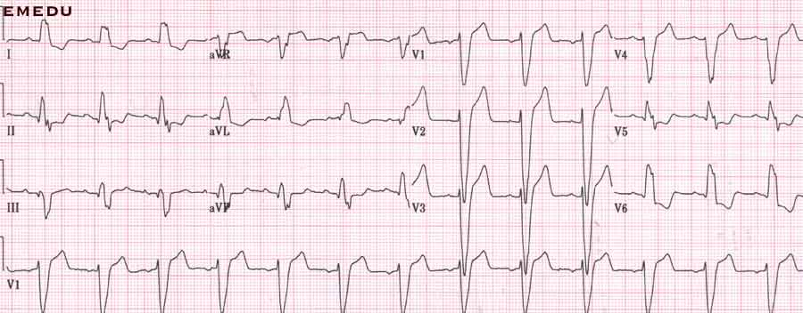

Slide 37
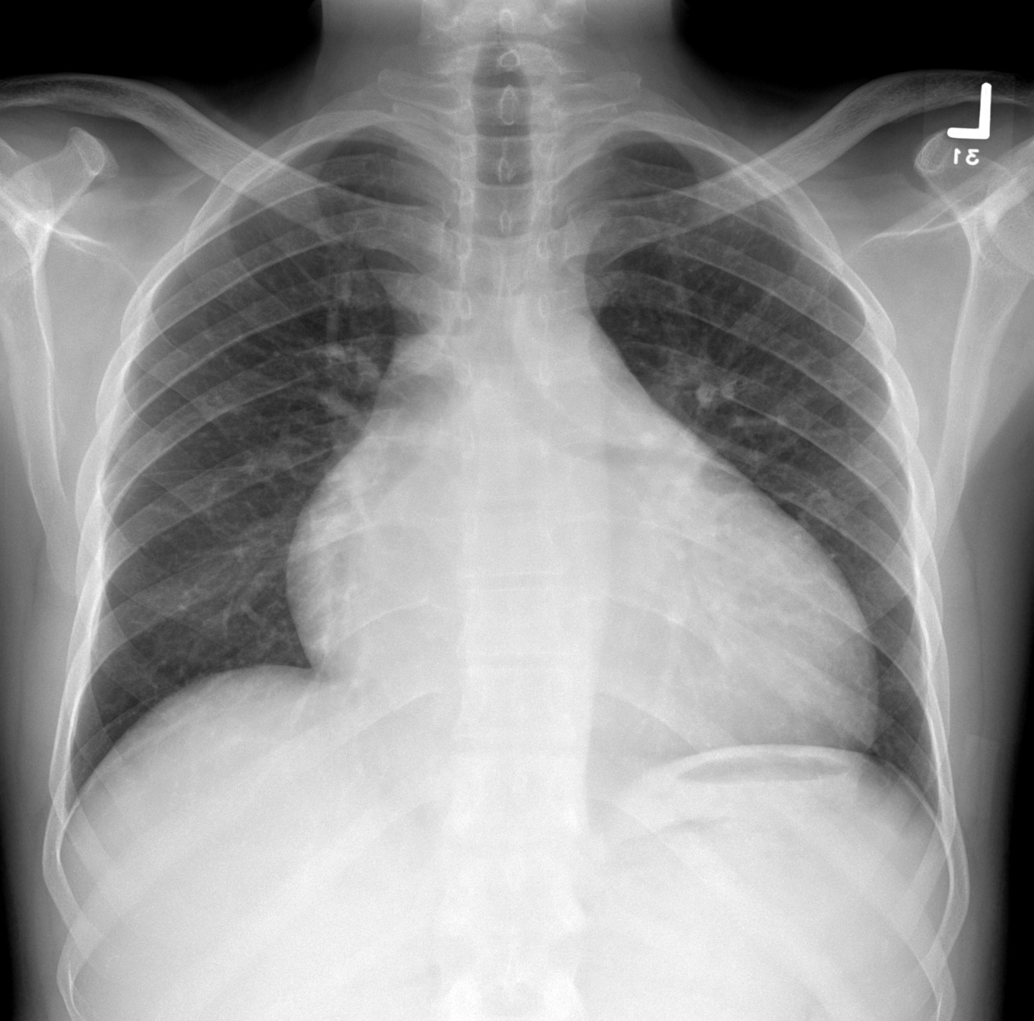

Slide 38
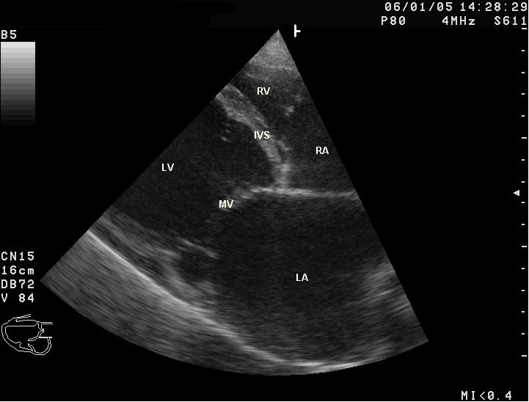

Slide 39
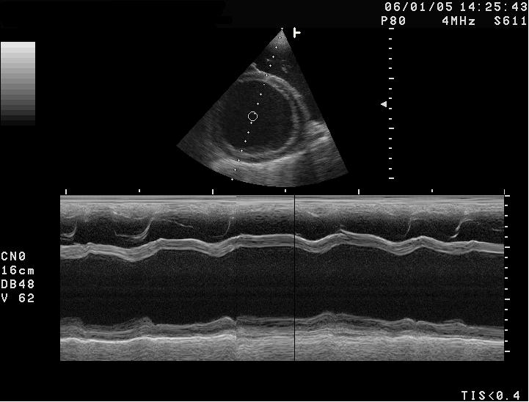

Slide 40
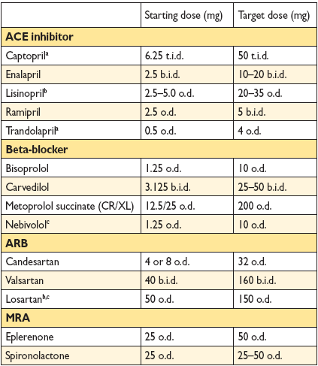

Slide 41
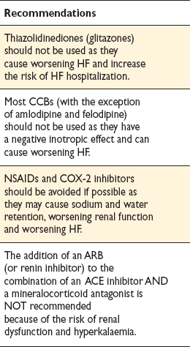
Treatments (or combinations of treatments) that may cause harm in patients with symptomatic (NYHA class
II–IV) systolic heart failure

Slide 42
Acute Heart Failure

Slide 43
FACTORS THAT MAY PRECIPITATE ACUTE DECOMPENSATION OF CHRONIC HEART FAILURE

Slide 44
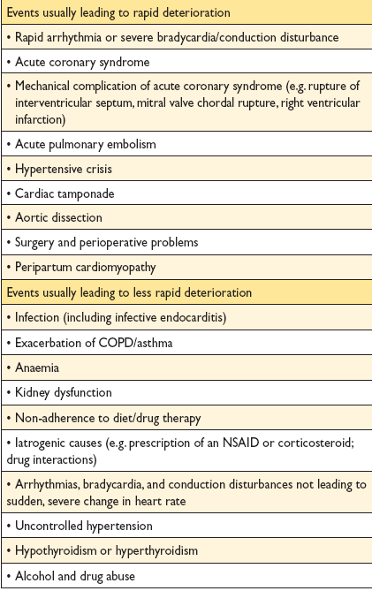

Slide 45
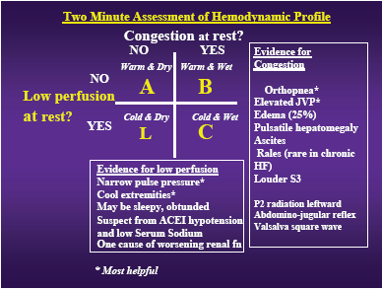
Notes:
45

Slide 46
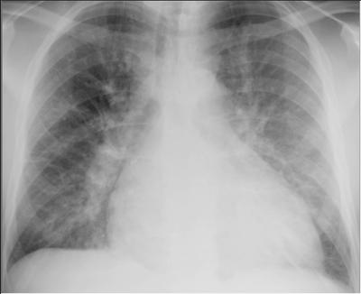

Slide 47
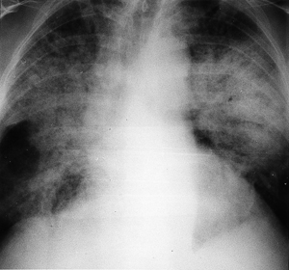

Slide 48
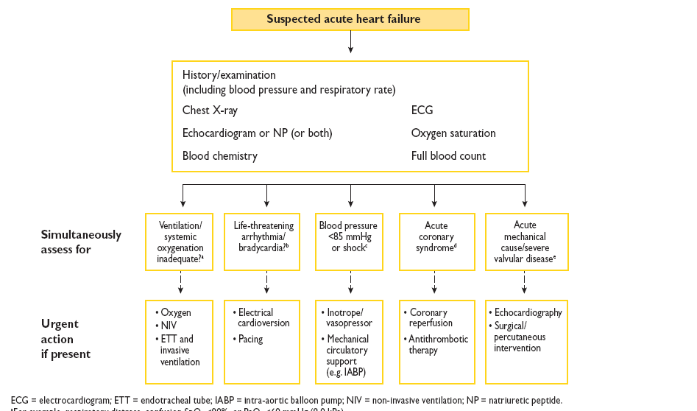

Slide 49
THANK YOU & GOOD LUCK

