Slide 1
Radiology & investigation of hepatobiliary system
Dr.Reshaid Aljurayyan
Assistant Professor department of radiology
college of medicine
King Saud university

Slide 2
Lecture outline:
What is the hepatobiliary system (HBS)?
Radiological modalities used in imaging HBS.
Advantages and Disadvantages of each radiology modality.
Indications of imaging HBS.

Slide 3
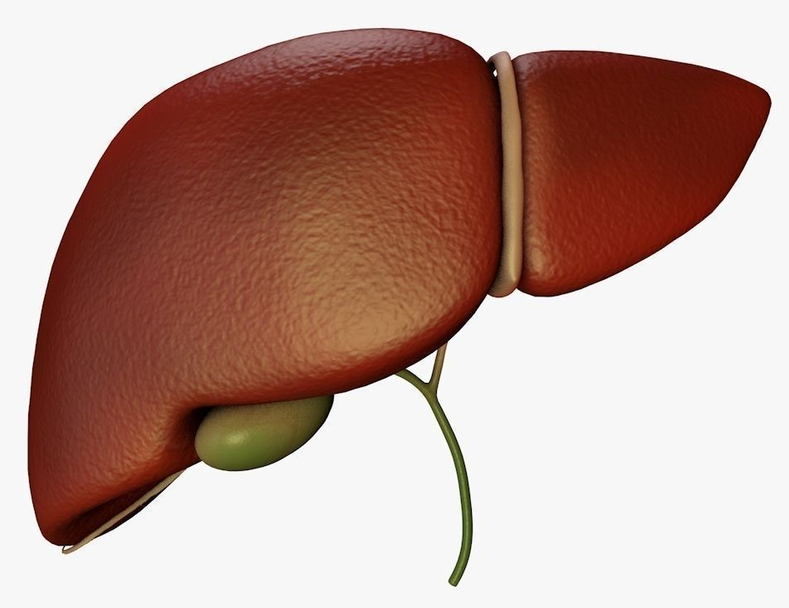
What HBS incudes?
It includes liver, gallbladder and biliary ducts.

Slide 4
What are Radiological modalities used in imaging HBS ?
X Ray.
Ultrasound.
Computed tomography CT scan.
Magnetic resonance imaging MRI.
Nuclear scan.

Slide 5
What are Radiological modalities used in imaging HBS ?
X Ray.
Ultrasound.
Computed tomography CT scan.
Magnetic resonance imaging MRI.
Nuclear scan.
ALL modalities can be used

Slide 6
What is this?

Slide 7
What is this?
Abdomen x-ray
OR
Abdomen radiography

Slide 8
What is this ????

Slide 9
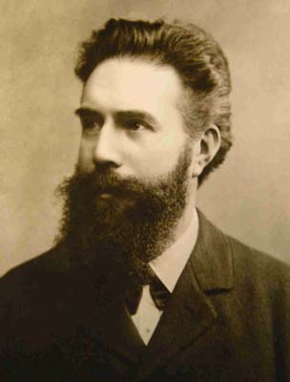
X ray was first observed and documented in 1895 by Wilhelm Conrad Roentgen
First x ray taken in history

Slide 10
What is X ray?
It is energetic form of electromagnetic and ionizing radiation that can penetrate solid objects and used to take images of the human body.

Slide 11
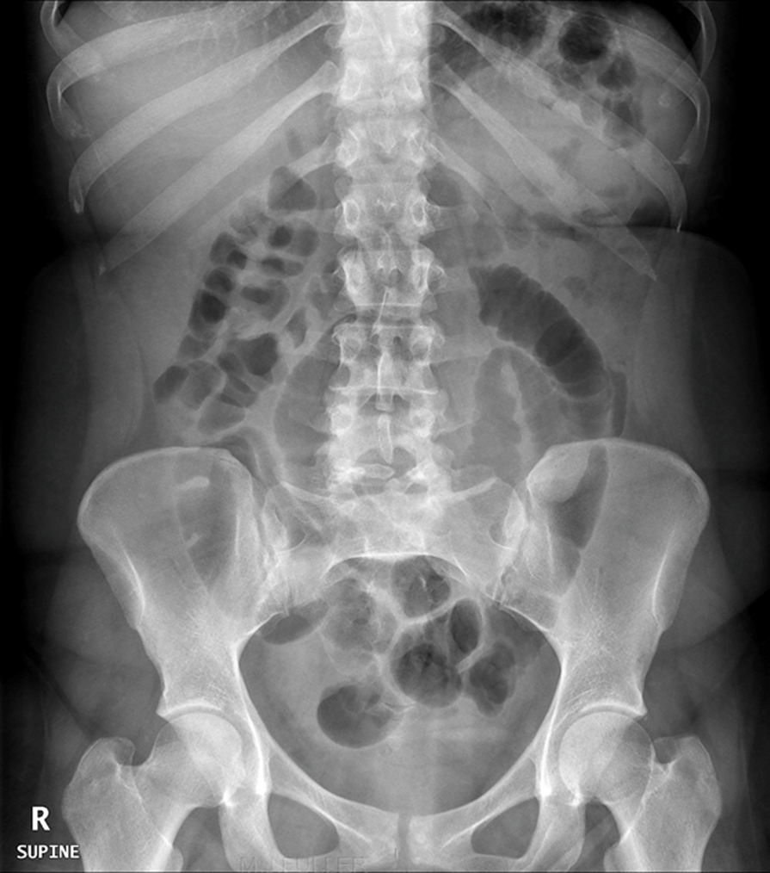
X-Ray language:
Radio-lucent = black
Radio-opaque= white

Slide 12
X-Ray:
Advantages:
Quick and widely available
Cheap
Can be done bedside (portable)
Disadvantages:
Use ionizing radiation
Very poor in tissue details including HBS
Very limited in detecting gallbladder stones

Slide 13
What is this?

Slide 14
What is this?
ULTRASOUND

Slide 15
What is US?
A diagnostic technique in which high-frequency sound waves penetrate the body and produce multiple echo patterns.
Diagnostic Medical applications in use since late 1950’s

Slide 16
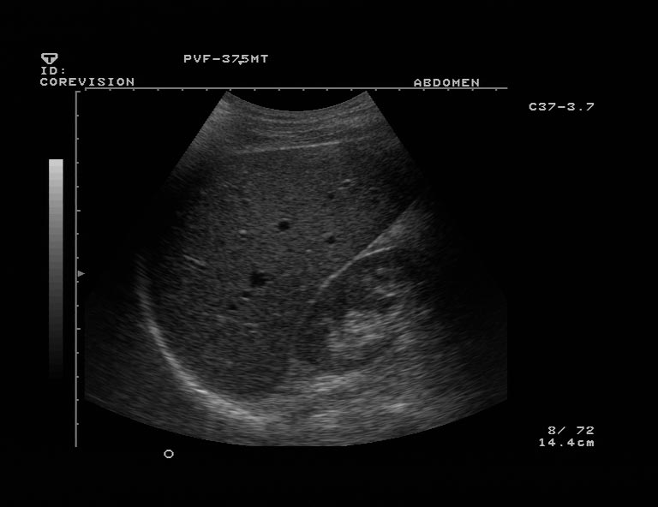
Ultrasound
Advantages:
No radiation.
Widely available.
Relatively cheap.
Very good in evaluating abdomen solid organs.
Can be done bedside (portable).
Disadvantages:
Operator dependent.
Very limited in evaluating structures with air ( e.g. bowel) or calcification (e.g. bone).

Slide 17
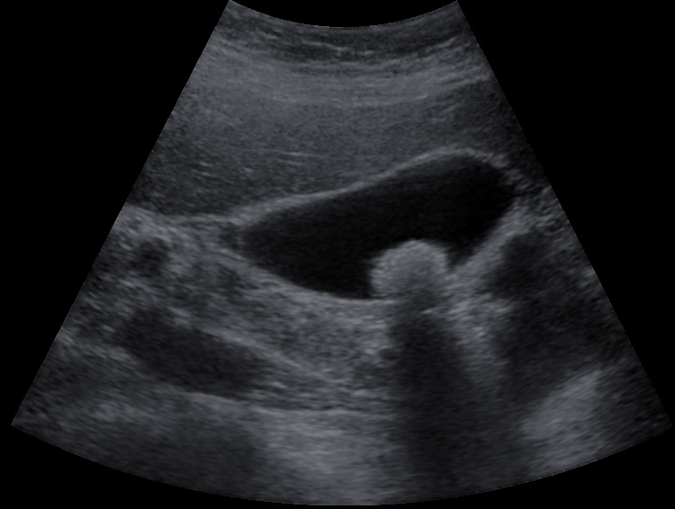
Echo patterns
Hyper-echoic = White
Hypo-echoic = Light Grey
An-echoic = Black
Acoustic shadow: black band behind dense object (e.g. stone)

Slide 18
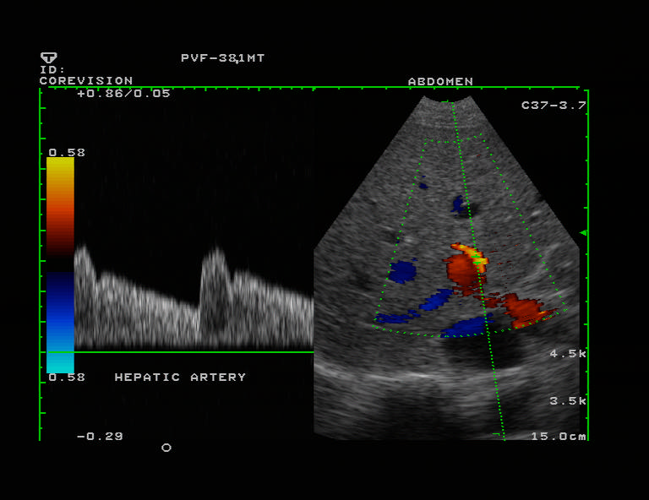
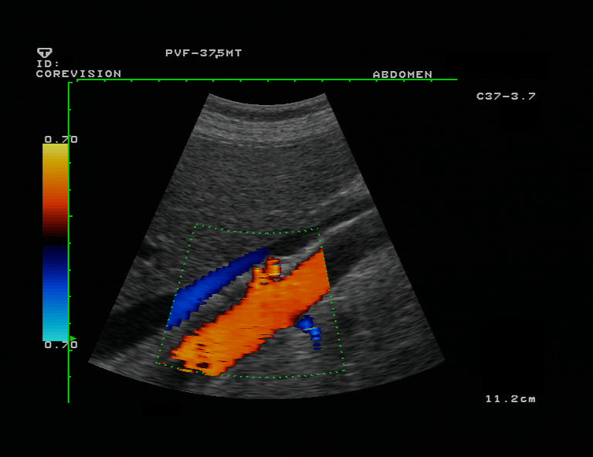
B- MODE
DUPLEX
COLOR DOPPLER

Slide 19
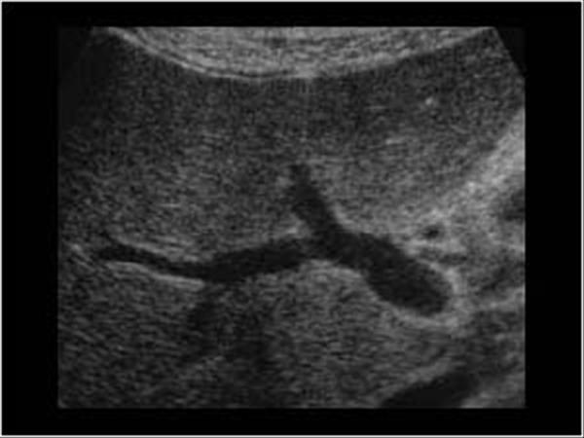
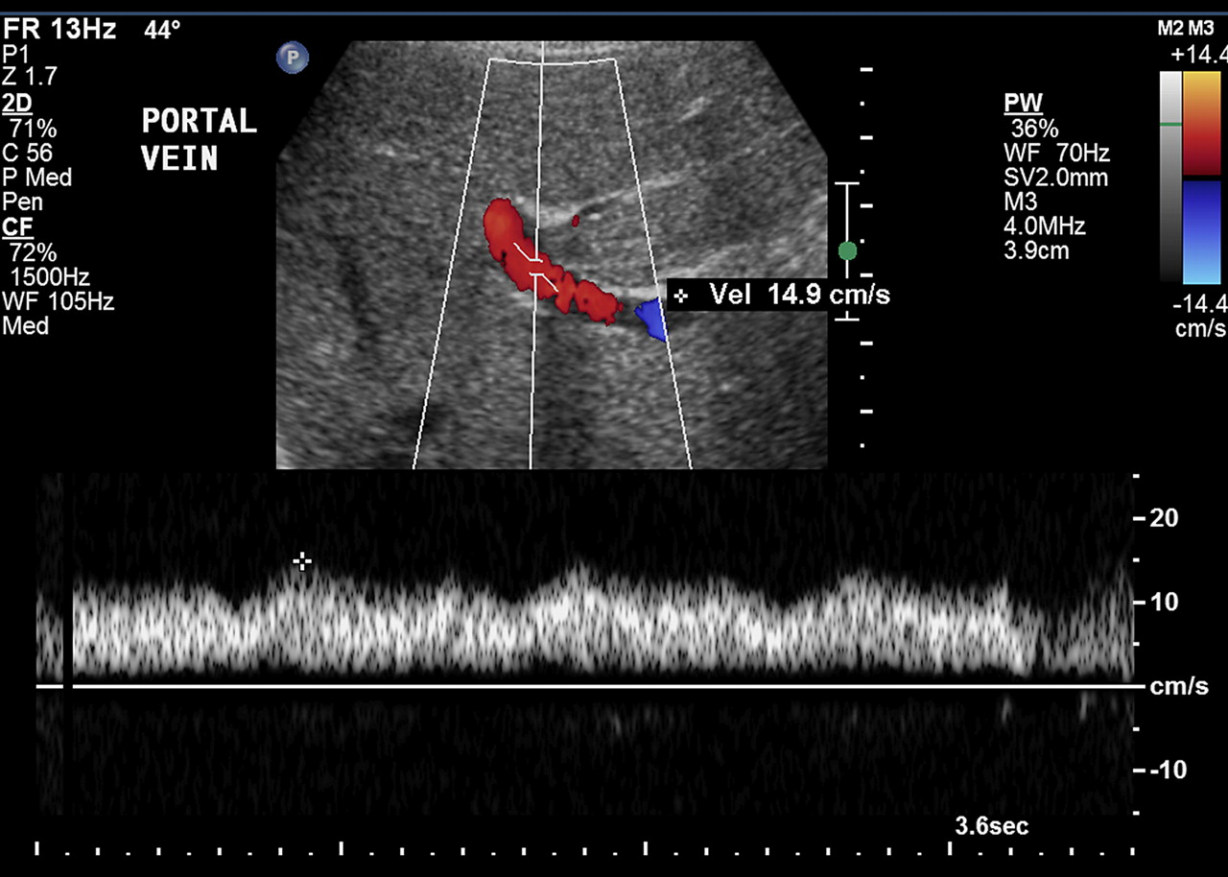
B- MODE
DUPLEX

Slide 20
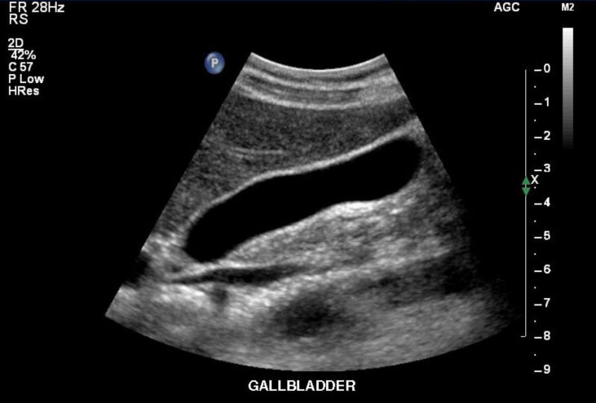

Slide 21
What is this?

Slide 22
What is this?
CT scan = Computed Tomography

Slide 23
What is CT scan?
A CT scan is computer-processing of many X-ray images taken from different angles to produce cross-sectional images.
CT scan can be done with and without intravenous IV contrast.
CT scan is limited in evaluating gallstones, Why?

Slide 24
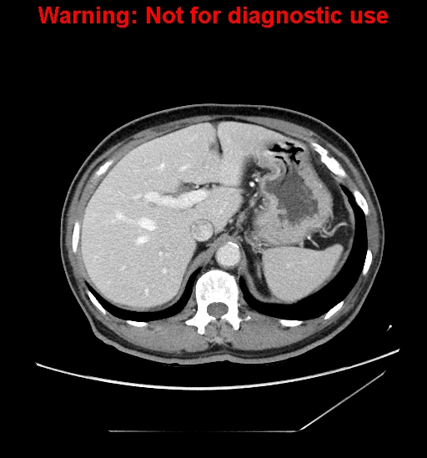
What is different between the tow iamges?

Slide 25
What is different between the tow iamges?
Without IV contrast
With IV contrast

Slide 26
Computed tomography CT scan:
Advantages:
Very good in evaluating solid organs.
Available more then MRI.
Disadvantages:
Use ionizing radiation.
Less available then x-ray and US.
Relatively expansive.
Intravenous contrast maybe harmful in patient with impaired renal function..

Slide 27
CT language
Hyper-dense = white
Hypo-dense=black to grey

Slide 28
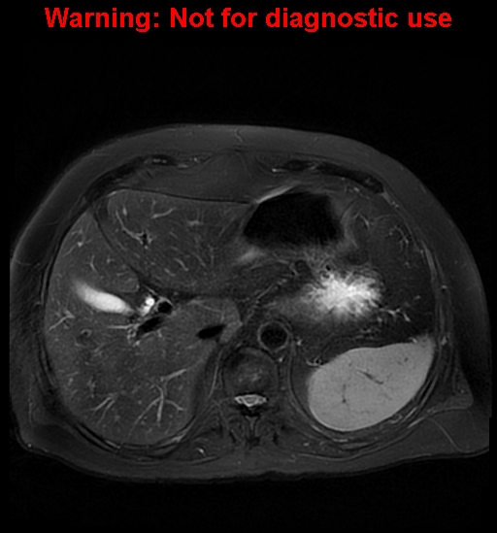
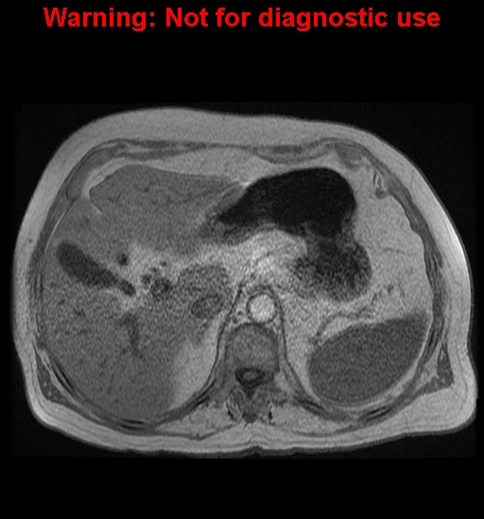
What is this?

Slide 29
What is this?
Magnetic resonance imaging (MRI)

Slide 30
Magnetic resonance imaging (MRI)
A medical imaging technique using strong magnetic fields and radio waves to form pictures of the anatomy.
It has no radiation.

Slide 31
Magnetic resonance imaging (MRI)
Advantages:
Excellent in showing tissue details.
No ionizing radiation.
Disadvantages:
Expensive.
Long scan time.
Less available then other modalities.
Intravenous contrast is not safe with impaired renal function.

Slide 32
MRI language
Hyper intense signal = more white
Hypo intense signal = more grey/black

Slide 33
What is this?

Slide 34
What is this?
Nuclear scan

Slide 35
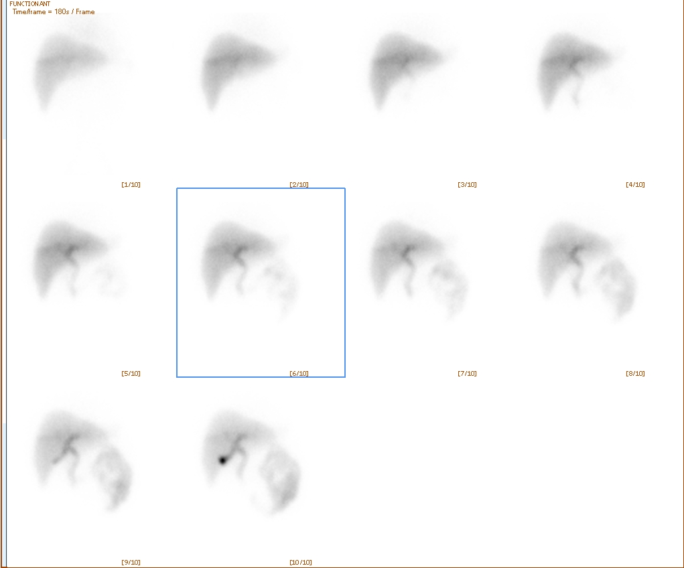
What is nuclear medicine?
Medical specialty involving the application of radioactive substances in the diagnosis and treatment of disease.

Slide 36
Nuclear medicine:
Advantages:
Excellent in evaluating oragn function/physiology.
Disadvantages:
Use ionizing radiation.
Not widely available.
Poor in evaluating anatomy.

Slide 37
THANK YOU

