Slide 1
Interactive lecture
Dr. MOHAMMAD AYESH ZAYED, MBBS
CONSULTANT RADIOLOGIST
Radiology and Medical Imaging Department

Slide 2
Name 5 radiological modalities

Slide 3
Name 5 radiological modalities
X-RAY
Fluoroscopy
U/S
MRI
CT scan
Nuclear Medicine
Angiography

Slide 4
What is the modality?
Mention 2 abnormalities?

Slide 5
What is the modality? Plain X-RAYS
Mention 2 abnormalities? Multiple air-Fluid levels and Stack of coins signs

Slide 6
Stack of Coins

Slide 7
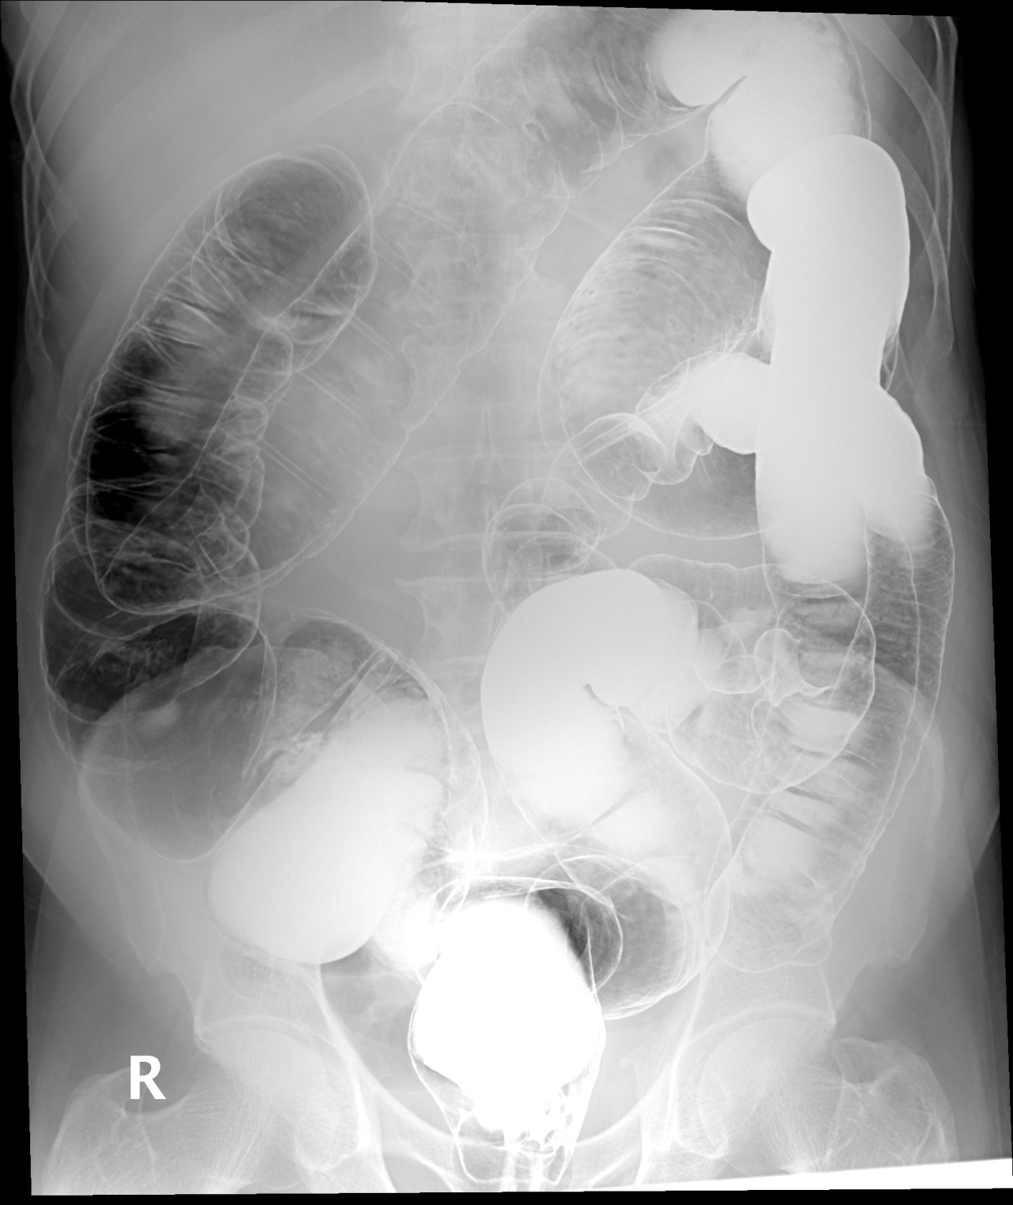
What is the name of the study?
Name the labelled structures?
4
5
6
3
7
2
8
1

Slide 8
Double barium enema
4
5
6
Rectum
Sigmoid colon
Descending colon
Splenic flexure
Transverse colon
Hepatic flexure
Ascending colon
cecum
3
7
2
8
1

Slide 9
What is the modality?
What is the diagnosis?

Slide 10
What is the modality?
Barium meal - fluoroscopy
What is the diagnosis?
Hiatus hernia

Slide 12
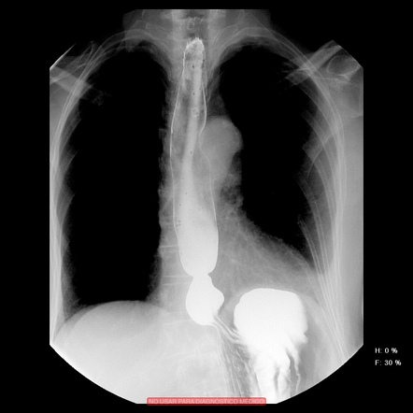
Another example of hiatus hernia

Slide 13
What is the modality?
What is the name of the sign?
What is the diagnosis?

Slide 14
What is the modality?
Barium enema – fluoroscopy
What is the name of the sign?
Lead pipe sign
What is the diagnosis?
IBD – Ulcerative colitis

Slide 15
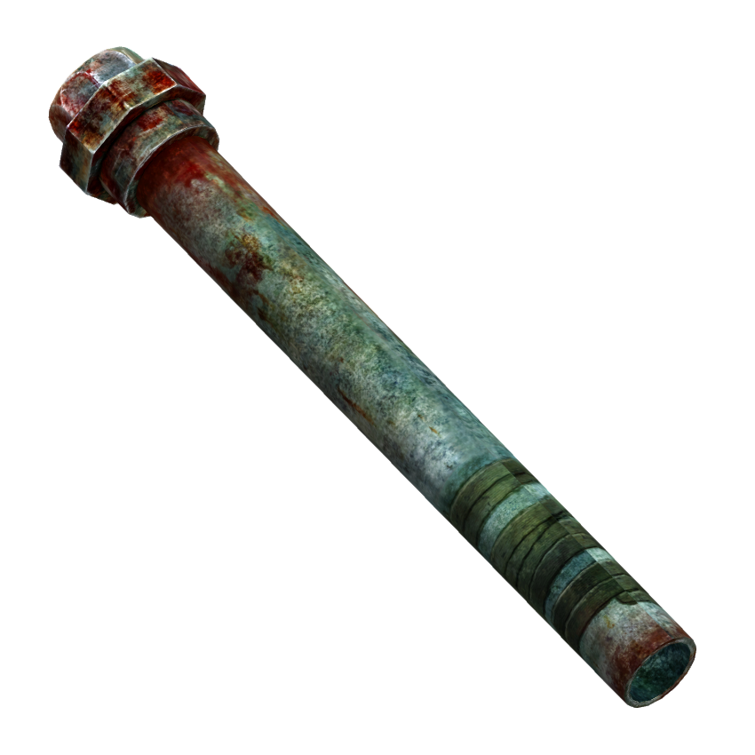
Lead pipe

Slide 16
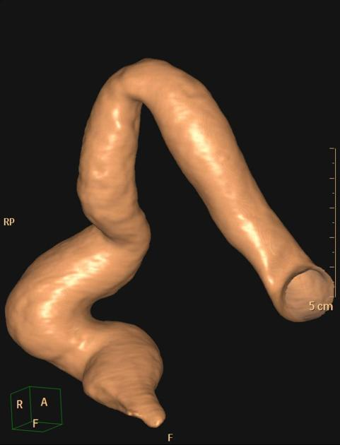
Another example of lead pipe colon (featureless colon)

Slide 17
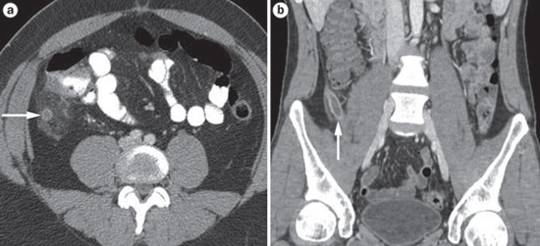
What is the name of the study?
What is structure labeled on the left image?
What is the diagnosis of the patient on right image?
What is the gold standard image modality for such diagnosis? What is the alternative image modality in pregnant/pediatric patients?

Slide 18
What is the name of the study? CT scan
What is structure labeled on the left image? appendix
What is the diagnosis of the patient on right image? appendicitis
What is the gold standard image modality for such diagnosis? What is the alternative image modality in pregnant/pediatric patients? CT scan is the gold standard, U/S is the alternative.

Slide 19
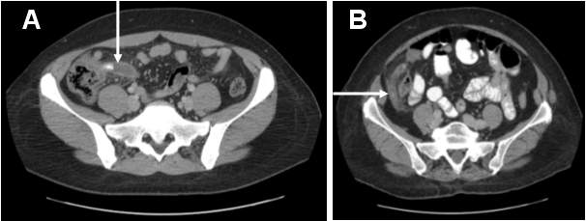
Appendix should not exceed 6 mm in diameter.
The surrounding fat should be clear.
Appendix normally is compressible by U/S probe.
Normally, there will be no appendiculith.

Slide 20
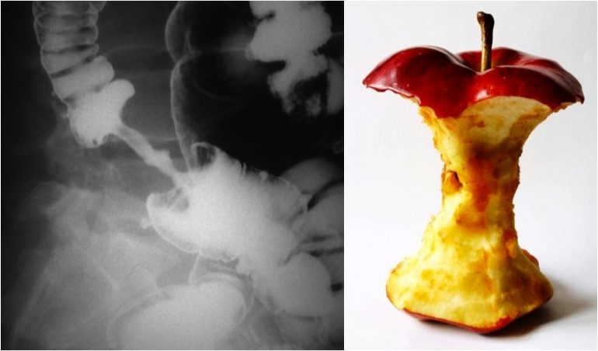
What is the name of the study?
What is the pertinent sign?
What is the diagnosis?

Slide 21
What is the name of the study?
Barium enema
What is the pertinent sign?
Apple-core sign
What is the diagnosis?
Colon cancer

Slide 22
Examples of colon cancer in barium enema and CT scan

Slide 23
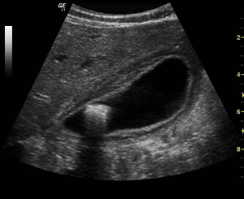
What is the name of the modality?
What is the diagnosis?
What are the expected symptoms the patient has?

Slide 24
What is the name of the modality?
UltraSound
What is the diagnosis?
Gallstone with cholecystitis
What are the expected symptoms the patient has?
RUQ pain radiating to right shoulder aggravating by fatty meal

Slide 25
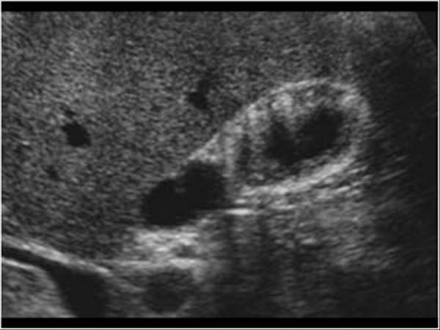
What is the name of the modality?
What is the findings?
What is the diagnosis?
What is the important of this disease?

Slide 26
What is the name of the modality?
UltraSound
What is the findings?
Hyperechoic lesions within the wall
What is the diagnosis?
Gallbladder adenomyomatosis
What is the important of this disease?
Misdiagnose with stone, benign lesion and can convert to malignant lesions, F/U is needed.

Slide 27
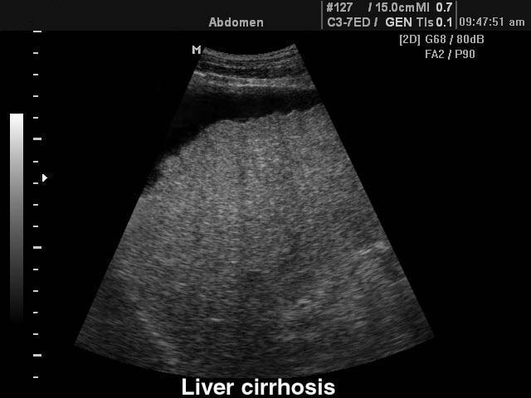
What is the modality?
What is the findings?
What is the diagnosis?

Slide 28
What is the modality? Ultrasound
What is the findings?
Shrink, nodular surface, hyperechoic texture, ascites.
What is the diagnosis?
Liver cirrhosis

Slide 29
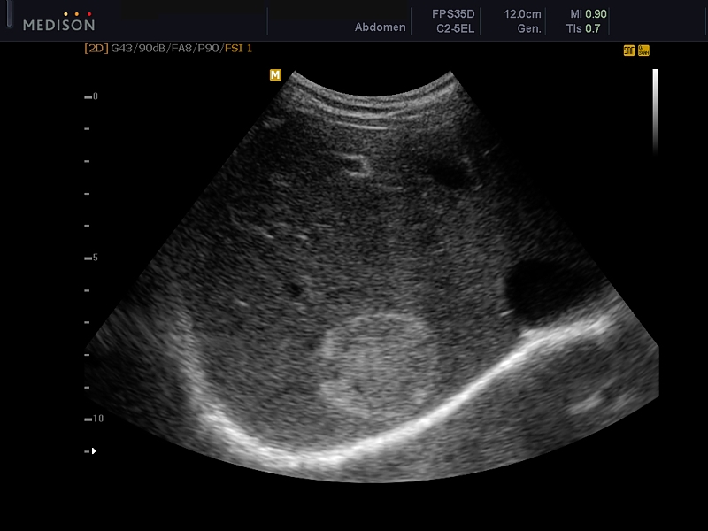
What is the modality?
What is the findings?
What is the diagnosis?
What is other imaging modality to confirm the diagnosis?

Slide 30
What is the modality?
U/S
What is the findings?
Hyper-echoic focal hepatic nodule
What is the diagnosis?
hemangioma
What is other imaging modality to confirm the diagnosis?
Triphasic liver CT scan
MRI

Slide 31
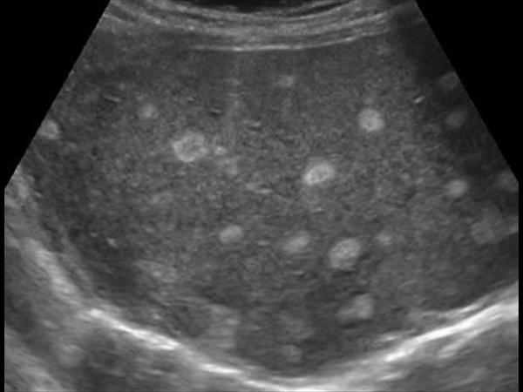
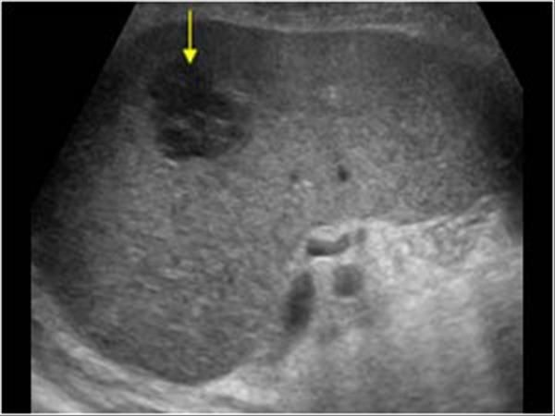
Hyper echoic lesions
Hypo echoic lesions

Slide 32
Triphasic liver CT scan of the same patient

Slide 33
What is the modality?
What are the findings?
What is the diagnosis?

Slide 34
What is the modality?
Triphasic liver CT scan
What are the findings?
Focal hepatic lesion with fill-in enhancement
What is the diagnosis?
HCC

Slide 35
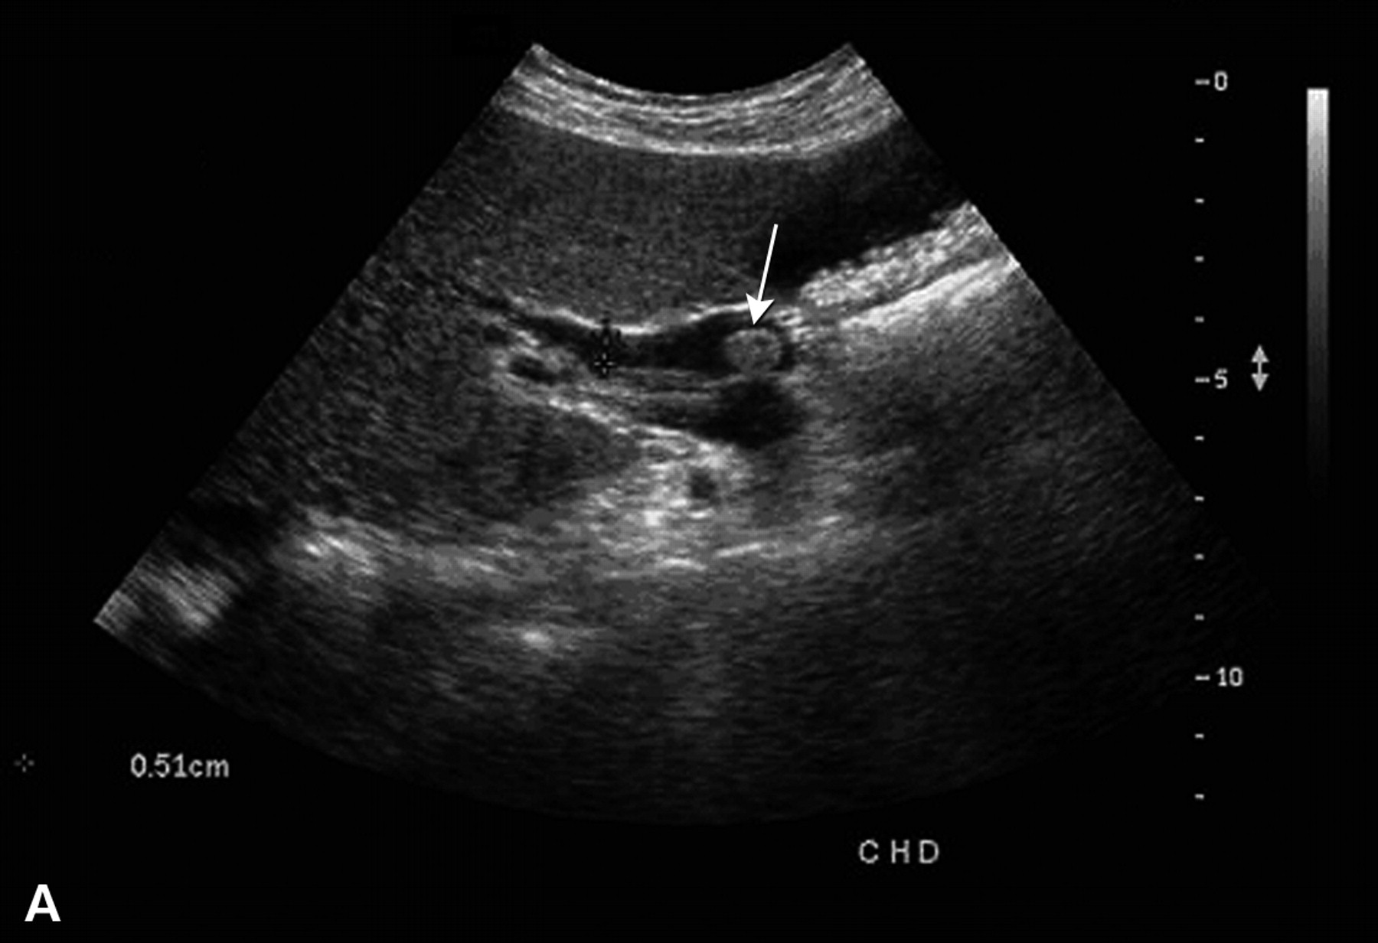
What is the modality?
What is the findings?
What is the diagnosis?
What is the expected symptoms and signs the patient has?

Slide 36
What is the modality?
U/S
What is the findings?
Hyperechoic lesion in CBD
What is the diagnosis?
CBD stone
What is the expected symptoms and signs the patient has?
Yellow discoloration. RUQ pain. Hyper-bilirubinemia.

Slide 37
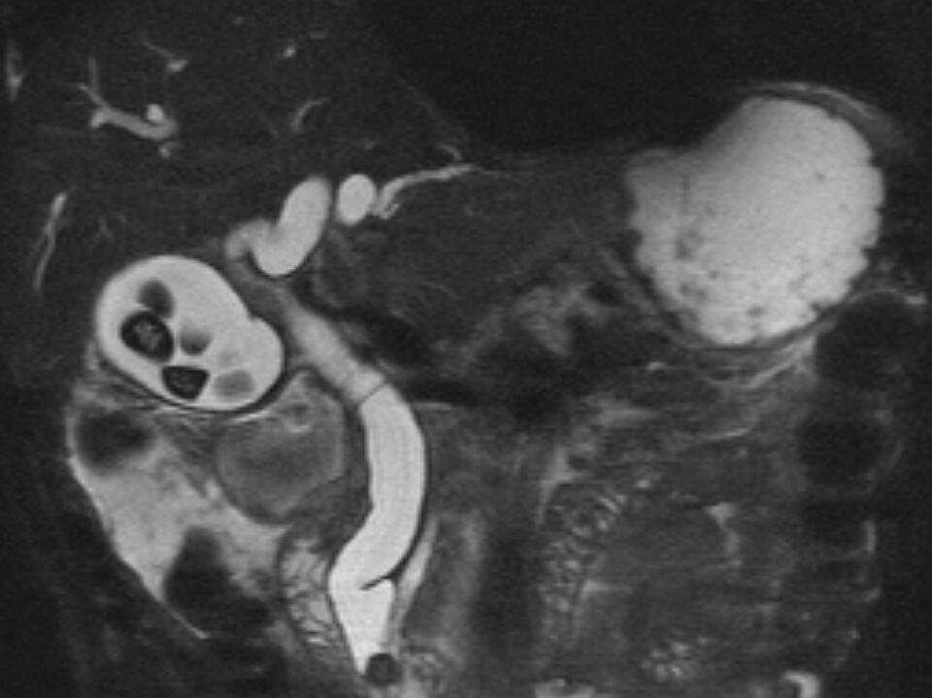
MRCP = MRI Cholangio-Pancreatico-graphy
The dark signals in the gallbladder = stones
The dark signal in the distal CBD is stone

Slide 38
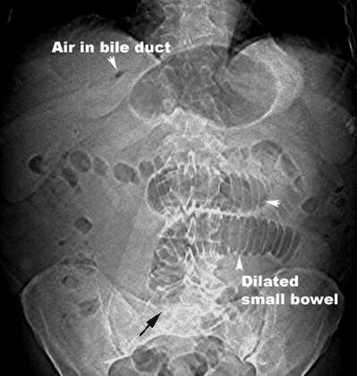
Triad:
Air in the bile ducts, Pneumobilia.
Dilatation of the small bowel.
Calcified stone in the distal bowel.
Triad of ? diagnosis

Slide 39
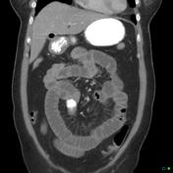
Gallstone Ileus
Diagnosis by Radiology
Treatment by Surgery

Slide 40
