Slide 1
UROGENITAL TRACT IMAGING Interactive session
Dr. Husain Alturkistani
Assistant Professor & Consultant

Slide 2
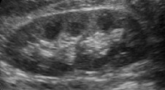
CASE (1)
Young Adult presented with right loin pain and microscopic hematuria. Ultrasound Exam was performed.
Which of the following is the likely finding?
a- Hydronephrosis
b- Normal
c- Renal mass
d- Upper pole renal stone

Slide 3
CASE (1)
Young Adult presented with right loin pain and microscopic hematuria. Ultrasound Exam was performed.
Which of the following is the likely finding?
a- Hydronephrosis
b- Normal
c- Renal mass
d- Upper pole renal stone

Slide 4
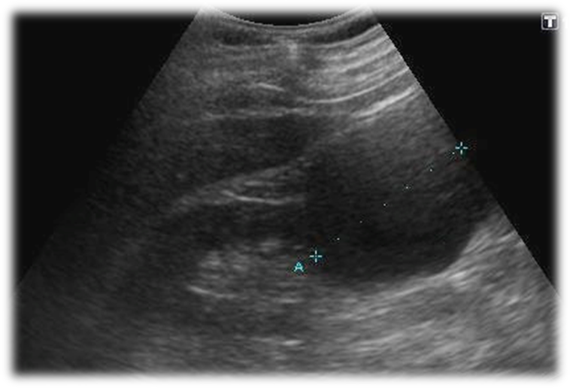
Case (2)
Young Adult presented with right loin pain. Ultrasound Exam was performed.
Which of the following is the likely finding?
a- Normal
b- Hydronephrosis
c- Renal cyst
d- Lower pole renal stone

Slide 5
Case (2)
Young Adult presented with right loin pain. Ultrasound Exam was performed.
Which of the following is the likely finding?
a- Normal
b- Hydronephrosis
c- Renal cyst
d- Lower pole renal stone

Slide 6
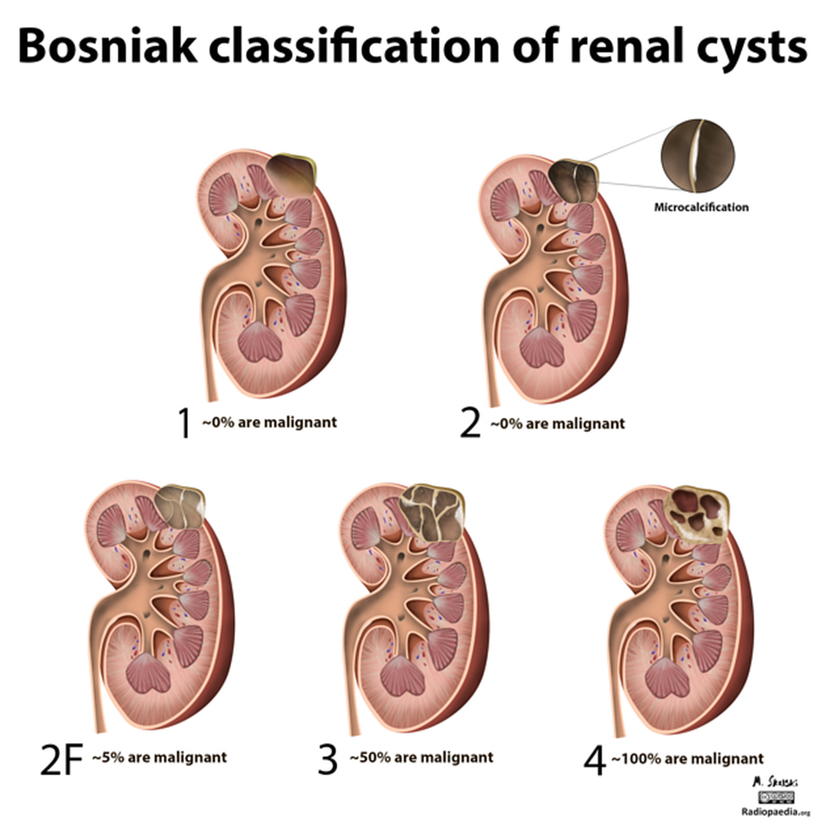

Slide 7
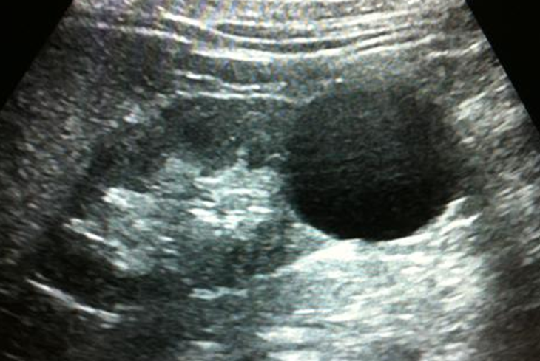

Slide 8
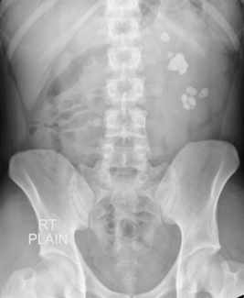
Case (3)
29 y/o female presented to the ER c/o sudden acute left flank pain radiated to the groin associated with hematuria
What is the name of the exam presented?
a- IVU
b- KUB
c- Double contrast exam
d- Single contrast exam

Slide 9
Case (3)
29 y/o female presented to the ER c/o sudden acute left flank pain radiated to the groin associated with hematuria
What is the name of the exam presented?
a- IVU
b- KUB
c- Double contrast exam
d- Single contrast exam

Slide 10
Case (3)
29 y/o female presented to the ER c/o sudden acute left flank pain radiated to the groin associated with hematuria
What is the major finding?
a- Renal mass
b- Renal cyst
c- Renal stone
d- Renal hemorrhage

Slide 11
Case (3)
29 y/o female presented to the ER c/o sudden acute left flank pain radiated to the groin associated with hematuria
What is the major finding?
a- Renal mass
b- Renal cyst
c- Renal stone
d- Renal hemorrhage

Slide 12
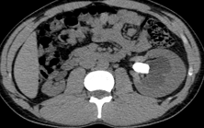
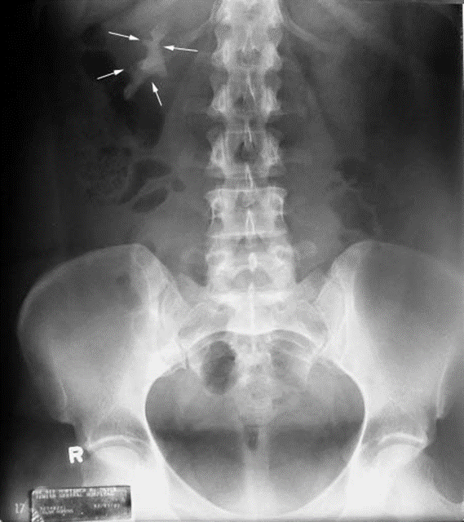

Slide 13
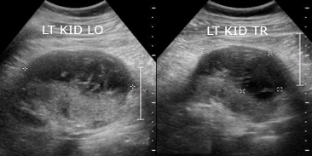
Case (4)
36 y/o male presented to the ER c/o acute sudden left flank pain radiated to the groin associated with hematuria post RTA. US was performed.
What is the major finding?
a- Renal mass
b- Renal cyst
c- Renal abscess
d- Renal hemorrhage

Slide 14
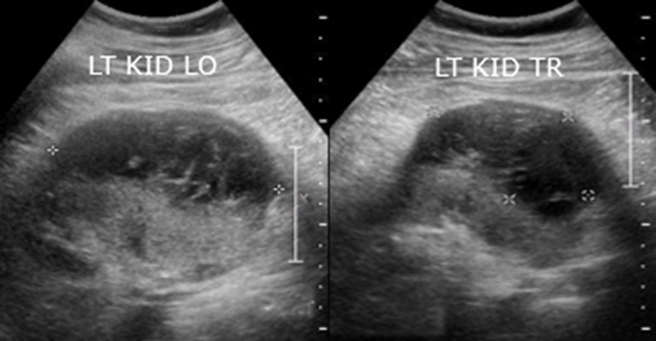
Case (4)
36 y/o male presented to the ER c/o acute sudden left flank pain radiated to the groin associated with hematuria post RTA. US was performed.
What is the major finding?
a- Renal mass
b- Renal cyst
c- Renal abscess
d- Renal hemorrhage

Slide 15
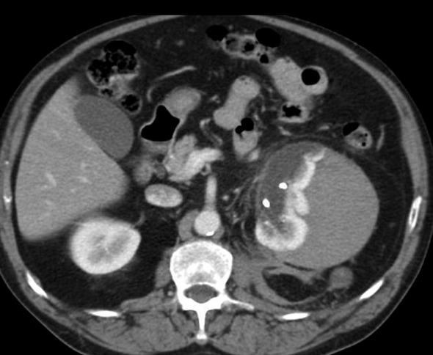
SUBCAPSULAR RENAL HAEMATOMA

Slide 16
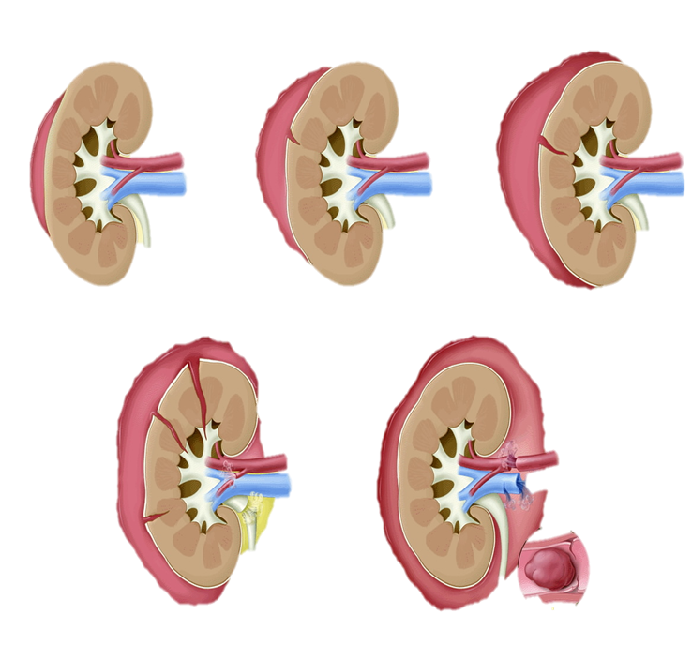
Grade 1 Grade 2 Grade 3
Grade 4 Grade 5

Slide 17
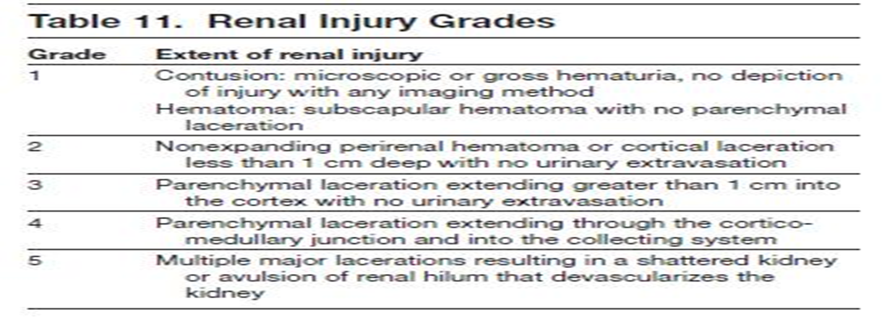

Slide 18
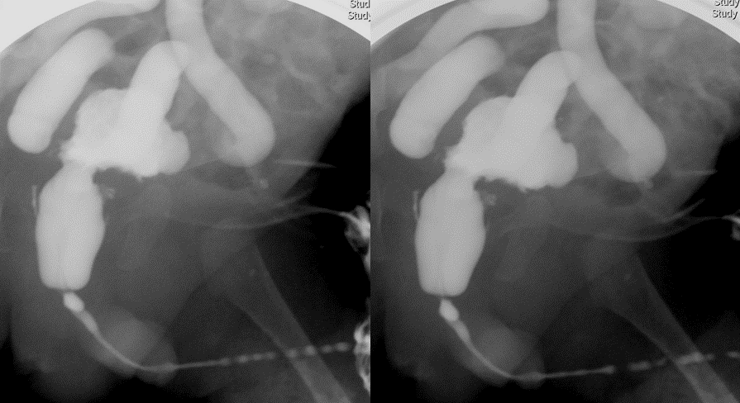
Case (5)
One month old boy with recurrent UTI.
What type of imaging is this?
a- Intravenous urography (IVU)
b- CT with IV contrast
c- Voiding cystourethrogram
d- scintigraphy

Slide 19
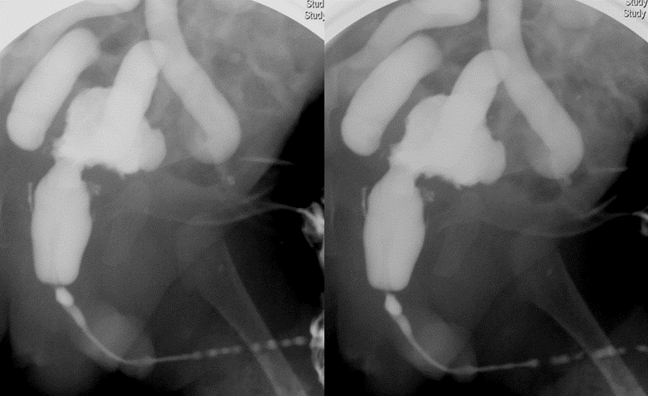
Case (5)
One month old boy with recurrent UTI.
What type of imaging is this?
a- Intravenous urography (IVU)
b- CT with IV contrast
c- Voiding cystourethrogram
d- scintigraphy

Slide 20
Case (5)
One month old boy with recurrent UTI.
What is the abnormality seen?
a- Normal VCUG
b- Vesico-colonic fistula
c- Beaded urethral strictures
d- Vesicoureteric reflux

Slide 21
Case (5)
One month old boy with recurrent UTI.
What is the abnormality seen?
a- Normal VCUG
b- Vesico-colonic fistula
c- Beaded urethral strictures
d- Vesicoureteric reflux

Slide 22
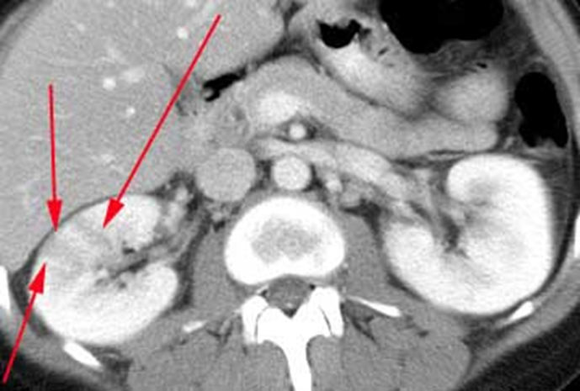
Case (6)
31 y/o female patient came to ER with high grade fever, right flank pain and vomiting. In addition, she has urinary frequency since 3 days.
What is this imaging modality?
a- MRI with contrast
b- MRI without contrast
c- CT with contrast
d- CT without contrast

Slide 23
Case (6)
31 y/o female patient came to ER with high grade fever, right flank pain and vomiting. In addition, she has urinary frequency since 3 days.
What is the most likely clinical diagnosis?

Slide 24
Case (6)
31 y/o female patient came to ER with high grade fever, right flank pain and vomiting. In addition, she has urinary frequency since 3 days.
What is the most likely clinical diagnosis?
Pyelonephritis

Slide 25
Case (6)
31 y/o pregnant patient came to ER with high grade fever, right flank pain and vomiting. In addition, she has urinary frequency since 3 days.
What is this imaging modality?
a- MRI with contrast
b- MRI without contrast
c- CT with contrast
d- CT without contrast

Slide 26
Case (6)
31 y/o pregnant patient came to ER with high grade fever, right flank pain and vomiting. In addition, she has urinary frequency since 3 days.
How do you describe this abnormality?
A- cortical mass
B- pelvicalicial dilatation
C- hypo perfused lesion
D- perirenal hematoma

Slide 27
Case (6)
31 y/o pregnant patient came to ER with high grade fever, right flank pain and vomiting. In addition, she has urinary frequency since 3 days.
How do you describe this abnormality?
A- cortical mass
B- pelvicalicial dilatation
C- hypo perfused lesion
D- perirenal hematoma

Slide 28
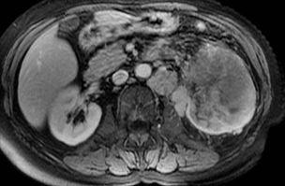
Case (7)
76 y/o male patient presented with painless hematuria and weight loss.
How do you describe this lesion?

Slide 29
Case (7)
76 y/o smoker male patient presented with painless hematuria and weight loss.
What is the most likely diagnosis?
A- pyelonephritis
B- renal adenocarcinoma
C- transitional cell carcinoma
D- angiomyolipoma

Slide 30
Case (7)
76 y/o male patient presented with painless hematuria and weight loss.
What is the most likely diagnosis?
A- pyelonephritis
B- renal adenocarcinoma
C- transitional cell carcinoma
D- angiomyolipoma

Slide 31
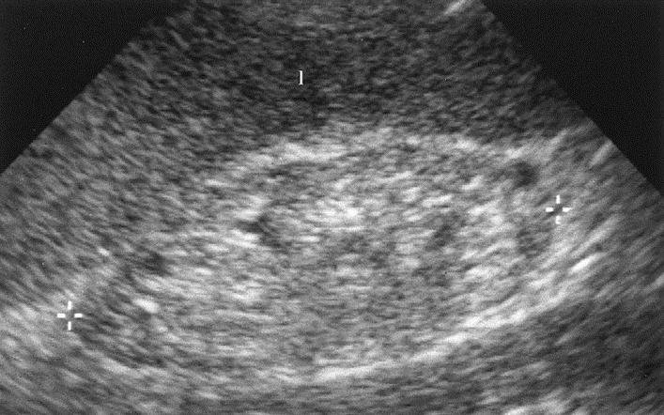
Case (8)
81 y/o female diabetic patient came to clinic with general fatigue, itching, loss of appetite and easy bruising. Initial lab works show a creatinine level of 180 Umol/L.
What does US show?
A- normal kidney
B- hypoechogenic kidney
C- atrophic undifferentiated kidney
D- atrophic kidney with normal
cortico-medullary differentiation
7 cm

Slide 32
Case (8)
81 y/o female diabetic patient came to clinic with general fatigue, itching, loss of appetite and easy bruising. Initial lab works show a creatinine level of 180 Umol/L.
What does US show?
A- normal kidney
B- hypoechogenic kidney
C- atrophic undifferentiated kidney
D- atrophic kidney with normal
cortico-medullary differentiation
7 cm

Slide 34
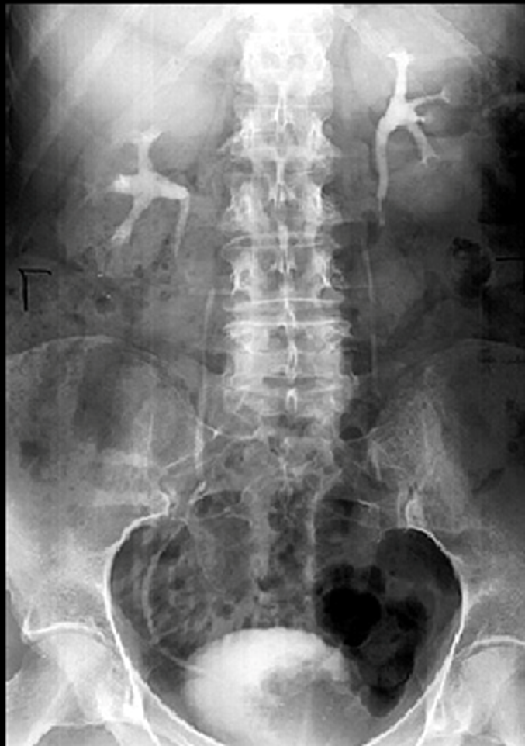
Case (9)
67 y/o male patient came to ER with worsening hematuria.
What is this exam?
A- KUB
B- IVP
C- CT: coronal section
D- scintigraphy

Slide 35
Case (9)
67 y/o male patient came to ER with worsening hematuria
What is this exam?
A- KUB
B- IVP
C- CT: coronal section
D- scintigraphy

Slide 36
Case (9)
67 y/o male patient came to ER with worsening hematuria
What is the major finding?
A- normal
B- left pelvicalicial dilatation
C- right ureteral dilatation
D- filling defect in urinary bladder

Slide 37
Case (9)
67 y/o male patient came to ER with worsening hematuria
What is the major finding?
A- normal
B- left pelvicalicial dilatation
C- right ureteral dilatation
D- filling defect in urinary bladder

Slide 38
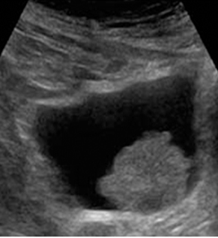

Slide 39
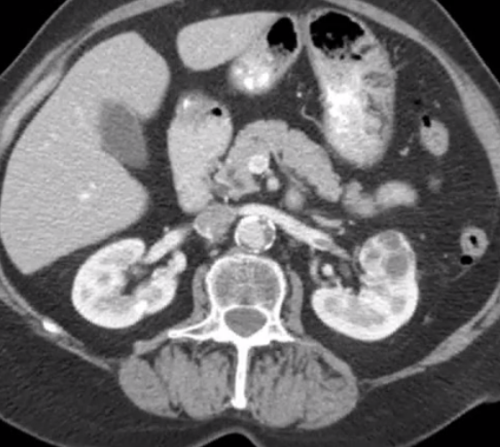
Case (10)
73 y/o female came with painless hematuria & general fatigue
What is the major finding?
A- Bosniak type II renal cyst
B- malignant tumor
C- focus of pyelonephritis
D- normal

Slide 40
Case (10)
73 y/o female came with painless hematuria & general fatigue
What is the major finding?
A- Bosniak type II renal cyst
B- malignant tumor
C- focus of pyelonephritis
D- normal

Slide 41
Case (10)
73 y/o female came with painless hematuria & general fatigue
What other secondary finding do you observe?
A- perirenal hemorrhage
B- mass effect on pancreas
C- renal vein filling defect
D- pelvicalicial dilatation

Slide 42
Case (10)
73 y/o female came with painless hematuria & general fatigue
What other secondary finding do you observe?
A- perirenal hemorrhage
B- mass effect on pancreas
C- renal vein filling defect
D- pelvicalicial dilatation

Slide 43
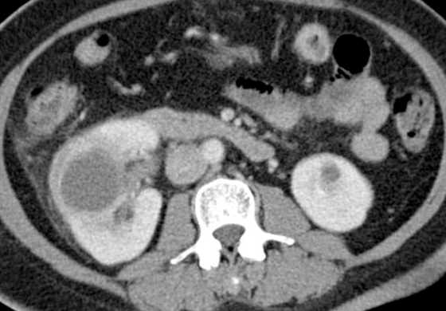
Case (11)
Middle aged diabetic male patient came to ER with a history of worsening fever and right abdominal pain since 2 weeks
How do you describe the lesion in right kidney?

Slide 44
Case (11)
Middle aged diabetic male patient came to ER with a history of worsening fever and right abdominal pain since 2 weeks
What is the most likely diagnosis in the right kidney?
A- pyelonephritis
B- renal abscess
C- simple cyst
D- pelvicalicial dilatation

Slide 45
Case (11)
Middle aged diabetic male patient came to ER with a history of worsening fever and right abdominal pain since 2 weeks
What is the most likely diagnosis in the right kidney?
A- pyelonephritis
B- renal abscess
C- simple cyst
D- pelvicalicial dilatation

Slide 46
The first preliminary imaging modality in emergency department for a renal colic patient to generally assess renal stones is one of the following:
A- Intravenous urography (IVU)
B- Plain X-ray (KUB)
C- CT scan
D- ultrasound

Slide 47
The first preliminary imaging modality in emergency department for a renal colic patient to generally assess renal stones is one of the following:
A- Intravenous urography (IVU)
B- Plain X-ray (KUB)
C- CT scan
D- ultrasound

Slide 48
One of the following is a common site of urinary stone obstruction:
A- proximal ureter
B- mid ureter
C- junction of mid-distal ureter
D- vesico-ureteric junction

Slide 49
One of the following is a common site of urinary stone obstruction:
A- proximal ureter
B- mid ureter
C- junction of mid-distal ureter
D- vesico-ureteric junction

Slide 50
One of the following is a relative contraindication for CT with contrast :
A- intracranial aneurysm clip
B- renal failure
C- cardiac pacemaker
D- high grade fever

Slide 51
One of the following is a relative contraindication for CT with contrast :
A- intracranial aneurysm clip
B- renal failure
C- cardiac pacemaker
D- high grade fever

Slide 52
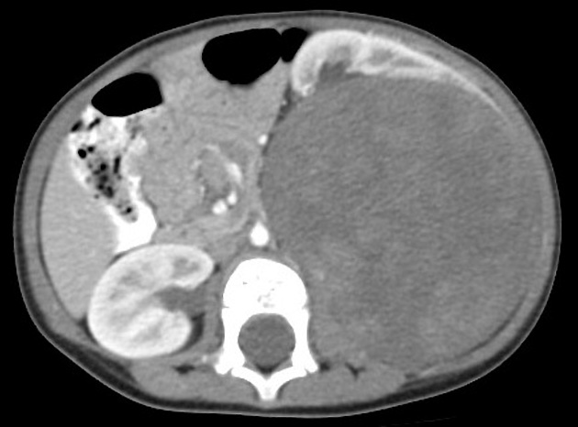

Slide 53
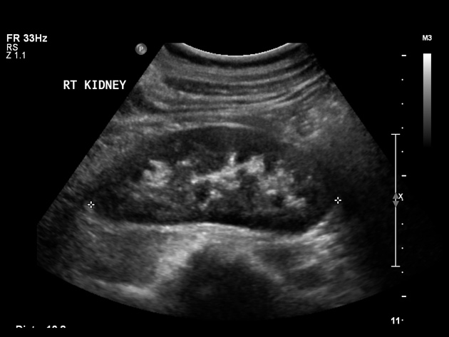

Slide 54
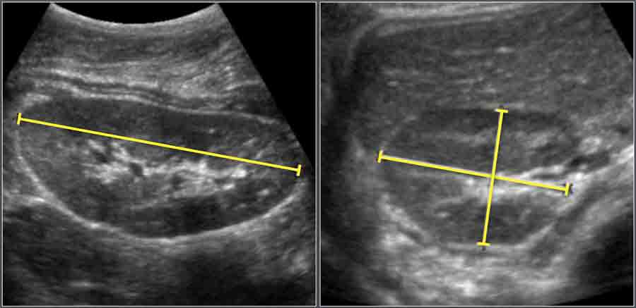

Slide 55
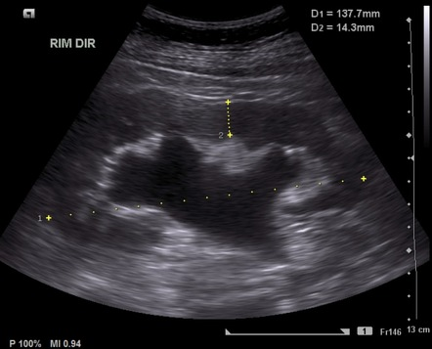

Slide 56
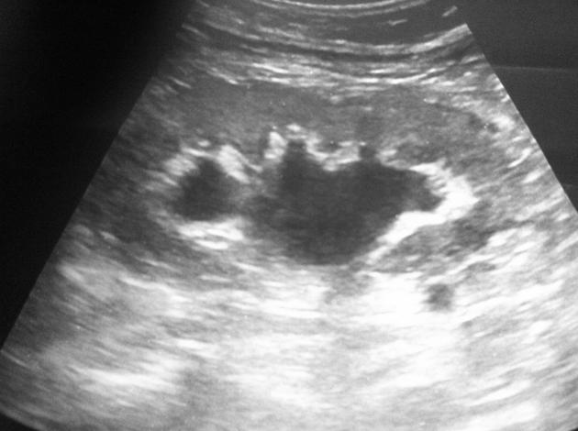

Slide 57
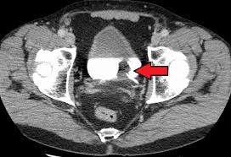

Slide 58
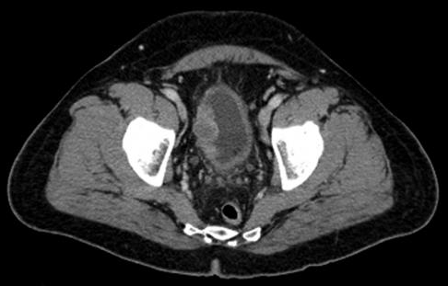

Slide 59
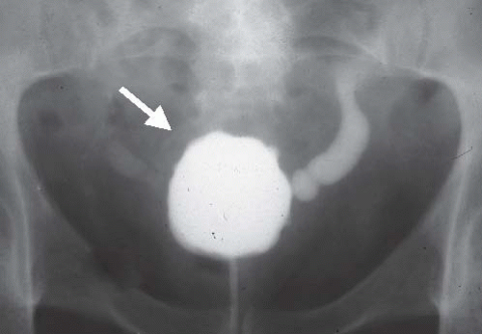

Slide 60
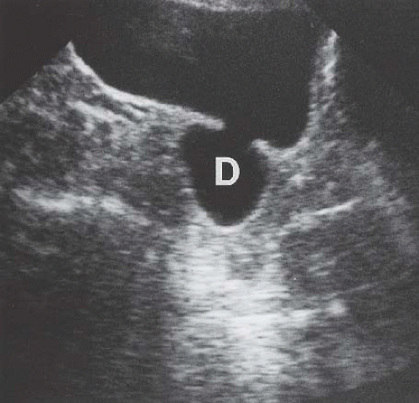

Slide 61
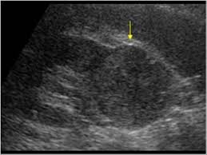

Slide 62
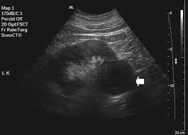

Slide 63
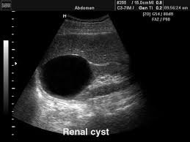

Slide 64
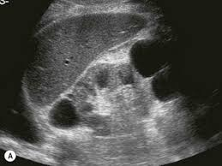

Slide 65
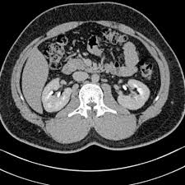

Slide 66
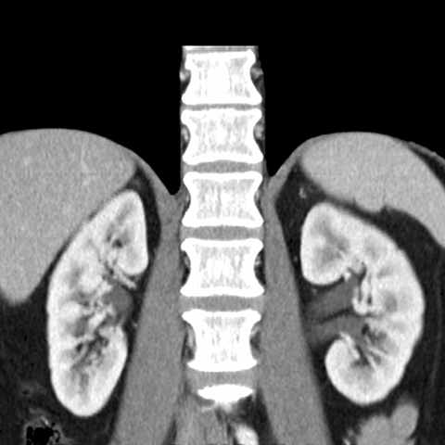

Slide 67
Thank you

