Slide 1
CMED 305 course Orientation
&
Introduction to Research
Dr.Shaik Shaffi Ahamed Ph.D.,
Professor
Department of Family & Community Medicine
College of Medicine, King Saud University
September, 2019

Slide 2
Introduction to Course
Course Objectives
The overall objectives of this course are to enable students understand & learn the basic elements of research, its design and conduct an epidemiological research study to answer a specific research question of interest.

Slide 3
Learning Methods for the course
  Course Units: ~ 6 academic credits
  Learning methods over the academic year include
  lectures ( ~ 28 contact hours),
  tutorials (~ 30 contact hours), &
  research group works with supervisor ( ~ 38 hours).
    Self initiative and learning is needed from students for a good outcome

Slide 4
Course Concepts taught in lectures & tutorials
How to formulate a research question and development of a study protocol
Designing of an epidemiological study
Ethics in research and avoiding plagiarism
Biostatistics concepts and skills in data management & analysis
Data interpretation, presentation of study findings

Slide 5
Focus on the entire process of concepts taught in lectures & tutorials to link with a research topic.

Slide 6
Group Meetings with Research Supervisor
The Research Supervisor, who is a faculty or expert in the research & specific topic of interest, will help you to choose research topic, formulate the research question and also supervising towards:
-the development of protocol,
-monitor the conduct of study,
-using appropriate scientific & ethical methods

Slide 7
Supervisor Selection
Based on your topic of interest
Initiated during the first week of classes & to complete at the most by the end of first 2 weeks of the first semester.
Important points for selection of supervisor are:
  availability,
  time commitment,
  conforming to schedule, and
  communication methods.
  Change in topic and supervisor is time constrained and usually leads to incomplete work, missing deadlines which will affect the final grades. Hence careful selection of topic and supervisor is important.

Slide 8
Supervisor Agreement Form & Supervisor’s research activity form
It is in your manual; Copy, fill it as a group, and explore your interest and supervisor
Copy it and get it signed and submit at the Support Staff at Department of Family & Community Medicine 2nd floor
Ms Sharmina for Female groups
Mr. Bader / Mr. Ali for Male groups

Slide 9
Formation of Research Group
4-6 students per group.
Males and females will make separate groups.
The supervisor - supervisee relationship needs to be strengthened with mutually accepted expectations on both sides.
The supervisor provides quality time, while students are expected to observe discipline, give respect and express maximum learning attitude.

Slide 10
List of Potential Departments for Selecting Research Supervisors
Anesthesia;
Cardiac Sciences;
Dermatology;
Emergency Medicine;
ENT;
Family & Community Medicine.
Medical Education;
Medicine;
Obs-Gynecology;
Ophthalmology;
Orthopedics;
Pediatrics;
Pharmacology;
Psychiatry;
Physiology;
Radiology;
Surgery;
Sections & Centers of Research at KSU

Slide 11
Source of data for research study
Preference should be given for primary data
-- From Community ( general population)
-- From outpatients and inpatients of any hospital
-- From the schools and colleges
-- From Government organizations and Industries
For secondary data --- ???????????? ( least preferred)
-- From Medical records,
Registries of Cancer and Diabetes etc.,

Slide 12
Read Your Manual Carefully
All information in details is present in Manual
Responsibilities of supervisors and students
Guidelines to develop protocol and report
Guidelines for collaboration within and outside KSU
Assessment Methods
Evaluation forms that will be used by supervisors and Ethical Review Committee

Slide 13
Submission Dates and Deadlines
Title of document / Form | Dates
Supervisor Agreement Form & Supervisor’s Research activity form | September 19, 2019
Study title, question, objectives, hypothesis, and study design | September 26, 2019
Protocol Submission for Ethical Review Committee | October 31, 2019
Evaluation by Supervisor (Form A) | October 31, 2019
Final manuscript submission | March 31, 2020
Evaluation by Supervisor (Form B) | March 31, 2020

Slide 14
Assessment of Students & Marks Distribution
I. Examinations (40%)
  1. Midterm: 15%
  2. Final exam: 25%
II. Continuous Assessment (60%)
1. Research Project (40%):
    For Research protocol by supervisor (10%);
    For Research protocol by Ethical Review Committee Clearance (5%);
    For Final manuscript by supervisor (10%); & CM unit review committee ( 10%);
    For Oral Presentation by assigned evaluators (5%);
2. Other (20%):
    Assignments (10%); Quizzes (10%) – in Research methodology & Biostatistics

Slide 15
Introduction to Research
Why do we need research?
Session Objectives
What is Research ? & Epidemiological research ?
Why is research important ?
How to start a research project ?
What is a criteria of a research project ?
What is the outline of a research protocol ?

Slide 16
Learning objectives:
At the end of this session, students will be able to:
1. Recognize benefits of engaging medical students in health research.
2. Define what is ' Research' & ‘Epidemiological research’
3. List the major characteristics of research.
4. Describe the main components of a research process.

Slide 17
What is “Research”
Research is an Endeavour to discover answers to intellectual and practical problems through the application of scientific method.
Research is the systematic process of collecting and analyzing information (data) in order to increase our understanding of the phenomenon about which we are concerned or interested.

Slide 18
SCIENTIFIC METHOD
Scientific method is the systematic collection of data (facts) and their theoretical treatment through proper observation, experimentation and interpretation.

Slide 19
Epidemiology
The study of the distribution and determinants of health in humans
It is the science of the occurrence of disease in human populations

Slide 20
… distribution and determinants…
Distribution
‘What’ (the disease), plus ‘when’ + ‘where’ + ‘who’
or the disease described by TIME + PLACE + POPULATION
Determinants
The ‘Why’
= the ‘causes’, or risk factors

Slide 21
… distribution and determinants…
Distribution
What, when, where, who
    Descriptive studies
Determinants
‘Why’
What is associated with/ caused by
    Analytic studies
    Interventive studies

Slide 22
Population
“a group sharing certain common characteristics”
Do not have to be people (most often are)
Does need to be clearly defined and specified

Slide 23
Pace of Change in Medicine
Changing patterns of diseases
Demographic transition & longevity
Variation in patient population and clinical care in various geographical regions differs for many reasons

Slide 24
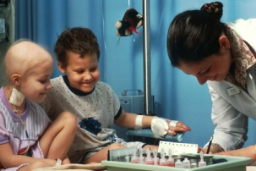
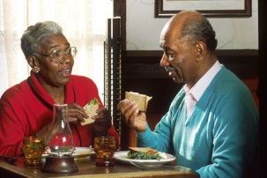

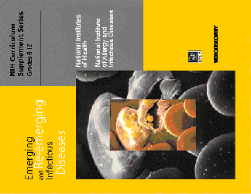
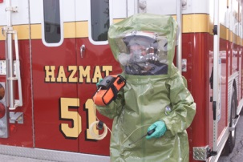
GLOBAL Public Health Challenges
Acute to Chronic Conditions
Aging Population
Health Disparities
Emerging and Re-emerging infectious Diseases
Emerging Non communicable diseases

Slide 25
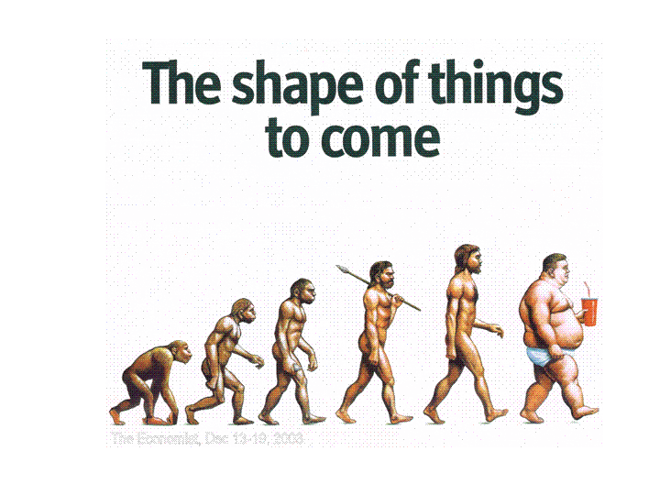

Slide 26
Obesity: A Worldwide Issue
Cancer
Athero-
scleroris
Hyper-
tension
Gall-
bladder
Disease
Obesity Health Risks
Kidney
Failure
Heart
Failure
Stroke
Diabetes

Slide 27
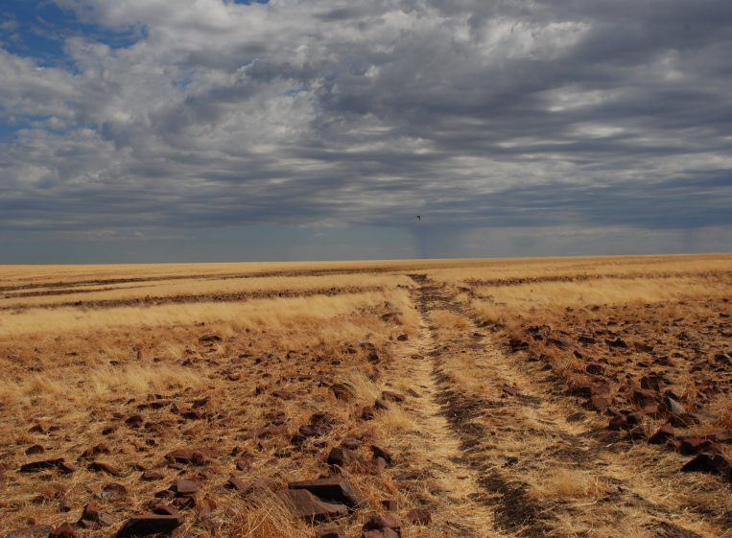

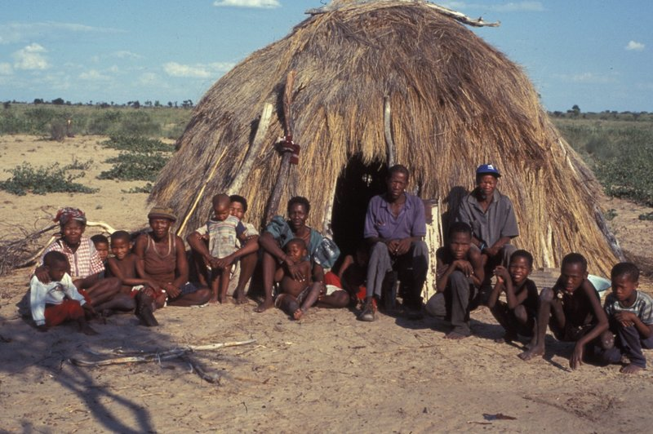
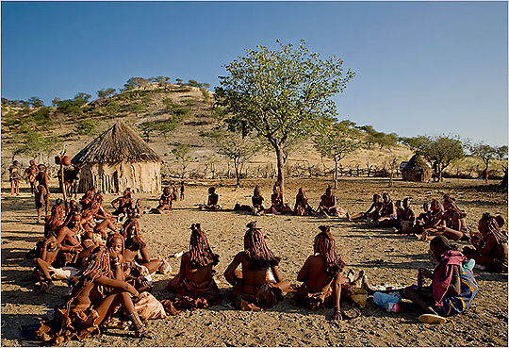

Slide 28
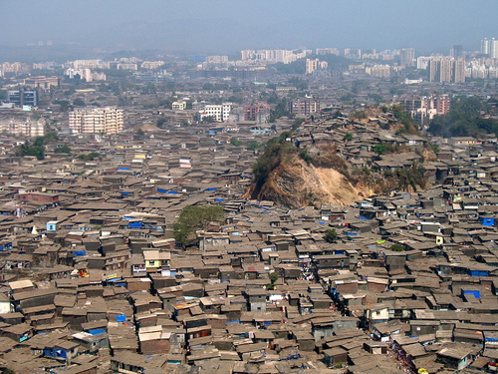
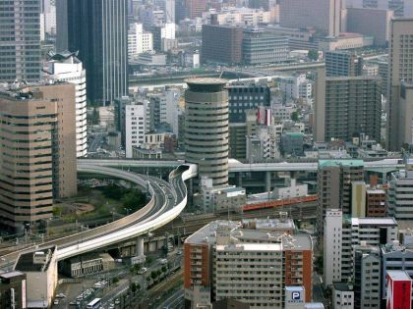
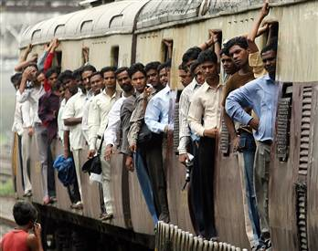

Slide 29
MODEL OF THE RELATIONSHIP BETWEEN DIFFERENT TYPES OF RESEARCH
Epidemiological
Biomedical
Policy making,
planning,
Management
evaluation
Health
systems
research
Statistical
Behavioral
Social &
economic

Slide 30
Causal model of risk factors for CVD
Morbidity and Mortality
(Stroke, MI)
Biological Risk Factors
(Hypertension, Blood Lipids, Homocysteine)
Genetic Risk Factors
(Family History)
Behavioral Risk Factors
(Cigarette, Diet, Exercise)
Environmental Factors
(Socioeconomic Status, Work Environment)
Notes:
30
30

Slide 31
‘How To Do’ Research
Start with defining the question
Write down a clear aim
Divide the problem into smaller, answerable questions

Slide 32
‘How To Do’ Research
Develop hypotheses
Decide what data is needed to test the hypotheses
Refine the above and check the line of thought

Slide 33
Good Research
CLEAR
  Essential for both the problem and the answer
ACCURATE
  Exactness and precision come from hard work and responsible effort
RELIABLE
  If repeated will the answer be the same?

Slide 34
CRITERIA OF A GOOD RESEARCH
Purpose clearly defined.
Research process detailed.
Research design thoroughly planned.
High ethical standards applied.
Limitations openly revealed.
Adequate analysis for decision maker’s needs.
Findings presented unambiguously.
Conclusions justified.

Slide 35
Getting Started
Learn your subject
Read, Read, Read
Start general and then focus
Begin with the problem

Slide 36
RESEARCH PROCESS
Review the literature
Review
Concepts
And
theories
Design
Research
(Including
Sample
Design)
Analyse
Data
(Test
Hypothesis
if any)
Formulate
hypothesis
Collect
Data
(Execution)
Interpret
and
report
Define
Research
Problem
Review
Previous
Research
findings
I
III
IV
V
VI
VII
II

Slide 37
THERE ARE ONLY A HANDFUL OF WAYS TO DO A STUDY PROPELY BUT A THOUSAND WAYS TO DO IT WRONG ---
Sackett (1986)

Slide 38
Protocol Development
Research Question
Hypotheses
Objectives
Background
Design
Subjects
Variables
Data Collection
Quality control
10. Data Management
11. Sample size
12. Plan of Analysis
13. Ethical issues
14. Budget
15. Report results
16. Institution capacity
17. Administration
18. Work Plan

Slide 39
References
Stephen B Hulley. Designing Clinical Research. Chapter 1 . Getting Started: The Anatomy and Physiology of Clinical Research . Pages 3-15. 3rd Edition . Wolters Kluwer Health Lippincott Williams and Wilkins 2007
Daniel P Schuster & William J Powers. Translational and Experimental Clinical Research. Introduction: The value of Translational and Experimental Clinical Research. Pages: xv-xxi Lippincott Williams and Wilkins 2005

