Slide 1
CMED 305
Introduction to Study Designs
Nurah Alamro, MD. MPH. DrPH.
Assistant Professor - Community Medicine Unit, Family & Community Medicine Department
nmalamro@ksu.edu.sa

Slide 2
Learning Objectives: By end of this session students will be able to:
List differences between descriptive and analytical study designs
Describe main types of study designs and their uses
Identify different study designs with examples

Slide 3
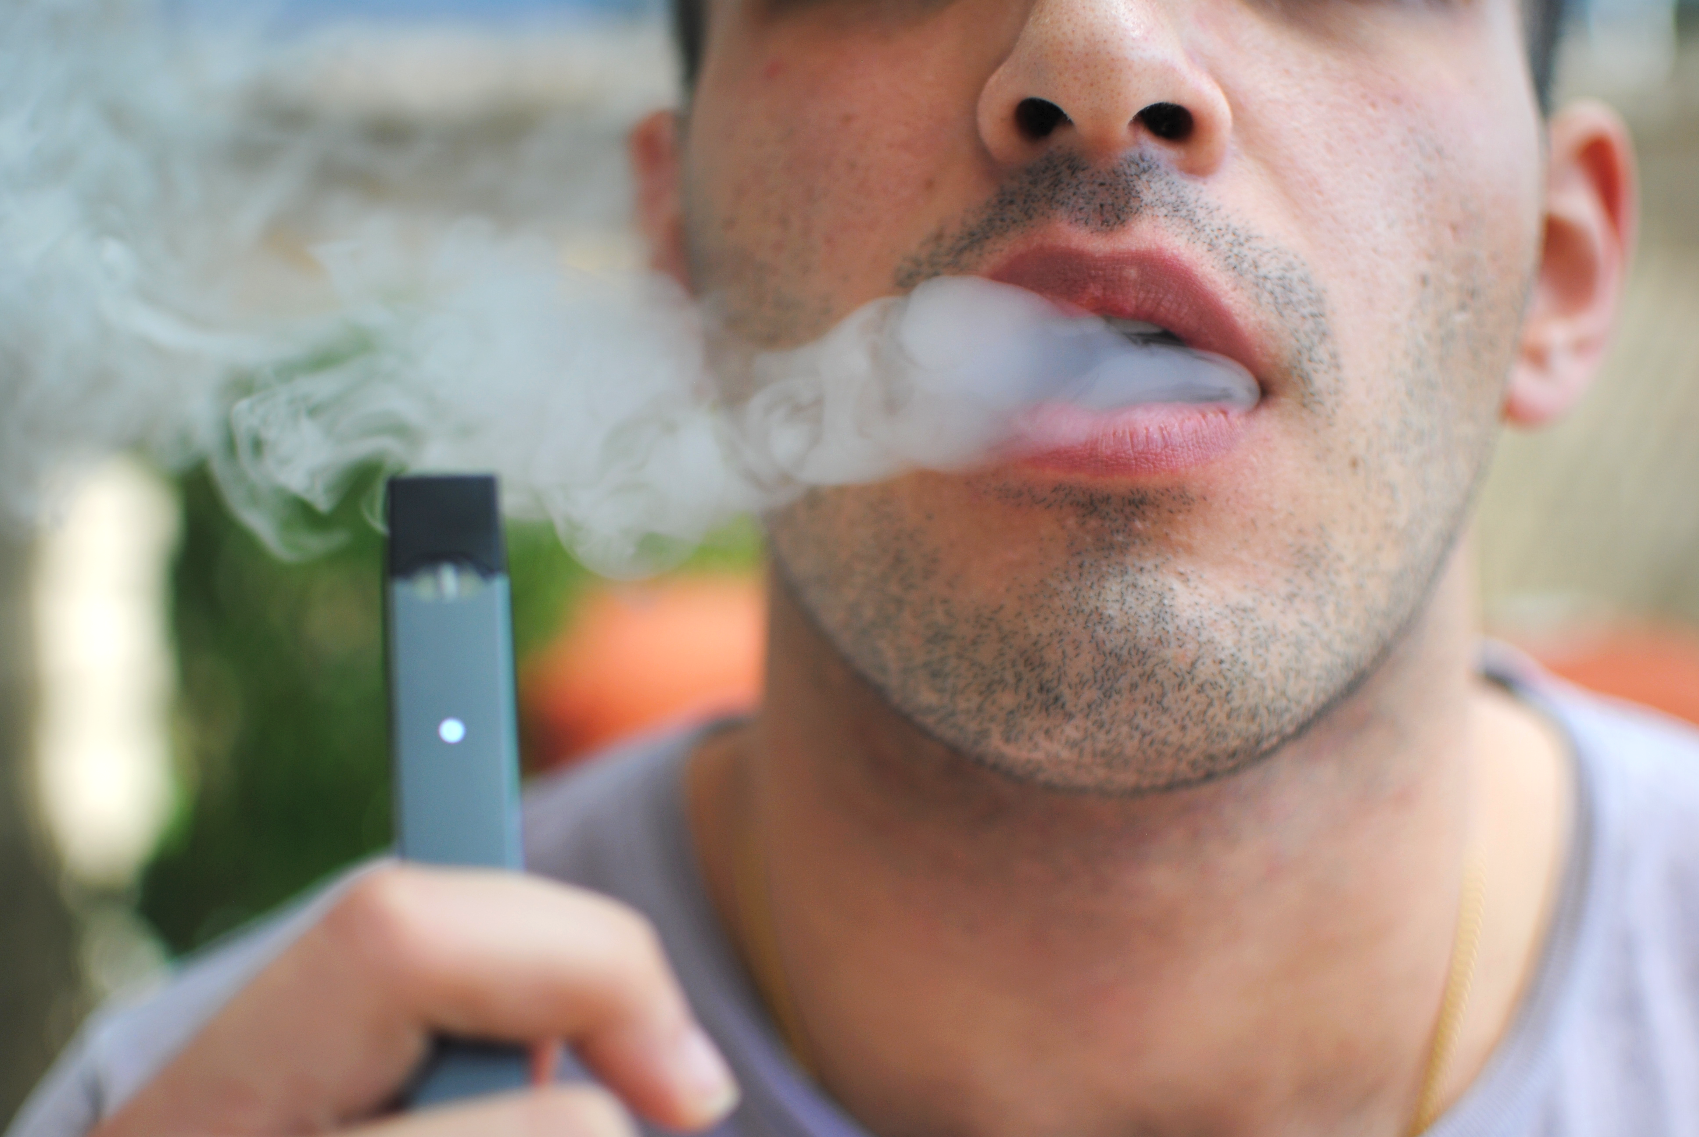

Slide 4
1
Study Design: Definition & The Five Ws

Slide 5
A study design is a detailed plan or approach for systematically collecting, analyzing, and interpreting data; it is a formal approach of scientific investigation.

Slide 6
The Five Ws of Epidemiological Studies
What = Diagnosis or Clinical Information
Who = Person
Where = Place
When = Time
Why / How = Causes / Risk Factors /
Mode of Transmission
Descriptive Studies
Analytical Studies
Notes:
Study designs in epidemiology are classified as either descriptive or analytic. Descriptive epidemiologic studies are used to assess and monitor the health of communities and identify health problems and priorities according to person, place, and time. Descriptive epidemiologic studies also lend support to more definitive evaluation using analytic methods. Analytic epidemiologic study designs employ comparison groups and are used to test one or more predetermined hypotheses about associations between exposure and outcome variables. Analytic epidemiology provides information on how and why a health-related state or event occurred.
We study what, who, where, and when, or in other words, clinical data plus person, place, and time informa- tion, through descriptive epidemiology, which investigates the distribution of diseases or conditions.
We study why and how, or in other words, causes, risk factors, and modes of transmission, through analytic epidemiology, which investigates the determinants of diseases or conditions.
.

Slide 7
2
The Study “Design Tree”

Slide 8
Remember PICOT ?
ALL research questions (Descriptive AND Analytical) have the below similar components:
A defined population (P) from which groups of subjects are studied
Outcomes (O) that are measured
Time (T) frame
ANALYTICAL research questions have the additional two components:
Intervention (I) that is applied to a groups of subjects
Comparison (C) group without the intervention
Notes:
Research question facilitates study design selection! Remember from our last lecture.

Slide 9
Remember??
clear research question facilitates choosing the optimal study design

Slide 10
All Studies
The study “designs tree”
Descriptive (PO)
Analytical (PICO)
Case report
Experimental
Observational
Case series
Randomized Clinical Trials (RCTs)
Group data
Individual
Cross-sectional (survey)
Ecological study
Cross-sectional (analytical)
Qualitative
Cohort
Case-Control
Notes:
Research question facilitates study design selection! Remember from our last lecture.

Slide 11
All Studies
Generates Hypotheses
Descriptive (PO)
Analytical (PICO)
Tests Hypotheses
Case report
Experimental
Observational
Case series
Randomized Clinical Trials (RCTs)
Group data
Individual
Cross-sectional (survey)
Ecological study
Cross-sectional (analytical)
Qualitative
Cohort
Case-Control
Notes:
Research question facilitates study design selection! Remember from our last lecture.

Slide 12
Whether a study is hypothesis-testing or hypothesis-generating depends on:
The sequence of past studies; and
The present state of knowledge (i.e., whether a hypothesis currently under evaluation was suggested by a previous study).

Slide 13
Sequence of Study Design
Increasing Knowledge of Exposure / Outcome (Strength of Evidence)
Descriptive
Analytical – Observational
CASE-CONTROL
Analytical – Observational
COHORT
Analytical – Experimental
RCT
Identifying hypotheses to test in analytic studies
Evaluate if the hypothesized exposure is related to the outcome of interest
Further define the importance of exposure for the development of the outcome
Test the actual link between exposure and outcome. i.e. Causality
Notes:
To further illustrate, if one seeks to identify the etiologic factors (e.g. causal factors) behind an outcome (e.g. an MI), then each step in the epidemiologic framework provides new and important information.
Descriptive studies are useful for identifying hypotheses to test in analytic studies. Case-control studies are then usually applied to evaluate if the hypothesized exposure is related to the outcome of interest. Subsequently, cohort or longitudinal studies are applied to further define the importance of exposure to the causal agent for the development of the outcome.

Slide 14
Two IMPORTANT DISTINCTIVE Factors in Study Designs:
1- Quantification of Relationship between Exposure and Outcome
2- Researcher Assignment (Manipulation) of Exposure
No
Descriptive
Quantification of the relationship
Assignment of the Exposure by Researcher
Yes
Experimental (RCT)
Yes
Analytical
No
Observational

Slide 15
3
Types of Studies: Uses, Comparisons and Examples

Slide 16
 | Descriptive Studies
Study Design | Case Report | Case-Series | Cross-Sectional (Survey) | Qualitative
Study Population | Single case | Collection of similar cases | Single sample from larger population – No comparison | Process of naturalistic inquiry that seeks in-depth understanding of phenomena within their natural setting (Individual, societies, languages)
Primary Use | Detailed report of the symptoms, signs, diagnosis, treatment, and follow-up of an individual patient. Typically an unusual/novel occurrence | Detailed report of the symptoms, signs, diagnosis, treatment, and follow-up of a group of patients or cases with similar issue. | Study prevalence of health related events at a point in time/snapshot Often used to study conditions that are relatively frequent with long duration of expression (nonfatal, chronic conditions) | Answers the 'why?' questions
Advantages | Detecting novelties Generating hypotheses Allowing in-depth understanding Educational value | Useful for hypothesis generation Informative for very rare disease with few established risk factors | Cheap and simple. Ethically safe. | Provides depth and detail Creates openness Simulates people’s individual experiences
Dis-advantages | Lack of ability to generalize No possibility to establish cause-effect relationship Publication bias | Cannot study cause and effect relationships Cannot assess disease frequency | Not suitable for studying rare or highly fatal diseases or a disease with short duration | Usually fewer people studied Less easy to generalize Dependent on skills of the researcher

Slide 17
Analytical Studies
 | Experimental | Observational
Data Level | Individual Data | Group Data | Individual Data
Study Design | RCT | Ecological | Cross-Sectional | Cohort | Case-Control
Study Population | Highly selected population, Highly controlled environment. Allocation of exposure is made by the researcher. | Population based study (city, country, geographic area). Usually using secondary data. | Single sample from larger population – compares two groups in the sample | Two samples – Exposed group and Not Exposed. NO allocation of exposure is made by the researcher | Two samples – group With Outcome (DISEASE) and group Without Outcome (NO DISEASE)
Directionality | Exposure is assigned BEFORE Outcome is measured | Exposure and Outcome BOTH measured at the SAME TIME at POPULATION level | Exposure and Outcome BOTH measured at the SAME TIME at INDIVIDUAL level | Exposure is measured BEFORE Outcome is measured | Outcome is measured BEFORE Exposure is measured
Primary Use | Efficacy of an intervention / Causality | Screening hypotheses at population level (BE AWARE of Ecological Fallacy) | Screening hypotheses at individual level, Prevalence studies | Assessing associations between exposures and outcomes over time | Assessing associations between exposures and rare outcomes (rare diseases)
Notes:
Directionality = when exposure and outcome assigned or measured
Ecological fallacy: refers to drawing inferences incorrectly from data on groups or about individuals in the groups.
In an example, researchers found that death rates from breast cancer were significantly increased in countries where fat consumption was high when compared with countries where fat consumption was low. This is an association for aggregate data in which the unit of observation is country. Thus, in countries with more fat in the diet and higher rates of breast cancer, women who eat fatty foods are not necessarily more likely to get breast cancer. One cannot be certain that the breast cancer cases had high fat intakes.

Slide 18
Examples of Analytical Studies
Experimental - RCT
Study of a new flu vaccine
Observational –
Ecological
Compares cases of flu and air quality in two countries
Observational –
Cohort
Study of who have received flu vaccine and did they get ill
Observational –
Case-Control
Observational –
Cross-Sectional
Study of who has flu and if they were vaccinated
Study of how many cases of flu in females and males
Exposure: Flu Vaccine
Outcome: Flu

Slide 19
3
Spotting the Study Design

Slide 20
All Studies
Spotting the Study Design
Descriptive (PO)
Q1
Analytical (PICO)
Case report
Experimental
Q2
Observational
Case series
Randomized Clinical Trials (RCTs)
Group data
Individual
Q3
Cross-sectional (survey)
Ecological study
Cross-sectional (analytical)
Qualitative
Cohort
Case-Control

Slide 21
The type of study canbe spotted by looking at three issues as per the “Design Tree”:
Q1. What was the aim of the study?
To simply describe a population (PO questions) ➔ Descriptive
To quantify the relationship between exposure & outcome (PICO questions) ➔ Analytic
Q2. If analytic, was the intervention randomly allocated (assigned by the researcher)?
Yes ➔ RCT
No ➔ Observational
Q3. If Observational, When were the outcomes determined (measured)?
Some time after the exposure (intervention) ➔ Cohort study
At the same time as the exposure (intervention) ➔ Cross-sectional
Before the exposure was measured ➔ Case-Control

Slide 23
“Primary spontaneous pneumothorax is a common disorder occurring in young adults without underlying lung disease. Although tobacco smoking is a well-documented risk factor for spontaneous pneumothorax, an association between electronic cigarette use (that is, vaping) and spontaneous pneumothorax has not been noted. We report a case of spontaneous pneumothoraces correlated with vaping”
Study design: Descriptive – Case Report
Bonilla, Alex, Alexander J. Blair, Suliman M. Alamro, Rebecca A. Ward, Michael B. Feldman, Richard A. Dutko, Theodora K. Karagounis, Adam L. Johnson, Erik E. Folch, and Jatin M. Vyas. "Recurrent spontaneous pneumothoraces and vaping in an 18-year-old man: a case report and review of the literature." Journal of Medical Case Reports 13, no. 1 (2019): 1-6.

Slide 24
“Fourteen patients were treated for electronic cigarette burns between 2012 and 2016. Burn size ranged from <1% to 6% total body surface area. Most patients suffered burns to their thighs because the battery or device exploded in their pocket. The majority suffered partial thickness burns while four patients had full thickness burns. Three patients required excision and autografting, all of which were full thickness burns. The average time to recovery was 24.5 days”
Study design: Descriptive – Case Series
Gibson, Cameron JS, Niknam Eshraghi, Nathan A. Kemalyan, and Charles Mueller. "Electronic cigarette burns: A case series." Trauma 21, no. 2 (2019): 103-106.

Slide 25
“We conducted 12 focus groups and two individual interviews with young adult nonusers, e-cigarette vapers, cigarette smokers, and dual users to assess beliefs about the effects of e-cigarettes. After a series of open-ended questions, follow-up questions assessed reactions to domains previously examined in expectancy measures for cigarette smoking and e-cigarette vaping. The constant comparative method was used to derive themes from transcripts”
Study design: Descriptive – Qualitative
Harrell, Paul T., Thomas H. Brandon, Kelli J. England, Tracey E. Barnett, Laurel O. Brockenberry, Vani N. Simmons, and Gwendolyn P. Quinn. "Vaping Expectancies: A Qualitative Study among Young Adult Nonusers, Smokers, Vapers, and Dual Users." Substance abuse: research and treatment 13 (2019): 1178221819866210.

Slide 26
“A survey of 6902 German students (mean age 13.1 years, 51.3% male) recruited in six German states was performed. Exposure to e-cigarette advertisements was measured with self-rated contact frequency to three advertising images. Multilevel mixed-effect logistic regression models were used to assess associations between exposure to e-cigarette advertisement and use of e-cigarettes, combustible cigarettes and hookahs (ever and past 30 days)”
Spot the design! Three questions:
Q1: Analytical (association)
Q2: Observational (exposure was not randomly allocated)
Q3: Cross-sectional (Exposure & Outcome at the same time)
Hansen, Julia, Reiner Hanewinkel, and Matthis Morgenstern. "Electronic cigarette marketing and smoking behaviour in adolescence: a cross-sectional study." ERJ open research 4, no. 4 (2018): 00155-2018.

Slide 27
“Adult smokers (≥18 years old) making their first purchase at local participating vape shops were asked by professional retail staff to complete a form with their basic demographic and smoking history details together with scoring of their level of nicotine dependence by a questionnaire. Participants were instructed how to charge, fill, activate and use their e-cigs. Key troubleshooting was addressed and phone numbers were supplied for technical assistance. Participants were encouraged to use these products in the anticipation of reducing the number of cig/day smoked. Their cigarette consumption was followed-up at 6 and 12 months”
Spot the design! Three questions:
Q1: Analytical (association)
Q2: Observational (exposure was not randomly allocated)
Q3: Cohort study (Exposure is measured BEFORE Outcome is measured)
Polosa, Riccardo, Pasquale Caponnetto, Fabio Cibella, and Jacques Le-Houezec. "Quit and smoking reduction rates in vape shop consumers: a prospective 12-month survey." International journal of environmental research and public health 12, no. 4 (2015): 3428-3438.

Slide 28
“We randomly assigned adults attending U.K. National Health Service stop-smoking services to either nicotine-replacement products of their choice or an e-cigarette starter pack with a recommendation to purchase further e-liquids of the flavor and strength of their choice. Treatment included weekly behavioral support for at least 4 weeks. The primary outcome was sustained abstinence for 1 year, which was validated biochemically at the final visit”
Spot the design! Three questions:
Q1: Analytical (association)
Q2: Experimental (exposure was randomly allocated) - RCT
Q3: Not Applicable
Polosa, Riccardo, Pasquale Caponnetto, Fabio Cibella, and Jacques Le-Houezec. "Quit and smoking reduction rates in vape shop consumers: a prospective 12-month survey." International journal of environmental research and public health 12, no. 4 (2015): 3428-3438.

Slide 29
Check the Video Here

Slide 30
Thank you!
Office Hours (by appointment via email):
Mondays & Wednesdays
11 AM – 1 PM
West Building
Level 1 - Office 4011034
nmalamro@ksu.edu.sa

Slide 31
References:
Celentano, David D., and Scd Mhs. Gordis Epidemiology. Elsevier, 2018.
Hulley, Stephen B., ed. Designing clinical research. Lippincott Williams & Wilkins, 2007.
Haynes, R. Brian. Clinical epidemiology: how to do clinical practice research. Lippincott williams & wilkins, 2012.
Carlson, Melissa DA, and R. Sean Morrison. "Study design, precision, and validity in observational studies." Journal of palliative medicine 12.1 (2009): 77-82.
The Centre for Evidence-Based Medicine develops, promotes and disseminates better evidence for healthcare. Study Design. NA. Accessed September 13, 2019: https://www.cebm.net/2014/04/study-designs/

