Slide 1
How To Do Literature Search
Dr. Noura Abouammoh
Family and Community Medicine Department
College of Medicine, King Saud University

Slide 2
Objectives
To explain the role of searching the literature in conducting research
To recognize the levels of evidence
To differentiate the EBM resources
To identify where to search for evidence
To prepare proper search terms
To perform Boolean operators and MeSH indexing
To conduct literature search for evidence using Pubmed and Cochrane
To summarize the literature review for the IRB

Slide 3
Why searching a literature?
Staying
Staying current with advances in medicine
Identifying
Identifying information and ideas
Increasing
Increasing your breadth of knowledge
Identifying
Identifying seminal works in your area
Carrying
Carrying on from where others have already reached
Avoiding
Avoiding reinventing the wheel
Putting
Putting your work into perspective

Slide 5
What is the first step in the evidence based practice process?
Applying research to practice
Acquiring available research and evidence
Assessing the impact of change
Asking a clinical question
Appraising the research quality

Slide 6
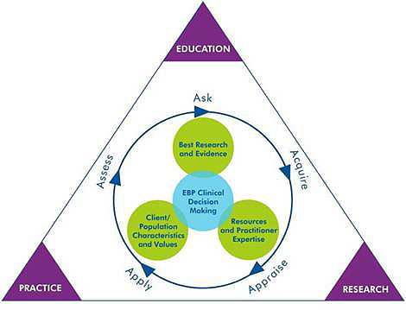
5-step EBM process
Notes:
The EBP process includes:
Asking a clinical question
Acquiring available research and evidence
Appraising its quality
Applying it to practice
Assessing the impact of change.

Slide 7
Foreground Vs. Background EBM questions
Notes:
Background questions have a clear, single answer, and can be used as an introduction to foreground questions.
Foreground questions address the actual research question in a paper.

Slide 8
Foreground OR Background?
“What is malaria?”
Are bed nets effective in lowering the incidence/prevalence of malaria in developing countries?

Slide 9
2nd step: Acquire
Notes:
The EBP process includes:
Asking a clinical question
Acquiring available research and evidence
Appraising its quality
Applying it to practice
Assessing the impact of change.

Slide 10
Where do you search for evidence?
ACP Clinical Guidelines and Recommendations
BMJ BestPractice / Clinical Evidence
ClinicalKey / MDConsult
Cochrane Library
DynaMed
Essential Evidence Plus
Google
Google Scholar
Medscape
PubMed
Saudi Digital Library
Skyscape
StatRef
TRIP Database
UpToDAte
Web of Knowledge
WebMD (Med-U)
Other

Slide 11
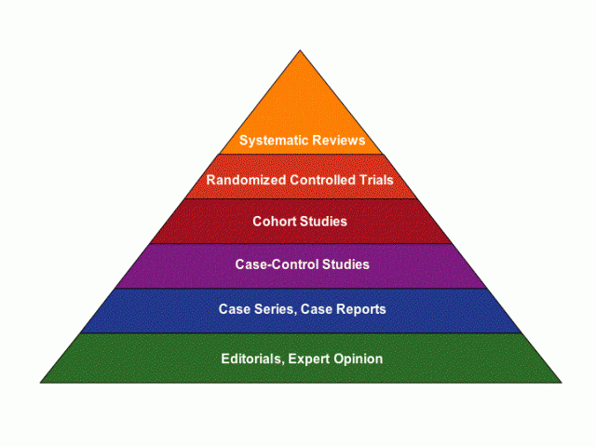
Hierarchy of evidence
Levels of evidence
Sources of evidence (6 Ss)

Slide 12
Oxford Centre for Evidence-based Medicine Levels of Evidence (May 2001)
Level | Therapy/Prevention, Aetiology/Harm | Prognosis | Diagnosis | Differential diagnosis/ symptom prevalence study | Economic and decision analyses
1a | SR (with homogeneity*) of RCTs | SR (with homogeneity*) of inception cohort studies; CDR† validated in different populations | SR (with homogeneity*) of Level 1 diagnostic studies; CDR† with 1b studies from different clinical centres | SR (with homogeneity*) of prospective cohort studies | SR (with homogeneity*) of Level 1 economic studies
1b | Individual RCT (with narrow Confidence Interval‡) | Individual inception cohort study with > 80% follow-up; CDR† validated in a single population | Validating** cohort study with good††† reference standards; or CDR† tested within one clinical centre | Prospective cohort study with good follow-up**** | Analysis based on clinically sensible costs or alternatives; systematic review(s) of the evidence; and including multi-way sensitivity analyses
1c | All or none§ | All or none case-series | Absolute SpPins and SnNouts†† | All or none case-series | Absolute better-value or worse-value analyses ††††
2a | SR (with homogeneity* ) of cohort studies | SR (with homogeneity*) of either retrospective cohort studies or untreated control groups in RCTs | SR (with homogeneity*) of Level >2 diagnostic studies | SR (with homogeneity*) of 2b and better studies | SR (with homogeneity*) of Level >2 economic studies
2b | Individual cohort study (including low quality RCT; e.g., <80% follow-up) | Retrospective cohort study or follow-up of untreated control patients in an RCT; Derivation of CDR† or validated on split-sample§§§ only | Exploratory** cohort study with good††† reference standards; CDR† after derivation, or validated only on split-sample§§§ or databases | Retrospective cohort study, or poor follow-up | Analysis based on clinically sensible costs or alternatives; limited review(s) of the evidence, or single studies; and including multi-way sensitivity analyses
2c | "Outcomes" Research; Ecological studies | "Outcomes" Research |  | Ecological studies | Audit or outcomes research
3a | SR (with homogeneity*) of case-control studies |  | SR (with homogeneity*) of 3b and better studies | SR (with homogeneity*) of 3b and better studies | SR (with homogeneity*) of 3b and better studies
3b | Individual Case-Control Study |  | Non-consecutive study; or without consistently applied reference standards | Non-consecutive cohort study, or very limited population | Analysis based on limited alternatives or costs, poor quality estimates of data, but including sensitivity analyses incorporating clinically sensible variations.
4 | Case-series (and poor quality cohort and case-control studies§§ ) | Case-series (and poor quality prognostic cohort studies***) | Case-control study, poor or non-independent reference standard | Case-series or superseded reference standards | Analysis with no sensitivity analysis
5 | Expert opinion without explicit critical appraisal, or based on physiology, bench research or "first principles" | Expert opinion without explicit critical appraisal, or based on physiology, bench research or "first principles" | Expert opinion without explicit critical appraisal, or based on physiology, bench research or "first principles" | Expert opinion without explicit critical appraisal, or based on physiology, bench research or "first principles" | Expert opinion without explicit critical appraisal, or based on economic theory or "first principles"
http://www.cebm.net/levels_of_evidence.asp
Notes:
Produced by Bob Phillips, Chris Ball, Dave Sackett, Doug Badenoch, Sharon Straus, Brian Haynes, Martin Dawes since November 1998.
By homogeneity we mean a systematic review that is free of worrisome variations (heterogeneity) in the directions and degrees of results between individual studies. Not all systematic reviews with statistically significant heterogeneity need be worrisome, and not all worrisome heterogeneity need be statistically significant. As noted above, studies displaying worrisome heterogeneity should be tagged with a "-" at the end of their designated level. † Clinical Decision Rule. (These are algorithms or scoring systems which lead to a prognostic estimation or a diagnostic category. ) ‡ See note #2 for advice on how to understand, rate and use trials or other studies with wide confidence intervals. § Met when all patients died before the Rx became available, but some now survive on it; or when some patients died before the Rx became available, but none now die on it. §§ By poor quality cohort study we mean one that failed to clearly define comparison groups and/or failed to measure exposures and outcomes in the same (preferably blinded), objective way in both exposed and non-exposed individuals and/or failed to identify or appropriately control known confounders and/or failed to carry out a sufficiently long and complete follow-up of patients. By poor quality case-control study we mean one that failed to clearly define comparison groups and/or failed to measure exposures and outcomes in the same (preferably blinded), objective way in both cases and controls and/or failed to identify or appropriately control known confounders. §§§ Split-sample validation is achieved by collecting all the information in a single tranche, then artificially dividing this into "derivation" and "validation" samples. †† An "Absolute SpPin" is a diagnostic finding whose Specificity is so high that a Positive result rules-in the diagnosis. An "Absolute SnNout" is a diagnostic finding whose Sensitivity is so high that a Negative result rules-out the diagnosis. ‡‡ Good, better, bad and worse refer to the comparisons between treatments in terms of their clinical risks and benefits. ††† Good reference standards are independent of the test, and applied blindly or objectively to applied to all patients. Poor reference standards are haphazardly applied, but still independent of the test. Use of a non-independent reference standard (where the 'test' is included in the 'reference', or where the 'testing' affects the 'reference') implies a level 4 study. †††† Better-value treatments are clearly as good but cheaper, or better at the same or reduced cost. Worse-value treatments are as good and more expensive, or worse and the equally or more expensive. ** Validating studies test the quality of a specific diagnostic test, based on prior evidence. An exploratory study collects information and trawls the data (e.g. using a regression analysis) to find which factors are 'significant'. *** By poor quality prognostic cohort study we mean one in which sampling was biased in favour of patients who already had the target outcome, or the measurement of outcomes was accomplished in <80% of study patients, or outcomes were determined in an unblinded, non-objective way, or there was no correction for confounding factors. **** Good follow-up in a differential diagnosis study is >80%, with adequate time for alternative diagnoses to emerge (eg 1-6 months acute, 1 - 5 years chronic)

Slide 13
Haynes’ 5S pyramid of EBM resources
Synopses
Syntheses
Studies
Summaries
Systems
Clinical decision support systems (CDS) | HER built-in CDSs Diagnosis One AHRQ ePSS
Evidence based CPG Evidence based textbooks | BMJ BestPractice BMJ ClinicalEvidence UptoDate StatRef
Evidence based journal abstracts | DynaMed PIER EE+
Systematic reviews | Cochrane library Trip Database
Original journals | Medline mobile
Notes:
Syntheses, studies, synopses, summaries systems

Slide 14
Where do you search for guidelines?
BMJ Best Practice
CMA Infobase
Cochrane
DynaMed
EMBASE
Essential Evidence Plus
Medline
National guideline Clearinghouse
TRIP database

Slide 15
Haynes’ 5S pyramid of EBM resources
Synopses
Syntheses
Studies
Summaries
Systems
Clinical decision support systems (CDS) | HER built-in CDSs Diagnosis One AHRQ ePSS
Evidence based CPG Evidence based textbooks | BMJ BestPractice BMJ ClinicalEvidence UptoDate StatRef
Evidence based journal abstracts | DynaMed PIER EE+
Systematic reviews | Cochrane library Trip Database
Original journals | Medline mobile
Notes:
Syntheses, studies, synopses, summaries systems

Slide 16
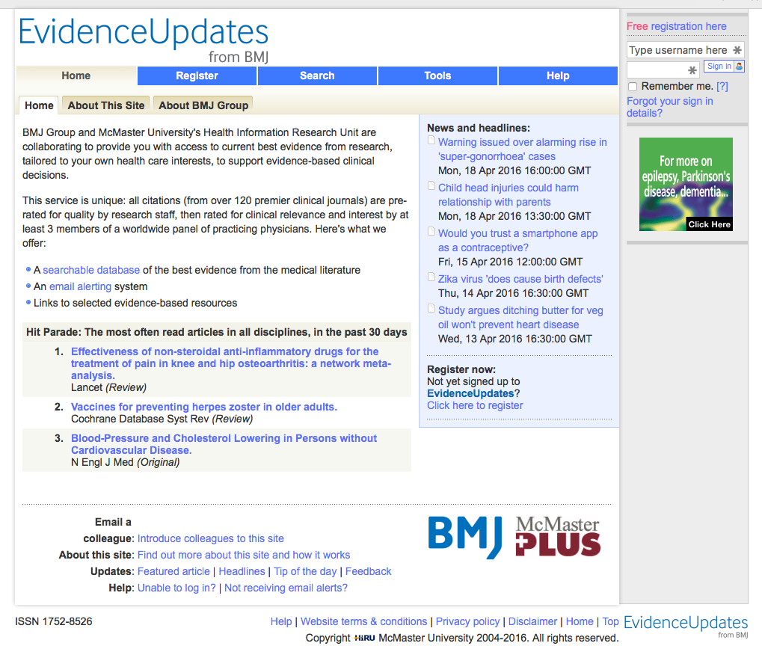

Slide 17
Haynes’ 5S pyramid of EBM resources
Synopses
Syntheses
Studies
Summaries
Systems
Clinical decision support systems (CDS) | HER built-in CDSs Diagnosis One AHRQ ePSS
Evidence based CPG Evidence based textbooks | BMJ BestPractice BMJ ClinicalEvidence UptoDate StatRef
Evidence based journal abstracts | DynaMed PIER EE+
Systematic reviews | Cochrane library Trip Database
Original journals | Medline mobile
Notes:
Syntheses, studies, synopses, summaries systems

Slide 18
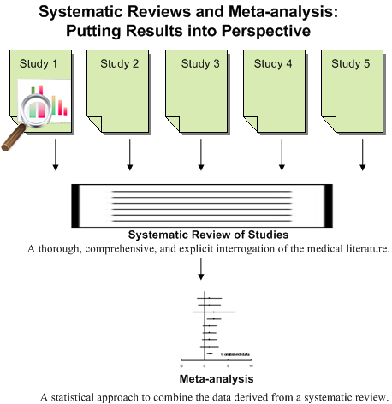

Slide 19
What is Cochrane
Archie Cochrane (1909-88)
British epidemiologist
Advocated RCTs to inform healthcare practice
Cochrane collaboration
Cochrane Reviews (>4,000) registered
Identify, appraise and synthesise research-based evidence and present it in accessible format; regularly updated
Focus on interventions
Outstanding general resource
The School of Medicine, Cardiff University and the Cochrane Archive
http://www.cochrane-handbook.org/

Slide 20
Filtered and Critically Appraised EBM Resources
The Cochrane Library by The Cochrane Collaboration via Wiley
Independent non-for-profit international collaboration
Reviews are among the studies of highest scientific evidence
Minimum Bias: Evidence is included/excluded on the basis of explicit quality criteria
Reviews involve exhaustive searches for all RCT, both published and unpublished, on a particular topic
Abstracts searchable for free on the Internet; complete database is available via OVID in SDL for all universities
1995-

Slide 21
Haynes’ 5S pyramid of EBM resources
Synopses
Syntheses
Studies
Summaries
Systems
Clinical decision support systems (CDS) | HER built-in CDSs Diagnosis One AHRQ ePSS
Evidence based CPG Evidence based textbooks | BMJ BestPractice BMJ ClinicalEvidence UptoDate StatRef
Evidence based journal abstracts | DynaMed PIER EE+
Systematic reviews | Cochrane library Trip Database
Original journals | Medline mobile
Notes:
Syntheses, studies, synopses, summaries systems

Slide 22
Primary Resources
Global databases
(Cochrane, PubMed, Health PubMed, Ovid, Science Citations, grey literature, etc.)
WHO databases
(global / regional): observatories; scientific journals (WHO Bulletin / EMHJ); surveillance; surveys; ICTRP; CPG, etc.
National databases:
ENSTINET, SaudiMedLit; NCHS, CAPMAS; healthcare delivery institutions (websites, reports); clinical trials; grey literature, etc.

Slide 23
PubMed https://www.ncbi.nlm.nih.gov/pubm

Slide 24
What is PubMed?
PubMed is a database developed by the National Center for Biotechnology Information (NCBI) at the U.S. National Library of Medicine (NLM) available on the Web.
NLM is the worlds largest medical library
NLM has been indexing the biomedical literature since 1879
MEDLINE is a database of indexes (with citations and abstracts)
PubMed provides access to MEDLINE
PubMed database is more current and comprehensive than MEDLINE ( it includes citations even prior to their indexing with MEDLINE)
PubMed Health provides information for consumers and clinicians on prevention and treatment of diseases and conditions.
PubMed Health specializes in reviews of clinical effectiveness research, with easy-to-read summaries for consumers as well as full technical reports. Clinical effectiveness research finds answers to the question “What works?” in medical and health care.

Slide 25
Why PubMed ?
Over 20 million citations for biomedical literature from app. 5500 selected journals from over 70 countries
Source:
MEDLINE (NLM database)
Life science journals
Online books
Fields:
Medicine
Nursing
Dentistry
Veterinary medicine
Health care system
Preclinical sciences

Slide 26
Indexing a literature
Journal Publishers
Users
indexing
PubMed
Web
reviewing
NLM
MEDLNE
MeSH indexing

Slide 27
Where to start…?
Internet search/Any search engine
Guidelines review
Database search – Medline/PsycINFO
Reference tracking-references in articles
Expert contacts
General overview
Thorough search
Refining

Slide 28
More thorough search?
If you fail to plan,
you plan to fail.
Ben Franklin
Prepare Organize Combine

Slide 29
Prepare
What do we need to know about our topic?
Make a list of all the terms connected with our topic.

Slide 30
Organize
Make a list of the words that are critical to your search.
1
Exchange/add some words if needed.
2
Note terms that you don’t want to appear.
3
Discard the rest.
4

Slide 31
Combine
Use Boolean operators to combine our most important terms
AND
Use AND to connect the terms we want to see.
NOT
Use NOT to exclude terms we don’t want.
OR
Use OR to include similar terms.

Slide 32
Boolean Operators

Slide 33
MeSH indexing
Acronym for “Medical Subject Headings”
Similar to key words on other systems
Used for indexing journal articles for MEDLINE
Arranged in hierarchy, from more general to more specific
Used by researchers

Slide 34
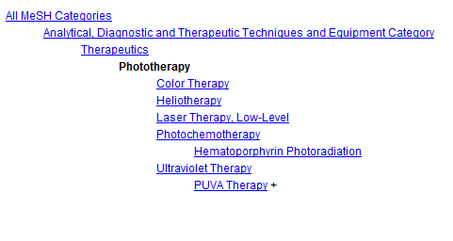
Tree of MeSH database

Slide 35
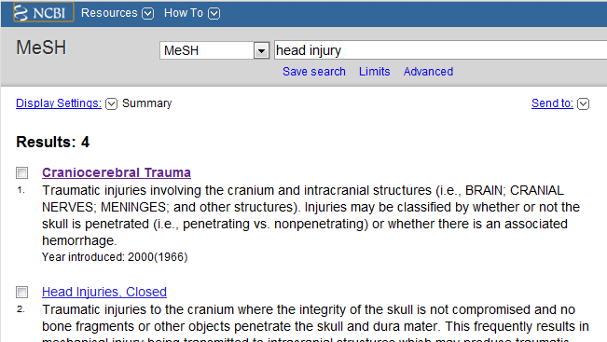
Searching MeSH Term

Slide 36
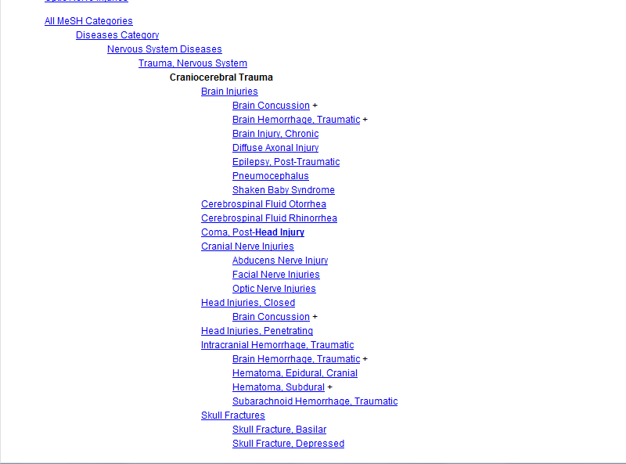

Slide 37
MeSH
This will help you exclude all other diseases in that category
This will give you fewer articles in your results page!

Slide 38
Keys to Successful Searching
Indexes: Identifying appropriate indexes through clinical questions
Components of “well-built clinical questions.”: PICO
Patient/problem
Intervention
Comparison intervention
Outcome

Slide 39
Try to make a search...
Case example
A 45-year-old man presents with a 10-month history of burning epigastric pain that has not improved with a proton- pump inhibitor. Findings on upper endoscopy are normal, but Helicobacter pylori serology is positive.
Treat Helicobacter pylori or not?
Try to make a search….

Slide 40
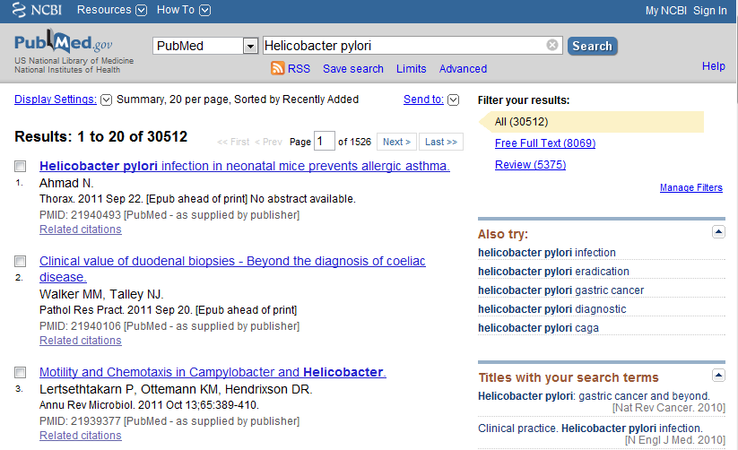
Case example

Slide 41
Components of “well-built clinical questions”
PICO
Patient/problem - “non-ulcer dyspepsia”
Intervention - “treatment of Helicobacter pylori infection”
Comparison intervention - “no treatment”
Outcome - “improve symptoms”

Slide 42
Case example

Slide 43
Components of “well-built clinical questions”
PICO
Patient/problem - “non-ulcer dyspepsia”
Intervention - “treatment of Helicobacter pylori infection”
Comparison intervention - “no treatment”
Outcome - “improve symptoms”

Slide 44
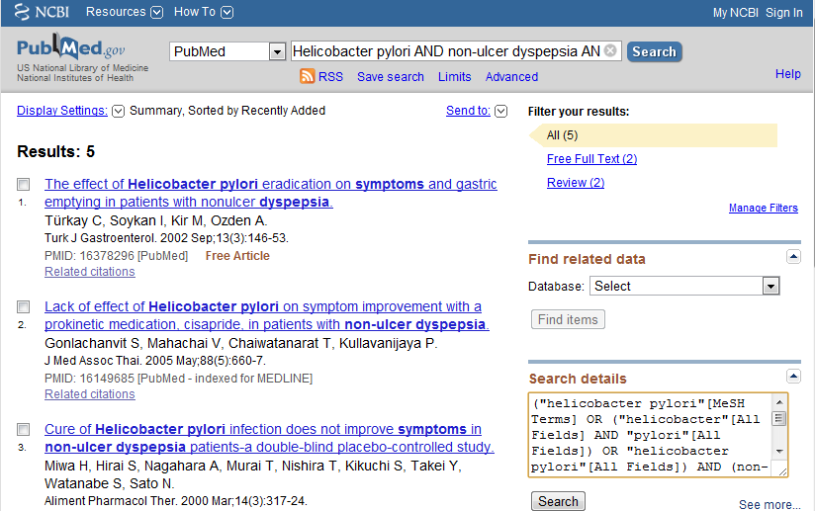
Case example
Boolean Operator

Slide 45
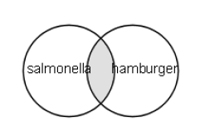
Boolean Operators
AND
Salmonella AND Hamburger
Salmonella - 69432
Hamburger - 2703
Salmonella AND Hamburger - 14

Slide 46
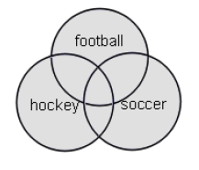
Boolean Operators
OR
Football OR Hockey OR Soccer
Football - 3948
Hockey - 1466
Soccer - 3137
Total - 7538

Slide 47
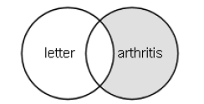
Boolean Operators
NOT
Arthritis NOT Letter
Arthritis - 185375
Letter - 686049
Arthritis “excluding” letter - 176352

Slide 48
Quiz
Which is the correct strategy to find information on Zika virus and any of these countries Brazil, Mexico and the United States?
Zika AND Brazil AND Mexico AND United States
Zika AND (Brazil OR Mexico OR United States)
Zika OR (Brazil OR Mexico OR United States)

Slide 49
Boolean Operators

Slide 50
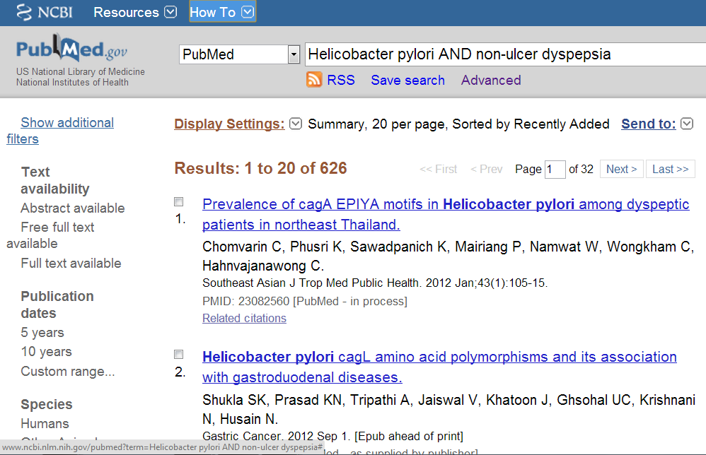
Filters

Slide 51
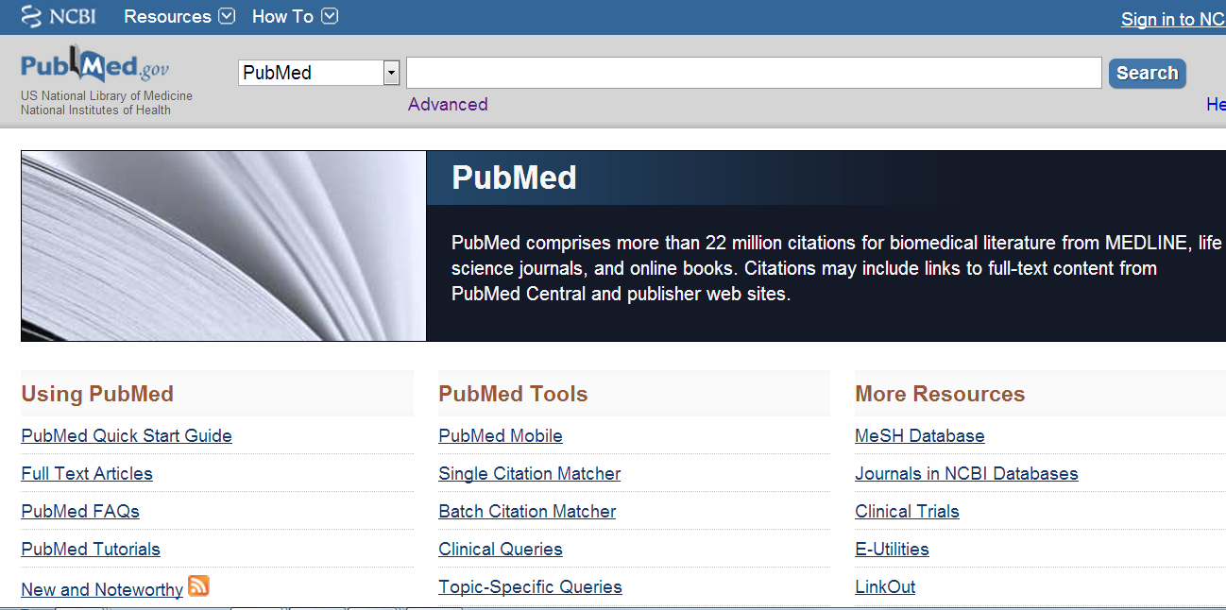

Slide 53
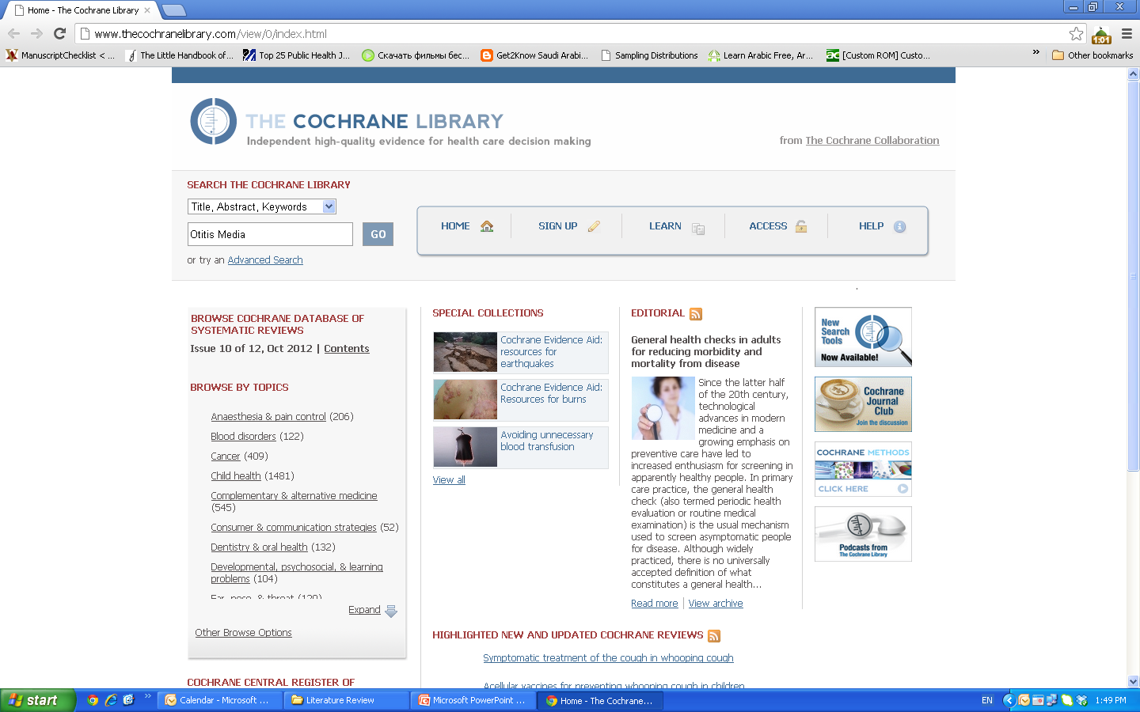

Slide 54
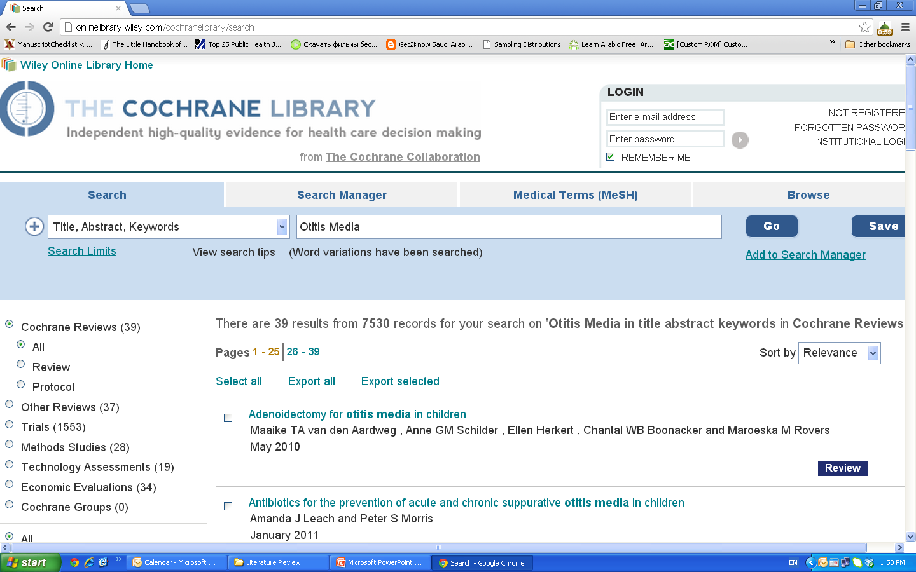

Slide 55
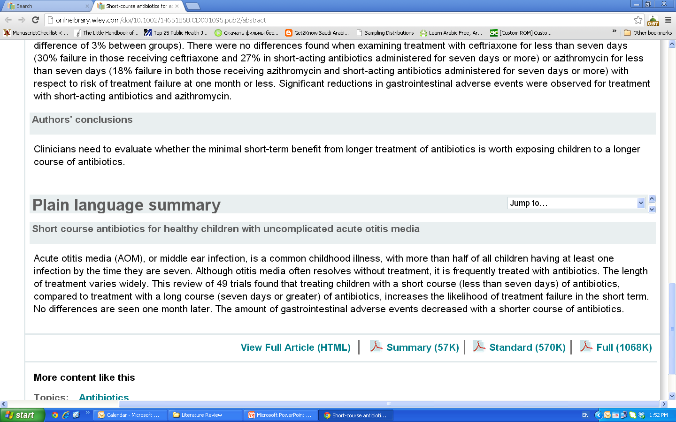

Slide 56
Clinical Scenario
Khalid is a 40 years old smoker, would like to quit smoking, he tried to do that, several times over the last two years, but he could not tolerate the withdrawal symptoms. Recently he read an article reporting that some medications can be used to help smoker to quit, he would like your advise about this issue!

Slide 57
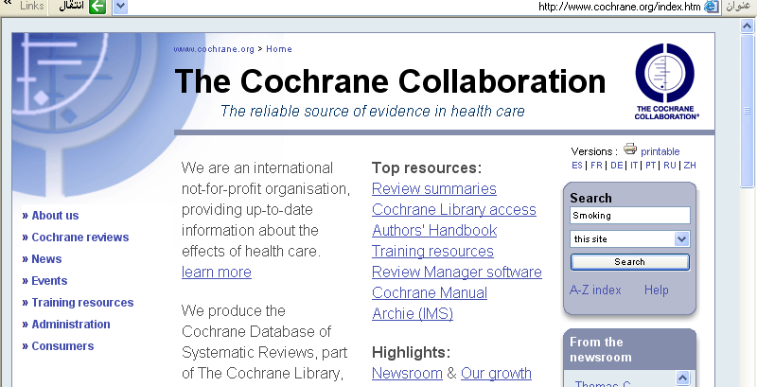

Slide 58
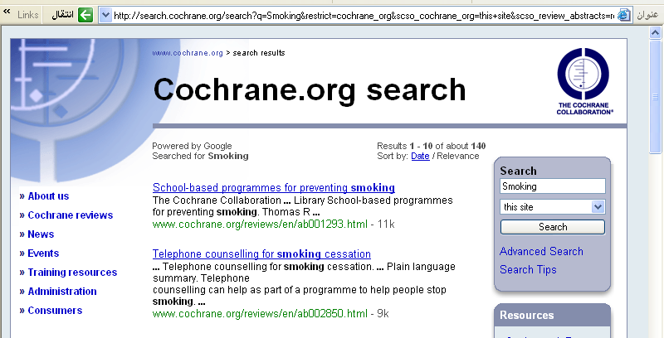

Slide 59
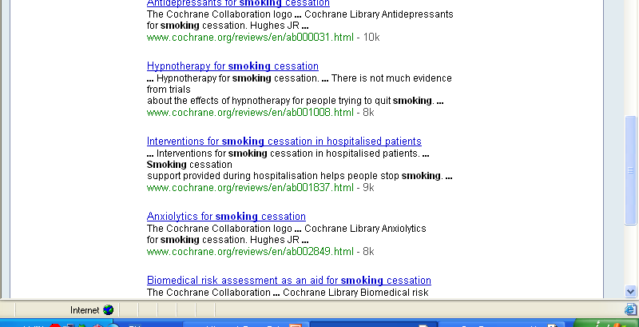

Slide 60
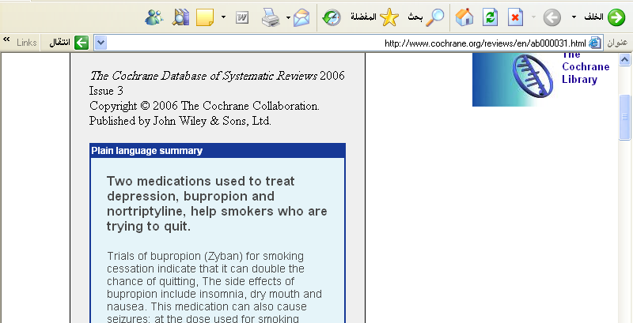

Slide 61
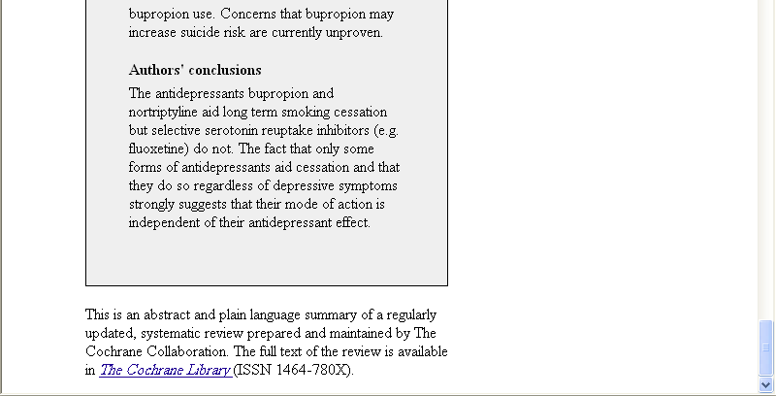

Slide 62
Exercise
Scenario: Professor X is teaching the Global Health course and asks that you write a descriptive five-page paper describing a program that has made a positive impact on one of the eight 2015 Millennium Development Goals or on one of the many Healthy People 2020 objectives.
How would you go about it?

Slide 64
Critical Appraisal Table – Key Elements
Reference or ID number: the table must include a unique identifier for ease in finding the record being appraised.
Study Design: this helps with determining the strength of evidence of the data.
Participants: How many participants were in the study?
Characteristics of the problem within the population
Intervention outcomes.
Include or exclude the study? based on what you find

Slide 66
Key Elements of High Quality Articles
Peer Reviewed Journal: This is a process where experts in a scholarly discipline review the research of an author or authors to ensure that the article meets standards for publication. The criteria includes: quality, significance, methodology, and importance.
Currency: Locating the most current five or ten years of information is not a gold standard. There are several factors that determine how far back in time your search should run.
Clearly recognized research question or problem: The introduction or background should include what is known, what is unknown and what is the author’s aim or hypothesis.
Study design: Revisit the PUBLIC HEALTH EVIDENCE-BASED PYRAMID to review different types of study designs.
Times Cited: This is an indication that something important is going on with the article, but one should not assume that the article is necessarily good.

Slide 67
Summarizing the Literature Review
Introduction: Gives a quick idea of the topic of the literature review, such as the central theme or organizational pattern.
Body: Contains your discussion of sources and is organized either chronologically, thematically, or methodologically
Conclusions/Recommendations: Discuss what you have drawn from reviewing literature so far. Where might the discussion proceed?
For more info:
https://writingcenter.unc.edu/tips-and-tools/literature-reviews/

Slide 68
Objectives
To explain the role of searching the literature in conducting a research
To recognize the levels of evidence
To differentiate the EBM resources
To identify where to search for evidence
To prepare proper search terms
To perform Boolean operators and MeSH indexing
To conduct literature search for evidence using Pubmed and Cochrane
To summarize the literature review for the IRB

Slide 69
Qs?

Slide 70
Thank You!

