Slide 1
Surgical Infections
Dr. Nuha Alsaleh
MD,MSc,FRCSC

Slide 2
Infection
Infection is defined by:
  Microorganisms in host tissue or the bloodstream
  Inflammatory response to their presence.

Slide 3
Inflammatory Response
Localized:
  Rubor, Calor, Dolor, Tumor, and functio laesa (loss of function)
Systemic:
  Systemic Inflammatory Response Syndrome (SIRS)

Slide 4
Cellulitis
Definition: Diffuse infection with severe inflammation of dermal and subcutaneous layers of the skin
Diagnosis: Pain, Warmth, Hyperesthesia
Treatment: Antibiotics.
Common Pathogens: Skin Flora (Streptococcus/Staphylococcus)

Slide 5
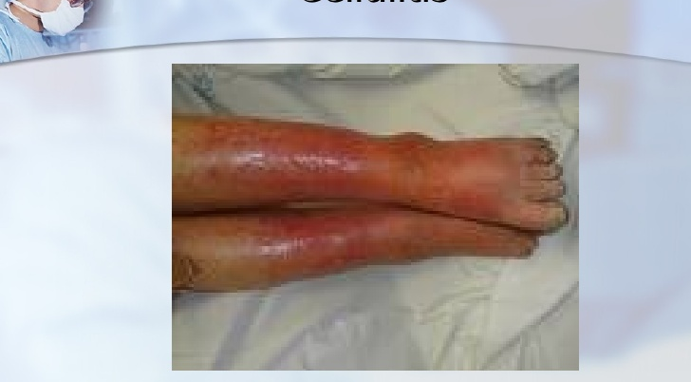
Cellulitis

Slide 6
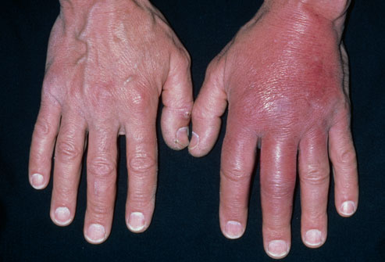
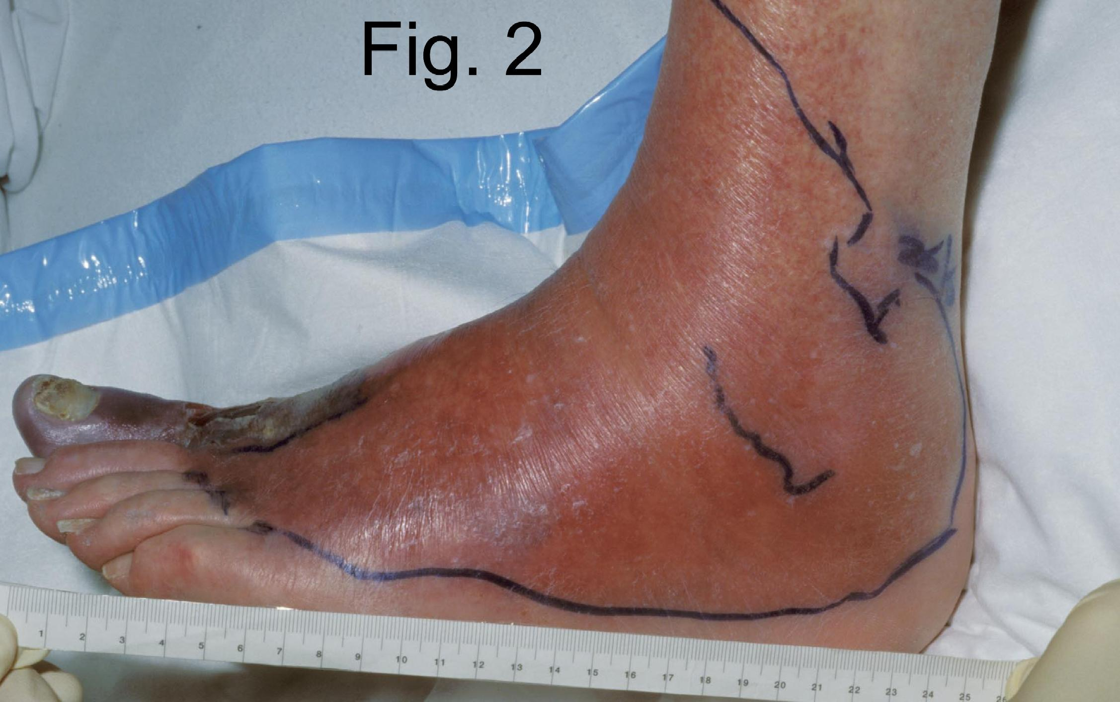
Cellulitis

Slide 7
FURUNCLES AND CARBUNCLES
Furuncles and carbuncles are cutaneous abscess that begin in skin glands and hair follicles.
If the pilosebaceous apparatus becomes obstructed at the skin level, the development of a furuncle can be anticipate
A carbuncle is a deep –seated mass of fistulous tracts between infected hair follicles.
Funruncles are the most common surgical infections, but carbuncles are rare

Slide 8
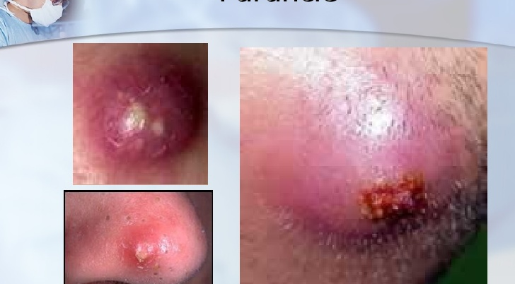
Furuncle

Slide 9
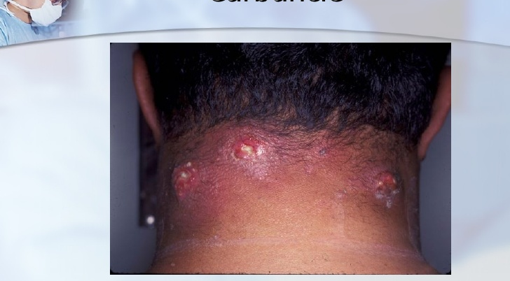
Carbuncle

Slide 10
HIDRADENITIS
Serious skin infection of the axillae or groin Consisting of multiple abscesses of the apocrine sweat glands.
The condition often becomes chronic
The cause is unknown but may involve a defect of terminal follicular epithelium

Slide 11
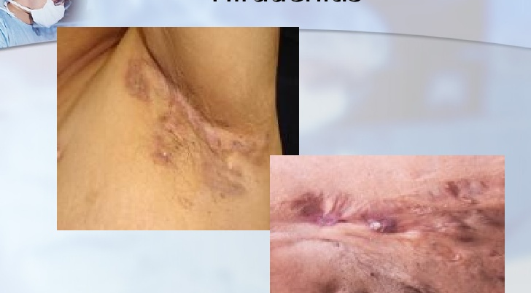
Hiradenitis

Slide 12
TREATMENT
The classic therapy of furuncle is drainage, not antibiotics.
Invasive carbuncles must be treated by excision and antibiotics.
Hidradenitis is usually treated by drainage of the individual abscess and followed by careful hygeine

Slide 13
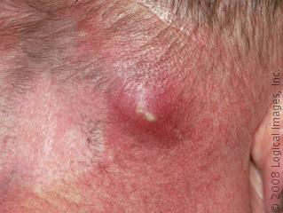
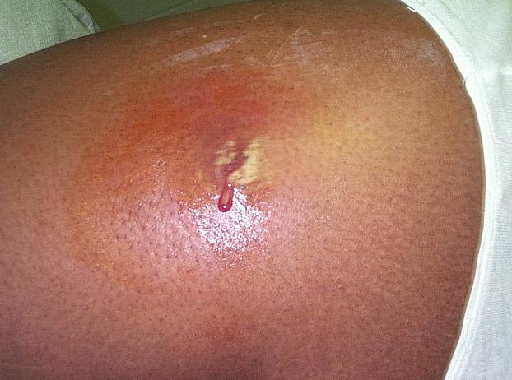
Abscess

Slide 14
Abscess
Definition: Infectious accumulation of purulent material (Neutrophils) in a closed cavity
Diagnosis: Fluctuant: Moveable and compressible
Treatment: Drainage

Slide 15
DIFFUSE NECROTIZING INFECTIONS
Particular dangerous
Difficult to diagnose, extremely toxic, spread rapidly, often leading to limb amputation

Slide 16
Pathogenic factors
Anaerobic
wound Bacterial exotoxins
Bacterial synergy
Thrombosis of nutrient bridging vessels

Slide 17
Clinical Findings
Crepitant abscess or cellulitis
Invasion is usually superficial to the deep fascia and may spread very quickly, producing discoloration.
Delayed debridement of injured tissue after devascularizing injury is the common setting.

Slide 18
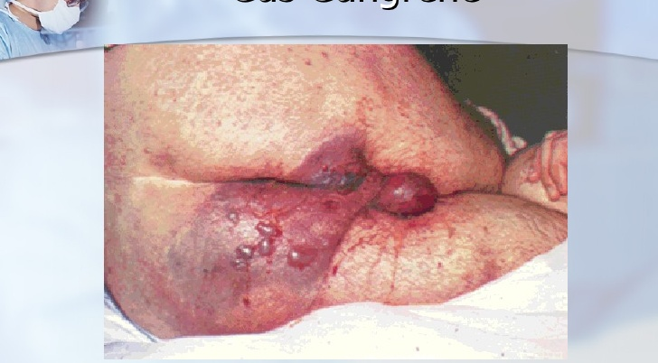
Gas Gangrene

Slide 19
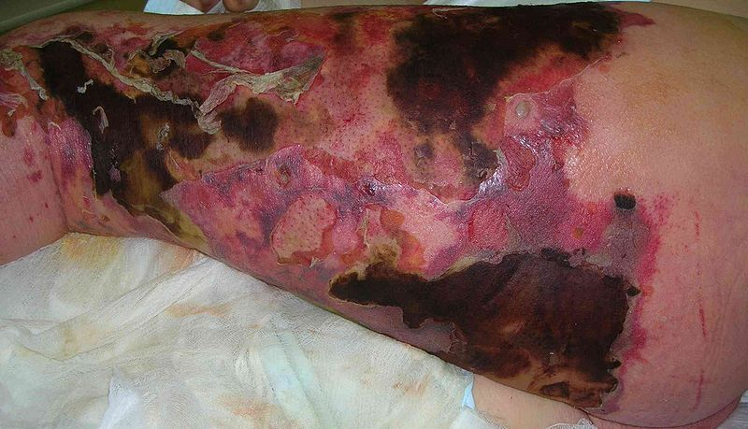
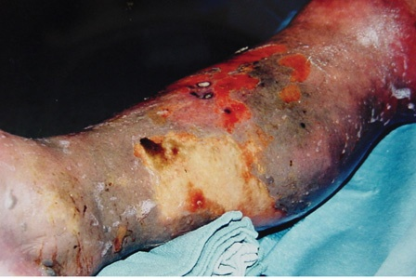
Necrotizing Soft Tissue Infection

Slide 20
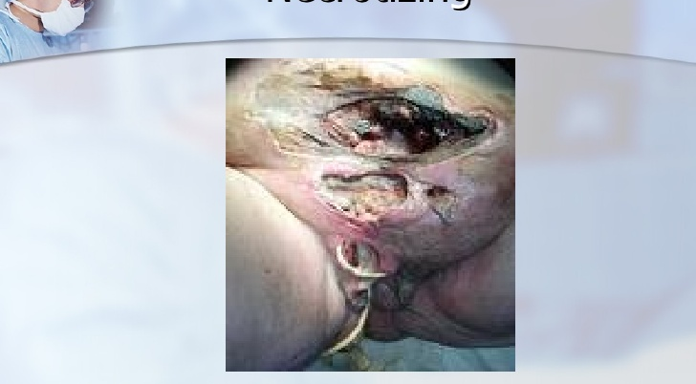
Necrotizing

Slide 21
TREATMENT
Broad-spectrum antibiotic therapy
Resuscitative therapy
Treat diabetes mellitus aggressively
Hyperbaric oxygenation inhibit bacterial invasion but does not eliminate the focus of infection.

Slide 22
TREATMENT
Complete debridement and depress tight fascial compartment. Amputation.

Slide 23
Post-Operative Infections
Fever After Surgery
The “Five W’s”
  Wind: Atelectisis
  Water: UTI
  Walking: DVT
  Wonder Drug: Medication Induced
  Wound: Surgical Site Infection

Slide 24
Surgical Site Infections
3rd most common hospital infection
Incisional
  Superficial
  Deep
Organ Space
  Generalized (peritonitis)
  Abscess

Slide 25
SSI – Definitions
Infection
  Systemic and local signs of inflammation
  Bacterial counts ≥ 10⁵ cfu/mL
  Purulent versus nonpurulent
  LOS effect
  Economic effect
Surgical wound infection is SSI
Notes:
Surgical sites are considered infected when there are signs of systemic and local inflammation and bacterial counts are 10⁵ cfu/mL or higher.
Infections are also differentiated by purulence or nonpurulence.
The length of stay for the patient and economic effects of the hospital stay are important factors to consider in SSIs.
It is important to note is that a surgical wound infection is a surgical site infection.

Slide 26
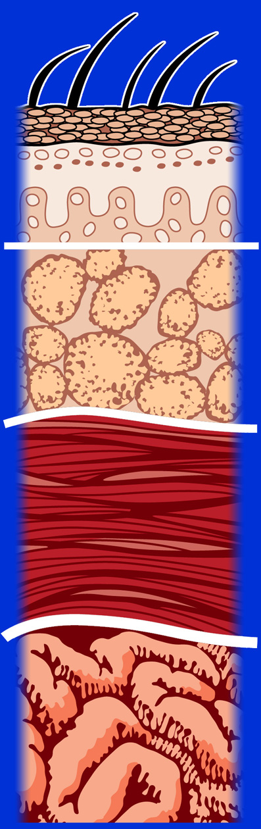
type of surgical infection
Superficial incisional SSI
Deep incisional SSI
Organ/space
Organ/space SSI
Mangram AJ et al. Infect Control Hosp Epidemiol.
1999;20:250-278.
Notes:
The most extensive of these surgical infections involves the organs and the space surrounding the organs. These infections can occur within 30 days post-op if no implant is left in place or within 1 year if an implant is in place and the infection appears to be related to the operation and the infection involves any part of the anatomy, other than the incision, which was opened or manipulated during the operation.

Slide 27
SSI – Risk Factors
Operation Factors
Duration of surgical scrub
Maintain body temp
Skin antisepsis
Preoperative shaving
Duration of operation
Antimicrobial prophylaxis
Operating room ventilation
Inadequate sterilization of instruments
Foreign material at surgical site
Surgical drains
Surgical technique
  Poor hemostasis
  Failure to obliterate dead space
  Tissue trauma
Mangram AJ et al. Infect Control Hosp Epidemiol. 1999;20:250-278.
Notes:
Both operation factors and patient characteristics may influence the risk of surgical site infection.
Depending on the conditions of the operation a patient can be at an even greater risk of infection. These factors can include duration of surgical scrub, maintenance of body temperature, the use of skin antisepsis, preoperative shaving, duration of the operation, antimicrobial prophylaxis, ventilation of the operating room, inadequate sterilization of instruments, the presence of foreign material at the surgical site, surgical drains, and surgical technique. Poor surgical technique includes poor hemostasis, failure to obliterate dead space, and tissue trauma.

Slide 28
SSI – Risk Factors
Patient Characteristics
Age
Diabetes
  HbA_{1C} and SSI
  Glucose > 200 mg/dL postoperative period
  (<48 hours)
Nicotine use: delays primary wound healing
Steroid use: controversial
Malnutrition: no epidemiological association
Obesity: 20% over ideal body weight
Prolonged preoperative stay: surrogate of the severity
of illness and comorbid conditions
Preoperative nares colonization with Staphylococcus aureus:
significant association
Perioperative transfusion: controversial
Coexistent infections at a remote body site
Altered immune response
Mangram AJ et al. Infect Control Hosp Epidemiol. 1999;20:250-278.
Notes:
This slide shows risk factors for patients who are considered to be at a higher risk for surgical site infection.
High-risk characteristics include advanced age, diabetes, smoking, poor nutritional status, obesity, coexisting infections at a particular body site, and altered immune response, among other factors.
Prolonged preoperative stay is also a risk, depending on the severity of illness and comorbid conditions. There is also a significant association between preoperative nares colonization with Staphylococcus aureus and surgical site infection. Perioperative transfusion remains a controversial issue.

Slide 29
Preoperative preparation

Slide 30
Pre-operative Shaving

Slide 31
Pre-operative shaving
Shaving the surgical site with a razor induces small skin lacerations
  potential sites for infection
  disturbs hair follicles which are often colonized with S. aureus
  Risk greatest when done the night before
  Patient education
    be sure patients know that they should not do you a favor and shave before they come to the hospital!

Slide 32
Prophylactic Antibiotics
Antibiotics given for the purpose of preventing infection when infection is not present but the risk of postoperative infection is present

Slide 33
Prophylactic Antibiotics
Questions
Which cases benefit?
Which drug should you use?
When should you start?
How much should you give?
How long should antibiotics be continued?

Slide 34
Surgical site prevention
Use antibiotics
appropriately
Avoid shaving
Site
Maintain normal
Body temp
Optimize oxygen
tension
Maintain normal
Blood glucose

Slide 35
Treatment
Incisional: open surgical wound, antibiotics for cellulitis or sepsis
Deep/Organ space: Source control, antibiotics for sepsis

Slide 36
Types of Surgery
Clean | Hernia repair breast biopsy | 1.5%
Clean-Contaminated | Cholecystectomy planned bowel resection | 2-5%
Contaminated | Non-preped bowel resection | 5-30%
Dirty/infected | perforation, abscess | 5-30%

Slide 37
Occupational Blood Bourne Virus Infections
 | HBV | HCV | HIV
Risk from Needle stick | 30% | 2% | 0.3%
Chemoprophylaxis | Yes | No | Yes
Vaccine | Yes | No | No

Slide 38
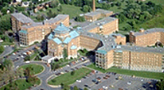
Q

