Slide 1
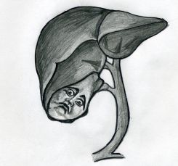
Cholelithiasis & obstructive jaundice
Dr. Abdulsalam Alsharabi
Asst. Professor of Surgery
Consultant Hepatobiliary and Transplant Surgeon

Slide 2
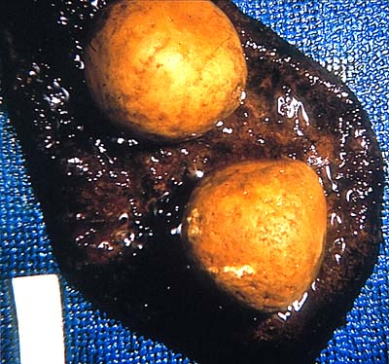
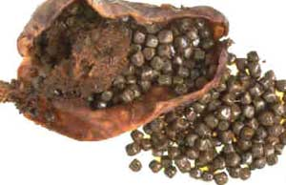
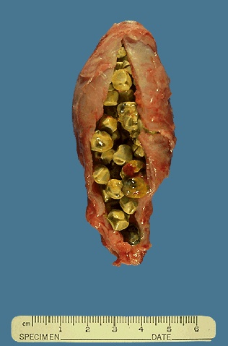
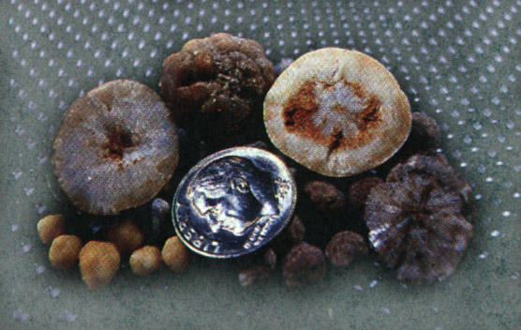
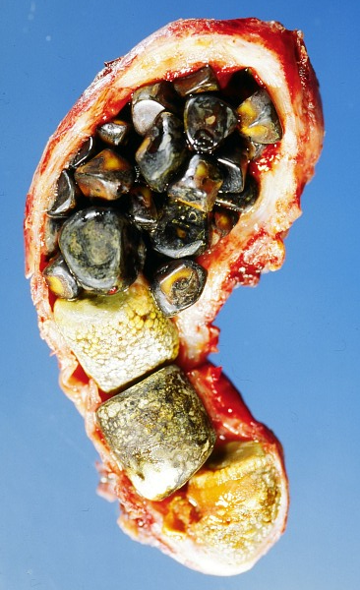
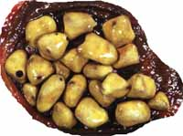
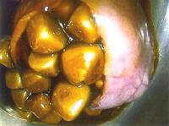
Harvest Time

Slide 3
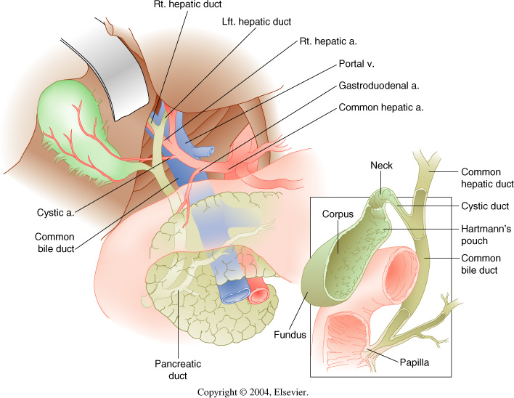
Anatomy

Slide 4
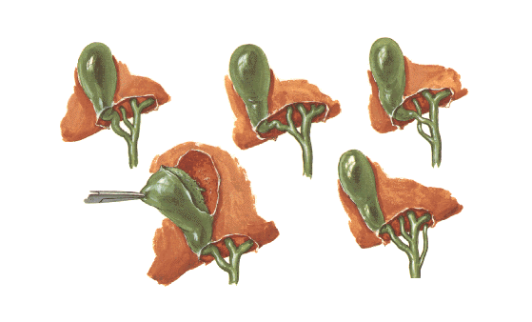
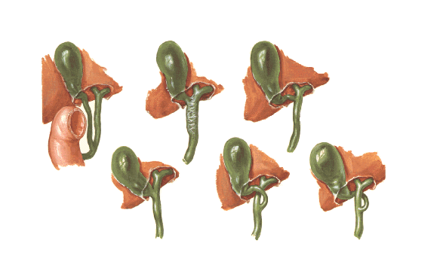
Variations in Bile Ducts

Slide 5
Gallstone Pathogenesis

Slide 10
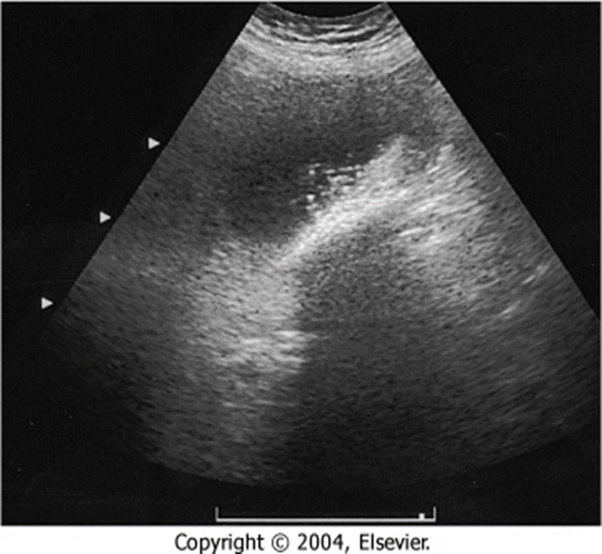

Slide 11
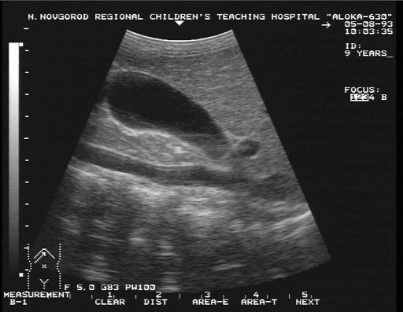
Ultrasound

Slide 12
Ultrasound

Slide 14
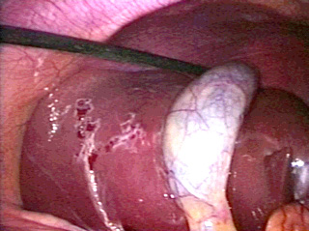

Slide 16
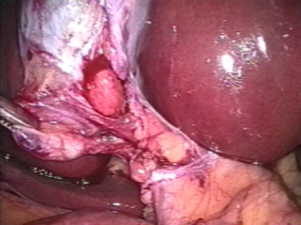

Slide 17
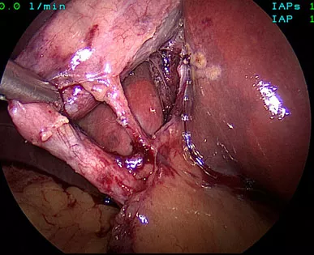

Slide 19
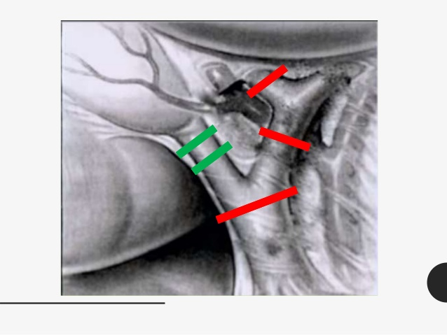

Slide 24
Ultrasound is the first choice for imaging
- Distended gallbladder
- Increased wall thickness (> 4 mm)
- Pericholecystic fluid
- Positive sonographic Murphy’s sign (very specific)

Slide 25
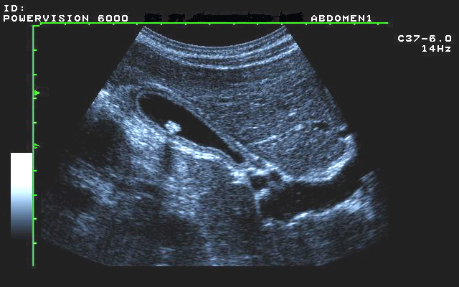
Ultrasound

Slide 26
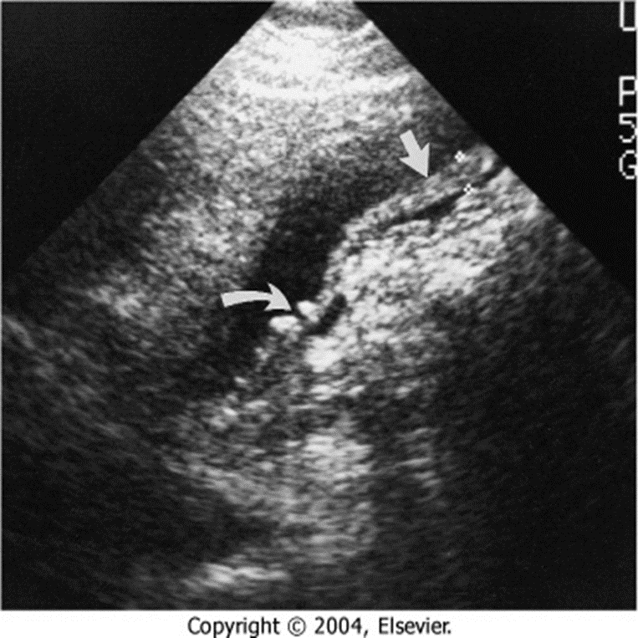

Slide 27
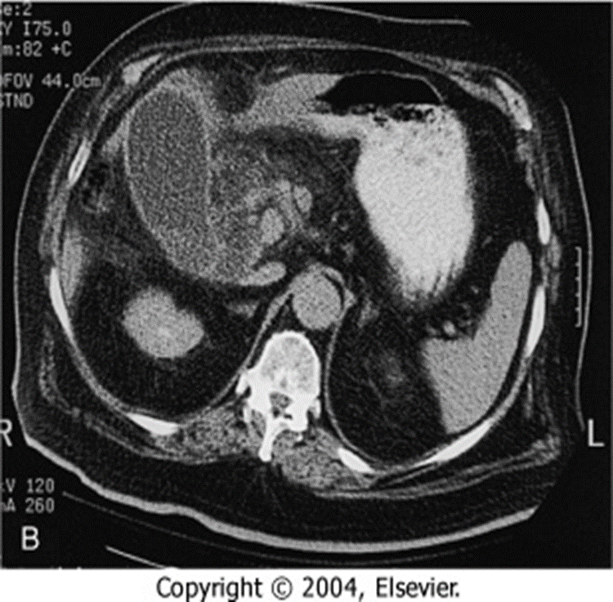

Slide 28
Complications of acute cholecystitis

Slide 31
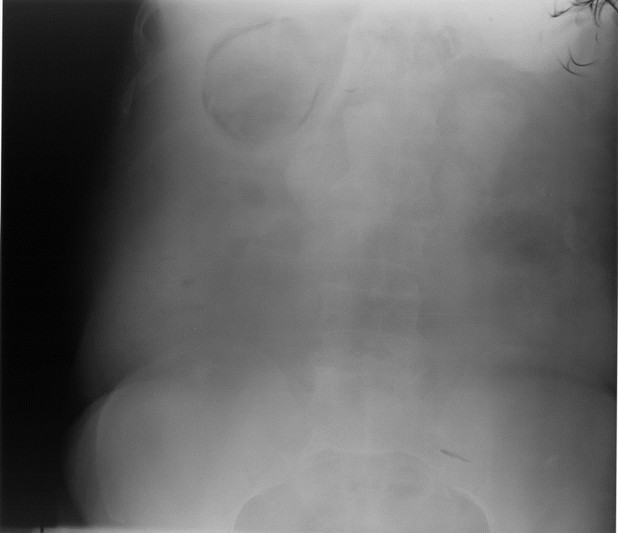

Slide 32
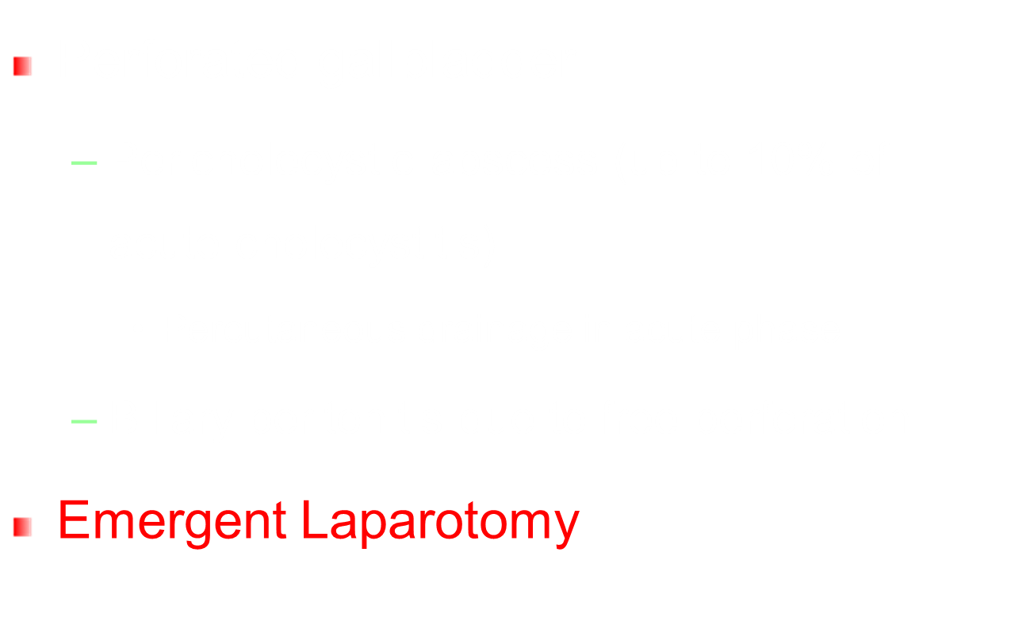

Slide 34
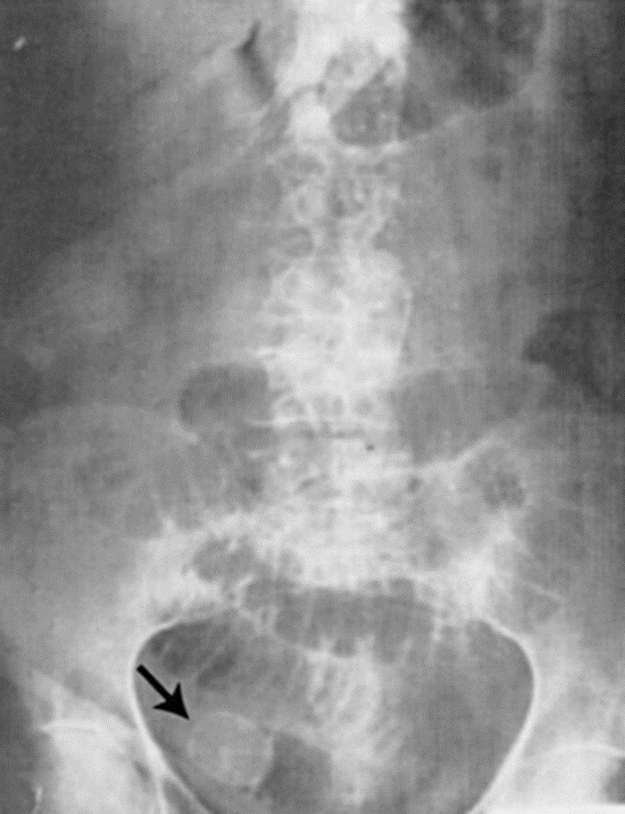
Gallstone Ileus

Slide 35
Acalculous cholecystitis
- A form of acute cholecystitis
- GB inflammation due to biliary stasis(5% of time) and not stones(95%).
- Often seen in critically ill patients

Slide 37
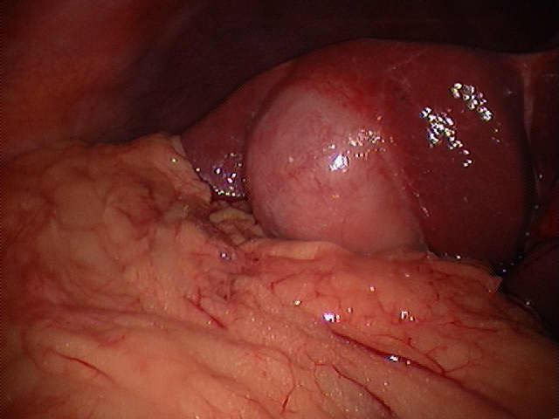

Slide 38
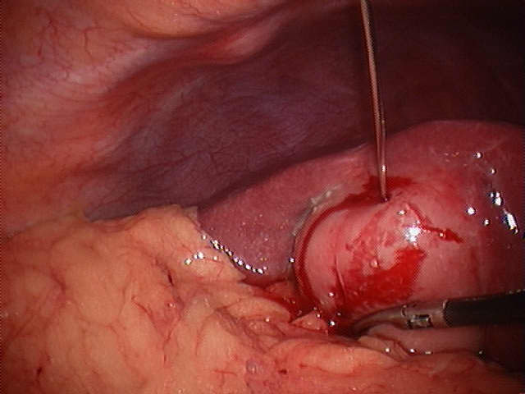

Slide 39
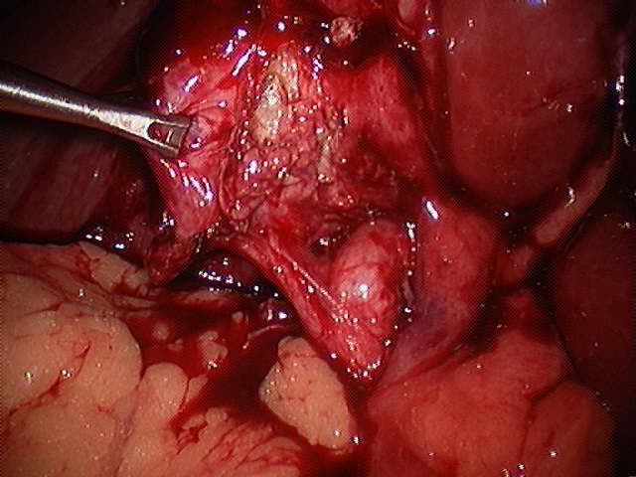

Slide 40
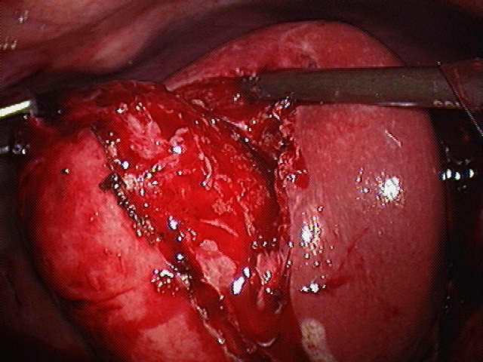

Slide 41
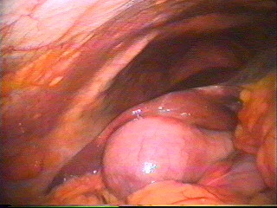
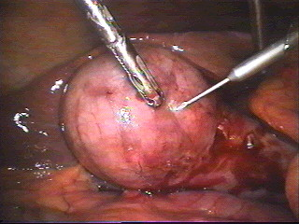
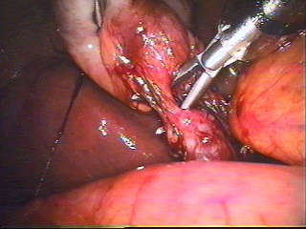
Laparoscopic Cholecystectomy

Slide 42
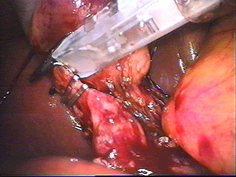
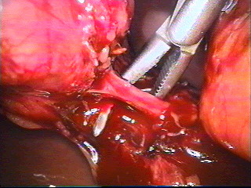
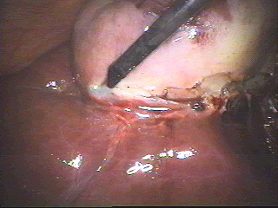
Laparoscopic Cholecystectomy

Slide 43
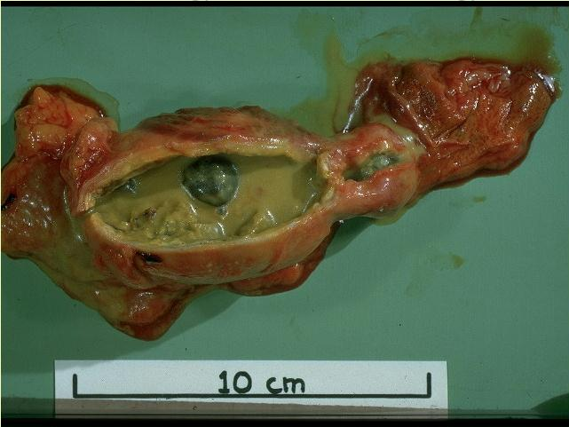

Slide 44
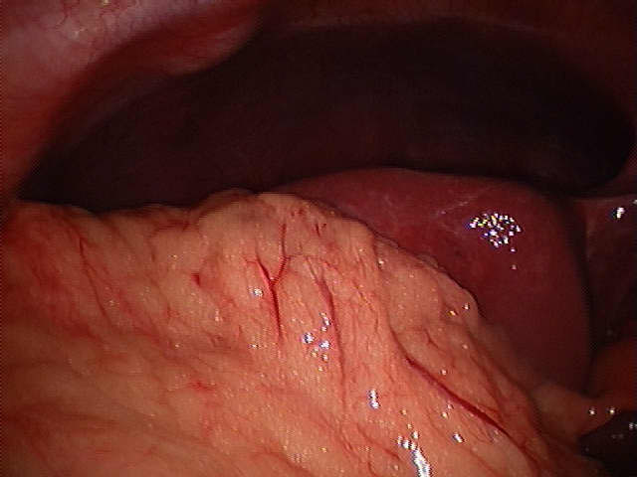

Slide 45
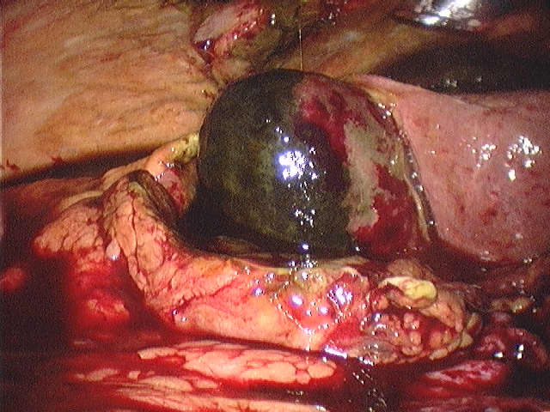

Slide 46
Pathogenesis:
Stone obstructing CBD (bear in mind there are other causes for obstructive jaundice) – danger is progression to ascending cholangitis.
USS
Will confirm gallstones in the gallbladder
CBD dilatation i.e. >8mm (not always!)
May visualise stone in CBD (most often does not)
MRCP
In cases where suspect stone in CBD but USS indeterminate
E.g.1 obstructive LFTs but USS shows no biliary dilatation and no stone in CBD
E.g. 2 normal LFTS but USS shows biliary dilatation
ERCP
If confirmed stone in CBD on USS or MRCP proceed to ERCP which will confirm this (diagnostic) and allow extraction of stones and sphincterotomy (therepeutic)
Treatment
Must unobstruct biliary tree with ERCP to prevent progression to ascending cholangitis
Whilst awaiting ERCP monitor for signs of sepsis suggestive of cholangitis

Slide 47
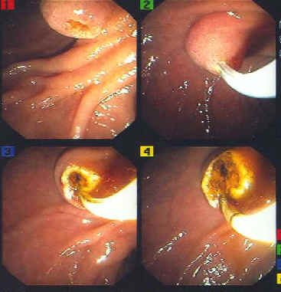
ERCP

Slide 49
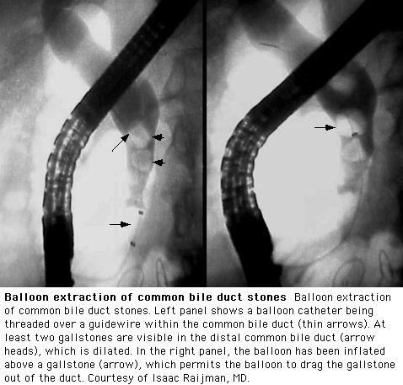
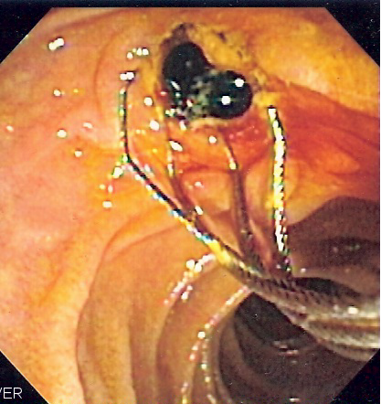
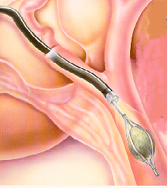

Slide 50
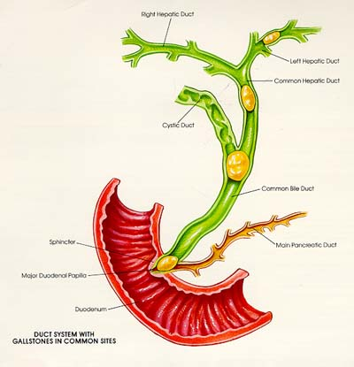
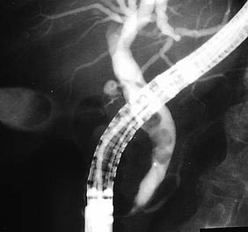
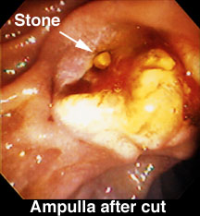

Slide 51
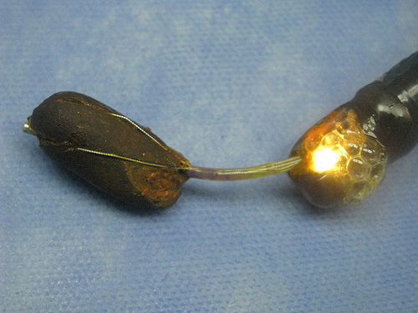
STONE EXTRACTION BY BASKET

Slide 52
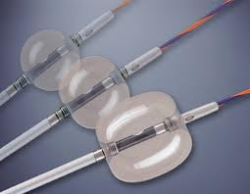
STONE EXTRACTION BY BALLON

Slide 54
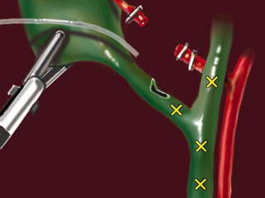

Slide 55
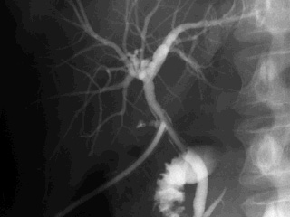

Slide 56
