Slide 1



Congenital Pediatric Urinary Disorders
Dr. Fahad Alyami
Assistant Professor and Consultant Pediatric Urologist

Slide 2

Learning Objectives:
Identify the common congenital anomalies.
How to detect this anomaly on radiological investigations.
Important steps in management.

Slide 3
Congenital Urinary Disorders
Anomalies of the Upper Urinary Tract
  Kidney
  Ureter
Anomalies of the Lower Urinary Tract
  Urinary Bladder
  Urethra

Slide 4
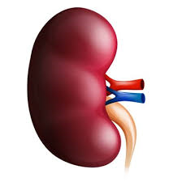
Anomalies of the Upper Urinary Tract
kidney

Slide 5

Anomalies of the kidney
Anomalies of:
  Number
  Ascent
  Form and Fusion
  Rotation

Slide 6
Anomalies of the kidney
Anomalies of:
  Number
  Ascent
  Form and Fusion
  Rotation

Slide 7
Anomalies of Number
Renal Agenesis:
  Unilateral
  Bilateral
Supernumerary Kidney

Slide 8
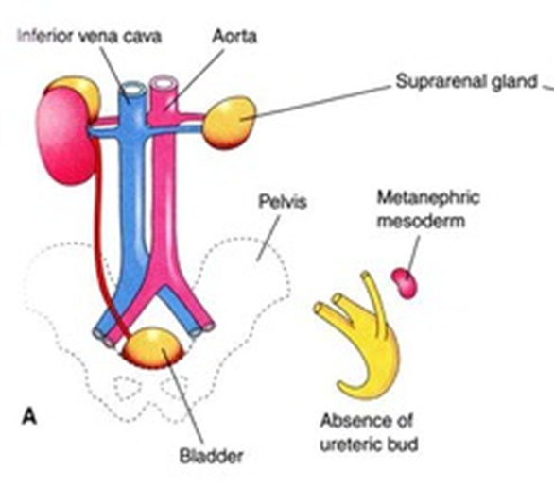
Unilateral Renal Agenesis (URA)
1 in 1100 births.
Male: Female of 1.8 : 1
The left side is absent more frequently .
The ipsilateral ureter is completely absent in 50%.
Anomalies of other organ systems are found frequently in affected individuals
  CVS,GIT,MSC

Slide 9
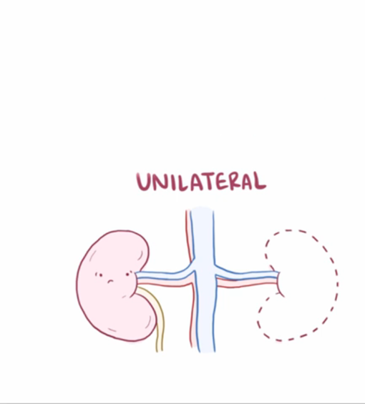
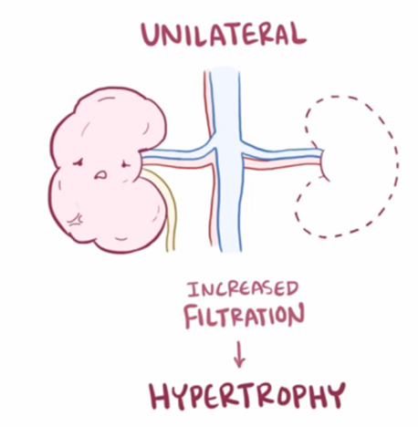
URA

Slide 10
URA…
Müllerian duct abnormalities occur in 25% to 50% of cases of females with URA compared with wolffian duct anomalies in 10% to 15% of males with URA.
Approximately one fourth to one third of women with müllerian duct anomalies are found to have URA.

Slide 11
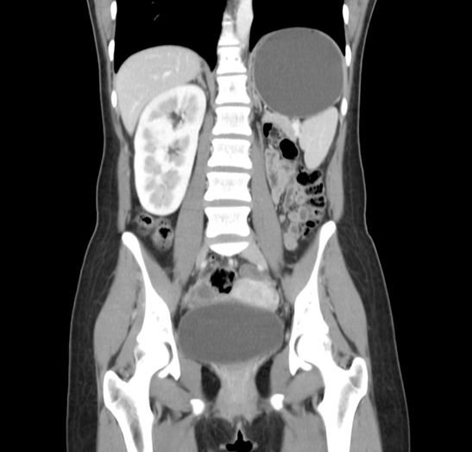
Diagnosis
DMSA
CT Abdomen

Slide 12
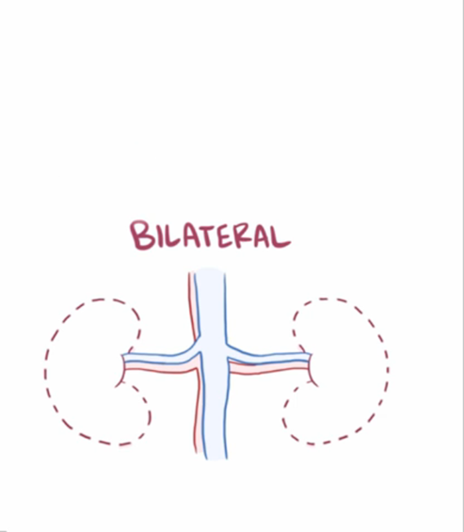
Bilateral Renal Agenesis

Slide 13
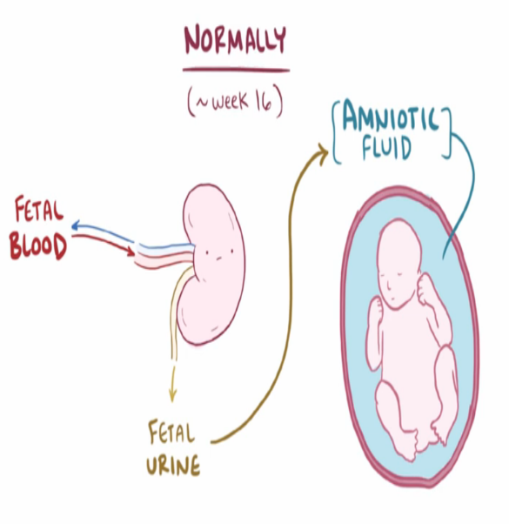
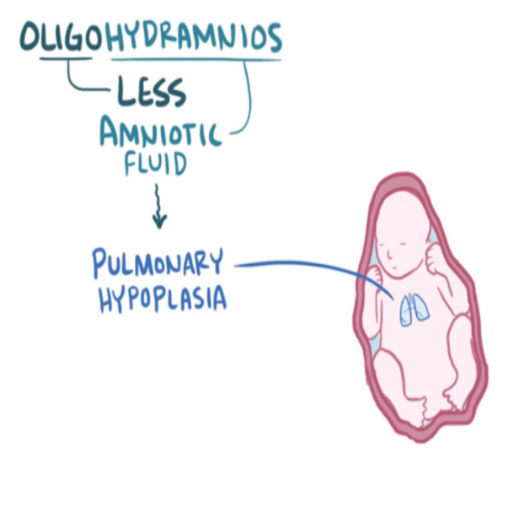
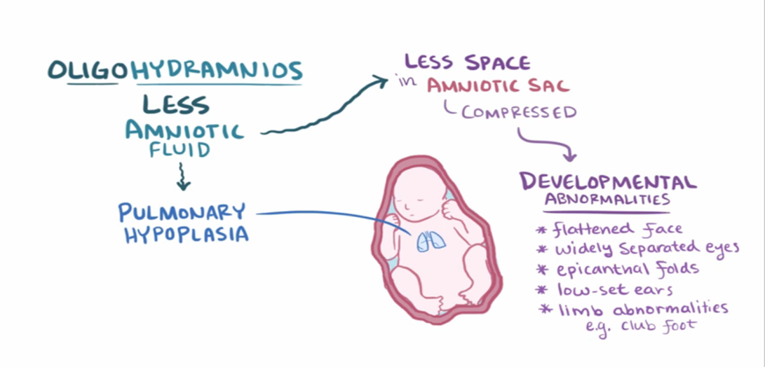
Bilateral Renal Agenesis…

Slide 14
Bilateral Renal Agenesis…
40% are stillborn.
Do not survive beyond 48 hours due to respiratory distress associated with pulmonary hypoplasia.
The characteristic
  Potter’s syndrome.
  Oligohydramnios

Slide 15
Bilateral Renal Agenesis
Ureters are almost always absent.
Bladder is either absent or hypoplastic.
Adrenal glands are usually positioned normally.
Müllerian duct anomalies are commonly observed.

Slide 16
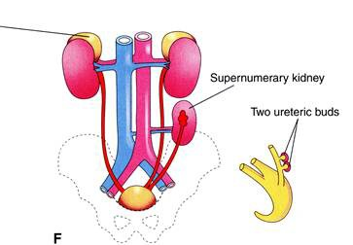
Supernumerary Kidney
Definitive accessory organ with its own collecting system, blood supply, and distinct encapsulated parenchyma.
Either completely separate or loosely attached to the kidney on the ipsilateral side.
The ureteral inter-relationships on the side of the supernumerary kidney can be variable.

Slide 17
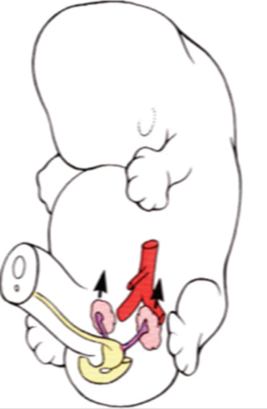
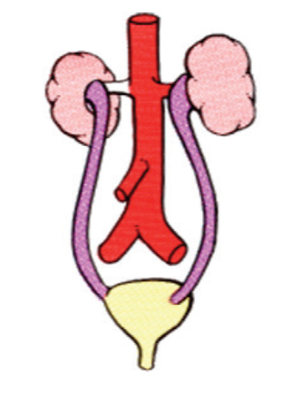

Anomalies of the kidney
Anomalies of:
  Number
  Ascent
  Form and Fusion
  Rotation

Slide 18
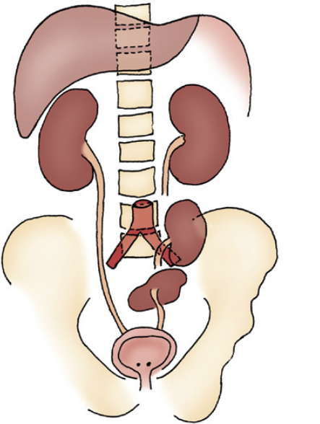
Simple Renal Ectopia
The left is more than the right.
Pelvic ectopia has been estimated to occur in 1 of 2100 to 3000 autopsies.
50% have a hydronephrosis:
  Obstruction: UPJO and UVJO
  Reflux: grade III or greater
  Malrotation
VUR is found in 30%
The incidence of genital anomalies in the patient with ectopia is about 15%.
Most ectopic kidneys are clinically asymptomatic

Slide 19
Anomalies of Ascent
Simple Renal Ectopia
Cephalad Renal Ectopia
Thoracic Kidney

Slide 20
Anomalies of the kidney
Anomalies of:
  Number
  Ascent
  Form and Fusion
  Rotation

Slide 21
Anomalies of Form and Fusion
Crossed Renal Ectopia:
  with Fusion
  without Fusion
Horseshoe Kidney

Slide 22
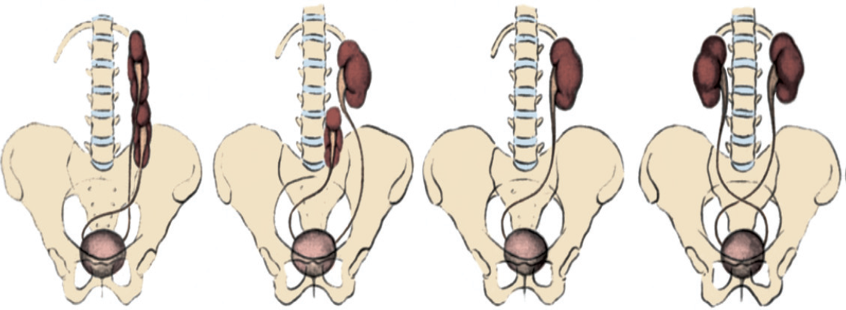
Crossed Renal Ectopia with and without Fusion

Slide 23
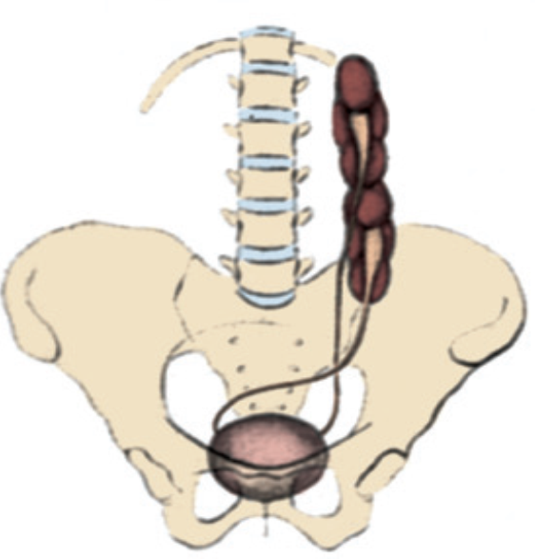
Crossed Renal Ectopia with and without Fusion
Crossed ectopia: kidney is located on the side opposite from that in which its ureter inserts into the bladder.
90% are fused with their mate
the superior pole of the ectopic kidney usually joins with the inferior aspect of the normal kidney.
The ureter from each kidney is usually orthotopic.

Slide 24
A)
Crossed renal
ectopia
with fusion
B)
Crossed renal ectopia
without fusion
C)
Solitary crossed
renal ectopia
D)
Bilaterally crossed
renal ectopia

Slide 25

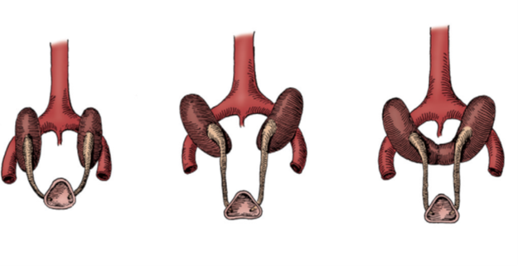
Horseshoe Kidney
Occurs 1 in 400 persons.
The isthmus is bulky and consists of parenchymatous tissue.
The calyces:
  normal in number
  atypical in orientation.
  pelvis remains in the vertical or obliquely lateral plane
The blood supply can be quite variable.
Horseshoe kidney is frequently found in association with other congenital anomalies.
UPJ obstruction in one third.
60 % asymptomatic.

Slide 26

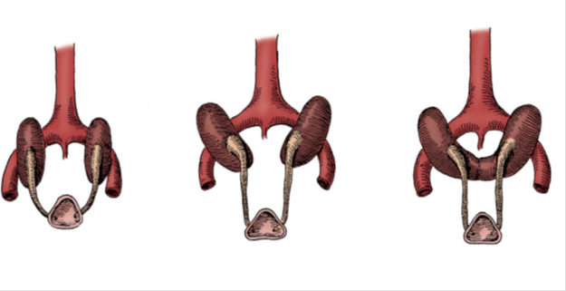
Horseshoe Kidney
The isthmus is bulky and consists of parenchymatous tissue.

Slide 27
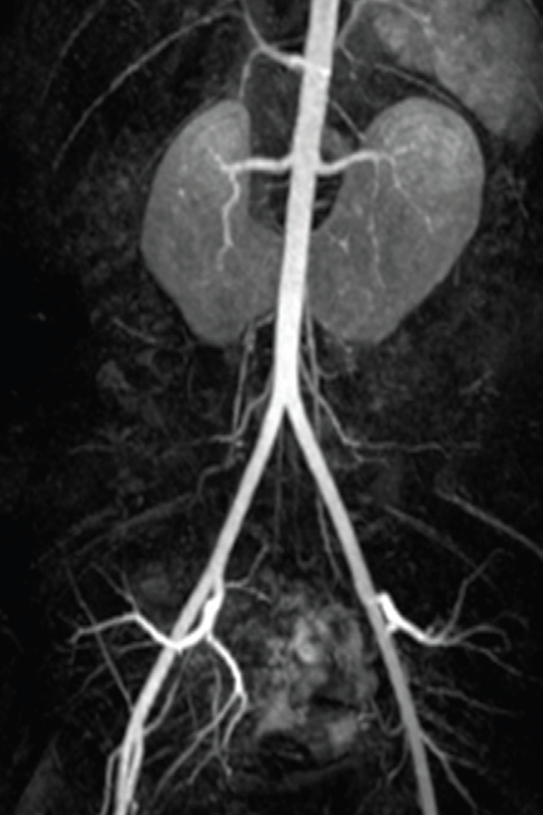
Horseshoe Kidney
.
The blood supply can be quite variable

Slide 29
Multicystic Dysplastic Kidney(MCDK)

Slide 30
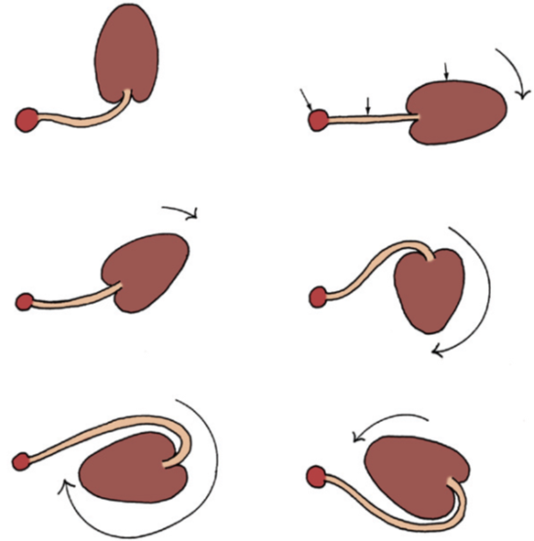
Anomalies of the kidney
Anomalies of:
  Number
  Ascent
  Form and Fusion
  Rotation

Slide 31
The kidney and renal pelvis normally rotate 90 degrees ventromedially during ascent
  the calyces point laterally.
  the pelvis faces medially.
When this alignment is not exact, the condition is known as malrotation.
Frequently associated with Turner syndrome.

Slide 32
Ureteral Anomalies
Ureteropelvic junction (UPJ) obstruction
Ureterovesical junction (UVJ) obstruction
Megaureters
Ectopic Ureter
Ureterocele
Vesicoureteral Reflux (VUR)

Slide 33
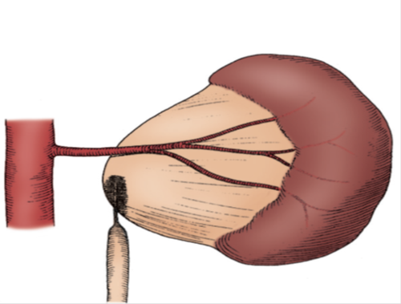
Ureteral Anomalies
Ureteropelvic junction (UPJ) obstruction
Ureterovesical junction (UVJ) obstruction
Megaureters
Ectopic Ureter
Ureterocele
Vesicoureteral Reflux (VUR)

Slide 34
UPJ…
Presentation:
Incidental in Neonates
Incidental in Children
Symptomatic:
  UTI
  Pain
  Mass
  Hematuria
  Stone

Slide 35
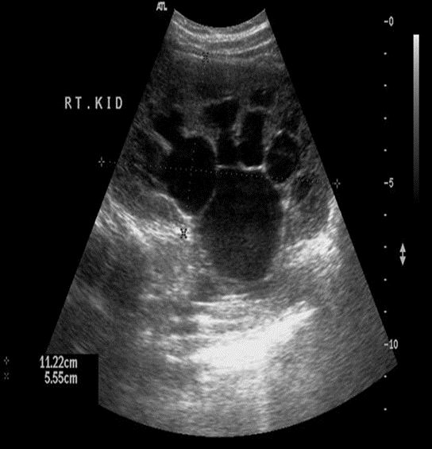
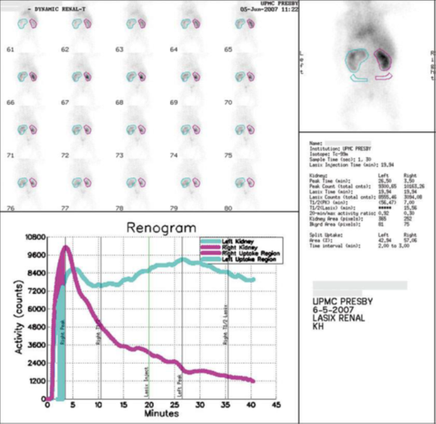
US, Diuretic renal scan (Nuclear)

Slide 36

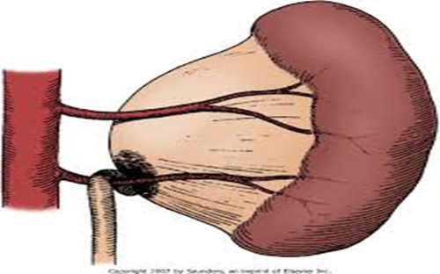
Ureteropelvic junction (UPJ) obstruction

Slide 37
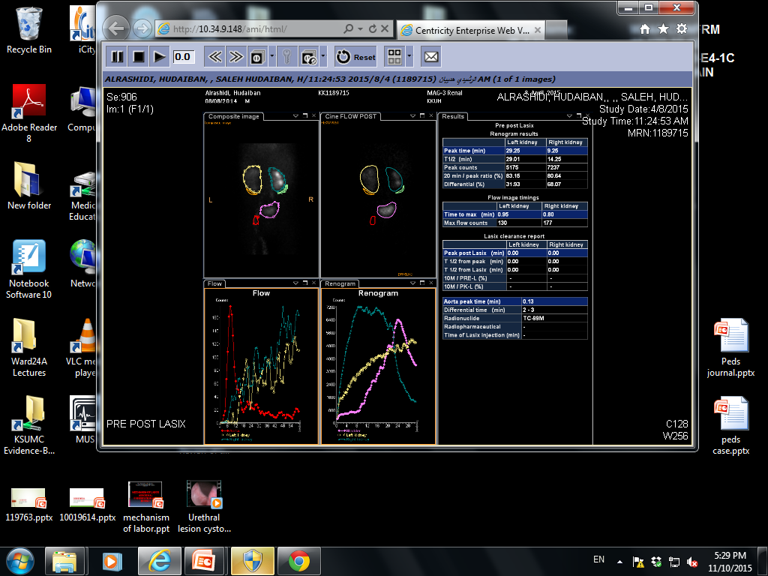
PUJO…
Dynamic renogram

Slide 38
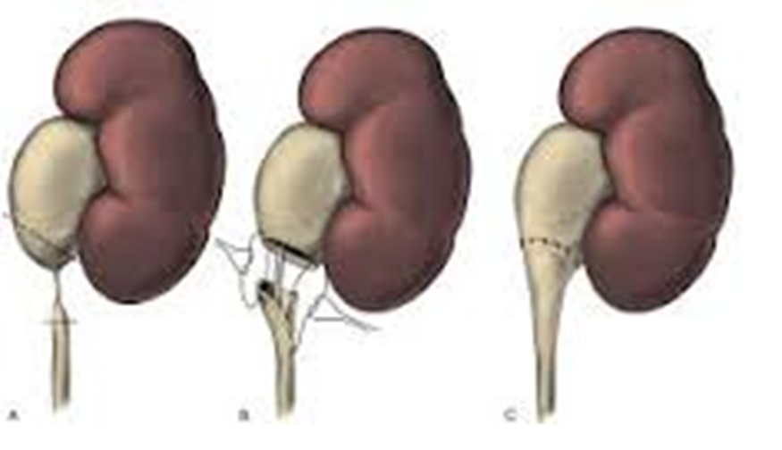
PUJO…
Dismembered Pyeloplasty

Slide 39
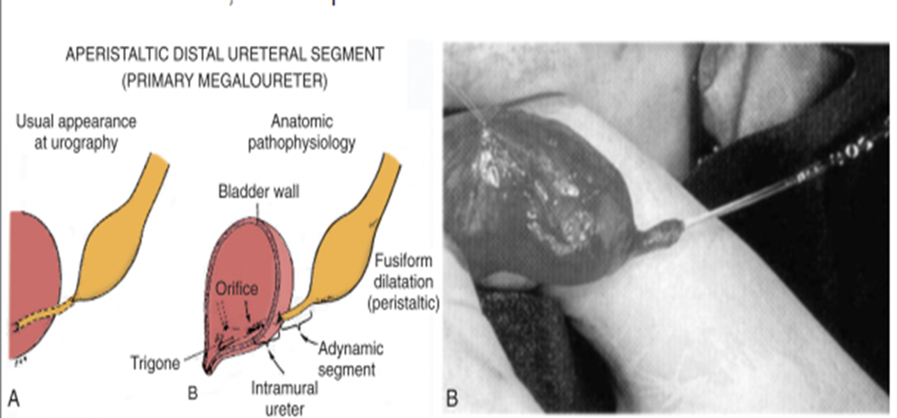
Ureteral Anomalies
Ureteropelvic junction (UPJ) obstruction
Ureterovesical junction (UVJ) obstruction
Megaureters
Ectopic Ureter
Ureterocele
Vesicoureteral Reflux (VUR)

Slide 40
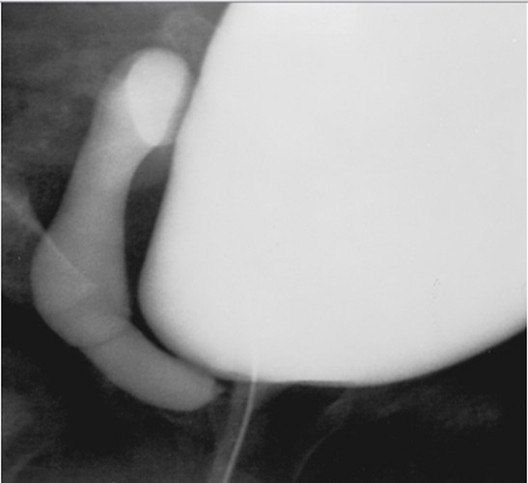
Ureteral Anomalies
Ureteropelvic junction (UPJ) obstruction
Ureterovesical junction (UVJ) obstruction
Megaureters
Ectopic Ureter
Ureterocele
Vesicoureteral Reflux (VUR)

Slide 41
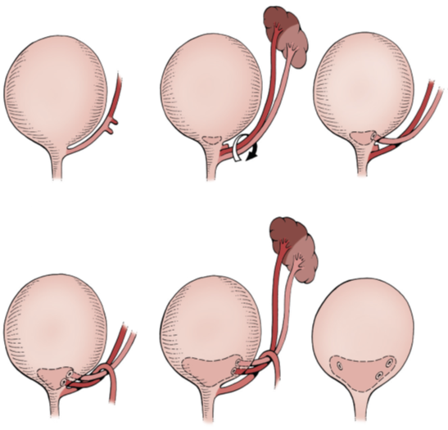
Ectopic Ureter
An ectopic ureter is any ureter, single or duplex, that doesn't enter the trigonal area of the bladder.
In a duplex system the ectopic ureter is inevitably the upper pole ureter due to its budding from the mesonephric duct later (more cephalad) than the lower pole ureteral bud.

Slide 42
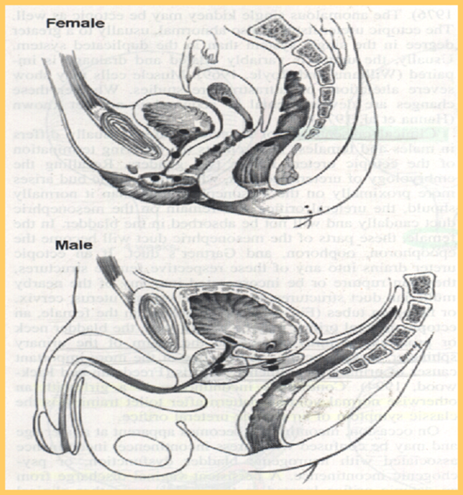
Ectopic Ureter
In females the ectopic ureter may enter anywhere from the bladder neck to the perineum and into the vagina, uterus,and even rectum.
One of the classic symptoms is continuous wetting.
In males the ectopic ureter always enters the urogenital system above the external sphincter or pelvic floor, and usually into the wolffian structures including vas deferens, seminal vesicles, or ejaculatory duct.

Slide 43
Ureteral Anomalies
Ureteropelvic junction (UPJ) obstruction
Ureterovesical junction (UVJ) obstruction
Megaureters
Ectopic Ureter
Ureterocele
Vesicoureteral Reflux (VUR)

Slide 44
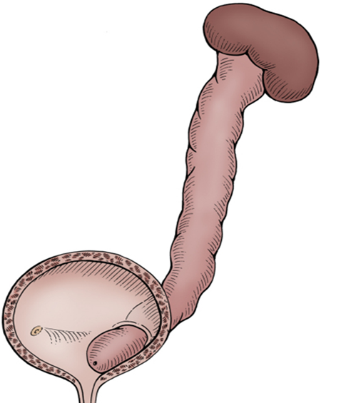
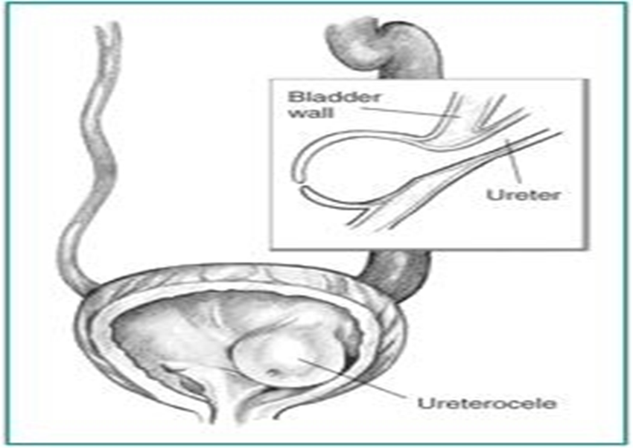
Ureterocele
A cystic dilation of the distal aspect of the ureter
Located either within the bladder or spanning the bladder neck and urethra.
Presentation:
Antenatal (U/S)
Urine retention
Infection
Calculus formation

Slide 45
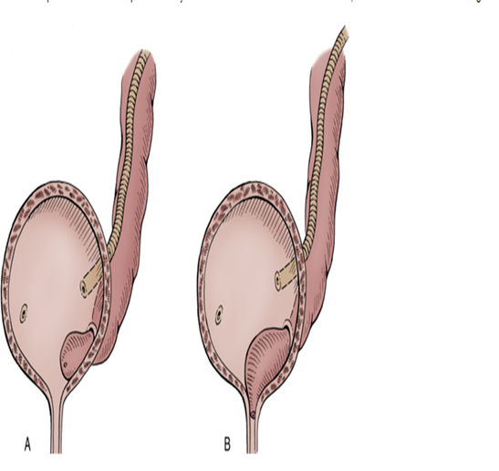
Types:
Intravesical: Orthotopic, simple, adult type.
Extravesical: Ectopic, duplex system, infant type.

Slide 46
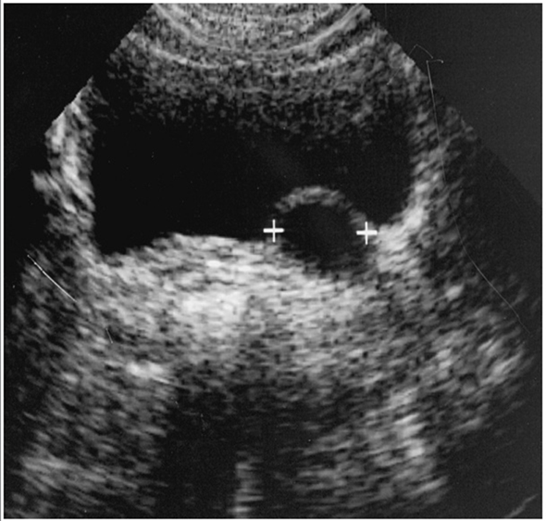
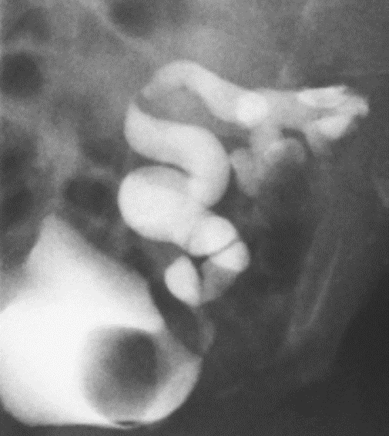

Slide 47
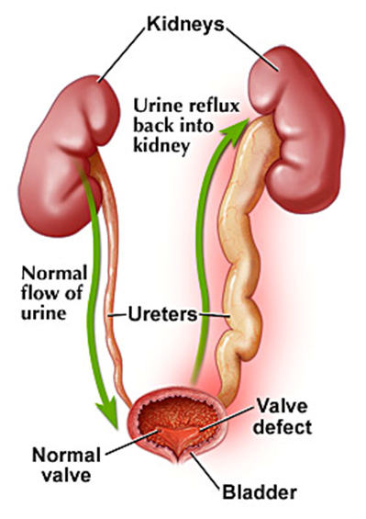
Ureteral Anomalies
Ureteropelvic junction (UPJ) obstruction
Ureterovesical junction (UVJ) obstruction
Megaureters
Ectopic Ureter
Ureterocele
Vesicoureteral Reflux (VUR)

Slide 48
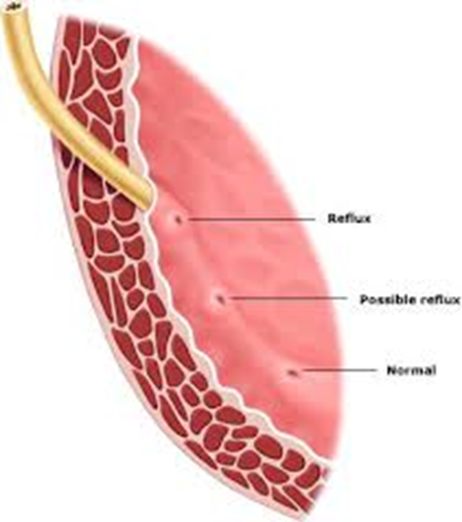
VUR
Normal anti-reflux mechanism “Flap valve”
1. Oblique course as it enters the bladder.
2. Proper muscular attachments to provide fixation.
3. Posterior support to enable its occlusion.
4. Adequate submucosal length.

Slide 49
VUR
Presentation
  Asymptomatic
    Prenatal
    Fluctuated dilatation
  Febrile UTIs

Slide 50
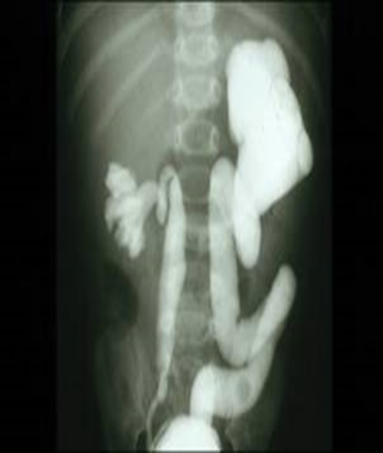
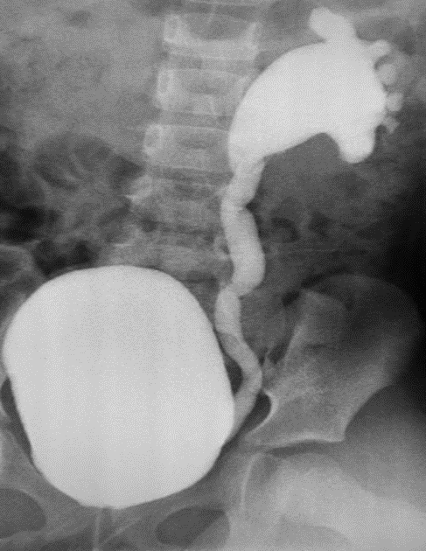
MCUG

Slide 51
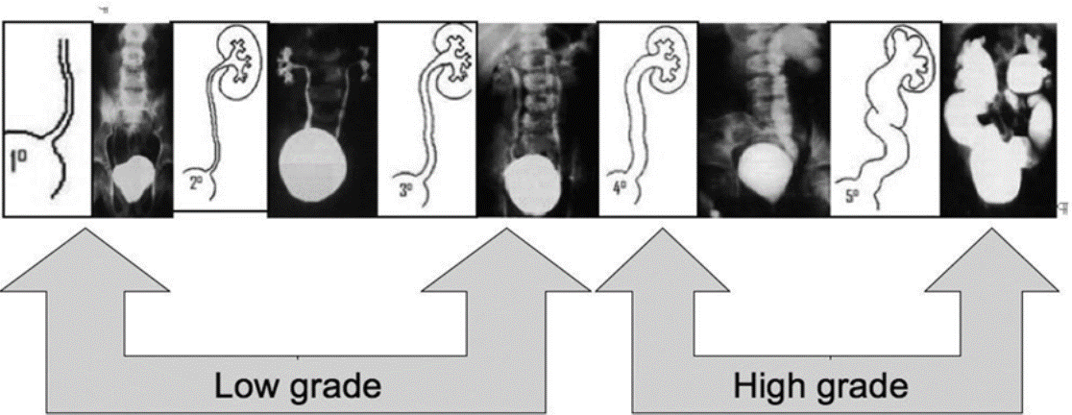

Slide 52
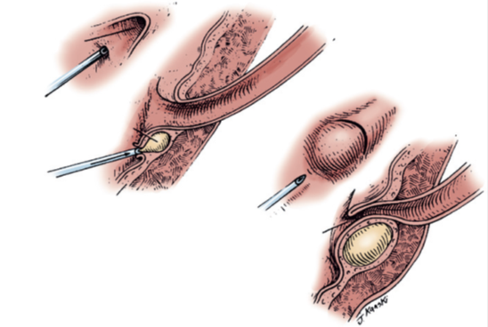
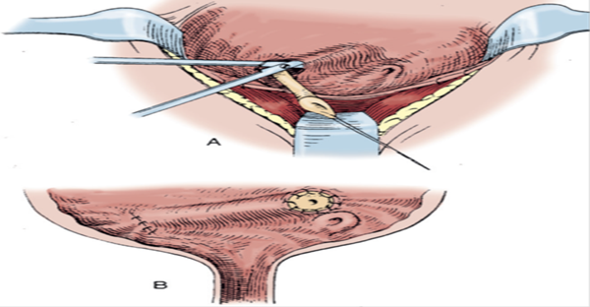
VUR: Management
Prophylactic antibiotic
Surgical treatment
  Endoscopic treatment
  Ureteral reimplantation

Slide 53
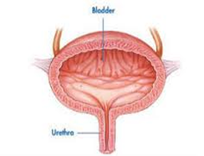
Bladder Anomalies
Urachal abnormalities
Bladder diverticulum
Bladder duplication
Bladder exstrophy

Slide 54
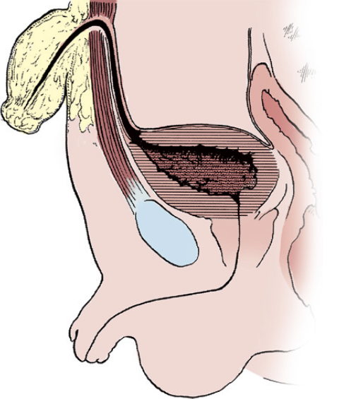
Bladder Anomalies
Urachal abnormalities
Urachal anomalies are usually detected postnatally due to umbilical drainage.
Imaging possibilities include ultrasound, CT, and VCUG

Slide 55
Urachal abnormalities
Patent urachus
Urachal cyst
Umbilical-urachus sinus
Vesicourachal diverticulum

Slide 56
Urachal abnormalities
Conservative treatment with observation is justified in asymptomatic cases due to possible spontaneous resolution
Infected urachal remnants are initially treated with drainage and antibiotics, followed by surgical excision.
Nonresolved urachal remnants should be excised due to theincreased risk of later adenocarcinoma formation

Slide 57
Bladder Anomalies

Slide 58
Bladder Diverticulum
Bladder diverticula can be detected on prenatal ultrasound, but the gold standard remains VCUG, which will reveal possible accompanying VUR.

Slide 59
Bladder Diverticulum
Primary diverticula
  arise as a localized herniation of bladder mucosa at the ureteral hiatus and are most likely caused by a congenitally deficient bladder wall.
Secondary para-ureteral diverticula
  are acquired and develop due to existing infra- vesical obstruction.
Symptomatic diverticula, especially in conjunction with VUR, should be treated surgically.

Slide 60
Bladder Duplication
Bladder duplication is often associated with duplication anomalies of the external genitalia and lower gastrointestinal tract.
Initial treatment is directed toward
  renal preservation.
  prevention of infections.

Slide 61
Bladder Duplication
Long-term goals include achieving continence and reconstructing the internal and external genitalia.
Due to the rarity of the disease and the large variety of presentations, the surgeries must be individualized

Slide 62
Classic Bladder Exstrophy
The incidence of bladder exstrophy has been estimated as between 1 in 10,000 and 1 in 50,000.

Slide 63
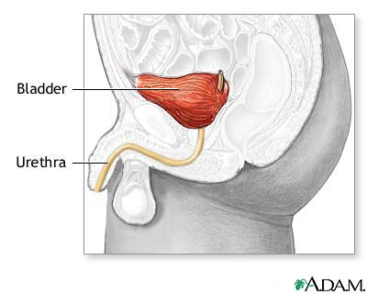
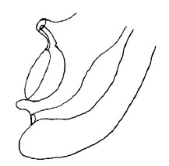
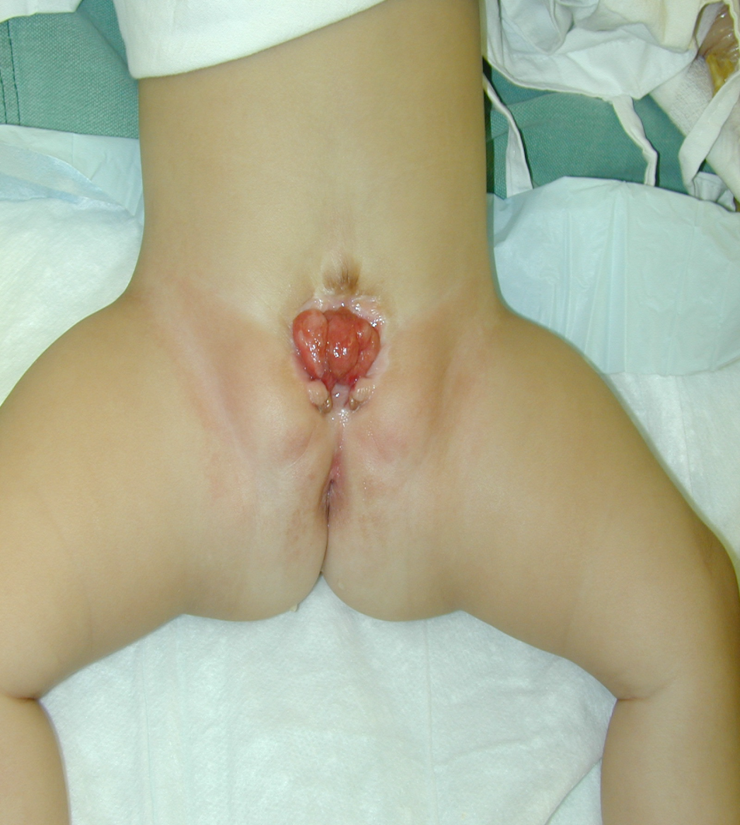

Slide 64
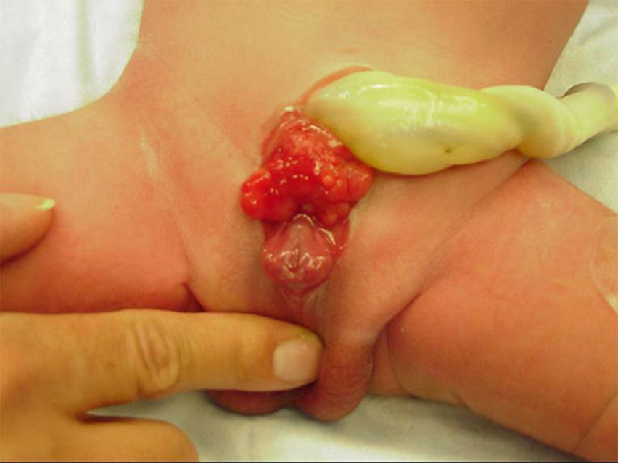

Slide 66
Urethral anomalies
Posterior Urethral Valves
Anterior Urethral Valves
Urethral Duplication
Congenital Urethral Stricture
Urethral Polyps

Slide 67
Urethral anomalies
Posterior Urethral Valves
Anterior Urethral Valves
Urethral Duplication
Congenital Urethral Stricture
Urethral Polyps

Slide 68
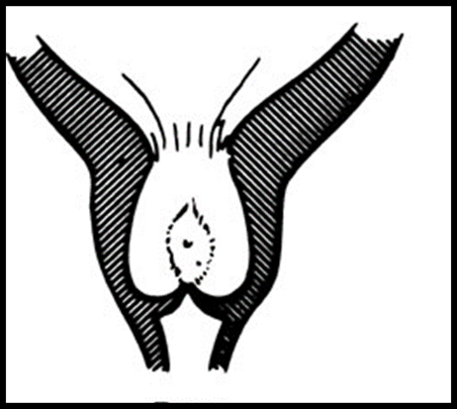
Posterior Urethral Valves
(PUV)

Slide 69
PUV
1 in 8000 to 25,000 live births.
Make up 10% of urinary obstructions diagnosed in utero.
Most common cause of urine retention in male infants.
50% have renal impairment.

Slide 70
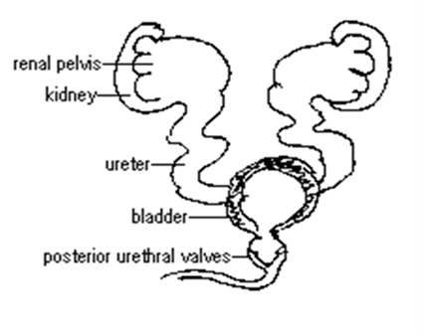
PUV
The bladder and the kidneys developed under high pressure and resistance.

Slide 71
PUV
Presentation:
  Antenatal
  Urine retention
  UTI
  Poor urinary stream
  Urinary incontinence
  CRF (ESRD)

Slide 72
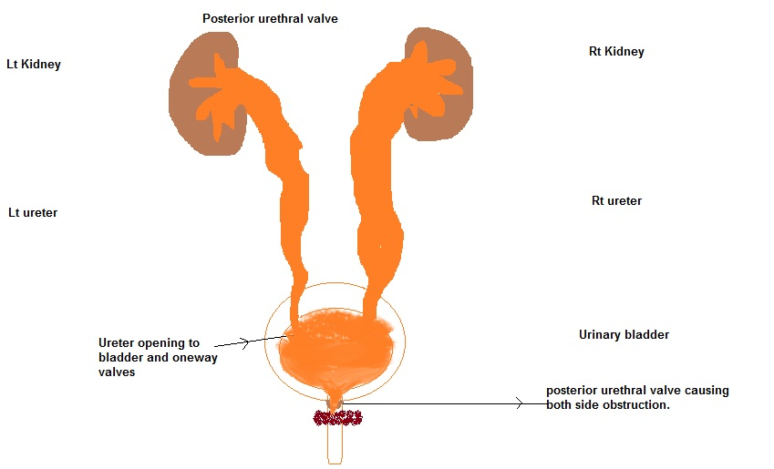
PUV
Associated findings:
  Oligohydramnios
  Bilateral renal dilatation
  VUR: 40%
  Valve bladder
  Renal impairment

Slide 73


PUV…
MCUG

Slide 74
PUV…
Management
Initial treatment
  Feeding tube insertion
  Start antibiotic prophylactic
  Ultrasound
  MCUG

Slide 75


PUV…
Surgical treatment
Endoscopic valve ablation
Cutaneous vesicostomy

Slide 76
Congenital Anomalies of the external Genitalia

Slide 77
Congenital Genital disordered
Hypospadias
Epispadias
Micropenis
Bladder Exstrophy
Cloacal Exstrophy

Slide 78

Hypospadias
Abnormal position of the EUM on the ventral surface.
Types:
  Distal hypospadias.
  Proximal hypospadias.
NO Circumcision
6 to 9 months repair.

Slide 79

Epispadias
Male
Female

Slide 80

Cloacal Exstrophy

Slide 81
Prune-Belly Syndrome
The incidence :1 in29,000 to 1 in 40,000 live births
The three major findings are
  deficiency of the abdominal musculature,
  bilateral intra-abdominal testes,
  anomalous urinary tract
Other names
  Triad syndrome
  Eagle-Barrett syndrome
  abdominal musculation syndrome

Slide 82

NEUROSPINAL DYSRAPHISMS
The most common cause of neurogenic bladder dysfunction in children is abnormal development of the spinal canal and internecine spinal cord.

Slide 83
NEUROSPINAL DYSRAPHISMS
Cutaneous lesions occur in 90% of children with various occult dysraphicstates.
These lesions vary from
  small lipomeningocele
  hair patch
  dermal vascular malformation
  sacral dimple
  abnormal gluteal cleft.

Slide 84



Slide 85
Antenatal Hydronephrosis(ANH)

Slide 86

Antenatal Hydronephrosis(ANH)
Causes:
Pelviureteric junction obstruction (41%)
Ureterovesical junction obstruction (23%)
Vesicoureteric reflux(7%)
Duplication anomalies (13%)
Posterior urethral valves (10 %)
MCDK
Others (6%)

Slide 87

ANH

Slide 88





SFU Grading
G0
G1
G2
G3
G4

Slide 89


Weigert- Meyer Rule

Slide 90


Slide 91


IVP

Slide 92


Slide 93


